Slide 1





10B
ENGLISH FILE B1 · 10B · Part 2 · SB pp.102–103
AND THE MURDERER IS…
READING & LISTENING · May and June (Ruth Rendell)
VOCABULARY · words from the story
VIDEO · Queens of crime
Two sisters. One man. Forty years.
What could possibly go wrong?
Teacher: timings, answers and tips are in the slide notes.
10B · Part 2
Notes:
10B PART 2 (60 min) · SB pp.102–103 — the last lesson of the Student's Book. Aims: read and listen to the short story 'May and June' by Ruth Rendell (Parts 1–2 in the book, Part 3 audio only); understand referencing; words from the story; video 'Queens of crime' (Ruth Rendell and Agatha Christie). Timing: cover 2 · revision 5 · lead-in 3 · Part 1 8 · Part 2 8 · vocabulary 3 · Part 3 10 · debate 4 · video 12 (embedded) · exit 3 = 58 min. Click 1: the question — predict from the title and the picture; click 2. The story ends with a murder: it's a classic literary crime story (no graphic detail), but check it suits your group. (2 min)

Slide 2


REVISION · 10B part 1 · Question tags
⏱ 5 min
Tag tennis!
PLAY! GIOCA!
1 You were a detective, …
weren't you?
2 He was never arrested, …
was he?
A serves, B returns the tag: 3 seconds!
A serve, B risponde con la tag: 3 secondi!
3 The police have found the evidence, …
haven't they?
4 You don't think she's right, …
do you?
5 Sickert was a painter, …
wasn't he?
6 They'll solve the mystery one day, …
won't they?
7 The witness can't remember, …
can she?
8 Maybrick lived on the Isle of Wight, …
didn't he?
📖 Teacher: revision of 10B pp.100–101 · Grammar Bank 10B · audio 10.7–10.13
10B · Part 2
Notes:
REVISION of 10B part 1 (5 min). VARIATION: change the energy — 'tag tennis'. Team A reads ('serves') a sentence; Team B must 'return' the tag in 3 seconds with FALLING intonation ↘; then the teams swap. Click once per item to show the tag (one per click). A wrong tag or no answer = point to the serving team. After the 8 slide items, teams serve their own sentences about Jack the Ripper (Bondeson thought he was a sailor, didn't he?). Content from the Jack the Ripper listening (10.7–10.9).

Slide 3
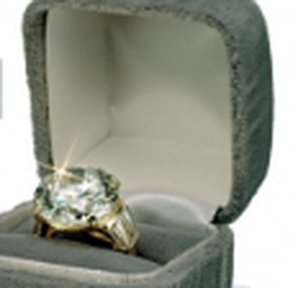
READING · Lead-in · Prediction
⏱ 3 min
Crime fiction
SPEAK! PARLA!
1 Do you enjoy reading crime novels?
Talk with a partner. Then predict the story!
Parla con un compagno. Poi prevedi la storia!
2 If yes, do you have a favourite author?
3 Ruth Rendell (1930–2015): who was she?
a famous English writer of thrillers and psychological murder mysteries
4 PREDICT: May and June are sisters. Walter is engaged to May…
Read and find out!
📖 Teacher: Student's Book p.102 · 5a
10B · Part 2
Notes:
LEAD-IN (3 min). 5a: pairs or whole class (lines 1–2 = the book's questions). If you have a favourite crime author, tell them (TG). Italian detectives work well here (Montalbano!). Click 1: Ruth Rendell (1930–2015) was a very famous English author of thrillers and psychological murder mysteries; many of her novels have been made into TV series and films (TG). VARIATION: prediction — 'May and June' are two sisters named after the months they were born in. Walter is engaged to May… what happens?

Slide 4
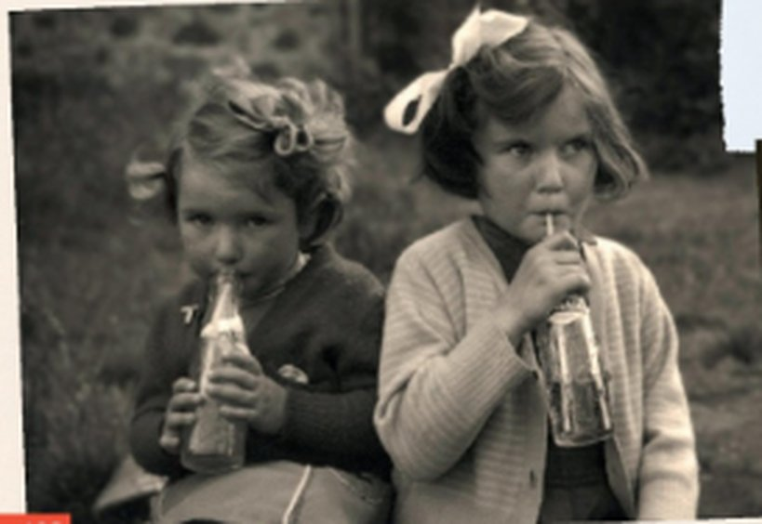
READING & LISTENING · Part 1 · audio 10.14
⏱ 8 min
What do they refer to?
READ! LEGGI!
1 June, however, was both, and her sunny personality brought her many admirers. (l.05)
pretty and clever
Read and listen to Part 1. What do the phrases refer to?
Leggi e ascolta la Parte 1. A cosa si riferiscono le frasi?
2 During that time, May almost became beautiful… (l.09)
when May was engaged to Walter
3 It was all very unfortunate, Mrs Thrace said over and over again. (l.15)
Walter fell in love with June and left May
4 'She's ruined my life.' (l.21)
'I will never be happy again.'
5 This thought was the only thing that comforted her. (l.31)
maybe Walter was sorry he'd married June, not her
📖 Teacher: Student's Book p.102 · 5b · audio 10.14 · Understanding referencing
10B · Part 2
Notes:
READING & LISTENING (8 min). 5b: play 10.14 while students read Part 1 on p.102 (about 3 minutes). Then pairs look at the highlighted phrases 1–5 and explain what they refer to (they must find each phrase in the story). Click 1 for answers (TG): 1 was both = pretty and clever · 2 During that time = the time when May was engaged to Walter · 3 It was all very unfortunate = the fact that Walter fell in love with June and left May · 4 'She's ruined my life.' = 'I will never be happy again.' · 5 This thought = that perhaps Walter was sorry he had married June and not her. Deal with new vocabulary: changeable, admirers, lawyer, wealthy, engaged, intensity. VARIATION: perspective change — 'Whose side are you on now: May's or June's?' (quick hands up, keep the answers for the end of the story).

Slide 5
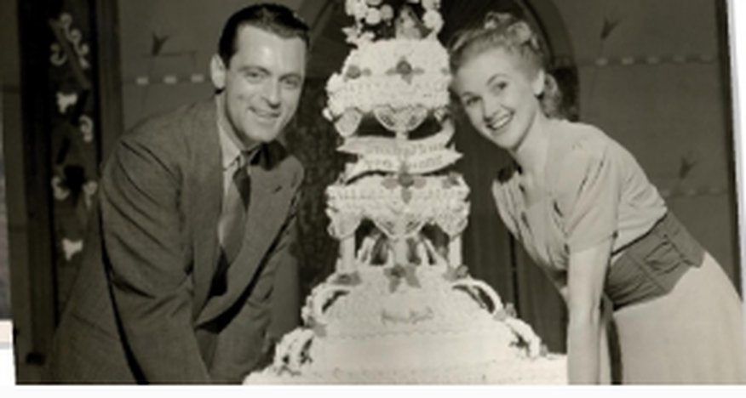
READING & LISTENING · Part 2 · audio 10.15
⏱ 8 min
Forty years later…
READ! LEGGI!
1 How did May react to her sister at a) her father's funeral, b) her brother-in-law's funeral?
a) refused to speak to her · b) was reconciled with her
Read and listen to Part 2. Answer with a partner.
Leggi e ascolta la Parte 2. Rispondi con un compagno.
2 Why did June invite May to live with her?
both alone; May had little money; to give her something back
3 Why do you think June didn't want to talk about her life with Walter?
painful for her? OR didn't want to hurt May (opinion)
4 Why did May search the house for letters or presents from Walter?
proof that Walter hadn't really loved June
5 Why do you think May started wearing her engagement ring again?
she now believed Walter had really loved HER
📖 Teacher: Student's Book p.103 · 5c · audio 10.15
10B · Part 2
Notes:
READING & LISTENING (8 min). 5c: give students time to read questions 1–5 in the book; play 10.15 while they read Part 2; pairs answer. Click 1 for answers (TG): 1 a she refused to speak to her · b she was reconciled with her · 2 because they were both alone and May didn't have very much money; June wanted to recompense May for marrying Walter · 3 possible answers: because she hadn't been very happy with Walter and it was painful for her OR she had been very happy with Walter and she didn't want to hurt May · 4 she was looking for proof that Walter hadn't really loved June · 5 possibly because she now believed that Walter had really loved her. The slide questions are the book's. Teach: funeral, reconciled, retired, engagement ring vs wedding ring.

Slide 6
VOCABULARY · Words from the story
⏱ 3 min
Find two words
THINK! PENSA!
1 Part 1: two adjectives: from change (v), wealth (n)
changeable, wealthy
Find two words in Parts 1 and 2 for each group.
Trova due parole nelle Parti 1 e 2 per ogni gruppo.
2 Part 1: two negative adjectives: from fortunate (adj), known (adj)
unfortunate, unknown
3 Part 1: two adverbs: from extreme (adj), passion (n)
extremely, passionately
4 Part 2: two nouns: from die (v), marry (v)
death, marriage
5 Part 2: two compound nouns with ring (n)
wedding ring, engagement ring
📖 Teacher: Student's Book p.103 · 5d
10B · Part 2
Notes:
VOCABULARY (3 min). 5d: students find the words in both parts of the story; click 1 for answers (TG): 1 changeable, wealthy · 2 unfortunate, unknown · 3 extremely, passionately · 4 death, marriage · 5 wedding ring, engagement ring. The prompts on the slide are the book's. Drill: wealthy /ˈwelθi/, passionately /ˈpæʃənətli/, marriage /ˈmærɪdʒ/. VARIATION: vocabulary branching — what are the opposites / related words? (wealthy – poor; marriage – to marry – married).

Slide 7
LISTENING · Part 3 · audio 10.16
⏱ 10 min
The ending
LISTEN! ASCOLTA!
🎧 10.16
PREDICT the ending first! Then listen to Part 3.
Prima PREVEDI il finale! Poi ascolta la Parte 3.
1 Why did May forgive June?
Walter hadn't loved June; June was punished
2 What did May think had happened when she heard the noise?
they had been burgled
3 What was the living room like when she went in?
messy – broken glass on the floor
4 What had June done?
thrown a bottle at the burglar
5 What effect did the letter have on May?
it made her angry
6 What did she do?
picked up the burglar's gun and killed June
7 What excuse did May give for touching the gun?
she wasn't thinking – the shock
📖 Teacher: Student's Book p.103 · 5e, 5f, 5g, 5h · audio 10.16
10B · Part 2
Notes:
LISTENING (10 min). 5e (whole class, 2 min): Do you think May and June are going to live happily together? How do you think the story is going to end? VARIATION: prediction — write 3–4 predictions on the board. 5f: play 10.16 once: were you right? (TG: May sees a letter from Walter to June saying how much he loved her; May picks up a gun and kills June.) 5g: students read questions 1–7 (the book's, on the slide); play again. Click 1 for all answers. TG answers: 1 because she thought Walter hadn't really loved June, and she thought June had been punished for what she did · 2 she thought they had been burgled · 3 it was messy, with broken glass on the floor · 4 she had thrown a bottle at the burglar · 5 it made her angry · 6 she picked up the burglar's gun and killed June · 7 she said she hadn't been thinking because of the shock. Note (TG): the script of Part 3 is not in the Student's Book so that students don't read ahead; photocopy script 10.16 if you want them to read it afterwards. Point out the irony: May touched the gun 'because of the shock' — her fingerprints are explained. 5h is the next slide.

Slide 8

SPEAKING · Mini debate
⏱ 4 min
Who's to blame?
SPEAK! PARLA!
"I feel sorry for May."
AGREE
NO WAY
Agree or no way? Give a reason!
D'accordo o per niente? Dai un motivo!
"June was the real victim – of her sister AND of Walter."
AGREE
NO WAY
"Walter is the real 'villain' of the story."
AGREE
NO WAY
"The police will never find out the truth."
AGREE
NO WAY
I agree, because… · I'm not so sure… · No way! In my opinion…
📖 Teacher: Student's Book p.103 · 5h
10B · Part 2
Notes:
SPEAKING (4 min). 5h = the book's question 'Do you feel sorry for May or June?' (TG: whole class — who do you feel sorry for and why? You could tell the class your own opinion). VARIATION: mild controversy + perspective change — pairs vote AGREE / NO WAY for each and give a reason; then compare with their prediction on the 'whose side are you on?' question from Part 1. Push for third conditionals: If Walter hadn't left May, she wouldn't have…

Slide 9

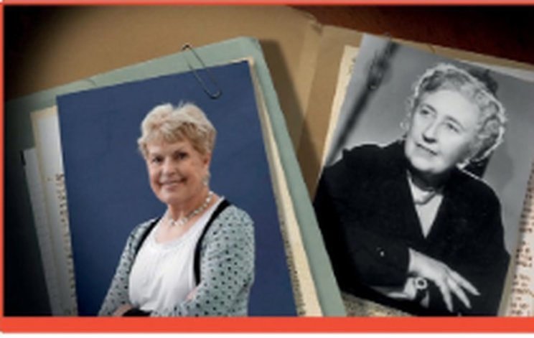
VIDEO LISTENING · Queens of crime
⏱ 12 min
Queens of crime
WATCH! GUARDA!
While you watch · Mentre guardi
1 Ruth Rendell: born where and when?
London, 1930
Watch. Who had the more interesting life? The happier life?
Guarda. Chi ha avuto la vita più interessante? Più felice?
2 Rendell's famous detective?
Inspector Wexford
3 Agatha Christie's two detectives?
Hercule Poirot · Miss Marple
Queens of crime
Video Listening 10B · SB p.103 · video (5'26")
4 Christie, December 1926?
she disappeared for 11 days
Rendell: WHY? · Christie: WHO? Which do you prefer?
5 Their pseudonyms?
Barbara Vine · Mary Westmacott
Rendell & Christie
📖 Teacher: Student's Book p.103 · 6a, 6b, 6c, 6d · video 10B
10B · Part 2
Notes:
VIDEO (12 min). The video is embedded (5 min 26 s). Timing: 6a + first viewing 6½ min · notes from memory and compare 2 min · second viewing of the parts students need (usually the second half, Agatha Christie – or the whole video if time allows) 2½ min · check 1 min. 6a: look at the photos — who is who, and roughly when did they live? Play once: who had the more interesting life? the happier life? Possible answers (TG): Rendell may have had a more interesting life (she was a journalist) — but Christie's mysterious disappearance was interesting too; Rendell's life may have been happier, as Christie had an unhappy first marriage. 6b–c: students make notes in the chart from memory, compare, then watch again. Chart answers (TG / video script): Rendell — born in London in 1930; father English, mother Danish; journalist; married Don Rendell, divorced in 1975 and remarried him in 1977; died 2015; first novel 1964 From Doon with Death; Inspector Wexford; pseudonym Barbara Vine; films La Cérémonie, Carne Trémula (Almodóvar); interested in characters and WHY a murder is committed. Christie — born in Torquay in 1890; father American, mother British; married Archie Christie 1914, later Max Mallowan (an archaeologist); disappeared for 11 days in 1926 and was found in Harrogate; first novel 1920 The Mysterious Affair at Styles; Hercule Poirot and Miss Marple; pseudonym Mary Westmacott; Murder on the Orient Express, The Mousetrap; interested in plots and WHO committed the murder. (⚠ The TG chart says Rendell married 'in 1950 and 1977' — the 1950 date is not in the video script.) 6d: have they read / seen anything by Rendell or Christie? Other crime writers? (Camilleri!) VARIATION: compare and contrast + personalisation.

Slide 10
Look what you can do!
Guarda cosa sai fare adesso!
HOMEWORK · COMPITI
• Workbook 10B: 2b, 2c, 3
• Revise Grammar Banks 9A–10B
• Homework sheet 10B-2
📷 Hand it in on the LLS app · Consegna nell'app LLS
✓ I can follow a short story and understand what words refer to.
😀 🙂 😐
✓ I can talk about who I feel sorry for and why.
😀 🙂 😐
✓ I can understand a video about two crime writers.
😀 🙂 😐
Next lesson: Revise and Check 9&10 · Games!
10B · Part 2
Notes:
EXIT (3 min). Homework: Workbook 10B 2b, 2c (question tags) and 3 (intonation – audio, optional) + revise the Grammar Banks 9A, 9B, 10A, 10B for the Revise and Check games + the 10B-2 homework sheet (easier version available). TG: if you want to end the course without the book, there is a Communicative revision photocopiable p.198 (no B1_ handout – print it from b1-official/pcm-all/EnglishFile4e_Intermediate_TG_PCM_Comm_Revision.pdf: 8 topic cards; pairs take turns to pick a card and talk about the topic using the prompts, the partner asks follow-up questions; non-cut alternative: one copy per pair, A chooses a number for B).

Slide 11

EXTRA · Communicative photocopiable 10B
EXTRA
⏱ 10 min
Four little mysteries
THINK! PENSA!
1 Baggy suit: the policeman thinks Sean is lying. How did he know?
Sean said a guy came up BEHIND him – but the victim was shot in the stomach.
Pairs: read the four mysteries on the handout. Solve them – give reasons!
In coppia: leggete i quattro misteri. Risolveteli – spiegate perché!
2 Sunday murder: who did it, and how did the police know?
The maid – she said she was getting the post, but there's no delivery on Sunday.
3 There's an insect on my plate! How did the man know?
His food came back on the same plate – the restaurant's only plain plate.
4 You have mail: what did the assistant say?
The key was locked inside the letterbox it opens – the businesswoman posted it there!
📖 📄 Print: B1_10B_Photocopiables.pdf, page 2 · Teacher: Communicative photocopiable 10B 'Four little mysteries' p.197
10B · Part 2
Notes:
EXTRA (10 min) = Communicative photocopiable 10B 'Four little mysteries' (TG p.197, notes p.175). 📄 Print: B1_10B_Photocopiables.pdf, page 2 – one copy per pair. Language: crime vocabulary. Official procedure (TG): put Sts in pairs and give out the worksheets; explain that they're going to solve some mysteries; give them time to read the four stories and answer the questions; monitor and help; elicit ideas from various pairs and then give the correct answers (one per click). Official answers (TG): 1 They knew Sean was lying because he said he saw 'a guy come up behind him', but the victim was shot in the stomach. · 2 It was the maid. She said she was getting the post, but there is no delivery on Sunday. · 3 The waitress had told him she served him on their only plain plate. When she brought his 'new plate of food', it was on the same plate. · 4 The assistant reminded the businesswoman that her key was safely locked inside the letterbox that it unlocks. After all, she posted it there. EXTRA CHALLENGE (TG): Sts write their own mysteries. Teach before reading if needed: baggy (= large and loose), suspect, staff, maid, run out of, forward (post), fire (= dismiss). VARIATION: curiosity gap + give reasons (pairs must justify their solution before the click).

Slide 12

EXTRA · Writing · Perspective
EXTRA
⏱ 8 min
May's diary
WRITE! SCRIVI!
Write 6–8 sentences in the first person: Tonight…
1
You are May. Write your diary the night of the 'burglary'.
Sei May. Scrivi il diario la notte del 'furto'.
Explain what you saw, what you found in the desk, how you felt.
2
Use one third conditional: If I hadn't read that letter, I wouldn't have…
3
Read it to a partner. Is May sorry – or not?
4
Tonight I found Walter's letter. If I hadn't seen it, June would still be alive…
10B · Part 2
Notes:
EXTRA (8 min). VARIATION: perspective change + recycling the File 9 grammar (third conditional). Keep it literary; no graphic detail needed.

Slide 13
EXTRA · Speaking · The detective
EXTRA
⏱ 6 min
Interview May!
SPEAK! PARLA!
1 You live with your sister, ___?
A = the inspector, B = May. Check the facts with question tags!
A = l'ispettore, B = May. Controlla i fatti con le question tag!
2 You heard a noise, ___?
3 You didn't see the man's face, ___?
4 You touched the gun, ___?
5 You weren't angry with your sister, ___?
10B · Part 2
Notes:
EXTRA (6 min). Tags: don't you · didn't you · did you · didn't you · were you. VARIATION: role play — the inspector gets suspicious; May must stay calm. Then swap. Links the story to the 10B grammar.

