Slide 1





5B
ENGLISH FILE B1 · 5B · Part 1 · SB pp.50–51
#THEWAYWEMET
READING & LISTENING · The way we met
GRAMMAR · used to / usually
PRONUNCIATION · the letter s, used to
A supermarket car park. Two identical cars…
…and that's the way we met!
Teacher: timings, answers and tips are in the slide notes.
5B · Part 1
Notes:
5B PART 1 (60 min) · SB pp.50–51. Aims: read two Instagram #thewaywemet stories and predict the end (Communication The way we met); listen to a man describing how he met his wife; used to / didn't use to for past habits and states vs usually + present simple (Grammar Bank 5B p.141); pronunciation of the letter s and used to; Communicative photocopiable 'Past and present' p.187 (board game). Timing: cover 2 · revision 5 · ranking 4 · reading 6 · Communication 7 · listening 7 · rule 6 · practice 5 · pronunciation 5 · board game 7 · exit 3 = 57 min. Click 1: question; let them guess the story before click 2. (2 min)

Slide 2



REVISION · 5A part 2 · Narrative tenses
⏱ 5 min
5.9
Backwards stories
THINK! PENSA!
1 …so the referee sent him off.
e.g. He had kicked another player.
Here's the END. What had happened before?
Ecco la FINE. Cosa era successo prima?
2 …so we couldn't get into the stadium.
e.g. We had forgotten our tickets.
3 …and she cried with happiness.
e.g. Her team had just won the cup.
4 Jonny Brownlee stopped at the side of the road. Why?
He hadn't drunk enough – he felt ill.
5 Henri Schoeman won the gold medal. How?
He had been behind them – he ran past.
6 Juan Antonio nearly stopped being a referee. Why?
He'd been attacked by players and spectators.
📖 Teacher: revision of 5A pp.48–49 · Grammar Bank 5A p.140 · audio 5.9
5B · Part 1
Notes:
REVISION of 5A part 2 (5 min). VARIATION: backwards recall (reverse the obvious – the ending first). Items 1–3: pairs invent what had happened before, with the past perfect (any logical answer is fine – click to show an example). Items 4–6: recall from the last lesson (Brownlee article p.48 and the referee interview 5.9): Jonny hadn't drunk enough in the hot conditions and felt ill · Henri Schoeman had been behind them until then and ran past them both · at 16 he was attacked and injured by the players of the home team and by the spectators (that's why). Extra point for a pair that adds a past continuous background ('It was raining and the players were getting tired…').

Slide 3





READING · Lead-in
⏱ 4 min
Where do people meet?
SPEAK! PARLA!
MOST LIKELY
?
A at work
How do people usually meet friends and partners nowadays? 1 = most popular
Come si conoscono di solito amici e partner oggi? 1 = il più comune
?
B at school or university
?
C online (e.g. on forums, social networking sites, etc.)
?
D in a bar, club, etc.
No right answer – compare and agree!
?
E through friends
LEAST LIKELY
📖 Teacher: Student's Book p.50 · 1a
5B · Part 1
Notes:
LEAD-IN (4 min). SB 1a: 'How do you think people usually meet friends and partners nowadays? Number the phrases 1–5 (1 = the most popular). Then compare with a partner. Do you agree?' – the slide shows the book's phrases A–E. Teach partner (= husband / wife, boyfriend / girlfriend). Pairs compare and agree on an order. VARIATION: ranking + forced choice (they must agree on ONE order). Feedback: what's number 1 for the class? Optional TG lead-in (books closed): three meanings of meet – I met my best friend at primary school (= see for the first time) · Where shall we meet? (= go to a place and wait) · I met an old school friend in town (= by chance). Keep it neutral: friends OR partners.

Slide 4

READING · #thewaywemet · SB p.50
⏱ 6 min
Tiffany or Kristina?
READ! LEGGI!
The first time she met her partner, she… 1 saw him from a distance.
T
Where did they meet? Read again: T (Tiffany) or K (Kristina)?
Dove si sono conosciuti? Rileggi: T (Tiffany) o K (Kristina)?
2 felt a bit frightened.
T
3 had moved away from her hometown.
K
4 had a problem with her health.
K
5 was immediately attracted to him.
K
6 felt that he didn't understand her.
T
📖 Teacher: Student's Book p.50 · 1b, 1c
5B · Part 1
Notes:
READING (6 min). 1b: students read the beginning of the two stories on p.50 – where did the women meet their partners? (TG: Tiffany – in a supermarket car park; Kristina – in an acupuncture clinic). 1c: 'Read the stories again. Write T (Tiffany) or K (Kristina).' – the slide has the book's six statements; click 1 – TG ANSWERS: 1 T · 2 T · 3 K · 4 K · 5 K · 6 T. Ask students to justify each answer with words from the text. Details for checking – Tiffany: a guy was standing beside her white Jeep with the door open; she thought he was trying to steal it or rob her; he was unloading his shopping; she pressed the lock button to prove it was her car and 'his face turned white'. Kristina: she came to New York to do a Master's degree in Creative Writing; Matt was a personal trainer, studying for a doctorate in Chinese medicine; she used to do a lot of running – she'd run two marathons – and got really bad back pain; doctors said different things; acupuncture was 'a last resort'; Matt was the acupuncturist and 'the moment we looked into each other's eyes, we connected'; he didn't ask her out; he wasn't going to celebrate his 29th birthday because he had to study. Notice for the grammar later: 'At the time, I used to do a lot of running'. Vocabulary: unload, rob, acupuncture, as a last resort.

Slide 5
SPEAKING · Communication p.107 / p.112
⏱ 7 min
How did it end?
SPEAK! PARLA!
1
Pairs: how do you think the two stories end? Guess!
Guess the end. Then read it and tell your partner!
Indovina il finale. Poi leggilo e raccontalo al compagno!
2
Student A: go to p.107 – the end of Tiffany's story. Student B: go to p.112 – the end of Kristina's story.
3
Read, then close your book. Before you tell the end, ask your partner: 'What do you think happened?'
4
Tell your partner the end of your story.
5
Together: what is the coincidence in each story?
In the end, it turned out that… · And the funny thing was…
📖 Teacher: Student's Book p.50 · 1d, 1e · Communication The way we met A p.107, B p.112
5B · Part 1
Notes:
COMMUNICATION / INFORMATION GAP (7 min). 1d: elicit ideas for both endings first (VARIATION: prediction + curiosity gap). Then A reads about Tiffany (p.107), B about Kristina (p.112); they close their books and tell the end, first eliciting their partner's guess (TG EXTRA IDEA). ANSWERS – the coincidences (TG): Tiffany and her partner own exactly the same car · Kristina was studying Creative Writing and her partner's surname is Tolstoy (like the great Russian novelist). ⚠ The endings are only in the Student's Book – check p.107 / p.112 before the lesson. 1e (if time) – book: 'Think of a couple you know well, e.g. your parents or friends. How did they meet? Do you know any couples who met in unusual circumstances?' (optional – no personal pressure; teens can talk about how they met their best friend).

Slide 6
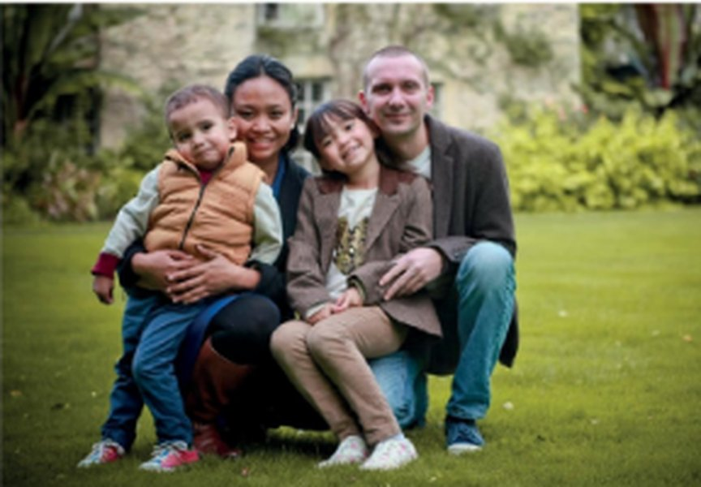
GRAMMAR · Presentation · audio 5.15
⏱ 3 min
Love at first sight?
LISTEN! ASCOLTA!
🎧 5.15
Where did John meet his partner? Was it romantic?
Dove ha conosciuto la sua compagna John? È stato romantico?
1 Where did they meet?
in a school corridor (in Indonesia)
2 Was it a romantic meeting?
No!
3 Listen again: sentences 1–8, T or F?
→ next slide
📖 Teacher: Student's Book p.51 · 2a, 2b, 2c · audio 5.15
5B · Part 1
Notes:
LISTENING (3 min + 4 min on the next slide). 2a: books closed; play 5.15 once – where did they meet, and was it romantic? (TG: in a school corridor; it wasn't romantic). 2b: play again – students mark sentences 1–8 T / F (next slide, with the answers). Also in the script: he used to be a teacher; they became friends and sometimes used to have tea or a beer together; after three years they got together, then got engaged and married. 2c: three extracts from the listening – 'I used to be a teacher…' · 'She didn't use to be very punctual…' · 'We sometimes used to have tea or a beer together…' – 1 When do we use used to? How do we make questions? 2 Are these things probably true now? ANSWERS: 1 used to = things that were true over a period of time in the past; questions: Did + person + use to + infinitive · 2 No (we can't use used to for the present). VARIATION: prediction ('love at first sight?').

Slide 7

GRAMMAR · Presentation · audio 5.15
⏱ 4 min
5.15
John's story: T or F?
LISTEN! ASCOLTA!
1 John was teaching English in Indonesia.
T
2 His future wife was one of his students.
F – not in his classes
T or F? Correct the F sentences.
Vero o falso? Correggi le frasi false.
3 She usually arrived for her classes on time.
F – not usually punctual
4 John was carrying a lot of things to class.
T
5 She made him drop them.
T
6 She helped him to pick them up.
F – she ran off, laughing
7 They were friends for a long time before going out together.
T
8 They've been married for ten years.
F – for 12 years
📖 Teacher: Student's Book p.51 · 2b · audio 5.15 (play it on the previous slide)
5B · Part 1
Notes:
LISTENING 2b (4 min). The book's sentences 1–8. Students mark T / F while listening the second time (play 5.15 from the previous slide), then compare and correct the F sentences. Click once per sentence. TG ANSWERS: 1 T · 2 F (She was a student at the school, but not in his classes.) · 3 F (She wasn't usually very punctual.) · 4 T · 5 T · 6 F (She ran off, laughing.) · 7 T · 8 F (They've been married for 12 years.). VARIATION: prediction – before the second listening, pairs guess T or F from what they remember.

Slide 8
GRAMMAR · Grammar Bank 5B p.141
⏱ 6 min
5.16
used to / usually
used to + infinitive (past)
usually + present simple (now)
I used to teach English when I was living abroad.
He didn't use to do any exercise, but now he runs marathons.
We used to be close friends, but we don't talk to each other any more.
Did they use to live in the city centre?
past habits and states that are NOT true now
I usually meet my friends at weekends.
I don't normally go out during the week.
Do you normally walk to work?
present habits: usually / normally (NOT use to)
Watch out! ✗ I use to go to bed at 11 → ✓ I usually go to bed at 11. ✗ didn't used to → ✓ didn't use to. I used to like cartoons, but I don't any more.
📖 Teacher: Grammar Bank 5B p.141 · audio 5.16
5B · Part 1
Notes:
GRAMMAR (6 min). Students open Grammar Bank 5B p.141; play 5.16 to listen and repeat (copy the rhythm) – the slide examples are from 5.16. Go through the rules and the information box. TG grammar notes: used to is revision from Pre-intermediate; it's a 'late assimilation' structure (students can say the same with past simple + time expression), so using it correctly shows a higher level. It only exists in the past – unlike Italian (solevo / di solito) – so for present habits we use usually / normally + present simple. Don't repeat the main verb with any more / any longer: I used to like cartoons, but I don't any more. Typical mistakes (TG): ✗ I use to go to bed about 11.00 · spelling ✗ We didn't used to wear a uniform. Also: never used to = didn't use to. Quick check: 'Tell me one thing you used to do at primary school and one thing you usually do now.'

Slide 9

GRAMMAR · Grammar Bank 5B · practice
⏱ 5 min
Then or now?
WRITE! SCRIVI!
a 1–3 Right ✓ or wrong ✗? (in your book, p.141)
1 ✗ didn't use to like · 2 ✓ · 3 ✗ never used to want
Grammar Bank 5B: a 1–5 and b 1–4. Then check!
Grammar Bank 5B: a 1–5 e b 1–4. Poi controlla!
a 4–5
4 ✗ did you use to keep in touch · 5 ✗ usually go
b1 We ___ a lot in common, but now we're completely different. (have)
used to have
b2 We ___ to bed early during the week. (go)
usually go
b3 I ___ TV on my phone, but now I often do. (not watch)
didn't use to watch
b4 ___ football on Sunday mornings? (you / play)
Do you usually play
📖 Teacher: Grammar Bank 5B p.141 · a 1–5, b 1–4 (a 6–9, b 5–10 = homework)
5B · Part 1
Notes:
PRACTICE (5 min). Students do Grammar Bank 5B a 1–5 (right or wrong? correct the wrong ones) and b 1–4. Click 1 for all answers (TG key, ✓ = correct): a 1 ✗ didn't use to like · 2 ✓ · 3 ✗ never used to want · 4 ✗ did you use to keep in touch · 5 ✗ usually go. b 1 We used to have a lot in common, but now we're completely different. · 2 We usually go to bed early during the week because we have to get up at 6.00 a.m. · 3 I didn't use to watch TV on my phone, but now I often do. · 4 Do you usually play football on Sunday mornings? The slide prompts are made from the key (⚠ check exact prompts in the book). Homework: a 6–9, b 5–10. VARIATION: student as teacher – partners explain why each wrong sentence is wrong. EXTRA SUPPORT: Grammar photocopiable p.158 (⚠ not in our files).

Slide 10
PRONUNCIATION · The letter s · audio 5.17–5.19
⏱ 5 min
5.17
5.18
5.19
Snake, zebra, shower…
THINK! PENSA!
1 snake /s/
used to · parents · practise · singer · sport · summer · supermarket
Say the words. Which sound is the s?
Di' le parole. Che suono ha la s?
2 zebra /z/
use · busy · friends · holidays · lose · music
3 shower /ʃ/
sugar · sure
4 television /ʒ/
usually · decision · occasion · unusual
used to · usually · use · busy · decision · friends · holidays · lose · music · occasion · parents · practise · singer · sport · sugar · summer · supermarket · sure · unusual
5 used to /juːst/
I used to live… ≠ I used (/juːzd/) Google Maps
📖 Teacher: Student's Book p.51 · 3a–3d · audio 5.17, 5.18, 5.19
5B · Part 1
Notes:
PRONUNCIATION (5 min). 3a: elicit the picture words snake, zebra, shower, television. Play 5.17 once; pairs write the words (yellow sticky) in the right column. 3b: play 5.18 to check – click once per sound (answers from the audio script). 3c (TG): 1 at the beginning of a word, s is usually /s/ – exceptions sure and sugar /ʃ/ · 2 at the end of a word, s can be /s/ or /z/ · 3 vowel + -sion = /ʒ/. Double s is always /s/. Click 5 (TG pronunciation notes): used to = /juːst/; used as a main verb = /juːzd/. Italian speakers often say /s/ in music, busy, lose – push the buzzing /z/. 3d dictation (5.19), play twice: 1 I'm sure you used to take sugar in your tea. 2 She didn't use to like classical music, but now she loves it. 3 We used to stay with my parents' friends in the summer holidays. 4 Did you use to use your car more? 5 The singer usually practises for six hours a day. Then pairs say them. VARIATION: phonological branching.

Slide 11
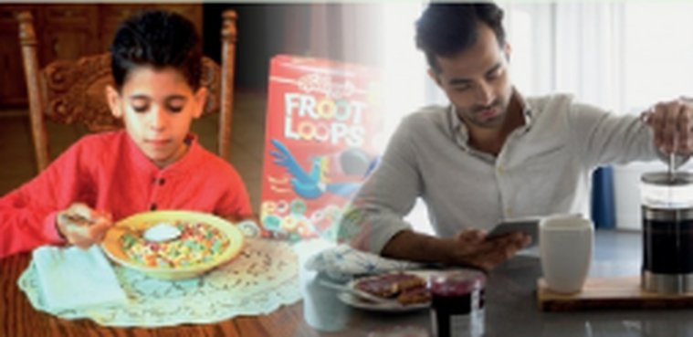
SPEAKING · Communicative photocopiable 5B · board game
⏱ 7 min
Past and present
PLAY! GIOCA!
1
📄 Print: B1_5B_Photocopiables.pdf, page 2 – one board per group of 3–4.
Throw the coin, move, answer the question!
Lancia la moneta, muoviti, rispondi alla domanda!
2
Throw a coin: heads = move 1, tails = move 2. Answer the question – with used to or usually!
3
Give more information. The others ask you ONE follow-up question.
4
'Have another go!' = throw again.
5
The first player to reach FINISH wins.
Did you use to get on with your cousins? – Yes, I used to see them every Sunday, but now I usually…
When you were young…
📖 Teacher: Communicative photocopiable 5B 'Past and present' p.187 · SB p.51 · 3e
5B · Part 1
Notes:
BOARD GAME (7 min). Print the Communicative photocopiable 5B 'Past and present' (TG p.187): B1_5B_Photocopiables.pdf, page 2 (page 3 is the same board in a different layout) – one board per group of 3–4, one coin per group and one counter per student. OFFICIAL RULES (TG p.172): each player puts their counter on START; students take turns to throw the coin and move one square for heads and two for tails; they answer the question in the circle and must give more information; play until time runs out – the first player to reach FINISH wins; if a group finishes very quickly, they go round the board again. Squares 1–18 mix past (Did you use to…? What used to be your favourite thing to eat as a child? Are there any films you used to love, but don't like any more?) and present habits (Who do you usually phone when you have a problem? How often do you usually see your extended family?); square 'Have another go!' = throw again. It replaces SB 3e (talk about two of the topics) – if you have no copies, do SB 3e in pairs instead: 'In pairs, tell each other about TWO of the following.' When you were young,… what did you use to have for breakfast? What do you usually have now? · what music did you use to listen to a lot? What do you usually listen to nowadays? · what books or comics did you use to read? What do you read now? · where did you use to spend your summer holidays? What do you usually do in the summer? Is there… a friend you used to be really close to, but don't see any more? · a TV programme you used to be addicted to? What kind of programmes do you usually watch now? · a machine or device you used to use a lot, but don't use any more? What apps or devices do you usually use now to communicate with your friends? · a sport or game you used to play a lot, but which you've given up? What exercise do you do nowadays? Monitor and correct used to / usually and the pronunciation /juːst/. VARIATION: follow-up questions (the turn only counts if someone asks a follow-up). Personalisation with boundaries: a player may say 'Pass!' once.

Slide 12
Look what you can do!
Guarda cosa sai fare adesso!
HOMEWORK · COMPITI
• Workbook 5B: 1a, 1b, 1c, 2a (audio: Online Practice)
• Grammar Bank 5B: a 6–9, b 5–10
• Homework sheet 5B-1
📷 Hand it in on the LLS app · Consegna nell'app LLS
✓ I can understand stories about how people met.
😀 🙂 😐
✓ I can talk about past and present habits with used to and usually.
😀 🙂 😐
✓ I can pronounce the letter s and used to correctly.
😀 🙂 😐
Next lesson: 5B part 2 · Relationships · Friendship facts
5B · Part 1
Notes:
EXIT (3 min). Students choose a face for each can-do. Homework: Workbook 5B 1a, 1b, 1c (used to / usually) and 2a (pronunciation; 2b is audio – optional at home) + Grammar Bank 5B a 6–9, b 5–10 + the 5B-1 homework sheet (easier version available). Answers are in the teacher key PDF.

Slide 13
EXTRA · Speaking · Then and now
EXTRA
⏱ 7 min
Life 30 years ago
SPEAK! PARLA!
1 phones and music
2 school and homework
How was life different? Use used to / didn't use to.
Com'era diversa la vita? Usa used to / didn't use to.
3 shopping in Bagheria
4 free time at the weekend
5 TV and films
6 getting in touch with friends
People used to… but now they usually…
5B · Part 1
Notes:
EXTRA (7 min). VARIATION: perspective change (the past from parents' / grandparents' point of view) + mild controversy (was life better then?). Pairs make two sentences for each topic: 'People used to buy CDs, but now they usually stream music.' Then vote: three things that were better 30 years ago. Homework idea: interview an older relative with 3 'Did you use to…?' questions.

Slide 14
EXTRA · Writing · Instagram story
EXTRA
⏱ 8 min
#thewaywemet – our version
WRITE! SCRIVI!
Pairs: invent how two people met – two friends, two flatmates or a couple. Make it funny or strange!
1
Write a short #thewaywemet story – true or invented!
Scrivi una breve storia #thewaywemet – vera o inventata!
Write 60–80 words: where, when, what was happening, what happened.
2
Use one used to and one past perfect.
3
Stop before the end! Other pairs guess how it ended.
4
I used to take the same bus every morning. One day, a woman was sitting in 'my' seat…
5B · Part 1
Notes:
EXTRA (8 min). VARIATION: student-generated content + curiosity gap (the story stops before the end). Good for a class that enjoyed the reading. Display the best stories on the class noticeboard (no real names).

Slide 15

EXTRA · Grammar photocopiable · used to / usually
EXTRA
⏱ 7 min
Thomas and Lucie: then and now
WRITE! SCRIVI!
Look at the chart: Thomas and Lucie then and now.
1
Look at the chart. Write sentences with used to or usually.
Guarda la tabella. Scrivi frasi con used to o usually.
Write sentences 2–10 with used to / didn't use to or the present simple (+ usually).
2
Compare with a partner. Then check.
3
Cover the sentences: say 3 with used to and 3 with usually.
4
📄 Print: B1_5B_Photocopiables.pdf, page 1
📖 Teacher: Grammar photocopiable 5B past and present habits and states (TG p.158)
5B · Part 1
Notes:
EXTRA (7 min) or HOMEWORK. Grammar photocopiable 5B 'past and present habits and states' – print B1_5B_Photocopiables.pdf, page 1. Example: 1 They used to be university students, but now he's a photographer and she's a journalist. OFFICIAL ANSWERS (TG): 2 They used to live in Paris, but now they live in Chicago. · 3 They used to eat takeaway food, but now they (usually) eat home-made food. · 4 They used to live in a house with friends, but now they live in a penthouse flat with their dog. · 5 They used to go camping, but now they (usually) stay in five-star hotels. · 6 They didn't use to play sport. Now, they both cycle at the weekend and Thomas often plays golf. · 7 They used to ride bikes, but now they drive a sports car. · 8 They used to wear second-hand clothes, but now they (usually) wear designer clothes. · 9 They used to get up late and go out at night with friends. Now, they (usually) stay in, cook, and watch TV. · 10 They used to have lots of friends, but now they have just a few close ones. ACTIVATION: cover the sentences, look at the chart and make three sentences with used to and three with usually. VARIATION: memory (activation).

