Slide 1





7B
ENGLISH FILE B1 · 7B · Part 2 · SB pp.72–73
THE HOTEL OF MUM AND DAD
VOCABULARY · houses
PRONUNCIATION · the letter c
LISTENING · The Handel Hendrix house
A composer and a rock star…
…in the same house?!
Teacher: timings, answers and tips are in the slide notes.
7B · Part 2
Notes:
7B PART 2 (60 min) · SB pp.72–73. Aims: vocabulary of houses and where people live (Vocabulary Bank Houses p.162); the three pronunciations of the letter c; listen to an audio guide about the Handel Hendrix house in London; describe a dream house. Timing: cover 2 · revision 5 · where people live 4 · parts of a house 5 · what's the difference? 5 · letter c 5 · prediction 3 · Handel 4 · Hendrix 4 · words 3 · dream house 7 · 20 questions 5 · exit 3 = 55 min. The writing (Writing p.120, describing a house) is optional homework. Click 1: question — what could they have in common? Click 2. (2 min)

Slide 2


REVISION · 7B part 1 · Conditionals
⏱ 5 min
Beat the clock: 1st or 2nd?
PLAY! GIOCA!
1 I / win the lottery / buy a boat
If I won the lottery, I'd buy a boat. (2nd)
Teams: 20 seconds! Make the sentence. Real or imaginary?
Squadre: 20 secondi! Fate la frase. Reale o immaginaria?
2 it / rain tomorrow / we / stay in
If it rains tomorrow, we'll stay in. (1st)
3 I / be you / talk to her
If I were you, I'd talk to her. (2nd)
4 Marco / leave home / have to cook
If Marco left home, he'd have to cook. (2nd)
5 you / not hurry / miss the bus
If you don't hurry, you'll miss the bus. (1st)
6 Carlos / have a dog / be happier
If Carlos had a dog, he'd be happier. (2nd)
📖 Teacher: revision of 7B part 1 · Grammar Bank 7B p.145
7B · Part 2
Notes:
REVISION of 7B part 1 (5 min). VARIATION: beat the clock + forced choice (teams must decide 1st or 2nd before they write). Two teams, team secretaries write. 20 seconds per prompt; click once per item to show a model answer. 1 point for a correct sentence; +1 if they can say WHY (1st = real / possible, 2nd = imaginary / unlikely). Accept other logical answers: item 2 could be 2nd if they say 'it never rains in July in Bagheria – imaginary!' if the form is right. Items 4 and 6 recycle Marco and Carlos from the online comments (SB p.71). Typical errors: ✗ If I would win · ✗ If it will rain.

Slide 3

VOCABULARY · Vocabulary Bank Houses p.162
⏱ 4 min
Where do you live?
THINK! PENSA!
1 I live ___ the country, surrounded by fields.
in
2 I live ___ the outskirts of Oxford.
on
in or on? Then say where YOU live.
in oppure on? Poi di' dove vivi TU.
3 I live ___ a village.
in
4 I live ___ Cromer, a small town.
in
5 I live ___ the second floor of a block of flats.
on
6 I live ___ Croydon, a suburb of London.
in
📖 Teacher: Vocabulary Bank Houses p.162 · 1 Where people live · audio 7.17
7B · Part 2
Notes:
VOCABULARY (4 min). Vocabulary Bank Houses p.162, 1 Where people live: students write the prepositions in the column; play 7.17 to check. Click 1 for answers (from audio 7.17): 1 in · 2 on · 3 in · 4 in · 5 on · 6 in. Vocabulary notes (TG): a suburb is simply a residential area outside the city centre — not a negative word like 'slum'; the outskirts = the area of a town furthest from the centre. ACTIVATION (pairs): describe where you live — 'I live in Bagheria, a town about 15 km from Palermo. I live on the second floor of a block of flats, on the outskirts…' (⚠ check the distance you give). VARIATION: personalisation with boundaries — they can describe the area, not the exact address.

Slide 4
















VOCABULARY · Parts of a house · audio 7.18
⏱ 5 min
Parts of a house
THINK! PENSA!
roof
chimney
attic
top floor
Say the words. Where is it? Inside or outside?
Di' le parole. Dov'è? Dentro o fuori?
tetto
comignolo
soffitta
ultimo piano
balcony
ground floor
entrance
basement
balcone
piano terra
ingresso
seminterrato
steps
path
wall
gate
gradini
vialetto
muro
cancello
terrace / patio
open fire
cosy
spacious
terrazza / patio
camino acceso
accogliente
spazioso
📖 Teacher: Vocabulary Bank Houses p.162 · 2 Parts of a house · 3 Describing a house or flat · audio 7.18, 7.19
7B · Part 2
Notes:
VOCABULARY (5 min). Quick start (SB 4a, 1 min): pairs write three more words in each column of the chart on p.72 — living room (table), kitchen (washing machine), bedroom (lamp). Then Vocabulary Bank p.162, 2 Parts of a house: students match the words and the picture; play 7.18 to check (numbers in the key). 3 Describing a house or flat: play 7.19 — a modern flat in the city centre (spacious, light, wooden floors, big windows) and a cottage in the country (old, made of stone, low ceilings, an open fire, cosy). Click 1 shows the Italian. Notes (TG): a terrace is outside on the ground floor; a balcony is always outside a window on an upper floor; a fireplace = the open space for a fire in the wall; an open fire = a fireplace with a wood fire in it. ACTIVATION: A points to a tile, B says the word and 'inside or outside?'. VARIATION: change the energy — 'Stand up if it's outside the house!'.

Slide 5

VOCABULARY · What's the difference?
⏱ 5 min
What's the difference?
THINK! PENSA!
1 outskirts / suburb
furthest area from the centre / residential area outside the centre
Explain the difference to your partner. Use English only!
Spiega la differenza al compagno. Solo in inglese!
2 village / town
very small, in the country / bigger than a village, smaller than a city
3 roof / ceiling
covers the whole house / top inside surface of a room
4 balcony / terrace
upstairs, outside a window / flat area outside, where you can sit
5 chimney / fireplace
takes smoke up through the roof / open space for a fire in a wall
6 ground floor / first floor
at street level / the level above (US first floor = ground floor!)
7 wood / wooden
noun – the material / adjective – made of wood
📖 Teacher: Student's Book p.72 · 4c
7B · Part 2
Notes:
VOCABULARY (5 min). SB 4c: 'What's the difference between…?' — pairs discuss the seven pairs (book order, same as the slide). Click once per pair for the TG definitions. VARIATION: student as teacher + forbidden easy answer — they must explain in English, no translation (then give the Italian at the end: tetto / soffitto, balcone / terrazza, comignolo / caminetto, piano terra / primo piano). Italian traps: ceiling ≠ roof (both 'tetto' in everyday Italian), first floor = primo piano (same as British English — but warn them about American English). Model and drill: ceiling /ˈsiːlɪŋ/, wooden /ˈwʊdn/, suburb /ˈsʌbɜːb/.

Slide 6

PRONUNCIATION · The letter c · audio 7.20
⏱ 5 min
Three sounds of c
THINK! PENSA!
1 carpet castle location cosy country balcony cooker cupboard cushion curtains
1 c before a, o, or u = /k/
Say the words. Then complete the rules with /s/, /ʃ/, /k/ or /ks/.
Di' le parole. Poi completa le regole con /s/, /ʃ/, /k/ o /ks/.
2 city cinema decide centre entrance ceiling terrace cycle agency icy
2 c before i, e, or y = /s/
3 spacious · special · musician
3 ci before a vowel = /ʃ/
4 occasion · accommodation · accuse
4 cc before a, o, or u = /k/
5 accent · success · accident
5 cc before e or i = /ks/
📖 Teacher: Student's Book p.72 · 5a, 5b, 5c · audio 7.20
7B · Part 2
Notes:
PRONUNCIATION (5 min). 5a: pairs say the words in groups 1–5 to each other (all the book words are on the slide). 5b: pairs complete rules 1–5 (book wording on the click: '1 c before a, o, or u is pronounced …'). 5c: play 7.20 to check; click once per group. Answers (TG): 1 /k/ · 2 /s/ · 3 /ʃ/ · 4 /k/ · 5 /ks/. Rules (TG pronunciation notes): c is usually /k/ before a, o, u and consonants; /s/ before e, i, y; /ʃ/ only before i + vowel (spacious, special, musician); with double c, /ks/ if the second c comes before e or i (success, accent) and /k/ before a, o, u (account, accommodation); c can be silent after s (science, scene). Play 7.20 again for repetition. VARIATION: phonological branching — each pair adds one more word to each group (e.g. /s/ Sicily, /ʃ/ delicious, /ks/ accept).

Slide 7
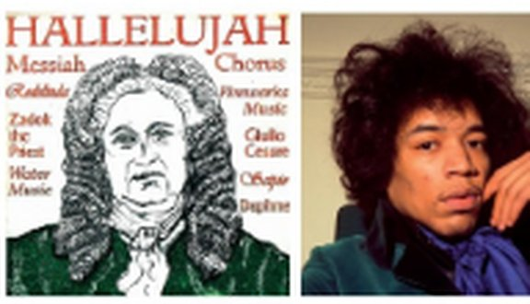
LISTENING · Prediction
⏱ 3 min
Handel and Hendrix
THINK! PENSA!
1 Who were they? What did they do?
both musicians
Guess first! Then read the poster on p.73.
Indovina prima! Poi leggi il poster a p.73.
2 Where did they come from? Where did they go?
they both left their countries to live in London
3 What else do they have in common?
they lived in the same building (Brook Street)
4 Which bedroom do you like best? Why?
Handel · Hendrix
📖 Teacher: Student's Book p.73 · 6a, 6b
7B · Part 2
Notes:
PREDICTION (3 min). 6a (whole class): what do they know about George Frideric Handel and Jimi Hendrix? Don't worry if they don't know — they'll find out. VARIATION: curiosity gap + prediction — make them guess before they read. 6b: students read the poster on p.73 and check. Click once per question (TG): they were both musicians; they both left their countries to live in London (Handel in the 18th century, Hendrix in the 1960s); they lived in the same building in London. Then: which bedroom do they like best, and why? (photos on p.73).

Slide 8
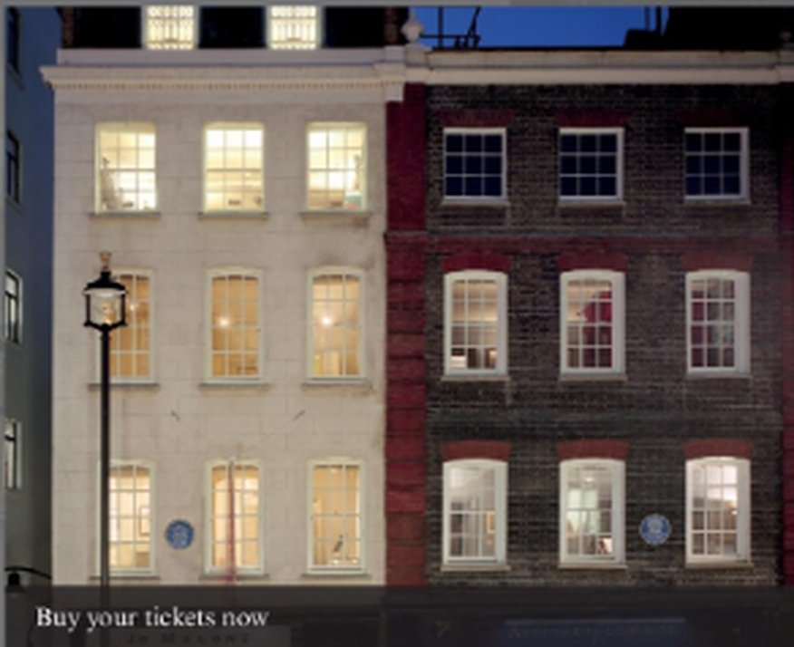
LISTENING · audio 7.21 · Handel's house
⏱ 4 min
Handel's house
LISTEN! ASCOLTA!
🎧 7.21
Who's it about: Handel or Hendrix? Then answer 1–5.
Di chi si parla: Handel o Hendrix? Poi rispondi 1–5.
1 Extracts 1–8 (6c–d): Handel or Hendrix?
Han Hen Han Han · Hen Hen Hen Han
2 Who lived in 25 Brook Street before Handel?
nobody
3 Why was he not allowed to buy the house?
he was a foreigner
4 What did Handel use the rooms on the first floor for?
entertaining and working
5 What rooms were there on the second floor?
a bedroom and a dressing room
6 Who lived in the attic?
the servants
23–25 Brook Street
📖 Teacher: Student's Book p.73 · 6c, 6d, 6e · audio 7.21 (script p.129)
7B · Part 2
Notes:
LISTENING (4 min + 4 min on the next slide). 6c: students read the eight extracts in the book (check the Glossary) and guess: Handel or Hendrix? 6d: play 7.21 once to check: 1 Han · 2 Hen · 3 Han · 4 Han · 5 Hen · 6 Hen · 7 Hen · 8 Han (TG). 6e: play again, pausing after the Handel part, for questions 1–5 (TG answers; the slide has the book's questions — slide rows 2–6 = book 1–5; rows 1–5 on the next slide = book 6–10): 1 nobody – he was the first occupant · 2 because he was a foreigner · 3 entertaining and working (and he rehearsed and composed there, e.g. the Messiah) · 4 a bedroom (at the front) and a dressing room (at the back) · 5 the servants. Extra facts from the script: he rented 25 Brook Street from 1723; his rent in 1742 was £50 a year; he was blind by 1754; he died in the house in 1759. Click 1 for all answers.

Slide 9
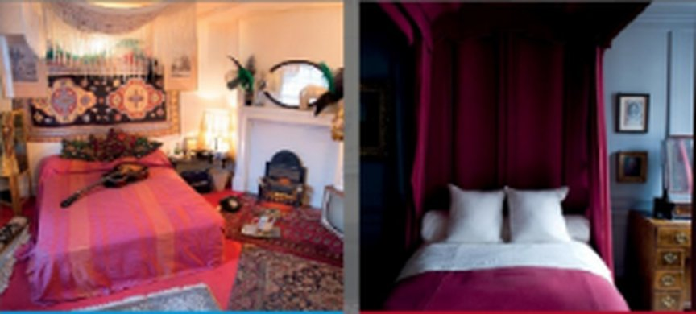
LISTENING · audio 7.21 · Hendrix's flat
⏱ 4 min
Hendrix's flat
LISTEN! ASCOLTA!
🎧 7.21
Listen to the second part. Answer 6–10.
Ascolta la seconda parte. Rispondi 6–10.
1 How long did Hendrix's career last?
four years
2 Who was Kathy Etchingham?
Hendrix's girlfriend (she found the flat)
3 When did Hendrix leave the flat?
in March 1969
4 Where did he die?
in a London hotel
5 What was the flat used for before it became a museum?
an office
Which bedroom is whose?
6 Would you like to visit the house? Why (not)?
📖 Teacher: Student's Book p.73 · 6e · audio 7.21 (script p.129)
7B · Part 2
Notes:
LISTENING (4 min). Before playing: the two bedrooms on the slide (from the poster) — which is Handel's and which is Hendrix's? (left: Hendrix's flat · right: Handel's house). Play the Hendrix part of 7.21. Pairs compare; click 1 for answers (TG): 6 four years · 7 Hendrix's girlfriend (Kathy Etchingham, who saw an advert in an evening newspaper) · 8 in March 1969 (he went back to New York and never lived there again) · 9 in a London hotel, in 1970, at the age of 27 — not in the flat · 10 as an office (until the Handel House Trust took it over in 2000; it opened to the public on 10 February 2016). Extra details: he bought curtains and cushions from John Lewis and ornaments from Portobello Road market; he called it 'my first real home of my own'. 6g (whole class, last question): have they ever visited the house of a famous person? (In Sicily: e.g. the house of Pirandello near Agrigento.) If there's time, students read the script on p.129.

Slide 10

VOCABULARY · From the listening · audio 7.22
⏱ 3 min
Words from the audio guide
THINK! PENSA!
1 Handel decided to s___ permanently in England…
settle
Complete the extracts. What do they mean? Then listen and check.
Completa le frasi. Cosa significano? Poi ascolta e controlla.
2 After living in Surrey for some years, he m___ to London…
moved
3 He was the first o___ of the house…
occupant
4 The flat on the u___ floors of 23 Brook Street was found by…
upper
5 He spent some time d___ the flat to his own taste.
decorating
6 The whole house is now a museum and a concert v___…
venue
📖 Teacher: Student's Book p.73 · 6f · audio 7.22
7B · Part 2
Notes:
VOCABULARY FROM THE LISTENING (3 min). 6f: pairs complete the six extracts (sentences from audio 7.22); play 7.22 to check; click 1 for the answers (TG): 1 settle · 2 moved · 3 occupant · 4 upper · 5 decorating · 6 venue. Check meaning and drill: occupant /ˈɒkjəpənt/, venue /ˈvenjuː/. These words are useful for the dream-house description on the next slide.

Slide 11
SPEAKING · Describing a house
⏱ 7 min
My dream house
SPEAK! PARLA!
Think for 2 minutes: Where would it be? What kind of house or flat? How many rooms? Special features? Decoration?
1
Describe your dream house. Which house in your group is the best?
Descrivi la tua casa dei sogni. Qual è la migliore del gruppo?
Groups of 3–5: take turns to describe your dream house in detail.
2
Listeners: ask 2 questions each. Would you live there? Why (not)?
3
Vote: which house would you most like to live in? (You can't vote for your own!)
4
It's a spacious stone house in the country, with a terrace, an open fire and…
📖 Teacher: Student's Book p.73 · 7a, 7b
7B · Part 2
Notes:
SPEAKING (7 min). 7a: give students 2 minutes to plan (help with vocabulary not in the Vocabulary Bank — swimming pool, garage, view of the sea…). 7b: groups of 3–5; each student describes their dream house in as much detail as possible; the others ask questions and finally say which house they like best. Feedback: the most popular house in each group. VARIATION: constraint challenge — each description must include at least 5 words from today (parts of a house + describing words: cosy, spacious, light, wooden, low ceilings…) and one second conditional: 'If I lived there, I'd…'.

Slide 12
GAME · Twenty questions
⏱ 5 min
Twenty questions
PLAY! GIOCA!
1
One student – the KNOWER – sits facing the screen.
Ask yes / no questions. Find the secret part of the house!
Fate domande sì / no. Trovate la parte segreta della casa!
2
Everybody else: you must NOT see the screen – turn round or close your eyes!
3
Teacher clicks → a word appears. The class asks yes / no questions: Is it inside? Is it on the roof?
4
The KNOWER can only say Yes, No or Sometimes. Maximum 20 questions!
5
Guessed in 10 questions or fewer = 2 points; in 20 = 1 point. Then a new knower.
📖 Teacher: Vocabulary Bank Houses p.162
7B · Part 2
Notes:
GAME (5 min). VARIATION: curiosity gap + question-forming practice (Is it…? Has it got…? Can you…? Do people usually…?). Two teams take turns to ask; the team that guesses gets the points. The teacher counts the questions on the board. If the class is quick, the knower can also secretly choose any word from Vocabulary Bank Houses p.162. IMPORTANT: guessers must not see the screen. Check they have turned round BEFORE you click each card. Every card is on its own slide.

Slide 13
GAME · Twenty questions · card 1 of 8
👀 Guessers: don't look! · Non guardate!
ATTIC
Knower – answer only:
Yes · No · Sometimes
7B · Part 2
Notes:
Card 1. Check the guessers can't see the screen, THEN click to show it.

Slide 14
GAME · Twenty questions · card 2 of 8
👀 Guessers: don't look! · Non guardate!
BASEMENT
Knower – answer only:
Yes · No · Sometimes
7B · Part 2
Notes:
Card 2. Check the guessers can't see the screen, THEN click to show it.

Slide 15
GAME · Twenty questions · card 3 of 8
👀 Guessers: don't look! · Non guardate!
CHIMNEY
Knower – answer only:
Yes · No · Sometimes
7B · Part 2
Notes:
Card 3. Check the guessers can't see the screen, THEN click to show it.

Slide 16
GAME · Twenty questions · card 4 of 8
👀 Guessers: don't look! · Non guardate!
BALCONY
Knower – answer only:
Yes · No · Sometimes
7B · Part 2
Notes:
Card 4. Check the guessers can't see the screen, THEN click to show it.

Slide 17
GAME · Twenty questions · card 5 of 8
👀 Guessers: don't look! · Non guardate!
CEILING
Knower – answer only:
Yes · No · Sometimes
7B · Part 2
Notes:
Card 5. Check the guessers can't see the screen, THEN click to show it.

Slide 18
GAME · Twenty questions · card 6 of 8
👀 Guessers: don't look! · Non guardate!
GATE
Knower – answer only:
Yes · No · Sometimes
7B · Part 2
Notes:
Card 6. Check the guessers can't see the screen, THEN click to show it.

Slide 19
GAME · Twenty questions · card 7 of 8
👀 Guessers: don't look! · Non guardate!
FIREPLACE
Knower – answer only:
Yes · No · Sometimes
7B · Part 2
Notes:
Card 7. Check the guessers can't see the screen, THEN click to show it.

Slide 20
GAME · Twenty questions · card 8 of 8
👀 Guessers: don't look! · Non guardate!
STEPS
Knower – answer only:
Yes · No · Sometimes
7B · Part 2
Notes:
Card 8. Check the guessers can't see the screen, THEN click to show it.

Slide 21
Look what you can do!
Guarda cosa sai fare adesso!
HOMEWORK · COMPITI
• Workbook 7B: 2c, 3a, 3b, 3c
• Vocabulary Bank Houses p.162: test yourself
• Homework sheet 7B-2
• Optional: Writing p.120 (d)
📷 Hand it in on the LLS app · Consegna nell'app LLS
✓ I can talk about where people live and describe a house.
😀 🙂 😐
✓ I can pronounce the letter c: /k/, /s/, /ʃ/, /ks/.
😀 🙂 😐
✓ I can understand an audio guide about a famous house.
😀 🙂 😐
Next lesson: Practical English 4 · Boys' night out
7B · Part 2
Notes:
EXIT (3 min). Students choose a face for each can-do. Homework: Workbook 7B 2c (letter c), 3a, 3b, 3c (houses) + Vocabulary Bank Houses p.162 (cover and test yourself) + the 7B-2 homework sheet (easier version available). Optional: Writing 'Describing a house or flat' p.120 — read the two posts and do d (a four-paragraph description for a holiday-rental website; TG possible answers for c: a fully-equipped kitchen, a sunny terrace, stunning views, a large garden, lovely beaches, ideal for a family). 2d is audio only.

Slide 22

EXTRA · Writing · Writing p.120
EXTRA
⏱ 10 min
Holiday home for rent
WRITE! SCRIVI!
Read the two posts on p.120. Which place would you choose for a holiday? Tell your partner why.
1
Which post would you choose? Then improve the boring one!
Quale annuncio sceglieresti? Poi migliora quello noioso!
Read about the flat in Florence. Underline the adjectives that make it attractive (stunning…).
2
Rewrite the description of the Turkish villa with better adjectives.
3
Plan your own post: 4 paragraphs – the place · the rooms · the location · who it's ideal for.
4
a fully-equipped kitchen · a sunny terrace · stunning views · ideal for a family
📖 Teacher: Writing Describing a house or flat p.120 · a, b, c
7B · Part 2
Notes:
EXTRA WRITING (10 min) — or set it as homework. a: pairs choose a post and explain (teach villa). b: underline the attractive adjectives in the Florence post (stunning = extremely attractive or impressive). c: improve the Turkish villa description — TG possible answers: a fully-equipped kitchen, a sunny terrace, stunning views, a large garden, lovely beaches, ideal for a family. Go through the Describing location box. d (homework): write their own post, 4 paragraphs, 15–20 minutes; they can invent a home. VARIATION: upgrade the language (boring → attractive).

Slide 23

EXTRA · Speaking · Estate agents
EXTRA
⏱ 8 min
Sell my house!
SPEAK! PARLA!
Teacher gives each pair a 'problem house': tiny, very old, next to a motorway, no kitchen…
1
Estate agents: sell a terrible house – honestly!
Agenti immobiliari: vendete una casa terribile – con onestà!
Pairs prepare a 1-minute sales pitch. You can't lie – but you can be positive!
2
Use houses vocabulary: It's cosy (= small!), it's got character (= old!)…
3
The class votes: would you buy it?
4
This cosy flat has a lovely view of the motorway – you'll never feel alone!
7B · Part 2
Notes:
EXTRA (8 min). VARIATION: perspective change + humour (turning negatives into positives — but never dishonestly: they can't invent things that aren't there). Good preparation for 8A (Dragons' Den pitches). Problem houses: a tiny flat on the top floor with no lift · an old cottage with low ceilings and no heating · a basement flat with no windows · a house next to a football stadium. For a written vocabulary check, use the EXTRA slide 'Houses for sale and rent' (Vocabulary photocopiable, 📄 B1_7B_Photocopiables.pdf, page 3).

Slide 24
EXTRA · Vocabulary · Photocopiable 7B
EXTRA
⏱ 6 min
Houses for sale and rent
READ! LEGGI!
TO RENT 2–3
2 second floor · 3 balcony
📄 Handout page 3: complete the ads in 3 minutes!
📄 Fotocopia pag. 3: completa gli annunci in 3 minuti!
FOR SALE: cottage 4–8
4 entrance · 5 wall · 6 gate · 7 roof · 8 chimney
FOR SALE: designer house 9–15
9 outskirts · 10 path · 11 terrace · 12 steps · 13 ground floor · 14 top floor · 15 basement
Activation: which home would you prefer? Why?
📖 Teacher: 📄 Print: B1_7B_Photocopiables.pdf, page 3 · Vocabulary 7B Houses
7B · Part 2
Notes:
EXTRA VOCABULARY PHOTOCOPIABLE (6 min) – or homework. 📄 Print: B1_7B_Photocopiables.pdf, page 3 (one per student). Official procedure (TG): set a time limit, e.g. three minutes; students read the three house descriptions and complete them with the correct words – the first letter or two is given (1 suburb = example). Check answers (official key): 2 second floor · 3 balcony · 4 entrance · 5 wall · 6 gate · 7 roof · 8 chimney · 9 outskirts · 10 path · 11 terrace · 12 steps · 13 ground floor · 14 top floor · 15 basement. Activation: pairs tell each other which home they prefer and why; get feedback. VARIATION: beat the clock (3-minute limit).

