Slide 1





9A
ENGLISH FILE B1 · 9A · Part 2 · SB pp.88–89
LUCKY ENCOUNTERS
READING · How to improve your luck
VOCABULARY · making adjectives and adverbs
SPEAKING · The sentence game
Are some people just born lucky?
No – they create their own luck!
Teacher: timings, answers and tips are in the slide notes.
9A · Part 2
Notes:
9A PART 2 (60 min) · SB pp.88–89. Aims: read an article by psychologist Richard Wiseman about how to improve your luck (topic sentences); make adjectives and adverbs from nouns (Vocabulary Bank Word-building p.164, part 2); the sentence game. Timing: cover 2 · revision 5 · superstitions 4 · topic sentences 6 · 4c a/b/c 6 · 4d questions 4 · word table 6 · audio 9.8 5 · sentence game 8 · story chain 6 · exit 3 = 55 min. Click 1: the question – take a quick show of hands: Who thinks they are lucky? Then click 2. (2 min)

Slide 2

REVISION · 9A part 1 · Third conditional
⏱ 5 min
Beat the clock!
WRITE! SCRIVI!
1 If the dog hadn't barked, …
30 seconds per sentence! Finish it with a correct third conditional.
30 secondi per frase! Completala con un third conditional corretto.
2 We wouldn't have missed the bus if …
3 If I had listened to my friend's advice, …
4 I would have won the race if …
5 If I hadn't got up so late, …
would have = /wʊdəv/
6 I would have been really annoyed if …
📖 Teacher: revision of 9A pp.86–87 · Student's Book p.87 · 2d, 2e
9A · Part 2
Notes:
REVISION of 9A part 1 (5 min) = SB 2d–2e (p.87: complete the sentences in your own words to make third conditional sentences; compare with a partner and check they are all correct). VARIATION: beat the clock. Teams; the teacher reads a beginning and starts a 30-second timer; each team writes ONE ending on paper / mini-whiteboard. Correct form (if + had + past participle / would have + past participle) = 1 point; the most creative or funniest correct ending = +1. Then one student per team SAYS the full sentence with the weak have /əv/ (9.5). Possible endings: …I wouldn't have woken up · …we had left earlier · …I wouldn't have made that mistake · …I had trained harder · …I wouldn't have been late · …you had told me. Accept any logical ending. Typical mistakes to watch (TG): ✗ If I would have…, ✗ If I had known, I had…

Slide 3






READING · Lead-in · 4a
⏱ 4 min
Good luck or bad luck?
SPEAK! PARLA!
a horseshoe
a four-leaf clover
a black cat
Good luck or bad luck in Italy? In the UK?
Porta fortuna o sfortuna in Italia? E nel Regno Unito?
ferro di cavallo
quadrifoglio
gatto nero
walk under a ladder
spill salt
umbrella indoors
passare sotto una scala
rovesciare il sale
aprire l'ombrello in casa
Friday 13th / 17th
touch wood!
venerdì 13 / 17
tocca ferro!
📖 Teacher: Student's Book p.88 · 4a · TG optional lead-in (horseshoe)
9A · Part 2
Notes:
LEAD-IN (4 min). TG optional lead-in: in Britain and America, people believe a horseshoe brings good luck if you find it, and often hang it on the wall – is it the same in Italy? Pairs sort the 8 items into GOOD LUCK / BAD LUCK in Italy (click 1 for the Italian). Compare cultures: the unlucky number in Italy is 17 (and Friday 17th), in the UK 13 (Friday 13th); English says 'touch wood', Italian 'tocca ferro'. ⚠ We only state the horseshoe fact from the TG; for the others, let students share what they believe – no 'right' answers. Do they really believe in these things? Then SB 4a (whole class or pairs): Do you think you're a lucky person? Why (not)? Show of hands (TG). Teach: be lucky (✗ have luck – Italians say 'avere fortuna'; TG note in 5a).

Slide 4
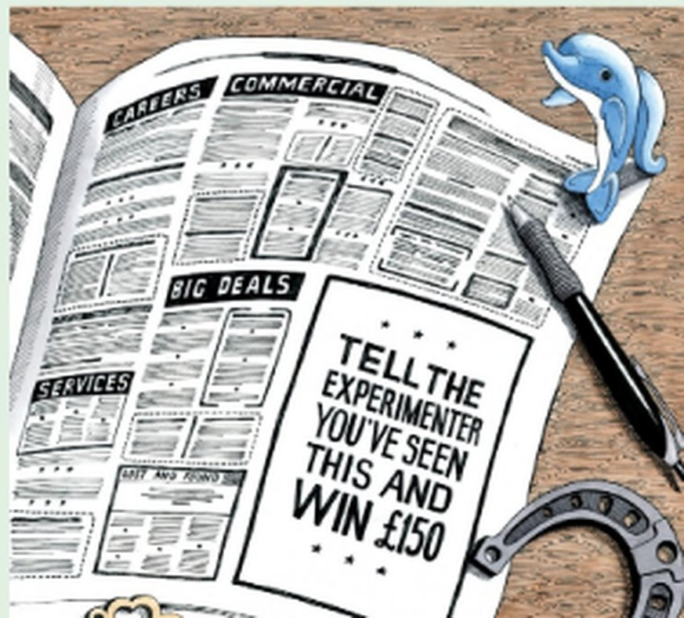
READING · Topic sentences · 4b
⏱ 6 min
How to improve your luck
READ! LEGGI!
1 I studied the lives of more than 400 people…
B A few years ago, I led a large research project about luck.
Read p.88. Put the topic sentences A–E in paragraphs 1–5.
Leggi p.88. Metti le frasi chiave A–E nei paragrafi 1–5.
2 Nor are people born lucky or unlucky…
E The results revealed that luck is not a magical ability…
3 Lucky people create and notice opportunities…
C Eventually, we uncovered four key psychological principles.
4 I asked a group of 200 volunteers…
D In a second phase of the project, I wanted to discover whether it was possible to change people's luck.
5 Unfortunately not. Lotteries are purely chance…
A But is it possible to use these techniques to win the lottery?
📖 Teacher: Student's Book pp.88–89 · 4b, 4c
9A · Part 2
Notes:
READING (6 min). 4a (whole class, before reading): Do you consider yourself in general to be a lucky person? Why (not)? 4b: go through the 'Topic sentences' box in the book (in a text, paragraphs usually begin with a topic sentence, which tells you what the paragraph is going to be about). Go through A–E and the highlighted words (they help to find the right paragraph). Students read the article 'How to improve your luck and win the lottery twice (possibly)' by Richard Wiseman and put a topic sentence at the start of each paragraph. Pairs compare. Click 1 for answers (TG): 1 B · 2 E · 3 C · 4 D · 5 A. The slide shows the first words of each paragraph (from the article) to help the check. Context: a British couple won £1m in the EuroMillions lottery for a second time – the chances are more than 283 billion to one. 4c = the next slide. VARIATION: prediction – before reading, students guess what the 'four key principles' might be (check on the next slide).

Slide 5
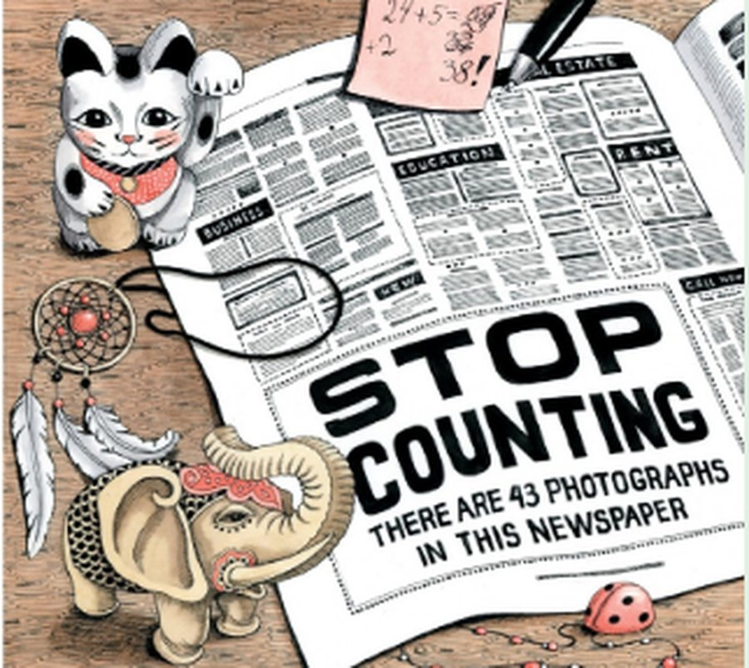
READING · 4c
⏱ 6 min
Read again: a, b or c?
READ! LEGGI!
1 In his first research project, the author asked the volunteers to ___. a record what happened to them every day · b answer questions about their jobs · c live together for a few months
a
Read the article again. Choose a, b or c.
Rileggi l'articolo. Scegli a, b o c.
2 In one experiment, the unlucky people ___. a didn't count the photographs correctly · b didn't notice something important in the newspaper · c were not able to finish the task
b
3 The researchers concluded that lucky people are generally ___. a optimistic · b hard-working · c ambitious
a
4 In a second phase of the project, Wiseman asked his volunteers to ___. a change their jobs · b change their attitude · c change their lifestyle
b
5 Wiseman believes that ___. a luck in your personal life matters more than luck at work · b winning the lottery is as important as luck in your personal life · c winning the lottery is less important than luck in your personal life
c
📖 Teacher: Student's Book p.88 · 4c
9A · Part 2
Notes:
READING (6 min). 4c: students read the article again (pp.88–89) and choose a, b or c (the slide = the book's questions). Pairs compare; click 1 for answers (TG): 1 a · 2 b · 3 a · 4 b · 5 c. Ask for the evidence in the text each time: 1 'keep diaries, complete personality tests, and take part in experiments' · 2 the unlucky people focused anxiously on counting and didn't see the two adverts ('STOP COUNTING. THERE ARE 43 PHOTOGRAPHS IN THIS NEWSPAPER' and 'TELL THE EXPERIMENTER YOU'VE SEEN THIS AND WIN £150') · 3 lucky people are confident that the future will be positive · 4 'to think and behave like a lucky person' · 5 being lucky in your personal life and career is far more important than winning the lottery. Deal with: spot, anxiously, intuition, give up, keep going. VARIATION: curiosity gap – before click 1, ask 'Would YOU have seen the advert?' (third conditional recycled: If I'd seen it, I would have won £150!).

Slide 6

SPEAKING · 4d
⏱ 4 min
Lucky or unlucky?
SPEAK! PARLA!
1 Do you agree with Richard Wiseman that people are not born lucky or unlucky, but can learn to make their own luck?
Ask and answer with a partner. Ask one follow-up question!
Fate domande e rispondete in coppia. Fai una domanda in più!
2 Can you remember a time when you were either very lucky or very unlucky? What happened?
3 Do you know anyone who you think is particularly lucky or unlucky? Why?
4 Think of a time when you were successful at something. Do you think it was because you worked hard at it, or because you were lucky and in the right place at the right time?
📖 Teacher: Student's Book p.89 · 4d
9A · Part 2
Notes:
SPEAKING (4 min). 4d: pairs ask and answer the four questions (the book's). TG: you could do question 1 with the whole class (show of hands – who agrees with Wiseman?). VARIATION: follow-up questions + personalisation with boundaries (an example from school, sport, music… – nothing too personal). Recap Wiseman's four principles if useful: lucky people create and notice opportunities (relaxed, open to change) · listen to their intuition and act quickly · are confident that the future will be positive · keep going and learn from their mistakes. Feedback: one lucky and one unlucky story from the class.

Slide 7
VOCABULARY · Vocabulary Bank Word-building p.164 · 2
⏱ 6 min
luck → lucky → luckily
THINK! PENSA!
1 luck
lucky · unlucky · luckily · unluckily
Make the adjectives (+ / –) and the adverbs (+ / –).
Forma gli aggettivi (+ / –) e gli avverbi (+ / –).
2 fortune
fortunate · unfortunate · fortunately · unfortunately
3 comfort
comfortable · uncomfortable · comfortably · uncomfortably
4 patience
patient · impatient · patiently · impatiently
-ful = with · -less = without
5 care
careful · careless · carefully · carelessly
📖 Teacher: Student's Book p.89 · 5a, 5b · Vocabulary Bank Word-building p.164, 2a, 2b · audio 9.7
9A · Part 2
Notes:
VOCABULARY (6 min). 5a: sentences from the article – luck is a noun, lucky / unlucky are adjectives. Questions 1 and 2 in the book – TG: 1 luckily · 2 unluckily. TG note: 'be lucky' is a problem for students who say 'have luck' in L1 (Italian: avere fortuna). 5b: Vocabulary Bank Word-building p.164, 2 Making adjectives and adverbs: go through the 'Adjective prefixes and suffixes' box, students complete the chart, play 9.7 to check. Click once per row (audio script 9.7). Notes (TG): -y and -able are typical adjective endings; un- and im- make adjectives negative; -ful (= full of / with) often → -less (= without): careful – careless, useful – useless (but NOT always); spelling: comfortable → comfortably (drop e), lucky → luckily (y → i). Stress: COMfortable /ˈkʌmftəbl/ – only 3 syllables! VARIATION: phonological branching – which words have a silent / 'eaten' syllable? (comfortable, uncomfortable).

Slide 8

VOCABULARY · Vocabulary Bank 2c, 2d · audio 9.8
⏱ 5 min
Good news or bad news?
LISTEN! ASCOLTA!
🎧 9.8
Write the right form of the word in brackets. Then listen.
Scrivi la forma giusta della parola tra parentesi. Poi ascolta.
1 The beach was beautiful, but ___ it rained every day. (fortune)
unfortunately
2 He did the exam quickly and ___, so he made mistakes. (care)
carelessly
3 We were really ___. We missed the flight by five minutes. (luck)
unlucky
4 Jack is a very ___ driver! (patience)
impatient
5 Fans waited ___ in the queue to buy tickets. (patience)
patiently
6 The bed in the hotel was incredibly ___. (comfort)
uncomfortable
📖 Teacher: Vocabulary Bank Word-building p.164 · 2c, 2d · audio 9.8
9A · Part 2
Notes:
VOCABULARY PRACTICE (5 min). Vocabulary Bank 2c: students complete each gap with the adjective or adverb made from the noun in bold – careful: some are positive, some negative. 2d: play 9.8 to check. The slide has 6 of the 10 sentences (shortened); click 1 for answers (audio script): 1 unfortunately · 3 carelessly · 4 unlucky · 5 impatient · 7 patiently · 10 uncomfortable. The others: 2 comfortable · 6 luckily · 8 carefully · 9 fortunately. VARIATION: forbidden easy answer – students must decide + or – BEFORE writing ('Is it good news or bad news?').

Slide 9

GAME · The sentence game · 5c–e
⏱ 8 min
The sentence game
PLAY! GIOCA!
1
Teams of 3–4. Write correct sentences with the EXACT number of words (contractions = one word).
Teams: write 5 sentences. Exact number of words!
Squadre: scrivete 5 frasi. Numero esatto di parole!
2
The sentences must make sense.
3
Include a form of the word: luck → lucky, luckily, unlucky…
4
5 minutes: 1 fortune (11 words) · 2 comfort (9) · 3 luck (7) · 4 care (6) · 5 patience (12)
5
Your teacher checks. Most correct sentences = winners!
FRIEND (7 words) → People in my country are very friendly.
📖 Teacher: Student's Book p.89 · 5c, 5d, 5e
9A · Part 2
Notes:
GAME (8 min). TG: read the rules of The sentence game together (p.89) and make sure everything is clear. Demo on the board: FRIEND (7 WORDS) → PEOPLE IN MY COUNTRY ARE VERY FRIENDLY. Teams of three or four, five minutes to write five sentences (extend if needed). When time is up, each team reads out its sentences; TG EXTRA SUPPORT: write each team's sentences on the board and get the other teams to say if they are correct. The rules and the five words are the book's (p.89): 1 You must write correct sentences with the exact number of words given (contractions count as one word). 2 The sentences must make sense. 3 You must include a form of the given word (e.g. if the word is luck, you can use lucky, luckily, unlucky, etc.). Words: 1 fortune (11 words) · 2 comfort (9 words) · 3 luck (7 words) · 4 care (6 words) · 5 patience (12 words). 5e: the teacher says if the sentences are correct; the team with the most correct sentences is the winner. VARIATION: constraint challenge.

Slide 10

GAME · Story chain
⏱ 6 min
Fortunately… unfortunately…
PLAY! GIOCA!
1
Groups of 4–5 in a circle.
Tell a story together. Good news, bad news, good news…
Raccontate una storia insieme. Buona notizia, cattiva notizia…
2
Student 1 starts: Last Saturday I went to Palermo by train.
3
Student 2: Unfortunately, … · Student 3: Fortunately, … – and so on.
4
You can also use: Luckily, … / Unluckily, … or a word from today: comfortable, impatiently, carelessly…
5
Hesitate for 5 seconds or repeat an idea? You're out!
Unfortunately, the train was very uncomfortable. Fortunately, I sat next to a famous singer…
📖 Teacher: Vocabulary Bank Word-building p.164 · 2 (adverbs as sentence adverbs)
9A · Part 2
Notes:
GAME (6 min). VARIATION: opposites + change the energy. Model with two strong students first. Fortunately / unfortunately / luckily / unluckily at the start of a sentence comment on the whole sentence (sentence adverbs), followed by a comma. Each student must add a new idea that is good news after bad news (and vice versa). Bonus point for using another word from today's table. Last student 'in' wins. Then each group retells its funniest story to the class in 30 seconds (past tenses).

Slide 11
Look what you can do!
Guarda cosa sai fare adesso!
HOMEWORK · COMPITI
• Workbook 9A: 3a, 3b, 3c, 3d, 3e
• Vocabulary Bank p.164 part 2: test yourself
• Homework sheet 9A-2
📷 Hand it in on the LLS app · Consegna nell'app LLS
✓ I can understand an article about how to improve your luck.
😀 🙂 😐
✓ I can make adjectives and adverbs from nouns.
😀 🙂 😐
✓ I can use words like luckily and impatient correctly.
😀 🙂 😐
Next lesson: 9B part 1 · Digital detox
9A · Part 2
Notes:
EXIT (3 min). Students choose a face for each can-do. Homework: Workbook 9A 3a–3e (adjectives and adverbs, including 3c with successful, possible, selfish, useful, suitable) + Vocabulary Bank Word-building p.164 part 2 (cover and test yourself) + the 9A-2 homework sheet (easier version available). Answers are in the teacher key PDF.

Slide 12
EXTRA · Game · In the manner of the adverb
EXTRA
⏱ 7 min
Do it… carefully!
PLAY! GIOCA!
1
The ACTOR stands facing the screen, back to the class.
Mime the action in the way on the card. Guess the adverb!
Mima l'azione nel modo indicato. Indovina l'avverbio!
2
Everybody else: you must NOT see the screen – turn round or close your eyes!
3
Teacher clicks → an action + an adverb. The actor mimes it: no words!
4
The team guesses the adverb: You're eating impatiently!
5
Correct adverb = 1 point. Correct full sentence = 2 points.
📖 Teacher: Vocabulary Bank Word-building p.164 · 2
9A · Part 2
Notes:
EXTRA GAME (7 min). VARIATION: change the energy + upgrade the language (present continuous + adverb: You're waiting for the bus impatiently!). The actor sees the adverb AND the action; the team only sees the mime. All adverbs from Vocabulary Bank 2 (audio 9.7). The Vocabulary photocopiable Word-building p.216 is the next EXTRA slide; the Grammar photocopiable and the Communicative photocopiable 'Sentence race' are extras in 9A part 1. IMPORTANT: guessers must not see the screen. Check they have turned round BEFORE you click each card. Every card is on its own slide.

Slide 13
EXTRA · Game · In the manner of the adverb · card 1 of 6
EXTRA
👀 Guessers: don't look! · Non guardate!
IMPATIENTLY
Mime this action:
wait for a bus
9A · Part 2
Notes:
Card 1. Check the guessers can't see the screen, THEN click to show it.

Slide 14
EXTRA · Game · In the manner of the adverb · card 2 of 6
EXTRA
👀 Guessers: don't look! · Non guardate!
CAREFULLY
Mime this action:
carry a very full cup of coffee
9A · Part 2
Notes:
Card 2. Check the guessers can't see the screen, THEN click to show it.

Slide 15
EXTRA · Game · In the manner of the adverb · card 3 of 6
EXTRA
👀 Guessers: don't look! · Non guardate!
UNCOMFORTABLY
Mime this action:
sit on a very small chair
9A · Part 2
Notes:
Card 3. Check the guessers can't see the screen, THEN click to show it.

Slide 16
EXTRA · Game · In the manner of the adverb · card 4 of 6
EXTRA
👀 Guessers: don't look! · Non guardate!
CARELESSLY
Mime this action:
do your homework
9A · Part 2
Notes:
Card 4. Check the guessers can't see the screen, THEN click to show it.

Slide 17
EXTRA · Game · In the manner of the adverb · card 5 of 6
EXTRA
👀 Guessers: don't look! · Non guardate!
PATIENTLY
Mime this action:
teach a child to ride a bike
9A · Part 2
Notes:
Card 5. Check the guessers can't see the screen, THEN click to show it.

Slide 18
EXTRA · Game · In the manner of the adverb · card 6 of 6
EXTRA
👀 Guessers: don't look! · Non guardate!
COMFORTABLY
Mime this action:
watch TV on the sofa
9A · Part 2
Notes:
Card 6. Check the guessers can't see the screen, THEN click to show it.

Slide 19

EXTRA · Vocabulary photocopiable 9A
EXTRA
⏱ 6 min
Change the word!
WRITE! SCRIVI!
14 The bed was so ___ that I wasn't able to sleep. COMFORT
uncomfortable
Handout race: write the right form of the word in bold. 3 minutes!
Gara sulla scheda: scrivi la forma giusta della parola. 3 minuti!
15 These sandals are so ___. It feels as if I'm not wearing anything on my feet. COMFORT
comfortable
16 Having to wait for people makes me really ___. PATIENT
impatient
17 Nick's ___ in love. His partners always leave him! LUCK
unlucky
18 Be ___ not to break your leg on the first day of your skiing holiday! CARE
careful
19 Paolo writes very ___ and doesn't check for mistakes. CARE
carelessly
20 ___, it rained on our wedding day, but we had a great day anyway. FORTUNE
Unfortunately
📖 📄 Print: B1_9A_Photocopiables.pdf, page 4 · Teacher: Vocabulary photocopiable 9A 'Word-building' p.216
9A · Part 2
Notes:
EXTRA (6 min) or HOMEWORK = Vocabulary photocopiable 9A 'Word-building – Change the word!' (TG p.216). 📄 Print: B1_9A_Photocopiables.pdf, page 4 – one copy per student. Official procedure (TG): give out the worksheets; set a time limit, e.g. three minutes; students complete the sentences with the correct form of the words in bold (nouns, positive or negative adjectives, adverbs), writing as many words as they can in the right-hand column. The first student to write all the words correctly wins, or the student with the most correct answers when time is up. Sentences 1–13 are nouns (Vocabulary Bank Word-building p.164, part 1 – revision of 8B); 14–20 are today's adjectives and adverbs (part 2) – the slide shows 14–20 (one answer per click). Official answers (TG): 1 complaint (example) · 2 compensation · 3 argument · 4 delivery · 5 success · 6 achievement · 7 explanation · 8 attachment · 9 agreement · 10 demonstration · 11 payment · 12 loss · 13 sale · 14 uncomfortable · 15 comfortable · 16 impatient · 17 unlucky · 18 careful · 19 carelessly · 20 Unfortunately. ACTIVATION: students cover the right-hand column, read the sentences aloud and try to remember the missing words. VARIATION: beat the clock + memory disruption.

Slide 20

EXTRA · Speaking · Mini debate
EXTRA
⏱ 5 min
Do you make your own luck?
SPEAK! PARLA!
"You can make your own luck."
AGREE
NO WAY
Agree or no way? Give a reason!
D'accordo o per niente? Dai un motivo!
"Superstitions are just for fun – nobody really believes them."
AGREE
NO WAY
"Winning the lottery would make me happier."
AGREE
NO WAY
"Some people are born lucky."
AGREE
NO WAY
I agree, because… · I'm not so sure… · No way! In my opinion…
9A · Part 2
Notes:
EXTRA (5 min). VARIATION: mild controversy. Pairs choose AGREE or NO WAY for each statement and give a reason; then find someone who disagrees. Link to the article: Wiseman says people are NOT born lucky or unlucky and that being lucky in your personal life and career is far more important than winning the lottery.

