Slide 1





9B
ENGLISH FILE B1 · 9B · Part 1 · SB pp.90–91
DIGITAL DETOX
VOCABULARY · electronic devices
PHRASAL VERBS · switch it on, turn it up…
PRONUNCIATION · linking
Three days. No phone. No Wi-Fi. Could you do it?
LISTENING · A digital detox
Switch it off… if you dare!
Teacher: timings, answers and tips are in the slide notes.
9B · Part 1
Notes:
9B PART 1 (60 min) · SB pp.90–91. Aims: electronic devices (1b) and phrasal verbs for using them (switch it on, turn it down…); linking + -ed endings; listen to journalist Anna Magee's three-day digital detox; discuss whether we could live without the internet. Timing: cover 2 · revision 5 · devices 7 · phrasal verbs 6 · linking 4 · tech habits 4 · detox article 4 · listening 9.12 3 · listening 9.13 9 · debate 4 · game 6 · exit 3 = 57 min. Click 1: the question; take two or three quick answers (hands up: Could you? Yes / No / Maybe) before click 2. (2 min)

Slide 2


REVISION · 9A part 2 · Luck & word building
⏱ 5 min
Odd one out!
THINK! PENSA!
1 luckily · carefully · patiently · comfortable
comfortable – adjective (the others are adverbs)
Find the odd one out. Say WHY!
Trova l'intruso. Spiega PERCHÉ!
2 unlucky · impatient · uncomfortable · careless
careless – suffix -less, not a prefix
3 lucky · comfortable · careful · impatient (stress!)
impatient – stress on the 2nd syllable: imPAtient
4 Lucky people: are relaxed · trust intuition · give up quickly · learn from mistakes
give up quickly – that's unlucky people
5 Luck is… magic · chance · something you're born with · how you think and act
how you think and act – the only TRUE one
📖 Teacher: revision of 9A pp.88–89 · Vocabulary Bank Word-building p.164 · audio 9.7, 9.8
9B · Part 1
Notes:
REVISION of 9A part 2 (5 min). VARIATION: odd one out (with a phonological item and a content item). Pairs; 40 seconds per line; they must give a REASON — no reason, no point. Click once per line to show its answer (one per click). 1 comfortable is an adjective; luckily, carefully, patiently are adverbs. 2 all four are negative, but careless uses the suffix -less; the others use the prefixes un- / im-. 3 stress: LUCKy, COMfortable (only 3 syllables: /ˈkʌmftəbl/), CAREful, imPAtient. 4 and 5 recall Richard Wiseman's article (SB pp.88–89): lucky people are relaxed, listen to their intuition, keep going and learn from their mistakes; unlucky people give up before they have begun. His research showed luck is NOT a magical ability or random chance, and people are not born lucky or unlucky — they create their luck by the way they think and behave. Fast finishers: make the adverb from each adjective in line 3 (luckily, comfortably, carefully, impatiently). (Unit 9 revision formats: 9A-1 number memory · 9A-2 beat the clock · 9B-1 odd one out · 9B-2 answers first – no repeats.)

Slide 3













VOCABULARY · Electronic devices · audio 9.9
⏱ 7 min
Plug it in!
THINK! PENSA!
a memory stick
an adaptor
a router /ˈruːtə/
a charger
Say the words. Which ones are on your desk now?
Di' le parole. Quali hai sulla scrivania adesso?
una chiavetta USB
un adattatore
un router
un caricabatterie
a keyboard
a plug
a switch
a printer
una tastiera
una spina
un interruttore
una stampante
a speaker
a remote control
a socket
a USB cable
una cassa (audio)
un telecomando
una presa
un cavo USB
a mouse
un mouse
📖 Teacher: Student's Book p.90 · 1a, 1b, 1c · audio 9.9
9B · Part 1
Notes:
VOCABULARY (7 min). 1a (1 min): elicit device /dɪˈvaɪs/, plural devices /dɪˈvaɪsɪz/; whole class: Which device do you use most? 1b (2 min): pairs match the words and the photos on p.90 (a memory stick is done as the example). 1c: play 9.9 to check (answers in the key: 1 a memory stick · 2 an adaptor · 3 a router · 4 a charger · 5 a keyboard · 6 a plug · 7 a switch · 8 a printer · 9 a speaker · 10 a remote control · 11 a socket · 12 a USB cable · 13 a mouse). Play again for repetition. This slide = the same 13 words (order as in the audio). Click 1 shows the Italian. Pronunciation: router /ˈruːtə/ (the book's phonetics, British; Italians often say /ˈraʊtər/ – the American pronunciation), adaptor stressed on the 2nd syllable /əˈdæptə/, socket /ˈsɒkɪt/. Watch out: plug (spina) ≠ socket (presa). VARIATION: memory disruption (TG optional lead-in) — after the drill, pairs look at the slide for 20 seconds, then the teacher switches the projector off (or covers the screen): How many devices can you write in 1 minute? Then pairs test each other covering the words in the book. EXTRA CHALLENGE (TG): other tech words — a screen, a joystick, hardware, software.

Slide 4
VOCABULARY · Phrasal verbs · audio 9.10
⏱ 6 min
What did I do?
THINK! PENSA!
1 I changed the heating from 20° to 18°.
I turned it down.
2 I disconnected my printer from the computer.
I unplugged it.
Match the action and the phrasal verb. Then listen and check.
Abbina l'azione al phrasal verb. Poi ascolta e controlla.
3 I made the volume on the TV louder.
I turned it up.
4 I pressed the 'off' button on the TV.
I switched it off.
5 I programmed the alarm on my phone for 7.30.
I set it.
6 I put my phone charger into a socket.
I plugged it in.
7 I pressed the 'on' button on my laptop.
I switched it on.
8 I got the latest version of an app.
I updated it.
9 I put antivirus software on my computer.
I installed it.
10 I removed a photo I didn't like.
I deleted it.
📖 Teacher: Student's Book p.90 · 1d, 1e · audio 9.10
9B · Part 1
Notes:
PHRASAL VERBS (6 min). 1d (3 min): students match 1–10 with A–J on p.90, then compare with a partner. 1e: play 9.10 to check. The slide shows the book's sentences 1–10 and, on click 1, the answers (from audio 9.10): book key 1 H · 2 F · 3 D · 4 A · 5 G · 6 I · 7 J · 8 C · 9 E · 10 B. Vocabulary notes (TG): switch on / off = turn on / off (same meaning today), but only TURN up / down for volume, heating, etc. VARIATION: reverse the obvious — after checking, the teacher says the phrasal verb (I unplugged it!) and pairs race to say the situation; then a student takes the teacher's role. Point out the object pronoun in the middle: switch it on ✓ — switch on it ✗ (this is the Separable phrasal verbs box, next slide).

Slide 5
PRONUNCIATION · Linking · audio 9.11
⏱ 4 min
Switched‿it‿off
LISTEN! ASCOLTA!
1 -ed = /t/
switched‿it‿off · switched‿it‿on
Listen. Put the phrases in the right group. Say them as ONE word!
Ascolta. Metti le frasi nel gruppo giusto. Dille come UNA parola!
2 -ed = /d/
turned‿it‿up · turned‿it‿down · installed‿it · unplugged‿it · plugged‿it‿in
3 -ed = /ɪd/
deleted‿it · updated‿it
Separable: switch it on ✓ switch on it ✗
4 no -ed!
set‿it (set – set – set)
📖 Teacher: Student's Book p.90 · 1f · audio 9.11 · Separable phrasal verbs box
9B · Part 1
Notes:
PRONUNCIATION (4 min). 1f: go through the Separable phrasal verbs box: with a pronoun, the pronoun goes between the verb and the particle (switch it on, NOT switch on it); with a noun both orders are possible (switch on the TV / switch the TV on). Play 9.11 (sentences A–J): students listen and notice the linking; after each phrase elicit /t/, /d/ or /ɪd/ (TG) — click once per group to check. Pronunciation notes (TG): it + particle are linked, and the linking helps you hear the -ed; in turned it down, it and down are linked because the sounds /t/ and /d/ are very similar. Play again: listen and repeat; then individuals. Finally (TG): students cover A–J, look at 1–10 and say A–J from memory. VARIATION: change the energy — whisper it, shout it, say it sadly (I deleted it…).

Slide 6

SPEAKING · 1g
⏱ 4 min
Give reasons!
SPEAK! PARLA!
1 Do you prefer to use a keyboard with or without a mouse? Do you prefer a wireless mouse?
Answer the questions with a partner. Give reasons.
Rispondi alle domande con un compagno. Spiega perché.
2 Do you normally listen to music with headphones or with a speaker?
3 How many remote controls do you have? Do you think you have too many?
4 How many pins do plugs in your country have? Do you need a travel adaptor if you go abroad?
5 In your house, do you usually agree about what the temperature should be, or is someone always turning the heating or air conditioning up and down?
📖 Teacher: Student's Book p.90 · 1g
9B · Part 1
Notes:
SPEAKING (4 min). 1g: go through questions 1–5 (the book's); pairs ask and answer and give reasons (TG). VARIATION: forced choice – for questions 1 and 2 'both' and 'it depends' are banned. Then the teacher asks 2–3 students: 'Who in your house always turns the heating up?' Q4 culture point: Italian plugs have 2 or 3 round pins (type F / L), British plugs 3 rectangular pins – so yes, you need a travel adaptor in the UK! Listen for the separable phrasal verbs with it (I turn it up / I switch it off…).

Slide 7
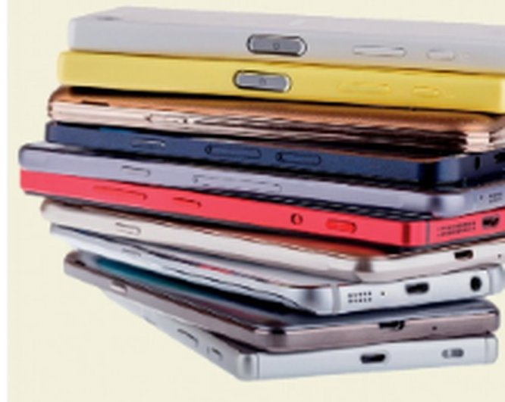
READING · Digital detox · 2a, 2b
⏱ 4 min
Are you addicted?
READ! LEGGI!
1 Do you think you're addicted to your phone? How many times an hour do you look at it? What for?
Read the short article on p.91. Answer with a partner.
Leggi il breve articolo a p.91. Rispondi con un compagno.
2 What does digital detox mean?
taking a break from technology – switching off / not using devices
3 Do you think phone stacking is a good idea? Do you and your friends ever do it?
4 What does unplug mean in the third paragraph? Do you have periods when you 'unplug'?
unplug = disconnect from technology
5 PREDICT: Anna does a 3-day detox. One good thing? One bad thing?
Listen and check!
phone stacking
📖 Teacher: Student's Book p.91 · 2a, 2b
9B · Part 1
Notes:
READING (4 min). 2a (1 min, line 1 = the book's question): teach to be addicted to something (= unable to stop using or doing something as a habit). Pairs or whole class. 2b (2 min): students read the short article 'Less time online: millions of Britons take digital detox' on p.91 and answer questions 1–3 in pairs (lines 2–4; 3 is shortened – the book adds: Do you enjoy life more when you're 'unplugged'?). Article facts: phone stacking = friends put their phones in the middle of the table when they go out for a coffee or a meal and agree not to look at them – the first person who looks pays the bill! · 34% of internet users have taken a break from their devices in the last 12 months · the under-25s are most likely to 'unplug'; 33% said they got more done and 21% enjoyed life more; only 8% found it 'stressful' (study by Ofcom). Click 1 for the answers from the TG: 1 a digital detox = taking a break from technology, e.g. switching off or not using digital devices · 2 opinion · 3 unplug = 'disconnect from technology'. Last line = PREDICTION for the listening: each pair writes one positive and one negative thing that might happen to someone with no phone for three days. Keep them on the board. VARIATION: prediction + personalisation with boundaries (nobody has to say how many hours a day they use their phone).

Slide 8
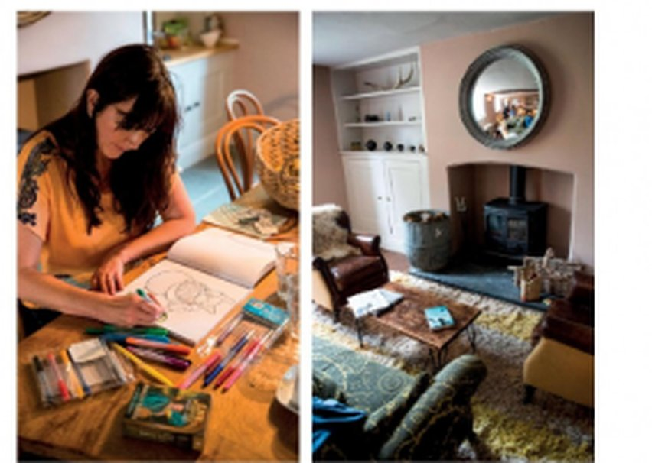
LISTENING · Understanding attitude · audio 9.12
⏱ 3 min
Positive or negative?
LISTEN! ASCOLTA!
🎧 9.12
How does Anna feel? Positive 🙂 or negative 🙁?
Come si sente Anna? Positiva 🙂 o negativa 🙁?
1 Suddenly I felt cut off and panicky.
🙁 negative
2 We had lots of conversations with real-life humans.
🙂 positive
3 I slept really well, for the first time in months.
🙂 positive
4 I felt really disconnected and lonely.
🙁 negative
5 I really noticed the beauty of the countryside.
🙂 positive
Anna's detox
📖 Teacher: Student's Book p.91 · 2c · audio 9.12
9B · Part 1
Notes:
LISTENING (3 min). 2c: Australian journalist Anna Magee went on a three-day digital detox course run by the organization Time to Log Off (the photos on p.91). Play 9.12 once (five things she said). Students decide positive or negative — listen to her TONE, not only the words. Compare, click 1 for answers (TG / audio script): 1 negative · 2 positive · 3 positive · 4 negative · 5 positive. Check: cut off = isolated; panicky = very anxious. Did any of the class's predictions come up?

Slide 9
LISTENING · audio 9.13
⏱ 9 min
True or false?
LISTEN! ASCOLTA!
🎧 9.13
Positive or negative experience? Listen again: T or F?
Esperienza positiva o negativa? Riascolta: vero o falso?
1 A quarter of UK adults check their phones in the middle of the night.
F – one in three
2 When Anna arrived at the house in Dorset, she felt very nervous.
T
3 The activities were not exactly what she was expecting.
T
4 The second day of the detox was easier than the first.
F – lonely, she cried
5 By the third day, her ability to concentrate had improved.
T
6 On her train journey home, she spent the time checking her phone.
F – she didn't check it
7 Since the detox, her weekends and evenings are technology-free.
F – Saturdays; no email after 8
8 She enjoys her friends' company more than she used to.
T
📖 Teacher: Student's Book p.91 · 2d, 2e · audio 9.13
9B · Part 1
Notes:
LISTENING (9 min). 2d: play 9.13 once – on the whole, did she feel it was a positive or negative experience? (TG: positive). 2e: students read sentences 1–8 (the book's, on the slide), then listen again and mark T / F, correcting the false ones (pause if necessary). Click 1 for all answers. TG answers: 1 F (one in three UK adults checks their phone in the middle of the night) · 2 T · 3 T · 4 F (the second evening she felt very disconnected and lonely and burst into tears during yoga) · 5 T · 6 F (she didn't check her phone on the train) · 7 F (she's technology-free on Saturdays and doesn't do email after 8 p.m.) · 8 T. Also in the script: the detox was in an old country house in Dorset; no mobile coverage, so she couldn't cheat; nine people handed in their devices at 6 p.m.; activities: yoga, walks, picking fruit, real conversations (no lectures); by day 3 she could read for nearly half an hour without losing concentration, and she was eating more slowly. Now she feels 'more present' with friends. EXTRA SUPPORT: listen a last time with the script on pp.130–131. VARIATION: curiosity gap – compare with the class predictions from the earlier slide.

Slide 10
SPEAKING · 2f
⏱ 4 min
Could you cope?
SPEAK! PARLA!
1 If you went on a digital detox course, what do you think you would miss the most? How would you feel?
Discuss the questions with a partner.
Discuti le domande con un compagno.
2 Do you think digital detoxes are a good idea or a stupid idea? Do you think it's really necessary to take a break from technology?
3 Have you been without the internet (or phone coverage) recently? Why? Did you miss it?
Good idea or stupid idea? Vote!
📖 Teacher: Student's Book p.91 · 2f
9B · Part 1
Notes:
SPEAKING (4 min). 2f: pairs discuss the three questions (the book's), then feedback (TG). VARIATION: mild controversy + forced choice – for question 2, the class votes GOOD IDEA or STUPID IDEA (stand up / stay seated), then two volunteers from each side give their best reason. Follow-up questions: What would you do instead? Would you pay for a detox course? Keep it light and non-judgemental: nobody has to reveal their screen time.

Slide 11
GAME · Twenty questions
⏱ 6 min
What's in the box?
PLAY! GIOCA!
1
ONE student (the 'box') stands next to the screen, looking at it.
Guess the secret device. Ask only yes / no questions!
Indovina il dispositivo segreto. Solo domande sì / no!
2
Everybody else: you must NOT see the screen – turn round or close your eyes!
3
Teacher clicks → a secret device. The class asks yes / no questions: Do you plug it in? Is it smaller than a phone?
4
The 'box' answers ONLY yes / no / sometimes. Max 20 questions!
5
Guess with a full sentence: It's a router! Fewer questions = more points for your team.
📖 Teacher: recycles SB p.90 devices + phrasal verbs
9B · Part 1
Notes:
GAME (6 min). VARIATION: curiosity gap + constraint challenge (only yes / no questions; the phrasal verbs from today are the most useful questions: Do you switch it on? Can you turn it up? Do you plug it in?). Two teams take turns to ask; the team that guesses gets 3 points if it took fewer than 6 questions, 2 points for 6–12, 1 point after that. Model card 1 yourself as the 'box'. A new 'box' student for each card. IMPORTANT: guessers must not see the screen. Check they have turned round BEFORE you click each card. Every card is on its own slide.

Slide 12
GAME · Twenty questions · card 1 of 7
👀 Guessers: don't look! · Non guardate!
ROUTER
Answer only:
yes · no · sometimes
9B · Part 1
Notes:
Card 1. Check the guessers can't see the screen, THEN click to show it.

Slide 13
GAME · Twenty questions · card 2 of 7
👀 Guessers: don't look! · Non guardate!
REMOTE CONTROL
Answer only:
yes · no · sometimes
9B · Part 1
Notes:
Card 2. Check the guessers can't see the screen, THEN click to show it.

Slide 14
GAME · Twenty questions · card 3 of 7
👀 Guessers: don't look! · Non guardate!
CHARGER
Answer only:
yes · no · sometimes
9B · Part 1
Notes:
Card 3. Check the guessers can't see the screen, THEN click to show it.

Slide 15
GAME · Twenty questions · card 4 of 7
👀 Guessers: don't look! · Non guardate!
PRINTER
Answer only:
yes · no · sometimes
9B · Part 1
Notes:
Card 4. Check the guessers can't see the screen, THEN click to show it.

Slide 16
GAME · Twenty questions · card 5 of 7
👀 Guessers: don't look! · Non guardate!
MEMORY STICK
Answer only:
yes · no · sometimes
9B · Part 1
Notes:
Card 5. Check the guessers can't see the screen, THEN click to show it.

Slide 17
GAME · Twenty questions · card 6 of 7
👀 Guessers: don't look! · Non guardate!
SPEAKER
Answer only:
yes · no · sometimes
9B · Part 1
Notes:
Card 6. Check the guessers can't see the screen, THEN click to show it.

Slide 18
GAME · Twenty questions · card 7 of 7
👀 Guessers: don't look! · Non guardate!
ADAPTOR
Answer only:
yes · no · sometimes
9B · Part 1
Notes:
Card 7. Check the guessers can't see the screen, THEN click to show it.

Slide 19
Look what you can do!
Guarda cosa sai fare adesso!
HOMEWORK · COMPITI
• Workbook 9B: 1a, 1b, 1c, 3a
• SB p.90 1b: cover & test yourself
• Homework sheet 9B-1
📷 Hand it in on the LLS app · Consegna nell'app LLS
✓ I can name electronic devices: a charger, a socket…
😀 🙂 😐
✓ I can use phrasal verbs: switch it on, turn it down…
😀 🙂 😐
✓ I can understand a radio programme about a digital detox.
😀 🙂 😐
Next lesson: 9B part 2 · Quantifiers · ough & augh
9B · Part 1
Notes:
EXIT (3 min). Students choose a face for each can-do. Homework: Workbook 9B 1a, 1b, 1c (devices + phrasal verbs) and 3a (linking: switched it on…; 3b is audio – optional at home) + test yourself on the devices on p.90 + the 9B-1 homework sheet (easier version available). Workbook 2 (quantifiers) and 3c (ough / augh) go with part 2. Answers are in the teacher key PDF.

Slide 20

EXTRA · Warmer · Memory
EXTRA
⏱ 6 min
Kim's game: the table
PLAY! GIOCA!
Teacher puts real objects on a table: an adaptor, a charger, a plug, a mouse, a speaker, a USB cable…
1
Look for 1 minute. Then write all the objects you remember!
Guarda per 1 minuto. Poi scrivi tutti gli oggetti che ricordi!
Students come and look for ONE minute – no photos!
2
Back in pairs: write down every object you remember, in English, with a / an.
3
Teacher takes the objects out one by one. 1 point per object, +1 for perfect pronunciation.
4
We remember a charger, an adaptor and a USB cable!
9B · Part 1
Notes:
EXTRA (6 min) — the TG's optional lead-in for 9B (books closed). Good as a warmer for part 2 too. VARIATION: memory disruption — while they write, take one object away secretly: who notices what's missing?

Slide 21


EXTRA · Speaking · Ranking
EXTRA
⏱ 6 min
Which could you live without?
SPEAK! PARLA!
CAN'T LIVE WITHOUT
?
my phone
Agree on an order with a partner. Explain your choices!
Mettetevi d'accordo sull'ordine. Spiegate le scelte!
?
the Wi-Fi router
?
the TV remote control
?
my speaker / headphones
?
my laptop / computer
?
the printer
WOULDN'T MISS IT
9B · Part 1
Notes:
EXTRA (6 min). VARIATION: ranking + perspective change — rank for yourself, then rank again for a grandparent or a 10-year-old: what changes? Recycle: I couldn't live without it because I use it to… / I'd unplug it tomorrow!

Slide 22
EXTRA · Speaking · Group task
EXTRA
⏱ 8 min
Design a detox weekend
SPEAK! PARLA!
1
Where? Choose a place near Bagheria (the sea, the mountains, a farm…).
In groups: plan a phone-free weekend for your class.
In gruppo: organizzate un weekend senza telefono per la classe.
2
Rules: what devices are allowed? When do you hand them in?
3
Plan 4 activities instead of screens (Anna did yoga, walks, picking fruit…).
4
One emergency: how can families contact you?
5
Present your weekend. The class votes: which one would you go on?
On Saturday morning everybody hands in their phones and we go for a walk on Monte Catalfano!
9B · Part 1
Notes:
EXTRA (8 min). VARIATION: student-generated content + local personalisation. Each group presents in 1 minute; the class asks follow-up questions. Encourage future forms and the device vocabulary (We'll switch off the router / unplug the TV).

