Slide 1





PE3
ENGLISH FILE B1 · PE3 · Part 1 · SB pp.54–55
OLD FRIENDS
PRACTICAL ENGLISH · Episode 3
Asking for permission · making requests
SOCIAL ENGLISH · meeting an old friend
Would you mind meeting my friend at the airport?
Not at all!
Teacher: timings, answers and tips are in the slide notes.
PE3 · Part 1
Notes:
PRACTICAL ENGLISH EPISODE 3 'Old friends' (60 min) · SB pp.54–55. Aims: asking for permission (Do you mind if I…? / Is it OK if I…?) and making requests (Could you…? / Would you mind + -ing? / Do you think you could…?) and how to answer them; Social English for meeting an old friend. Story: Jenny meets her old friend Monica, who is getting married; Rob joins them and asks Jenny a big favour; Jenny picks up Rob's old friend Paul at the airport. The six Episode 3 videos are embedded (scenes 1–3, listen and check, listen and repeat, Social English phrases); audio 5.23–5.28 is the back-up. Timing: cover 2 · revision 5 · scene 1 7 · scene 2 5 · T/F check 2 · guess 2 · listen and check 2 · listen and repeat 2 · rule 3 · Communication 7 · scene 3 6 · Social English 5 · polite game 5 · exit 3 = 56 min. Optional TG lead-in: what do they remember about Episode 2 (Kerri and Don, the argument about New York and London waiters)? Click 1: the question – ask 'What's the answer if you're happy to do it?' before click 2 (trap: Not at all = YES!). (2 min)

Slide 2


REVISION · 5B part 2 · Relationships
⏱ 5 min
Timeline race
PLAY! GIOCA!
A they broke up
4
B they got married
8
Pairs: put the story in order. Fastest correct pair wins!
In coppia: mettete la storia in ordine. Vince la coppia più veloce!
C they met at university
1
D they got in touch again
6
E they became friends
2
F he proposed
7
G they lost touch
5
H they went out together
3
📖 Teacher: revision of 5B pp.52–53 · Vocabulary Bank Relationships p.158 · audio 5.21
PE3 · Part 1
Notes:
REVISION of 5B part 2 (5 min). VARIATION: race + memory (the order follows Mark's story, audio 5.21). Pairs write the letters in order: C met · E became friends · H went out together · A broke up · G lost touch · D got in touch again · F proposed · B got married (click 1 shows the numbers). The first pair with the correct order stands up and tells the story in the past, adding one detail to each step ('They met at York University…'). Then one quick question from the friendship programme: 'Which fact surprised you?' (Animals / social media / productive / love / health).

Slide 3

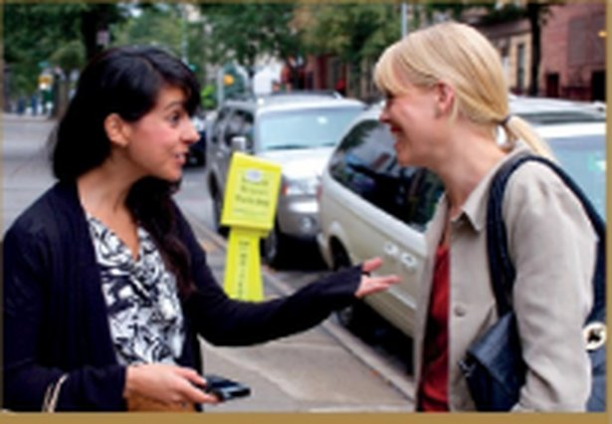
PRACTICAL ENGLISH · Scene 1 · video 5.23
⏱ 7 min
Jenny meets Monica
WATCH! GUARDA!
While you watch · Mentre guardi
1 What's Monica's news?
she's getting married
What's Monica's news? Then watch again and answer.
Qual è la notizia di Monica? Poi riguarda e rispondi.
2 Scott? Engaged when? Who knows?
fiancé · days ago · only family
3 Monica at night: then / now?
clubbing → wedding magazines
Jenny has coffee with a friend
Practical English Episode 3 · SB p.54 · 1a, 1b (1'58")
4 Who wants to organise the wedding?
the two mothers
5 Jenny and Rob: together long?
no, not long
6 Rob is British. Monica thinks…?
hard to persuade him to stay in NY
Jenny and Monica
📖 Teacher: Student's Book p.54 · 1a, 1b · Practical English Episode 3 · video / audio 5.23
PE3 · Part 1
Notes:
WATCH (7 min). The scene 'Jenny has coffee with a friend' is embedded (1 min 58 s). 1a: look at the photos – what's happening? Books closed (or cover the page); play the video once: What's Monica's news? (TG: she has got engaged / she and Scott are getting married). 1b: students read questions 1–7 in the book (the slide has short versions: row 1 = 1a, row 2 = 1b 1–3, then 4–7); play again, pausing if necessary. Click 1 for the answers. TG ANSWERS 1b: 1 Monica's fiancé / future husband · 2 a few days ago · 3 only family · 4 she used to go clubbing; now she stays in and reads wedding magazines · 5 the two mothers want to organize the wedding · 6 that they haven't been together long · 7 she thinks it will be hard for Jenny to persuade him to stay in New York. Notice used to (5B!) – 'And to think you used to go clubbing every night!' EXTRA SUPPORT: watch again with subtitles. VARIATION: prediction ('Monica says Five minutes! – what's the news?'). If the embedded video doesn't play, use audio 5.23.

Slide 4
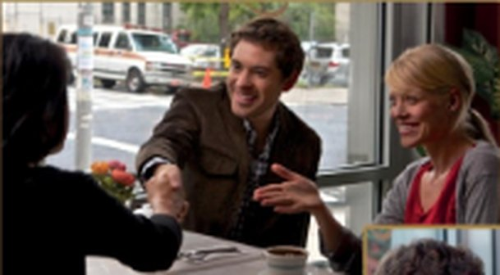
PRACTICAL ENGLISH · Scene 2 · video 5.24
⏱ 5 min
Rob asks a favour
WATCH! GUARDA!
While you watch · Mentre guardi
1 What favour does Rob ask?
meet Paul at the airport + take him to his flat
What favour does Rob ask? Then watch again: true or false?
Che favore chiede Rob? Poi riguarda: vero o falso?
2 Who's Paul?
an old friend of Rob's from university
Permissions and requests
Practical English Episode 3 · SB p.54 · 2a, 2b (2'17")
3 Watch again: 2b, sentences 1–8 in the book. True or false?
📖 Teacher: Student's Book p.54 · 2a, 2b · Practical English Episode 3 · video / audio 5.24
PE3 · Part 1
Notes:
WATCH (5 min). The scene is embedded (2 min 17 s). 2a: photos – where is Rob? who's he talking to? Play the video once: what favour does Rob ask? (TG: he asks Jenny to meet his friend Paul at the airport and to take him back to his flat). Paul (video script): an old friend of Rob's – they haven't seen each other since university; he's travelling around the States and Rob has invited him to stay for the week. 2b: students read sentences 1–8 in the book; play again; they mark T / F and correct the false ones. Check on the next slide. If the embedded video doesn't play, use audio 5.24. VARIATION: prediction – 'Rob says I want to ask you a favour – what is it?' (pause the video there).

Slide 5
PRACTICAL ENGLISH · Scene 2 · check · 2b
⏱ 2 min
5.24
True or false?
THINK! PENSA!
1 Rob orders a cappuccino.
F – a large latte
2 Rob says Monica looks different from her photos.
F – she hasn't changed
True or false? Correct the false sentences.
Vero o falso? Correggi le frasi false.
3 Monica gets a good impression of Rob.
T
4 Monica leaves because she has to go to work.
F – she needs to meet someone
5 Jenny says that most of their friends aren't in serious relationships.
F – most are getting married
6 Paul is going to stay for a fortnight.
F – for a week
7 Paul used to be very quiet when they were younger.
F – he used to be a bit wild
8 Jenny is keen to meet Paul.
T
📖 Teacher: Student's Book p.54 · 2a, 2b · Practical English Episode 3 · audio 5.24
PE3 · Part 1
Notes:
CHECK 2b (2 min) – after the second viewing on the previous slide. The slide has the book's sentences 1–8; students compare with a partner, then click 1 for all answers. TG ANSWERS: 1 F (He orders a large latte.) · 2 F (He says she hasn't changed.) · 3 T · 4 F (She needs to meet someone.) · 5 F (She says most of their friends are getting married.) · 6 F (He is going to stay for a week.) · 7 F (He used to be a bit wild.) · 8 T. Also teach: settle down, You're a real star, What's up? VARIATION: student as teacher – a student corrects each false sentence for the class.

Slide 6
PRACTICAL ENGLISH · Permission and requests · 2c
⏱ 2 min
Mind the gap!
THINK! PENSA!
1 Rob: Do you ___ if I join you? Monica: Of ___ not. Come on, sit down.
Can you remember the missing words? Guess with a partner.
Ricordi le parole mancanti? Indovina con un compagno.
2 Rob: Is it ___ if we change our plans a bit this week? Jenny: Er… sure.
3 Rob: ___ you pass the sugar? Jenny: ___ .
4 Rob: Could you do me a big ___ ? I have to work late this evening, so… would you mind ___ him at the airport? Jenny: ___ at all. I'd like to meet him.
5 Rob: And do you think you ___ take him to my flat? I'll give you the keys. Jenny: No ___ , Rob.
📖 Teacher: Student's Book p.54 · 2c
PE3 · Part 1
Notes:
LANGUAGE (2 min). 2c: 'Look at some extracts from the conversation. Can you remember any of the missing words?' (the slide = book wording: 1–2 Asking permission, 3–5 Requests: asking someone to do something). Pairs guess and write their answers; DON'T confirm yet – the next slide (video 'listen and check') checks them. ANSWERS (TG / script): 1 mind, course · 2 OK · 3 Can, Sure · 4 favour, meeting, Not · 5 could, problem. VARIATION: prediction.

Slide 7
PRACTICAL ENGLISH · Listen and check · 5.25
⏱ 2 min
Listen and check
WATCH! GUARDA!
While you watch · Mentre guardi
1 Do you ___ if I join you? – Of ___ not.
mind · course
Watch and check your guesses.
Guarda e controlla le tue ipotesi.
2 Is it ___ if we change our plans?
OK
3 ___ you pass the sugar? – ___ .
Can · Sure
Permissions and requests – listen and check
Practical English Episode 3 · SB p.54 · 2c (54")
4 a big ___ ? · mind ___ him? · ___ at all.
favour · meeting · Not
5 you ___ take him to my flat? – No ___ .
could · problem
📖 Teacher: Student's Book p.54 · 2c · video / audio 5.25
PE3 · Part 1
Notes:
CHECK (2 min). The clip is embedded (54 s): the five extracts from the scene. Play once; students check their guesses from the previous slide; click 1 for all answers. ANSWERS (TG / script): 1 mind, course · 2 OK · 3 Can, Sure · 4 favour, meeting, Not · 5 could, problem. If the embedded video doesn't play, use audio 5.25.

Slide 8
PRACTICAL ENGLISH · Listen and repeat · 5.26
⏱ 2 min
Listen and repeat
SPEAK! PARLA!
While you watch · Mentre guardi
1 Do you mind if I join you? – Of course not.
Watch and repeat. Copy the rhythm and the polite intonation!
Guarda e ripeti. Copia il ritmo e l'intonazione cortese!
2 Is it OK if…? – Er… sure.
3 Can you pass the sugar? – Sure.
Permissions and requests – listen and repeat
Practical English Episode 3 · SB p.54 · 2e, 2f (1'32")
4 Would you mind meeting him? – Not at all.
2f Now practise the five mini-conversations with a partner!
5 Do you think you could take him…? – No problem.
📖 Teacher: Student's Book p.54 · 2e, 2f · video / audio 5.26
PE3 · Part 1
Notes:
REPEAT (2 min). The clip is embedded (1 min 32 s) with pauses for repetition. 2e: students repeat the highlighted phrases, copying the rhythm and polite intonation (a big rise-fall on 'Would you MIND…'). 2f: pairs practise the five mini-conversations from 2c, swapping roles. If the embedded video doesn't play, use audio 5.26. VARIATION: change the energy (act them out standing up, with a coffee cup!).

Slide 9
PRACTICAL ENGLISH · How to ask
⏱ 3 min
Asking politely
Permission (I want to…)
Requests (you do it)
Answers = YES
Can I…?
Is it OK if I…?
Do you mind if I join you?
+ present simple
Can you pass the sugar?
Could you do me a favour?
Do you think you could…?
Would you mind meeting him?
Would you mind + -ing
Sure. / No problem.
Do you mind…? / Would you mind…? → Of course not. / Not at all.
'mind' = dare fastidio: NO = va bene!
Watch out! Do you mind if I sit here? – ✗ Yes! (= it's a problem!) → ✓ Of course not. More polite: Could you… / Would you mind… / Do you think you could…
📖 Teacher: Student's Book p.54 · 2d
PE3 · Part 1
Notes:
RULE (3 min). SB 2d: 'Look at the highlighted phrases in c and answer the questions. 1 How do you respond to Do you mind if…? and Would you mind…? when you mean OK, no problem? 2 Which two forms of request should you use if you want to be very polite or are asking a very big favour?' – TG ANSWERS: 1 we say Of course not / Not at all to say yes after Do you mind…? / Would you mind…? · 2 the more polite requests are Could you…? / Would you mind…? (and Do you think you could…?). Italian learners answer 'Yes!' to 'Do you mind…?' meaning 'yes, go ahead' – which actually means 'it's a problem'. Drill with a quick test: 'Do you mind if I open the window?' – class answers with gestures + 'Not at all!'. Also: would you mind + -ing (NOT ✗ would you mind to meet).

Slide 10

SPEAKING · Communication p.107
⏱ 7 min
Could you do me a favour?
SPEAK! PARLA!
1
Go to Communication 'Could you do me a favour?' p.107. Read the instructions.
Stand up! Ask different people for help.
Alzati! Chiedi aiuto a persone diverse.
2
Stand up and ask different classmates – use a different request each time.
3
Answer: say yes (Sure / Not at all) or say no politely and give a reason (I'm sorry, but…).
4
Write down who says yes.
5
Who got the most people to help them?
Would you mind lending me your car this weekend? – I'm really sorry, but I need it myself.
📖 Teacher: Student's Book p.55 · 2g · Communication Could you do me a favour? p.107
PE3 · Part 1
Notes:
COMMUNICATION / MINGLE (7 min). SB 2g: students go to Communication 'Could you do me a favour?' p.107. Go through the instructions carefully (⚠ the page is not in our files – check the task before the lesson). Monitor and help; insist on the polite forms and correct answers to 'mind'. Feedback: who got the most people to help them? VARIATION: change the interaction (mingle) + negative experiences – practise saying NO politely too.

Slide 11
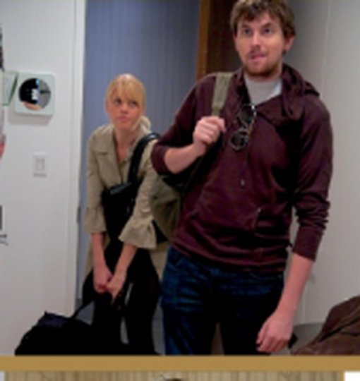
PRACTICAL ENGLISH · Scene 3 · video 5.27
⏱ 6 min
Paul arrives
WATCH! GUARDA!
While you watch · Mentre guardi
1 Paul's looks: changed?
hasn't changed much
How do Rob and Jenny feel? Then watch again and circle.
Come si sentono Rob e Jenny? Poi riguarda e cerchia.
2 His flight: on time?
no – late
3 In the car, Paul talked about…?
himself
Paul arrives
Practical English Episode 3 · SB p.55 · 3a, 3b (1'31")
4 Rob suggests eating…?
in
5 Paul feels exhausted?
no – full of energy
6 Jenny wants to go out?
no – doesn't feel like it
Paul
📖 Teacher: Student's Book p.55 · 3a, 3b · Practical English Episode 3 · video / audio 5.27
PE3 · Part 1
Notes:
WATCH (6 min). The scene 'Paul arrives' is embedded (1 min 31 s). 3a: photos – what's happening? Play the video once: how do Rob and Jenny feel? (TG: Rob is delighted to see Paul; Jenny seems tired and not very enthusiastic). 3b: play again; students circle the right answer in sentences 1–6 in the book. Click 1 for all answers (TG): 1 hasn't changed much · 2 late · 3 talked a lot about himself · 4 eating in · 5 full of energy · 6 doesn't feel like. (The slide has short versions of the book's sentences; the book has the options to circle.) Why was Paul late? His flight from LA was delayed and the traffic was awful. VARIATION: prediction – 'Paul used to be a bit wild. Has he changed?' (before watching). Ask: Do you think Jenny likes Paul? Why not? (Episode 4 continues the story). If the embedded video doesn't play, use audio 5.27.

Slide 12
SOCIAL ENGLISH · video 5.28
⏱ 5 min
It's great to see you, mate!
THINK! PENSA!
While you watch · Mentre guardi
1 It's great to see you, ___ .
mate
Complete the phrases. Watch and check. Then say them like Paul!
Completa le frasi. Guarda e controlla. Poi dille come Paul!
2 How ___ you're so late?
come
3 No ___ , man!
way
Social English phrases
Practical English Episode 3 · SB p.55 · 3c, 3d, 3e (1'09")
4 I'll go home if you don't ___ .
mind
5 Just like the old ___ !
days
3e Complete conversations A–F in the book. Act them out!
6 We've got a lot to talk ___ !
about
📖 Teacher: Student's Book p.55 · 3c, 3d, 3e · video / audio 5.28
PE3 · Part 1
Notes:
SOCIAL ENGLISH (5 min). 3c: in pairs, students try to remember the missing words (EXTRA CHALLENGE). 3d: play the embedded clip 'Social English phrases' (1 min 9 s; or audio 5.28); click 1 for all answers (TG): 1 mate · 2 come · 3 way · 4 mind · 5 days · 6 about. Play again for repetition. 3e: 'Complete conversations A–F with Social English phrases 1–6. Then practise them with a partner.' A Are there any good films on tonight? – Actually, I might go to bed early ___ . I'm exhausted. · B I've rung you at least five times. ___ you never called me back? – I'm really sorry. I left my phone at home and I've only just got back. · C I can't believe it's so long since we last met! – Yes, at least two years. ___ . To start with, I've got a new job! · D Hey Josh! ___ . – Yeah, good to see you too! · E Shall we have dinner at that Indian restaurant we used to go to? – Good idea! It'll be ___ . · F OK, so you can clean the bathrooms and I'll tidy the living room. – ___ ! I hate cleaning bathrooms. TG ANSWERS: A 4 · B 2 · C 6 · D 1 · E 5 · F 3. Meaning check: mate = friend (informal, British); How come…? = Why…?; No way! = Absolutely not! Then pairs act out the scene (5.27). VARIATION: change the energy – act it three times: excited, tired (like Jenny), bored. Finally the CAN YOU…? box at the end of p.55: use different expressions to ask permission to do something and respond · use different expressions to ask another person to do something and respond · greet someone you haven't seen for a long time.

Slide 13

GAME · Upgrade the language
⏱ 5 min
Make it polite!
PLAY! GIOCA!
1 "Give me your pen."
e.g. Could you lend me your pen, please?
Teams: make it more polite! Better form = more points.
Squadre: rendetela più educata! Forma migliore = più punti.
2 "I'm opening the window."
e.g. Do you mind if I open the window?
3 "Carry my bag."
e.g. Would you mind carrying my bag?
4 "I'm using your phone."
e.g. Is it OK if I use your phone?
5 "Take me to the station."
e.g. Do you think you could take me…?
6 "Move!"
e.g. Would you mind moving, please?
📖 Teacher: practice of Practical English 3 · permission and requests
PE3 · Part 1
Notes:
GAME (5 min). VARIATION: upgrade the language. Two teams. Read the rude sentence (in a funny rude voice!); teams have 15 seconds to write a polite version. Points: Can I / Can you = 1 · Could you / Is it OK if = 2 · Would you mind + -ing / Do you mind if / Do you think you could = 3. Wrong form (✗ Would you mind to carry) = 0. Click once per item for one model answer – accept any correct polite form. The other team must then answer correctly (Sure / Not at all / I'm sorry, but…) for a bonus point.

Slide 14
Look what you can do!
Guarda cosa sai fare adesso!
HOMEWORK · COMPITI
• Workbook Practical English 3: 1a–1d, 2a, 2b
• Homework sheet PE3
📷 Hand it in on the LLS app · Consegna nell'app LLS
✓ I can ask for permission politely.
😀 🙂 😐
✓ I can ask people to do things for me – and answer.
😀 🙂 😐
✓ I can greet an old friend I haven't seen for a long time.
😀 🙂 😐
Next lesson: 6A part 1 · Behind the scenes · the passive
PE3 · Part 1
Notes:
EXIT (3 min). Students choose a face for each can-do. Homework: Workbook Practical English 3 – 1 Permission and requests (1a–1d) and 2 Social English (2a, 2b) + the PE3 homework sheet (easier version available). The TG also lists 'Can you remember? 1–5' in the Workbook (good revision before File 6) and Quick Test 5 / File 5 Test / Progress Test Files 1–5 in the Teacher's Resource Centre. Answers are in the teacher key PDF.

Slide 15

EXTRA · Speaking · Role-play
EXTRA
⏱ 8 min
What happens next?
SPEAK! PARLA!
It's the next morning. Rob and Paul came home very late after their 'boys' night out'.
1
Groups of 3: write and act the next scene!
Gruppi di 3: scrivete e recitate la scena successiva!
Jenny calls Rob. What do they say?
2
Use two requests and one Social English phrase from today.
3
Act it out for the class (1 minute). The best scene wins!
4
Jenny: Rob, could you call me back? / Paul: No way, man! It's only 10 o'clock!
PE3 · Part 1
Notes:
EXTRA (8 min). VARIATION: student-generated content + prediction (Episode 4 shows what really happens – Paul stays longer and Jenny isn't happy; don't tell them!).

Slide 16
EXTRA · Speaking · Favour chain
EXTRA
⏱ 6 min
Yes, but…
SPEAK! PARLA!
1 water my plants
2 feed my cat
Ask a favour. Your partner says yes – but asks one back!
Chiedi un favore. Il compagno dice sì – ma ne chiede uno!
3 help me move flat
4 lend me 20 euros
5 pick me up at the airport
6 check my English homework
Sure – but could you…? / Not at all – if you…
PE3 · Part 1
Notes:
EXTRA (6 min). VARIATION: constraint challenge – every 'yes' must come with a favour in return ('Not at all – but would you mind feeding my dog next week?'). Pairs keep the chain going as long as possible with a different request form each time.

