Slide 1





PE4
ENGLISH FILE B1 · PE4 · Part 1 · SB pp.74–75
BOYS' NIGHT OUT
FUNCTION · making and responding to suggestions
FUNCTION · making an excuse, apologising
SOCIAL ENGLISH · It won't happen again.
Dancing, a museum or a gig?
Why don't we stay in?
Teacher: timings, answers and tips are in the slide notes.
PE4 · Part 1
Notes:
PRACTICAL ENGLISH EPISODE 4 (60 min) · SB pp.74–75 · 'Boys' night out'. Function: making and responding to suggestions (Why don't we…? What about…? That's a great idea.), making an excuse and apologizing. Story (TG): Rob and Paul play pool and Paul says Rob has become 'American' because of Jenny; Jenny joins them for a meal but they can't agree what to do — Paul and Rob go to Kerri's gig and Jenny, upset, goes to Monica's; the next morning Rob phones in sick and misses the meeting with Don. The episode VIDEOS are embedded: Rob and Paul catch up (7.23, 2'41"), Making suggestions (7.24, 3'27"), listen and check (7.25), listen and repeat (7.26), The morning after the night before (7.27, 2'04"), Social English phrases (7.28). Each scene is watched first on a video slide; the detail task comes on the next slide, where the audio of the same scene is embedded for the second play (or go back one slide and play the video again). Timing: cover 2 · revision 5 · scene 1 video 3 + T/F 4 · scene 2 video 5 · who said it? 4 · listen and check 2 · suggestions rule 3 · listen and repeat 2 · class party 6 · scene 3 video 3 + sentences 4 · Social English recall 2 + video 3 · excuses game 5 · exit 3 = 56 min. OPTIONAL LEAD-IN (TG): what do they remember about Episode 3? Who is Monica? What is her big news? (she's getting married) Whose friend is Paul? What do Rob and Paul do at the end? (go out for a pizza – a boys' night out). (2 min)

Slide 2


REVISION · 7B part 2 · Houses + Handel Hendrix
⏱ 5 min
Lie detector!
THINK! PENSA!
1 Handel bought the house in Brook Street.
LIE – he rented it (a foreigner)
True or a lie? If it's a lie, correct it!
Vero o bugia? Se è una bugia, correggila!
2 Handel's servants slept in the basement.
LIE – in the attic
3 Hendrix's girlfriend found the flat.
TRUE – Kathy Etchingham
4 Hendrix died in his Brook Street flat.
LIE – in a London hotel
5 A balcony is outside, on the ground floor.
LIE – that's a terrace
6 In 'special', c is pronounced /ʃ/.
TRUE – c + i + vowel
📖 Teacher: revision of 7B part 2 · audio 7.21 · Vocabulary Bank Houses p.162
PE4 · Part 1
Notes:
REVISION of 7B part 2 (5 min). VARIATION: spot the lie + correction — teams hold up a green card (TRUE) or red card (LIE), or simply stand up for LIE. 1 point for the right decision, +1 for the correction. Click once per item. Facts from audio 7.21 (Handel was not allowed to buy the house as a foreigner and continued to rent it; the servants had their rooms in the attic; Kathy Etchingham found the flat; Hendrix died in a London hotel in 1970). Item 5 (TG vocabulary notes): a terrace is on the ground floor, a balcony is outside a window on an upper floor. Item 6: letter c (7.20). Fast finishers: invent one lie about the house for the other team.

Slide 3

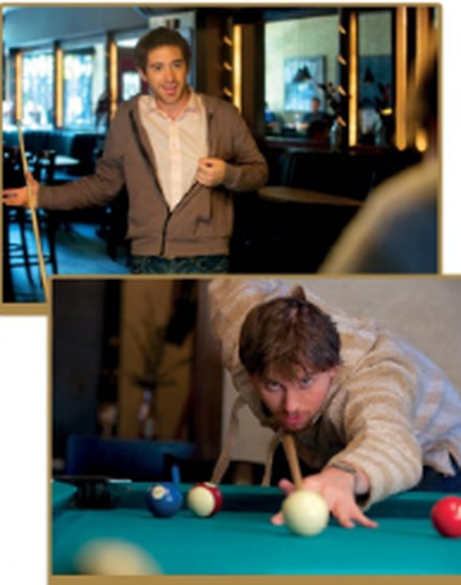
VIDEO · Scene 1 · 7.23
⏱ 3 min
Rob and Paul catch up
WATCH! GUARDA!
While you watch · Mentre guardi
1 What game are they playing?
pool
Watch. What are they playing? What does Paul think of Jenny?
Guarda. A cosa giocano? Cosa pensa Paul di Jenny?
2 What does Paul think of Jenny?
doesn't like her – bossy
Episode 4 · Rob and Paul catch up
Practical English Episode 4 · class video · 7.23 (2'41")
Is Paul a good friend? Is Rob happy?
📖 Teacher: Student's Book p.74 · 1a · video / audio 7.23
PE4 · Part 1
Notes:
SCENE 1 – FIRST VIEWING (3 min). The video is embedded (2 min 41 s). 1a: books open; this is the day after Episode 3, after work. Look at the photos — what's happening? Teach pool (the game). Play the video once: What does Paul think of Jenny? Answer (TG): he clearly doesn't like her, and implies that she is bossy / controlling. Evidence (video script): 'Jenny seems to know what she wants – and she probably gets it'; 'If you don't come back to London soon, you'll become an all-American boy!' Click 1 for the answers. VARIATION: perspective change — 'Is Paul a good friend? Is Rob happy?' (30 seconds). Note the 7A grammar in the script: 'If you don't come back…, you'll become…' (first conditional).

Slide 4
VIDEO / LISTENING · Scene 1 · 1b · audio 7.23
⏱ 4 min
True or false?
WATCH! GUARDA!
🎧 7.23
Watch or listen again. True or false? Correct the false ones.
Riguarda o riascolta. Vero o falso? Correggi quelle false.
1 Rob used to play pool when he was younger.
T
2 Rob has a lot of free time.
F – his job keeps him busy
3 Rob had fair hair the last time Paul saw him.
T
4 Paul thinks Rob has changed a lot.
T
5 Jenny's parents gave Rob the shirt he's wearing.
F – Jenny gave it to him
6 Rob doesn't want to keep Jenny waiting.
T
📖 Teacher: Student's Book p.74 · 1b · audio 7.23 (or the video on the previous slide)
PE4 · Part 1
Notes:
SCENE 1 – DETAIL (4 min). 1b: students read the six sentences (book sentences 1–6 on the slide), then play the scene again — the audio 7.23 is embedded here (same soundtrack), or go back one slide and play the video. Pairs compare and correct the false sentences. Click once per sentence; answers (TG): 1 T · 2 F (He doesn't have much free time. / His job keeps him busy.) · 3 T · 4 T · 5 F (Jenny gave Rob the shirt he's wearing.) · 6 T. VARIATION: forbidden easy answer — for every F they must give the correct version.

Slide 5
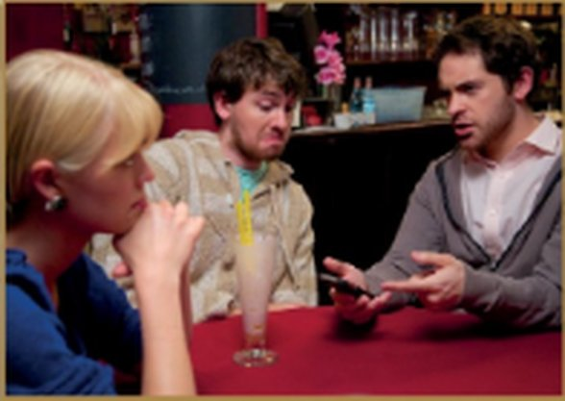
VIDEO · Scene 2 · 7.24
⏱ 5 min
What shall we do now?
WATCH! GUARDA!
While you watch · Mentre guardi
1 PREDICT: what will they do tonight?
Guess first! Then watch and answer.
Indovina prima! Poi guarda e rispondi.
2 What do Paul and Rob decide?
go to Kerri's gig
3 Jenny's excuse?
a busy day tomorrow
Episode 4 · Making suggestions
Practical English Episode 4 · class video · 7.24 (3'27")
4 Where does Jenny go?
to Monica's house
5 How does Jenny feel?
upset – 'I need to talk'
📖 Teacher: Student's Book p.74 · 2a · video / audio 7.24
PE4 · Part 1
Notes:
SCENE 2 (5 min). The video is embedded (3 min 27 s). Teach a gig /gɪg/ = a performance by musicians playing popular music or jazz in front of an audience (TG). VARIATION: prediction — after the photos, pairs predict what the three will do tonight and who will be unhappy. Play the video once; click 1 for answers (TG): Paul and Rob decide to go and see Kerri playing in a gig; Jenny says she has a busy day the next day; she ends up going to Monica's house. Last question from the script: she calls Monica late ('it's not too late to call, is it?… I need to talk') and Monica says 'Why don't you take a cab?'. Kerri is the singer from Episode 2.

Slide 6

LISTENING · Who suggested it?
⏱ 4 min
Paul, Jenny or Rob?
LISTEN! ASCOLTA!
1 going dancing
P
Who made each suggestion? Write P, J or R.
Chi ha fatto ogni proposta? Scrivi P, J o R.
2 doing some exercise
J
3 going to a club
P
4 going to an art gallery
J
5 staying at home
J
6 going to a gig
P
7 meeting Kerri
R
📖 Teacher: Student's Book p.74 · 2b · video on the previous slide / audio 7.24
PE4 · Part 1
Notes:
WHO SAID IT? (4 min). 2b: students read the suggestions and guess who made each one before listening again — VARIATION: prediction (it's easy to guess from their personalities: Paul = party, Jenny = sensible). Play the scene again (go back one slide and replay the video, or play audio 7.24); click 1 for answers (TG): 1 P · 2 J · 3 P · 4 J · 5 J · 6 P · 7 R. The slide has the book's 'Who suggests…?' list. The exact lines from audio 7.24: 1 'Let's go dancing!' · 2 'Why don't you join me?' (running) · 3 'We could go there.' (Deep Space) · 4 'What about going to the late show at MOMA?' · 5 '…staying in and watching a movie on TV?' · 6 'So shall we go there?' · 7 'We could meet her outside and go together.' MOMA = the Museum of Modern Art (a Kandinsky exhibition). Ask: how does Paul REFUSE each of Jenny's ideas? ('No, thanks. I'm not very keen on running.' / 'That isn't exactly my idea of a great night out.' / 'I can watch TV anywhere.')

Slide 7
FUNCTION · Making suggestions · 7.25
⏱ 2 min
Listen and check
LISTEN! ASCOLTA!
While you watch · Mentre guardi
1 Paul – dancing
do · Let's
Complete the extracts in your book. Then watch and check.
Completa gli estratti nel libro. Poi guarda e controlla.
2 Jenny – running
don't · keen · could
3 Jenny – MOMA
How
Making suggestions · listen and check
Practical English Episode 4 · 2c · 7.25 (1'24")
4 Jenny – staying in
What
5 Paul – the gig
shall · Why
6 Rob – meet Kerri
could · idea
📖 Teacher: Student's Book p.74 · 2c · video / audio 7.25
PE4 · Part 1
Notes:
LISTEN AND CHECK (2 min). The clip is embedded (1 min 24 s). 2c: students complete the six extracts in the book (1–2 min, pairs), then play the clip to check; click 1 for answers (TG): 1 do, Let's · 2 don't, keen, could · 3 How · 4 What · 5 shall, Why · 6 could, idea. The video clip has 'How about going to the late show?' and 'What about staying in?' (= the TG key); the SB audio script 7.25 has 'What about…' in 3 — accept both. VARIATION: prediction (complete before watching).

Slide 8
FUNCTION · Making suggestions · 2d
⏱ 3 min
Why don't we…?
+ infinitive
+ -ing
Responding
Let's go dancing!
Shall we go there?
Why don't you join me?
We could meet her outside.
Let's = the most emphatic (2d)
What about going to the late show?
How about staying in?
What / How about + -ing
✓ That's a great idea! · Why not? · OK.
✗ No, thanks. I'm not very keen on running.
✗ I'm not crazy about her music.
✗ That isn't exactly my idea of a great night out.
Watch out! ✗ Why don't we to go…? → ✓ Why don't we go…? ✗ What about go…? → ✓ What about going…? ✗ Let's to go → ✓ Let's go
📖 Teacher: Student's Book p.74 · 2d (Verb forms box)
PE4 · Part 1
Notes:
FUNCTION (3 min). 2d Verb forms box: Let's, Shall we, Why don't we, We could + infinitive without to; What / How about + -ing. The most emphatic = Let's (TG). Ask the class to find each form in the extracts they have just checked (2c, previous slide). Responding: positive (That's a great idea! · Why not?) and negative (No, thanks. I'm not very keen on… · I'm not crazy about… · That isn't exactly my idea of a great night out.). All examples on the slide are from the video script 7.24 / 7.25. Italian learners: 'Why don't we…?' is a suggestion, not a real question — intonation goes down. VARIATION: spot the error (Why don't we to go…?).

Slide 9
FUNCTION · Making suggestions · 7.26
⏱ 2 min
Listen and repeat
LISTEN! ASCOLTA!
While you watch · Mentre guardi
1 Let's go dancing!
Watch and repeat. Copy the rhythm and intonation!
Guarda e ripeti. Copia il ritmo e l'intonazione!
2 Why don't you join me?
3 I'm not very keen on running.
Making suggestions · listen and repeat
Practical English Episode 4 · 2e · 7.26 (1'50")
4 Shall we go there? – Why not?
2f: practise the conversations in 2c in pairs. Then swap!
5 That's a great idea!
📖 Teacher: Student's Book p.74 · 2e, 2f · video / audio 7.26
PE4 · Part 1
Notes:
LISTEN AND REPEAT (2 min). The clip is embedded (1 min 50 s). 2e: students watch and repeat the highlighted phrases, copying the rhythm and intonation (enthusiastic for 'That's a great idea!'). The phrases on the slide are from the clip (video script 7.26). 2f (if time, else go straight to the party): pairs practise the conversations in 2c, then swap roles. VARIATION: change the energy — the class repeats in chorus, then in two halves (A side / B side of the room).

Slide 10

SPEAKING · Plan a class party
⏱ 6 min
The end-of-term party
SPEAK! PARLA!
1
Groups of 4. Decide: WHERE? WHEN? FOOD? MUSIC? an ACTIVITY?
Groups: plan the party. Suggest, accept, refuse – politely!
In gruppo: organizzate la festa. Proponete, accettate, rifiutate – con gentilezza!
2
Each person must make at least 3 suggestions – use a different phrase each time.
3
Refuse at least one idea politely: I'm not very keen on… What about…?
4
You have 4 minutes. Then one person presents your plan to the class.
5
Class vote: which party would you go to?
Why don't we have it at the beach in Aspra? – I'm not very keen on… What about…?
📖 Teacher: Student's Book p.74 · 2g
PE4 · Part 1
Notes:
SPEAKING (6 min). SB 2g: in small groups, students organize their end-of-term class party using the expressions for making suggestions (TG). VARIATION: constraint challenge — every suggestion must use a different phrase, and each student must politely refuse one idea and offer an alternative. Monitor and note good / wrong forms (What about go…) for quick feedback. Make it age-appropriate: no alcohol; a budget of €10 each if you want a realistic constraint. Feedback: each group presents in 30 seconds; class vote.

Slide 11
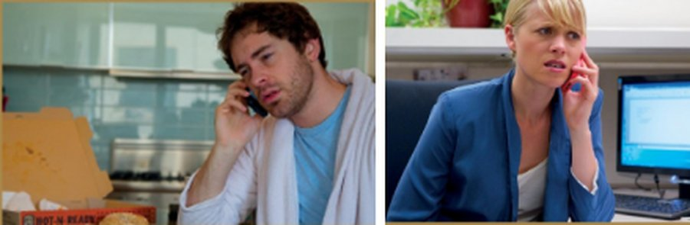
VIDEO · Scene 3 · 7.27
⏱ 3 min
The morning after
WATCH! GUARDA!
While you watch · Mentre guardi
1 Where is Rob?
at home
Watch. Where is Rob? What's the problem?
Guarda. Dov'è Rob? Qual è il problema?
2 What's the problem?
he can't make the meeting with Don
Episode 4 · The morning after the night before
Practical English Episode 4 · class video · 7.27 (2'04")
3 Who covers for him?
Jenny
📖 Teacher: Student's Book p.75 · 3a · video / audio 7.27
PE4 · Part 1
Notes:
SCENE 3 – FIRST VIEWING (3 min). The video is embedded (2 min 04 s). 3a: look at the photos — where are Rob and Jenny? What's happening? Play the video once: Rob and Jenny have a meeting with Don, but Rob hasn't come in to work because he isn't feeling well (TG). Script: 'I'm at home. I'm feeling terrible.' · 'That's why I'm calling. I'm not going to make it.' · Jenny: 'I'll cover for you this time, but I won't be able to do it again.' Click 1 for answers.

Slide 12
VIDEO / LISTENING · Scene 3 · 3b · audio 7.27
⏱ 4 min
Complete the sentences
WATCH! GUARDA!
🎧 7.27
Watch or listen again. Complete with 1–3 words.
Riguarda o riascolta. Completa con 1–3 parole.
1 Rob says that he's feeling ___.
terrible
2 Kerri invited Rob and Paul to ___.
a party
3 Rob says that he can't make ___.
the meeting
4 Jenny is upset because it's an ___.
important meeting
5 Rob promises that ___ again.
it won't happen
6 Rob also says that Paul ___ that afternoon.
is leaving
7 Jenny tells Don that Rob is such ___.
a professional
📖 Teacher: Student's Book p.75 · 3b · audio 7.27 (or the video on the previous slide)
PE4 · Part 1
Notes:
SCENE 3 – DETAIL (4 min). The audio 7.27 is embedded here (same soundtrack), or go back one slide and replay the video. 3b: students complete sentences 1–7 in the book with 1–3 words; play again, pausing if necessary. Click once per sentence; answers (TG): 1 terrible · 2 a party · 3 the meeting · 4 important meeting · 5 it won't happen · 6 is leaving · 7 a professional. The sentences on the slide are the book's. VARIATION: mild controversy — 'Is Jenny right to cover for Rob? Is Rob really ill?' (forced choice, 1 min). Notice Jenny's irony: 'You know Rob. He's such a professional.'

Slide 13

SOCIAL ENGLISH · 3c
⏱ 2 min
Social English
REMEMBER! RICORDA!
1 Where are you, ___?
anyway
Can you remember the missing words? Then watch and check.
Ricordi le parole mancanti? Poi guarda e controlla.
2 That's ___ I'm calling. I'm not going to make it.
why
3 It won't ___ again.
happen
4 He's ___ to Boston this afternoon.
off
5 I mean, it's not ___ I don't like Paul, but…
that
6 I wanted to have a ___ with him.
word
7 He's ___ a professional.
such
📖 Teacher: Student's Book p.75 · 3c (check on the next slide)
PE4 · Part 1
Notes:
SOCIAL ENGLISH – RECALL (2 min). 3c: pairs try to remember the missing words BEFORE watching (EXTRA CHALLENGE in the book). Don't click yet: check with the video on the next slide, then come back and click once per phrase if you want them on this slide too. Answers (TG / video script 7.28): 1 anyway · 2 why · 3 happen · 4 off · 5 that · 6 word · 7 such. VARIATION: memory challenge.

Slide 14
SOCIAL ENGLISH · 3d, 3e · 7.28
⏱ 3 min
Watch and check
WATCH! GUARDA!
While you watch · Mentre guardi
1 1 · 2 · 3
anyway · why · happen
Watch and check. Then repeat the phrases!
Guarda e controlla. Poi ripeti le frasi!
2 4 · 5
off · that
Episode 4 · Social English phrases
Practical English Episode 4 · 3d · 7.28 (1'17")
3 6 · 7
word · such
3e: match phrases 1–7 to conversations A–G in the book.
📖 Teacher: Student's Book p.75 · 3d, 3e · video / audio 7.28
PE4 · Part 1
Notes:
SOCIAL ENGLISH – CHECK (3 min). The clip is embedded (1 min 17 s). 3d: play the clip to check; click 1 for answers (TG / video script): 1 Where are you anyway? · 2 That's why I'm calling. I'm not going to make it. · 3 It won't happen again. · 4 He's off to Boston this afternoon. · 5 I mean, it's not that I don't like Paul, but… · 6 I wanted to have a word with him before the meeting. · 7 He's such a professional. Play again for repetition. Translate (TG suggests L1): anyway = comunque; That's why… = è per questo che…; I'm not going to make it = non ce la faccio a venire; He's off to… = parte per…; have a word with = scambiare due parole con. 3e: students complete conversations A–G in the book with phrases 1–7: A 7 (Your mum's such a darling!) · B 2 (That's why I'm ordering takeaway) · C 6 (I need to have a word with him) · D 5 (It's not that I don't like it…) · E 3 (It won't happen again) · F 4 (He's off to Manchester…) · G 1 (And anyway, I don't like cabbage) (TG), then practise the mini-conversations in pairs. Finally the CAN YOU…? questions in the book.

Slide 15
GAME · Excuses, excuses!
⏱ 5 min
Excuses, excuses!
PLAY! GIOCA!
1
The CALLER faces the screen. The 'boss' (teacher or a student) has their back to it.
Phone your 'boss'. Make an excuse and apologise!
Telefona al tuo 'capo'. Trova una scusa e chiedi scusa!
2
Everybody else: you must NOT see the screen – turn round or close your eyes!
3
Teacher clicks → the situation appears. The caller phones the boss: That's why I'm calling…
4
The caller must use: I'm really sorry · I'm not going to make it · It won't happen again.
5
The class guesses what the situation was. Correct guess = 1 point for each team.
📖 Teacher: Student's Book p.75 · extra practice of Social English (7.28)
PE4 · Part 1
Notes:
GAME (5 min). VARIATION: change the energy + role-play with an information gap (the class doesn't know the situation and must guess it from the phone call). The red line under each situation is the ATTITUDE the caller must show (a mini acting challenge). Model first: you are Rob phoning Jenny. The 'boss' can answer like Jenny: 'Rob! It's a very important meeting!' / 'I'll cover for you this time, but…'. Two or three calls per team; stop after 5 minutes. IMPORTANT: guessers must not see the screen. Check they have turned round BEFORE you click each card. Every card is on its own slide.

Slide 16
GAME · Excuses, excuses! · card 1 of 6
👀 Guessers: don't look! · Non guardate!
YOU'RE STUCK IN A LIFT
Use: I'm really sorry · It won't happen again
be very calm
PE4 · Part 1
Notes:
Card 1. Check the guessers can't see the screen, THEN click to show it.

Slide 17
GAME · Excuses, excuses! · card 2 of 6
👀 Guessers: don't look! · Non guardate!
YOUR DOG ATE YOUR KEYS
Use: I'm really sorry · It won't happen again
be very embarrassed
PE4 · Part 1
Notes:
Card 2. Check the guessers can't see the screen, THEN click to show it.

Slide 18
GAME · Excuses, excuses! · card 3 of 6
👀 Guessers: don't look! · Non guardate!
YOU WENT TO A CONCERT AND OVERSLEPT
Use: I'm really sorry · It won't happen again
be honest!
PE4 · Part 1
Notes:
Card 3. Check the guessers can't see the screen, THEN click to show it.

Slide 19
GAME · Excuses, excuses! · card 4 of 6
👀 Guessers: don't look! · Non guardate!
YOUR CAR HAS BROKEN DOWN IN THE COUNTRY
Use: I'm really sorry · It won't happen again
be stressed
PE4 · Part 1
Notes:
Card 4. Check the guessers can't see the screen, THEN click to show it.

Slide 20
GAME · Excuses, excuses! · card 5 of 6
👀 Guessers: don't look! · Non guardate!
YOU'RE AT THE WRONG OFFICE IN PALERMO
Use: I'm really sorry · It won't happen again
be confused
PE4 · Part 1
Notes:
Card 5. Check the guessers can't see the screen, THEN click to show it.

Slide 21
GAME · Excuses, excuses! · card 6 of 6
👀 Guessers: don't look! · Non guardate!
YOUR GRANDMOTHER IS VISITING
Use: I'm really sorry · It won't happen again
be polite
PE4 · Part 1
Notes:
Card 6. Check the guessers can't see the screen, THEN click to show it.

Slide 22
Look what you can do!
Guarda cosa sai fare adesso!
HOMEWORK · COMPITI
• Workbook Practical English 4: 1a, 1b, 2, 3
• Homework sheet PE4
📷 Hand it in on the LLS app · Consegna nell'app LLS
✓ I can make, accept and refuse suggestions.
😀 🙂 😐
✓ I can make an excuse and apologise.
😀 🙂 😐
✓ I can understand a story in a video episode.
😀 🙂 😐
Next lesson: 8A part 1 · The right job for you
PE4 · Part 1
Notes:
EXIT (3 min). Students choose a face for each can-do (= the CAN YOU…? questions in the book). Homework: Workbook Practical English 4 (Making suggestions 1a, 1b; Verb forms 2; Social English 3) + the PE4 homework sheet (easier version available). If they need more practice: Online Practice Practical English 4 (watch the episode again). Optional review: Workbook 'Can you remember…? 1–7'.

Slide 23

EXTRA · Speaking · Role-play
EXTRA
⏱ 8 min
You choose the evening
SPEAK! PARLA!
Paul: So! What shall we do now?
Useful phrases
Let's…
Why don't we…?
What / How about + -ing?
We could…
Shall we…?
That's a great idea!
I'm not very keen on…
Groups of 3: Paul, Jenny, Rob. Change the ending!
Gruppi di 3: Paul, Jenny, Rob. Cambiate il finale!
Rob: What do you want to do?
Paul: Let's go dancing.
Jenny: Not on a Wednesday night. What about…?
Paul: …
Rob: …
PE4 · Part 1
Notes:
EXTRA (8 min). VARIATION: perspective change — groups of three replay scene 2 but this time JENNY must win: they find a plan that all three like. The first lines are from audio 7.24. Then the groups perform; the class votes for the most realistic ending. Alternatively, mime the story of the whole episode in 6 freeze-frames and the class tells the story.

Slide 24

EXTRA · Speaking · Mini debate
EXTRA
⏱ 5 min
Whose side are you on?
SPEAK! PARLA!
"Paul is a bad influence on Rob."
AGREE
NO WAY
Agree or no way? Give a reason!
D'accordo o per niente? Dai un motivo!
"Jenny was wrong not to go to the gig."
AGREE
NO WAY
"Rob was wrong to miss the meeting."
AGREE
NO WAY
"Jenny was right to cover for Rob."
AGREE
NO WAY
I think… because… · On the other hand… · No way! If I were Jenny, I'd…
PE4 · Part 1
Notes:
EXTRA (5 min). VARIATION: mild controversy + second conditional recycling ('If I were Rob, I'd…'). Pairs choose AGREE or NO WAY for each statement with a reason; then find someone who disagrees. Prediction for Episode 5: what will happen between Rob and Jenny?

