Slide 1

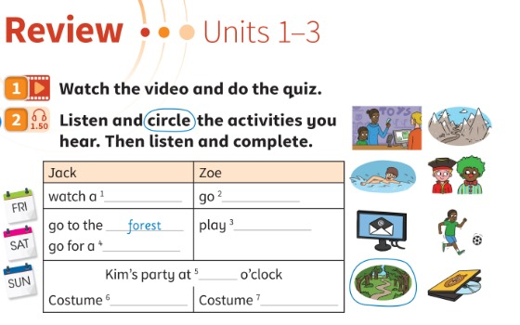

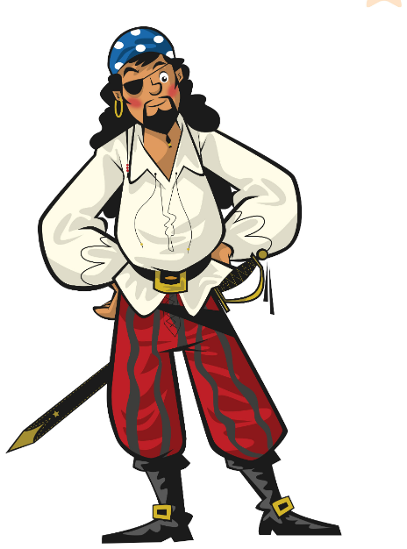
REVIEW · UNITS 1–3
Today: Units 1–3 games! 🎲
Oggi: giochi delle Unità 1–3!
Review games day!
1
🎲 PLAY
Play games with all our words!
Gioca con tutte le nostre parole!
It's games day!
Oggi si gioca!
2
👂 LISTEN
Listen to Jack and Zoe's weekend.
Ascolta il weekend di Jack e Zoe.
3
💬 SPEAK
Ask, answer and guess who!
Chiedi, rispondi e indovina chi è!
📘 Pupil's Book p.42–43 · 🎬 review video · 🎧 1.50
Notes:
REVIEW LESSON (60 min, lots of games). Make 2 teams for the whole lesson and keep the score on the board – a small prize/sticker for everyone at the end. Recycled language (TB42): countryside, daily routines, days of the week, free-time activities, parties, times (o'clock), How often…?, present simple, present continuous, jobs, physical descriptions, must.

Slide 2

WATCH
Watch the video and do the quiz.
Guarda il video e fai il quiz.
Video quiz!
👀 WATCH · ⏱ 3 MIN
▶ Review video Units 1–3 (book video – Pupil's Book p.42)
How many answers can you remember? 🧠
Quante risposte ricordi?
We do the quiz again at the end! 🏆
Teacher: preview every link before class (ads, content). The lesson works without it. · Controllare i link prima della lezione.
📘 Pupil's Book p.42 · 🎬 review video
Notes:
VIDEO QUIZ (5 min, TB42). Show the review video from the book's digital resources and do the quiz. Check how many answers learners remember. Repeat the video and quiz at the end of the Review (TB43) to measure progress. The link is only a YouTube SEARCH – use the book video if you have it. External resources are suggestions only: the teacher must preview and check all links, videos, adverts and content before using them with children. Always have the PowerPoint/classroom alternative ready.

Slide 3


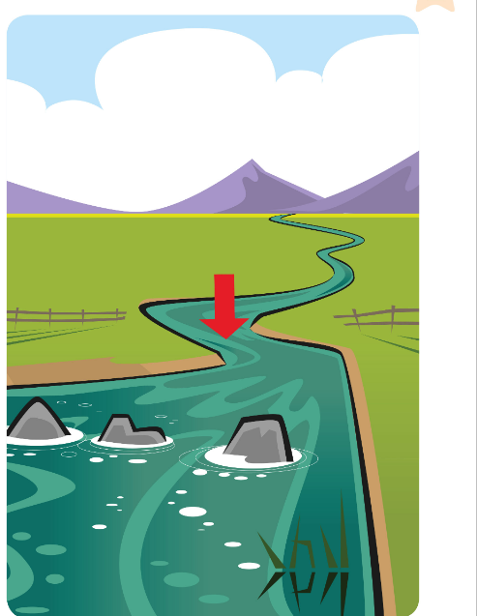

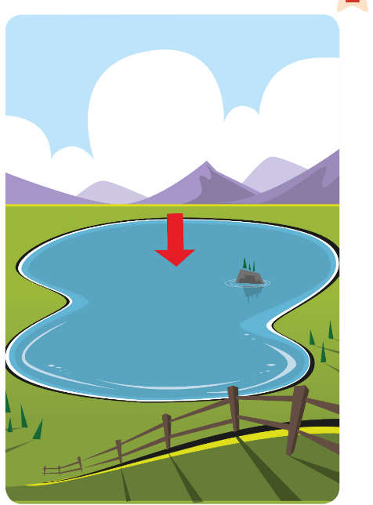
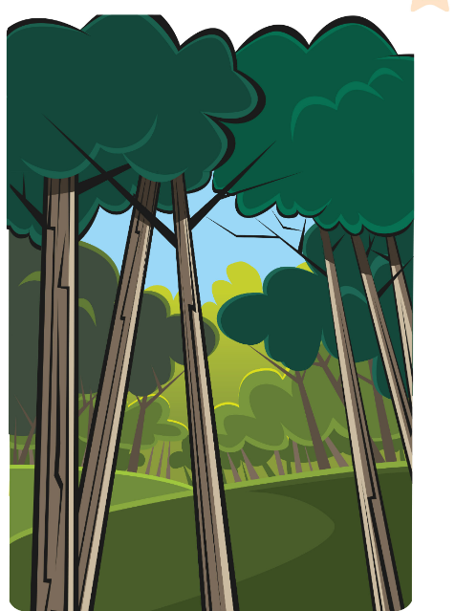

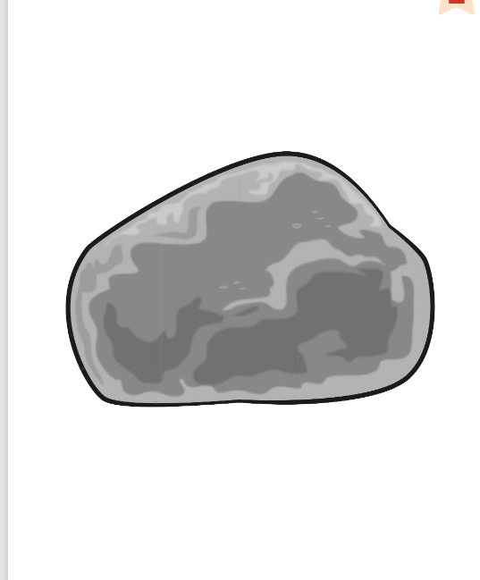
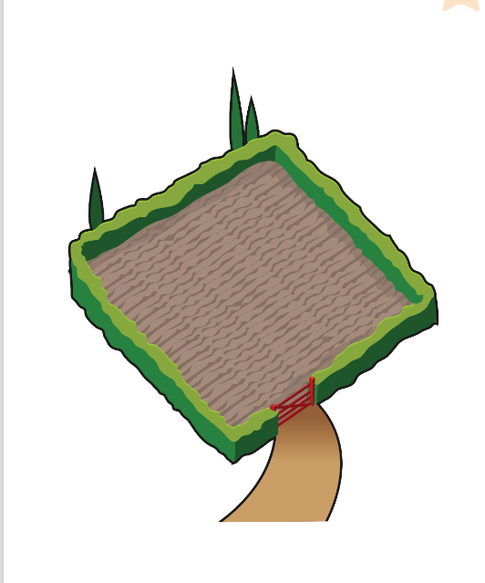
GAME
Listen. Run and find the card!
Ascolta. Corri e trova la carta!
Run and find it!
👥👥 TEAMS · ⏱ 6 MIN
1
👂 LISTEN
'You need this after a shower.'
'Ti serve dopo la doccia.'
2
🏃 MOVE
Front players: run and find the card!
I primi della fila: correte a trovare la carta!
3
💬 SPEAK
Say the word = the card is yours!
Di' la parola = la carta è tua!
Notes:
RUN AND FIND IT (7 min, TB42 warm-up). Two lines at the front, a line down the middle of the board with team names. Flashcards (Countryside + Daily routines) on a table/floor at the back. Define a word: 'You need this after a shower' (towel), 'You clean your teeth with this' (toothbrush), 'A farmer drives it' (tractor), 'Water goes down it to the sea' (river), 'It's very big and high' (mountain), 'You can swim in it, it's not the sea' (lake), 'A lot of trees' (forest), 'They're green and they fall in autumn' (leaves), 'It's big, grey and hard' (rock), 'Cows eat grass in it' (field). The two front players race; the first to find the card sticks it on their team's side. Stronger: use word cards instead of flashcards.

Slide 4


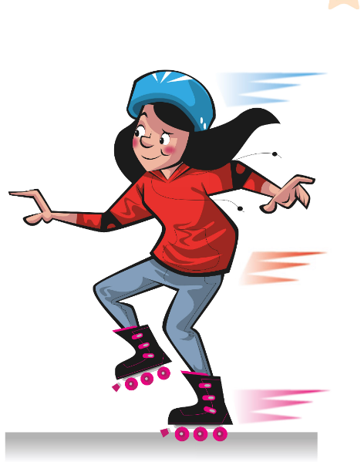
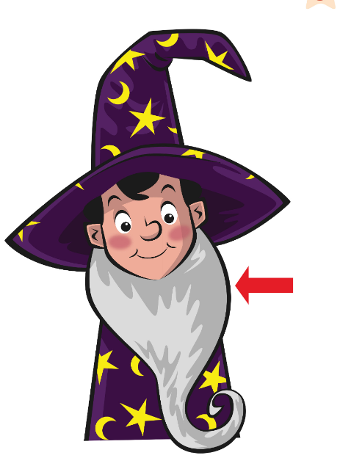

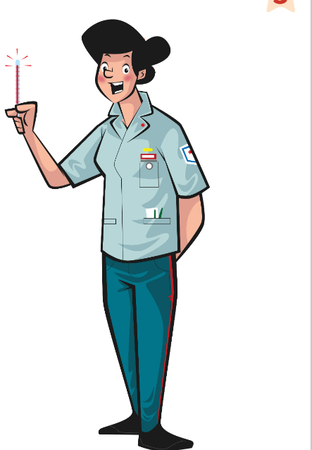
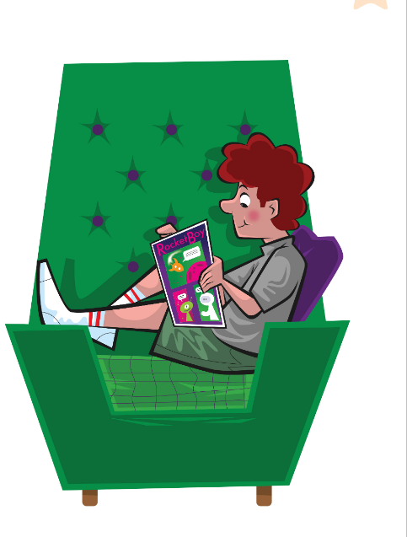
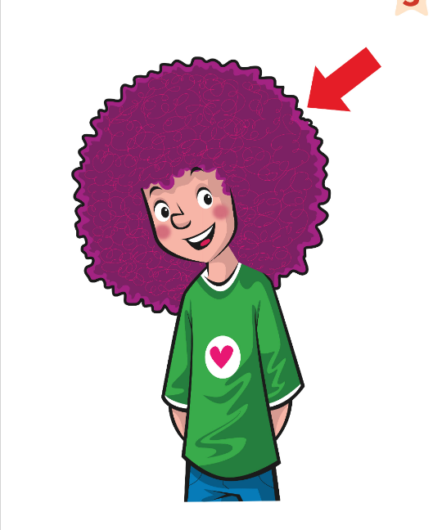
GAME
👀 Look for 10 seconds. Remember ALL the pictures!
Guarda e ricorda tutte le immagini!
Look and remember!
lake
get dressed
pirate
go skating
beard
tractor
have breakfast
nurse
read a comic
curly
📘 Units 1–3 words
Notes:
WHAT'S MISSING? Step 1 – LOOK (10 s). Say the words together first (choral). Count down aloud. Then: "Close your eyes!" and go to the next slide.

Slide 5
GAME
Open your eyes! What's missing? Write it or whisper it to your partner.
Apri gli occhi! Cosa manca? Scrivilo o dillo al compagno.
What's missing?
lake
get dressed
pirate
go skating
beard
?
tractor
nurse
read a comic
curly
Notes:
Step 2 – COMMIT. Students write the word on a mini-whiteboard / paper (or teams agree in 10 s). 'Show me!' Then go to the next slide. Points: 1 per team with the right word, +1 if spelt correctly.

Slide 6
ANSWER
have breakfast!
fare colazione!
Were you right?
lake
get dressed
pirate
go skating
beard
tractor
have breakfast
nurse
read a comic
curly
Notes:
Step 3 – REVEAL. The missing card comes back with a green frame. Everybody says the word 3 ways: whisper, normal, monster voice. WHAT'S MISSING – MIXED UNITS (4 min, 2 rounds). Words from Units 1, 2 and 3 mixed together. Teams: 1 point per word, +1 for a sentence ('I have breakfast at 7 o'clock'). Round 2 = lake and nurse.

Slide 7
GAME · ROUND 2 🔥
👀 Look for 15 seconds. Remember ALL the pictures!
Guarda e ricorda tutte le immagini!
Look and remember!
lake
get dressed
pirate
go skating
beard
tractor
have breakfast
nurse
read a comic
curly
📘 Units 1–3 words
Notes:
WHAT'S MISSING? Step 1 – LOOK (15 s). Say the words together first (choral). Count down aloud. Then: "Close your eyes!" and go to the next slide.

Slide 8
GAME · ROUND 2 🔥
TWO pictures are missing! Write them down.
Mancano DUE immagini! Scrivile.
What's missing?
?
get dressed
pirate
go skating
beard
?
tractor
have breakfast
read a comic
curly
Notes:
Step 2 – COMMIT. Students write the word on a mini-whiteboard / paper (or teams agree in 10 s). 'Show me!' Then go to the next slide. Points: 1 per team with the right word, +1 if spelt correctly.

Slide 9
ANSWER
It's the lake and the nurse!
Were you right?
lake
get dressed
pirate
go skating
beard
tractor
have breakfast
nurse
read a comic
curly
Notes:
Step 3 – REVEAL. The missing card comes back with a green frame. Everybody says the word 3 ways: whisper, normal, monster voice. WHAT'S MISSING – MIXED UNITS (4 min, 2 rounds). Words from Units 1, 2 and 3 mixed together. Teams: 1 point per word, +1 for a sentence ('I have breakfast at 7 o'clock'). Round 2 = lake and nurse.

Slide 10
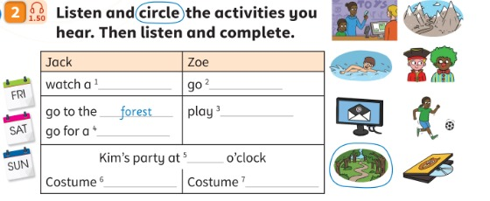
LISTEN
Listen and circle the activities you hear.
Ascolta e cerchia le attività che senti.
Jack and Zoe
👂 LISTEN · ✍ CIRCLE
1 Which activities do you hear? (6)
shopping · swimming · costumes · football · forest · DVD
2 Which picture is NOT in the audio?
writing an email / the mountains
📘 Pupil's Book p.42 · 🎧 1.50
Notes:
LISTEN AND CIRCLE (4 min, TB42). Give time to look at the small pictures: play football, go for a swim, watch a DVD, go shopping, go to a costume party, write an email, go to the forest, go to the mountains. Say an activity at random – students point. Play 1.50: students circle. KEY (TB42): shopping, swimming, costumes, football, forest and DVD.

Slide 11
LISTEN
Listen again and complete.
Ascolta di nuovo e completa.
Complete the table
👤 ALONE · ✍ WRITE
1 Jack, Friday: watch a …
DVD
2 Zoe, Friday: go …
shopping
3 Zoe, Saturday: play …
football
4 Jack, Saturday: go for a …
swim
5 Sunday: Kim's party at … o'clock
five
6 Costumes: Jack … · Zoe …
pirate · clown
📘 Pupil's Book p.42 · 🎧 1.50
Notes:
COMPLETE (4 min, TB42). Play the audio again. KEY (TB42): 1 DVD 2 shopping 3 football 4 swim 5 five 6 pirate 7 clown. (Example: go to the forest.)

Slide 12

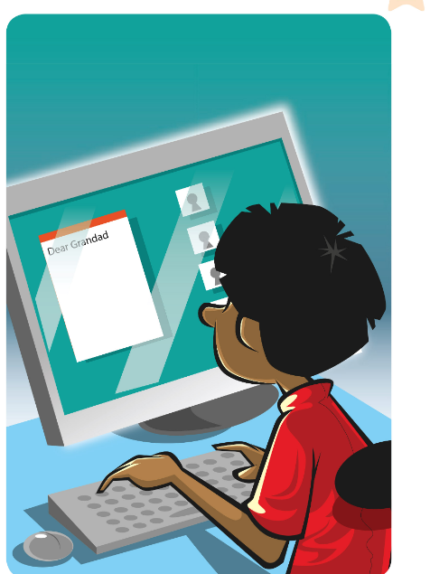

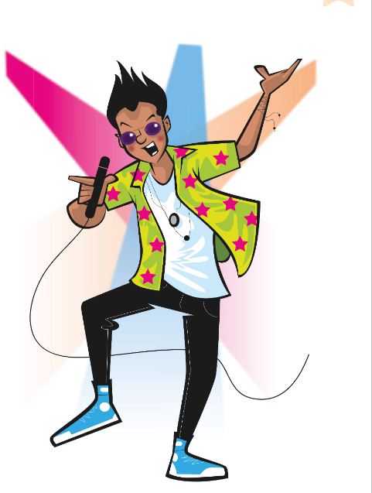
GAME
Do it only if Simon says!
Fallo solo se lo dice Simon!
Simon says!
🏃 CLASS · ⏱ 3 MIN
Simon says: go skating! ⛸️
Simon says: listen to music! 🎧
Simon says: read a comic! 📖
Simon says: write an email! 💻
Simon says: have a shower! 🚿
Simon says: be a pop star! 🎤
Notes:
SIMON SAYS (3 min) – mixed units. SEE: 6 pictures; actions on click. TEACHER: mix units: 'Simon says: climb a mountain! Simon says: drive a tractor! Brush your teeth!' (no 'Simon says' → anyone who moves sits down). STUDENTS: do the action and say the phrase. GROUPING: whole class (2 teams standing on opposite sides). SCORE: the team with more children standing after 2 minutes gets 3 points. LANGUAGE: Unit 1 (countryside actions), Unit 2 (routines, free time), Unit 3 (jobs). Speed up.

Slide 13

SAY IT!
Which word sounds different? Show me 1, 2 or 3!
Quale parola suona diversa? Mostra 1, 2 o 3!
Sound detectives!
👥👥 TEAMS · ⏱ 3 MIN
1 ① Thursday ② thin ③ tractor
③ – no 'th' (tongue out for ① ②!)
2 ① hair ② have breakfast ③ eat
③ – no H (breathe on your hand ✋)
3 ① doctor ② pirate ③ police
③ – po-LICE (the others: DOC-tor, PI-rate)
4 Ha i capelli lunghi e neri. → ?
He's got long black hair.
🔥 Find another 'th' word!
Notes:
PRONUNCIATION – INTERLEAVED UNITS 1–3 (3 min). SEE: 3 words per row, answers hidden. TEACHER: say the three words clearly. STUDENTS: teams hold up 1, 2 or 3 fingers (commit), then click. Practise the 'odd' sound: th = tongue between the teeth; h = warm breath; stress = big clap. CATCH IT: say 'Tursday', 'air', 'PO-lice' – first team to catch it gets a point. Row 4 = the Italian word-order trap (describing words BEFORE 'hair'). SCORE: 1 point per correct row.

Slide 14
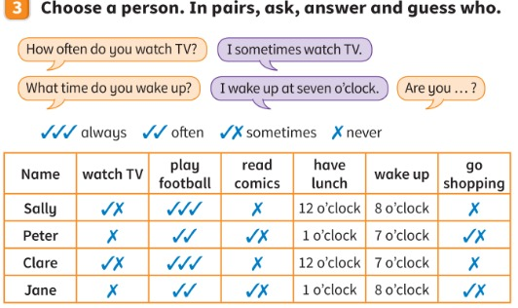
SPEAK
Choose a person. Ask and guess who!
Scegli una persona. Chiedi e indovina!
Guess who!
👥 PAIRS · ⏱ 7 MIN
1 I sometimes watch TV. I wake up at seven o'clock.
Clare
2 I never watch TV. I wake up at eight o'clock.
Jane
3 I always play football. I wake up at eight o'clock.
Sally
4 I sometimes read comics. I wake up at seven o'clock.
Peter
📘 Pupil's Book p.42 · ex.3
⭐ How often do you …?
🔥 Only 3 questions!
Notes:
GUESS WHO (7 min, TB42). Revise free-time activities with flashcards. Make sentences from the table ('She wakes up at eight o'clock and she never reads comics' – Sally). Model with a learner: you choose a person, they ask 'How often do you watch TV? What time do you wake up?' Pairs take turns. The 4 class examples (answers on click) come from the table. Extra support: show o'clock times on a clock. Stronger: 'On Saturdays I play tennis at … What time do I play tennis?' – 3 guesses.

Slide 15
GAME
Choose LEFT or RIGHT. Say why!
Scegli SINISTRA o DESTRA. Di' perché!
Would you rather…?
🏃 CLASS · ⏱ 4 MIN
1
👂 LISTEN
be a pirate 🏴‍☠️ or be a pop star 🎤?
live by a lake 🏞️ or on a mountain 🏔️?
go skating ⛸️ or watch a film 🎬?
have a beard 🧔 or have curly blue hair 💙?
get up at 6 o'clock or never have breakfast?
Listen to the two choices.
Ascolta le due scelte.
2
🏃 MOVE
Walk to the LEFT or RIGHT wall.
Vai alla parete SINISTRA o DESTRA.
3
💬 SPEAK
Say why: 'Because …'
Di' perché: 'Because …'
⭐ I want to … because …
🔥 Which would an alien choose?
Notes:
WOULD YOU RATHER (4 min) – interleaves Units 1, 2 and 3. SEE: 5 choices. TEACHER: read a choice, pointing LEFT for the first, RIGHT for the second. STUDENTS: walk to that side of the room, then 2 children per side say why with the frame 'I want to be a pirate because I love treasure!'. GROUPING: whole class. SCORE: no points – but the funniest 'because' sentence chooses the next question. LANGUAGE: Unit 1 countryside, Unit 2 routines/free time, Unit 3 jobs/appearance + Why/Because. REVEAL: personal answers. Challenge: 'Which one would an alien choose? Why?'

Slide 16
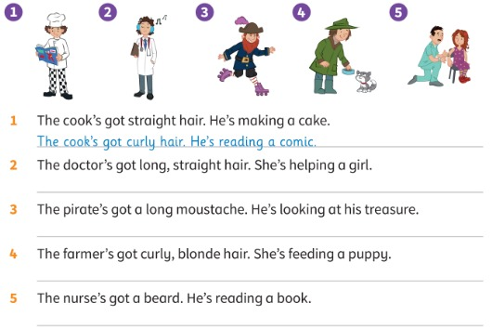
READ
Look and read. Correct the sentences.
Guarda e leggi. Correggi le frasi.
Correct it!
👥 PAIRS · ✍ · ⏱ 6 MIN
1 1 The cook (example)
curly hair · reading a comic
2 2 The doctor
short, curly hair · listening to music
3 3 The pirate
a long beard · (roller) skating
4 4 The farmer
straight, brown hair · feeding a kitten
5 5 The nurse
a moustache · helping a girl
📘 Pupil's Book p.43 · ex.4
⭐ No! He's got …
Notes:
CORRECT THE SENTENCES (6 min, TB43). 'Where's the cook?' – learners point. Do the example together. Pairs read and correct. Extra support: ask about the pictures first ('Has the farmer got curly hair? Is it blonde? What's she doing?'). KEY (TB43): 2 The doctor's got short, curly hair. She's listening to music. 3 The pirate's got a long beard. He's (roller) skating. 4 The farmer's got straight, brown hair. She's feeding a kitten. 5 The nurse's got a moustache. He's helping a girl. EXTENSION: learners find a person in the book and write two sentences with one mistake; their partner corrects it.

Slide 17

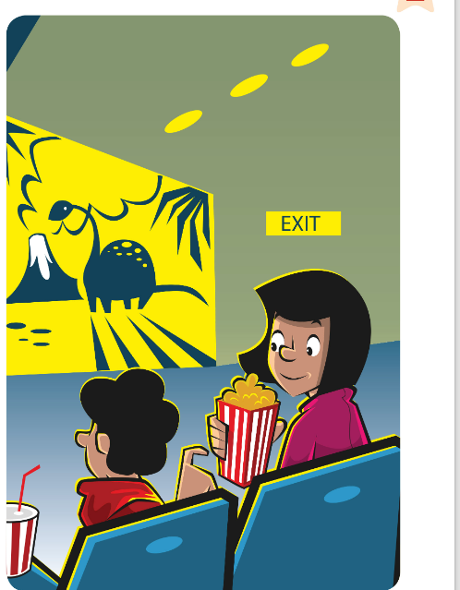
GAME
Write 9 words. Listen. Cross them out!
Scrivi 9 parole. Ascolta. Cancellale!
Bingo!
👤 ALONE · ✍ · ⏱ 6 MIN
1
✏️ WRITE
Draw a 3×3 grid. Write 9 words from the cards.
Disegna una griglia 3×3. Scrivi 9 parole.
mountain
river
tractor
toothbrush
rock
2
👂 LISTEN
Listen to the clue. Cross out the word.
Ascolta l'indizio. Cancella la parola.
go skating
go shopping
watch a film
beard
curly
3
💬 SPEAK
3 in a row? Shout 'BINGO!'
Tris? Grida 'BINGO!'
Notes:
BINGO (6 min). SEE: 10 pictures with words (spelling support). TEACHER: students draw a 3×3 grid and write 9 of the 10 words. Don't say the word – say a CLUE: 'You can climb it' (mountain), 'Water, fish, boats' (river), 'The farmer drives it' (tractor), 'You clean your teeth with it' (toothbrush), 'It's big, grey and hard' (rock), 'You do it on ice' (go skating), 'You buy things' (go shopping), 'You watch it at the cinema' (watch a film), 'Hair on a man's chin' (beard), 'Not straight hair' (curly). STUDENTS: cross out the word. GROUPING: alone. SCORE: first line (3 in a row) = 'BINGO!' – they must read the 3 words back correctly to win 2 points for their team; full card = 5. LANGUAGE: interleaved Units 1–3 vocabulary from meaning. REVEAL: teacher keeps a list of called words to check.

Slide 18
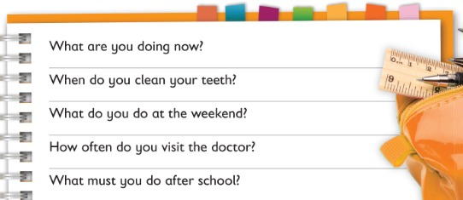
WRITE
Read the questions and write about you.
Leggi le domande e scrivi di te.
Write about you
👤 ALONE · ✍ · ⏱ 6 MIN
1 What are you doing now?
I'm having an English lesson!
2 When do you clean your teeth?
In the morning and in the evening.
3 What do you do at the weekend?
I play football.
4 How often do you visit the doctor?
I sometimes visit the doctor.
5 What must you do after school?
I must do my homework.
📘 Pupil's Book p.43 · ex.5
⭐ I … every day.
🔥 Write 3 questions!
Notes:
WRITE ABOUT YOU (6 min, TB43). Read the questions and check comprehension. Ask two or three learners to give answers to the first two questions. Learners write individually. Answers on the slide are MODELS only (students' own answers). Extra support: model answers / prompts on the board. Stronger learners write three more questions for a partner ('How often do you…? When do you…? What do you do…?').

Slide 19
WELL DONE!
Today I can… · Oggi so…
Show me with your thumbs! 👍 👌 👎
Bye bye! 👋
⭐ I can remember the words from Units 1–3.
Ricordo le parole delle Unità 1–3.
🏠 HOMEWORK · COMPITI
• Homework sheet
• Activity Book p.42: ex.2
• Activity Book p.43: ex.3–4
⭐ I can ask and answer 'How often…?' and 'What time…?'
So chiedere e rispondere 'Quanto spesso…?' e 'A che ora…?'
⭐ I can describe people and correct sentences.
So descrivere le persone e correggere frasi.
➡ Next: Unit 4! 🚀
Notes:
EXIT (3 min). Count the team points – everyone gets a sticker! Repeat the video quiz (TB43) if there's time and compare with the beginning. Ending (TB42): pairs ask and answer How often…? about the pictures in Activity 2 ('How often do you play football?'). AB p.42 ex.1 needs the AB audio (4.19) – do it in class next time.

Slide 20
GAME
Draw the secret word. Team, guess!
Disegna la parola segreta. Squadra, indovina!
EXTRA: Pictionary!
👥👥 TEAMS · ⏱ 6 MIN
1
👀 LOOK
leaves · lake · rock · grass · ground
towel · toothpaste · Sunday · write an email
treasure · present · moustache · fat · thin · clown
Look at the secret word.
Guarda la parola segreta.
2
🖍️ DRAW
Draw it on the board. No letters!
Disegnala alla lavagna. Niente lettere!
3
💬 SPEAK
Team: 'It's a … !'
Squadra: 'È un … !'
Notes:
EXTRA – PICTIONARY (6 min). SEE: the word list is for the TEACHER – turn the screen off / freeze it before playing. TEACHER: whisper a secret word (or show a word card) to one child from each team. STUDENTS: both draw at the board at the same time; their own team guesses ('It's a lake!'). GROUPING: 2 teams, new artists each round. SCORE: first team to say the word in a full sentence ('It's a towel!') = 1 point. LANGUAGE: Units 1–3 words. REVEAL: the artist shows the word card.

Slide 21
GAME
Two circles. Ask, answer, move!
Due cerchi. Chiedi, rispondi, spostati!
EXTRA: Speed interviews!
👥 PAIRS · ⏱ 6 MIN
1
🏃 MOVE
How often do you go to the mountains?
What time do you get up on Saturdays?
What's your mum / dad doing now?
Has your best friend got curly hair?
What do you want to be? Why?
Two circles, face a partner.
Due cerchi, uno di fronte all'altro.
2
💬 SPEAK
Ask a question from your page. 1 minute!
Fai una domanda. 1 minuto!
3
🏃 MOVE
Ding! Outer circle moves 1 step →
Ding! Il cerchio esterno si sposta →
⭐ How often do you …?
Notes:
EXTRA – SPEED INTERVIEWS (6 min, TB43 pair work). SEE: 5 questions (support). TEACHER: make two circles, inner facing outer; ring a bell / say 'Ding!' every minute. STUDENTS: inner circle asks one question, outer answers in a full sentence, then swap; on 'Ding!' the outer circle moves one place. GROUPING: pairs (changing). SCORE: none – at the end ask 'Who has the most interesting answer?' and that child tells the class. LANGUAGE: How often…? What time…? present continuous, Has he got…?, want to be + because.

Slide 22
GAME
Guess the word! Watch out! 🦈
Indovina la parola! Attenzione!
EXTRA: Shark attack!
👥👥 TEAMS · ⏱ 5 MIN
1
👀 LOOK
tractor · mountain · toothpaste
Wednesday · costume · moustache
firefighter · treasure · blonde
Look: _ _ _ _ _ _ _
Guarda: _ _ _ _ _ _ _
2
💬 SPEAK
Say a letter: 'Is there an E?'
Di' una lettera: 'C'è una E?'
3
🎲 PLAY
Wrong letter = the person walks to the shark! 🦈
Lettera sbagliata = la persona va verso lo squalo! 🦈
Notes:
EXTRA – SHARK ATTACK (5 min, TB41 Hangman alternative). Draw a cliff dropping down to the sea with a shark fin, and 6 steps on the cliff. Write a line for each letter. Learners call letters; a wrong letter = the stick person goes one step towards the shark. They must guess the word before step 6! Write the wrong letters at the side.

Slide 23
GAME
Whisper it down the line. Write it!
Sussurra la frase. Scrivila!
EXTRA: Whisper race!
👥👥 TEAMS · ⏱ 5 MIN
1
👂 LISTEN
The farmer's got a red tractor in the field.
Jack always goes for a swim on Saturdays.
The pirate's got a long beard and treasure.
Zoe's wearing a clown costume at the party.
First player reads a sentence.
Il primo legge una frase.
2
💬 SPEAK
Whisper it to the next player…
Sussurrala al prossimo…
3
✏️ WRITE
Last player writes it on the board!
L'ultimo la scrive alla lavagna!
Notes:
EXTRA – WHISPER RACE (5 min). Two teams in lines. Show the first player of each team the same sentence (on paper). They whisper it down the line; the last player runs to the board and writes it. Closest sentence = 1 point, perfect spelling = 2 points.

