Slide 1

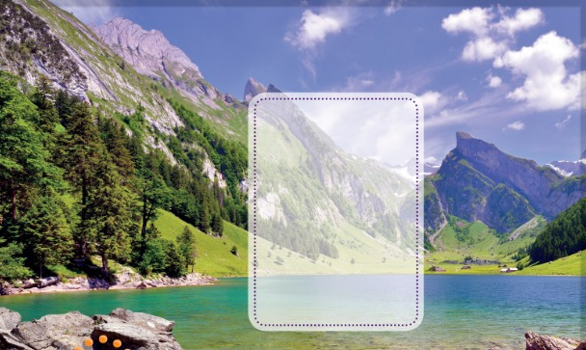

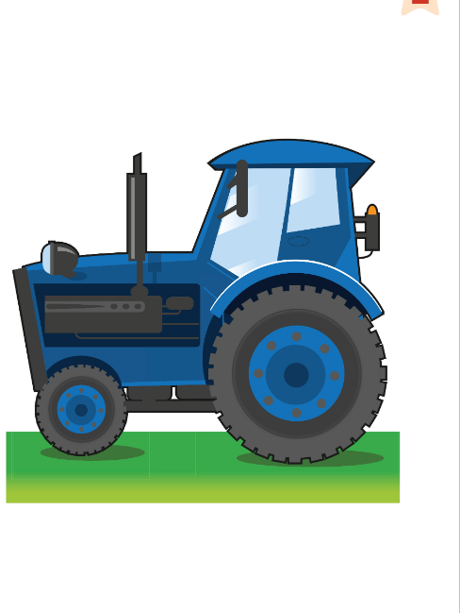
UNIT 1 · LESSON 1
Today: words for the countryside 🌲🏔️🚜
Oggi: le parole della campagna
A day on the farm
1
🎬 WATCH
Watch the video. Draw!
Guarda il video. Disegna!
Let's go to the countryside!
Andiamo in campagna!
2
👂 LISTEN
Listen, point, chant.
Ascolta, indica, chant.
3
🏃 MOVE
Climb, swim, drive!
Arrampicati, nuota, guida!
📘 Pupil's Book pp.6–7 · 🎬 video 1 · 🎧 1.07–1.09
Notes:
COVER (2 min). HOOK (TB): hold up the photo. 'Are there lots of houses?' (No) 'Lots of cars and people?' (No) 'It's the countryside. It's quiet. It's beautiful.' Quick retrieval of the Starter: 'Who lives on the Friendly Farm?' – learners call out the animal names.

Slide 2

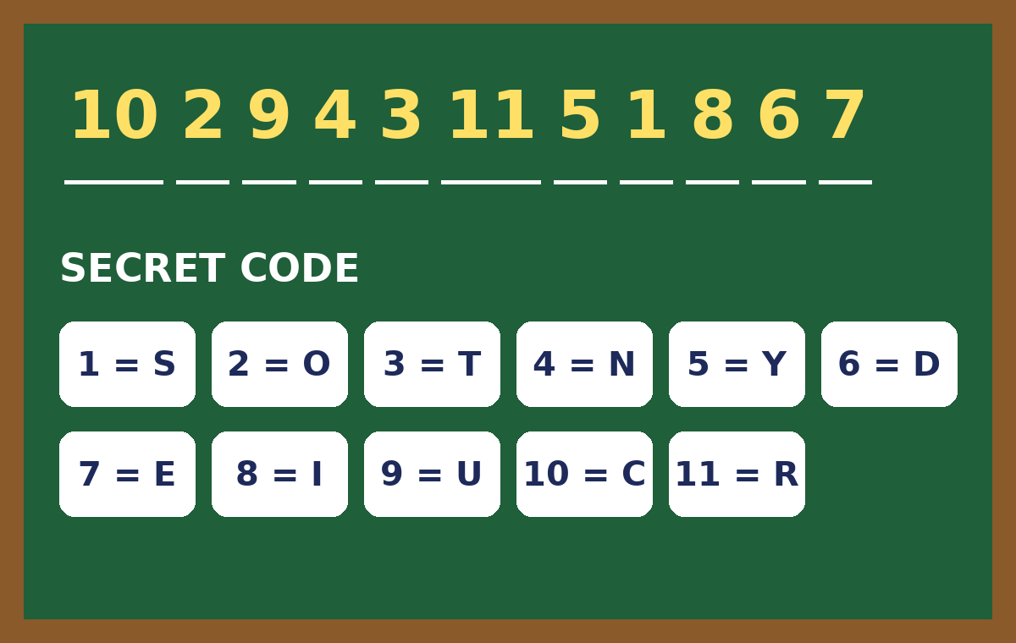
WARM-UP
Crack the code! Find the secret word.
Decifra il codice! Trova la parola segreta.
Secret code!
👥 PAIRS · ⏱ 3 MIN
1 Letters 1–7:
C · O · U · N · T · R · Y
2 Letters 8–11:
S · I · D · E
3 The secret word is …
COUNTRYSIDE 🌄 = la campagna
Notes:
GAME PLAN
SEE: A chalkboard with numbers and a code (1 = S, 2 = O …).
TEACHER: 'Use the code. Find the secret word. Stand up when you know it!'
STUDENTS: Copy the numbers, decode the letters, stand up and whisper the word to you.
GROUPING: Pairs.
SCORE / WIN: First 3 pairs standing with the right word = 1 point each.
TIME: 3 min.
LANGUAGE: Spelling the letters aloud (C-O-U-N…).
REVEAL: One click shows all three answers.
AIM: Hook + spelling of the unit topic word. Then (TB): pairs name 5 things they already know in the countryside (cow, sheep, flower…) – first pair with 5 wins.

Slide 3
WATCH 1
Watch. Then draw one thing you can see in the countryside.
Guarda. Poi disegna una cosa della campagna.
Watch and draw!
✍ ALONE · ⏱ 5 MIN
▶ Countryside for kids (search)
Draw it in the box on page 6. ✏️
Tell me: It's a … !
Teacher: preview every link before class (ads, content). The lesson works without it. · Controllare i link prima della lezione.
📘 Pupil's Book p.6 · 🎬 video 1
Notes:
EX 1 (5 min). Play the book's video 1 (Unit 1 opener). Learners draw something they can see in the countryside in the dotted box on p.6. Monitor and tell each learner the English name of their drawing – these words feed straight into the flashcards next. External resources are suggestions only: the teacher must preview and check all links, videos, adverts and content before using them with children. Always have the PowerPoint/classroom alternative ready.

Slide 4
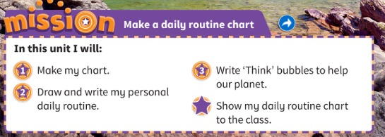
MISSION
Our Mission: make a daily routine chart!
La nostra missione: una tabella della routine!
Our Mission!
👀 LOOK · ⏱ 3 MIN
📘 Pupil's Book p.6 · Activity Book p.6 (My unit goals)
Notes:
MISSION (3 min). 'Our Mission is: Make a daily routine chart.' A routine = something we do every day (mime getting up, eating breakfast). Stages: 1 Make my chart 2 Draw and write my routine (What time do you get up?) 3 Write 'Think' bubbles to help our planet ⭐ Show my chart to the class. Activity Book p.6: learners circle the unit goals.

Slide 5
FLASHCARDS
Look! Say the word before it appears!
Guarda! Di' la parola prima che appaia!
What's this?
🏃 TPR Climb the mountain! 🧗
montagna
mountain
📘 Pupil's Book p.7 · 🎧 1.07
1 / 10
Notes:
FLASHCARDS (8 min). PROMPT: picture only. THINK 3 s – 'Do you know it? Whisper it to your partner!' REVEAL click 1: word. Click 2: Italian. Click 3: TPR – everyone does it. Say each word whisper → normal → MONSTER voice. Some words they drew from the video may appear – 'You drew this!' TPR: Climb the mountain! 🧗

Slide 6
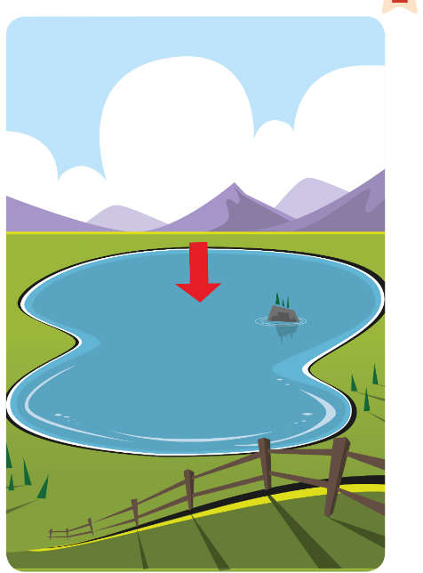
FLASHCARDS
Look! Say the word before it appears!
Guarda! Di' la parola prima che appaia!
What's this?
🏃 TPR Row a boat on the lake! 🚣
lago
lake
📘 Pupil's Book p.7 · 🎧 1.07
2 / 10
Notes:
FLASHCARDS (8 min). PROMPT: picture only. THINK 3 s – 'Do you know it? Whisper it to your partner!' REVEAL click 1: word. Click 2: Italian. Click 3: TPR – everyone does it. Say each word whisper → normal → MONSTER voice. Some words they drew from the video may appear – 'You drew this!' TPR: Row a boat on the lake! 🚣

Slide 7
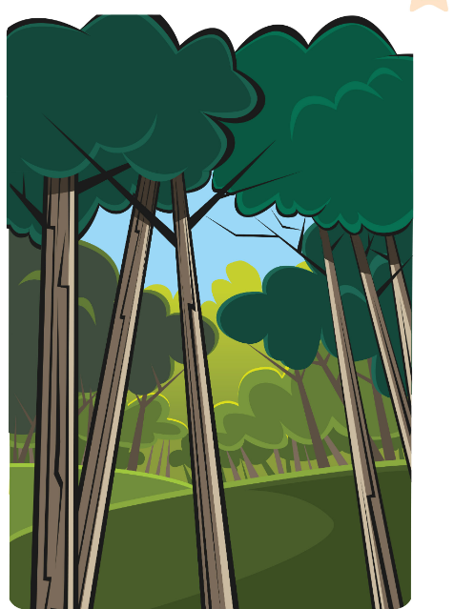
FLASHCARDS
Look! Say the word before it appears!
Guarda! Di' la parola prima che appaia!
What's this?
🏃 TPR Be a tall tree! Arms up! 🌲
bosco / foresta
forest
📘 Pupil's Book p.7 · 🎧 1.07
3 / 10
Notes:
FLASHCARDS (8 min). PROMPT: picture only. THINK 3 s – 'Do you know it? Whisper it to your partner!' REVEAL click 1: word. Click 2: Italian. Click 3: TPR – everyone does it. Say each word whisper → normal → MONSTER voice. Some words they drew from the video may appear – 'You drew this!' TPR: Be a tall tree! Arms up! 🌲

Slide 8
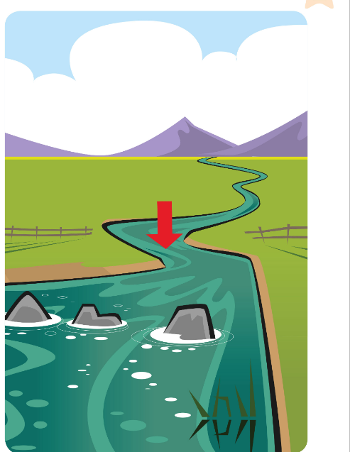
FLASHCARDS
Look! Say the word before it appears!
Guarda! Di' la parola prima che appaia!
What's this?
🏃 TPR Swim in the river! 🏊
fiume
river
📘 Pupil's Book p.7 · 🎧 1.07
4 / 10
Notes:
FLASHCARDS (8 min). PROMPT: picture only. THINK 3 s – 'Do you know it? Whisper it to your partner!' REVEAL click 1: word. Click 2: Italian. Click 3: TPR – everyone does it. Say each word whisper → normal → MONSTER voice. Some words they drew from the video may appear – 'You drew this!' TPR: Swim in the river! 🏊

Slide 9
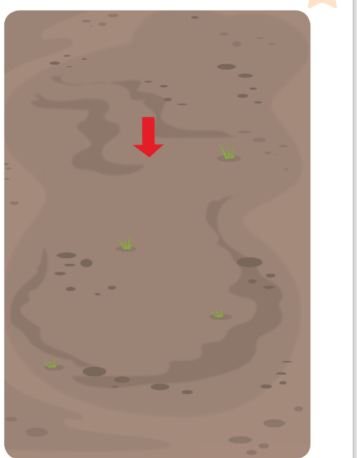
FLASHCARDS
Look! Say the word before it appears!
Guarda! Di' la parola prima che appaia!
What's this?
🏃 TPR Touch the ground! 👇
terra / suolo
ground
📘 Pupil's Book p.7 · 🎧 1.07
5 / 10
Notes:
FLASHCARDS (8 min). PROMPT: picture only. THINK 3 s – 'Do you know it? Whisper it to your partner!' REVEAL click 1: word. Click 2: Italian. Click 3: TPR – everyone does it. Say each word whisper → normal → MONSTER voice. Some words they drew from the video may appear – 'You drew this!' TPR: Touch the ground! 👇

Slide 10

FLASHCARDS
Look! Say the word before it appears!
Guarda! Di' la parola prima che appaia!
What's this?
🏃 TPR Grow like grass! 🌱
erba
grass
📘 Pupil's Book p.7 · 🎧 1.07
6 / 10
Notes:
FLASHCARDS (8 min). PROMPT: picture only. THINK 3 s – 'Do you know it? Whisper it to your partner!' REVEAL click 1: word. Click 2: Italian. Click 3: TPR – everyone does it. Say each word whisper → normal → MONSTER voice. Some words they drew from the video may appear – 'You drew this!' TPR: Grow like grass! 🌱

Slide 11

FLASHCARDS
Look! Say the word before it appears!
Guarda! Di' la parola prima che appaia!
What's this?
🏃 TPR Fall like leaves – slowly! 🍂
foglia / foglie
leaf / leaves
📘 Pupil's Book p.7 · 🎧 1.07
7 / 10
Notes:
FLASHCARDS (8 min). PROMPT: picture only. THINK 3 s – 'Do you know it? Whisper it to your partner!' REVEAL click 1: word. Click 2: Italian. Click 3: TPR – everyone does it. Say each word whisper → normal → MONSTER voice. Some words they drew from the video may appear – 'You drew this!' TPR: Fall like leaves – slowly! 🍂

Slide 12
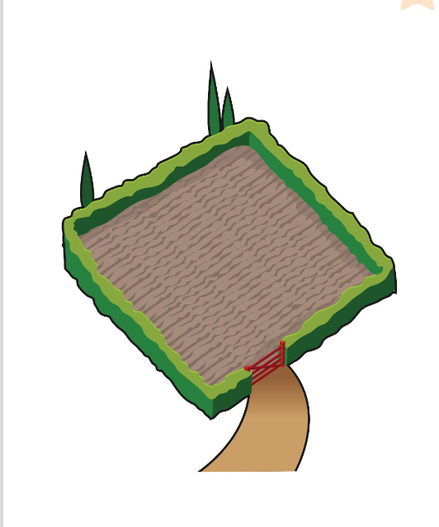
FLASHCARDS
Look! Say the word before it appears!
Guarda! Di' la parola prima che appaia!
What's this?
🏃 TPR Plant seeds in the field! 🌾
campo
field
📘 Pupil's Book p.7 · 🎧 1.07
8 / 10
Notes:
FLASHCARDS (8 min). PROMPT: picture only. THINK 3 s – 'Do you know it? Whisper it to your partner!' REVEAL click 1: word. Click 2: Italian. Click 3: TPR – everyone does it. Say each word whisper → normal → MONSTER voice. Some words they drew from the video may appear – 'You drew this!' TPR: Plant seeds in the field! 🌾

Slide 13
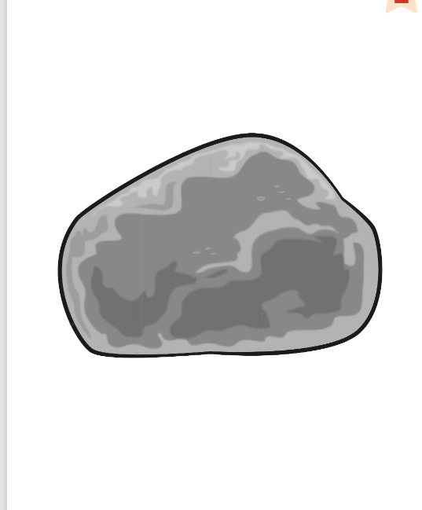
FLASHCARDS
Look! Say the word before it appears!
Guarda! Di' la parola prima che appaia!
What's this?
🏃 TPR Be a rock! Don't move! 🪨
roccia / sasso
rock
📘 Pupil's Book p.7 · 🎧 1.07
9 / 10
Notes:
FLASHCARDS (8 min). PROMPT: picture only. THINK 3 s – 'Do you know it? Whisper it to your partner!' REVEAL click 1: word. Click 2: Italian. Click 3: TPR – everyone does it. Say each word whisper → normal → MONSTER voice. Some words they drew from the video may appear – 'You drew this!' TPR: Be a rock! Don't move! 🪨

Slide 14
FLASHCARDS
Look! Say the word before it appears!
Guarda! Di' la parola prima che appaia!
What's this?
🏃 TPR Drive the tractor! Brrrm! 🚜
trattore
tractor
📘 Pupil's Book p.7 · 🎧 1.07
10 / 10
Notes:
FLASHCARDS (8 min). PROMPT: picture only. THINK 3 s – 'Do you know it? Whisper it to your partner!' REVEAL click 1: word. Click 2: Italian. Click 3: TPR – everyone does it. Say each word whisper → normal → MONSTER voice. Some words they drew from the video may appear – 'You drew this!' TPR: Drive the tractor! Brrrm! 🚜

Slide 15
SAY IT!
Clap the syllables. Which part is BIG?
Batti le sillabe. Quale parte è FORTE?
Clap the word!
👏 WHOLE CLASS · ⏱ 3 MIN
1
👂 LISTEN
MOUN-tain ●•
FOR-est ●•
TRAC-tor ●•
RI-ver ●•
lake · field · rock · grass ●
Teacher says: MOUN-tain.
L'insegnante dice: MOUN-tain.
2
⚙️ DO
Clap it: BIG clap + small clap!
Batti: forte + piano!
3
💬 SPEAK
Catch the teacher's mistake!
Trova l'errore dell'insegnante!
Notes:
PRONUNCIATION (3 min). English 2-syllable nouns stress the FIRST syllable; Italians often say 'mounTAIN', 'foREST'. Big clap on the stressed syllable, small clap on the other. Then 'Catch the teacher': say 'forEST', 'tracTOR', 'MOUNtain' – learners shout STOP! when you're wrong and say it right. Also: one-syllable words have no extra vowel – 'lake' not 'lak-e', 'rock' not 'rocke'. LEAF → LEAVES (f → v) – hold one finger, then lots of fingers.

Slide 16
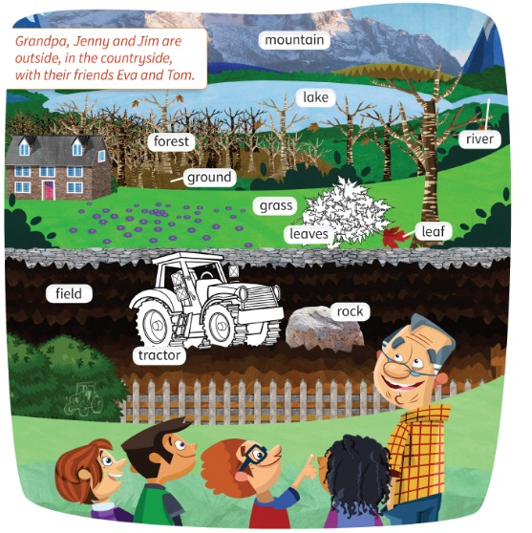
LISTEN 1
Listen and point. Then listen and colour.
Ascolta e indica. Poi ascolta e colora.
Listen and point
👂 LISTEN · ⏱ 6 MIN
1 Who can you see?
Jim, Jenny, Grandpa, Tom, Eva
2 Where's the small tractor?
Find it! 🔎
3 Guess! What colour is the tractor?
blue 🔵
4 Guess! What colour are the leaves?
red, yellow and brown 🍂
📘 Pupil's Book p.7 · 🎧 1.07
Notes:
EX 1 (6 min). New characters: Tom and Eva. 'Where's the lake? Where are the leaves?' – learners point. Play 🎧 1.07: point to the items. PREDICT before listening again: 'What colour is the tractor? Guess!' – each learner COMMITS by pointing at something that colour in the classroom. Play again and colour. REVEAL. KEY (TB): tractor – blue; leaves – red, yellow and brown. Extra support: 'What colour is the rock?' (grey).

Slide 17
CHANT 2
Listen, point and chant. Do the actions!
Ascolta, indica e di' il chant. Fai i gesti!
Say the chant!
🗣 WHOLE CLASS · ⏱ 4 MIN
1
👂 LISTEN
Countryside, countryside,
Forest and field,
Grass on the ground,
And leaves on the trees,
Mountains and rocks, rivers and lakes.
Listen and point.
Ascolta e indica.
2
💬 SPEAK
Say the chant.
Di' il chant.
3
🏃 MOVE
Chant with actions!
Chant con i gesti!
📘 Pupil's Book p.7 · 🎧 1.08 · 🎬 chant video
Notes:
CHANT (4 min). Play 🎧 1.08: listen and point. Then chant with the flashcard actions (arms up = forest, touch the ground, wiggle fingers = leaves, climb = mountains, swim = rivers). Half the class whispers, half shouts – swap.

Slide 18
LISTEN 3
Listen. YES = stand up! NO = sit down!
Ascolta. SÌ = alzati! NO = siediti!
Yes or no? Stand up!
👂 LISTEN · ⏱ 3 MIN
1 Grandpa's got a new tractor.
YES ✓
2 His tractor's in his garden.
NO ✗
3 The purple flowers are in the forest.
NO ✗
4 Grandpa's garden is next to the forest.
YES ✓
📘 Pupil's Book p.7 · 🎧 1.09
Notes:
EX 3 (6 min, 2 slides). Demo: 'Grandpa's got a red tractor. Yes or no?' (No). Play 🎧 1.09, pause after each sentence. COMMIT: everyone stands (yes) or sits (no) at the same time on '3-2-1!'. REVEAL click. KEY (TB): 1 yes 2 no 3 no 4 yes 5 no 6 yes 7 yes 8 no. Ask a 'no' learner: 'Where's the tractor?' (in the field).

Slide 19
LISTEN 3
Listen. YES = stand up! NO = sit down!
Ascolta. SÌ = alzati! NO = siediti!
Yes or no? (2)
👂 LISTEN · ⏱ 3 MIN
1 There's a big rock behind the tractor.
NO ✗
2 There are lots of leaves under the tree in the garden.
YES ✓
3 The river's next to the lake.
YES ✓
4 They can swim in the lake this afternoon.
NO ✗
📘 Pupil's Book p.7 · 🎧 1.09
Notes:
EX 3 sentences 5–8. KEY: 5 no 6 yes 7 yes 8 no. TB extension: pairs ask and answer – What colour are the flowers? (purple) Where's the rock? (in the field).

Slide 20
GAME
👀 Look for 10 seconds. Remember ALL the pictures!
Guarda e ricorda tutte le immagini!
Look and remember!
field
forest
grass
ground
lake
leaf leaves
mountain
river
rock
tractor
Notes:
WHAT'S MISSING? Step 1 – LOOK (10 s). Say the words together first (choral). Count down aloud. Then: "Close your eyes!" and go to the next slide.

Slide 21
GAME
Open your eyes! What's missing? Write it or whisper it to your partner.
Apri gli occhi! Cosa manca? Scrivilo o dillo al compagno.
What's missing?
field
forest
grass
ground
lake
?
leaf leaves
mountain
rock
tractor
Notes:
Step 2 – COMMIT. Students write the word on a mini-whiteboard / paper (or teams agree in 10 s). 'Show me!' Then go to the next slide. Points: 1 per team with the right word, +1 if spelt correctly.

Slide 22
ANSWER
It's the river!
È il fiume!
Were you right?
field
forest
grass
ground
lake
leaf leaves
mountain
river
rock
tractor
Notes:
Step 3 – REVEAL. The missing card comes back with a green frame. Everybody says the word 3 ways: whisper, normal, monster voice. Teams of 4 with a mini-whiteboard or paper. Round 1: one card; round 2 🔥: two cards. +1 for the right word, +1 for correct spelling, +1 for correct stress (MOUN-tain!).

Slide 23
GAME · ROUND 2 🔥
👀 Look for 15 seconds. Remember ALL the pictures!
Guarda e ricorda tutte le immagini!
Look and remember!
field
forest
grass
ground
lake
leaf leaves
mountain
river
rock
tractor
Notes:
WHAT'S MISSING? Step 1 – LOOK (15 s). Say the words together first (choral). Count down aloud. Then: "Close your eyes!" and go to the next slide.

Slide 24
GAME · ROUND 2 🔥
TWO pictures are missing! Write them down.
Mancano DUE immagini! Scrivile.
What's missing?
?
field
grass
ground
lake
?
leaf leaves
mountain
river
rock
Notes:
Step 2 – COMMIT. Students write the word on a mini-whiteboard / paper (or teams agree in 10 s). 'Show me!' Then go to the next slide. Points: 1 per team with the right word, +1 if spelt correctly.

Slide 25
ANSWER
It's the forest and the tractor!
Were you right?
field
forest
grass
ground
lake
leaf leaves
mountain
river
rock
tractor
Notes:
Step 3 – REVEAL. The missing card comes back with a green frame. Everybody says the word 3 ways: whisper, normal, monster voice. Teams of 4 with a mini-whiteboard or paper. Round 1: one card; round 2 🔥: two cards. +1 for the right word, +1 for correct spelling, +1 for correct stress (MOUN-tain!).

Slide 26
GAME
Which one doesn't belong? Why?
Quale non c'entra? Perché?
Odd one out!
👥 PAIRS · ⏱ 4 MIN
1
👀 LOOK
1 lake · river · rock · grass?
2 mountain · forest · tractor · field?
3 leaf · grass · forest · river?
Look at the 4 pictures.
Guarda le 4 immagini.
2
💬 SPEAK
Agree with your partner.
Mettetevi d'accordo.
3
⚙️ DO
Point on 3-2-1!
Indica al 3-2-1!
⭐ It's … because …
🔥 Find TWO answers!
Notes:
GAME PLAN
SEE: Three sets of 4 countryside words.
TEACHER: Read set 1. 'Which one doesn't belong? 10 seconds – agree with your partner.' Count 3-2-1.
STUDENTS: Point / hold up 1–4 fingers, then explain.
GROUPING: Pairs, scoring as two teams (left/right side of the room).
SCORE / WIN: 1 point for an answer + 1 point for a reason in English. Any good reason counts!
TIME: 4 min.
LANGUAGE: It's the rock because it isn't green / it isn't water / it's not a plant.
REVEAL: No fixed answer – the teacher accepts any logical reason. Suggested: 1 rock (no water / not green) · 2 tractor (people make it) · 3 river (not a plant / not green).
AIM: Retrieve the words and think about meaning.

Slide 27
GAME
Listen and do it!
Ascolta e fallo!
Countryside moves!
🏃 WHOLE CLASS · ⏱ 4 MIN
Climb the mountain! 🧗
Swim in the river! 🏊
Fall like leaves! 🍂
Drive the tractor! 🚜
Be a rock! Freeze!
Grow like grass! 🌱
Row a boat! 🚣
Be a tree! 🌲
Notes:
GAME PLAN
SEE: 8 pictures with actions.
TEACHER: Say only the WORD – learners remember the action. Speed up. Then say two words together ('mountain + river!').
STUDENTS: Do the action.
GROUPING: Whole class standing.
SCORE / WIN: Freeze round: 'rock!' = freeze completely; anyone who moves sits down. Last 3 standing win.
TIME: 4 min.
LANGUAGE: The 10 countryside words (listening; learners echo them).
REVEAL: Click to show each action if needed.
AIM: Fix the meanings with movement.

Slide 28
WELL DONE!
Today I can… · Oggi so…
Show me with your thumbs! 👍 👌 👎
Bye bye! 👋
⭐ I can name 10 things in the countryside.
So dire 10 cose della campagna.
🏠 HOMEWORK · COMPITI
• Homework sheet: Countryside
• Activity Book p.7 ex 1 (Read and match)
⭐ I can clap MOUN-tain, FOR-est, TRAC-tor.
So battere le sillabe giuste.
⭐ I know our Mission: a daily routine chart.
Conosco la nostra missione.
➡ Next: The Friendly Farm story!
Notes:
EXIT (3 min). EXIT TICKET: each learner says one countryside word to you at the door (no repeats! If your word is taken, find another). Thumbs for each 'I can'. AB p.7 ex 2 (/r/ sound, 🎧 4.09) – do in class next lesson.

Slide 29
EXTRA
Listen. Run and touch the picture first!
Ascolta. Corri e tocca l'immagine per primo!
EXTRA: Board race!
👥👥 TEAMS · ⏱ 5 MIN
1
👀 LOOK
Two teams in lines.
Due squadre in fila.
2
field
forest
lake
river
👂 LISTEN
Listen to the sentence.
Ascolta la frase.
3
🏃 MOVE
Run! Touch it! 1 point!
Corri! Toccala! 1 punto!
rock
tractor
mountain
grass
Notes:
GAME PLAN
SEE: 8 labelled pictures (or real flashcards on the board).
TEACHER: Say a SENTENCE, not a word: 'There's a big grey rock in the field.' 'Let's swim in the lake!'
STUDENTS: First learner in each line runs and touches the right picture.
GROUPING: Two teams.
SCORE / WIN: First touch = 1 point; bonus point if they repeat the sentence.
TIME: 5 min.
LANGUAGE: Countryside words inside sentences (listening for key words).
REVEAL: The teacher points to the right card.
AIM: Recognise the words in connected speech.

