Slide 1

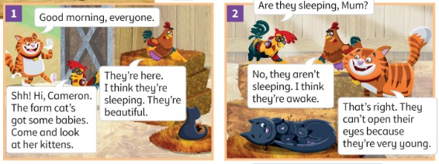


UNIT 1 · LESSON 2
Today: the Friendly Farm story and What are you doing? 🐱🐶
Oggi: la storia della Friendly Farm e il presente progressivo
Kittens and puppies
1
👂 LISTEN
Listen to the story.
Ascolta la storia.
The farm cat's got babies!
La gatta della fattoria ha i cuccioli!
2
💬 SPEAK
Ask: Are you reading?
Chiedi: Stai leggendo?
3
🏃 MOVE
Freeze frame!
Fermo immagine!
📘 Pupil's Book pp.8–9 · 🎧 1.10–1.13 · 🎬 video
Notes:
COVER (1 min). 'Who can you see? Is Cameron a horse?' (No, a cat). 'Look – a mother cat with babies!'

Slide 2
REMEMBER?
Listen. Draw fast! Don't look at the book!
Ascolta. Disegna veloce! Non guardare il libro!
Listen and draw!
✍ ALONE · ⏱ 5 MIN
1
👂 LISTEN
Draw some mountains. Draw a river and a lake.
Draw a forest next to the lake.
Draw a field with a tractor and a big rock.
Draw some leaves on the ground.
Listen to the teacher.
Ascolta l'insegnante.
2
🖍️ DRAW
Draw quickly!
Disegna velocemente!
3
👀 LOOK
Compare with a friend.
Confronta con un compagno.
🔥 Label your picture!
Notes:
GAME PLAN
SEE: Nothing yet – BLANK the screen (press B) while you dictate; show the slide only to check.
TEACHER: Dictate the 4 lines slowly, twice. No flashcards on the board (retrieval from memory!).
STUDENTS: Draw on scrap paper. 🔥 Label the words.
GROUPING: Alone, then compare in pairs.
SCORE / WIN: Pairs check each other: 1 point for every item in the right place (max 8).
TIME: 5 min.
LANGUAGE: Lesson 1 countryside words (listening) + prepositions next to / on / with.
REVEAL: Show the slide: learners tick what they drew.
AIM: Retrieval of Lesson 1 vocabulary (TB warm-up).

Slide 3
GUESS!
Watch the teacher. Guess!
Guarda l'insegnante. Indovina!
What am I doing?
🗣 WHOLE CLASS · ⏱ 4 MIN
1
👀 LOOK
drink 🥤 · sleep 😴 · eat 🍕 · swim 🏊
play tennis 🎾 · ride a bike 🚲 · run 🏃 · watch TV 📺
Watch the mime.
Guarda il mimo.
2
💬 SPEAK
You're drinking!
Stai bevendo!
3
⚙️ DO
Now YOU mime!
Ora mima TU!
⭐ You're …ing!
Notes:
GAME PLAN
SEE: Verbs they know + the starter 'You're …ing!'
TEACHER: Mime drinking: 'What am I doing?' Help them build 'You're drinking.' Repeat with 3–4 verbs (TB presentation).
STUDENTS: Guess with 'You're …ing!' Then a learner mimes for the class.
GROUPING: Whole class.
SCORE / WIN: The first correct FULL sentence (You're swimming – not just 'swimming') gets to mime next.
TIME: 4 min.
LANGUAGE: You're …ing. (present continuous – meaning: NOW).
REVEAL: The mimer says 'Yes! I'm swimming!'
AIM: Present the meaning of present continuous before the story.

Slide 4

FLASHCARDS
Look! Say the word before it appears!
Guarda! Di' la parola prima che appaia!
Story words
🏃 TPR Be a kitten! Meow! Wash your paws! 🐾
gattino
kitten
📘 Pupil's Book p.8 · story words
1 / 5
Notes:
STORY WORDS (5 min) from the TB: kitten, puppy (puppies), awake, naughty, wash (+ fat: puff out your cheeks). Mime holding a baby: 'A baby cat is a kitten. A baby dog is a puppy.' PICTURE FIRST – learners guess, then click. NAUGHTY: the 'gh' is silent – NAW-tee. TPR: Be a kitten! Meow! Wash your paws! 🐾

Slide 5
FLASHCARDS
Look! Say the word before it appears!
Guarda! Di' la parola prima che appaia!
Story words
🏃 TPR Be a puppy! Woof! Wag your tail!
cucciolo · cuccioli
puppy · puppies
📘 Pupil's Book p.8 · story words
2 / 5
Notes:
STORY WORDS (5 min) from the TB: kitten, puppy (puppies), awake, naughty, wash (+ fat: puff out your cheeks). Mime holding a baby: 'A baby cat is a kitten. A baby dog is a puppy.' PICTURE FIRST – learners guess, then click. NAUGHTY: the 'gh' is silent – NAW-tee. TPR: Be a puppy! Woof! Wag your tail!

Slide 6

FLASHCARDS
Look! Say the word before it appears!
Guarda! Di' la parola prima che appaia!
Story words
🏃 TPR Open your eyes wide! I'm awake! 👀
sveglio
awake
📘 Pupil's Book p.8 · story words
3 / 5
Notes:
STORY WORDS (5 min) from the TB: kitten, puppy (puppies), awake, naughty, wash (+ fat: puff out your cheeks). Mime holding a baby: 'A baby cat is a kitten. A baby dog is a puppy.' PICTURE FIRST – learners guess, then click. NAUGHTY: the 'gh' is silent – NAW-tee. TPR: Open your eyes wide! I'm awake! 👀

Slide 7
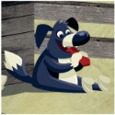
FLASHCARDS
Look! Say the word before it appears!
Guarda! Di' la parola prima che appaia!
Story words
🏃 TPR Wag your finger: Naughty puppy! ☝️
birichino / cattivello
naughty
📘 Pupil's Book p.8 · story words
4 / 5
Notes:
STORY WORDS (5 min) from the TB: kitten, puppy (puppies), awake, naughty, wash (+ fat: puff out your cheeks). Mime holding a baby: 'A baby cat is a kitten. A baby dog is a puppy.' PICTURE FIRST – learners guess, then click. NAUGHTY: the 'gh' is silent – NAW-tee. TPR: Wag your finger: Naughty puppy! ☝️

Slide 8

FLASHCARDS
Look! Say the word before it appears!
Guarda! Di' la parola prima che appaia!
Story words
🏃 TPR Wash your face! Wash your hands! 🧼
lavare
wash
📘 Pupil's Book p.8 · story words
5 / 5
Notes:
STORY WORDS (5 min) from the TB: kitten, puppy (puppies), awake, naughty, wash (+ fat: puff out your cheeks). Mime holding a baby: 'A baby cat is a kitten. A baby dog is a puppy.' PICTURE FIRST – learners guess, then click. NAUGHTY: the 'gh' is silent – NAW-tee. TPR: Wash your face! Wash your hands! 🧼

Slide 9
STORY
Guess first: are the kittens sleeping?
Indovina: i gattini stanno dormendo?
The Friendly Farm (1)
👂 LISTEN · ⏱ 4 MIN
1 Are the kittens ugly? (pic 1)
No, they're beautiful.
2 Are the kittens sleeping? (pic 2)
No, they aren't. They're awake.
3 Why are their eyes closed?
They're very young.
📘 Pupil's Book p.8 · 🎧 1.10 · 🎬 video
Notes:
STORY (10 min for 3 slides). PREDICT: 'Are the kittens sleeping? Thumbs up = yes, thumbs down = no.' Everyone COMMITS. Song at the start (🎧 1.10): happy face line 1, thumbs up line 2, wave line 3. Play the whole story once. Was your guess right? Then play again, pause after each picture and ask the TB questions; pairs whisper, then click to REVEAL. Check 'young'. Whose sock is it? (Grandpa's).

Slide 10
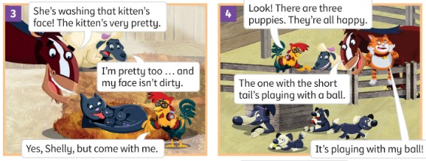
STORY
What's the mother cat doing?
Cosa sta facendo la gatta?
The Friendly Farm (2)
👂 LISTEN · ⏱ 3 MIN
1 What's the cat doing? (pic 3)
She's washing the kitten's face.
2 How many puppies are there? (pic 4)
Three.
3 The one with the short tail – what's it doing?
It's playing with a ball.
📘 Pupil's Book p.8 · 🎧 1.10 · 🎬 video
Notes:
TB: confirm 'wash' with mime; check 'pretty'. COMMIT: learners mime the answer before you click (washing / playing).

Slide 11
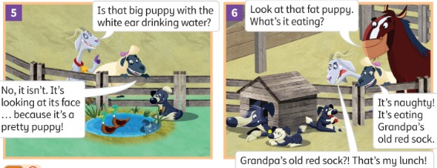
STORY
Guess: what's the fat puppy eating?
Indovina: cosa mangia il cucciolo grasso?
The Friendly Farm (3)
👂 LISTEN · ⏱ 3 MIN
1 The big puppy with the white ear – is it drinking? (pic 5)
No, it isn't. It's looking at its face.
2 What's the fat puppy eating? (pic 6)
Grandpa's old red sock! 🧦
3 Why is Gracie angry?
The sock is her lunch!
📘 Pupil's Book p.8 · 🎧 1.10 · 🎬 video
Notes:
TB: check 'naughty' and 'lunch'. Fun prediction before revealing pic 6: 'What's the puppy eating? A shoe? A book? A sock?' – hands up to vote.

Slide 12
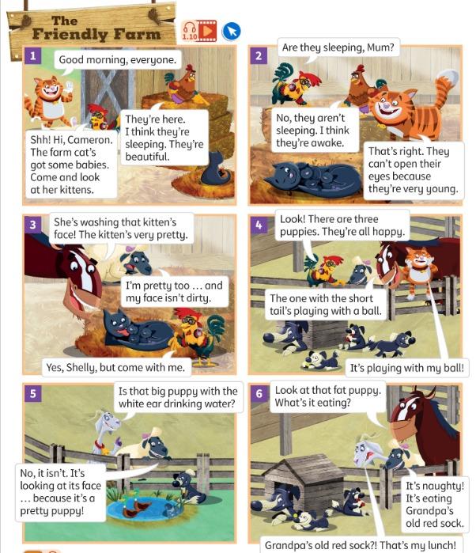
LISTEN 1
Listen. Show the number with your fingers!
Ascolta. Mostra il numero con le dita!
Which picture? (1)
👂 LISTEN · ⏱ 2 MIN
1 a It's eating Grandpa's old red sock.
6
2 b The one with the short tail's playing with a ball.
4
3 c Is that big puppy with the white ear drinking water?
5
4 d It's looking at its face.
5
📘 Pupil's Book p.8 · 🎧 1.11
Notes:
EX 1 (4 min, 2 slides). Play 🎧 1.11, pause after each sentence. THINK 3 s, COMMIT: everyone holds up fingers on '3-2-1-show!'. REVEAL click. KEY (TB audioscript): a 6 (Shelly) · b 4 (Harry) · c 5 (Gracie) · d 5 (Shelly) · e 6 (Harry) · f 2 (Rocky) · g 3 (Harry) · h 2 (Henrietta). Bonus: who says it?

Slide 13
LISTEN 1
Listen. Show the number with your fingers!
Ascolta. Mostra il numero con le dita!
Which picture? (2)
👂 LISTEN · ⏱ 2 MIN
1 e What's it eating?
6
2 f Are they sleeping, Mum?
2
3 g She's washing that kitten's face!
3
4 h No, they aren't sleeping. I think they're awake.
2
📘 Pupil's Book p.8 · 🎧 1.11
Notes:
KEY: e 6 · f 2 · g 3 · h 2.

Slide 14

NOTICE
Look! What word comes FIRST in a question?
Guarda! Quale parola viene PRIMA nella domanda?
Gracie's Grammar
👥 PAIRS · ⏱ 5 MIN
Are you reading a book? – No, I'm not.
Is she playing tennis? – Yes, she is.
Are they putting on their boots? – No, they aren't.
1 Is the big puppy drinking water? (pic 5)
No, it isn't.
2 Are the kittens sleeping? (pic 2)
No, they aren't.
3 Is the cat washing the kitten? (pic 3)
Yes, she is.
4 Are you reading a book?
Yes, I am. / No, I'm not.
📘 Pupil's Book p.9 · 🎧 1.12
Notes:
GRACIE'S GRAMMAR (5 min). NOTICE FIRST: before playing, ask 'Look at the red words. What comes first in a question? What's at the end of the verb?' Pairs find the pattern (Are/Is + -ing). Then play 🎧 1.12 and learners repeat. Spelling: put → putting, take → taking. PRACTICE: read the question, pairs whisper the short answer, then click. Short answers only – Italians often answer just 'Yes' or 'Yes, she is playing' – push 'Yes, she is.'

Slide 15
WATCH OUT 🇮🇹
The robot makes mistakes. Can you fix them?
Il robot sbaglia. Riesci a correggerlo?
Fix the robot!
👥 PAIRS · ⏱ 3 MIN
🇮🇹 Stai leggendo? → Are you reading? Not: You reading? ✗
1 🤖 You are reading a book?
Are you reading a book?
2 🤖 Is she play tennis?
Is she playing tennis?
3 🤖 Yes, she playing.
Yes, she is.
4 Say it: readin-GHE? ✗
reading – soft 'ng' 👃
Notes:
ITALIAN TRAP + PRONUNCIATION (3 min). Italian makes questions with intonation only ('Stai leggendo?'), so learners say 'You are reading?' or drop the -ing. The robot (you, in a robot voice) says the wrong sentence; pairs whisper the correct one; click to reveal. LAST LINE: Italians add a vowel or a hard g after -ing ('readinghe'). The 'ng' is in the nose: hold your nose while saying 'singing' – you feel it buzz! Whisper → normal → monster voice: 'I'm reading! I'm playing! I'm eating!'

Slide 16
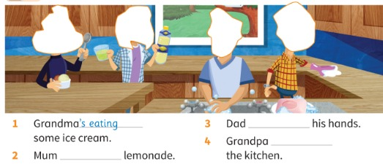
LISTEN 1
Listen and stick. Then write.
Ascolta e attacca. Poi scrivi.
Listen and stick
✍ ALONE · ⏱ 5 MIN
1 Grandma ______ some ice cream.
's eating 🍦
2 Mum ______ lemonade.
's drinking 🥤
3 Dad ______ his hands.
's washing 🧼
4 Grandpa ______ the kitchen.
's cleaning 🧽
📘 Pupil's Book p.9 · 🎧 1.13 · stickers
⭐ eat · drink · wash · clean
Notes:
EX 1 (5 min). Play 🎧 1.13: learners point to the right sticker; play again and they stick. 'What does 's mean?' (is). Learners write ALONE, then compare with a partner. REVEAL one line per click. KEY (TB): 1 's eating (example) 2 's drinking 3 's washing 4 's cleaning. ⭐ verbs are on the slide.

Slide 17
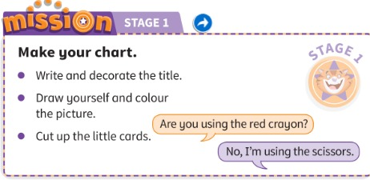
MISSION 1
Mission Stage 1: title, picture of you, 12 cards.
Missione fase 1: titolo, il tuo disegno, 12 carte.
Make your chart!
✍ ALONE · ⏱ 7 MIN
📘 Pupil's Book p.9 · Activity Book p.6 (My mission diary)
Notes:
MISSION STAGE 1 (7 min). Worksheet: Teacher's Resource Book p.14 – or paper/card. Learners draw themselves in one corner, write 'My daily routine chart, by …', decorate it, then cut 12 small cards. Everything in a named envelope – collect them. While they work, USE the grammar: 'Are you using the red crayon?' – 'No, I'm not. I'm using the scissors.' AB p.6: smiley for 'My mission diary 1'. Tick Stage 1 on the Mission poster.

Slide 18
GAME
Make a story picture with your bodies. FREEZE!
Fate una scena della storia col corpo. FERMI!
Freeze frame!
👥👥 GROUPS OF 4 · ⏱ 5 MIN
1
⚙️ DO
Choose a picture. Secret!
Scegliete un'immagine. Segreto!
2
🏃 MOVE
Make it. FREEZE!
Fatela. FERMI!
3
💬 SPEAK
Class: Are they washing? Picture 3?
Classe: Stanno lavando? Immagine 3?
⭐ Is it picture …? Are they …ing?
Notes:
GAME PLAN
SEE: Only the instructions (show the story slide again if needed).
TEACHER: Groups of 4 choose a story picture (1–6) in secret – 1 minute to practise. Each group performs.
STUDENTS: Make a still picture. The class asks 'Are you washing?' / 'Is it picture 3?' – the group answers 'Yes, we are / No, we aren't.'
GROUPING: Groups of 4.
SCORE / WIN: The audience team that guesses with a correct QUESTION gets 1 point; the performing group gets 1 point if the class guesses in under 3 questions.
TIME: 5 min.
LANGUAGE: Are you/they …ing? Is she …ing? + short answers.
REVEAL: The group says 'It's picture …! We're …ing.'
AIM: Communicative practice of the target questions with movement.

Slide 19
WELL DONE!
Today I can… · Oggi so…
Show me with your thumbs! 👍 👌 👎
Bye bye! 👋
⭐ I can understand the Friendly Farm story.
Capisco la storia della Friendly Farm.
🏠 HOMEWORK · COMPITI
• Homework sheet: What are they doing?
• Activity Book p.9 ex 1 and 2
⭐ I can ask: Are you …ing? Is she …ing?
So chiedere: Stai …? Lei sta …?
⭐ I can answer: Yes, I am. / No, she isn't.
So rispondere: Sì / No.
➡ Next: A day on the farm – daily routines! ⏰
Notes:
EXIT (3 min). EXIT QUESTION: mime an action at the door; each learner asks you a question ('Are you eating?') before leaving – no question, no exit! Thumbs for each 'I can'. Give out the homework and the Stage 1 sticker. AB p.8 (story listening) at the start of next lesson if time.

Slide 20

EXTRA
Copy your partner. Say what they're doing!
Copia il compagno. Di' cosa sta facendo!
EXTRA: Mirror, mirror!
👥 PAIRS · ⏱ 4 MIN
Wash your face like a kitten
Play with a ball like a puppy
Sleep… then wake up!
Eat a sock! Yuck!
Wash your hands
Look at your face
Notes:
GAME PLAN
SEE: 6 actions from the story.
TEACHER: Pairs face each other. Call 'Mirror!' – A does an action, B copies like a mirror and says 'You're washing your face!'
STUDENTS: A mimes, B mirrors + speaks, A answers 'Yes, I am!' Swap on 'Change!'
GROUPING: Pairs.
SCORE / WIN: No points – speed round: 6 actions in 1 minute?
TIME: 4 min.
LANGUAGE: You're …ing. / Yes, I am.
REVEAL: Click to show each action as a prompt.
AIM: Fluency with the present continuous + movement.

Slide 21
EXTRA
Two teams. Make a question – win the square!
Due squadre. Fai una domanda – vinci la casella!
EXTRA: O and X game
👥👥 TEAMS · ⏱ 6 MIN
1
👀 LOOK
1 you / read 2 she / swim 3 they / play football
4 he / eat 5 the kitten / sleep 6 you / drink
7 the puppy / play 8 they / wash 9 Grandpa / clean
3×3 grid on the board.
Griglia 3×3.
2
💬 SPEAK
Choose a square. Make a question!
Scegli una casella. Fai una domanda!
3
🎲 PLAY
Three in a line wins!
Tre in fila vince!
⭐ Is she …ing?
Notes:
GAME PLAN
SEE: 9 prompts (copy the grid numbers on the board).
TEACHER: Teams O and X. A team chooses a square.
STUDENTS: Team makes the question (Is she swimming?); a learner from the other team answers with a short answer.
GROUPING: Two teams.
SCORE / WIN: Correct question = draw O/X in the square. Three in a line wins.
TIME: 6 min.
LANGUAGE: Am/Is/Are + -ing questions and short answers.
REVEAL: Teacher confirms each question aloud.
AIM: Accuracy with question word order.

