Slide 1

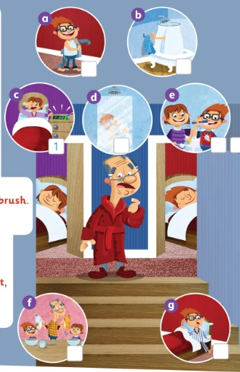
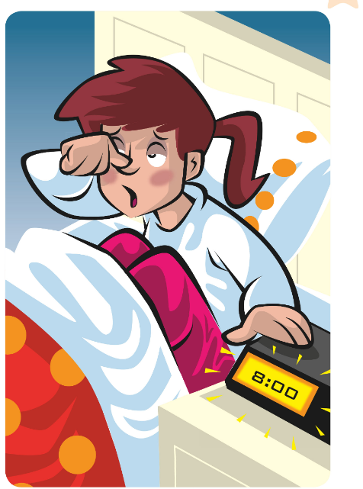
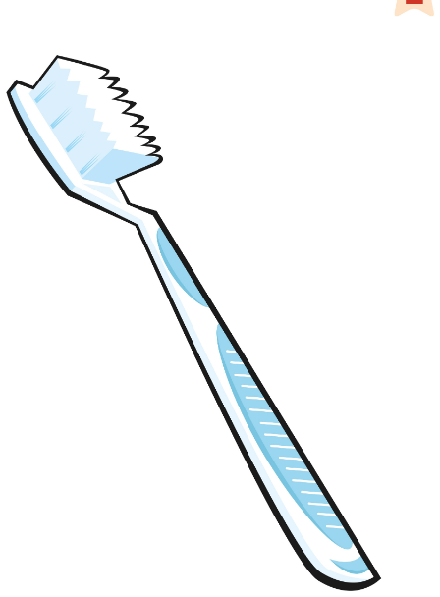
UNIT 1 · LESSON 3
Today: morning routines and What time…? ⏰🪥🚿
Oggi: la routine del mattino e A che ora…?
Time for us to run!
1
🎵 SING
Sing the morning song.
Canta la canzone del mattino.
Wake up! Get up! Time to run!
Svegliati! Alzati! È ora di correre!
2
💬 SPEAK
Ask: What time do you get up?
Chiedi: A che ora ti alzi?
3
🎲 PLAY
Mime it! Make a human clock!
Mima! Fai un orologio umano!
📘 Pupil's Book pp.10–11 · 🎧 1.14–1.17 · 🎬 song video
Notes:
COVER (1 min). 'Who can you see?' (Grandpa, Jenny, Jim). 'It's the morning. Grandpa's in his dressing gown – he's waking up!'

Slide 2

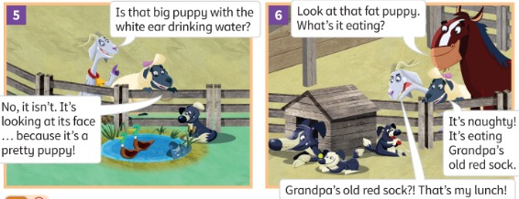
REMEMBER?
Two are true. One is a LIE! Which one?
Due sono vere. Una è una BUGIA! Quale?
Spot the lie!
👥👥 TEAMS · ⏱ 4 MIN
1 A The kittens are awake. B The kittens are blue. C The cat is washing a kitten.
LIE = B 🙈
2 A The fat puppy is eating a sock. B The puppy is naughty. C Gracie is happy.
LIE = C 😠
3 A There are three puppies. B One puppy is sleeping in a tractor. C Gracie wants her lunch.
LIE = B 🚜
📘 Story: Pupil's Book p.8
Notes:
GAME PLAN
SEE: A story picture + 3 sentences per round (answers hidden).
TEACHER: Read the three sentences of round 1 aloud with drama. 'Two are true. One is a lie! 10 seconds – talk to your team.'
STUDENTS: Teams agree and hold up A, B or C fingers (1, 2, 3) on '3-2-1!'
GROUPING: Two or three teams.
SCORE / WIN: 1 point for the right letter; +1 if a learner corrects the lie ('The kittens are black and white!').
TIME: 4 min (3 rounds).
LANGUAGE: Lesson 2 words: awake, kitten, puppy, naughty, wash + present continuous.
REVEAL: Click 1/2/3 reveals the lie for each round.
AIM: Retrieval of Lesson 2 in a new format.

Slide 3
WARM-UP
Move only when Simon says!
Muoviti solo quando Simon dice!
Simon says!
🏃 WHOLE CLASS · ⏱ 3 MIN
1
👂 LISTEN
play the guitar 🎸 · play football ⚽ · swim 🏊
run 🏃 · get up · sit down · go to the door
Simon says: play the guitar!
Simon dice: suona la chitarra!
2
🏃 MOVE
Do it!
Fallo!
3
👀 LOOK
No 'Simon says'? Don't move!
Senza 'Simon dice'? Fermo!
Notes:
GAME PLAN
SEE: Some actions they know.
TEACHER: Give quick instructions with 'Simon says…'; every 4–5 give one WITHOUT it.
STUDENTS: Mime only when Simon says.
GROUPING: Whole class standing.
SCORE / WIN: Move without 'Simon says' = sit down. Last one standing becomes Simon.
TIME: 3 min.
LANGUAGE: Imperatives: get up, sit down, go, run (TB warm-up).
REVEAL: None.
AIM: Recycle imperatives + 'get up' before the routine words.

Slide 4
FLASHCARDS
Look! Say the word before it appears!
Guarda! Di' la parola prima che appaia!
My morning!
🏃 TPR Stretch and yawn! Switch off the alarm! ⏰
svegliarsi
wake up
📘 Pupil's Book p.10 · 🎧 1.14
1 / 8
Notes:
FLASHCARDS (7 min). TB presentation: mime switching off an alarm: 'It's the morning. Every day I do the same thing. I wake up.' PICTURE FIRST – learners guess (they may know 'get up'), then click. Use a real towel / toothbrush / toothpaste if you have them. tooth → teeth. 'We use a towel to get dry.' TPR: Stretch and yawn! Switch off the alarm! ⏰

Slide 5
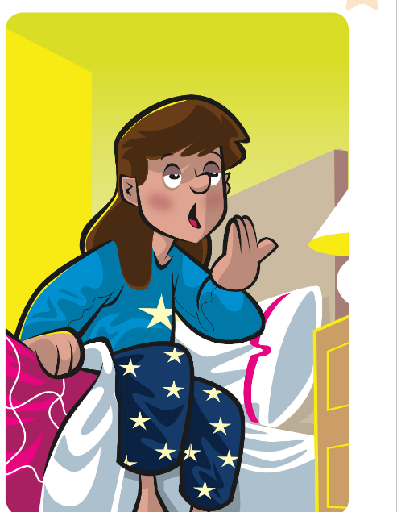
FLASHCARDS
Look! Say the word before it appears!
Guarda! Di' la parola prima che appaia!
My morning!
🏃 TPR Jump out of bed! 🛏️
alzarsi
get up
📘 Pupil's Book p.10 · 🎧 1.14
2 / 8
Notes:
FLASHCARDS (7 min). TB presentation: mime switching off an alarm: 'It's the morning. Every day I do the same thing. I wake up.' PICTURE FIRST – learners guess (they may know 'get up'), then click. Use a real towel / toothbrush / toothpaste if you have them. tooth → teeth. 'We use a towel to get dry.' TPR: Jump out of bed! 🛏️

Slide 6

FLASHCARDS
Look! Say the word before it appears!
Guarda! Di' la parola prima che appaia!
My morning!
🏃 TPR Wash your hair in the shower! 🚿
fare la doccia
have a shower
📘 Pupil's Book p.10 · 🎧 1.14
3 / 8
Notes:
FLASHCARDS (7 min). TB presentation: mime switching off an alarm: 'It's the morning. Every day I do the same thing. I wake up.' PICTURE FIRST – learners guess (they may know 'get up'), then click. Use a real towel / toothbrush / toothpaste if you have them. tooth → teeth. 'We use a towel to get dry.' TPR: Wash your hair in the shower! 🚿

Slide 7

FLASHCARDS
Look! Say the word before it appears!
Guarda! Di' la parola prima che appaia!
My morning!
🏃 TPR Get dry with your towel!
asciugamano
towel
📘 Pupil's Book p.10 · 🎧 1.14
4 / 8
Notes:
FLASHCARDS (7 min). TB presentation: mime switching off an alarm: 'It's the morning. Every day I do the same thing. I wake up.' PICTURE FIRST – learners guess (they may know 'get up'), then click. Use a real towel / toothbrush / toothpaste if you have them. tooth → teeth. 'We use a towel to get dry.' TPR: Get dry with your towel!

Slide 8

FLASHCARDS
Look! Say the word before it appears!
Guarda! Di' la parola prima che appaia!
My morning!
🏃 TPR Put on your T-shirt and shoes! 👕
vestirsi
get dressed
📘 Pupil's Book p.10 · 🎧 1.14
5 / 8
Notes:
FLASHCARDS (7 min). TB presentation: mime switching off an alarm: 'It's the morning. Every day I do the same thing. I wake up.' PICTURE FIRST – learners guess (they may know 'get up'), then click. Use a real towel / toothbrush / toothpaste if you have them. tooth → teeth. 'We use a towel to get dry.' TPR: Put on your T-shirt and shoes! 👕

Slide 9

FLASHCARDS
Look! Say the word before it appears!
Guarda! Di' la parola prima che appaia!
My morning!
🏃 TPR Eat your cereal! Yum! 🥣
fare colazione
have breakfast
📘 Pupil's Book p.10 · 🎧 1.14
6 / 8
Notes:
FLASHCARDS (7 min). TB presentation: mime switching off an alarm: 'It's the morning. Every day I do the same thing. I wake up.' PICTURE FIRST – learners guess (they may know 'get up'), then click. Use a real towel / toothbrush / toothpaste if you have them. tooth → teeth. 'We use a towel to get dry.' TPR: Eat your cereal! Yum! 🥣

Slide 10
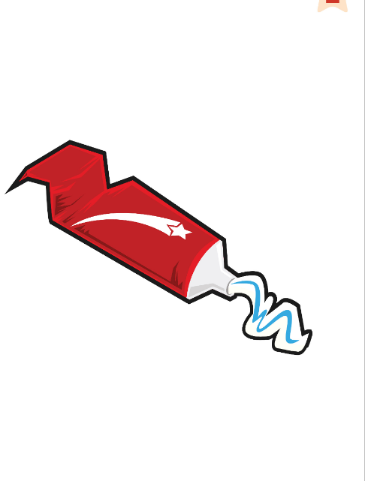
FLASHCARDS
Look! Say the word before it appears!
Guarda! Di' la parola prima che appaia!
My morning!
🏃 TPR Squeeze the toothpaste! 🦷
dentifricio
toothpaste
📘 Pupil's Book p.10 · 🎧 1.14
7 / 8
Notes:
FLASHCARDS (7 min). TB presentation: mime switching off an alarm: 'It's the morning. Every day I do the same thing. I wake up.' PICTURE FIRST – learners guess (they may know 'get up'), then click. Use a real towel / toothbrush / toothpaste if you have them. tooth → teeth. 'We use a towel to get dry.' TPR: Squeeze the toothpaste! 🦷

Slide 11
FLASHCARDS
Look! Say the word before it appears!
Guarda! Di' la parola prima che appaia!
My morning!
🏃 TPR Clean your teeth! Brush, brush! 🪥
spazzolino
toothbrush
📘 Pupil's Book p.10 · 🎧 1.14
8 / 8
Notes:
FLASHCARDS (7 min). TB presentation: mime switching off an alarm: 'It's the morning. Every day I do the same thing. I wake up.' PICTURE FIRST – learners guess (they may know 'get up'), then click. Use a real towel / toothbrush / toothpaste if you have them. tooth → teeth. 'We use a towel to get dry.' TPR: Clean your teeth! Brush, brush! 🪥

Slide 12
LISTEN 1
Guess the order first! Then listen and number.
Prima indovina l'ordine! Poi ascolta e numera.
Listen and number
👂 LISTEN · ⏱ 4 MIN
1 c (example)
1 – wake up
2 g
2 – get up
3 d
3 – have a shower
4 b · a
4 – towel · 5 – get dressed
5 e
6 – toothpaste · 7 – toothbrush
6 f
8 – have breakfast
📘 Pupil's Book p.10 · 🎧 1.14 · 🎬 video
Notes:
EX 1 (4 min). TB: 'Find a towel' – learners point (repeat for toothbrush, toothpaste, breakfast, shower). PREDICT: in pairs, guess the order of the pictures (pencil, lightly). Play the audio/video; learners correct their numbers. REVEAL one per click. KEY (TB): a 5 · b 4 · (c 1) · d 3 · e 6, 7 · f 8 · g 2.

Slide 13
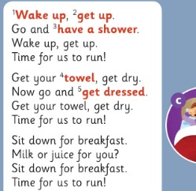
SONG
Sing and do the actions!
Canta e fai i gesti!
Time for us to run! (1)
🎵 SING · ⏱ 5 MIN
📘 Pupil's Book p.10 · 🎧 1.14 · karaoke 🎧 1.15
Notes:
SONG (5 min, 2 slides). TB: learners stand. Say each activity and do the action; learners repeat words and actions. Play the audio/video: sing and do the actions. When confident, sing the karaoke version (🎧 1.15).

Slide 14
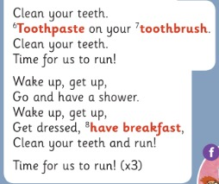
SONG
Sing and do the actions! Faster!
Canta e fai i gesti! Più veloce!
Time for us to run! (2)
🎵 SING
📘 Pupil's Book p.10 · 🎧 1.14 · karaoke 🎧 1.15
Notes:
Second half. 'Time for us to run!' ×3 – everybody runs on the spot!

Slide 15
WATCH OUT 🇮🇹
How do we say it? Think! Then click.
Come si dice? Pensa! Poi clicca.
Fare = have?
👥 PAIRS · ⏱ 3 MIN
🇮🇹 fare la doccia / colazione → 🇬🇧 HAVE a shower / breakfast
1 I make a shower. ✗
I have a shower. ✓
2 I do breakfast at 8. ✗
I have breakfast at 8. ✓
3 I wash my tooths. ✗
I clean my teeth. ✓
4 Say it: 'ave a shower ✗
HHHave a shower – huff! ✋
Notes:
ITALIAN TRAP + PRONUNCIATION (3 min). Italian 'fare' becomes HAVE for shower, breakfast, lunch, a bath. PROMPT: read the wrong sentence in a robot voice; pairs whisper the right one; click. Then pronunciation: /h/ (hand in front of mouth from the Starter lesson) and TH in teeth/toothbrush: tongue between your teeth – 'Show me your tongue!' – teeth, toothbrush, toothpaste: whisper → normal → monster. Catch the teacher: say 'tees', 'toospaste' – learners shout STOP!

Slide 16
GAME 2
Mime the card. Your team guesses!
Mima la carta. La squadra indovina!
Mime it!
👥👥 TEAMS · ⏱ 5 MIN
1
⚙️ DO
One player from each team.
Uno per squadra.
2
🏃 MOVE
Mime the card: What am I doing?
Mima: Cosa sto facendo?
3
💬 SPEAK
First correct sentence = 1 point!
Prima frase giusta = 1 punto!
📘 Pupil's Book p.10 · Play the game
⭐ You're …ing!
Notes:
GAME PLAN
SEE: The 8 routine pictures (no words – learners must retrieve them).
TEACHER: Show a different card secretly to one learner from each team; both mime at the same time.
STUDENTS: Mime and ask 'What am I doing?' Teams guess: 'You're having breakfast!'
GROUPING: Two teams.
SCORE / WIN: First CORRECT full sentence = 1 point (not just 'breakfast'). Bonus point for a good /h/ in 'having'.
TIME: 5 min.
LANGUAGE: You're having a shower / getting dressed / cleaning your teeth (present continuous recycled from L2).
REVEAL: The mimer shows the card.
AIM: PB ex 2. Then TB: Rocky's question 'What do you do in the morning?' – learners order the cards on the board.

Slide 17
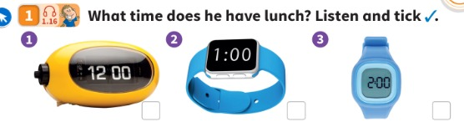
LISTEN 1
Guess first! Then listen and tick ✓.
Prima indovina! Poi ascolta e spunta ✓.
What time is lunch?
👂 LISTEN · ⏱ 4 MIN
1 What time does he have lunch?
At one o'clock – picture 2 ✓
2 What time does he get up?
At seven o'clock.
3 What time do lessons start in the afternoon?
At two o'clock.
4 What time does school finish?
At four o'clock.
📘 Pupil's Book p.11 · 🎧 1.16
Notes:
EX 1 (4 min). TB presentation first: teaching clock at seven o'clock – 'I have breakfast at seven o'clock.' Move the hands (always o'clock); learners say the times. Point to the clocks: learners read them (12, 1, 2 o'clock). PREDICT: 'What time does the boy have lunch? Vote: 1, 2 or 3!' Play 🎧 1.16; learners tick. REVEAL. KEY (TB): one o'clock – picture 2. Extension questions (TB) – click for each.

Slide 18

GRAMMAR
Gracie's Grammar
👥 PAIRS · ⏱ 4 MIN
What time do you get up? – I get up at seven o'clock.
What time does school finish? – It finishes at four o'clock.
1 What time ___ you have breakfast?
do
2 What time ___ he have lunch?
does
3 School ___ at four o'clock. (finish)
finishes
4 What time does Grandpa wake up? (6:00)
He wakes up at six o'clock.
📘 Pupil's Book p.11 · 🎧 1.17
Notes:
GRACIE'S GRAMMAR (4 min). NOTICE: 'do you…? but does school…? Why?' (he/she/it). Play 🎧 1.17, pause for repetition. PRACTICE: pairs whisper the missing word, then click. Watch the final -s: he gets up, school finishes (Italians drop it).

Slide 19
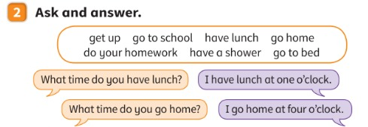
SPEAK 2
Ask and answer with a friend.
Fai domande e rispondi con un compagno.
Ask and answer
👥 PAIRS · ⏱ 5 MIN
1 What time do you get up?
I get up at seven o'clock.
2 What time do you go to school?
I go to school at eight o'clock.
3 What time do you have lunch?
I have lunch at two o'clock.
4 What time do you go to bed?
I go to bed at nine o'clock.
📘 Pupil's Book p.11
⭐ I … at … o'clock.
🔥 Ask about your mum!
Notes:
EX 2 (5 min). MODEL: you answer the first question yourself. SUPPORTED: pairs ask and answer with the slide (answers show as models on click). INDEPENDENT: blank the screen (B) – find a new partner and ask 3 questions from memory. 🔥 'What time does your mum get up?' – 'She gets up at…'. Sicilian reality: lunch is often at 1.30–2 – 'round it': two o'clock.

Slide 20
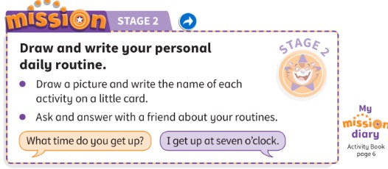
MISSION 2
Mission Stage 2: draw and write your routine.
Missione fase 2: disegna e scrivi la tua routine.
My daily routine
✍ ALONE · ⏱ 8 MIN
📘 Pupil's Book p.11 · Activity Book p.6 (My mission diary)
Notes:
MISSION STAGE 2 (8 min). Give back the envelopes. Learners write six routines on six cards and draw them on the other six. Pairs pick up a card and ask: 'What time do you get up?' 'I get up at seven o'clock.' Then (TB) on A4 card (landscape): picture/title at the top, word cards in a row at the bottom, matching pictures above, cut flaps. AB p.6: smiley for My mission diary 2. Tick Stage 2; give a sticker.

Slide 21
WELL DONE!
Today I can… · Oggi so…
Show me with your thumbs! 👍 👌 👎
Bye bye! 👋
⭐ I can say my morning routine.
So dire la mia routine del mattino.
🏠 HOMEWORK · COMPITI
• Homework sheet: My day
• Activity Book p.10 ex 1 · p.11 ex 1 and 2
⭐ I can say: I HAVE breakfast (not make!).
So dire have breakfast.
⭐ I can ask: What time…? At … o'clock.
So chiedere e dire l'ora.
➡ Next: Look after our planet! 🌍
Notes:
EXIT (3 min). EXIT CHALLENGE: 'Can you say the morning routine in order – in 20 seconds?' Volunteers race the clock. Thumbs for each 'I can'. Play the song again if there's time. AB p.10 ex 2 is listening (🎧 4.10) – in class.

Slide 22

EXTRA
Make the clock with your bodies!
Fate l'orologio con il corpo!
EXTRA: Human clocks!
👥👥 GROUPS OF 3 · ⏱ 5 MIN
1
👂 LISTEN
I have lunch at one o'clock!
Pranzo all'una!
2
🏃 MOVE
Short arm + long arm = the hands!
Braccio corto + lungo = lancette!
3
💬 SPEAK
Say the sentence!
Di' la frase!
Notes:
GAME PLAN
SEE: A clock and routine pictures.
TEACHER: Say a routine + time: 'I get up at seven o'clock!'
STUDENTS: In groups of 3: one learner is the clock face (stands in the middle), one is the short hour hand (bent arm), one is the long minute hand (arm straight up for o'clock).
GROUPING: Groups of 3.
SCORE / WIN: First group with the right time = 1 point – then they must say the sentence ('She gets up at seven o'clock').
TIME: 5 min.
LANGUAGE: o'clock times + routines + he/she -s.
REVEAL: Teacher shows the time on a real or drawn clock.
AIM: Times + routines with movement.

