Slide 1

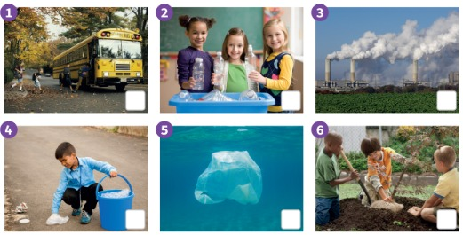


UNIT 1 · LESSON 4
Today: our planet Earth – how can we help? 🌍♻️
Oggi: il nostro pianeta Terra – come possiamo aiutarlo?
Look after our planet
1
🎬 WATCH
Watch the video.
Guarda il video.
Let's look after our planet!
Prendiamoci cura del pianeta!
2
📖 READ
Read about Earth.
Leggi della Terra.
3
🏃 MOVE
Be a planet hero!
Sii un eroe del pianeta!
📘 Pupil's Book pp.12–13 · 🎬 video · 🎧 1.18–1.19
Notes:
COVER (1 min). Show the Earth: 'This is a planet. We live on a planet.' 'What do living things need?' – collect ideas (water, food…). 'Let's find out!'

Slide 2
REMEMBER?
Take a card. Mime it. Then stand in order!
Prendi una carta. Mimala. Poi mettetevi in ordine!
Routine line-up!
🚶 WHOLE CLASS · ⏱ 5 MIN
1
⚙️ DO
Take a card. Secret!
Prendi una carta. Segreto!
2
🏃 MOVE
Mime it + show the time.
Mima + mostra l'ora.
3
💬 SPEAK
Class: You have a shower at 8!
Classe: Fai la doccia alle 8!
⭐ You … at … o'clock!
Notes:
GAME PLAN
SEE: Only the instructions – NO pictures (they must remember the words).
TEACHER: Hand out the Daily routines flashcards (verbs) face down. Model: mime + hold up fingers: 'What do I do? What time?'
STUDENTS: Each card holder mimes + shows a time; the class says 'You have a shower at eight o'clock!' Then the card holders line up in the order of the day.
GROUPING: Whole class.
SCORE / WIN: Class vs teacher: the class wins if the line-up is in the right order in under 30 seconds.
TIME: 5 min.
LANGUAGE: Lesson 3: wake up, get up, have a shower, get dressed, have breakfast, clean my teeth + o'clock.
REVEAL: The line says their routines in order, one each.
AIM: Retrieval of Lesson 3 (TB warm-up).

Slide 3
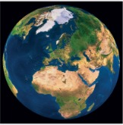
WATCH 1
Watch the video. Answer the questions at the end.
Guarda il video. Rispondi alle domande alla fine.
Our planet
👂 WATCH · ⏱ 4 MIN
▶ Look after our planet – kids (search)
What can we do to look after our planet? 🌍
Teacher: preview every link before class (ads, content). The lesson works without it. · Controllare i link prima della lezione.
📘 Pupil's Book p.12 · 🎬 video (Look after our planet)
Notes:
EX 1 (4 min). Play the book's video; learners answer the questions at the end (⚠ answers are in the video – check while you watch). The YouTube link is only a backup search. External resources are suggestions only: the teacher must preview and check all links, videos, adverts and content before using them with children. Always have the PowerPoint/classroom alternative ready.

Slide 4

LOOK 2
Good 👍 or bad 👎? Vote on 3-2-1!
Buono 👍 o cattivo 👎? Vota al 3-2-1!
Good for our planet?
🗳 VOTE · ⏱ 4 MIN
1 Photo 1
👍 ✓
2 Photo 2
👍 ✓
3 Photo 3
👎
4 Photo 4
👍 ✓
5 Photo 5
👎
6 Photo 6
👍 ✓
📘 Pupil's Book p.12
Notes:
EX 2 (4 min). TB: act out dropping litter and putting it in the bin: 'Which is good for our planet?' For each photo: THINK 3 s, everyone COMMITS with thumbs up/down on 3-2-1, then click to REVEAL. Learners tick in their books. KEY (TB): pictures 1, 2, 4, 6. Say: 'He's looking after our planet.' Stronger learners make a sentence about each photo.

Slide 5
FLASHCARDS
Look! Say the word before it appears!
Guarda! Di' la parola prima che appaia!
Planet words
🏃 TPR Make a big circle with your arms! 🌍
pianeta · la Terra
planet · Earth
📘 Pupil's Book pp.12–13
1 / 7
Notes:
NEW WORDS (5 min). PB p.12: air, Earth, planet, plant, need, oxygen, look after, keep healthy; p.13: glass, plastic, plastic bag, recycle, save water, tap, light, turn off. Picture first, learners guess, then click. TPR: Make a big circle with your arms! 🌍

Slide 6

FLASHCARDS
Look! Say the word before it appears!
Guarda! Di' la parola prima che appaia!
Planet words
🏃 TPR Breathe in deeply… and out! 🌬️
aria
air
📘 Pupil's Book pp.12–13
2 / 7
Notes:
NEW WORDS (5 min). PB p.12: air, Earth, planet, plant, need, oxygen, look after, keep healthy; p.13: glass, plastic, plastic bag, recycle, save water, tap, light, turn off. Picture first, learners guess, then click. TPR: Breathe in deeply… and out! 🌬️

Slide 7

FLASHCARDS
Look! Say the word before it appears!
Guarda! Di' la parola prima che appaia!
Planet words
🏃 TPR Grow like a plant! 🌱
pianta
plant
📘 Pupil's Book pp.12–13
3 / 7
Notes:
NEW WORDS (5 min). PB p.12: air, Earth, planet, plant, need, oxygen, look after, keep healthy; p.13: glass, plastic, plastic bag, recycle, save water, tap, light, turn off. Picture first, learners guess, then click. TPR: Grow like a plant! 🌱

Slide 8

FLASHCARDS
Look! Say the word before it appears!
Guarda! Di' la parola prima che appaia!
Planet words
🏃 TPR Turn off the tap! 🚰
rubinetto
tap
📘 Pupil's Book pp.12–13
4 / 7
Notes:
NEW WORDS (5 min). PB p.12: air, Earth, planet, plant, need, oxygen, look after, keep healthy; p.13: glass, plastic, plastic bag, recycle, save water, tap, light, turn off. Picture first, learners guess, then click. TPR: Turn off the tap! 🚰

Slide 9

FLASHCARDS
Look! Say the word before it appears!
Guarda! Di' la parola prima che appaia!
Planet words
🏃 TPR Turn off the light! Click! 💡
luce
light
📘 Pupil's Book pp.12–13
5 / 7
Notes:
NEW WORDS (5 min). PB p.12: air, Earth, planet, plant, need, oxygen, look after, keep healthy; p.13: glass, plastic, plastic bag, recycle, save water, tap, light, turn off. Picture first, learners guess, then click. TPR: Turn off the light! Click! 💡

Slide 10
FLASHCARDS
Look! Say the word before it appears!
Guarda! Di' la parola prima che appaia!
Planet words
🏃 TPR Throw the bottle in the bin! ♻️
riciclare
recycle
📘 Pupil's Book pp.12–13
6 / 7
Notes:
NEW WORDS (5 min). PB p.12: air, Earth, planet, plant, need, oxygen, look after, keep healthy; p.13: glass, plastic, plastic bag, recycle, save water, tap, light, turn off. Picture first, learners guess, then click. TPR: Throw the bottle in the bin! ♻️

Slide 11

FLASHCARDS
Look! Say the word before it appears!
Guarda! Di' la parola prima che appaia!
Planet words
🏃 TPR Say NO with your finger! ☝️
sacchetto di plastica
plastic bag
📘 Pupil's Book pp.12–13
7 / 7
Notes:
NEW WORDS (5 min). PB p.12: air, Earth, planet, plant, need, oxygen, look after, keep healthy; p.13: glass, plastic, plastic bag, recycle, save water, tap, light, turn off. Picture first, learners guess, then click. TPR: Say NO with your finger! ☝️

Slide 12
SAY IT!
Sit down. Stand up on the strong syllable!
Seduti. Alzati sulla sillaba forte!
Stand up on the BIG part!
🗣 WHOLE CLASS · ⏱ 2 MIN
1
👂 LISTEN
PLA-net ●•
OX-y-gen ●••
im-POR-tant •●•
re-CY-cle •●•
Teacher: PLA-net.
L'insegnante: PLA-net.
2
🏃 MOVE
Stand up on PLA! Sit on net!
Alzati su PLA! Siediti su net!
3
💬 SPEAK
Say it with me!
Dillo con me!
Notes:
PRONUNCIATION (2 min). Italians transfer Italian stress (pia-NE-ta → pla-NET, os-SI-ge-no → ox-Y-gen, rici-CLA-re → re-CY-cle). Learners sit; they jump UP on the stressed syllable and sit on the others. Then 'catch the teacher': say 'oxYgen', 'reCYcle' – learners shout STOP! Also AIR: one sound (/eə/), not 'a-ri-a'.

Slide 13
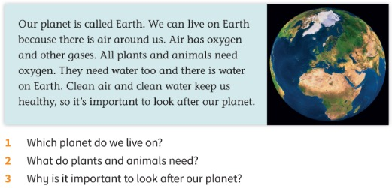
READ 3
Guess first! Then listen and read.
Prima indovina! Poi ascolta e leggi.
Our planet Earth
👂 READ · ⏱ 6 MIN
1 Which planet do we live on?
We live on Earth.
2 What do plants and animals need?
They need oxygen and water.
3 Why is it important to look after our planet?
Clean air and clean water keep us healthy.
📘 Pupil's Book p.12 · 🎧 1.18
⭐ We live on … · They need …
Notes:
EX 3 (6 min). PREDICT: read the 3 questions; pairs guess the answers BEFORE reading (Italian OK). Play 🎧 1.18; learners listen and read and check their guesses, then answer in pairs. REVEAL one per click. KEY (TB): 1 We live on Earth. 2 They need oxygen and water. 3 Because clean air and clean water keep us healthy. Keep healthy: do exercise (mime), eat good food, drink clean water, breathe clean air. Extension: What makes the air / water dirty?

Slide 14
GAME
TRUE? Jump right ➡ FALSE? Jump left ⬅
VERO? Salta a destra. FALSO? A sinistra.
True or false? Jump!
🏃 WHOLE CLASS · ⏱ 3 MIN
1 Our planet is called Venus.
FALSE ✗ (Earth!)
2 Plants and animals need oxygen.
TRUE ✓
3 There isn't any water on Earth.
FALSE ✗
4 Clean air keeps us healthy.
TRUE ✓
Notes:
GAME PLAN
SEE: A sentence about the text; the answer appears on click.
TEACHER: Tape/chalk line down the middle of the room. Read a sentence, count 3-2-1.
STUDENTS: Jump to the TRUE side (right) or FALSE side (left) on 'JUMP!'
GROUPING: Whole class standing.
SCORE / WIN: Wrong side = you're a 'judge' for the next round (you help the teacher spot mistakes) – nobody sits out.
TIME: 3 min.
LANGUAGE: Listening to the text sentences; learners correct the false ones ('It's called Earth!').
REVEAL: Click per sentence.
AIM: Check comprehension of the reading (TB ending game).

Slide 15
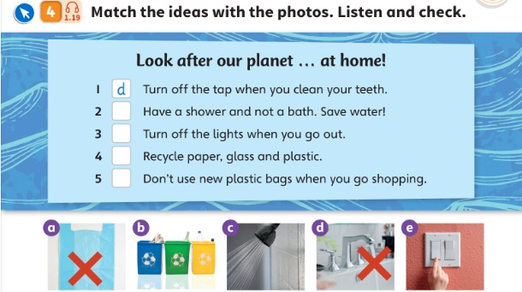
LISTEN 4
Match first! Then listen and check.
Prima abbina! Poi ascolta e controlla.
Match the ideas
👤 ALONE · ⏱ 5 MIN
1 Turn off the tap when you clean your teeth.
d (example)
2 Have a shower and not a bath. Save water!
c
3 Turn off the lights when you go out.
e
4 Recycle paper, glass and plastic.
b
5 Don't use new plastic bags.
a
📘 Pupil's Book p.13 · 🎧 1.19
Notes:
EX 4 (5 min). 'What can you see?' (a plastic bag, bins, a shower, a tap, a light switch). TB: don't pre-teach; learners use known words. ALONE: match (pencil). Then play 🎧 1.19 and check. REVEAL one per click. KEY (TB): 2 c · 3 e · 4 b · 5 a. Turn the classroom lights on/off; 'Turning off the taps saves water.'

Slide 16
WATCH OUT 🇮🇹
Robot mistakes! Fix them with your partner.
Errori del robot! Correggili con il compagno.
Open the light?
👥 PAIRS · ⏱ 2 MIN
🇮🇹 accendere / spegnere la luce → 🇬🇧 turn on / turn off the light
1 🤖 Open the light, please!
Turn on the light, please!
2 🤖 Close the tap!
Turn off the tap!
3 🤖 I close the TV at 9.
I turn off the TV at 9.
Notes:
ITALIAN TRAP (2 min). Many Italians say 'open/close the light' (from 'aprire/chiudere'). Robot voice: say the wrong sentence; pairs whisper the right one; click. Then TPR flash: you say 'Turn on the light!' – a learner actually does it; 'Turn off the light!' etc.

Slide 17
SPEAK 5
Easy → hard. What do YOU do? Tell your partner.
Facile → difficile. Cosa fai TU? Dillo al compagno.
Rank it!
👥 PAIRS · ⏱ 5 MIN
1
📖 READ
Look at the 4 ideas.
Guarda le 4 idee.
2
⚙️ DO
Order them: easy → hard.
Ordinale: facile → difficile.
3
💬 SPEAK
We recycle paper, glass and plastic. I have showers.
Tell your partner what you do.
Di' al compagno cosa fai.
📘 Pupil's Book p.13
⭐ I recycle … · I turn off …
🔥 What would an alien do?
Notes:
GAME PLAN
SEE: Four pictures (tap, light, recycling bins, plastic bags) + model sentences.
TEACHER: MODEL: 'For me, turning off the light is easy. I always turn off the light. Not using plastic bags is hard!'
STUDENTS: Pairs put the 4 ideas in order (easy → hard) and tell each other what they do (PB ex 5).
GROUPING: Pairs, then 3 pairs report.
SCORE / WIN: No points – personal answers. 🔥 'What would an alien do on Earth?' (funny ideas welcome).
TIME: 5 min.
LANGUAGE: I recycle … / I turn off … / I have showers. (TB: extension – a new idea not in Ex 4).
REVEAL: Pairs share; write new ideas on the board.
AIM: Personalised speaking with support.

Slide 18
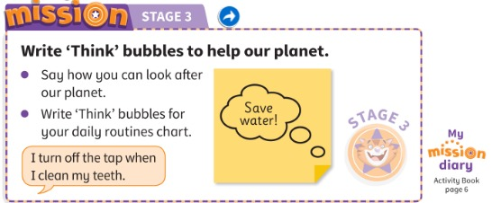
MISSION 3
Mission Stage 3: write 'Think' bubbles for our planet.
Missione fase 3: scrivi le nuvolette 'Think'.
'Think' bubbles
✍ ALONE · ⏱ 8 MIN
📘 Pupil's Book p.13 · Activity Book p.6 (My mission diary)
⭐ I … when I …
Notes:
MISSION STAGE 3 (8 min). Mime thinking: 'I'm thinking.' Draw your face + a Think bubble on the board: 'I want some tea.' Groups think of ideas to save resources in their routine (prompts on the board: have a shower, go to school, have lunch, go home, do my homework, go to bed). Learners write Think bubbles on sticky notes, cut them out and stick them on their routine chart. ⭐ Match halves (TB): I have a shower / to save water · I walk / to school · I recycle my plastic cup / when I have a drink of water · I don't use lots of paper / when I do my homework · I turn off the computer and TV / when I go to bed. AB p.6: smiley for My mission diary 3. Tick Stage 3; give a sticker.

Slide 19
WELL DONE!
Today I can… · Oggi so…
Show me with your thumbs! 👍 👌 👎
Bye bye! 👋
⭐ I can say what plants and animals need.
So dire di cosa hanno bisogno piante e animali.
🏠 HOMEWORK · COMPITI
• Homework sheet: Look after our planet
• Activity Book p.12 ex 1–2 · p.13 ex 3–4
⭐ I can say: turn off the light (not close!).
So dire turn off the light.
⭐ I can write a 'Think' bubble.
So scrivere una nuvoletta 'Think'.
➡ Next: The race – a poem!
Notes:
EXIT (3 min). EXIT TICKET: each learner tells you one thing they do for the planet ('I turn off the tap.'). Thumbs for each 'I can'. Give out the homework.

Slide 20
EXTRA
Listen. Do it – in slow motion!
Ascolta. Fallo – al rallentatore!
EXTRA: Planet heroes!
🏃 WHOLE CLASS · ⏱ 3 MIN
Turn off the tap!
Turn off the lights!
Recycle the bottles!
Plant a tree!
Breathe the clean air!
Hug the planet!
Notes:
GAME PLAN
SEE: 6 planet actions.
TEACHER: Say the action; then call 'Slow motion!' or 'Super fast!'
STUDENTS: Do the action at that speed.
GROUPING: Whole class.
SCORE / WIN: No points; finish with 'Hug the planet!' – everyone makes a big circle.
TIME: 3 min.
LANGUAGE: turn off, recycle, plant, breathe.
REVEAL: Click to show each action.
AIM: Fix the planet phrases with movement.

Slide 21






EXTRA
Run! Put it in the right bin!
Corri! Mettilo nel bidone giusto!
EXTRA: Recycling relay
👥👥 TEAMS · ⏱ 5 MIN
1
👀 LOOK
3 bins: PAPER · GLASS · PLASTIC
CARTA · VETRO · PLASTICA
2
👂 LISTEN
Teacher: a newspaper!
L'insegnante: un giornale!
3
🏃 MOVE
Run and touch the bin!
Corri e tocca il bidone!
Notes:
GAME PLAN
SEE: 6 objects (no labels).
TEACHER: Draw three bins on the board. Point to an object or say its name.
STUDENTS: First learner from each team runs, touches the right bin and says 'Recycle the newspaper in the paper bin!'
GROUPING: Two teams in lines.
SCORE / WIN: Right bin = 1 point, full sentence = +1.
TIME: 5 min.
LANGUAGE: recycle, paper, glass, plastic.
REVEAL: Newspaper/box → paper; jar/glass bottle → glass; plastic bottle/cup → plastic.
AIM: Recycle the p.13 language.

