Slide 1

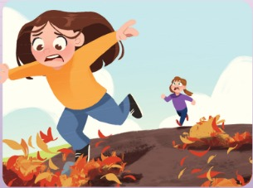


UNIT 1 · LESSON 5
Today: a poem about two sisters – and being a good friend 🏃‍♀️🤝
Oggi: una poesia su due sorelle – e su come essere un buon amico
The race
1
📖 READ
Read and listen to the poem.
Leggi e ascolta la poesia.
Are you OK, Beth?
Stai bene, Beth?
2
⚙️ DO
Act out the poem.
Recita la poesia.
3
💬 SPEAK
How can we help people?
Come possiamo aiutare gli altri?
📘 Pupil's Book pp.14–15 · 🎧 1.20
Notes:
COVER (1 min). 'We're going to read a poem about two sisters. There's an animal in the poem too. What animal? Guess!' Learners write their guess on scrap paper – check later.

Slide 2

REMEMBER?
Write 5 planet words in 20 seconds. GO!
Scrivi 5 parole del pianeta in 20 secondi. VIA!
Beat the clock!
👥👥 TEAMS · ⏱ 3 MIN
1
👂 LISTEN
Teacher: Planet words – GO!
L'insegnante: parole del pianeta – VIA!
2
✏️ WRITE
Write fast with your team!
Scrivete veloce in squadra!
3
💬 SPEAK
Read them out: 1 point each!
Leggetele: 1 punto ciascuna!
⭐ air · tap · …
Notes:
GAME PLAN
SEE: Only a timer (no words!).
TEACHER: Teams of 4, one pen per team. 'Lesson 4 words! 20 seconds – GO!' Count down aloud. Round 2: 'Daily routine words!' Round 3: 'Countryside words!'
STUDENTS: Write as many words as they can remember.
GROUPING: Teams of 4 (pass the pen – everybody writes one word).
SCORE / WIN: 1 point per correct word; +1 if nobody else has it. ⭐ weaker teams may draw a picture + say the word.
TIME: 3 min (3 rounds).
LANGUAGE: Lesson 4 (planet, air, plant, tap, light, recycle, plastic bag), L3 routines, L1 countryside.
REVEAL: Teams read out their lists; write them on the board.
AIM: Spaced retrieval of the whole unit so far.

Slide 3

FLASHCARDS
Look! Say the word before it appears!
Guarda! Di' la parola prima che appaia!
Poem words
🏃 TPR Ready, steady, GO! Run on the spot! 🏃
gara / corsa
race
📘 Pupil's Book pp.14–15
1 / 6
Notes:
NEW WORDS (4 min). TB presentation: 'People can run in a race. They want to be fast. The person who finishes at the front wins.' Mime/draw a race. PICTURE FIRST – learners guess. Quick personal questions: 'Do you like racing? Who wins in your family? Who is last?' TPR: Ready, steady, GO! Run on the spot! 🏃

Slide 4

FLASHCARDS
Look! Say the word before it appears!
Guarda! Di' la parola prima che appaia!
Poem words
🏃 TPR Arms up! I'm the winner! 🏆
vincere
win
📘 Pupil's Book pp.14–15
2 / 6
Notes:
NEW WORDS (4 min). TB presentation: 'People can run in a race. They want to be fast. The person who finishes at the front wins.' Mime/draw a race. PICTURE FIRST – learners guess. Quick personal questions: 'Do you like racing? Who wins in your family? Who is last?' TPR: Arms up! I'm the winner! 🏆

Slide 5

FLASHCARDS
Look! Say the word before it appears!
Guarda! Di' la parola prima che appaia!
Poem words
🏃 TPR Run very fast! 💨
veloce
fast
📘 Pupil's Book pp.14–15
3 / 6
Notes:
NEW WORDS (4 min). TB presentation: 'People can run in a race. They want to be fast. The person who finishes at the front wins.' Mime/draw a race. PICTURE FIRST – learners guess. Quick personal questions: 'Do you like racing? Who wins in your family? Who is last?' TPR: Run very fast! 💨

Slide 6

FLASHCARDS
Look! Say the word before it appears!
Guarda! Di' la parola prima che appaia!
Poem words
🏃 TPR Walk very slowly… I'm last! 🐌
ultimo
last
📘 Pupil's Book pp.14–15
4 / 6
Notes:
NEW WORDS (4 min). TB presentation: 'People can run in a race. They want to be fast. The person who finishes at the front wins.' Mime/draw a race. PICTURE FIRST – learners guess. Quick personal questions: 'Do you like racing? Who wins in your family? Who is last?' TPR: Walk very slowly… I'm last! 🐌

Slide 7
FLASHCARDS
Look! Say the word before it appears!
Guarda! Di' la parola prima che appaia!
Poem words
🏃 TPR Fall down slowly… Ouch! 🤕
cadere
fall
📘 Pupil's Book pp.14–15
5 / 6
Notes:
NEW WORDS (4 min). TB presentation: 'People can run in a race. They want to be fast. The person who finishes at the front wins.' Mime/draw a race. PICTURE FIRST – learners guess. Quick personal questions: 'Do you like racing? Who wins in your family? Who is last?' TPR: Fall down slowly… Ouch! 🤕

Slide 8

FLASHCARDS
Look! Say the word before it appears!
Guarda! Di' la parola prima che appaia!
Poem words
🏃 TPR Make a sad face. Boo-hoo! 😢
sentirsi triste
feel sad
📘 Pupil's Book pp.14–15
6 / 6
Notes:
NEW WORDS (4 min). TB presentation: 'People can run in a race. They want to be fast. The person who finishes at the front wins.' Mime/draw a race. PICTURE FIRST – learners guess. Quick personal questions: 'Do you like racing? Who wins in your family? Who is last?' TPR: Make a sad face. Boo-hoo! 😢

Slide 9
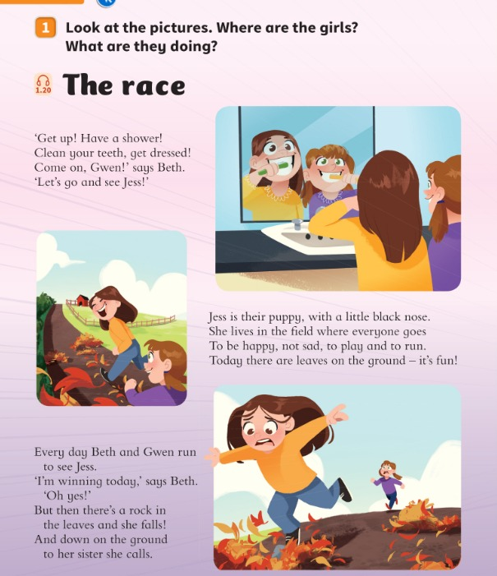
LOOK 1
Look at the pictures. Where are the girls? What are they doing?
Guarda. Dove sono le ragazze? Cosa fanno?
What happens?
👥 PAIRS · ⏱ 4 MIN
1 Picture 1: Where are they?
At home. They're cleaning their teeth.
2 Picture 2: Where are they now?
In the countryside, near some fields.
3 Picture 3: What's happening?
They're racing. One girl falls.
4 Guess! What does the other girl do?
She goes back and helps! (page 15)
📘 Pupil's Book pp.14–15
⭐ They're …ing.
Notes:
EX 1 (4 min). PREDICT: pairs talk about each picture with 'They're …ing' (present continuous from L2!). For question 4 every pair COMMITS to a guess: 'She wins the race' or 'She helps her sister'. Hands up for each. REVEAL later in the poem. KEY (TB, possible answers): They're at home. They're cleaning their teeth. They're in the countryside. They want to see a puppy. They're racing. One girl falls. The other girl wants to win but she goes back and helps. They go to see the puppy.

Slide 10
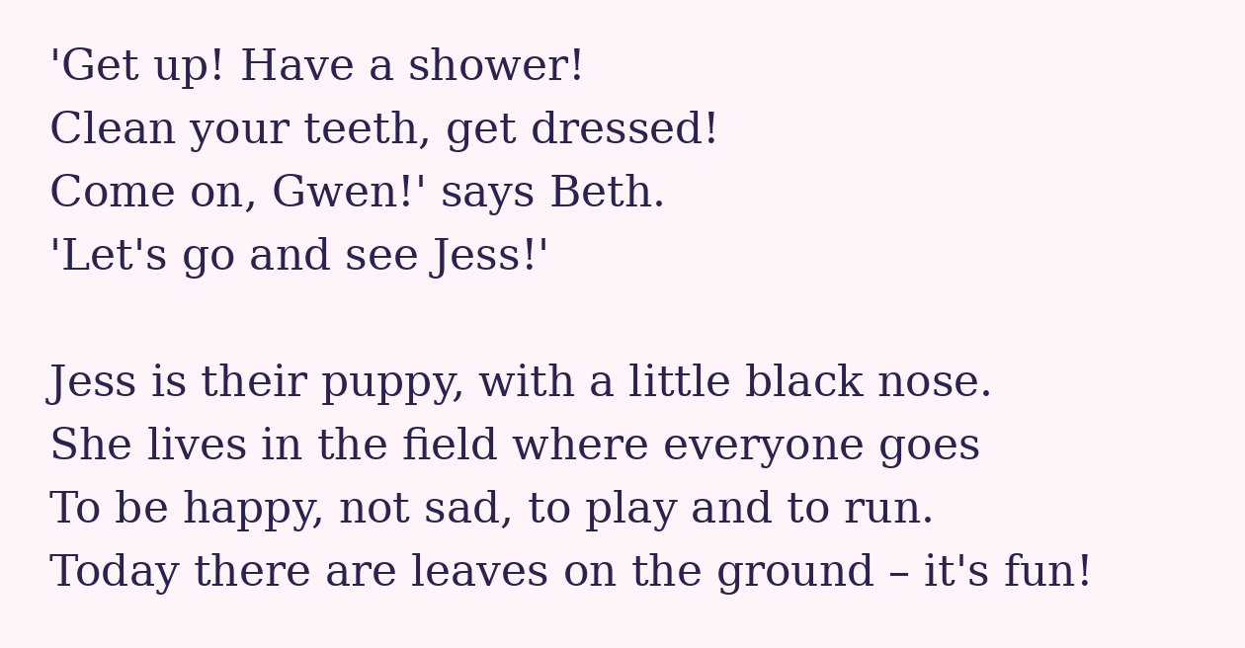
POEM
Listen and read. What's the dog's name?
Ascolta e leggi. Come si chiama il cane?
The race (1)
👂 LISTEN + READ · ⏱ 3 MIN
📘 Pupil's Book p.14 · 🎧 1.20
Notes:
THE RACE (8 min, 3 slides – poem text typed from PB pp.14–15 so it is big enough to read). Play 🎧 1.20; pause after verse 1: 'What are the girls' names?' (Beth and Gwen) 'What's the dog's name?' (Jess). Was your animal guess right? Verse 2: 'What colour is Jess's nose?' (Black) 'Where does she live?' (In a field) 'What's on the ground?' (Leaves) – learners answer, then show the PB picture (Pupil's Book p.14).

Slide 11
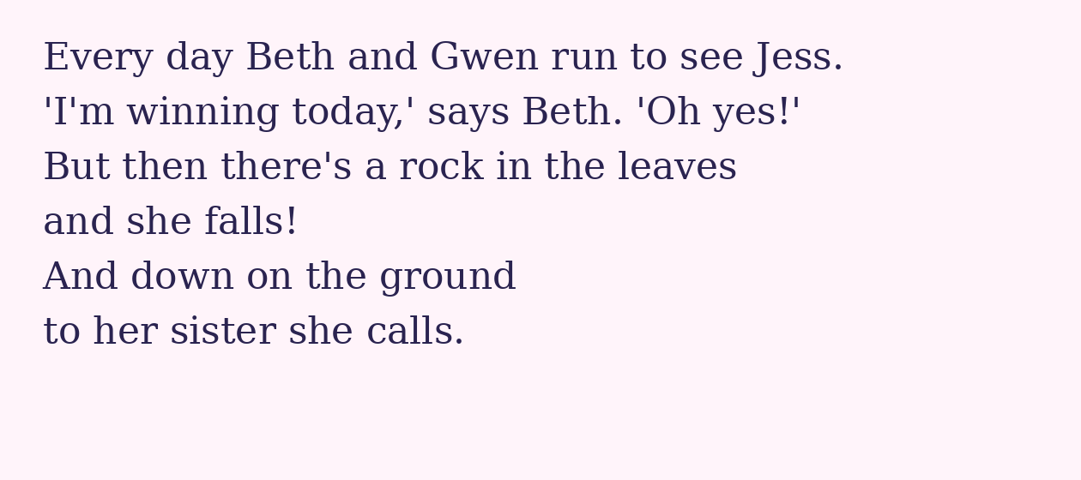
POEM
Listen and read. Who's winning the race?
Ascolta e leggi. Chi sta vincendo?
The race (2)
👂 LISTEN + READ · ⏱ 2 MIN
📘 Pupil's Book p.14 · 🎧 1.20
Notes:
Verse 3 (TB): 'Who's winning the race?' (Beth) 'Why does she fall?' (Because there's a rock in the leaves). Mime falling!

Slide 12
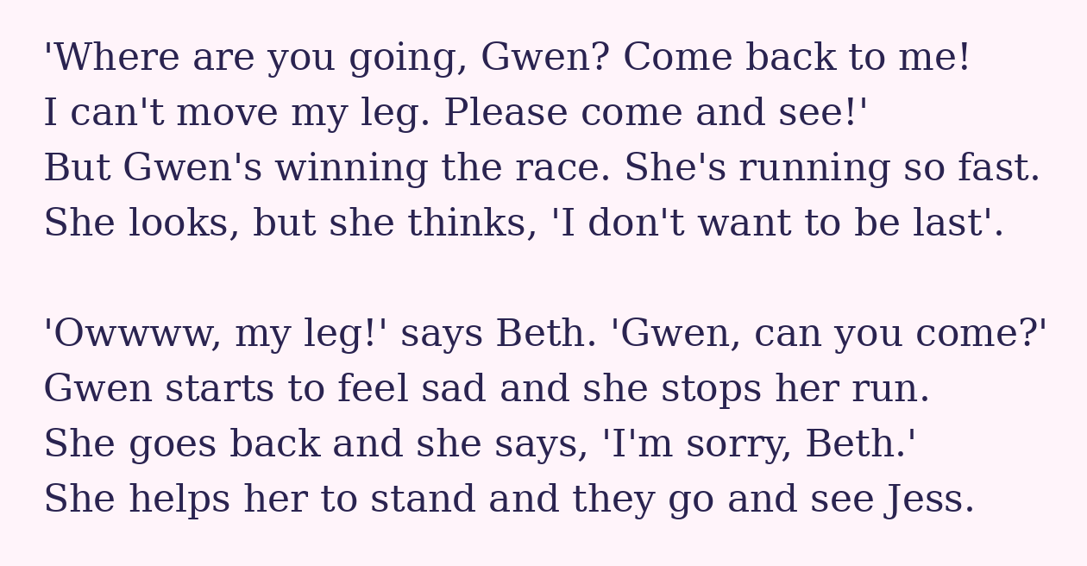
POEM
Listen and read. Was your guess right?
Ascolta e leggi. Avevi indovinato?
The race (3)
👂 LISTEN + READ · ⏱ 3 MIN
📘 Pupil's Book p.15 · 🎧 1.20
Notes:
Verses 4–5 (TB): 'What's the problem with Beth's leg?' (She can't move it) 'What does Gwen think?' ('I don't want to be last!') 'How does Gwen feel?' (Sad) 'What does she do?' (She goes back and helps her sister – then they go and see the puppy.) Check the prediction from the 'What happens?' slide – who was right? Extension: play the whole poem again without pauses.

Slide 13
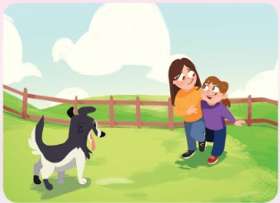
QUIZ
Whisper to your partner. Then hands up!
Bisbiglia al compagno. Poi alza la mano!
The race – quiz
👥👥 TEAMS · ⏱ 3 MIN
1 What's the dog's name?
Jess.
2 Who's winning the race?
Beth.
3 Why does Beth fall?
There's a rock in the leaves.
4 How does Gwen feel?
Sad.
5 What does Gwen do?
She helps her sister.
📘 Pupil's Book pp.14–15 · 🎧 1.20
Notes:
GAME PLAN
SEE: 5 questions; answers appear one per click.
TEACHER: Read a question; 5 seconds whisper time; 'Hands up!'
STUDENTS: Pairs whisper; a team member answers.
GROUPING: Two teams.
SCORE / WIN: Correct answer = 1 point; full sentence = 2 points (She's sad.).
TIME: 3 min.
LANGUAGE: Questions from the TB about the poem.
REVEAL: Click per question.
AIM: Check understanding of the poem.

Slide 14
SAY IT!
Find the rhyming pairs in the poem!
Trova le coppie di parole in rima!
Rhyme time!
👥 PAIRS · ⏱ 3 MIN
1
👂 LISTEN
nose · run · fast · see · Jess
last · goes · yes · fun · me
nose … ?
nose … ?
2
💬 SPEAK
goes! Same sound at the end!
goes! Stesso suono finale!
3
⚙️ DO
Clap on the rhyme!
Batti le mani sulla rima!
Notes:
PRONUNCIATION (3 min). PROMPT: pairs match the words in line 1 with their rhyme in line 2 (THINK 30 s). REVEAL by saying them: nose–goes, run–fun, fast–last, see–me, Jess–yes (the 2nd line is shuffled so the answer isn't visible). Italian tip: final consonants! Say the end clearly – 'fast' not 'fas', 'last' not 'lasta'. Then read the poem together and CLAP on every rhyming word. Catch the teacher: say 'lasta', 'nosa' – learners shout STOP!

Slide 15
WATCH OUT 🇮🇹
The robot forgets something. What?
Il robot dimentica qualcosa. Cosa?
She falls!
👥 PAIRS · ⏱ 2 MIN
Beth falls. Gwen helps her. She goes back.
1 🤖 Beth fall on the ground.
Beth falls on the ground.
2 🤖 Gwen help her sister.
Gwen helps her sister.
3 🤖 Jess live in a field.
Jess lives in a field.
Notes:
ITALIAN TRAP (2 min). Italian verbs change for 'lui/lei' but learners forget the English -s ('she fall'). Robot voice reads the wrong sentence; pairs find the missing -s; click. Make it physical: hiss like a snake 'ssss' on every he/she -s.

Slide 16
DO 2
Work in pairs. Act it out. Then swap!
In coppia. Recitate. Poi scambiatevi!
Act out the poem!
👥 PAIRS · ⏱ 7 MIN
1
📖 READ
Beth: Let's go and see Jess! · I'm winning!
Beth: Owwww, my leg! Gwen, can you come?
Gwen: I don't want to be last! … I'm sorry, Beth.
Gwen: Are you OK, Beth? Can you stand up?
Read the lines.
Leggi le battute.
2
🏃 MOVE
Act it out: run, fall, help!
Recita: corri, cadi, aiuta!
3
💬 SPEAK
Say the lines with feeling!
Di' le battute con emozione!
📘 Pupil's Book p.15
⭐ Are you OK? Can you stand up?
🔥 Add a new ending!
Notes:
GAME PLAN
SEE: The key lines from the poem + PB speech bubbles.
TEACHER: MODEL with a confident learner first (you are Gwen). Give 3 minutes practice, then 2–3 pairs perform.
STUDENTS: Act the story using the lines; swap roles.
GROUPING: Pairs.
SCORE / WIN: The class gives each performance 1–3 ⭐ for expression (feeling!), not accuracy.
TIME: 7 min.
LANGUAGE: Poem lines + Are you OK? Can you stand up? I'm sorry.
REVEAL: —
AIM: PB ex 2. 🔥 Extension (TB): continue the story – 'Let me help you, Beth.' / 'Thanks, Gwen.'

Slide 17
THINK 3
When do you help people like Gwen? Hands up!
Quando aiuti gli altri come Gwen? Alza la mano!
Be supportive!
👥👥 GROUPS OF 3 · ⏱ 6 MIN
1 I help carry books or bags.
🙋
2 I help someone who falls in the playground.
🙋
3 I talk to someone who is sad or scared.
🙋
4 Who is supportive to YOU?
My mum, my grandpa…
📘 Pupil's Book p.15
⭐ I help my … when …
Notes:
EX 3 + SOCIAL AND EMOTIONAL SKILL (6 min). Complete orally (TB): Gwen and Beth have a … (race) every day. Beth … (falls). Gwen feels … (bad). Gwen goes to … (help) Beth. 'She is being supportive.' Read the ways – learners put up their hands for the ones they do. Groups of 3: each learner tells the group how they support people (⭐ starter on the slide). Optional: thank-you card for someone supportive.

Slide 18
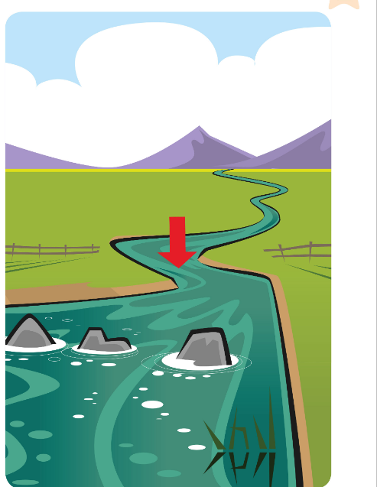


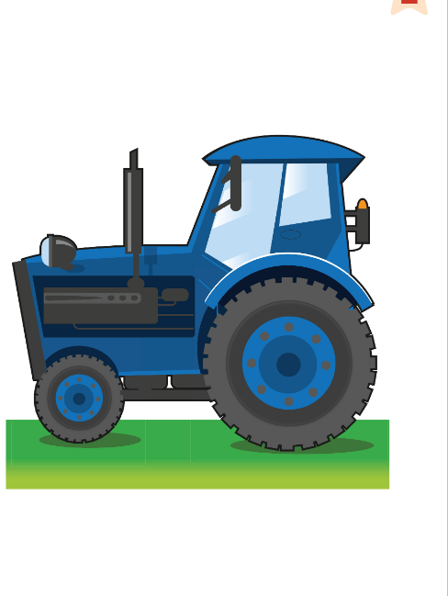



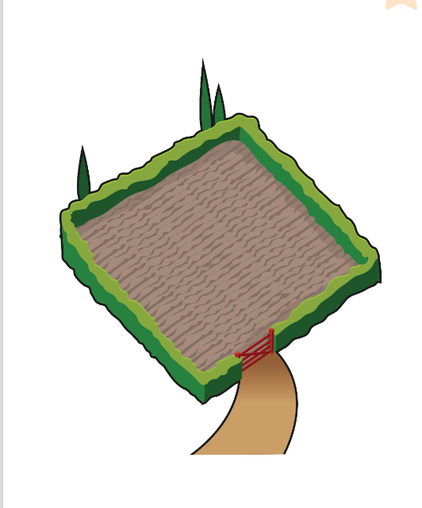
GAME
Answer and step on the card. Don't fall in!
Rispondi e sali sulla carta. Non cadere!
Cross the river!
👥👥 TEAMS · ⏱ 6 MIN
1
👀 LOOK
Cards on the floor = stones.
Carte sul pavimento = sassi.
2
💬 SPEAK
Answer the question.
Rispondi alla domanda.
3
🏃 MOVE
Correct? Step on the card!
Giusto? Fai un passo!
Notes:
GAME PLAN
SEE: Countryside + routine pictures (= the stepping stones).
TEACHER: Put the flashcards on the floor like a winding river (TB ending). Ask about each card as the learner reaches it: 'Is he having a shower?' 'Is it a mountain?' 'What colour is the tractor?'
STUDENTS: Answer correctly to step onto the card.
GROUPING: Two teams; one learner from each team crosses at a time.
SCORE / WIN: Wrong answer = 'Splash!' – back to the start, next player. A team scores 1 point for each learner who crosses.
TIME: 6 min.
LANGUAGE: Units words + present continuous questions/answers.
REVEAL: Teacher confirms each answer.
AIM: Recycling Lessons 1–3 language with movement.

Slide 19
WELL DONE!
Today I can… · Oggi so…
Show me with your thumbs! 👍 👌 👎
Bye bye! 👋
⭐ I can read and understand the poem 'The race'.
So leggere e capire la poesia.
🏠 HOMEWORK · COMPITI
• Homework sheet: The race
• Activity Book p.14 ex 1, 2 and 3
⭐ I can act out the poem with a friend.
So recitare la poesia con un amico.
⭐ I can say how I help people.
So dire come aiuto gli altri.
➡ Next: Movers practice + Mission in action!
Notes:
EXIT (3 min). EXIT: each learner says one rhyming pair at the door (nose–goes…). Self-assessment (TB). AB p.15 ex 4 (🎧 4.11 Listen and draw lines) – in class.

Slide 20


EXTRA
Listen. Tell the story with your body!
Ascolta. Racconta la storia con il corpo!
EXTRA: Race moves!
🏃 WHOLE CLASS · ⏱ 3 MIN
Run fast on the spot!
Stop! Freeze!
Fall down slowly… Ouch!
Go back! Walk backwards!
Help your friend stand up!
Jump and cheer!
Notes:
GAME PLAN
SEE: 6 actions from the poem.
TEACHER: Tell the poem as a story: 'Beth and Gwen run… fast!… Beth falls!…' – learners act it. Then mix the order.
STUDENTS: Move with the story.
GROUPING: Whole class.
SCORE / WIN: No points.
TIME: 3 min.
LANGUAGE: run, stop, fall, go back, help, win.
REVEAL: Click to show actions.
AIM: Fix poem verbs physically.

Slide 21
EXTRA
Who says it? Run to the right corner!
Chi lo dice? Corri nell'angolo giusto!
EXTRA: Beth or Gwen?
🏃 WHOLE CLASS · ⏱ 4 MIN
1 'Let's go and see Jess!'
Beth
2 'I'm winning today!'
Beth
3 'I don't want to be last.'
Gwen
4 'Come back to me!'
Beth
5 'I'm sorry, Beth.'
Gwen
Notes:
GAME PLAN
SEE: A line from the poem.
TEACHER: Name two corners: BETH corner / GWEN corner. Read a line.
STUDENTS: Run to the right corner on '3-2-1-GO!'
GROUPING: Whole class.
SCORE / WIN: Wrong corner = say the line in that character's voice (no one is out).
TIME: 4 min.
LANGUAGE: Poem lines (listening).
REVEAL: Click to reveal each answer.
AIM: Re-read the poem with movement (TB warm-up p.15).

