Slide 1

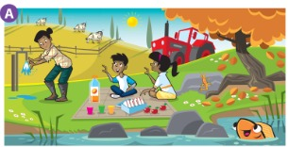
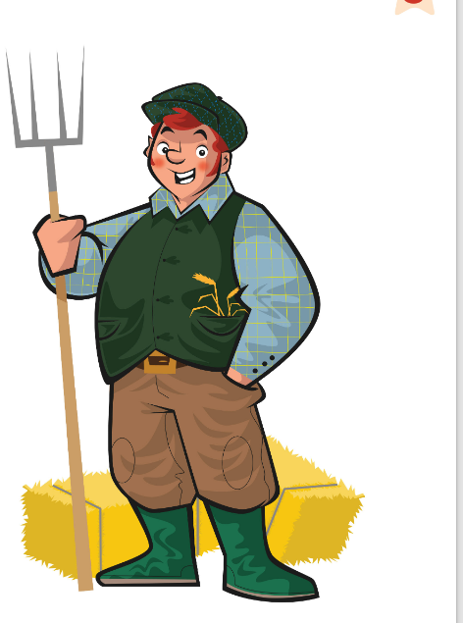

UNIT 1 · LESSON 6
Today: Movers Speaking practice + show your routine chart! 🗣️⭐
Oggi: pratica Speaking Movers + presenta la tua tabella!
Mission in action!
1
💬 SPEAK
Practise for the Movers exam.
Esercitati per l'esame Movers.
Show us your chart!
Mostraci la tua tabella!
2
👀 LOOK
Find the differences!
Trova le differenze!
3
⚙️ DO
Show your routine chart.
Presenta la tua tabella.
📘 Pupil's Book pp.16–17 · Activity Book pp.16–17
Notes:
COVER (1 min). Last lesson of Unit 1: exam practice (A1 Movers Speaking Part 1) and Mission presentations. Charts on the desks!

Slide 2

REMEMBER?
Say a word – then it's the other team's turn! Don't stop!
Di' una parola – tocca all'altra squadra! Non fermarti!
Vocabulary tennis!
👥👥 2 TEAMS · ⏱ 4 MIN
1
👂 LISTEN
Teacher: COUNTRYSIDE!
L'insegnante: CAMPAGNA!
2
💬 SPEAK
Team A: river! Team B: lake! …
Squadra A: river! B: lake! …
3
🎲 PLAY
Round 1: countryside 🌲
Round 2: my morning ⏰
Round 3: the poem / the planet 🌍
5 seconds – no word? Point lost!
5 secondi – niente parola? Punto perso!
⭐ Look at the board!
Notes:
GAME PLAN
SEE: A tennis ball and the three categories.
TEACHER: Two teams face each other. Call the category and 'serve' (point to Team A).
STUDENTS: Teams take turns to say a word from the category, like hitting a tennis ball. One learner per turn (go along the line so everyone plays).
GROUPING: Two teams.
SCORE / WIN: A team that repeats a word or takes more than 5 seconds loses the point. First to 5 points wins the round.
TIME: 4 min (3 rounds).
LANGUAGE: Unit 1 vocabulary: countryside, routines, planet words, poem words (race, fast, last, win).
REVEAL: Teacher keeps score on the board. ⭐ Weaker learners may 'pass' once to a teammate.
AIM: Spaced retrieval of the whole unit.

Slide 3

FLASHCARDS
Look! Say the word before it appears!
Guarda! Di' la parola prima che appaia!
New words
🏃 TPR Drive your tractor and feed the animals! 🚜
contadino / agricoltore
farmer
📘 Pupil's Book p.16
1 / 3
Notes:
NEW WORDS (3 min) from the TB: farmer, have a picnic, sandwich(es). Picture first – 'Who's this?' Remember: HAVE a picnic (not 'make/do' – like have breakfast in Lesson 3). TPR: Drive your tractor and feed the animals! 🚜

Slide 4
FLASHCARDS
Look! Say the word before it appears!
Guarda! Di' la parola prima che appaia!
New words
🏃 TPR Sit on the grass and eat! Yum! 🧺
fare un picnic
have a picnic
📘 Pupil's Book p.16
2 / 3
Notes:
NEW WORDS (3 min) from the TB: farmer, have a picnic, sandwich(es). Picture first – 'Who's this?' Remember: HAVE a picnic (not 'make/do' – like have breakfast in Lesson 3). TPR: Sit on the grass and eat! Yum! 🧺

Slide 5

FLASHCARDS
Look! Say the word before it appears!
Guarda! Di' la parola prima che appaia!
New words
🏃 TPR Make a sandwich – bread, cheese, bread! 🥪
panino · panini
sandwich(es)
📘 Pupil's Book p.16
3 / 3
Notes:
NEW WORDS (3 min) from the TB: farmer, have a picnic, sandwich(es). Picture first – 'Who's this?' Remember: HAVE a picnic (not 'make/do' – like have breakfast in Lesson 3). TPR: Make a sandwich – bread, cheese, bread! 🥪

Slide 6
SPEAK 1
Practise with a friend. Speak clearly!
Esercitati con un compagno. Parla chiaramente!
Meet the examiner!
👥 PAIRS · ⏱ 5 MIN
1
👂 LISTEN
Examiner: Hello. What's your name? → My name's …
Examiner: How old are you? → I'm … (NOT I have!)
Examiner: Thank you. Goodbye! → Goodbye!
Examiner: What's your name?
Esaminatore: Come ti chiami?
2
💬 SPEAK
Answer clearly. Look at the examiner!
Rispondi chiaro. Guarda l'esaminatore!
3
⚙️ DO
Swap: you are the examiner!
Scambiatevi!
📘 Pupil's Book p.16
⭐ My name's … I'm …
🔥 Add: I live in …
Notes:
GAME PLAN
SEE: The examiner's questions + answer starters.
TEACHER: MODEL: say your name in a quiet, unclear voice: 'Is that good for an exam?' (No) Say it clearly, smile, eye contact: 'Is this good?' (Yes). Role play with a learner: walk them to the 'examiner's table', greet, ask the questions.
STUDENTS: Pairs: one is the examiner (serious voice!), one the candidate. Swap.
GROUPING: Pairs.
SCORE / WIN: Partner gives a ⭐ for: clear voice, eye contact, full answer.
TIME: 5 min.
LANGUAGE: What's your name? How old are you? (Recycle the Starter trap: I'm nine – BZZZ for 'I have nine years'.)
REVEAL: —
AIM: PB ex 1: exam format, confidence.

Slide 7
SPEAK 2
Look at picture A. Tell your partner 5 things!
Guarda l'immagine A. Di' 5 cose al compagno!
What can you see?
👥 PAIRS · ⏱ 5 MIN
1 Who's this? What's she doing?
A farmer. She's washing her hands.
2 What are the children doing?
They're having a picnic.
3 What food can you see?
Sandwiches, orange juice, apples.
4 What's on the rock?
A lizard. 🦎
5 How many cows are there?
Three. 🐄
📘 Pupil's Book p.16
⭐ I can see … · There's … · There are …
🔥 Say what they're doing!
Notes:
EX 2 (5 min). MODEL: say 2 sentences yourself ('I can see a farmer. She's washing her hands.'). SUPPORTED: pairs say 5 things using the ⭐ starters – count on fingers. Then ask the questions on the slide; pairs whisper, click to REVEAL. KEY (TB, possible answers): There's a farmer. She's washing her hands under a tap. She's got two children, a boy and a girl. They're having a picnic. There are sandwiches, orange juice and apples. There's an orange fish in the river. There's a lizard on a rock. There are three cows.

Slide 8
WATCH OUT 🇮🇹
C'è / ci sono. Which one? Think, then click!
C'è / ci sono. Quale? Pensa, poi clicca!
There's or there are?
👥 PAIRS · ⏱ 3 MIN
There's a duck. (1) There are four cows. (2, 3, 4…)
1 🤖 There is four cows.
There are four cows.
2 🤖 There are a lizard.
There's a lizard.
3 🤖 There aren't some leaves.
There aren't any leaves.
4 Say it: 'Dere are' ✗ – cow / cows
THere are – tongue out! cowZ 🐄🐄
Notes:
ITALIAN TRAP + PRONUNCIATION (3 min). Learners mix up there is / there are, and say 'dere' (no TH). Robot voice reads each wrong sentence; pairs whisper the correction; click. Pronunciation: put your tongue between your teeth for THere (show me your tongue!). The plural -s in cows, sandwiches, leaves sounds like a bee: zzz – Italians often drop it. Whisper → normal → monster voice: 'There are four COWZZZ!'

Slide 9
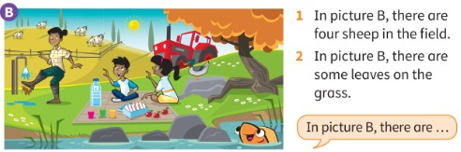
READ 3
Look at picture B. The sentences are wrong. Fix them!
Guarda l'immagine B. Le frasi sono sbagliate. Correggile!
Read and correct
👥 PAIRS · ⏱ 3 MIN
1 In picture B, there are four sheep in the field. ✗
There are four cows in the field.
2 In picture B, there are some leaves on the grass. ✗
There aren't any leaves on the grass.
📘 Pupil's Book p.16
Notes:
EX 3 (3 min). Pairs look carefully at picture B and correct the sentences (write them). REVEAL one per click. KEY (TB): 1 In picture B, there are four cows in the field. 2 In picture B, there are no leaves on the grass / there aren't (any) leaves on the grass. Note: in the real exam the pictures aren't labelled A and B.

Slide 10
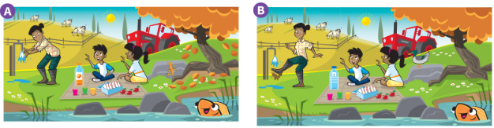
SPEAK 4
Compare A and B. Finish the sentences.
Confronta A e B. Completa le frasi.
Look and say
👥 PAIRS · ⏱ 3 MIN
1 Orange juice in picture A. Here, it's …
water 💧
2 In A, she's washing her hands. Here, she's washing …
her boots 👢
3 A lizard on the rock in A. In picture B, there's …
a duck 🦆
📘 Pupil's Book p.16
⭐ Here, there's …
Notes:
EX 4 (3 min). Do the first one together, then pairs finish the others (whisper), then click. Extra support: all three as a class. KEY (TB): 1 water 2 her boots 3 a duck. Monkey tip (PB): 'You can say Here, there's / there are … and There isn't / aren't.'

Slide 11
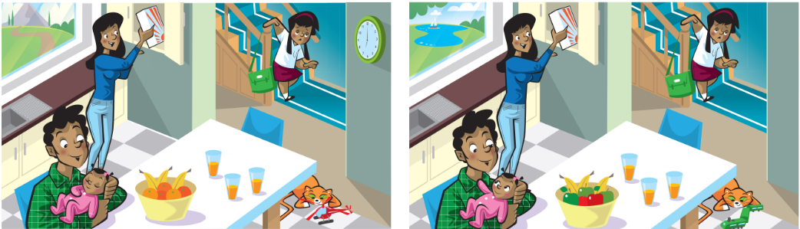
PLAY
Find 4 differences. Race your partner!
Trova 4 differenze. Sfida il compagno!
Spot the difference!
👥 PAIRS · ⏱ 5 MIN
📘 Activity Book p.16 · 🎧 4.12
⭐ In picture 1 … Here, there's …
Notes:
GAME PLAN
SEE: The two kitchen pictures side by side (AB p.16).
TEACHER: 'You have 60 seconds. Find 4 differences – don't say them, write the number!' Then play 🎧 4.12 (AB audio) to check.
STUDENTS: Pairs find differences; then they SAY them in exam style: 'In picture 1 there are mountains. Here, there's a lake.'
GROUPING: Pairs.
SCORE / WIN: 1 point for each difference said with a correct sentence.
TIME: 5 min.
LANGUAGE: There's / there are / Here, there's … / isn't / aren't.
REVEAL: ⚠ The TB gives no key for this page – check with 🎧 4.12. Differences we can see (⚠ check): the view out of the window (mountains → a lake/boat); the clock on the wall (picture 1 only); the fruit in the bowl (oranges → apples); the cat's toy (red → green).
AIM: Exam Part 1 practice (AB p.16 ex 1).

Slide 12
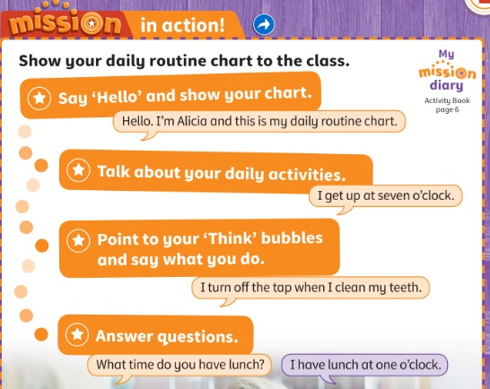
MISSION
Show your daily routine chart to the class.
Presenta alla classe la tua tabella della routine.
Mission in action!
🗣 PRESENT · ⏱ 15 MIN
📘 Pupil's Book p.17 · Activity Book p.6
⭐ Hello. I'm … This is my chart.
🔥 Answer 2 questions!
Notes:
MISSION IN ACTION (15 min). MODEL: present your own example chart, stage by stage: 1 'Hello. I'm … and this is my daily routine chart.' 2 'I get up at seven o'clock.' 3 Point to a Think bubble: 'I turn off the tap when I clean my teeth.' 4 Answer questions ('What time do you have lunch?' – 'I have lunch at one o'clock.'). SUPPORTED: pairs rehearse (3 min) with the starters on the slide; you ask prep questions ('Do you have a shower or a bath?'). INDEPENDENT: learners present to the class or in groups of 4 (faster); listeners must ask ONE question each. Spread over two lessons if needed. Charts go home – fold up each flap after doing the activity. Self-assessment (TB): Did you like our Mission? cheer / smile / shrug. Next Mission: 'Plan a fun activities timetable for two friends'.

Slide 13
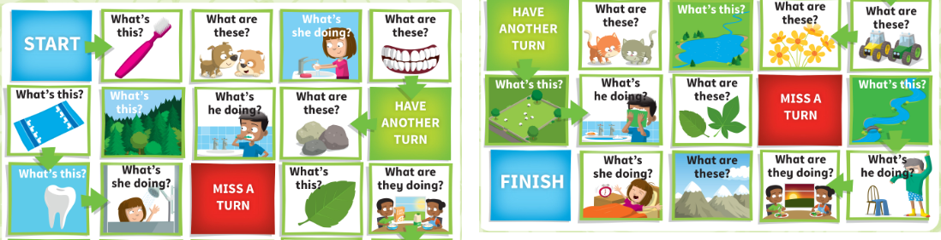
GAME
Roll the dice. Move. Answer the question!
Lancia il dado. Muovi. Rispondi!
Play the game!
👥👥 GROUPS OF 4 · ⏱ 8 MIN
📘 Activity Book p.17 · dice + counters
⭐ It's a … · They're … · She's …ing
Notes:
GAME PLAN
SEE: The AB p.17 board (START top-left → FINISH bottom-left of the 2nd half).
TEACHER: Groups of 4 with a die and counters. Model one turn: roll, move, read the square, answer.
STUDENTS: Answer the square's question: 'What's this? – It's a toothbrush.' 'What are these? – They're puppies.' 'What's she doing? – She's washing her hands.'
GROUPING: Groups of 4.
SCORE / WIN: Wrong answer = go back one square (the group decides, the teacher is the judge). HAVE ANOTHER TURN / MISS A TURN squares. First to FINISH wins. 🔥 Add a colour or a second sentence.
TIME: 8 min.
LANGUAGE: Unit 1 vocabulary + It's / They're / present continuous.
REVEAL: Groups check each other; teacher monitors.
AIM: Unit review (AB p.17).

Slide 14
WELL DONE!
Today I can… · Oggi so…
Show me with your thumbs! 👍 👌 👎
Bye bye! 👋
⭐ I can talk about two pictures and find differences.
So parlare di due immagini e trovare le differenze.
🏠 HOMEWORK · COMPITI
• Homework sheet: Unit 1 review
• Activity Book p.6: colour the sunflower leaves
⭐ I can show my daily routine chart.
So presentare la mia tabella.
⭐ I can say: There's a duck. There are four cows.
So usare there's / there are.
➡ Next: Unit 2! New Mission: a fun activities timetable 📅
Notes:
EXIT (3 min). EXIT CHALLENGE: show picture B for 10 seconds, hide it – 'Tell me one thing in picture B!' (There are four cows…). AB p.6 (TB): smiley for the final stage; read the sunflower 'can do' statements and colour each leaf green (very confident) or orange (need more practice); word stack: write 5 new unit words. Tick the completion stage on the Mission poster; give a sticker: 'You have finished your Mission! Well done!'

Slide 15


EXTRA
Ask Mr Wolf the time. DINNER TIME – run!
Chiedi l'ora al signor Lupo. ORA DI CENA – scappa!
What's the time, Mr Wolf?
🏃 WHOLE CLASS · ⏱ 6 MIN
1
💬 SPEAK
Class: What time is it, Mr Wolf?
Classe: Che ore sono, signor Lupo?
2
🏃 MOVE
Wolf: It's three o'clock! → 3 steps.
Lupo: Sono le tre! → 3 passi.
3
🎲 PLAY
Wolf: It's dinner time! → run back!
Lupo: Ora di cena! → scappa!
Notes:
GAME PLAN
SEE: Wolf + clock.
TEACHER: Clear a space or go to the playground. Stand at one end with your back to the class: 'I'm Mr Wolf. I want to eat you!' (TB p.17 extension).
STUDENTS: Ask 'What time is it, Mr Wolf?' and take that number of steps. Variation: 'It's eight o'clock – have breakfast!' – mime while stepping.
GROUPING: Whole class.
SCORE / WIN: On 'It's dinner time!' the wolf turns and chases; the learner caught becomes Mr Wolf.
TIME: 6 min.
LANGUAGE: What time is it? It's … o'clock + routines.
REVEAL: —
AIM: Recycle o'clock times with movement.

Slide 16

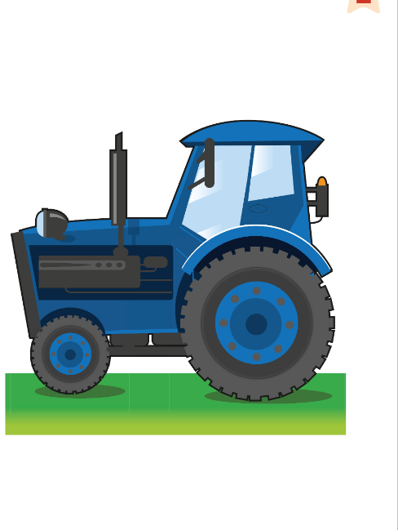
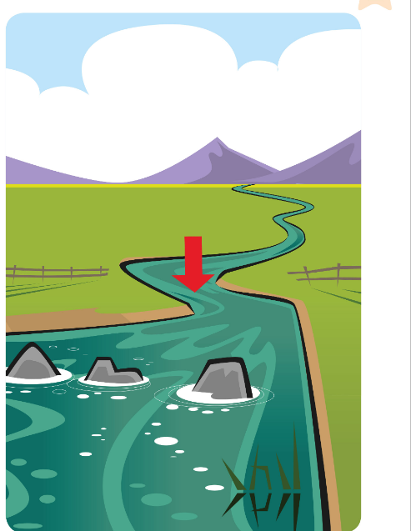




EXTRA
Choose a card. Describe it. Your group guesses!
Scegli una carta. Descrivila. Il gruppo indovina!
EXTRA: Describe it!
👥👥 GROUPS OF 4 · ⏱ 5 MIN
1
👀 LOOK
Choose a card – secret!
Scegli una carta – segreta!
2
grass
tractor
river
towel
💬 SPEAK
It's green. Cows eat it.
È verde. Le mucche la mangiano.
3
🎲 PLAY
Is it grass? – Yes!
È l'erba? – Sì!
toothbrush
mountain
farmer
have breakfast
⭐ It's … · It's in …
Notes:
GAME PLAN
SEE: 8 labelled unit pictures.
TEACHER: Model: 'It's big. It's grey and white. You can climb it.' (mountain).
STUDENTS: Each learner chooses and describes one card (TB p.16 ending); others guess.
GROUPING: Groups of 4.
SCORE / WIN: Guessed after 1 clue = 3 points, 2 clues = 2, 3 clues = 1 (for the describer AND the guesser).
TIME: 5 min.
LANGUAGE: It's … / It's in the … / You can … / He's …ing.
REVEAL: The describer shows the card.
AIM: Unit 1 vocabulary in descriptions.

