Slide 1

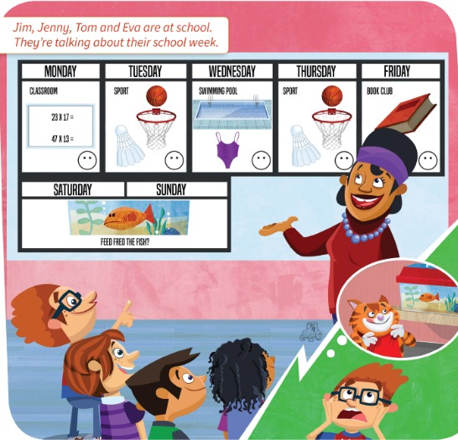
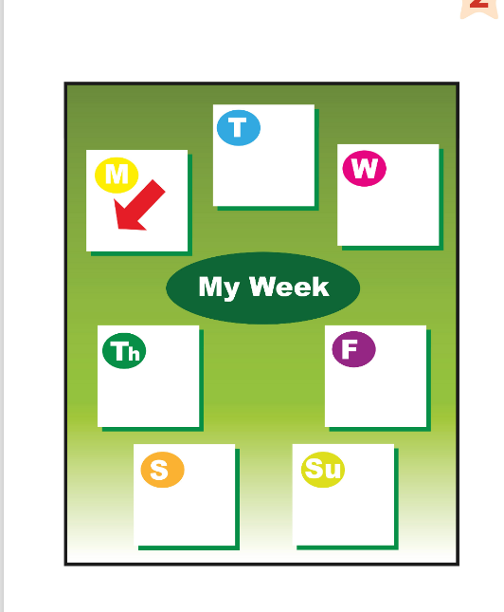
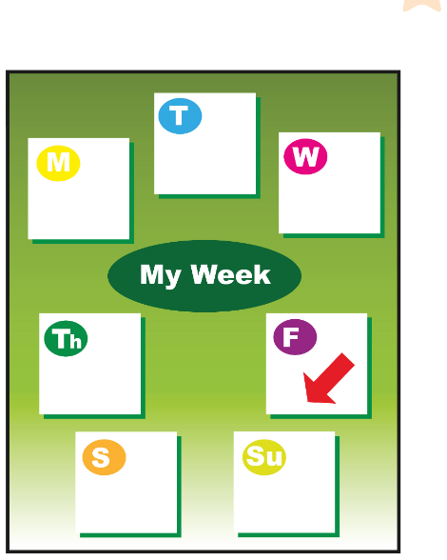
UNIT 2 · LESSON 1
Today: the days of the week 📅
Oggi: i giorni della settimana
My week
1
🎬 WATCH
Watch the video.
Guarda il video.
What's your favourite day?
Qual è il tuo giorno preferito?
2
💬 SPEAK
Say the days of the week.
Di' i giorni della settimana.
3
🏃 MOVE
Play and move!
Gioca e muoviti!
📘 Pupil's Book pp.18–19 · 🎬 video · 🎧 1.21–1.23
Notes:
COVER (2 min). TB warm-up: write 'My week' on the board. Learners have 30 seconds to think of four things they do in their free time every week (Italian is OK for now – you give the English). Write 3–4 ideas on the board. Ask: What's your favourite day? (accept Italian, then: 'Let's learn the days in English!').

Slide 2
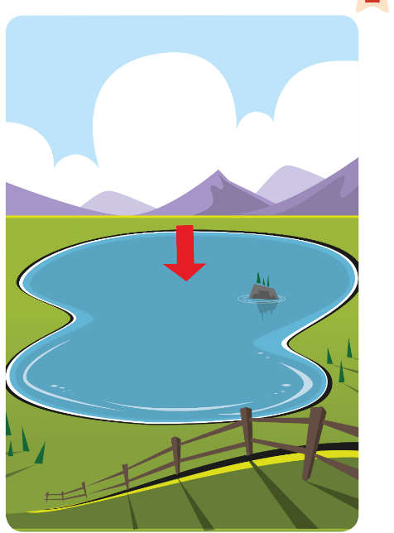
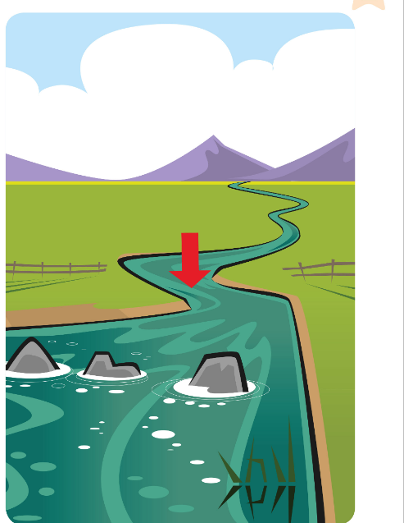
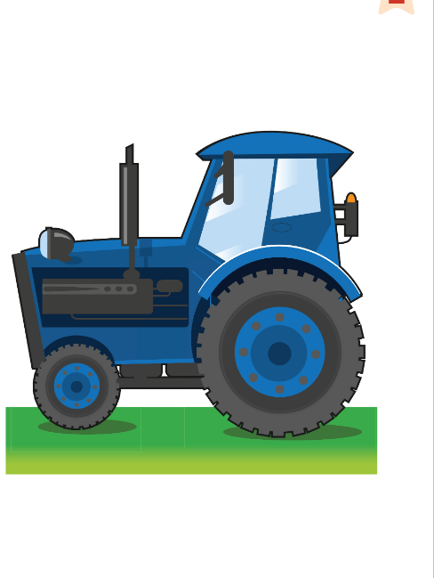
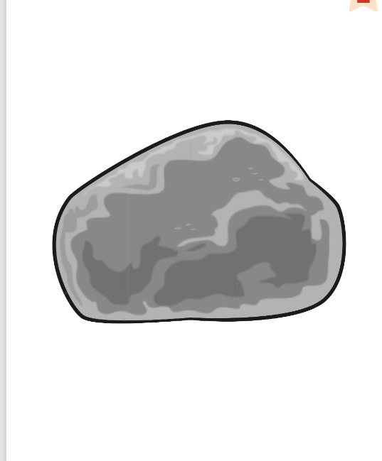
REMEMBER?
Which one is different? Why? Team answers!
Quale è diverso? Perché? Risponde la squadra!
Odd one out!
👥👥 TEAMS · ⏱ 3 MIN
1
👀 LOOK
Look at the 4 pictures.
Guarda le 4 immagini.
2
lake
river
tractor
rock
💬 SPEAK
Team: choose one + say why.
Squadra: scegline uno + di' perché.
3
🎲 PLAY
Good reason = 1 point!
Buona ragione = 1 punto!
📘 Retrieval · Unit 1 countryside words
⭐ The ___ is different.
🔥 Find TWO answers!
Notes:
RETRIEVAL OF UNIT 1 (3 min). GAME PLAN · SEE: 4 Unit 1 countryside cards with labels (lake, river, tractor, rock) · TEACHER: Say the 4 words with the class first (choral). Then: 'Which one is different? Why? Teams, 20 seconds – go!' Count down. · STUDENTS: Each team agrees on ONE odd one out and a reason; a team speaker says it · GROUPING: 2–3 teams · SCORE/WIN: Any logical answer with a reason = 1 point; a reason no other team said = 2 points · TIME: 3 min (round 2 orally: field, forest, mountain, leaves) · LANGUAGE: The tractor is different. It's a machine. / You can't swim in it. / The rock isn't water. · REVEAL: No single right answer – the teacher accepts/rejects each reason. Possible: tractor (not nature / you drive it), rock (not water), river/lake (water)

Slide 3


WATCH
Watch the video. What are they doing?
Guarda il video. Cosa fanno?
Free time!
👀 LOOK · 🗣 SPEAK
1 Photo 1: What are they doing?
Reading and listening to music 📱🎧
2 Photo 2: What's he doing?
Shopping (talking on the phone) 🛍️
3 Photo 3: What are they doing?
Watching television 📺
4 Box 4: What do YOU like doing?
Draw it! e.g. riding my bike 🚲
📘 Pupil's Book p.18 · 🎬 video · ex.1
Notes:
PB p.18 ex.1 (5 min). Say: In this unit we're talking about activities. Play the video. Then ask question 1: learners THINK, whisper to a partner, a volunteer answers, THEN click to reveal (TB: reading / listening to music / watching television / shopping). Box 4: learners draw an activity they like (book or paper). Monitor and give each learner the English name of their activity. Fast finishers: write 'I like … in my free time.'

Slide 4
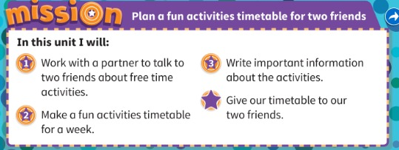
MISSION
Plan a fun activities timetable for two friends.
Prepara un programma di attività divertenti per due amici.
Our mission!
📘 Pupil's Book p.18 · Mission
Notes:
MISSION (2 min). Say: Our Mission is: Plan a fun activities timetable for two friends. A timetable has days – 'Look! On Tuesday I play tennis.' Show the 4 stages quickly (talk to two friends; make a timetable; write important information; give it to your friends). One quick Italian check: 'Cosa faremo alla fine dell'unità?'

Slide 5
FLASHCARDS
Look! Say the word before it appears!
Guarda! Di' la parola prima che appaia!
What's this?
🏃 TPR Monday: sleepy! Stretch and YAWN! 🥱
lunedì
Monday
📘 Pupil's Book p.19 · Days of the week
1 / 7
Notes:
DAYS FLASHCARDS (7 min). TB: 'There are seven days in a week.' Picture first – the red arrow and the letter show which day: learners GUESS (Italian is fine: 'lunedì!'). Click 1: English word. Click 2: Italian. Click 3: TPR action – everybody does it while saying the day. Say each word 3 ways: whisper → normal → MONSTER voice. Then put the paper cards on the board in order and ask: Which is the first day? The last? Which day comes BEFORE Wednesday? (Tuesday) AFTER Thursday? (Friday) – teach 'before' and 'after' with gestures (point left / right). TPR: Monday: sleepy! Stretch and YAWN! 🥱

Slide 6
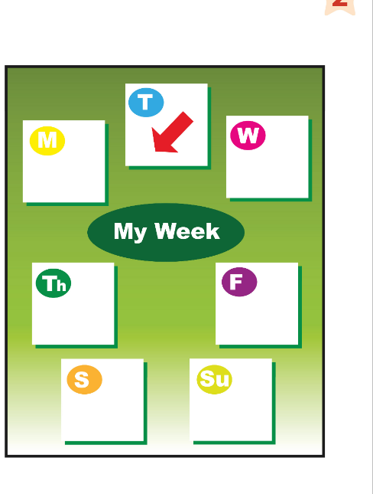
FLASHCARDS
Look! Say the word before it appears!
Guarda! Di' la parola prima che appaia!
What's this?
🏃 TPR Tuesday: TWO fingers up! ✌️ (Tues = two!)
martedì
Tuesday
📘 Pupil's Book p.19 · Days of the week
2 / 7
Notes:
DAYS FLASHCARDS (7 min). TB: 'There are seven days in a week.' Picture first – the red arrow and the letter show which day: learners GUESS (Italian is fine: 'lunedì!'). Click 1: English word. Click 2: Italian. Click 3: TPR action – everybody does it while saying the day. Say each word 3 ways: whisper → normal → MONSTER voice. Then put the paper cards on the board in order and ask: Which is the first day? The last? Which day comes BEFORE Wednesday? (Tuesday) AFTER Thursday? (Friday) – teach 'before' and 'after' with gestures (point left / right). TPR: Tuesday: TWO fingers up! ✌️ (Tues = two!)

Slide 7
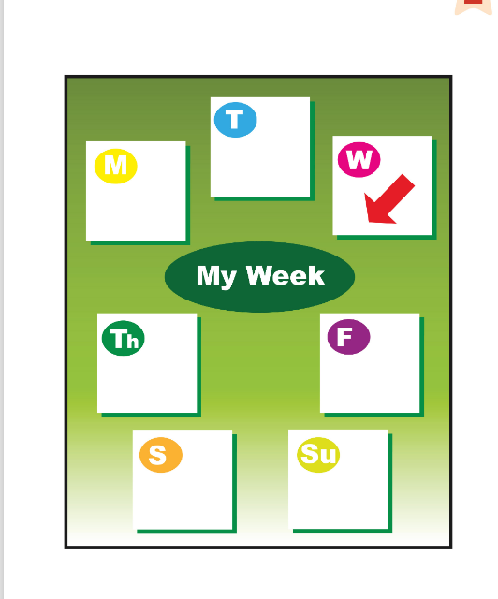
FLASHCARDS
Look! Say the word before it appears!
Guarda! Di' la parola prima che appaia!
What's this?
🏃 TPR Wednesday: Wet day! Swim! 🏊 (say WENZ-day)
mercoledì
Wednesday
📘 Pupil's Book p.19 · Days of the week
3 / 7
Notes:
DAYS FLASHCARDS (7 min). TB: 'There are seven days in a week.' Picture first – the red arrow and the letter show which day: learners GUESS (Italian is fine: 'lunedì!'). Click 1: English word. Click 2: Italian. Click 3: TPR action – everybody does it while saying the day. Say each word 3 ways: whisper → normal → MONSTER voice. Then put the paper cards on the board in order and ask: Which is the first day? The last? Which day comes BEFORE Wednesday? (Tuesday) AFTER Thursday? (Friday) – teach 'before' and 'after' with gestures (point left / right). TPR: Wednesday: Wet day! Swim! 🏊 (say WENZ-day)

Slide 8
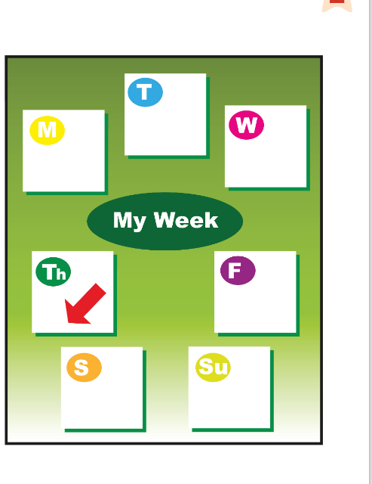
FLASHCARDS
Look! Say the word before it appears!
Guarda! Di' la parola prima che appaia!
What's this?
🏃 TPR Thursday: tongue out – th! THUMBS up! 👍
giovedì
Thursday
📘 Pupil's Book p.19 · Days of the week
4 / 7
Notes:
DAYS FLASHCARDS (7 min). TB: 'There are seven days in a week.' Picture first – the red arrow and the letter show which day: learners GUESS (Italian is fine: 'lunedì!'). Click 1: English word. Click 2: Italian. Click 3: TPR action – everybody does it while saying the day. Say each word 3 ways: whisper → normal → MONSTER voice. Then put the paper cards on the board in order and ask: Which is the first day? The last? Which day comes BEFORE Wednesday? (Tuesday) AFTER Thursday? (Friday) – teach 'before' and 'after' with gestures (point left / right). TPR: Thursday: tongue out – th! THUMBS up! 👍

Slide 9
FLASHCARDS
Look! Say the word before it appears!
Guarda! Di' la parola prima che appaia!
What's this?
🏃 TPR Friday: FRY an egg in a pan! 🍳
venerdì
Friday
📘 Pupil's Book p.19 · Days of the week
5 / 7
Notes:
DAYS FLASHCARDS (7 min). TB: 'There are seven days in a week.' Picture first – the red arrow and the letter show which day: learners GUESS (Italian is fine: 'lunedì!'). Click 1: English word. Click 2: Italian. Click 3: TPR action – everybody does it while saying the day. Say each word 3 ways: whisper → normal → MONSTER voice. Then put the paper cards on the board in order and ask: Which is the first day? The last? Which day comes BEFORE Wednesday? (Tuesday) AFTER Thursday? (Friday) – teach 'before' and 'after' with gestures (point left / right). TPR: Friday: FRY an egg in a pan! 🍳

Slide 10
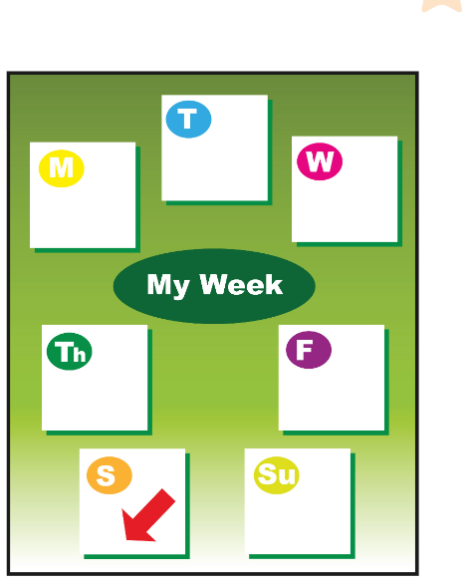
FLASHCARDS
Look! Say the word before it appears!
Guarda! Di' la parola prima che appaia!
What's this?
🏃 TPR Saturday: SIT down on the floor! 🪑
sabato
Saturday
📘 Pupil's Book p.19 · Days of the week
6 / 7
Notes:
DAYS FLASHCARDS (7 min). TB: 'There are seven days in a week.' Picture first – the red arrow and the letter show which day: learners GUESS (Italian is fine: 'lunedì!'). Click 1: English word. Click 2: Italian. Click 3: TPR action – everybody does it while saying the day. Say each word 3 ways: whisper → normal → MONSTER voice. Then put the paper cards on the board in order and ask: Which is the first day? The last? Which day comes BEFORE Wednesday? (Tuesday) AFTER Thursday? (Friday) – teach 'before' and 'after' with gestures (point left / right). TPR: Saturday: SIT down on the floor! 🪑

Slide 11
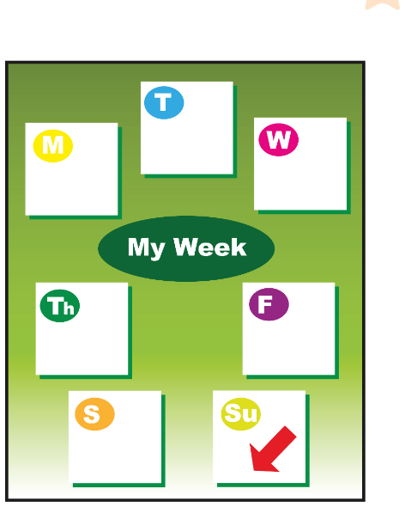
FLASHCARDS
Look! Say the word before it appears!
Guarda! Di' la parola prima che appaia!
What's this?
🏃 TPR Sunday: SUNglasses on! Relax! 😎
domenica
Sunday
📘 Pupil's Book p.19 · Days of the week
7 / 7
Notes:
DAYS FLASHCARDS (7 min). TB: 'There are seven days in a week.' Picture first – the red arrow and the letter show which day: learners GUESS (Italian is fine: 'lunedì!'). Click 1: English word. Click 2: Italian. Click 3: TPR action – everybody does it while saying the day. Say each word 3 ways: whisper → normal → MONSTER voice. Then put the paper cards on the board in order and ask: Which is the first day? The last? Which day comes BEFORE Wednesday? (Tuesday) AFTER Thursday? (Friday) – teach 'before' and 'after' with gestures (point left / right). TPR: Sunday: SUNglasses on! Relax! 😎

Slide 12
SOUNDS 👄
Listen. Is the teacher right or wrong? 👍 or 👎?
Ascolta. L'insegnante ha ragione o sbaglia? Pollice su o giù!
Catch the teacher!
👂 LISTEN · 👍👎
Wednesday = WENZ-day (no 'd'! 🤫)
Thursday = th – tongue out! 👅
MON-day · TUES-day · SAT-ur-day
1 Teacher: 'Wed-nes-day'
👎 WENZ-day
2 Teacher: 'Tursday'
👎 th – Thursday
3 Teacher: 'SAT-ur-day'
👍 right!
4 Teacher: 'mon-DAY'
👎 MON-day
📘 Pronunciation · days of the week
Notes:
PRONUNCIATION FOR ITALIAN LEARNERS (3 min). Model each day; learners repeat. Mouth tips: Wednesday has a silent 'd' and only 2 claps (WENZ-day); 'th' = tongue between the teeth (Italians often say 't'); stress is on the FIRST part: MON-day, TUES-day, FRI-day. Then 'Catch the teacher': say each practice item exactly as written (some deliberately wrong!). Learners commit with thumbs BEFORE you click. Click = the correct version; everybody says it right 3 times. Extra round: say days with Italian stress (fri-DAY) – learners catch you. Bonus: clap the syllables (Sat-ur-day = 3, Wednes-day = 2!).

Slide 13
GAME
👀 Look for 10 seconds. Remember ALL the pictures!
Guarda e ricorda tutte le immagini!
Look and remember!
monday
tuesday
wednesday
thursday
friday
saturday
sunday
📘 Days of the week flashcards
Notes:
WHAT'S MISSING? Step 1 – LOOK (10 s). Say the words together first (choral). Count down aloud. Then: "Close your eyes!" and go to the next slide.

Slide 14
GAME
Open your eyes! What's missing? Write it or whisper it to your partner.
Apri gli occhi! Cosa manca? Scrivilo o dillo al compagno.
What's missing?
?
monday
tuesday
wednesday
friday
saturday
sunday
Notes:
Step 2 – COMMIT. Students write the word on a mini-whiteboard / paper (or teams agree in 10 s). 'Show me!' Then go to the next slide. Points: 1 per team with the right word, +1 if spelt correctly.

Slide 15
ANSWER
It's Thursday!
È giovedì!
Were you right?
monday
tuesday
wednesday
thursday
friday
saturday
sunday
Notes:
Step 3 – REVEAL. The missing card comes back with a green frame. Everybody says the word 3 ways: whisper, normal, monster voice. (3 min in total) 1 point per team for the right day + 1 bonus for a perfect 'th'.

Slide 16
LISTEN
Listen and point. Draw a happy face on Jim's favourite school days.
Ascolta e indica. Disegna una faccina felice sui giorni preferiti di Jim.
Jim's school week
👂 LISTEN · 👤 ALONE
1 Who can you see?
Jim, Jenny, Tom, Eva and a teacher
2 Where are they?
In the classroom
3 What are they looking at?
A timetable
4 Jim's favourite school days?
Monday 🙂 and Friday 🙂
📘 Pupil's Book p.19 · 🎧 1.21
Notes:
PB p.19 ex.1 (6 min). Ask questions 1–3 BEFORE listening; learners answer, then click to confirm (TB). Who's in the small picture? (Cameron and a fish). Where's the small tractor? (learners find it – recycles Unit 1!). Read the caption. 'Where's Monday?' Learners point. Play 1.21: learners listen and point to the days. Explain 'favourite day = the day you like more than the other days'. PREDICT first: 'Which are Jim's favourite days? Guess!' (hands up for each day). Play again: learners draw happy faces. Then click Q4 to reveal: Monday and Friday (TB key). Point to the swimming pool: What do the children need on Wednesday? (a towel, a swimsuit).

Slide 17
CHANT
Listen and say the chant. Clap the rhythm!
Ascolta e di' il chant. Batti le mani a ritmo!
Say the chant!
🗣 WHOLE CLASS · ⏱ 4 MIN
1
👂 LISTEN
Monday, Tuesday! 👏👏
Monday, Tuesday! 👏👏
Wednesday, Thursday! 👏👏
Wednesday, Thursday! 👏👏
Friday! Friday! 🙌
Saturday, Sunday! 😎
Saturday, Sunday! 😎
Listen and point to the days.
Ascolta e indica i giorni.
2
🎵 SING
Whisper… normal… MONSTER!
Sussurra… normale… MOSTRO!
3
🏃 MOVE
Stand up on YOUR day!
Alzati quando senti il TUO giorno!
📘 Pupil's Book p.19 · 🎧 1.22 · 🎬 chant video
Notes:
PB p.19 ex.2 CHANT (4 min). GAME PLAN · SEE: the chant words · TEACHER: Play 1.22 (or the video). Then lead the chant 3 times: whisper → normal → monster voice. Then give each learner a day (count round the class Monday…Sunday). · STUDENTS: Point and chant; then stand up and sit down quickly when they hear THEIR day · GROUPING: whole class, then 2 groups as a round (TB) · SCORE/WIN: Last round: anyone who stands up on the wrong day sits out for one verse (no points – keep it light) · TIME: 4 min · LANGUAGE: the 7 days with correct stress (WENZ-day, th-) · REVEAL: n/a – the teacher models and corrects pronunciation immediately

Slide 18
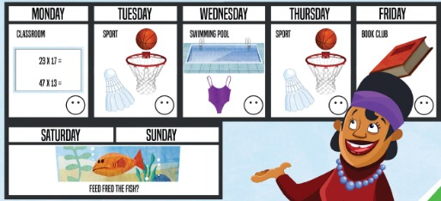
LISTEN
Listen and say the days.
Ascolta e di' i giorni.
When do they…?
👂 LISTEN · 🗣 SPEAK
1 They can play badminton or basketball.
Tuesday, Thursday
2 They write about the book of the week.
Friday
3 They don't go to school.
Saturday, Sunday
4 They need a swimsuit and a towel.
Wednesday
5 They're in the classroom.
Monday
6 They go for a swim.
Wednesday
📘 Pupil's Book p.19 · 🎧 1.23
Notes:
PB p.19 ex.3 (5 min). Focus on the timetable: 'When do they swim?' (Wednesday). Play 1.23 and PAUSE after each sentence: learners whisper the day to a partner (commit), a volunteer says it, then click to reveal. KEY (TB): 1 Tuesday, Thursday 2 Friday 3 Saturday, Sunday 4 Wednesday 5 Monday 6 Wednesday.

Slide 19
ITALIAN TRAP ⚠
Look! What's different from Italian?
Guarda! Cosa cambia rispetto all'italiano?
English is different!
👤 ALONE · ✍ WRITE
Monday – BIG letter! (italiano: lunedì)
On Monday I go swimming. (not 'in Monday')
il lunedì = on Mondays (every Monday)
1 i go swimming on wednesday.
I … Wednesday (2 big letters!)
2 ___ Friday we've got book club.
On
3 We play basketball in Tuesday.
✗ → on Tuesday
📘 Days of the week · on + day
Notes:
ITALIAN → ENGLISH TRAPS (3 min). NOTICE first: show the rule box and ask 'What's different from Italian?' (Italian: lunedì with a small letter, 'il lunedì'; English: capital letter + ON). Then practice: learners copy and correct each sentence on paper / mini-whiteboard (commit), 'Show me!', then click to reveal. Answers: 1 I go swimming on Wednesday. 2 On 3 We play basketball on Tuesday. Fast finishers: write your own sentence 'On … I …'.

Slide 20
GAME
Catch the ball. Answer quickly. Then ask a friend!
Prendi la palla. Rispondi velocemente. Poi chiedi a un amico!
Pass the ball!
🗣 WHOLE CLASS · ⏱ 5 MIN
1
👂 LISTEN
What day comes after Tuesday?
What day comes before Friday?
Which day is between Saturday and Monday?
What's your favourite day? Why?
Teacher asks and throws the ball.
L'insegnante chiede e lancia la palla.
2
💬 SPEAK
Catch, answer, ask a friend!
Prendi, rispondi, chiedi a un amico!
3
🎲 PLAY
5 seconds! Too slow? Sit down.
5 secondi! Troppo lento? Siediti.
📘 Days of the week · before / after
⭐ It's … · It comes after …
🔥 Say the days backwards!
Notes:
PASS THE BALL (5 min). GAME PLAN · SEE: 4 model questions (no answers on screen) · TEACHER: Ask a question and throw a soft ball. Model the first 2 rounds yourself so learners hear the pattern. · STUDENTS: Catch → answer within 5 seconds → ask a NEW question (using the slide) and throw to someone who hasn't had the ball · GROUPING: whole class in a circle or standing at desks · SCORE/WIN: Too slow / wrong = sit down for one round, then back in. Last 2 rounds = challenge: 'Say the days BACKWARDS!' (Sunday, Saturday…) in 10 seconds · TIME: 5 min · LANGUAGE: What day comes after/before…? It's … / My favourite day is … because … · REVEAL: Answers: Wednesday · Thursday · Sunday · open. The teacher confirms each answer; the class repeats the correct answer

Slide 21







GAME
Listen to the day and do the activity!
Ascolta il giorno e fai l'attività!
My busy week!
🏃 MOVE · ⏱ 4 MIN
Monday: maths! Count!
Tuesday: bounce and shoot!
Wednesday: swim!
Thursday: play badminton!
Friday: open a big book!
Saturday: feed Fred!
Sunday: sleep! Snore!
📘 Pupil's Book p.19 · timetable
Notes:
TPR 'MY BUSY WEEK' (4 min) – recycles the timetable from p.19. Click to show each action and practise. Then call days in random order, faster and faster. Variation 1: call TWO days ('Tuesday and Sunday!'). Variation 2 (retrieval): do the ACTION only – learners shout the day. Then a learner is the teacher (good pronunciation = a point for their team).

Slide 22
WELL DONE!
Today I can… · Oggi so…
Show me with your thumbs! 👍 👌 👎
Bye bye! 👋
⭐ I can say the 7 days of the week.
So dire i 7 giorni della settimana.
🏠 HOMEWORK · COMPITI
• Homework sheet
• Activity Book p.19: ex.1 and 2 (rhyme)
• Activity Book p.18: My unit goals
⭐ I can say Wednesday and Thursday well.
So pronunciare bene Wednesday e Thursday.
⭐ I can say what comes before and after.
So dire cosa viene prima e dopo.
➡ Next: The Friendly Farm story – How often?
Notes:
EXIT (3 min). Exit challenge: each learner whispers the 7 days to a partner in under 10 seconds (the partner checks Wednesday/Thursday!). Then thumbs up/middle/down for each 'I can'. Give out the homework sheet. AB p.18 'My unit goals': help learners complete the unit goals. TIMING CHECK (core ≈ 57 min): cover 2 · odd one out 3 · video 5 · mission 2 · flashcards 7 · sounds 3 · what's missing 3 · listen 6 · chant 4 · when 5 · trap 3 · pass the ball 5 · TPR 4 · exit 3 (+ transitions).

Slide 23
GAME
Get a day card. Stand in the right order. Quick!
Prendi un giorno. Mettetevi in ordine. Veloci!
EXTRA: Days line-up!
👥👥 TEAMS · ⏱ BEAT THE CLOCK
1
⚙️ DO
7 learners get a day card.
7 alunni prendono un giorno.
2
🏃 MOVE
Stand in the correct order!
Mettetevi nell'ordine giusto!
3
💬 SPEAK
Say your day: Monday… Tuesday…
Dite il vostro giorno in ordine.
📘 Days of the week flashcards
Notes:
EXTRA LINE-UP (5 min). GAME PLAN · SEE: 7 day cards, mixed up · TEACHER: Give the paper flashcards (mixed) to 7 learners; start the stopwatch: 'Go!' · STUDENTS: Run to the front and stand in order; then each says their day aloud in order (and BACKWARDS for a bonus) · GROUPING: two teams take turns (with fewer learners some hold 2 cards) · SCORE/WIN: Fastest correct line-up wins; +5 seconds for each mispronounced day · TIME: 5 min · LANGUAGE: the 7 days; 'Which day comes before Thursday?' → that learner steps forward · REVEAL: the class checks the order aloud together

