Slide 1

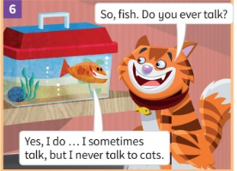
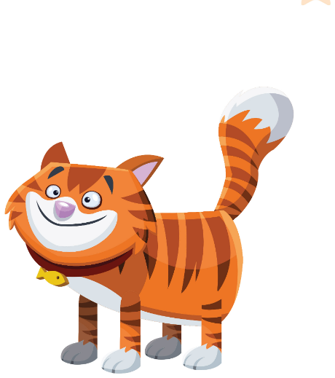
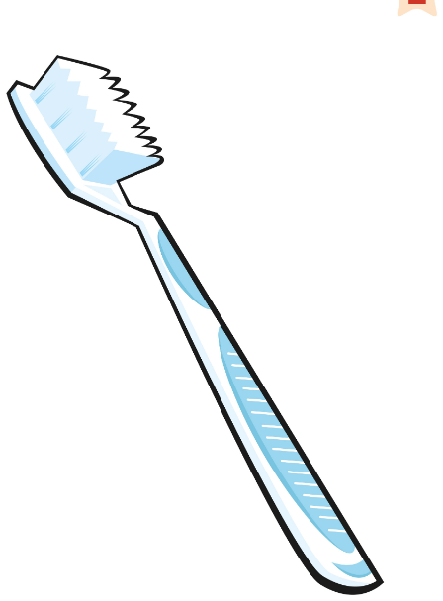
UNIT 2 · LESSON 2
Today: my day & How often…? ⏰🪥
Oggi: la mia giornata e 'Quanto spesso…?'
How often?
1
👀 LOOK
Learn words for your day.
Impara le parole della giornata.
Do you ever talk?
Parli mai?
2
📖 READ
Read the Friendly Farm story.
Leggi la storia della Friendly Farm.
3
💬 SPEAK
Ask: How often do you…?
Chiedi: Quanto spesso…?
📘 Pupil's Book pp.20–21 · 🎧 1.24–1.27 · 🎬 video
Notes:
COVER (1 min). Point to the picture: Who's this? (Cameron) What's in the box? (a fish – we'll meet him today!).

Slide 2
REMEMBER?
Say the days – forwards, then BACKWARDS! Beat the clock!
Di' i giorni – in avanti, poi AL CONTRARIO! Batti il tempo!
Days: beat the clock!
👥👥 TEAMS · ⏱ 3 MIN
1
💬 SPEAK
Round 1: forwards ➡️ Monday … Sunday
Round 2: backwards ⬅️ Sunday … Monday
Round 3: one word each – pass it on!
🔥 Boss level: start from Thursday!
Team says the 7 days. Go!
La squadra dice i 7 giorni. Via!
2
💬 SPEAK
Now BACKWARDS: Sunday, Saturday…
Ora AL CONTRARIO: Sunday, Saturday…
3
🎲 PLAY
Fastest team wins!
Vince la squadra più veloce!
📘 Retrieval · Lesson 1 days of the week
Notes:
RETRIEVAL OF LESSON 1 (3 min). GAME PLAN · SEE: the 4 rounds (no day cards – from memory!) · TEACHER: Time each team with a stopwatch (or count aloud). Listen for Wednesday (WENZ-day) and 'th' in Thursday. · STUDENTS: Round 1: the whole team chants the days. Round 2: backwards. Round 3: learners in a line each say one day in turn. Boss level: start from Thursday and go round (Thursday … Wednesday) · GROUPING: 2–3 teams · SCORE/WIN: Fastest correct time wins the round; +3 seconds penalty for 'Tursday' or 'Wed-nes-day' · TIME: 3 min · LANGUAGE: the 7 days in and out of order · REVEAL: the teacher writes each team's time on the board; winning team chosen at the end

Slide 3

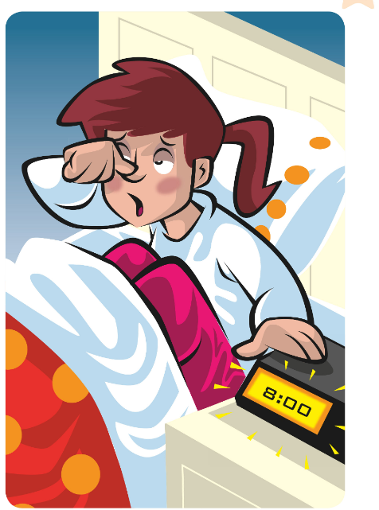
FLASHCARDS
Look! Say the word before it appears!
Guarda! Di' la parola prima che appaia!
My day
🏃 TPR Open your eyes! Stretch! 'It's 7 o'clock!' ⏰
svegliarsi
wake up
📘 Daily routines flashcards
1 / 7
Notes:
DAILY ROUTINES (7 min). TB presentation: mime and say 'Look! I'm sleeping. It's seven o'clock… It's eight o'clock… Oh, no!' Mime waking up, point to a clock: 'It's time for school! I'm late!' Then the cards: picture first – learners guess (Italian is OK), click 1 word, click 2 Italian, click 3 TPR. 'clean your teeth' = lavarsi i denti (with a toothbrush and toothpaste). Italian trap: 'have breakfast' (NOT 'make breakfast' – fare colazione) and 'have a shower' (NOT 'make a shower'). TPR: Open your eyes! Stretch! 'It's 7 o'clock!' ⏰

Slide 4
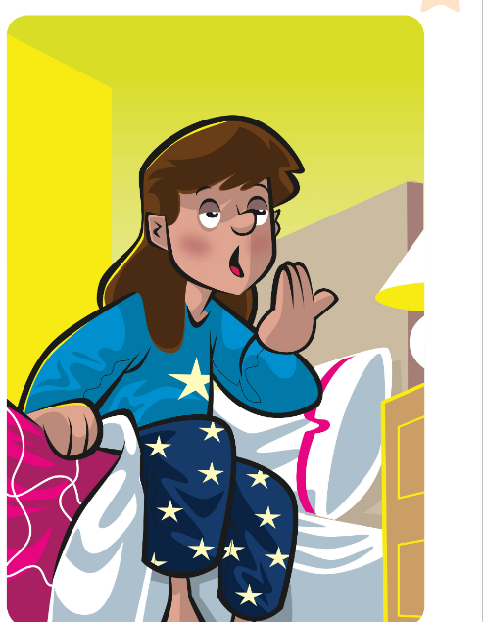
FLASHCARDS
Look! Say the word before it appears!
Guarda! Di' la parola prima che appaia!
My day
🏃 TPR Jump out of bed! Stand up! 🛏️
alzarsi
get up
📘 Daily routines flashcards
2 / 7
Notes:
DAILY ROUTINES (7 min). TB presentation: mime and say 'Look! I'm sleeping. It's seven o'clock… It's eight o'clock… Oh, no!' Mime waking up, point to a clock: 'It's time for school! I'm late!' Then the cards: picture first – learners guess (Italian is OK), click 1 word, click 2 Italian, click 3 TPR. 'clean your teeth' = lavarsi i denti (with a toothbrush and toothpaste). Italian trap: 'have breakfast' (NOT 'make breakfast' – fare colazione) and 'have a shower' (NOT 'make a shower'). TPR: Jump out of bed! Stand up! 🛏️

Slide 5

FLASHCARDS
Look! Say the word before it appears!
Guarda! Di' la parola prima che appaia!
My day
🏃 TPR Wash your hair! Shhhh! 🚿
fare la doccia
have a shower
📘 Daily routines flashcards
3 / 7
Notes:
DAILY ROUTINES (7 min). TB presentation: mime and say 'Look! I'm sleeping. It's seven o'clock… It's eight o'clock… Oh, no!' Mime waking up, point to a clock: 'It's time for school! I'm late!' Then the cards: picture first – learners guess (Italian is OK), click 1 word, click 2 Italian, click 3 TPR. 'clean your teeth' = lavarsi i denti (with a toothbrush and toothpaste). Italian trap: 'have breakfast' (NOT 'make breakfast' – fare colazione) and 'have a shower' (NOT 'make a shower'). TPR: Wash your hair! Shhhh! 🚿

Slide 6

FLASHCARDS
Look! Say the word before it appears!
Guarda! Di' la parola prima che appaia!
My day
🏃 TPR Eat your cereal! Yum! 🥣
fare colazione
have breakfast
📘 Daily routines flashcards
4 / 7
Notes:
DAILY ROUTINES (7 min). TB presentation: mime and say 'Look! I'm sleeping. It's seven o'clock… It's eight o'clock… Oh, no!' Mime waking up, point to a clock: 'It's time for school! I'm late!' Then the cards: picture first – learners guess (Italian is OK), click 1 word, click 2 Italian, click 3 TPR. 'clean your teeth' = lavarsi i denti (with a toothbrush and toothpaste). Italian trap: 'have breakfast' (NOT 'make breakfast' – fare colazione) and 'have a shower' (NOT 'make a shower'). TPR: Eat your cereal! Yum! 🥣

Slide 7
FLASHCARDS
Look! Say the word before it appears!
Guarda! Di' la parola prima che appaia!
My day
🏃 TPR Clean your teeth! Up and down! 🪥
spazzolino
toothbrush
📘 Daily routines flashcards
5 / 7
Notes:
DAILY ROUTINES (7 min). TB presentation: mime and say 'Look! I'm sleeping. It's seven o'clock… It's eight o'clock… Oh, no!' Mime waking up, point to a clock: 'It's time for school! I'm late!' Then the cards: picture first – learners guess (Italian is OK), click 1 word, click 2 Italian, click 3 TPR. 'clean your teeth' = lavarsi i denti (with a toothbrush and toothpaste). Italian trap: 'have breakfast' (NOT 'make breakfast' – fare colazione) and 'have a shower' (NOT 'make a shower'). TPR: Clean your teeth! Up and down! 🪥

Slide 8
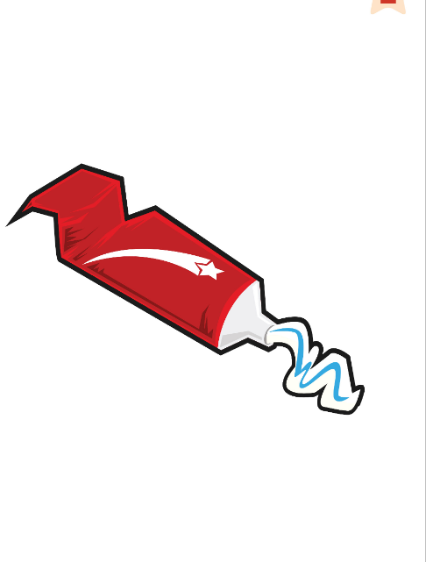
FLASHCARDS
Look! Say the word before it appears!
Guarda! Di' la parola prima che appaia!
My day
🏃 TPR Squeeze the toothpaste! 🧴
dentifricio
toothpaste
📘 Daily routines flashcards
6 / 7
Notes:
DAILY ROUTINES (7 min). TB presentation: mime and say 'Look! I'm sleeping. It's seven o'clock… It's eight o'clock… Oh, no!' Mime waking up, point to a clock: 'It's time for school! I'm late!' Then the cards: picture first – learners guess (Italian is OK), click 1 word, click 2 Italian, click 3 TPR. 'clean your teeth' = lavarsi i denti (with a toothbrush and toothpaste). Italian trap: 'have breakfast' (NOT 'make breakfast' – fare colazione) and 'have a shower' (NOT 'make a shower'). TPR: Squeeze the toothpaste! 🧴

Slide 9

FLASHCARDS
Look! Say the word before it appears!
Guarda! Di' la parola prima che appaia!
My day
🏃 TPR Dry your face with a towel!
asciugamano
towel
📘 Daily routines flashcards
7 / 7
Notes:
DAILY ROUTINES (7 min). TB presentation: mime and say 'Look! I'm sleeping. It's seven o'clock… It's eight o'clock… Oh, no!' Mime waking up, point to a clock: 'It's time for school! I'm late!' Then the cards: picture first – learners guess (Italian is OK), click 1 word, click 2 Italian, click 3 TPR. 'clean your teeth' = lavarsi i denti (with a toothbrush and toothpaste). Italian trap: 'have breakfast' (NOT 'make breakfast' – fare colazione) and 'have a shower' (NOT 'make a shower'). TPR: Dry your face with a towel!

Slide 10
SOUNDS 👏
How many claps? Clap and count – then check!
Quanti battiti? Batti e conta – poi controlla!
Clap it!
👥 PAIRS · 👏 CLAP
TOOTH-brush 👏👏
have BREAK-fast 👏👏👏 (not brek-FAST!)
1 have a shower
👏👏👏👏 have-a-SHOW-er
2 toothpaste
👏👏 TOOTH-paste
3 towel
👏👏 TOW-el
4 wake up
👏👏 wake UP
📘 Pronunciation · syllables + word stress
Notes:
PRONUNCIATION (3 min). Model the two examples, clapping the syllables and making the STRESSED clap louder. Then for each practice item: say it once; pairs clap and agree on the number (commit: show fingers 1–5!); click to reveal. Everyone says it 3 ways: whisper → normal → monster voice. Italian learners often stress the end (brek-FAST) and add a vowel at the end (wake-uppa) – catch it! Also: 'shower' = SHOW-er (rhymes with 'flower').

Slide 11

GAME
It's 7 o'clock! Listen and do it – fast!
Sono le 7! Ascolta e fallo – veloce!
Morning rush!
🏃 MOVE · ⏱ 4 MIN
Wake up! Yawn!
Get up! Jump!
Have a shower!
Clean your teeth!
Dry your face!
Have breakfast!
Oh no! I'm late! Run!
📘 Daily routines
Notes:
TPR MORNING RUSH (4 min). Round 1: click and do each action together. Round 2: say a time + routine ('It's 7 o'clock! Wake up!'), faster and faster, mixed order. Round 3 (retrieval): YOU mime, learners shout the phrase. 'Oh no! I'm late!' = everybody runs on the spot. Then a learner calls the actions.

Slide 12
NEW!
Look at the ticks. What do the words mean?
Guarda le spunte. Cosa significano le parole?
How often?
👀 LOOK · 🗣 SPEAK
always ✓✓✓✓✓✓✓ = sempre
often ✓✓✓✓✓ = spesso (OF-en, no 't'!)
sometimes ✓✓ = a volte
never ✗ = mai
1 I clean always my teeth. ✗
I always clean my teeth.
2 I get up never late. ✗
I never get up late.
📘 always · often · sometimes · never
Notes:
PRESENT THE ADVERBS (3 min) – TB presentation. Say: 'I brush my hair on Monday, Tuesday, Wednesday… every day. I ALWAYS brush my hair. I walk to school four days a week. I OFTEN walk to school.' Present sometimes and never the same way. Learners guess the Italian before you show it. Pronunciation: often = OF-en (silent t is fine). ITALIAN TRAP (word order): Italian says 'Mi lavo SEMPRE i denti', so learners say 'I clean always…'. In English the adverb goes BEFORE the verb: I ALWAYS clean. Practice: learners say the correct sentence in pairs (commit) → click → reveal. Gesture: put your hand between 'I' and the verb – 'the adverb lives HERE!'

Slide 13
GAME
Listen. How often do YOU do it? Run to the wall!
Ascolta. Quanto spesso lo fai TU? Corri alla parete giusta!
Four walls: How often?
🏃 MOVE · ⏱ 5 MIN
1
👂 LISTEN
🧱 ALWAYS · 🧱 OFTEN · 🧱 SOMETIMES · 🧱 NEVER
Teacher says: I get up late.
L'insegnante dice un'attività.
2
🏃 MOVE
Go to your wall!
Vai alla tua parete!
3
💬 SPEAK
Say: I sometimes get up late.
Di': I sometimes get up late.
📘 always · often · sometimes · never
⭐ I always / often / … + verb
🔥 Add a day: on Sundays!
Notes:
FOUR WALLS (5 min). GAME PLAN · SEE: the four words (stick 4 A4 signs on 4 walls before the lesson) · TEACHER: Say a sentence: I get up late. / I have a shower in the morning. / I eat pizza for breakfast. / I clean my teeth after lunch. / I watch TV on Saturdays. / I play football on Mondays. · STUDENTS: Decide how often THEY do it and walk to that wall; one learner at each wall says the full sentence ('I sometimes get up late.') · GROUPING: whole class, individual choice · SCORE/WIN: no winners – personal answers; bonus clap for a perfect sentence with the adverb in the right place · TIME: 5 min · LANGUAGE: I always / often / sometimes / never + verb · REVEAL: the teacher repeats a correct sentence from each wall; correct 'I clean always' → 'I always clean'

Slide 14
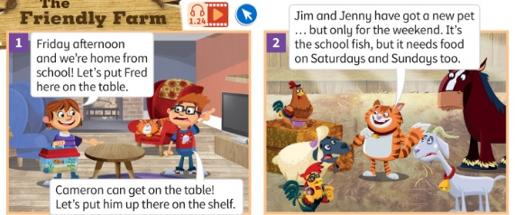
STORY
Listen and read. Does the fish talk? Guess!
Ascolta e leggi. Il pesce parla? Indovina!
The Friendly Farm
👂 LISTEN · 👀 LOOK
📘 Pupil's Book p.20 · 🎧 1.24 · 🎬 video
Notes:
STORY part 1 (pictures 1–2) (≈ 9 min for the 3 story slides). PREDICT: 'Does the fish talk? Yes or no? Hands up!' (write the votes on the board). Play the Friendly Farm song (start of track 1.24 / video). Ask: Where are they? (In the living room) Where's Cameron? (on a chair) – teach SHELF. What's this? (a fish) What's his name? (Fred). Play the audio/video. Picture 1: Which day is it? (Friday) Is it the morning? (No, the afternoon) Why can't they put Fred on the table? (Because Cameron can get on the table – and he loves eating fish!) Picture 2: When does Fred need food? (every day).

Slide 15
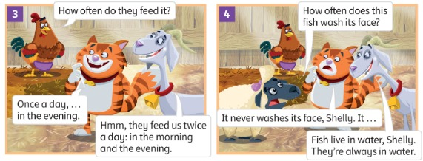
STORY
How often do they feed the fish?
Quanto spesso danno da mangiare al pesce?
The Friendly Farm
📘 Pupil's Book p.20 · 🎧 1.24
Notes:
STORY part 2 (pictures 3–4). Picture 3: When do Jim and Jenny feed Fred? (Once a day / in the evening) When do they feed the other animals? (Twice a day / in the morning and the evening). once a day = una volta al giorno, twice a day = due volte. Picture 4: Does the fish wash its face? (No – it lives in water). Everyone mimes washing their face.

Slide 16
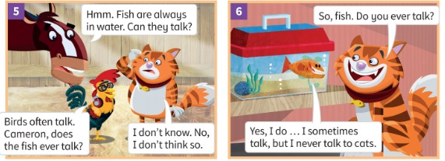
STORY
Do birds talk? Does Fred talk? Were you right?
Gli uccelli parlano? Fred parla? Avevi ragione?
The Friendly Farm
📘 Pupil's Book p.20 · 🎧 1.24
Notes:
STORY part 3 (pictures 5–6). Picture 5: Do birds talk? (Yes, often) Picture 6: Does the fish talk? (Yes, sometimes!) Check the predictions on the board – who was right? Why doesn't Fred talk to cats? (Because cats want to eat him!) Teach EVER: Do you ever talk? = Parli mai?

Slide 17
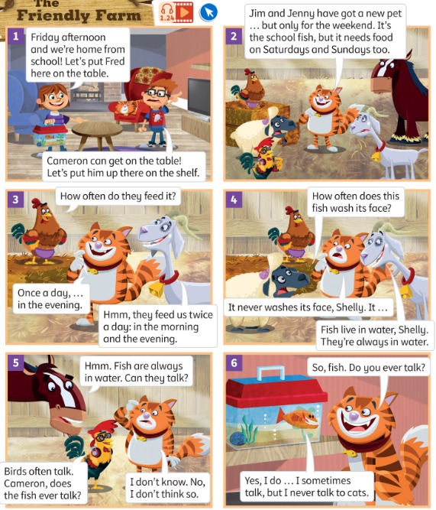
LISTEN
Listen. Who says it? Whisper to your partner!
Ascolta. Chi lo dice? Sussurralo al compagno!
Who says it? (1)
👥 PAIRS · 👂 LISTEN
1 How often do they feed it?
Henrietta 🐔
2 I sometimes talk, but I never talk to cats.
Fred (the fish) 🐟
3 Fish are always in water. Can they talk?
Harry 🐴
4 Cameron can get on the table!
Jim 👦
📘 Pupil's Book p.20 · 🎧 1.25
Notes:
PB p.20 ex.1 (part 1). Play track 1.25 and PAUSE after each sentence: pairs whisper the name (commit), then a volunteer says it, then click to reveal. KEY (TB audioscript): 1 Henrietta 2 Fred/fish 3 Harry 4 Jim.

Slide 18
LISTEN
Listen. Who says it? Whisper to your partner!
Ascolta. Chi lo dice? Sussurralo al compagno!
Who says it? (2)
👥 PAIRS · 👂 LISTEN
1 Fish live in water, Shelly. They're always in water.
Gracie 🐐
2 It's the school fish, but it needs food on Saturdays and Sundays too.
Cameron 🐱
3 How often does this fish wash its face?
Shelly 🐑
4 Birds often talk. Cameron, does the fish ever talk?
Rocky 🐓
📘 Pupil's Book p.20 · 🎧 1.25
Notes:
PB p.20 ex.1 (part 2). KEY (TB audioscript): 5 Gracie 6 Cameron 7 Shelly 8 Rocky. Extension (TB): learners role-play picture 1 in pairs.

Slide 19

GRAMMAR
Gracie's Grammar
👤 ALONE · ✍ WRITE
How often do you clean your teeth?
I always clean them after breakfast, lunch and dinner.
Do you ever get up late?
No, I never get up late.
1 Fish live in water. They're ___ in water.
always
2 Birds ___ talk. (✓✓✓✓✓)
often
3 This fish ___ washes its face. (✗)
never
📘 Pupil's Book p.21 · 🎧 1.26
Notes:
GRACIE'S GRAMMAR (4 min). Play 1.26 and pause for learners to repeat (rising intonation on 'Do you ever get up late?'). NOTICE: 'They're ALWAYS in water' – with 'be' the adverb goes AFTER (they're always), with other verbs BEFORE (I always clean). Practice: learners write the word (commit) → click. More (oral): 'I ___ talk, but I never talk to cats.' (sometimes) 'How ___ do they feed it?' (often).

Slide 20
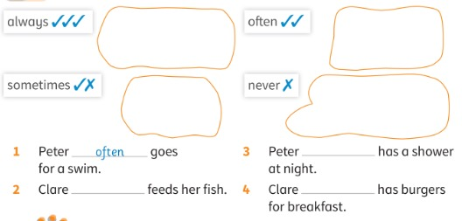
LISTEN
Listen. Draw (or stick) the activity in the right box. Then read and write.
Ascolta. Disegna (o attacca) l'attività nel riquadro giusto. Poi leggi e scrivi.
Peter and Clare
👤 ALONE · 👂 LISTEN
1 Peter ___ goes for a swim.
often
2 Clare ___ feeds her fish.
always
3 Peter ___ has a shower at night.
sometimes
4 Clare ___ has burgers for breakfast.
never
📘 Pupil's Book p.21 · 🎧 1.27
Notes:
PB p.21 ex.1 (5 min). Play 1.27: learners point to the correct sticker (or draw quick pictures: swimming, fish, shower, burger). Play again: learners stick/draw. Then 'look, read and write' – learners write first, then click for each answer. KEY: 1 often (example) 2 always 3 sometimes 4 never. Audio details: Peter swims with his class on Mondays, Wednesdays and Fridays and with his parents on Saturdays; Clare feeds her fish once a day, every day; Peter sometimes has a shower at night; Clare never has burgers for breakfast – she always has cake and milk!

Slide 21
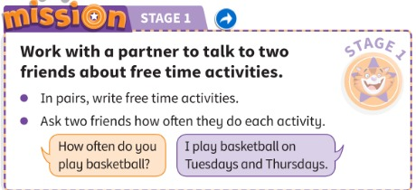
MISSION
Work with a partner. Ask two friends how often they do free time activities.
Lavora con un compagno. Chiedi a due amici quanto spesso fanno attività nel tempo libero.
Mission Stage 1
👥 PAIRS · ⏱ 5 MIN
📘 Pupil's Book p.21 · Mission Stage 1
Notes:
MISSION STAGE 1 (5 min). MODEL → SUPPORTED → INDEPENDENT. Write on the board: activities (play football, ride a bike, swim, play basketball, watch TV…) + the frames 'How often do you …?' / 'I always / often / sometimes / never …' / 'I … on Tuesdays.' Model with one learner (you ask, write the answer in a 3-column table on the board). Then groups of four (two pairs): pairs choose activities and write the names of the other pair, then take turns to ask and answer. Challenge: add a day ('I play basketball on Tuesdays and Thursdays'). KEEP the tables for Lesson 3! AB p.18: smiley face for 'My mission diary 1'.

Slide 22
WELL DONE!
Today I can… · Oggi so…
Show me with your thumbs! 👍 👌 👎
Bye bye! 👋
⭐ I can say my morning routine.
So dire la mia routine del mattino.
🏠 HOMEWORK · COMPITI
• Homework sheet
• Activity Book p.20: ex.1 and 2
• Activity Book p.21: ex.1 and 2
⭐ I can ask and answer: How often…?
So chiedere e rispondere: Quanto spesso…?
⭐ I can put always / never in the right place.
So mettere always / never al posto giusto.
➡ Next: a song about free time activities!
Notes:
EXIT (3 min). Exit challenge: each learner tells a partner ONE true sentence with an adverb about their morning ('I never have a shower in the morning'). Partner checks the word order. Thumbs for each 'I can'. Add a tick to Stage 1 on the Mission poster. TIMING (core ≈ 57 min): cover 1 · days race 3 · flashcards 7 · clap 3 · TPR 4 · adverbs 3 · four walls 5 · story 9 · who says it 5 · grammar 4 · Peter & Clare 5 · mission 5 · exit 3.

Slide 23
GAME
Walk and ask: Do you ever…? Write a name!
Cammina e chiedi: Do you ever…? Scrivi un nome!
EXTRA: Find a friend!
🏃 MINGLE · ⏱ 6 MIN
1
📖 READ
Find someone who… never gets up late.
…always has breakfast at home.
…sometimes has a shower in the evening.
…often plays football.
…never watches TV in the morning.
Copy the 5 sentences.
Copia le 5 frasi.
2
💬 SPEAK
Ask: Do you ever get up late?
Chiedi: Do you ever…?
3
✏️ WRITE
Yes? Write the name!
Sì? Scrivi il nome!
📘 How often…? · Do you ever…?
⭐ Do you ever …? Yes, I do.
Notes:
EXTRA FIND SOMEONE WHO (6 min). GAME PLAN · SEE: 5 'find someone who' sentences · TEACHER: Model one exchange with a strong learner: 'Do you ever get up late?' – 'No, never!' – write the name. · STUDENTS: Copy the 5 lines, walk around, ask Do you ever…? / How often do you…?, write a classmate's name next to a true sentence · GROUPING: individual mingle; only ONE name per classmate · SCORE/WIN: first with 5 names shouts 'Bingo!' and must report: 'Marco never gets up late.' (correct sentence = win) · TIME: 6 min · LANGUAGE: Do you ever…? How often do you…? Yes, I do / No, never. He/She always… · REVEAL: the winner reads their sentences; the named classmates confirm (yes/no)

Slide 24
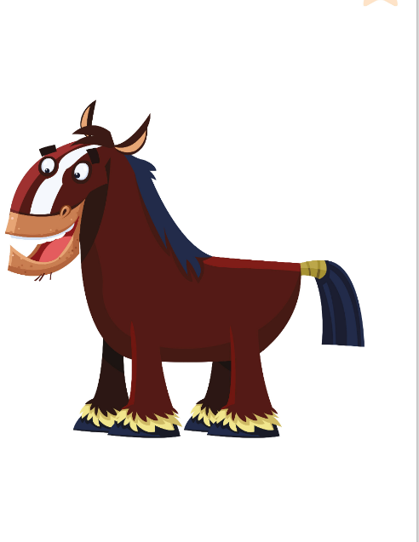
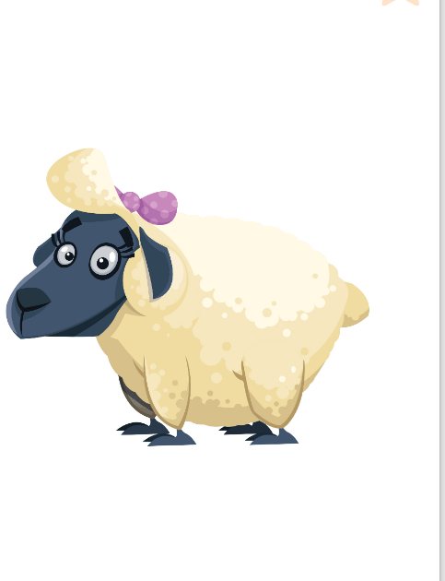
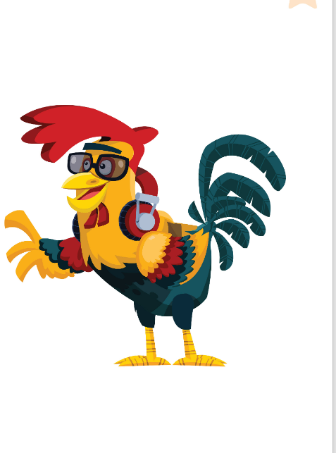
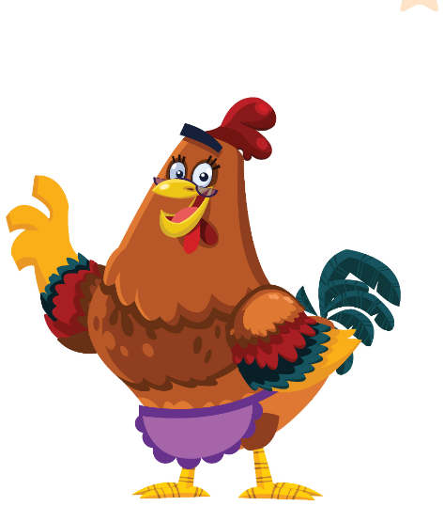
GAME
You are a Friendly Farm animal! The class asks. Answer!
Sei un animale della Friendly Farm! La classe chiede. Rispondi!
EXTRA: Hot seat!
👥👥 TEAMS · ⏱ 5 MIN
1
⚙️ DO
Choose a character. Don't tell!
Scegli un personaggio. Non dirlo!
2
cameron
harry
shelly
gracie
💬 SPEAK
Class asks: How often do you…?
La classe chiede: How often do you…?
3
🎲 PLAY
Guess the character!
Indovina il personaggio!
rocky
henrietta
📘 The Friendly Farm characters
Notes:
EXTRA HOT SEAT (5 min). GAME PLAN · SEE: the 6 Friendly Farm characters · TEACHER: Go first: sit in the hot seat as Cameron and answer ('I always eat fish!'). · STUDENTS: One learner secretly picks a character and sits facing the class; teams take turns to ask ONE question (How often do you eat fish? Do you ever talk? Do you ever swim?) and may then guess · GROUPING: 2 teams · SCORE/WIN: correct guess = 1 point; a wrong guess passes the turn; the guesser takes the hot seat · TIME: 5 min · LANGUAGE: How often do you…? Do you ever…? I always / never… · REVEAL: the hot-seat learner says 'Yes! I'm Cameron!'

