Slide 1

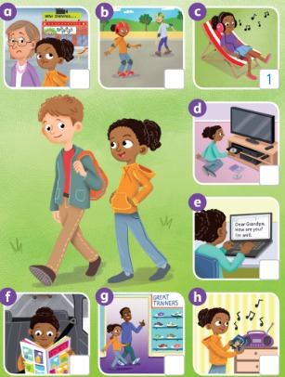
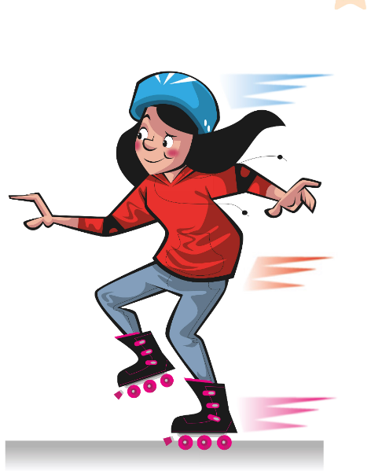
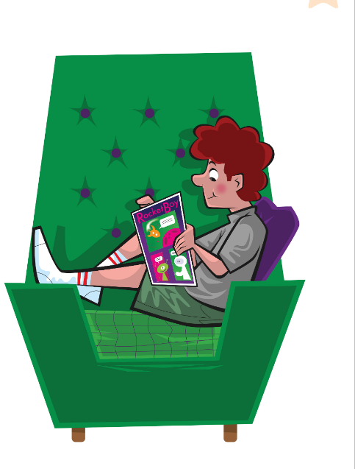
UNIT 2 · LESSON 3
Today: free time activities 🛼🎧 + must / mustn't
Oggi: le attività del tempo libero + must / mustn't
Free time fun!
1
👀 LOOK
Learn 8 free time activities.
Impara 8 attività del tempo libero.
How often do you go skating?
Quanto spesso vai sui pattini?
2
🎵 SING
Sing Rocky's song!
Canta la canzone di Rocky!
3
💬 SPEAK
Make class rules: must / mustn't.
Crea le regole della classe.
📘 Pupil's Book pp.22–23 · 🎧 1.28–1.31 · 🎬 song video
Notes:
COVER (1 min). Point to the picture: What can you see? (a boy and a girl, music, a TV…). Today we learn 8 free time activities and sing a song.

Slide 2

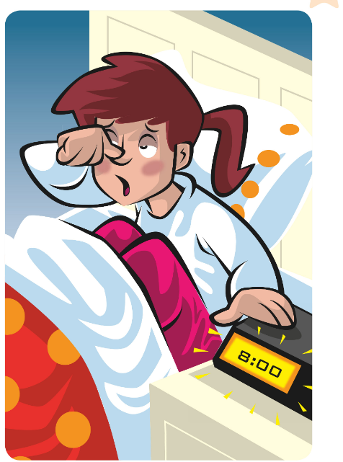

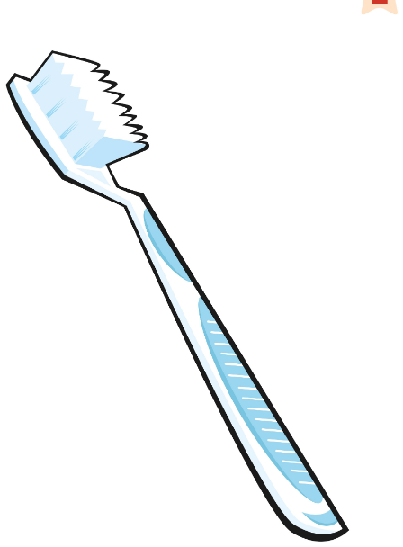
REMEMBER?
The teacher says 3 sentences. ONE is a lie! Which one?
L'insegnante dice 3 frasi. UNA è una bugia! Quale?
Which one is a lie?
👥👥 TEAMS · ⏱ 4 MIN
1
👂 LISTEN
Listen to 3 sentences.
Ascolta 3 frasi.
2
💬 SPEAK
Team: which is the lie? 1, 2 or 3?
Squadra: quale è la bugia? 1, 2 o 3?
3
🎲 PLAY
Your turn! Tell your partner 3.
Tocca a te! Dinne 3 al compagno.
📘 Retrieval · Lesson 2 routines + always / never
⭐ I always / never + verb
🔥 Add a day or a time!
Notes:
RETRIEVAL OF LESSON 2 (4 min). GAME PLAN · SEE: a 'liar' emoji + 3 routine flashcards (no sentences on screen) · TEACHER: Say 3 sentences about yourself, e.g. 1 'I always have a shower in the morning.' 2 'I never have breakfast.' 3 'I sometimes clean my teeth with chocolate toothpaste.' Pause 10 s: 'Which one is a lie? Teams, hold up 1, 2 or 3 fingers!' · STUDENTS: Teams agree and show fingers (commit). Then in pairs, each learner says 3 sentences (2 true, 1 lie); the partner guesses · GROUPING: teams (round 1), then pairs · SCORE/WIN: 1 point per team that finds the lie; in pairs: 1 point if your partner DOESN'T find your lie · TIME: 4 min · LANGUAGE: I always / often / sometimes / never + wake up / get up / have a shower / have breakfast / clean my teeth · REVEAL: the teacher reveals the lie (e.g. 3!) and the class corrects it: 'You never clean your teeth with chocolate!'

Slide 3

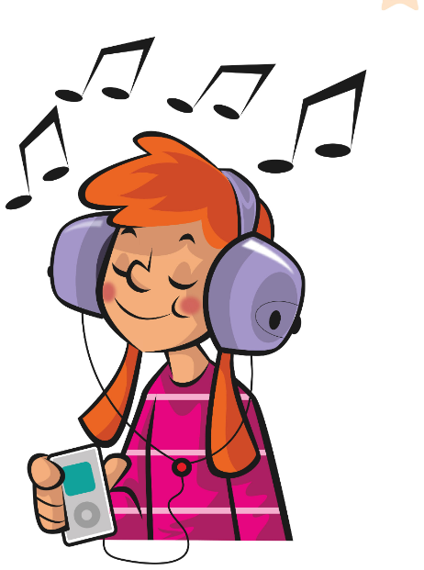
FLASHCARDS
Look! Say the word before it appears!
Guarda! Di' la parola prima che appaia!
Free time!
🏃 TPR Headphones on! Dance with your head! 🎧
ascoltare musica
listen to music
📘 Pupil's Book p.22 · Free time flashcards
1 / 8
Notes:
FREE TIME FLASHCARDS (8 min). Picture first – learners guess (Italian OK), click 1 word, click 2 Italian, click 3 TPR mime. TB questions while you go: Which film do you often watch? Where can you go skating in Bagheria? Who do you write emails to? Do you like going shopping? Italian trap: 'go shopping' (NOT 'make shopping' – fare shopping). TPR: Headphones on! Dance with your head! 🎧

Slide 4
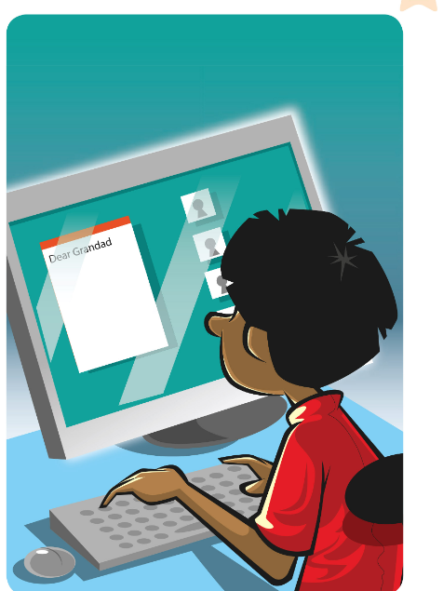
FLASHCARDS
Look! Say the word before it appears!
Guarda! Di' la parola prima che appaia!
Free time!
🏃 TPR Type on the keyboard! Click 'send'! 💻
scrivere un'email
write an email
📘 Pupil's Book p.22 · Free time flashcards
2 / 8
Notes:
FREE TIME FLASHCARDS (8 min). Picture first – learners guess (Italian OK), click 1 word, click 2 Italian, click 3 TPR mime. TB questions while you go: Which film do you often watch? Where can you go skating in Bagheria? Who do you write emails to? Do you like going shopping? Italian trap: 'go shopping' (NOT 'make shopping' – fare shopping). TPR: Type on the keyboard! Click 'send'! 💻

Slide 5
FLASHCARDS
Look! Say the word before it appears!
Guarda! Di' la parola prima che appaia!
Free time!
🏃 TPR Skate! Left foot, right foot! 🛼
andare sui pattini
go skating
📘 Pupil's Book p.22 · Free time flashcards
3 / 8
Notes:
FREE TIME FLASHCARDS (8 min). Picture first – learners guess (Italian OK), click 1 word, click 2 Italian, click 3 TPR mime. TB questions while you go: Which film do you often watch? Where can you go skating in Bagheria? Who do you write emails to? Do you like going shopping? Italian trap: 'go shopping' (NOT 'make shopping' – fare shopping). TPR: Skate! Left foot, right foot! 🛼

Slide 6
FLASHCARDS
Look! Say the word before it appears!
Guarda! Di' la parola prima che appaia!
Free time!
🏃 TPR Open the comic and laugh! Ha ha! 📖
leggere un fumetto
read a comic
📘 Pupil's Book p.22 · Free time flashcards
4 / 8
Notes:
FREE TIME FLASHCARDS (8 min). Picture first – learners guess (Italian OK), click 1 word, click 2 Italian, click 3 TPR mime. TB questions while you go: Which film do you often watch? Where can you go skating in Bagheria? Who do you write emails to? Do you like going shopping? Italian trap: 'go shopping' (NOT 'make shopping' – fare shopping). TPR: Open the comic and laugh! Ha ha! 📖

Slide 7

FLASHCARDS
Look! Say the word before it appears!
Guarda! Di' la parola prima che appaia!
Free time!
🏃 TPR Push the trolley! Pay! 🛒
fare shopping
go shopping
📘 Pupil's Book p.22 · Free time flashcards
5 / 8
Notes:
FREE TIME FLASHCARDS (8 min). Picture first – learners guess (Italian OK), click 1 word, click 2 Italian, click 3 TPR mime. TB questions while you go: Which film do you often watch? Where can you go skating in Bagheria? Who do you write emails to? Do you like going shopping? Italian trap: 'go shopping' (NOT 'make shopping' – fare shopping). TPR: Push the trolley! Pay! 🛒

Slide 8
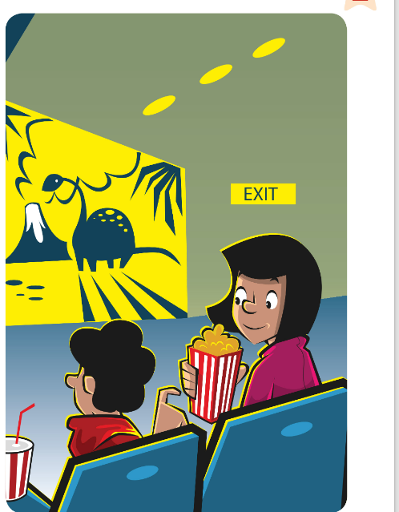
FLASHCARDS
Look! Say the word before it appears!
Guarda! Di' la parola prima che appaia!
Free time!
🏃 TPR Eat popcorn! Wow! 🍿
guardare un film
watch a film
📘 Pupil's Book p.22 · Free time flashcards
6 / 8
Notes:
FREE TIME FLASHCARDS (8 min). Picture first – learners guess (Italian OK), click 1 word, click 2 Italian, click 3 TPR mime. TB questions while you go: Which film do you often watch? Where can you go skating in Bagheria? Who do you write emails to? Do you like going shopping? Italian trap: 'go shopping' (NOT 'make shopping' – fare shopping). TPR: Eat popcorn! Wow! 🍿

Slide 9
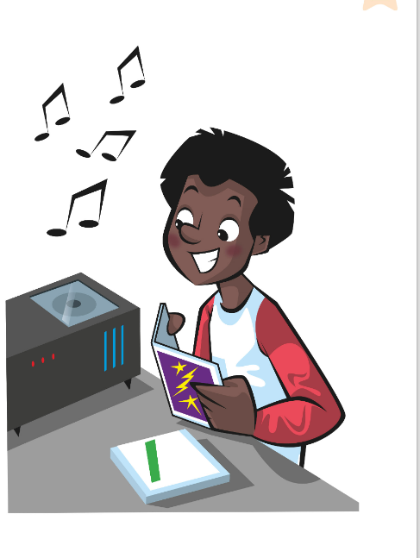
FLASHCARDS
Look! Say the word before it appears!
Guarda! Di' la parola prima che appaia!
Free time!
🏃 TPR Put in the CD… press PLAY! 💿
ascoltare un CD
listen to a CD
📘 Pupil's Book p.22 · Free time flashcards
7 / 8
Notes:
FREE TIME FLASHCARDS (8 min). Picture first – learners guess (Italian OK), click 1 word, click 2 Italian, click 3 TPR mime. TB questions while you go: Which film do you often watch? Where can you go skating in Bagheria? Who do you write emails to? Do you like going shopping? Italian trap: 'go shopping' (NOT 'make shopping' – fare shopping). TPR: Put in the CD… press PLAY! 💿

Slide 10
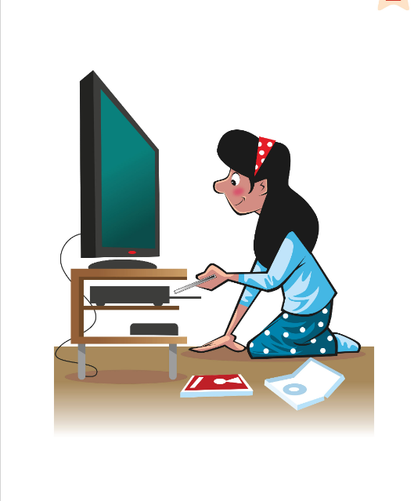
FLASHCARDS
Look! Say the word before it appears!
Guarda! Di' la parola prima che appaia!
Free time!
🏃 TPR Press the remote control! Sit on the sofa! 📺
guardare un DVD
watch a DVD
📘 Pupil's Book p.22 · Free time flashcards
8 / 8
Notes:
FREE TIME FLASHCARDS (8 min). Picture first – learners guess (Italian OK), click 1 word, click 2 Italian, click 3 TPR mime. TB questions while you go: Which film do you often watch? Where can you go skating in Bagheria? Who do you write emails to? Do you like going shopping? Italian trap: 'go shopping' (NOT 'make shopping' – fare shopping). TPR: Press the remote control! Sit on the sofa! 📺

Slide 11
SOUNDS 👂
Listen. Is it an English sound or an Italian sound?
Ascolta. È un suono inglese o italiano?
English or Italian?
👂 LISTEN · ✋ VOTE
CD = see-dee (not 'ci-di')
DVD = dee-vee-dee (not 'di-vu-di')
listen = LIS-en (no 't'!) · skating = SKAY-ting
1 Teacher: 'ci-di'
🇮🇹 → see-dee
2 Teacher: 'dee-vee-dee'
🇬🇧 right!
3 Teacher: 'lis-TEN'
🇮🇹 → LIS-en
4 Teacher: 'shopping-a'
🇮🇹 → SHOP-ing (no 'a'!)
📘 Pronunciation · letters + -ing
Notes:
PRONUNCIATION FOR ITALIAN LEARNERS (3 min). Italians read letters the Italian way (CD = 'ci-dì', DVD = 'di-vu-dì') and add a vowel after final consonants (shopping-a, skating-e). Model the rule lines. Then say each practice item as written: learners vote – right hand up = English 🇬🇧, left hand up = Italian 🇮🇹 (commit) → click → everybody says the English version 3 times (whisper, normal, monster). -ing ends softly in the nose: 'ng' – no 'g' sound and no vowel after it.

Slide 12
GAME
Listen and mime! Faster… faster!
Ascolta e mima! Più veloce… più veloce!
Free time moves!
🏃 MOVE · ⏱ 3 MIN
Skate!
Dance!
Type!
Read and laugh!
Push the trolley!
Eat popcorn!
Press PLAY!
Sit on the sofa!
📘 Free time activities
Notes:
TPR (3 min). Say the activity, learners mime. Then 'Stop!' – everybody freezes. Speed up. Round 3 (retrieval): YOU mime only – learners shout the phrase.

Slide 13
LISTEN
Listen and number the pictures a–h.
Ascolta e numera le immagini a–h.
Listen and number
👤 ALONE · 👂 LISTEN
1 a ? b ?
a 6 · b 3
2 c ? d ?
c 1 (example) · d 8
3 e ? f ?
e 2 · f 4
4 g ? h ?
g 5 · h 7
📘 Pupil's Book p.22 · 🎧 1.28 · 🎬 song video
Notes:
PB p.22 ex.1 (4 min). Say a sentence – learners point: She's listening to music. / She's skating. / She's watching a DVD. Number 1 = c (example). Play the audio or video: learners write numbers in their book (or on paper a–h). Pairs compare (commit), then click once to show ALL answers. KEY: a 6 b 3 (c 1) d 8 e 2 f 4 g 5 h 7.

Slide 14
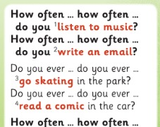
SONG
Sing the song and do the actions!
Canta la canzone e fai le azioni!
Rocky's song (1)
🎵 SING · 🏃 MOVE
📘 Pupil's Book p.22 · 🎧 1.28 (karaoke 1.29) · 🎬
Notes:
SONG part 1 (with slide 2/2) (5 min). Say each activity from the song with its action; learners repeat. Play the audio or video: learners sing and do the actions. Then everybody STANDS UP and performs it. Extension: karaoke version (track 1.29).

Slide 15
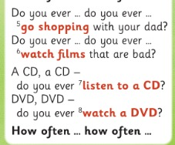
SONG
Sing the song and do the actions!
Canta la canzone e fai le azioni!
Rocky's song (2)
🎵 SING · 🏃 MOVE
📘 Pupil's Book p.22 · 🎧 1.28 (karaoke 1.29) · 🎬
Notes:
SONG part 2. Activities 5–8: go shopping, watch films, listen to a CD, watch a DVD. Split the class: boys sing 'How often… how often…', girls sing 'Do you ever… do you ever…' – then swap. Pronunciation check: see-dee, dee-vee-dee!

Slide 16
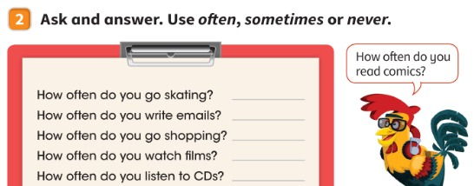
SPEAK
Ask your partner. Answer with often, sometimes or never.
Chiedi al compagno. Rispondi con often, sometimes o never.
Ask and answer
👥 PAIRS · ⏱ 4 MIN
1 Model: How often do you go skating?
I sometimes go skating.
2 Your turn: How often do you read comics?
I often / sometimes / never read comics.
📘 Pupil's Book p.22 · ex.2
Notes:
PB p.22 ex.2 (4 min). MODEL → SUPPORTED → INDEPENDENT. 1) Model with a strong learner, miming a clipboard (Q1, click for the model answer). 2) Supported: Q2 – everyone answers with the frame (click). 3) Independent: pairs ask the 5 questions on the clipboard and write their partner's answers. Stronger learners: once/twice a week, on Saturdays. Fast finishers: write how often they read a book, a magazine, an e-book. Watch the word order: 'I never read comics' (not 'I read never').

Slide 17
GAME
Mime an activity. The class guesses and asks: How often…?
Mima un'attività. La classe indovina e chiede: How often…?
Mime it!
👥👥 TEAMS · ⏱ 4 MIN
1
⚙️ DO
Mime a free time activity.
Mima un'attività del tempo libero.
2
💬 SPEAK
Class: You're reading a comic!
Classe: Stai leggendo un fumetto!
3
💬 SPEAK
Ask: How often do you…?
Chiedi: Quanto spesso…?
📘 Free time activities · How often…?
⭐ You're …ing! How often…?
Notes:
MIME IT (4 min). GAME PLAN · SEE: 4 example cards (only to remind them of the activities) · TEACHER: Whisper an activity to a learner (or show a flashcard secretly). Start a 20-second timer. · STUDENTS: The mimer mimes; the OTHER team guesses with the present continuous ('You're watching a film!'). The guesser then asks 'How often do you watch films?' and the mimer answers truthfully · GROUPING: 2 teams take turns · SCORE/WIN: Correct guess = 1 point; correct How often question = +1 point; perfect -ing pronunciation = +1 bonus · TIME: 4 min · LANGUAGE: You're …ing! · How often do you …? · I sometimes … · REVEAL: the mimer says 'Yes!' or 'No!'; after 20 s the teacher shows the card

Slide 18

LISTEN
Where can Jack go with his birthday present? Listen and tick ✓.
Dove può andare Jack con il suo regalo di compleanno? Ascolta e spunta ✓.
Jack's present
👤 ALONE · 👂 LISTEN
1 What's in picture 1, 2, 3?
1 a street · 2 a skate park · 3 a swimming pool
2 Guess first: where can Jack go?
Picture 2 ✓ (the skate park)
3 What's Jack's birthday present?
Roller skates 🛼
📘 Pupil's Book p.23 · 🎧 1.30
Notes:
PB p.23 ex.1 (5 min). TB presentation: 'I sometimes ride my bike to school. When I ride my bike there are RULES. I MUST wear a helmet. I MUSTN'T ride on the pavement.' Ask Q1 (click). PREDICT: 'What's Jack's present? Where can he go? Guess!' (vote 1, 2 or 3). Play 1.30: learners tick (commit), then click. KEY: Picture 2. Audio: Jack mustn't skate in the street; he must skate in the roller skating area in the park and wear a helmet; he mustn't wear his skates in the house – he must put them in the cupboard.

Slide 19

GRAMMAR
Gracie's Grammar
👤 ALONE · ✍ WRITE
What must I do?
You mustn't wear your skates in the house.
You must put them in the cupboard.
1 You must to wear a helmet. ✗
must wear (no 'to'!)
2 You ___ skate in the street. ✗
mustn't
3 You ___ eat sweets in the swimming pool. ✗
mustn't
📘 Pupil's Book p.23 · 🎧 1.31
Notes:
GRACIE'S GRAMMAR (4 min). Play 1.31 and pause for learners to repeat. must = devi (✓ thumbs up) · mustn't = non devi (✗ crossed arms). PRONUNCIATION: mustn't = MUS-nt – the first 't' is silent. ITALIAN TRAP: 'devo indossare' → learners say 'I must TO wear'. No 'to' after must! Practice: learners write (commit) → click. Items 2–3 are based on Jack's audio (our sentences, not in the book).

Slide 20
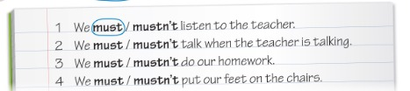
READ
Read and circle to make class rules.
Leggi e cerchia per creare le regole della classe.
Class rules
👥 PAIRS · ✍ WRITE
1 We ___ listen to the teacher.
must (example)
2 We ___ talk when the teacher is talking.
mustn't
3 We ___ do our homework.
must
4 We ___ put our feet on the chairs.
mustn't
📘 Pupil's Book p.23 · ex.2 and 3
Notes:
PB p.23 ex.2 + 3 (5 min). 'Let's think about rules in the classroom. Must you put up your hand to speak?' (Yes, we must.) Learners read and circle (commit), then click for each answer. KEY: 2 mustn't 3 must 4 mustn't. Ex.3: in pairs, write 2 more class rules (We must speak English! We mustn't eat in class…) – frames on the board 'We must … / We mustn't …'. Best rules go on an LLS class rules poster.

Slide 21
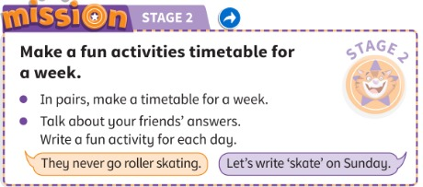
MISSION
In pairs, make a fun activities timetable for a week.
In coppia, fate un programma di attività divertenti per una settimana.
Mission Stage 2
👥 PAIRS · ⏱ 5 MIN
📘 Pupil's Book p.23 · Mission Stage 2
Notes:
MISSION STAGE 2 (5 min). Learners work in their Stage 1 pairs with the tables from Lesson 2. They draw a weekly timetable (Monday–Sunday – capital letters!) and add a fun activity for each day for the pair they interviewed. Model: 'They never go roller skating.' 'Let's write skate on Sunday.' Support: days + activities on the board. LEAVE SPACE for safety information (Stage 3). KEEP the timetables! AB p.18: 'My mission diary 2'.

Slide 22
WELL DONE!
Today I can… · Oggi so…
Show me with your thumbs! 👍 👌 👎
Bye bye! 👋
⭐ I can say 8 free time activities.
So dire 8 attività del tempo libero.
🏠 HOMEWORK · COMPITI
• Homework sheet
• Activity Book p.22: ex.1 and 2
• Activity Book p.23: ex.1 and 2
⭐ I can say CD and DVD in English!
So dire CD e DVD in inglese!
⭐ I can make rules with must and mustn't.
So fare regole con must e mustn't.
➡ Next: Let's be healthy! Safe sport 🚴
Notes:
EXIT (3 min). Exit challenge: 'Tell your partner ONE rule for your house with must or mustn't' (e.g. You mustn't play football in the kitchen!). Thumbs for each 'I can'. Add a tick to Stage 2 on the Mission poster. TIMING (core ≈ 58 min): cover 1 · lie game 4 · flashcards 8 · sounds 3 · TPR 3 · number 4 · song 5 · ask & answer 4 · mime 4 · Jack 5 · grammar 4 · rules 5 · mission 5 · exit 3.

Slide 23
GAME
Choose 4 activities. Listen. Cross them out. BINGO!
Scegli 4 attività. Ascolta. Cancellale. BINGO!
EXTRA: Bingo!
👤 ALONE · ⏱ 5 MIN
1
🖍️ DRAW
Write 4 activities in a 2×2 grid.
Scrivi 4 attività in una griglia 2×2.
2
go shopping
go skating
listen to a cd
listen to music
👂 LISTEN
Teacher: How often do you…?
L'insegnante: How often do you…?
3
🎲 PLAY
4 crossed out? Shout BINGO!
4 cancellate? Grida BINGO!
read a comic
watch a dvd
watch a film
write an email
📘 Free time activities
Notes:
EXTRA BINGO (5 min). GAME PLAN · SEE: the 8 activities with words (for spelling support) · TEACHER: Call questions in random order ('Do you ever watch a DVD?'). Keep a list of what you called. · STUDENTS: Write 4 of the 8 activities in a 2×2 grid; cross out the ones they hear · GROUPING: individual · SCORE/WIN: first to cross out all 4 shouts BINGO! and reads back their 4 activities with correct pronunciation (see-dee!); the winner calls the next round · TIME: 5 min · LANGUAGE: the 8 free time phrases · REVEAL: the teacher checks the winner's card against the called list

Slide 24
GAME
Two teams. Listen, run and touch the picture!
Due squadre. Ascolta, corri e tocca l'immagine!
EXTRA: Board race!
👥👥 TEAMS · ⏱ 5 MIN
1
👂 LISTEN
Teacher says a line from the song.
L'insegnante dice una frase della canzone.
2
🏃 MOVE
Run and touch the right picture!
Corri e tocca l'immagine giusta!
3
💬 SPEAK
Say: I sometimes … / I never …
Di': I sometimes … / I never …
📘 Free time activities flashcards
Notes:
EXTRA BOARD RACE (5 min). GAME PLAN · SEE: 8 pictures without words (stick the paper flashcards on the board too) · TEACHER: Say e.g. 'Do you ever read a comic in the car?' or a definition ('You use a computer') · STUDENTS: the first learner of each team runs and touches the picture · GROUPING: 2 teams in lines · SCORE/WIN: first touch = 1 point, +1 if they then say a true sentence with an adverb ('I often read comics') · TIME: 5 min · LANGUAGE: the 8 phrases + always/often/sometimes/never · REVEAL: the teacher names the correct picture after each round

