Slide 1

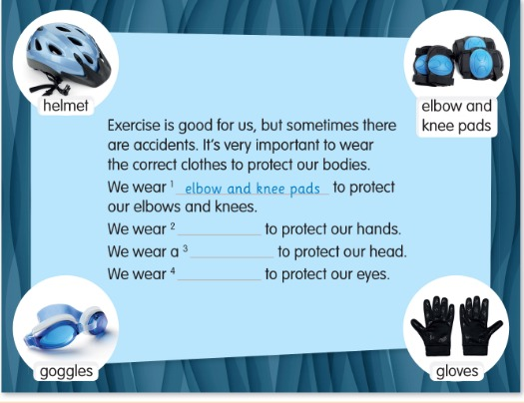
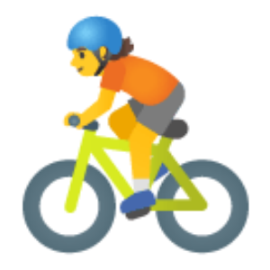
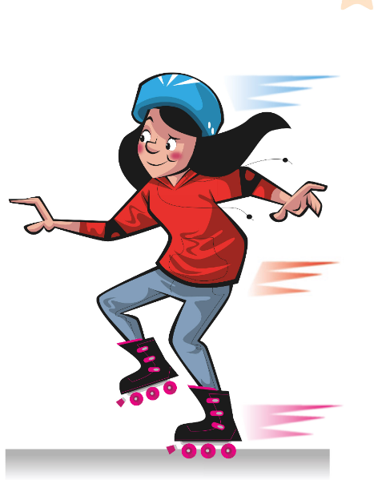
UNIT 2 · LESSON 4
Today: be safe in sport! ⛑️🧤🥽
Oggi: lo sport in sicurezza!
Let's be healthy!
1
🎬 WATCH
Watch the video.
Guarda il video.
What must you wear?
Cosa devi indossare?
2
📖 READ
Read about safe sport.
Leggi come fare sport in sicurezza.
3
🏃 MOVE
Get ready for sport!
Preparati per lo sport!
📘 Pupil's Book pp.24–25 · 🎬 video · 🎧 1.32–1.33
Notes:
COVER (1 min). Ask: What do you like doing in your free time? Do you wear special clothes to do it? Why? 'Let's find out!'

Slide 2


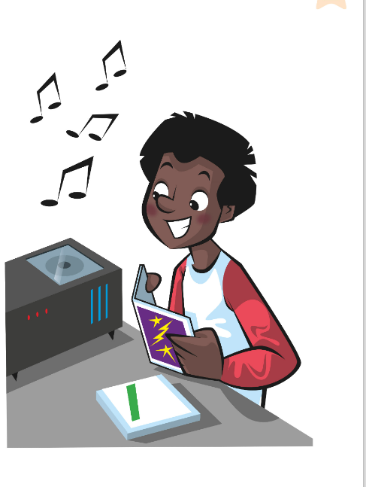
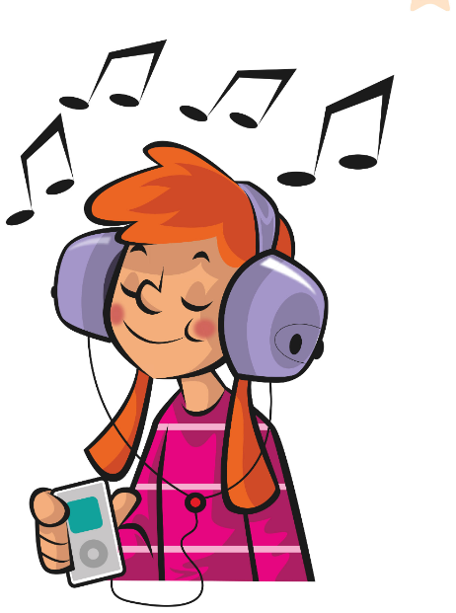
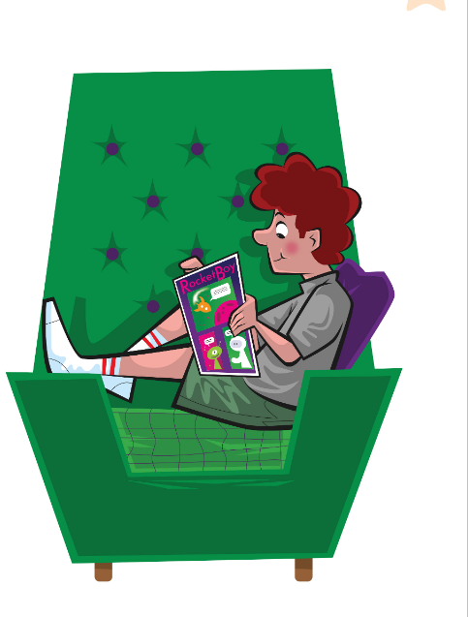
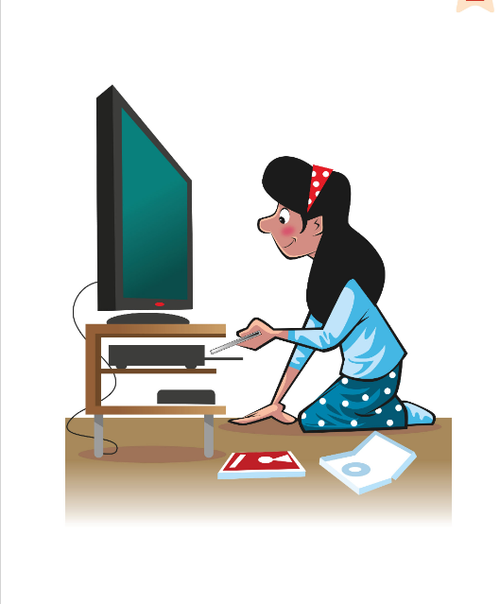
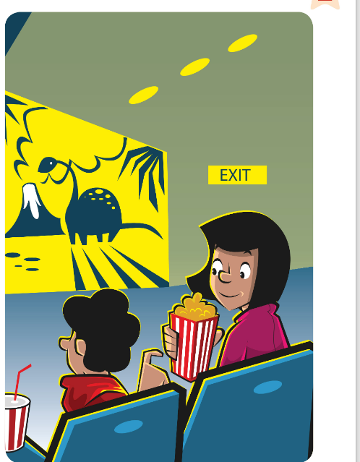
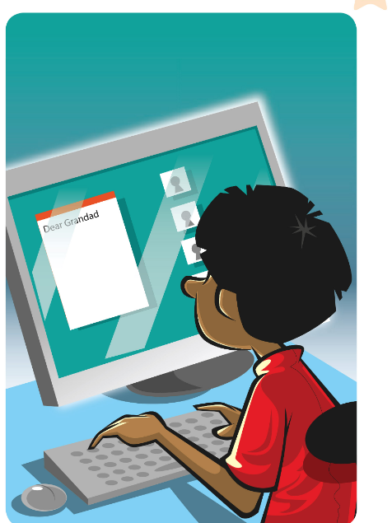
GAME
👀 Look for 10 seconds. Remember ALL the pictures!
Guarda e ricorda tutte le immagini!
Look and remember!
📘 Retrieval · Lesson 3 free time activities
Notes:
WHAT'S MISSING? Step 1 – LOOK (10 s). Say the words together first (choral). Count down aloud. Then: "Close your eyes!" and go to the next slide.

Slide 3
GAME
Open your eyes! What's missing? Write it or whisper it to your partner.
Apri gli occhi! Cosa manca? Scrivilo o dillo al compagno.
What's missing?
?
Notes:
Step 2 – COMMIT. Students write the word on a mini-whiteboard / paper (or teams agree in 10 s). 'Show me!' Then go to the next slide. Points: 1 per team with the right word, +1 if spelt correctly.

Slide 4
ANSWER
read a comic!
leggere un fumetto!
Were you right?
Notes:
Step 3 – REVEAL. The missing card comes back with a green frame. Everybody says the word 3 ways: whisper, normal, monster voice. RETRIEVAL OF LESSON 3 (4 min, 2 rounds). No labels: learners must RECALL the phrases. Teams write the missing phrase on paper (spelling counts: +1). Round 2 (two missing) = go skating + watch a film. After each reveal: 'How often do you …?' – one learner answers with an adverb.

Slide 5
GAME · ROUND 2 🔥
👀 Look for 15 seconds. Remember ALL the pictures!
Guarda e ricorda tutte le immagini!
Look and remember!
📘 Retrieval · Lesson 3 free time activities
Notes:
WHAT'S MISSING? Step 1 – LOOK (15 s). Say the words together first (choral). Count down aloud. Then: "Close your eyes!" and go to the next slide.

Slide 6
GAME · ROUND 2 🔥
TWO pictures are missing! Write them down.
Mancano DUE immagini! Scrivile.
What's missing?
?
?
Notes:
Step 2 – COMMIT. Students write the word on a mini-whiteboard / paper (or teams agree in 10 s). 'Show me!' Then go to the next slide. Points: 1 per team with the right word, +1 if spelt correctly.

Slide 7
ANSWER
It's: go skating and watch a film!
Were you right?
Notes:
Step 3 – REVEAL. The missing card comes back with a green frame. Everybody says the word 3 ways: whisper, normal, monster voice. RETRIEVAL OF LESSON 3 (4 min, 2 rounds). No labels: learners must RECALL the phrases. Teams write the missing phrase on paper (spelling counts: +1). Round 2 (two missing) = go skating + watch a film. After each reveal: 'How often do you …?' – one learner answers with an adverb.

Slide 8



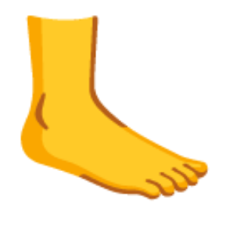


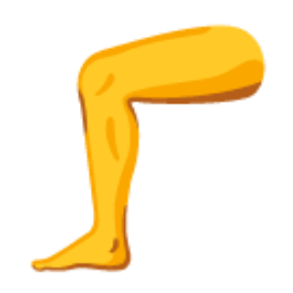

GAME
Only move if the teacher says 'Teacher says'!
Muoviti solo se l'insegnante dice 'Teacher says'!
Teacher says…
🏃 MOVE · ⏱ 3 MIN
Touch your head!
Wave your hand!
Shake your arm!
Stamp your feet!
Close your eyes!
Touch your ears!
Lift your leg!
Touch your nose!
📘 Warm-up · parts of the body (TB p.24)
Notes:
TPR WARM-UP (3 min) – TB. GAME PLAN · SEE: 8 body actions · TEACHER: Give instructions with 'Teacher says…' (do the action too at first, then stop modelling and go faster). Sometimes give an instruction WITHOUT 'Teacher says'. Teach ELBOW and KNEE here: 'Teacher says touch your knees!' · STUDENTS: follow only 'Teacher says' instructions · GROUPING: whole class, standing · SCORE/WIN: anyone who moves without 'Teacher says' (or is last) sits down; last 3 standing win. Stronger learners: lead in pairs · TIME: 3 min · LANGUAGE: head, hand, arm, feet, eyes, ears, leg, nose, elbow, knee · REVEAL: n/a

Slide 9
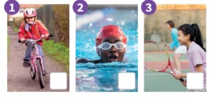
WATCH
Watch the video. What are they doing? Do you do it?
Guarda il video. Cosa fanno? Tu lo fai?
Let's be healthy!
👀 LOOK · 🗣 SPEAK
1 Photo 1? Do you do it?
riding a bike 🚲
2 Photo 2? Do you do it?
swimming 🏊
3 Photo 3? Do you do it?
playing tennis 🎾
📘 Pupil's Book p.24 · 🎬 video · ex.1–2
Notes:
PB p.24 ex.1–2 (5 min, with next slide). Play the video (being safe when doing exercise and sports); learners answer the video's questions at the end. Then for each photo: learners whisper the activity to a partner (commit) → click → reveal. Learners tick the ones they do and say: 'I ride a bike.' (TB key: 1 riding a bike 2 swimming 3 playing tennis 4 roller skating 5 playing basketball 6 playing football).

Slide 10
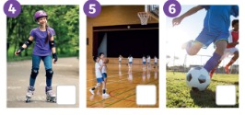
LOOK
What are these activities? Tick ✓ the ones you do.
Quali sono queste attività? Spunta ✓ quelle che fai.
Tick what you do!
👤 ALONE · ✍ TICK
1 Photo 4? Do you do it?
roller skating 🛼
2 Photo 5? Do you do it?
playing basketball 🏀
3 Photo 6? Do you do it?
playing football ⚽
📘 Pupil's Book p.24 · ex.2
Notes:
PB p.24 ex.2 (part 2). KEY: 4 roller skating 5 playing basketball 6 playing football. Quick class survey (TB extension): 'Who likes riding a bike? Hands up!' – count and write. Stronger learners: 'I often play football / once a week.'

Slide 11

FLASHCARDS
Look! Say the word before it appears!
Guarda! Di' la parola prima che appaia!
Be safe!
🏃 TPR Put on your helmet! Click! ⛑️
casco
helmet
📘 Pupil's Book p.24 · ex.3
1 / 6
Notes:
SAFETY WORDS (6 min). Picture first – learners guess (Italian OK), click 1 word, click 2 Italian, click 3 TPR. Ask: Which part of the body does a helmet protect? (Head) 'It PROTECTS your head.' (proteggere). Have you got a helmet? When do you wear it? 'warm up' and 'sun cream' come from p.25. TPR: Put on your helmet! Click! ⛑️

Slide 12

FLASHCARDS
Look! Say the word before it appears!
Guarda! Di' la parola prima che appaia!
Be safe!
🏃 TPR Touch your elbows… touch your knees!
gomitiere e ginocchiere
elbow and knee pads
📘 Pupil's Book p.24 · ex.3
2 / 6
Notes:
SAFETY WORDS (6 min). Picture first – learners guess (Italian OK), click 1 word, click 2 Italian, click 3 TPR. Ask: Which part of the body does a helmet protect? (Head) 'It PROTECTS your head.' (proteggere). Have you got a helmet? When do you wear it? 'warm up' and 'sun cream' come from p.25. TPR: Touch your elbows… touch your knees!

Slide 13

FLASHCARDS
Look! Say the word before it appears!
Guarda! Di' la parola prima che appaia!
Be safe!
🏃 TPR Make goggles with your fingers! 🥽
occhialini
goggles
📘 Pupil's Book p.24 · ex.3
3 / 6
Notes:
SAFETY WORDS (6 min). Picture first – learners guess (Italian OK), click 1 word, click 2 Italian, click 3 TPR. Ask: Which part of the body does a helmet protect? (Head) 'It PROTECTS your head.' (proteggere). Have you got a helmet? When do you wear it? 'warm up' and 'sun cream' come from p.25. TPR: Make goggles with your fingers! 🥽

Slide 14

FLASHCARDS
Look! Say the word before it appears!
Guarda! Di' la parola prima che appaia!
Be safe!
🏃 TPR Put on your gloves – one, two! 🧤
guanti
gloves
📘 Pupil's Book p.24 · ex.3
4 / 6
Notes:
SAFETY WORDS (6 min). Picture first – learners guess (Italian OK), click 1 word, click 2 Italian, click 3 TPR. Ask: Which part of the body does a helmet protect? (Head) 'It PROTECTS your head.' (proteggere). Have you got a helmet? When do you wear it? 'warm up' and 'sun cream' come from p.25. TPR: Put on your gloves – one, two! 🧤

Slide 15
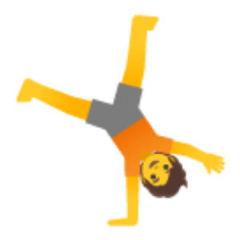
FLASHCARDS
Look! Say the word before it appears!
Guarda! Di' la parola prima che appaia!
Be safe!
🏃 TPR Warm up! Stretch your arms and legs! 🤸
riscaldarsi
warm up
📘 Pupil's Book p.24 · ex.3
5 / 6
Notes:
SAFETY WORDS (6 min). Picture first – learners guess (Italian OK), click 1 word, click 2 Italian, click 3 TPR. Ask: Which part of the body does a helmet protect? (Head) 'It PROTECTS your head.' (proteggere). Have you got a helmet? When do you wear it? 'warm up' and 'sun cream' come from p.25. TPR: Warm up! Stretch your arms and legs! 🤸

Slide 16

FLASHCARDS
Look! Say the word before it appears!
Guarda! Di' la parola prima che appaia!
Be safe!
🏃 TPR Put sun cream on your face and arms! ☀️
crema solare
sun cream
📘 Pupil's Book p.24 · ex.3
6 / 6
Notes:
SAFETY WORDS (6 min). Picture first – learners guess (Italian OK), click 1 word, click 2 Italian, click 3 TPR. Ask: Which part of the body does a helmet protect? (Head) 'It PROTECTS your head.' (proteggere). Have you got a helmet? When do you wear it? 'warm up' and 'sun cream' come from p.25. TPR: Put sun cream on your face and arms! ☀️

Slide 17
SOUNDS 🕵️
Some letters are SILENT. Find them!
Alcune lettere sono MUTE. Trovale!
Silent letter hunt!
👥 PAIRS · 🔍 FIND
knee – silent k! = NEE
HEL-met · GOG-gles (stress the start!)
gloves = zzz at the end 🐝
1 muscles – which letter is silent?
c → MUS-lz 💪
2 listen – which letter is silent?
t → LIS-en 👂
3 Teacher: 'tow-EL'
👎 TOW-el
📘 Pronunciation · silent letters + stress
Notes:
PRONUNCIATION (3 min). Italian learners read every letter (k-nee, mus-kles) and stress the end (hel-MET). Model the rule lines. For each practice item, pairs decide (commit: write the letter in the air with a finger) → click → reveal → everyone says it 3 ways (whisper, normal, monster). Final -s in gloves/goggles is a buzzing 'z' – no extra vowel ('glovesa').

Slide 18
READ
Read, look and complete. Then listen and check.
Leggi, guarda e completa. Poi ascolta e controlla.
Protect your body!
👤 ALONE · ✍ WRITE
1 We wear ___ to protect our elbows and knees.
elbow and knee pads (example)
2 We wear ___ to protect our hands.
gloves
3 We wear a ___ to protect our head.
helmet
4 We wear ___ to protect our eyes.
goggles
📘 Pupil's Book p.24 · 🎧 1.32
Notes:
PB p.24 ex.3 (5 min). Read the text with the class and go through the example. Check 'accidents' (incidenti) and 'bodies' (corpi). Learners complete the sentences individually (commit), then play 1.32: learners listen and check. Then click for each answer. KEY (TB): 2 gloves 3 helmet 4 goggles. Extension (TB): Why do we wear sunglasses? (To protect our eyes) caps or sun hats? (our heads) walking boots? (our feet).

Slide 19
GAME
Draw a sport or a safety thing. Your team guesses!
Disegna uno sport o un oggetto di sicurezza. La tua squadra indovina!
Pictionary!
👥👥 TEAMS · ⏱ 5 MIN
1
🖍️ DRAW
Draw on the board – no words!
Disegna alla lavagna – niente parole!
2
💬 SPEAK
Team: It's a helmet!
Squadra: È un casco!
3
💬 SPEAK
Say: For skating, you must wear…
Di': Per pattinare devi indossare…
📘 helmet · elbow and knee pads · goggles · gloves
⭐ For ___, you must wear …
🔥 Add: to protect your …
Notes:
PICTIONARY (5 min). GAME PLAN · SEE: the 4 safety pictures as a reminder (the words are NOT on screen) · TEACHER: Whisper a word or sport to the drawer (helmet, gloves, goggles, knee pads, sun cream, skating, swimming, riding a bike, ice hockey). Time 30 s. · STUDENTS: the drawer draws (no letters!); their team guesses; then the team makes a safety sentence · GROUPING: 2 teams take turns · SCORE/WIN: correct guess = 1 point; correct sentence 'For swimming, you must wear goggles.' = +1; challenge 'to protect your eyes' = +1 · TIME: 5 min · LANGUAGE: helmet, gloves, goggles, knee pads + For …, you must wear … · REVEAL: the drawer says 'Yes!'; after 30 s the teacher tells the word

Slide 20
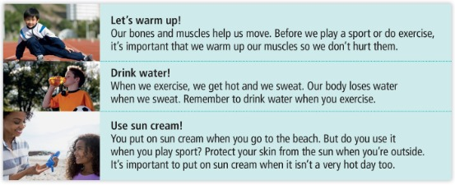
READ
Listen and read. Then say yes or no.
Ascolta e leggi. Poi di' yes o no.
Healthy tips
👂 LISTEN · 👍👎
1 We warm up before exercise to look after our skin.
no ✗ (our muscles)
2 We drink water when we get hot.
yes ✓
3 We use sun cream when we play inside.
no ✗ (outside)
4 Sun cream is always important when you're outside.
yes ✓
📘 Pupil's Book p.25 · 🎧 1.33
Notes:
PB p.25 ex.4 (6 min). Pictures first: What are they doing? (He's warming up / She's putting on sun cream / drinking water). Ask: What happens to our bodies when we exercise? (We get hot.) Teach SWEAT and SKIN (pelle). Play 1.33: learners listen and read. For each sentence: thumbs up (yes) / down (no) = commit → click. Check BONES (ossa) and MUSCLES (muscoli). KEY (TB): 1 no 2 yes 3 no 4 yes. Do you warm up? Show us a warm-up exercise!

Slide 21
GAME
Listen. YES = jump right ➡️. NO = jump left ⬅️!
Ascolta. YES = salta a destra. NO = salta a sinistra!
Yes or no? Jump!
🏃 MOVE · ⏱ 4 MIN
1
👂 LISTEN
➡️ YES ✓
⬅️ NO ✗
Teacher says a sentence.
L'insegnante dice una frase.
2
🏃 MOVE
Yes → right. No → left.
Sì → destra. No → sinistra.
3
💬 SPEAK
Wrong side? Correct the sentence!
Lato sbagliato? Correggi la frase!
📘 Pupil's Book pp.24–25 · review
Notes:
YES/NO JUMP (4 min). GAME PLAN · SEE: just YES (right) / NO (left) – the sentences are only spoken · TEACHER: Say: 1 We wear goggles to protect our feet. (no – our eyes) 2 We drink water when we sweat. (yes) 3 You must wear a helmet on your bike. (yes) 4 You mustn't warm up before football. (no – you must!) 5 We wear gloves to protect our hands. (yes) 6 We put sun cream on our skin. (yes) 7 Knee pads protect our ears. (no – our knees) · STUDENTS: jump right for yes, left for no · GROUPING: whole class standing in the middle · SCORE/WIN: learners on the wrong side get back in by saying the correct sentence; anyone who jumps late is 'out' for one round · TIME: 4 min · LANGUAGE: protect our …, must / mustn't, safety words · REVEAL: the teacher says the answer after everyone has jumped; a learner corrects the false sentences

Slide 22
SPEAK
Tell a partner about your favourite sport or activity.
Parla a un compagno del tuo sport o attività preferita.
My favourite sport
👥 PAIRS · ⏱ 4 MIN
1
👂 LISTEN
I like horse riding. 🐴
I go on Saturdays.
I must wear a helmet and boots.
Teacher's model.
Il modello dell'insegnante.
2
💬 SPEAK
Tell your partner.
Racconta al compagno.
3
💬 SPEAK
Tell the class about your partner!
Racconta alla classe del compagno!
📘 Pupil's Book p.25 · ex.5
⭐ I like… I go on… I must…
🔥 Add: I never / always …
Notes:
PB p.25 ex.5 (4 min). MODEL → SUPPORTED → INDEPENDENT. 1 Model: read the book's speech bubble (on screen); check 'horse riding'. 2 Supported: a confident learner says theirs with the frame on screen. 3 Independent: pairs tell each other, then report: 'Marco likes skating. He goes on Sundays. He must wear knee pads.' (he/she + -s!). Extra support: frames on the board.

Slide 23
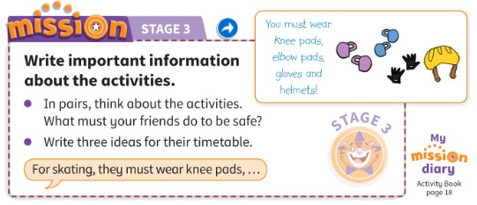
MISSION
Write important information. What must your friends do to be safe?
Scrivi informazioni importanti. Cosa devono fare i tuoi amici per stare al sicuro?
Mission Stage 3
👥 PAIRS · ⏱ 6 MIN
📘 Pupil's Book p.25 · Mission Stage 3
Notes:
MISSION STAGE 3 (6 min). Same pairs as Stage 2, with their timetables. They write THREE safety sentences for their friends, e.g. 'For skating, they must wear knee pads, elbow pads, gloves and helmets.' 'Play tennis – you must use sun cream and drink water.' Paper, scissors and glue: cut out the sentences and stick them on the timetable (drawings / shapes welcome). Extra support: sentence frames for different activities on the board. AB p.18: 'My mission diary 3'.

Slide 24
WELL DONE!
Today I can… · Oggi so…
Show me with your thumbs! 👍 👌 👎
Bye bye! 👋
⭐ I can name 4 things that protect my body.
So nominare 4 cose che proteggono il corpo.
🏠 HOMEWORK · COMPITI
• Homework sheet
• Activity Book p.24: ex.1–3
• Activity Book p.25: ex.4 and 5
⭐ I can say knee and muscles well.
So pronunciare bene knee e muscles.
⭐ I can say what we must do to be safe.
So dire cosa dobbiamo fare per stare al sicuro.
➡ Next: a story – A bad, bad Monday morning!
Notes:
EXIT (3 min). Exit challenge 'Point and say': point to a part of your body; learners shout what protects it (head → helmet! eyes → goggles!). Thumbs for each 'I can'. Add a tick to Stage 3 on the Mission poster. TIMING (core ≈ 59 min): cover 1 · what's missing 4 · teacher says 3 · photos 5 · flashcards 6 · silent letters 3 · protect 5 · pictionary 5 · tips 6 · jump 4 · speaking 4 · mission 6 · exit 3 (+ transitions).

Slide 25


GAME
Get ready for sport! Listen and do it!
Preparati per lo sport! Ascolta e fallo!
EXTRA: Get ready!
🏃 MOVE · ⏱ 4 MIN
Warm up! Stretch!
Put on your helmet!
Put on your knee pads!
Put on your gloves!
Put on your goggles!
Put on sun cream!
Drink some water!
What sport is it?
📘 Ending the lesson (TB p.24)
Notes:
EXTRA GET READY! (4 min) – TB ending. Mime and give instructions for a sport WITHOUT naming it: 'Put on your trainers. Put on elbow pads, knee pads and big shoulder pads. Put on a helmet. Pick up the ball.' Learners follow and then GUESS the sport (American football!). Then a learner gives instructions for another sport (skating, swimming, skiing) and the class guesses.

Slide 26
GAME
Guess the letters. Save the man!
Indovina le lettere. Salva l'omino!
EXTRA: Hangman
👥👥 TEAMS · ⏱ 5 MIN
1
👀 LOOK
_ _ _ _ _ _ ? → Is there an E?
Make a rule: You must wear a … when you …!
Teacher writes _ _ _ _ _ _ on the board.
L'insegnante scrive i trattini.
2
💬 SPEAK
Say a letter: Is there an E?
Di' una lettera: C'è una E?
3
💬 SPEAK
Guess the word + make a rule!
Indovina la parola + fai una regola!
📘 Unit 2 safety words
Notes:
EXTRA HANGMAN (5 min). GAME PLAN · SEE: only blanks (the words are NOT on the slide) · TEACHER: Draw dashes on the board for HELMET, GOGGLES, GLOVES, KNEE PADS, SUN CREAM, MUSCLES, WATER · STUDENTS: teams take turns to say a letter with the English letter name (careful: E = 'ee', I = 'eye', A = 'ay') · GROUPING: 2 teams · SCORE/WIN: a team that guesses the word wins 2 points, +1 if they make a must/mustn't rule with it; a letter said the Italian way doesn't count – try again · TIME: 5 min · LANGUAGE: English letter names + safety words + must · REVEAL: the teacher fills in each correct letter; full word at the end

