Slide 1

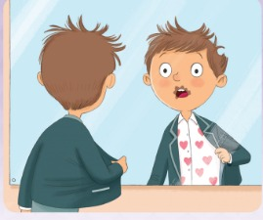


UNIT 2 · LESSON 5
Today: a story – A bad, bad Monday morning 😱
Oggi: una storia – Un lunedì mattina terribile
A bad Monday!
1
📖 READ
Read a story about Alex.
Leggi una storia su Alex.
Oh no! I'm late!
Oh no! Sono in ritardo!
2
💬 SPEAK
Talk about bad things and why.
Parla delle cose brutte e del perché.
3
🏃 MOVE
Act out the story!
Recita la storia!
📘 Pupil's Book pp.26–27 · 🎧 1.34
Notes:
COVER (2 min). Write the title 'A bad, bad Monday morning' on the board. PREDICT: Look at the boy. Why is the morning bad? (learners guess – write 2–3 ideas, check them after the story). Ask: What wakes you up in the morning? Do you have an alarm clock? Why do people need alarms? (So they aren't late.)

Slide 2







REMEMBER?
Team A says a word, Team B says a word… Don't stop!
La squadra A dice una parola, la squadra B un'altra… Non fermatevi!
Vocabulary tennis!
👥👥 TEAMS · ⏱ 3 MIN
1
👀 LOOK
Topic: things that keep us safe.
Tema: cose che ci proteggono.
2
💬 SPEAK
Say a word – ping! Next team – pong!
Di' una parola – ping! L'altra squadra – pong!
3
🎲 PLAY
5 seconds! No repeats!
5 secondi! Niente ripetizioni!
📘 Retrieval · Lesson 4 safety words
Notes:
RETRIEVAL OF LESSON 4 (3 min). GAME PLAN · SEE: 7 pictures from Lesson 4 (no words) · TEACHER: Split the class into 2 teams facing each other. Say the topic and 'serve' the first word: 'Helmet!' · STUDENTS: teams take turns to say one word from the topic; any team member can answer but they can't repeat a word · GROUPING: 2 teams · SCORE/WIN: a team that can't answer in 5 seconds or repeats a word loses the point. Round 2 topic: daily routines (wake up, get up, have a shower…). Round 3 🔥: sentences – 'You must wear a helmet!' · TIME: 3 min · LANGUAGE: helmet, gloves, goggles, knee pads, elbow pads, sun cream, water, warm up, muscles + Unit 2 routines · REVEAL: the teacher points to the pictures not used: 'You forgot… goggles!'

Slide 3

FLASHCARDS
Look! Say the word before it appears!
Guarda! Di' la parola prima che appaia!
Story words
🏃 TPR Ring ring! Turn off the alarm! ⏰
sveglia
alarm clock
📘 Pupil's Book pp.26–27
1 / 4
Notes:
STORY WORDS (4 min). New language (TB): alarm, get dressed (flashcard), lights (= traffic lights), mirror; also blanket (coperta), downstairs (al piano di sotto), presentation (presentazione), assembly hall (aula magna), shout (gridare), suddenly (all'improvviso) – teach those with the story pictures. Traffic lights mini-game: RED – freeze! GREEN – walk! YELLOW – walk slowly! TPR: Ring ring! Turn off the alarm! ⏰

Slide 4
FLASHCARDS
Look! Say the word before it appears!
Guarda! Di' la parola prima che appaia!
Story words
🏃 TPR Put on your T-shirt… and your trousers! 👕
vestirsi
get dressed
📘 Pupil's Book pp.26–27
2 / 4
Notes:
STORY WORDS (4 min). New language (TB): alarm, get dressed (flashcard), lights (= traffic lights), mirror; also blanket (coperta), downstairs (al piano di sotto), presentation (presentazione), assembly hall (aula magna), shout (gridare), suddenly (all'improvviso) – teach those with the story pictures. Traffic lights mini-game: RED – freeze! GREEN – walk! YELLOW – walk slowly! TPR: Put on your T-shirt… and your trousers! 👕

Slide 5

FLASHCARDS
Look! Say the word before it appears!
Guarda! Di' la parola prima che appaia!
Story words
🏃 TPR Red = STOP! Green = GO! 🚦
semaforo
traffic lights
📘 Pupil's Book pp.26–27
3 / 4
Notes:
STORY WORDS (4 min). New language (TB): alarm, get dressed (flashcard), lights (= traffic lights), mirror; also blanket (coperta), downstairs (al piano di sotto), presentation (presentazione), assembly hall (aula magna), shout (gridare), suddenly (all'improvviso) – teach those with the story pictures. Traffic lights mini-game: RED – freeze! GREEN – walk! YELLOW – walk slowly! TPR: Red = STOP! Green = GO! 🚦

Slide 6

FLASHCARDS
Look! Say the word before it appears!
Guarda! Di' la parola prima che appaia!
Story words
🏃 TPR Look in the mirror… fix your hair! 🪞
specchio
mirror
📘 Pupil's Book pp.26–27
4 / 4
Notes:
STORY WORDS (4 min). New language (TB): alarm, get dressed (flashcard), lights (= traffic lights), mirror; also blanket (coperta), downstairs (al piano di sotto), presentation (presentazione), assembly hall (aula magna), shout (gridare), suddenly (all'improvviso) – teach those with the story pictures. Traffic lights mini-game: RED – freeze! GREEN – walk! YELLOW – walk slowly! TPR: Look in the mirror… fix your hair! 🪞

Slide 7
SOUNDS 👹
Say it in a MONSTER voice! Which part is BIG?
Dillo con la voce da MOSTRO! Quale parte è FORTE?
Monster stress!
👥 PAIRS · 🗣 SPEAK
a-LARM (not A-larm)
BREAK-fast (not brek-FAST)
1 presentation – where's the monster?
pre-sen-TA-tion (4 claps)
2 downstairs
down-STAIRS
3 chocolate
CHOK-lit (only 2!)
4 It's 8 o'clock. Italian: 'Sono le otto' → 'They are 8' ✗
It's eight o'clock ✓
📘 Pronunciation · word stress + It's … o'clock
Notes:
PRONUNCIATION + ITALIAN TRAP (3 min). Model: say the BIG (stressed) part in a monster voice and the rest in a whisper: a-LARM. For each practice word, pairs try it and agree which part is the monster (commit: they say it together) → click → everybody says it. 'chocolate' has only 2 syllables (Italians say cio-co-la-to → 'cho-co-late'). Italian trap: 'Sono le otto' → English uses IT'S: It's eight o'clock (never 'They are eight').

Slide 8
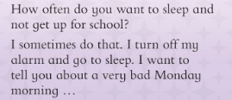
SPEAK
Read the question. Tell a classmate your answer and say why.
Leggi la domanda. Di' la tua risposta a un compagno e spiega perché.
Sleep or get up?
👥 PAIRS · ⏱ 3 MIN
1 Model: How often do you want to sleep and not get up for school?
I often do! I don't like mornings.
2 Does Alex sometimes turn off his alarm?
Yes – 'I sometimes do that.'
📘 Pupil's Book p.26 · ex.1
Notes:
PB p.26 ex.1 (3 min). Read the question; click for the model answer (always / often / sometimes / never + a reason). Frames on the board: 'I always / often / sometimes / never want to sleep because …'. Pairs talk, then 2–3 learners share. Q2: learners read Alex's first lines and answer (commit) → click.

Slide 9
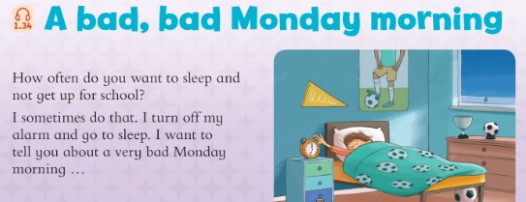
STORY
Listen and read. What's the time?
Ascolta e leggi. Che ore sono?
A bad, bad Monday (1)
👂 LISTEN · 📖 READ
📘 Pupil's Book p.26 · 🎧 1.34
Notes:
STORY (with the next 4 slides, ≈ 12 min). Before listening, ask (TB): Picture 1: Where is the boy? (In his bedroom / in bed) What does he like? (Football) Has he got an alarm clock? (Yes, he has.) What's the time? (Seven o'clock – 'It's seven o'clock!'). Play track 1.34 (first part) and pause at 'school today!'.

Slide 10
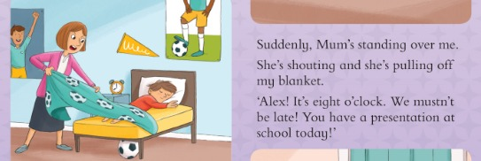
STORY
Who's the woman? Why mustn't they be late?
Chi è la donna? Perché non devono fare tardi?
A bad, bad Monday (2)
📘 Pupil's Book p.26 · 🎧 1.34
Notes:
Picture 2: Who's the woman? (The boy's mum) What's the boy's name? (Alex) What time is it? (Eight o'clock) Why mustn't they be late? (Because he has a presentation at school). Teach 'blanket' and 'suddenly'. PREDICT: 'What happens next? Guess!'

Slide 11
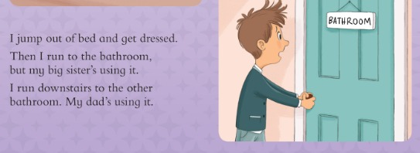
STORY
Why can't Alex use the bathroom?
Perché Alex non può usare il bagno?
A bad, bad Monday (3)
📘 Pupil's Book p.26 · 🎧 1.34
Notes:
Picture 3: What does the boy want to do? (Open the door) Why can't he get in? (guess first: maybe someone is in the bathroom). Play the next part; pause after the third paragraph. What does Alex do after he jumps out of bed? (He gets dressed.) Who's in the bathroom? (His big sister) Who's in the bathroom downstairs? (His dad).

Slide 12
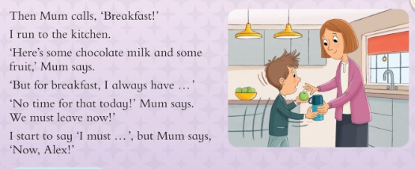
STORY
What does Mum give Alex for breakfast?
Cosa dà la mamma ad Alex per colazione?
A bad, bad Monday (4)
📘 Pupil's Book p.27 · 🎧 1.34
Notes:
Picture 4: Where is the boy? (In the kitchen) What's his mum giving him? (An apple and a drink) Play the next part; pause after 'Now, Alex!' What does Alex have for breakfast? (Chocolate milk and fruit) Does he always have that? (No) Why doesn't he have breakfast at home? (There's no time.)

Slide 13
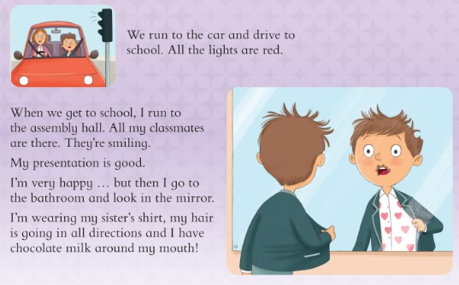
STORY
Is the presentation OK? What does Alex see in the mirror?
La presentazione va bene? Cosa vede Alex nello specchio?
A bad, bad Monday (5)
📘 Pupil's Book p.27 · 🎧 1.34
Notes:
Picture 5: Where are they now? (In the car) – traffic lights. Picture 6: Is the boy happy? (No). Play the rest. Why are they in the car for a long time? (All the traffic lights are red.) Where does Alex go at school? (The assembly hall) Is his presentation OK? (Yes, it's good.) What does he see in the mirror? (His sister's shirt, crazy hair and chocolate milk around his mouth.) Check the cover predictions – who was right?

Slide 14
GAME
Teams: put the story in order 1–6! Then check.
Squadre: mettete la storia in ordine 1–6! Poi controllate.
Story order race!
👥👥 TEAMS · ⏱ 60 SEC
⏱ 60 seconds – write the numbers!
1 We run to the car. All the lights are red.
5
2 Alex turns off his alarm and goes to sleep.
1
3 Alex looks in the mirror. Oh no!
6
4 His big sister is using the bathroom.
3
5 Mum gives him chocolate milk and fruit.
4
6 Mum is shouting: 'It's eight o'clock!'
2
📘 Pupil's Book pp.26–27 · story review
Notes:
STORY ORDER RACE (5 min). GAME PLAN · SEE: 6 story events in the wrong order (numbers hidden) · TEACHER: Books closed! Say 'Go!' and start a 60-second timer · STUDENTS: teams write the order 1–6 on paper (e.g. 2 = …); then hold it up (commit) · GROUPING: teams of 3–4 · SCORE/WIN: 1 point per correct position; all 6 correct = +3 bonus; fastest team with all correct = +1 · TIME: 5 min including checking · LANGUAGE: reading the story sentences; then teams read their order aloud · REVEAL: click 6 times – the numbers appear one by one (answers: 5, 1, 6, 3, 4, 2). Correct order: alarm → Mum shouting → sister in bathroom → chocolate milk → car/lights → mirror

Slide 15
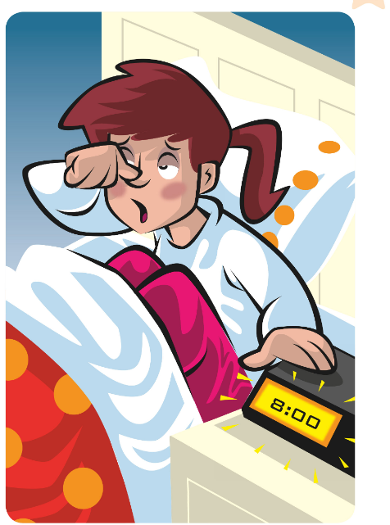


GAME
Listen and act like Alex! Quick – you're late!
Ascolta e fai come Alex! Veloce – sei in ritardo!
Alex's morning
🏃 MOVE · ⏱ 4 MIN
Turn off the alarm! Sleep!
Mum shouts! Wake up!
Jump out of bed! Get dressed!
Knock on the door! Knock!
Drink your chocolate milk!
Drive the car… red light! Stop!
Look in the mirror! Oh no!
📘 Pupil's Book pp.26–27 · story actions
Notes:
TPR ACT OUT THE STORY (4 min). Say the actions in story order; learners act them out. Then mix the order. Extension (TB p.27): pairs act out the story – one is Alex, one is Mum. Play the audio; they do the actions and join in with their characters' lines.

Slide 16
THINK
What bad things happen to Alex? Why? Think first!
Quali cose brutte succedono ad Alex? Perché? Pensa prima!
Bad things… why?
👥 PAIRS · 🗣 SPEAK
1 Alex wakes up late. Why?
He turns off his alarm.
2 He can't use the bathroom upstairs.
His big sister is using it.
3 He can't use the bathroom downstairs.
His dad is using it.
4 He doesn't have his usual breakfast.
There's no time.
5 He arrives at school late.
All the traffic lights are red.
6 He's very surprised in the mirror.
Sister's shirt, bad hair, chocolate milk!
📘 Pupil's Book p.27 · ex.2
Notes:
PB p.27 ex.2 (5 min). For each bad thing: pairs think of the reason (commit: whisper), a volunteer answers 'Because …', then click to reveal (TB answers). SOCIAL AND EMOTIONAL SKILL: Alex has a bad Monday because he gets up late – there are CONSEQUENCES (conseguenze) to his actions. Ask: Do you sometimes get up late? What happens? Quick extension: 'What can Alex do next Monday?' (go to bed early, put the alarm far from the bed…).

Slide 17
SPEAK
Ask and answer: Tell me about your favourite day of the week.
Chiedi e rispondi: Parlami del tuo giorno preferito della settimana.
Tell me about…
👥 PAIRS · ⏱ 4 MIN
1
👂 LISTEN
I love … because …
On … I always / often …
💡 Movers exam: 'Tell me about …'
A: Tell me about your favourite day.
A: Parlami del tuo giorno preferito.
2
💬 SPEAK
B: I love Fridays. We play games!
B: Amo il venerdì. Giochiamo!
3
💬 SPEAK
Swap! Then tell the class.
Scambiatevi! Poi raccontate alla classe.
📘 Pupil's Book p.27 · ex.3
⭐ I love … because …
🔥 Say 3 sentences!
Notes:
PB p.27 ex.3 (4 min). MODEL → SUPPORTED → INDEPENDENT. Model: 'I love Fridays. We play games in our English class.' (book example). Point out: in the Movers Speaking test, the examiner may say 'Tell me about…' or 'Let's talk about…'. Supported: a learner answers with the frames. Independent: pairs ask and answer; then 2–3 learners tell the class about their PARTNER (She loves Saturdays because…). Recycles days + adverbs + free time activities.

Slide 18
WELL DONE!
Today I can… · Oggi so…
Show me with your thumbs! 👍 👌 👎
Bye bye! 👋
⭐ I can read and understand a story.
So leggere e capire una storia.
🏠 HOMEWORK · COMPITI
• Homework sheet
• Activity Book p.26: ex.1–3
• Activity Book p.27: ex.4 (🎧 4.14)
⭐ I can say what happens and why.
So dire cosa succede e perché.
⭐ I can say It's eight o'clock.
So dire che ore sono: It's eight o'clock.
➡ Next: Movers practice + Mission in action!
Notes:
EXIT (3 min). Exit challenge: 'One word, one sentence': point to a learner and say a story word (mirror, alarm, lights) – they say one sentence from the story with it. Thumbs for each 'I can'. Give out the homework sheet. TIMING (core ≈ 58 min): cover 2 · tennis 3 · flashcards 4 · stress 3 · sleep 3 · story 12 · order race 5 · TPR 4 · why 5 · speaking 4 · exit 3 (+ transitions; extras below if time).

Slide 19
GAME
Choose! Run to the left or to the right!
Scegli! Corri a sinistra o a destra!
EXTRA: Would you rather…?
🏃 MOVE · ⏱ 4 MIN
1
👂 LISTEN
⬅️ get up at 6 o'clock OR go to bed at 11 o'clock ➡️
⬅️ chocolate milk for breakfast OR pizza for breakfast ➡️
⬅️ have a shower in the morning OR in the evening ➡️
⬅️ wear your sister's shirt OR your dad's shoes ➡️
Teacher: Would you rather… ?
L'insegnante: Preferiresti…?
2
🏃 MOVE
Left or right – choose!
Sinistra o destra – scegli!
3
💬 SPEAK
Say why: I'd rather … because …
Di' perché: Preferisco … perché …
📘 Unit 2 routines · personalisation
⭐ I'd rather … because …
Notes:
EXTRA WOULD YOU RATHER? (4 min). GAME PLAN · SEE: 4 funny choices (left / right) · TEACHER: Read a choice and point left/right. Model the answer: 'I'd rather have pizza because I love pizza!' · STUDENTS: move to the left or right side of the room; 1–2 learners per side say why · GROUPING: whole class · SCORE/WIN: no winners – personal opinions; a bonus clap for a funny reason · TIME: 4 min · LANGUAGE: I'd rather … because … + routines (get up, have breakfast, have a shower, get dressed) · REVEAL: n/a

Slide 20
GAME
Run, read, remember, run back and tell your writer!
Corri, leggi, ricorda, torna e detta al tuo compagno!
EXTRA: Running dictation
👥 PAIRS · ⏱ 6 MIN
1
🏃 MOVE
🏃 Runner + ✍ Writer
📄 5 sentences on the wall
🏆 First pair with 5 correct sentences wins!
Runner: run to the wall. Read!
Corridore: corri al muro. Leggi!
2
💬 SPEAK
Run back and say it.
Torna e dettala.
3
✏️ WRITE
Writer: write it! Then swap.
Chi scrive: scrivila! Poi scambiatevi.
📘 Pupil's Book pp.26–27
Notes:
EXTRA RUNNING DICTATION (6 min). GAME PLAN · SEE: only the rules (the sentences are on paper on the wall) · TEACHER: Before class, print and stick these 5 story sentences on the wall: 1 I turn off my alarm and go to sleep. 2 I jump out of bed and get dressed. 3 We run to the car and drive to school. 4 All the lights are red. 5 I look in the mirror! · STUDENTS: the runner reads one sentence, remembers it, runs back and dictates; swap after each sentence · GROUPING: pairs · SCORE/WIN: first pair with all 5 correct (spelling + capital letters) wins; then they put them in story order for a bonus · TIME: 6 min · LANGUAGE: story sentences; spelling aloud (How do you spell 'mirror'?) · REVEAL: the teacher reads the 5 sentences; pairs self-check

