Slide 1

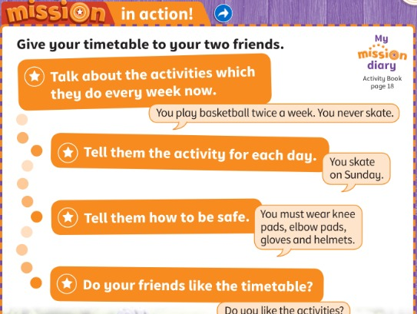

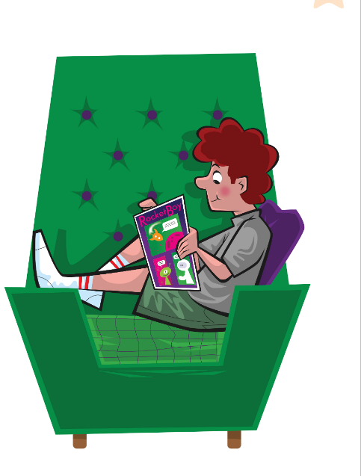
UNIT 2 · LESSON 6
Today: Movers practice + our timetables! 📝🏆
Oggi: esercizi Movers + i nostri programmi!
Mission in action!
1
📖 READ
Read and write: Movers practice.
Leggi e scrivi: esercizi Movers.
Do you like the activities?
Ti piacciono le attività?
2
💬 SPEAK
Present your timetable.
Presenta il tuo programma.
3
🎲 PLAY
Unit 2 team quiz!
Quiz a squadre dell'unità 2!
📘 Pupil's Book pp.28–29 · Activity Book p.29
Notes:
COVER (1 min). Today: Cambridge Movers practice (Reading and Writing Part 1) and the Mission in action – learners give their timetables to their two friends.

Slide 2




REMEMBER?
The teacher starts a sentence from Alex's story. Finish it!
L'insegnante inizia una frase della storia di Alex. Finiscila!
Finish my sentence!
👥👥 TEAMS · ⏱ 3 MIN
1
👂 LISTEN
Teacher: 'I turn off my…'
L'insegnante: 'I turn off my…'
2
💬 SPEAK
Team: '…alarm!'
Squadra: '…alarm!'
3
🎲 PLAY
Fastest hand = 1 point!
Mano più veloce = 1 punto!
📘 Retrieval · Lesson 5 story
Notes:
RETRIEVAL OF LESSON 5 (3 min). GAME PLAN · SEE: 4 story pictures (no sentences) · TEACHER: Say the beginning of a sentence and stop: 1 'I turn off my…' (alarm) 2 'I jump out of bed and get…' (dressed) 3 'My big sister's…' (using the bathroom) 4 'Here's some chocolate milk and some…' (fruit) 5 'All the lights are…' (red) 6 'I go to the bathroom and look in the…' (mirror) 7 'It's eight…' (o'clock) · STUDENTS: put a hand up (one per team) and finish the sentence · GROUPING: 2–3 teams · SCORE/WIN: first correct ending = 1 point; a wrong answer passes to the next team · TIME: 3 min · LANGUAGE: story vocabulary + present simple · REVEAL: the teacher repeats the full sentence; the class repeats it

Slide 3

SOUNDS 🔤
English letters sound different! Listen. Which letter?
Le lettere inglesi suonano diverse! Ascolta. Quale lettera?
Letter traps!
👤 ALONE · ✍ WRITE
A = 'ei' · E = 'ii' · I = 'ai'
G = 'gii' · J = 'gei' · Y = 'uai'
1 Teacher says: 'ii'
E (not I!)
2 Teacher says: 'ai'
I
3 Spell 'leaves'
L – E – A – V – E – S
4 Spell 'email'
E – M – A – I – L
📘 Pronunciation · English letter names
Notes:
PRONUNCIATION – ALPHABET TRAPS (3 min). For Italian children, English E sounds like Italian 'i', English I sounds like 'ai' and A sounds like 'ei' – the #1 problem in spelling activities and in the Movers Listening test (spelling names!). Model the rule lines; learners repeat. Practice: say the letter sound, learners WRITE the letter (commit: show me!) → click. Then you spell slowly, learners write the word → click. Needed for the spelling bee next.

Slide 4
GAME
Listen and spell the word. Right? Stay standing!
Ascolta e fai lo spelling. Giusto? Resta in piedi!
Spelling bee!
🗣 WHOLE CLASS · ⏱ 5 MIN
1
👂 LISTEN
🐝 Easy word = 1 point
🐝🐝 Medium word = 2 points
🐝🐝🐝 Boss word = 3 points!
Teacher says a word from Unit 2.
L'insegnante dice una parola dell'unità 2.
2
💬 SPEAK
Spell it: T-O-W-E-L!
Fai lo spelling: T-O-W-E-L!
3
🏃 MOVE
Wrong? Sit down. Last one standing wins!
Sbagliato? Siediti. L'ultimo in piedi vince!
📘 Unit 2 vocabulary
Notes:
SPELLING BEE (5 min). GAME PLAN · SEE: only the 3 levels (no words on screen). Words – Easy: towel, lake, comic · Medium: Monday, helmet, skates, goggles · Boss: Wednesday, Thursday, breakfast, toothpaste · TEACHER: Say a word, use it in a sentence ('Towel. I dry my face with a towel. Towel.'). Choose the level per learner – weaker learners get Easy words. · STUDENTS: spell the word aloud letter by letter (English letter names!) · GROUPING: whole class standing · SCORE/WIN: learners choose the level (weaker learners can win points with Easy words); wrong letter = sit down (get back in by spelling the next missed word); most points / last 3 standing win · TIME: 5 min · LANGUAGE: English letter names; Unit 2 words (towel, lake, comic, Monday, helmet, skates, Wednesday, Thursday, breakfast, toothpaste, goggles) · REVEAL: after each attempt the teacher writes the word on the board letter by letter while the class spells it together

Slide 5
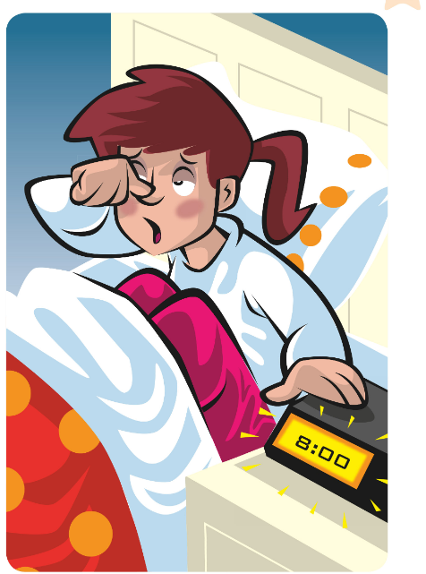



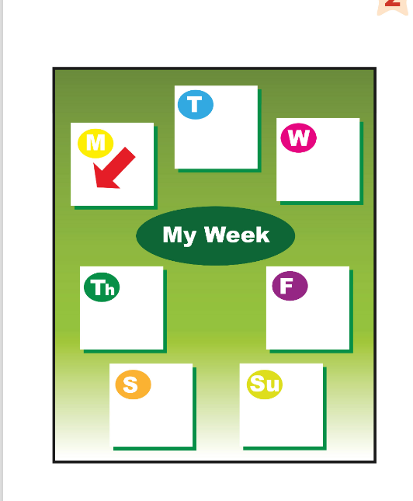
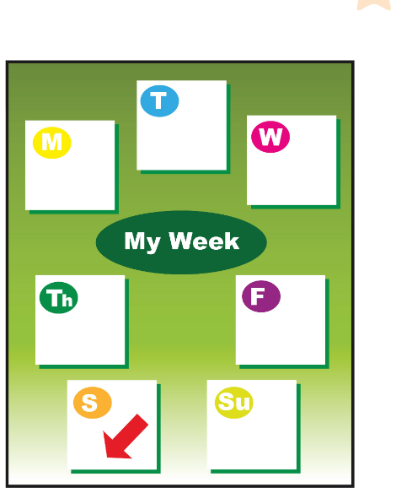
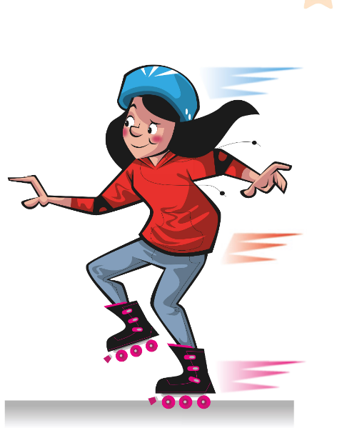
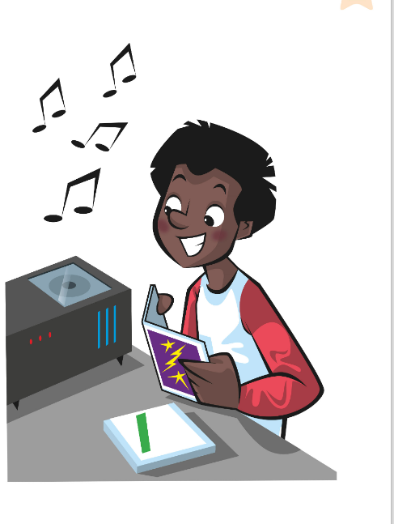
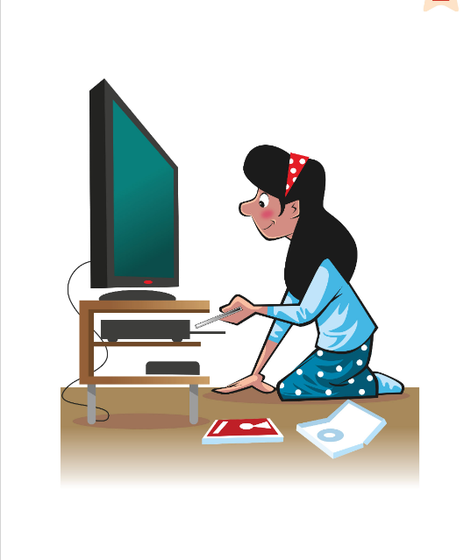
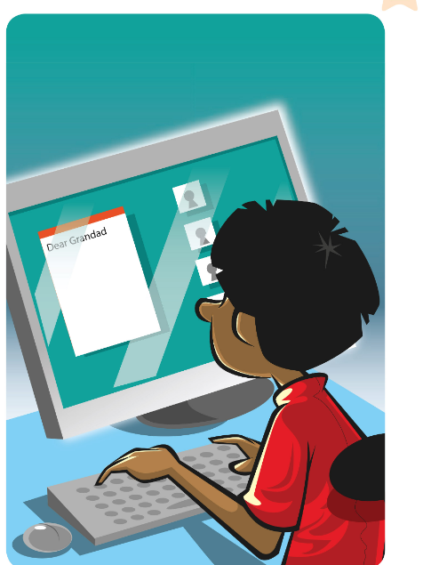
GAME
👀 Look for 10 seconds. Remember ALL the pictures!
Guarda e ricorda tutte le immagini!
Look and remember!
wake up
have a shower
toothpaste
towel
monday
saturday
go skating
listen to a cd
watch a dvd
write an email
📘 Unit 2 flashcards
Notes:
WHAT'S MISSING? Step 1 – LOOK (10 s). Say the words together first (choral). Count down aloud. Then: "Close your eyes!" and go to the next slide.

Slide 6
GAME
Open your eyes! What's missing? Write it or whisper it to your partner.
Apri gli occhi! Cosa manca? Scrivilo o dillo al compagno.
What's missing?
wake up
have a shower
toothpaste
towel
monday
?
saturday
go skating
watch a dvd
write an email
Notes:
Step 2 – COMMIT. Students write the word on a mini-whiteboard / paper (or teams agree in 10 s). 'Show me!' Then go to the next slide. Points: 1 per team with the right word, +1 if spelt correctly.

Slide 7
ANSWER
listen to a CD!
ascoltare un CD!
Were you right?
wake up
have a shower
toothpaste
towel
monday
saturday
go skating
listen to a cd
watch a dvd
write an email
Notes:
Step 3 – REVEAL. The missing card comes back with a green frame. Everybody says the word 3 ways: whisper, normal, monster voice. UNIT 2 REVIEW (3 min). After the reveal, point at cards quickly: learners say a sentence with an adverb (I never listen to CDs!). Bonus point: 'see-dee', not 'ci-di'!

Slide 8
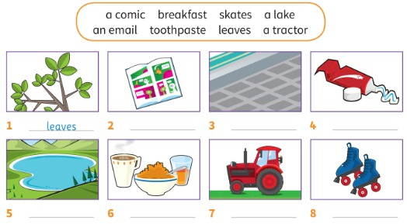
MOVERS
Look at the pictures. Copy a word from the box.
Guarda le immagini. Copia una parola dal riquadro.
Look and read
👥 PAIRS · ✍ WRITE
1 Pictures 1–4
1 leaves (example) · 2 a comic · 3 an email · 4 toothpaste
2 Pictures 5–8
5 a lake · 6 breakfast · 7 a tractor · 8 skates
📘 Pupil's Book p.28 · ex.1
Notes:
PB p.28 ex.1 (5 min). TB presentation: 'Part 1 of the exam has eight pictures. On the next page there are five sentences. You match each sentence with a picture and copy the word carefully. So there are three pictures you don't use.' Pairs write the words (commit), then click once to show all answers. KEY (TB): 1 leaves 2 a comic 3 an email 4 toothpaste 5 a lake 6 breakfast 7 a tractor 8 skates. Ask: How many words have articles? (Four). Note: candidates lose marks for unclear letters. Italian trap: 'an email' (an before a vowel sound).

Slide 9
MOVERS
Read and think. Circle the correct answer.
Leggi e pensa. Cerchia la risposta giusta.
Read and think
👤 ALONE · ✍ CIRCLE
1 You find these on trees and they're green.
leaves (example)
2 Most people eat this in the morning.
breakfast
3 You can use these in the park. It's fun!
skates
4 You write this on a computer or phone.
an email
📘 Pupil's Book p.28 · ex.2
Notes:
PB p.28 ex.2 (4 min). (The slide shows the ex.1 pictures as clues; the sentences are on the right.) TB: point to each picture in Activity 1 and say This is a/an … or These are … Learners practise. Read the first sentence, exaggerating THESE and THEY'RE: plural answer (leaves). Learners do the rest alone (commit), then click. KEY (TB): 2 breakfast 3 skates 4 an email. Strategy: circle the words that help you (these, they're, this, a/an).

Slide 10
MOVERS
Look at the answers. Read and complete.
Guarda le risposte. Leggi e completa.
Read and complete
👤 ALONE · ✍ WRITE
1 You use this to clean your t_ _ _ _.
teeth (→ toothpaste)
2 There are lots of different st_ _ _ _ _ in this.
stories (→ a comic)
📘 Pupil's Book p.28 · ex.3
Notes:
PB p.28 ex.3 (3 min). Learners complete the missing words (commit) → click. KEY (TB): 1 teeth 2 stories. Point out: toothpaste uses 'tooth' but we clean our TEETH (one tooth, two teeth); story → stories.

Slide 11

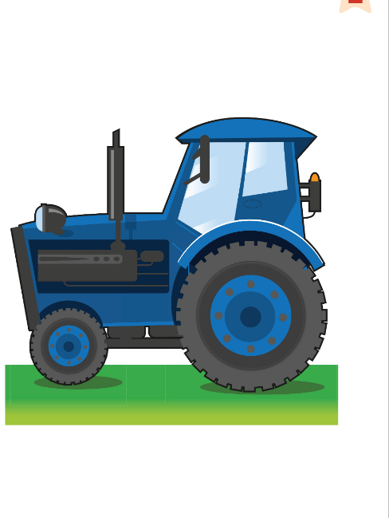
GAME
Write sentences like Activity 3. Can your friend say the words?
Scrivi frasi come nell'attività 3. Il tuo amico indovina le parole?
Guess my word!
👥 PAIRS · ⏱ 5 MIN
1
✏️ WRITE
Write: You use this to…
Scrivi: You use this to…
2
💬 SPEAK
Read it to your partner.
Leggila al compagno.
3
🎲 PLAY
Partner writes the word!
Il compagno scrive la parola!
📘 Pupil's Book p.28 · ex.4
⭐ You use this to … / This is …
🔥 Write 5 – no pictures!
Notes:
PB p.28 ex.4 (5 min). GAME PLAN · SEE: 4 example pictures + frames · TEACHER: Model one: 'You use this to dry your face.' (towel) 'This is the first school day of the week.' (Monday). Write the frames on the board: You use this to … / You can … / There is/are … on the … / This is … / These are … · STUDENTS: each learner writes 3 definitions (challenge: 5, from any Unit 1–2 words); pairs swap and write the words (with a/an or plural!) · GROUPING: pairs · SCORE/WIN: 1 point for each word your partner gets right AND 1 for each correct article/plural · TIME: 5 min · LANGUAGE: definitions with this/these, you use, you can · REVEAL: the writer checks the partner's answers; 2–3 best definitions are read to the class

Slide 12
GAME
Two teams. Answer – then spell one word!
Due squadre. Rispondi – poi fai lo spelling di una parola!
Team quiz: Unit 2!
👥👥 TEAMS · ⏱ 5 MIN
1
👂 LISTEN
1 Which day comes after Wednesday?
2 What does Fred the fish never do?
3 What protects your eyes when you swim?
4 Why is Alex's Monday morning bad?
5 How often do you clean your teeth?
Teacher reads a question.
L'insegnante legge una domanda.
2
💬 SPEAK
Team answers in 10 seconds.
La squadra risponde in 10 secondi.
3
🎲 PLAY
Correct = 1 point. Spelling = bonus!
Giusto = 1 punto. Spelling = bonus!
📘 Unit 2 review
Notes:
TEAM QUIZ (5 min). GAME PLAN · SEE: 5 questions (answers NOT on screen) · TEACHER: Read each question; count down 10 seconds · STUDENTS: teams discuss and write the answer on paper, then show it (commit) · GROUPING: 2–3 teams · SCORE/WIN: correct answer = 1 point; bonus point if the team spells the key word with English letter names (T-H-U-R-S-D-A-Y) · TIME: 5 min · LANGUAGE: Unit 2 review: days, adverbs, safety, story · REVEAL: answers: 1 Thursday 2 talk to cats 3 goggles 4 he turns off his alarm / gets up late 5 open (I always clean my teeth…). The teacher says each answer after all teams have shown theirs

Slide 13
MISSION
Give your timetable to your two friends.
Dai il tuo programma ai tuoi due amici.
Mission in action!
👥👥 GROUPS OF 4 · ⏱ 10 MIN
📘 Pupil's Book p.29 · Mission in action
Notes:
MISSION IN ACTION (10 min). MODEL → PRACTISE → PRESENT. 1 Model (TB): hold up an example survey from Stage 1 and talk about the activities the two learners do every week now ('You play basketball twice a week. You never skate.'); then describe an example timetable day by day with safety advice ('You skate on Sunday. You must wear knee pads…'). 2 Practise: pairs rehearse with their own timetable (sentence frames on the board: You … every week. / On … you … / You must … / Do you like the activities?). 3 Present: each pair joins their Stage 1 pair and presents; then swap. Fast finishers: write a response ('We like the timetable. We want to try horse riding. Our favourite day is Friday.'). Display the timetables on the wall.

Slide 14
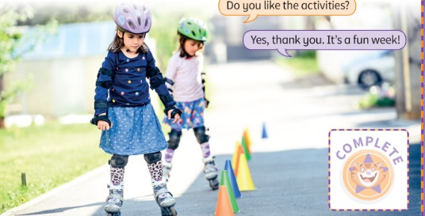
MISSION
Ask your friends. Then think about your mission.
Chiedi ai tuoi amici. Poi pensa alla tua missione.
Did you like it?
👤 ALONE · ✍ WRITE
1 Do you like the activities?
Yes, thank you. It's a fun week!
2 Did you like our Mission?
A lot! 🎉 / It's OK 🙂 / Not much 🤷
3 Write one activity you want to try + a rule.
e.g. I want to try skating. You must wear a helmet.
📘 Pupil's Book p.29 · Activity Book p.18
Notes:
MISSION REFLECTION (4 min) – TB self-assessment. 'Did you like our Mission? A lot? (cheer) It's OK? (smile) Not much? (shrug)'. Then: Write one fun activity you want to try and a rule with must or mustn't – share. AB p.18: review My unit goals; smiley face for My mission diary (final stage); colour the sunflower leaves (green = confident, orange = more practice); 5+ new words in the word stack. SA: tick on the digital Mission poster, completion stickers: 'You have finished your Mission! Well done!' Next Mission (Unit 3): 'Plan and act out a scene'.

Slide 15
WELL DONE!
Today I can… · Oggi so…
Show me with your thumbs! 👍 👌 👎
Bye bye! 👋
⭐ I can do Movers Reading and Writing Part 1.
So fare la Parte 1 di Reading and Writing Movers.
🏠 HOMEWORK · COMPITI
• Homework sheet
• Activity Book p.28: ex.1 (Movers practice)
• Activity Book p.29: board game (play at home!)
⭐ I can spell words with English letters.
So fare lo spelling con le lettere inglesi.
⭐ I can present a fun activities timetable.
So presentare un programma di attività.
➡ Next: Unit 3!
Notes:
EXIT (3 min). Exit challenge: spell your name with English letters to your partner (Movers Listening often asks for names!). Thumbs for each 'I can'. Give out the homework sheet. AB p.28 ex.1: Reading and Writing Part 1 practice. AB p.29: board game for home. TIMING (core ≈ 59 min): cover 1 · finish my sentence 3 · letters 3 · spelling bee 5 · what's missing 3 · look & read 5 · read & think 4 · complete 3 · guess my word 5 · quiz 5 · mission 10 · reflection 4 · exit 3.

Slide 16
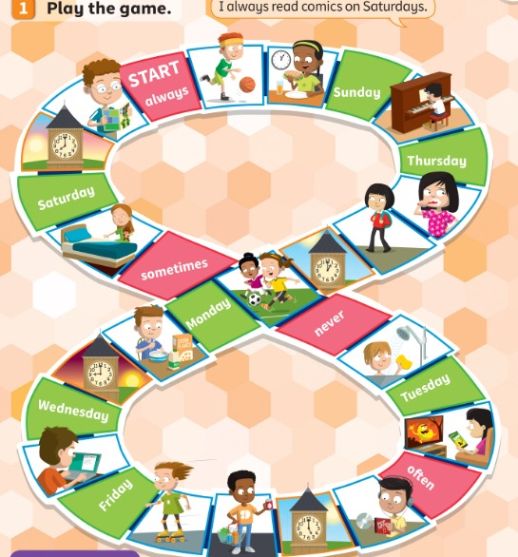
EXTRA
Roll the dice. Make a sentence with the picture and the word!
Tira il dado. Fai una frase con l'immagine e la parola!
EXTRA: Board game!
👥👥 GROUPS · ⏱ 8 MIN
1 Picture + always
I always read comics on Saturdays.
2 Picture + Monday
I play football on Mondays.
3 Picture + never
I never have a shower in the morning.
4 Clock square?
Say the time + a routine: It's 8 o'clock. I have breakfast.
📘 Activity Book p.29 · ex.1 (Units 1–2 review)
Notes:
EXTRA BOARD GAME (8 min). GAME PLAN · SEE: the AB p.29 board (also in the Activity Book) · TEACHER: Model one turn: roll, move, make the sentence from the picture + the word on the coloured square (example on the page: 'I always read comics on Saturdays.'). Click to show model sentences one by one AFTER learners try · STUDENTS: roll the dice, move, say a sentence; the group checks · GROUPING: groups of 3–4 with a dice and counters (rubbers / coins); without ABs: project and play as 2 teams · SCORE/WIN: correct sentence = stay; wrong = go back one square; first to FINISH wins · TIME: 8 min · LANGUAGE: free time activities + days + adverbs (always/often/sometimes/never) · REVEAL: the group decides; teacher is the judge for disputes. ⚠ Clock squares: our suggestion – say the time + a daily routine

Slide 17
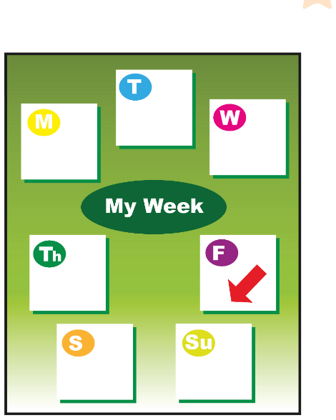
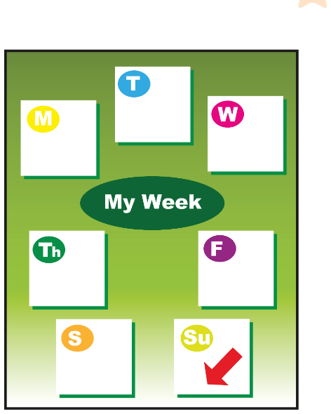
GAME
Turn over two cards. Picture + word = a pair!
Gira due carte. Immagine + parola = una coppia!
EXTRA: Find the pair
👥👥 GROUPS · ⏱ 6 MIN
1
⚙️ DO
Cards face down on the table.
Carte coperte sul tavolo.
2
wake up
have breakfast
go skating
read a comic
💬 SPEAK
Turn two cards. Say the words!
Gira due carte. Di' le parole!
3
🎲 PLAY
A pair? Keep it! Most pairs wins.
Una coppia? Tienila! Vince chi ne ha di più.
write an email
towel
friday
sunday
📘 Unit 2 flashcards
Notes:
EXTRA MEMORY PAIRS (6 min). GAME PLAN · SEE: 8 picture + word cards as an example set · TEACHER: Give each group 8 small picture cards + 8 word cards (or learners make them in 3 minutes) · STUDENTS: take turns to turn over 2 cards, say both aloud; a match = keep the pair + say a sentence ('I often read comics.') · GROUPING: groups of 3–4 · SCORE/WIN: most pairs wins; a pair only counts with a correct sentence · TIME: 6 min · LANGUAGE: Unit 2 vocabulary + adverbs · REVEAL: cards are turned face up; the group checks

