Slide 1

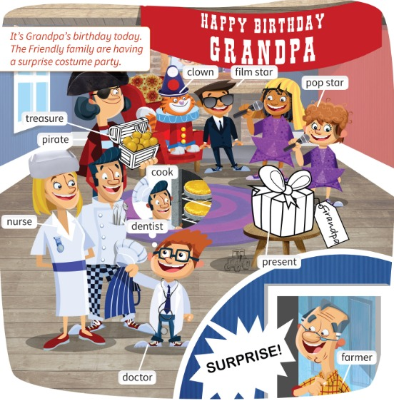
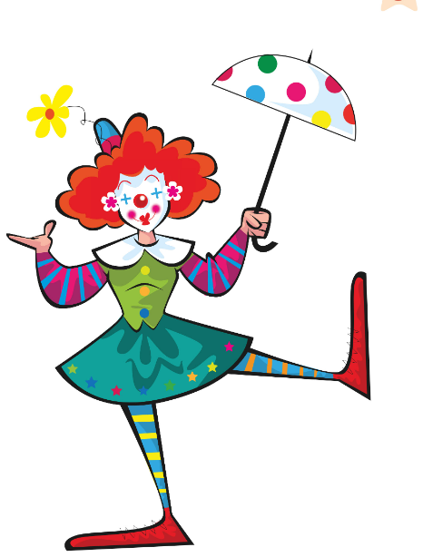
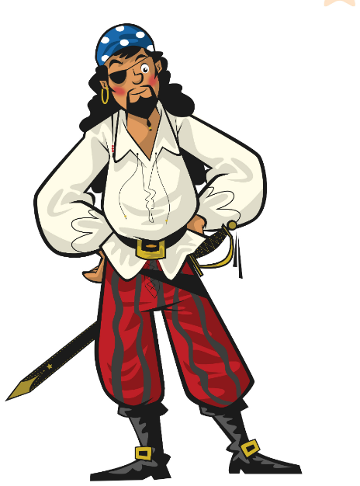
UNIT 3 · LESSON 1
Today: jobs and party words 🎉
Oggi: mestieri e parole della festa
Party time!
1
🎬 WATCH
Watch the party video.
Guarda il video della festa.
Surprise! It's a party!
Sorpresa! È una festa!
2
💬 SPEAK
Learn 11 party words.
Impara 11 parole della festa.
3
🏃 MOVE
Mime the jobs!
Mima i mestieri!
📘 Pupil's Book p.30–31 · 🎬 video · 🎧 1.35–1.37
Notes:
COVER (2 min). Self-assessment (TB30): 'What's happening?' (A party.) Point to the unit title: 'Yes, it's party time! Look, everyone's wearing costumes.' Check 'costume' (vestito in maschera). 'Do you like wearing costumes?' Don't teach the job words yet – they come in the flashcards.

Slide 2
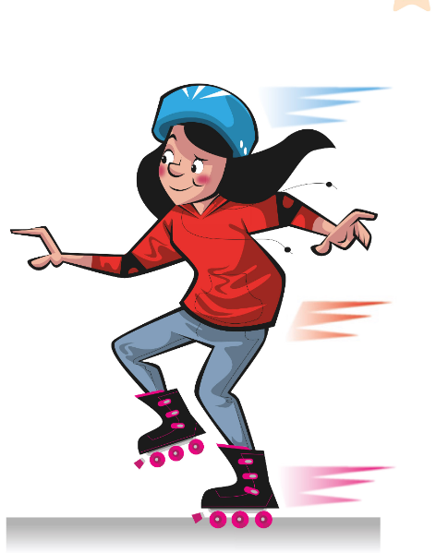

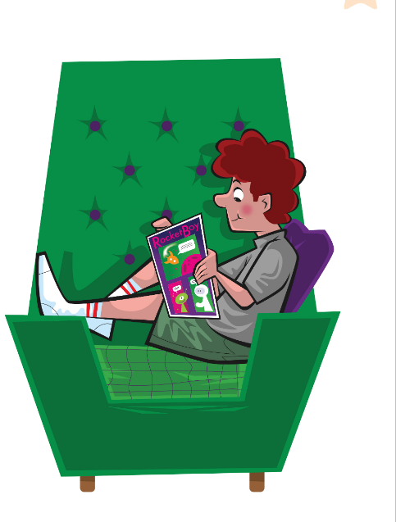
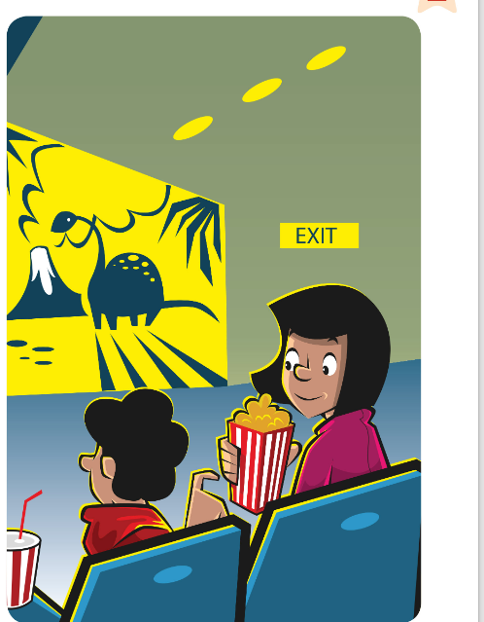
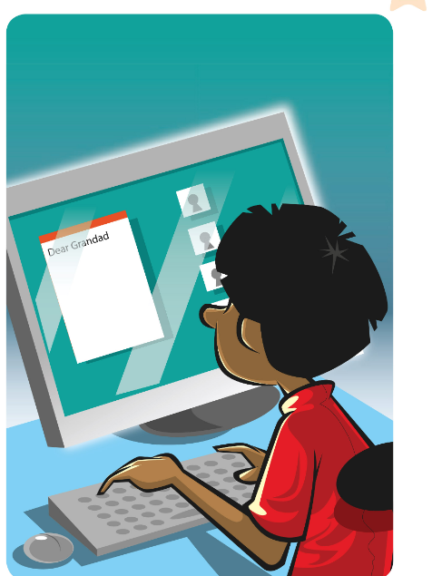



REMEMBER?
Unit 2! Say the words before the time is up!
Unità 2! Di' le parole prima che finisca il tempo!
Beat the clock!
👥👥 TEAMS · ⏱ 20 SEC
1
👀 LOOK
Look at the pictures.
Guarda le immagini.
2
💬 SPEAK
Team: say all 8 in 20 seconds!
Squadra: dite tutte e 8 in 20 secondi!
3
🎲 PLAY
Beat the other team's time!
Batti il tempo dell'altra squadra!
Notes:
RETRIEVAL OF UNIT 2 (3 min). SEE: 8 Unit 2 pictures, NO words. TEACHER: 'Team A – ready, steady, GO!' and time 20 seconds on your phone. STUDENTS: the team says the phrases one by one, pointing (any team member can speak, but each child must say at least one). GROUPING: 2 teams. SCORE: 1 point per correct phrase in 20 s; then Team B tries to beat it. LANGUAGE: go skating, listen to music, read a comic, watch a film, write an email, go shopping, have breakfast, get dressed. REVEAL: the teacher confirms each phrase aloud; disputed ones = class decides. Bonus: 'How often do you go skating?' to the winner.

Slide 3

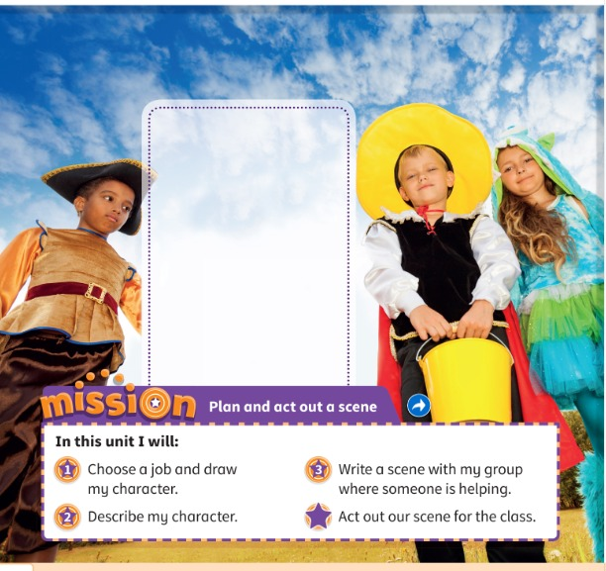
WATCH
Watch the video. Draw yourself at the party.
Guarda il video. Disegnati alla festa.
Costume party!
👤 ALONE · ⏱ 5 MIN
1 What are the children wearing?
Costumes! (a pirate, a vampire, a monster…)
2 Our Mission: Plan and act out a scene!
1 job · 2 describe · 3 write · ⭐ act!
📘 Pupil's Book p.30 · 🎬 Unit 3 video
Notes:
WATCH (5 min). PB p.30 ex.1: play the unit video. 'What are you wearing at the costume party? Draw yourself in the box.' 2 minutes of quick drawing (book or paper). Children can say their costume in Italian if they don't know the word yet – recast in English ('Ah, you're a pirate!'). MISSION (TB30): 'This is our Mission: Plan and act out a scene.' Go through the 4 stages quickly (click 2).

Slide 4
FLASHCARDS
Look! Say the word before it appears!
Guarda! Di' la parola prima che appaia!
What's this?
🏃 TPR Big red nose! Make a funny face! 🤡
pagliaccio
clown
📘 Pupil's Book p.31 · 🎧 1.35
1 / 11
Notes:
FLASHCARDS (8 min). PRESENTATION (TB31): 'I'm a teacher. It's my job. Is Mr Friendly a teacher? (No, a cook.) Let's learn some more jobs.' PICTURE FIRST – students guess (Italian guesses are fine: you say the English). Click 1: word – repeat whisper → normal → monster voice. Click 2: Italian. Click 3: TPR – everyone does it. Always say the full chunk: 'He's a doctor. She's a nurse.' TPR: Big red nose! Make a funny face! 🤡

Slide 5
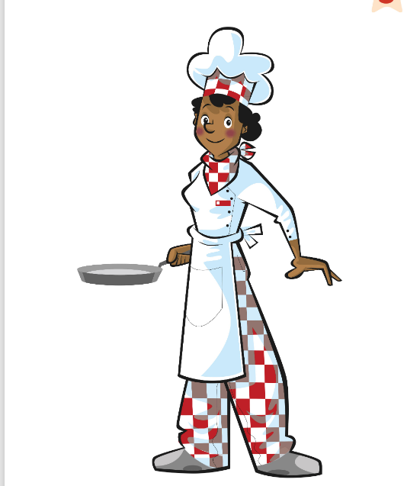
FLASHCARDS
Look! Say the word before it appears!
Guarda! Di' la parola prima che appaia!
What's this?
🏃 TPR Stir the pot! Mmm, yummy! 🍳
cuoco / cuoca
cook
📘 Pupil's Book p.31 · 🎧 1.35
2 / 11
Notes:
FLASHCARDS (8 min). PRESENTATION (TB31): 'I'm a teacher. It's my job. Is Mr Friendly a teacher? (No, a cook.) Let's learn some more jobs.' PICTURE FIRST – students guess (Italian guesses are fine: you say the English). Click 1: word – repeat whisper → normal → monster voice. Click 2: Italian. Click 3: TPR – everyone does it. Always say the full chunk: 'He's a doctor. She's a nurse.' TPR: Stir the pot! Mmm, yummy! 🍳

Slide 6
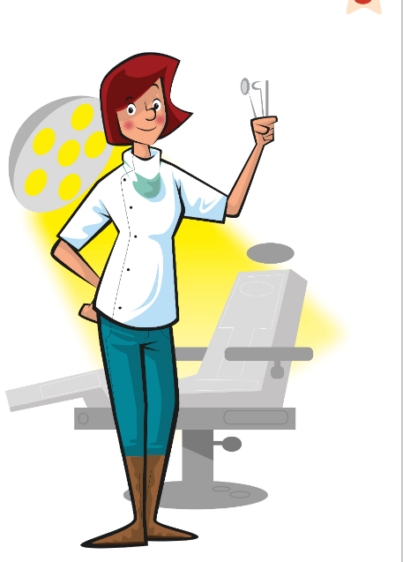
FLASHCARDS
Look! Say the word before it appears!
Guarda! Di' la parola prima che appaia!
What's this?
🏃 TPR Open your mouth! Say 'Aaah!' 🦷
dentista
dentist
📘 Pupil's Book p.31 · 🎧 1.35
3 / 11
Notes:
FLASHCARDS (8 min). PRESENTATION (TB31): 'I'm a teacher. It's my job. Is Mr Friendly a teacher? (No, a cook.) Let's learn some more jobs.' PICTURE FIRST – students guess (Italian guesses are fine: you say the English). Click 1: word – repeat whisper → normal → monster voice. Click 2: Italian. Click 3: TPR – everyone does it. Always say the full chunk: 'He's a doctor. She's a nurse.' TPR: Open your mouth! Say 'Aaah!' 🦷

Slide 7
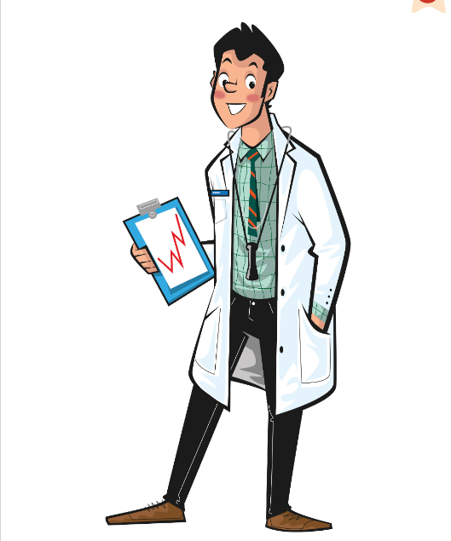
FLASHCARDS
Look! Say the word before it appears!
Guarda! Di' la parola prima che appaia!
What's this?
🏃 TPR Listen to the heart: boom-boom! 🩺
medico / dottore
doctor
📘 Pupil's Book p.31 · 🎧 1.35
4 / 11
Notes:
FLASHCARDS (8 min). PRESENTATION (TB31): 'I'm a teacher. It's my job. Is Mr Friendly a teacher? (No, a cook.) Let's learn some more jobs.' PICTURE FIRST – students guess (Italian guesses are fine: you say the English). Click 1: word – repeat whisper → normal → monster voice. Click 2: Italian. Click 3: TPR – everyone does it. Always say the full chunk: 'He's a doctor. She's a nurse.' TPR: Listen to the heart: boom-boom! 🩺

Slide 8
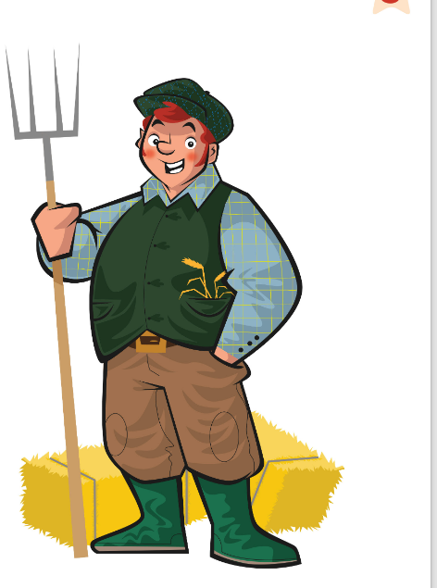
FLASHCARDS
Look! Say the word before it appears!
Guarda! Di' la parola prima che appaia!
What's this?
🏃 TPR Drive the tractor! 🚜
contadino / agricoltore
farmer
📘 Pupil's Book p.31 · 🎧 1.35
5 / 11
Notes:
FLASHCARDS (8 min). PRESENTATION (TB31): 'I'm a teacher. It's my job. Is Mr Friendly a teacher? (No, a cook.) Let's learn some more jobs.' PICTURE FIRST – students guess (Italian guesses are fine: you say the English). Click 1: word – repeat whisper → normal → monster voice. Click 2: Italian. Click 3: TPR – everyone does it. Always say the full chunk: 'He's a doctor. She's a nurse.' TPR: Drive the tractor! 🚜

Slide 9
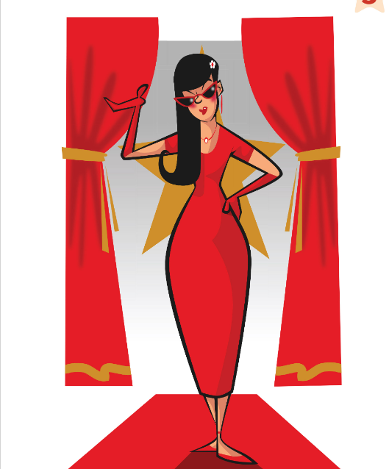
FLASHCARDS
Look! Say the word before it appears!
Guarda! Di' la parola prima che appaia!
What's this?
🏃 TPR Sunglasses on! Smile! 😎
star del cinema
film star
📘 Pupil's Book p.31 · 🎧 1.35
6 / 11
Notes:
FLASHCARDS (8 min). PRESENTATION (TB31): 'I'm a teacher. It's my job. Is Mr Friendly a teacher? (No, a cook.) Let's learn some more jobs.' PICTURE FIRST – students guess (Italian guesses are fine: you say the English). Click 1: word – repeat whisper → normal → monster voice. Click 2: Italian. Click 3: TPR – everyone does it. Always say the full chunk: 'He's a doctor. She's a nurse.' TPR: Sunglasses on! Smile! 😎

Slide 10
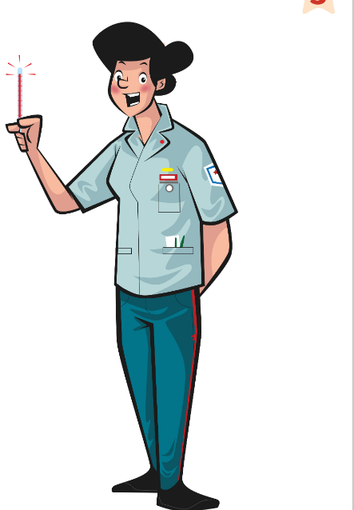
FLASHCARDS
Look! Say the word before it appears!
Guarda! Di' la parola prima che appaia!
What's this?
🏃 TPR Put a plaster on your arm! 🩹
infermiere / infermiera
nurse
📘 Pupil's Book p.31 · 🎧 1.35
7 / 11
Notes:
FLASHCARDS (8 min). PRESENTATION (TB31): 'I'm a teacher. It's my job. Is Mr Friendly a teacher? (No, a cook.) Let's learn some more jobs.' PICTURE FIRST – students guess (Italian guesses are fine: you say the English). Click 1: word – repeat whisper → normal → monster voice. Click 2: Italian. Click 3: TPR – everyone does it. Always say the full chunk: 'He's a doctor. She's a nurse.' TPR: Put a plaster on your arm! 🩹

Slide 11
FLASHCARDS
Look! Say the word before it appears!
Guarda! Di' la parola prima che appaia!
What's this?
🏃 TPR One eye closed! Arrr! 🏴‍☠️
pirata
pirate
📘 Pupil's Book p.31 · 🎧 1.35
8 / 11
Notes:
FLASHCARDS (8 min). PRESENTATION (TB31): 'I'm a teacher. It's my job. Is Mr Friendly a teacher? (No, a cook.) Let's learn some more jobs.' PICTURE FIRST – students guess (Italian guesses are fine: you say the English). Click 1: word – repeat whisper → normal → monster voice. Click 2: Italian. Click 3: TPR – everyone does it. Always say the full chunk: 'He's a doctor. She's a nurse.' TPR: One eye closed! Arrr! 🏴‍☠️

Slide 12
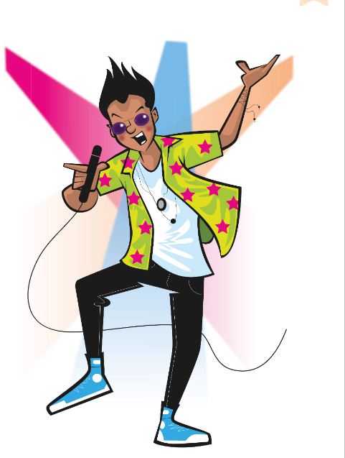
FLASHCARDS
Look! Say the word before it appears!
Guarda! Di' la parola prima che appaia!
What's this?
🏃 TPR Hold the microphone and sing! 🎤
pop star / cantante
pop star
📘 Pupil's Book p.31 · 🎧 1.35
9 / 11
Notes:
FLASHCARDS (8 min). PRESENTATION (TB31): 'I'm a teacher. It's my job. Is Mr Friendly a teacher? (No, a cook.) Let's learn some more jobs.' PICTURE FIRST – students guess (Italian guesses are fine: you say the English). Click 1: word – repeat whisper → normal → monster voice. Click 2: Italian. Click 3: TPR – everyone does it. Always say the full chunk: 'He's a doctor. She's a nurse.' TPR: Hold the microphone and sing! 🎤

Slide 13

FLASHCARDS
Look! Say the word before it appears!
Guarda! Di' la parola prima che appaia!
What's this?
🏃 TPR Open the present! Wow! 🎁
regalo
present
📘 Pupil's Book p.31 · 🎧 1.35
10 / 11
Notes:
FLASHCARDS (8 min). PRESENTATION (TB31): 'I'm a teacher. It's my job. Is Mr Friendly a teacher? (No, a cook.) Let's learn some more jobs.' PICTURE FIRST – students guess (Italian guesses are fine: you say the English). Click 1: word – repeat whisper → normal → monster voice. Click 2: Italian. Click 3: TPR – everyone does it. Always say the full chunk: 'He's a doctor. She's a nurse.' TPR: Open the present! Wow! 🎁

Slide 14
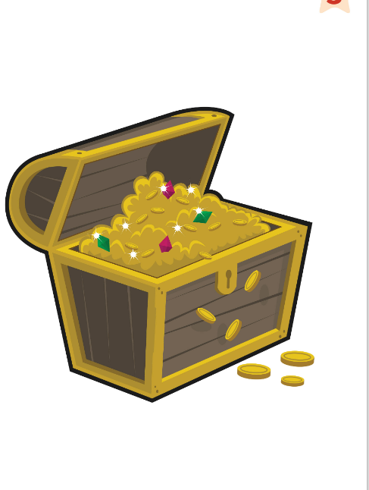
FLASHCARDS
Look! Say the word before it appears!
Guarda! Di' la parola prima che appaia!
What's this?
🏃 TPR Dig, dig, dig… treasure! 💰
tesoro
treasure
📘 Pupil's Book p.31 · 🎧 1.35
11 / 11
Notes:
FLASHCARDS (8 min). PRESENTATION (TB31): 'I'm a teacher. It's my job. Is Mr Friendly a teacher? (No, a cook.) Let's learn some more jobs.' PICTURE FIRST – students guess (Italian guesses are fine: you say the English). Click 1: word – repeat whisper → normal → monster voice. Click 2: Italian. Click 3: TPR – everyone does it. Always say the full chunk: 'He's a doctor. She's a nurse.' TPR: Dig, dig, dig… treasure! 💰

Slide 15
SAY IT!
Clap the word. Which part is BIG?
Batti le mani. Quale parte è FORTE?
Clap it!
🗣 CLASS · ⏱ 4 MIN
1 doctor
DOC-tor ● •
2 dentist
DEN-tist ● •
3 pirate
PI-rate ● • (not pi-RA-ta!)
4 present
PRE-sent ● •
5 treasure
TREA-sure ● •
6 È dottore. → in English?
He's A doctor. (Don't forget 'a'!)
⭐ BIG = ● · small = •
Notes:
PRONUNCIATION (4 min). SEE: the words, answers hidden. TEACHER: say each word, students clap the syllables – a BIG clap on the strong part, a small clap on the weak part. Ask 'Which part is big?' – students hold up 1 or 2 fingers (commit), THEN click to reveal. CATCH IT: say some words wrong on purpose ('doc-TOR', 'pi-RA-te', 'treasur-a') – students shout 'NO!' and say it right. Final consonants: no extra vowel ('dentist', not 'dentist-a'). ITALIAN TRAP (item 6): in Italian 'è dottore', in English we need 'a': 'He's a doctor', 'She's a nurse'. Teams: you say an Italian job sentence, first team with 'a' in the right place wins a point.

Slide 16
LISTEN
Listen and point. Then listen again and colour.
Ascolta e indica. Poi ascolta di nuovo e colora.
Point and colour
👂 LISTEN · ⏱ 5 MIN
1 Whose birthday is it?
Grandpa's! 🎂
2 What colour is the present?
purple 💜
3 What colour is the treasure box?
orange 🧡
📘 Pupil's Book p.31 · 🎧 1.35
Notes:
LISTEN AND POINT (5 min). TB31: 'What's happening? (A birthday party.) Whose birthday is it?' – students answer, then click. Read the caption, teach 'surprise'. Play 1.35: students point. Play again: they colour (or say the colour on the screen version). Before each reveal: 'Show me with your pencil – which colour?' (commit). KEY (TB31): present – purple, treasure box – orange. Audio: Eva and Jenny are pop stars, Tom is a film star (Craig Daniels), Cameron a clown, Grandma a pirate, Jim a doctor, Mrs Friendly a nurse, Mr Friendly a cook, Grandpa a farmer.

Slide 17
CHANT
Say the chant. Stand up for YOUR job!
Di' il chant. Alzati per il TUO mestiere!
Say the chant!
🗣 CLASS · ⏱ 5 MIN
1
👂 LISTEN
It's Farmer Friendly's costume party!
Wear a costume, bring a present.
A clown, a doctor, a pirate with treasure,
A pop star, a film star, a dentist and a nurse.
Mr Friendly's a cook and he's cooking for the party.
Invite everyone to a costume party! (×2)
Listen to the chant.
Ascolta il chant.
2
💬 SPEAK
Say it. Clap the rhythm!
Dillo. Batti il ritmo!
3
🏃 MOVE
Stand up for YOUR job!
Alzati per il TUO mestiere!
📘 Pupil's Book p.31 · 🎧 1.36 · 🎬 chant video
Notes:
CHANT (5 min). Play 1.36 (or the chant video). Check 'invite' (invitare). Round 1: listen and point to the pictures in the book. Round 2: say it with the audio, clapping. Round 3: give each child a job flashcard – they jump up and mime when they hear their job (and sit down fast!). Round 4 (if time): girls / boys alternate lines.

Slide 18
LISTEN
Listen. Who is it? Say the name!
Ascolta. Chi è? Di' il nome!
Who is it?
👥 PAIRS · ⏱ 3 MIN
1 Who's the pirate?
Grandma
2 Who's the film star?
Tom
3 Who are the pop stars?
Eva and Jenny
4 Who's the nurse?
Mrs Friendly
📘 Pupil's Book p.31 · 🎧 1.37
Notes:
LISTEN AND ANSWER part 1 (3 min). Play 1.37 and pause after each question: pairs whisper the name to each other (commit), then one pair says it, then click to reveal. KEY (TB31): 1 Grandma 2 Tom 3 Eva and Jenny 4 Mrs Friendly.

Slide 19
LISTEN
Listen. Who is it? Say the name!
Ascolta. Chi è? Di' il nome!
Who is it?
👥 PAIRS · ⏱ 3 MIN
1 Who's the farmer?
Grandpa
2 Who's the clown?
Cameron
3 Who's the doctor?
Jim
4 Who's the dentist and the cook?
Mr Friendly
📘 Pupil's Book p.31 · 🎧 1.37
🔥 Say: Grandpa's a farmer!
Notes:
LISTEN AND ANSWER part 2. KEY (TB31): 5 Grandpa 6 Cameron 7 Jim 8 Mr Friendly. Challenge: answer with a full sentence and 'a' ('Jim's a doctor').

Slide 20
GAME
👀 Look for 10 seconds. Remember ALL the pictures!
Guarda e ricorda tutte le immagini!
Look and remember!
clown
cook
dentist
doctor
farmer
film star
nurse
pirate
pop star
treasure
📘 Words: Pupil's Book p.31
Notes:
WHAT'S MISSING? Step 1 – LOOK (10 s). Say the words together first (choral). Count down aloud. Then: "Close your eyes!" and go to the next slide.

Slide 21
GAME
Open your eyes! What's missing? Write it or whisper it to your partner.
Apri gli occhi! Cosa manca? Scrivilo o dillo al compagno.
What's missing?
clown
cook
dentist
doctor
farmer
?
film star
nurse
pop star
treasure
Notes:
Step 2 – COMMIT. Students write the word on a mini-whiteboard / paper (or teams agree in 10 s). 'Show me!' Then go to the next slide. Points: 1 per team with the right word, +1 if spelt correctly.

Slide 22
ANSWER
It's the pirate!
È il pirata!
Were you right?
clown
cook
dentist
doctor
farmer
film star
nurse
pirate
pop star
treasure
Notes:
Step 3 – REVEAL. The missing card comes back with a green frame. Everybody says the word 3 ways: whisper, normal, monster voice. WHAT'S MISSING (4 min, 2 rounds). Teams: 1 point for the right word, +1 for 'He's a pirate!' with 'a'. Round 2 = dentist and treasure.

Slide 23
GAME · ROUND 2 🔥
👀 Look for 15 seconds. Remember ALL the pictures!
Guarda e ricorda tutte le immagini!
Look and remember!
clown
cook
dentist
doctor
farmer
film star
nurse
pirate
pop star
treasure
📘 Words: Pupil's Book p.31
Notes:
WHAT'S MISSING? Step 1 – LOOK (15 s). Say the words together first (choral). Count down aloud. Then: "Close your eyes!" and go to the next slide.

Slide 24
GAME · ROUND 2 🔥
TWO pictures are missing! Write them down.
Mancano DUE immagini! Scrivile.
What's missing?
?
clown
cook
doctor
farmer
?
film star
nurse
pirate
pop star
Notes:
Step 2 – COMMIT. Students write the word on a mini-whiteboard / paper (or teams agree in 10 s). 'Show me!' Then go to the next slide. Points: 1 per team with the right word, +1 if spelt correctly.

Slide 25
ANSWER
It's the dentist and the treasure!
Were you right?
clown
cook
dentist
doctor
farmer
film star
nurse
pirate
pop star
treasure
Notes:
Step 3 – REVEAL. The missing card comes back with a green frame. Everybody says the word 3 ways: whisper, normal, monster voice. WHAT'S MISSING (4 min, 2 rounds). Teams: 1 point for the right word, +1 for 'He's a pirate!' with 'a'. Round 2 = dentist and treasure.

Slide 26
GAME
Listen to the teacher and do the action!
Ascolta l'insegnante e fai l'azione!
Party moves!
🏃 CLASS · ⏱ 4 MIN
Clown! Jump and fall down! 🤡
Pirate! Wooden leg walk! 🏴‍☠️
Pop star! Sing and dance! 🎤
Film star! Wave to your fans! 👋
Doctor! 'Open your mouth!' 🩺
Cook! Make a big cake! 🎂
Notes:
TPR – PARTY MOVES (4 min). SEE: 6 pictures; actions appear on click. TEACHER: click and shout the job ('You're a CLOWN!'), model the action once. STUDENTS: stand, do the action and say the word. Round 2 'Simon says': only move if I say 'Simon says… be a pirate!'; wrong move → sit down. GROUPING: whole class. SCORE: last 3 standing = winners (no points needed). LANGUAGE: the 6 jobs (receptive) + 'I'm a clown!' when you point at a child. Keep it fast, 4 min max.

Slide 27
GAME
Mime a job. Your team guesses!
Mima un mestiere. La tua squadra indovina!
Mime it! Who am I?
👥👥 TEAMS · ⏱ 7 MIN
1
👀 LOOK
Look at the secret card.
Guarda la carta segreta.
2
clown
cook
dentist
doctor
⚙️ DO
Mime the job. No words!
Mima il mestiere. Niente parole!
3
💬 SPEAK
Team: 'Are you a …?' – 'Yes, I am!'
Squadra: 'Are you a …?' – 'Yes, I am!'
farmer
film star
nurse
pirate
⭐ Are you a …?
🔥 Are you a nurse or a doctor?
Notes:
MIME IT! (7 min). SEE: the 8 jobs with words (support for weaker children). TEACHER: shows one child a real flashcard secretly (or whispers the job). STUDENTS: the child mimes for 20 seconds; ONLY their team may ask 'Are you a …?' – the mimer answers 'Yes, I am / No, I'm not.' GROUPING: 2 teams, alternating turns. SCORE: correct guess with the full question = 2 points; just the word = 1 point; if the team fails, the other team can steal for 1 point. LANGUAGE: Are you a …? Yes, I am. / No, I'm not. REVEAL: the mimer shows the card. Make sure quieter children get a turn as mimers (no speaking needed).

Slide 28
WELL DONE!
Today I can… · Oggi so…
Show me with your thumbs! 👍 👌 👎
Bye bye! 👋
⭐ I can name jobs and party things.
So dire i mestieri e le cose della festa.
🏠 HOMEWORK · COMPITI
• Homework sheet (jobs!)
• Activity Book p.31: ex.1 (crossword)
⭐ I can say 'He's a doctor' with 'a'.
So dire 'He's a doctor' con 'a'.
⭐ I can say the party chant.
So dire il chant della festa.
➡ Next: the Friendly Farm costume story!
Notes:
EXIT (3 min). Exit challenge: point at 3 children – each says one job with 'a' before leaving ('She's a nurse!'). Thumbs up / middle / down for each 'I can'. AB p.30 = My unit goals (look at it together). AB p.31 ex.2–3 (/ɑː/ sound, AB audio 4.15–4.16) – do them at the start of next lesson.

Slide 29
GAME
Two teams. Run and touch the right picture!
Due squadre. Corri e tocca l'immagine giusta!
EXTRA: Board race!
👥👥 TEAMS · ⏱ 5 MIN
1
👂 LISTEN
Listen to the clue.
Ascolta l'indizio.
2
🏃 MOVE
Run and touch the card first!
Corri e tocca la carta per primo!
3
💬 SPEAK
Say: 'She's a nurse!' = 1 point
Di': 'She's a nurse!' = 1 punto
Notes:
EXTRA – BOARD RACE (5 min). SEE: 8 pictures, no words (also stick real flashcards on the board). TEACHER: gives a CLUE, not the word: 'This person looks at your teeth' (dentist), 'You give it at a birthday party' (present), 'This person sings' (pop star), 'A pirate loves it' (treasure), 'This person makes food' (cook), 'This person has got a tractor' (farmer), 'This person works with a doctor' (nurse), 'Big red nose!' (clown). STUDENTS: one runner per team touches the card. GROUPING: 2 teams, new runners each round. SCORE: touch first = 1 point, +1 if they say the sentence with 'a'. LANGUAGE: He's / She's a …. REVEAL: teacher says the answer and the class repeats.

