Slide 1

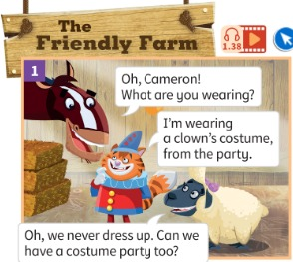
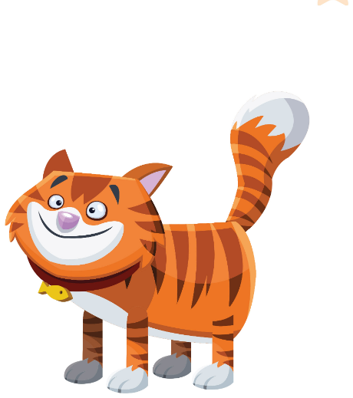

UNIT 3 · LESSON 2
Today: a story + always / now 🤡
Oggi: una storia + always / now
Dressing up!
1
👂 LISTEN
Listen to the Friendly Farm story.
Ascolta la storia della fattoria.
What are you wearing?
Cosa indossi?
2
💬 SPEAK
He never… / He's …ing now!
Lui non… mai / Ora sta…!
3
🖍️ DRAW
Choose a job for our Mission.
Scegli un mestiere per la Missione.
📘 Pupil's Book p.32–33 · 🎧 1.38–1.41 · 🎬 story video
Notes:
COVER (2 min). 'Look! Who can you see?' Students name the characters. Teach 'dress up' (travestirsi). Ask: 'Do you like dressing up? What do you dress up as?'

Slide 2

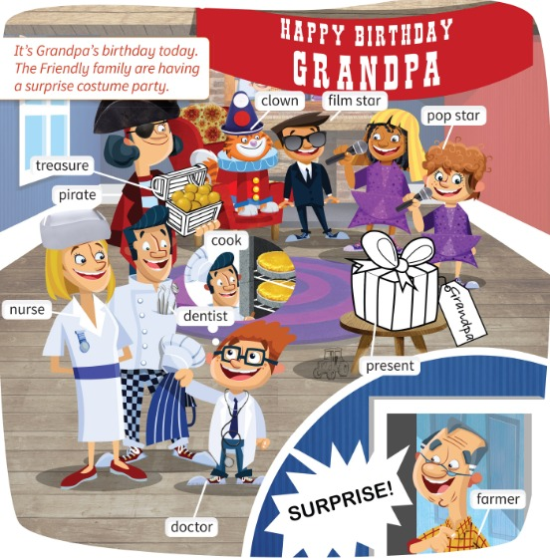
REMEMBER?
👀 Look for 30 seconds. Remember WHO is WHAT!
Guarda 30 secondi. Ricorda chi fa cosa!
30-second memory!
👀 LOOK · ⏱ 30 SEC
📘 Pupil's Book p.31
Notes:
RETRIEVAL OF LESSON 1 – PICTURE MEMORY (4 min with the next slide). SEE: the party picture from last lesson. TEACHER: 'You have 30 seconds. Remember who is the nurse, the pirate, the farmer…' Count down the last 5 seconds aloud. Then 'Close your books!' and go to the next slide.

Slide 3

REMEMBER?
No picture! Write the name. Then check.
Niente immagine! Scrivi il nome. Poi controlla.
Who's who?
👥 PAIRS · ✍ WRITE · ⏱ 3 MIN
1 Who's a nurse?
Mrs Friendly
2 Who's a pirate?
Grandma
3 Who's a farmer?
Grandpa
4 Who's a cook?
Mr Friendly
5 Who's a film star?
Tom
6 Who's a clown?
Cameron
⭐ Mrs Friendly · Grandma · Tom…
Notes:
PICTURE MEMORY – COMMIT AND REVEAL. Pairs write the 6 names on paper (no book!). Then click the answers one by one; pairs tick and count. SCORE: 1 point per name; best pair = 'memory champions'. Support (say it only if needed): names to choose from – Mrs Friendly, Mr Friendly, Grandma, Grandpa, Tom, Cameron. Bonus: answer with 'a' – 'Mrs Friendly's a nurse.'

Slide 4
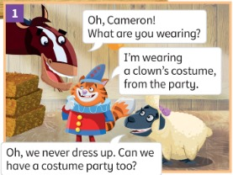
STORY
Listen and read. What's Cameron wearing?
Ascolta e leggi. Cosa indossa Cameron?
The Friendly Farm 1
👂 LISTEN · 👀 LOOK
1 What's Cameron wearing?
a clown's costume
2 How often do the animals wear costumes?
Never!
3 What does Shelly want to do?
Have a costume party
📘 Pupil's Book p.32 · 🎧 1.38 · 🎬 story video
Notes:
STORY (12 min for all 6 pictures). First play the Friendly Farm song (1.38 intro, TB32). Then play the story audio/video, pausing after each picture. Ask the questions (TB32). Picture 1: (Never) (Have a costume party). Note (TB): 'a clown's costume' and 'a clown costume' are both correct.

Slide 5
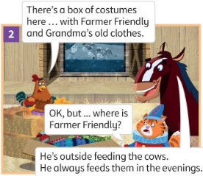
STORY
Listen and read. Where's Farmer Friendly?
Ascolta e leggi. Dov'è il contadino Friendly?
The Friendly Farm 2
1 Whose clothes are in the box?
Grandma and Grandpa's
2 Where's Farmer Friendly?
He's outside feeding the cows.
3 When does he feed them?
always in the evenings
📘 Pupil's Book p.32 · 🎧 1.38
Notes:
Picture 2 (TB32): Whose clothes are in the box? (Grandma and Grandpa's clothes) Where's Grandpa? (He's feeding the cows.) Point out: 'He's feeding the cows' = now; 'He always feeds them' = every day.

Slide 6
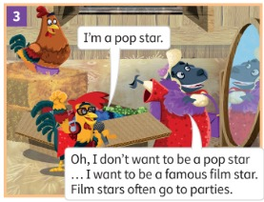
STORY
Listen and read. What does Shelly want to be?
Ascolta e leggi. Cosa vuole essere Shelly?
The Friendly Farm 3
1 What costume is Rocky wearing?
a pop star costume
2 What does Shelly want to be?
a famous film star
3 Why?
Because film stars often go to parties.
📘 Pupil's Book p.32 · 🎧 1.38
Notes:
Picture 3 (TB32): What costume is Rocky wearing? (Pop star) Why does Shelly want to be a film star? (Because they go to lots of parties.) Explain 'famous' (famoso). Ask: 'Do you want to be famous?'

Slide 7
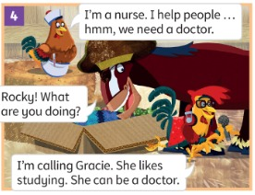
STORY
Listen and read. What's Rocky doing?
Ascolta e leggi. Cosa sta facendo Rocky?
The Friendly Farm 4
1 What costume is Henrietta wearing?
a nurse costume
2 What's Rocky doing?
He's calling Gracie.
3 What does Gracie like doing?
studying 📚
📘 Pupil's Book p.32 · 🎧 1.38
Notes:
Picture 4 (TB32): What costume is Henrietta wearing? (Nurse) What does Gracie like doing? (Studying.) Explain 'call' (chiamare).

Slide 8
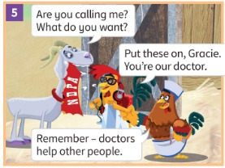
STORY
Listen and read. What's Gracie's costume?
Ascolta e leggi. Qual è il costume di Gracie?
The Friendly Farm 5
1 What costume does Gracie put on?
a doctor costume 🩺
2 What must Gracie remember?
Doctors help other people.
📘 Pupil's Book p.32 · 🎧 1.38
Notes:
Picture 5 (TB32): What costume does Gracie put on? (A doctor costume.) What must Gracie remember? (Doctors help other people.) Check 'help other people' (aiutare gli altri).

Slide 9
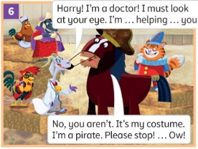
STORY
Listen and read. Is Gracie helping Harry?
Ascolta e leggi. Gracie sta aiutando Harry?
The Friendly Farm 6
1 What does Gracie want to look at?
Harry's eye 👁️
2 Does Harry need a doctor?
No! It's his pirate costume.
3 Is she helping Harry?
No, she isn't! Ow!
📘 Pupil's Book p.32 · 🎧 1.38
Notes:
Picture 6 (TB32): What does Gracie want to look at? (Harry's eye) Is she helping Harry? (No, she isn't.) Does Harry need a doctor? (No – he doesn't have a problem with his eye, it's his pirate costume.) Draw a pirate with an eye patch on the board. Act out picture 6 with a volunteer!

Slide 10
LISTEN
Books closed! Listen and complete. Use one word.
Libri chiusi! Ascolta e completa. Usa una parola.
Use one word!
👤 ALONE · ✍ WRITE · ⏱ 2 MIN
1 Harry: Oh, Cameron! What are you …
wearing?
2 Shelly: Oh, we never dress …
up
3 Harry: He's outside feeding the …
cows
4 Shelly: I want to be a famous film …
star
📘 Pupil's Book p.32 · 🎧 1.39
Notes:
LISTEN AND COMPLETE (5 min, both slides). Books closed. Play 1.39 and pause for students to complete. Extra support: write the missing words in random order on the board. KEY (TB32): 1 wearing? 2 up 3 cows 4 star.

Slide 11
LISTEN
Books closed! Listen and complete. Use one word.
Libri chiusi! Ascolta e completa. Usa una parola.
Use one word!
👤 ALONE · ✍ WRITE · ⏱ 2 MIN
1 Harry: Rocky! What are you …
doing?
2 Rocky: I'm calling Gracie. She likes …
studying
3 Gracie: Are you calling me? What do you …
want?
4 Gracie: Harry! I must look at your …
eye
📘 Pupil's Book p.32 · 🎧 1.39
Notes:
KEY (TB32): 5 doing? 6 studying 7 want? 8 eye.

Slide 12
GRAMMAR
Gracie's Grammar
👥 PAIRS · ⏱ 6 MIN
He never works at the weekend. ⟷ It's Friday. He's working today.
I don't often listen to the radio. ⟷ I'm not listening to it now.
Do you eat meatballs? ⟷ What are you eating at the moment?
always, often, never = habits now, today, at the moment = now!
1 Look! Rocky ___ a song now. (sing)
's singing
2 Harry never ___ costumes. (wear)
wears
3 ___ you often go to parties? (do)
Do
📘 Pupil's Book p.33 · 🎧 1.40
Notes:
GRAMMAR (6 min, TB33). Play 1.40 – students repeat. Write the sentences on the board, underline the s in 'works' (he/she/it + s). LEFT = present simple (habits: always, often, never). RIGHT = present continuous (now, today, at the moment). Italian: 'Lavora sempre' vs 'Sta lavorando adesso'. Practice: answers on click.

Slide 13

SAY IT!
He / She + verb: add -s! Hiss! 🐍
He / She + verbo: aggiungi -s!
Snake sound -s!
🗣 CLASS · ⏱ 3 MIN
1 He work… every day.
He workSSS! 🐍
2 She feed… the cows.
She feedZZZ! 🐝
3 He watch… TV.
He watch-ES (2 parts!)
4 Lavora oggi? → in English?
Is he working today?
5 Lavora sempre? → in English?
Does he always work?
🔥 Lavora? → Does he work?
Notes:
PRONUNCIATION + ITALIAN TRAP (3 min). Italian speakers often drop the final -s ('he work') or add a vowel ('he work-a'). SEE: sentences, answers hidden. TEACHER: read item 1 without the -s – 'Is that right?' – students hiss 'SSS!' and say it, then click. Feeds = buzzy /z/, watches = extra syllable /ɪz/. CATCH IT: say 'He feed-a the cows' – students catch it. Whisper → normal → monster voice: 'He never works at the weekend!'. ITALIAN TRAP (4–5): Italian uses no helper verb in questions ('Lavora?'); English needs IS (now) or DOES (always). Pairs decide which one before you click.

Slide 14
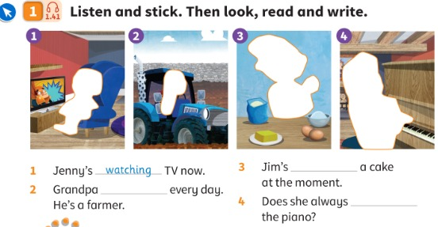
LISTEN
Listen and stick. Then look, read and write.
Ascolta e attacca gli sticker. Poi guarda, leggi e scrivi.
Listen and stick
👂 LISTEN · ✍ WRITE
1 Jenny's ___ TV now.
watching (example)
2 Grandpa ___ every day. He's a farmer.
works
3 Jim's ___ a cake at the moment.
making
4 Does she always ___ the piano?
play
📘 Pupil's Book p.33 · 🎧 1.41
Notes:
LISTEN AND STICK (6 min, TB33). Play 1.41: students point to the correct sticker (Jenny watching TV / Grandpa on the tractor / Jim making a cake / Mrs Friendly at the piano). Play again: they stick. Ask 'What's Jenny doing now?' (Watching TV) and explain: it's happening now → present continuous. Students complete 2–4. KEY (TB33): 2 works 3 making 4 play. Extra support: do all three sentences as a class.

Slide 15
GAME
How often? Walk to your corner!
Quanto spesso? Vai nel tuo angolo!
Four corners!
🏃 CLASS · ⏱ 5 MIN
1
👀 LOOK
I do my homework.
I eat meatballs.
I dress up in a costume.
I go to parties.
I watch TV in the morning.
I help my mum at home.
4 corners: ALWAYS · OFTEN · SOMETIMES · NEVER
4 angoli: sempre · spesso · a volte · mai
2
👂 LISTEN
Listen to the sentence.
Ascolta la frase.
3
🏃 MOVE
Walk to your corner. Say: 'I always …'
Vai nel tuo angolo. Di': 'I always …'
⭐ I always / never …
Notes:
FOUR CORNERS (5 min, TB33 warm-up idea). SEE: 6 sentences. TEACHER: stick 4 sheets on the walls – ALWAYS / OFTEN / SOMETIMES / NEVER – and read one sentence. STUDENTS: walk (don't run!) to the corner that is true for them; 2 children per corner say the full sentence ('I never eat meatballs!'). GROUPING: whole class. SCORE: no points – but 'spot the liar': one child per round may say something false and the class guesses. Then a NOW question about someone: 'Is Marco eating meatballs now?' – 'No, he isn't!'. LANGUAGE: adverbs of frequency + present simple; contrast with present continuous. REVEAL: n/a (personal answers). TIME: 5 min, 5–6 sentences.

Slide 16
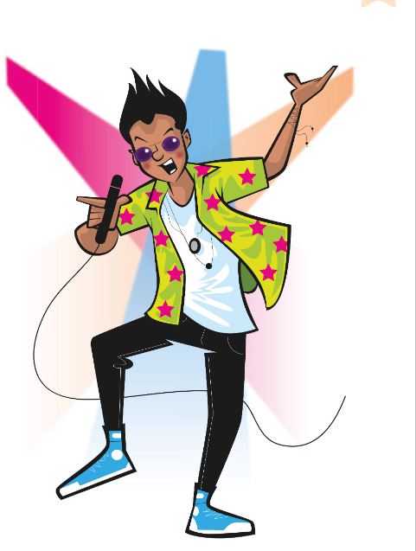
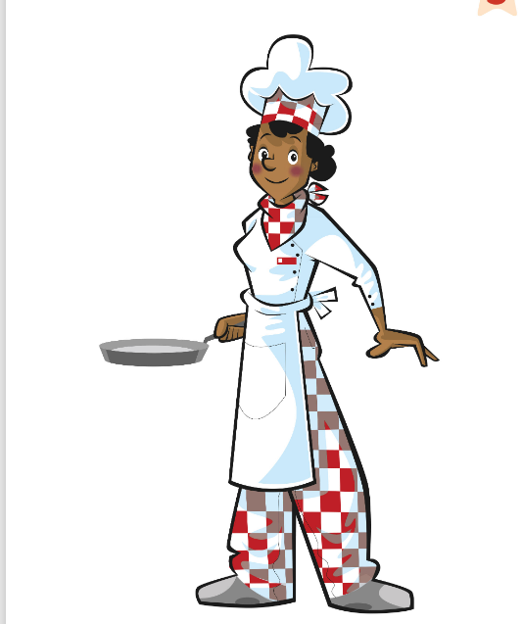


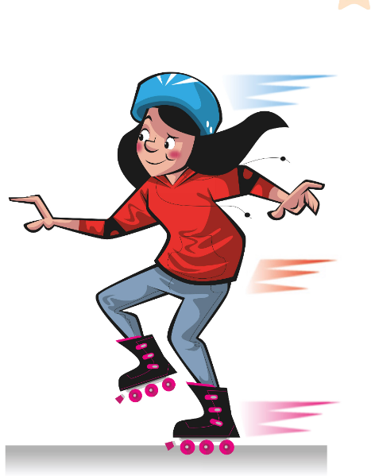
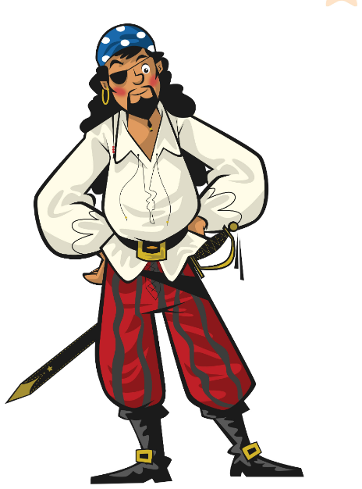
GAME
Do the action. FREEZE! What are you doing?
Fai l'azione. STOP! Cosa stai facendo?
Freeze! 🧊
🏃 CLASS · ⏱ 3 MIN
Sing like a pop star! 🎤
Make a cake! 🎂
Have a shower! 🚿
Get dressed! 👕
Go skating! ⛸️
Look for treasure! 🏴‍☠️
Notes:
TPR – FREEZE! (3 min). SEE: 6 pictures, actions appear on click. TEACHER: say the action, students do it; shout 'FREEZE!' – everyone stops like a statue. Point to one child: 'What are you doing?' – 'I'm singing!'; point to another and ask the class: 'What's she doing?' – 'She's singing!'. GROUPING: whole class. SCORE: anyone who moves after FREEZE sits down for one round (then comes back – nobody is out for long). LANGUAGE: I'm …ing / She's …ing (present continuous). Recycles Unit 2 routines.

Slide 17
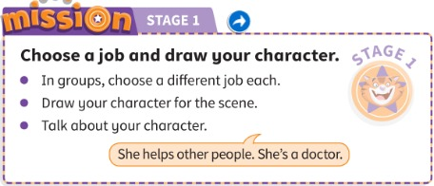
MISSION
Choose a job. Draw your character.
Scegli un mestiere. Disegna il tuo personaggio.
Stage 1: My job!
👥👥 GROUPS · ⏱ 8 MIN
1 What's your job?
I'm a doctor.
2 What do you do?
I help other people.
3 What are you wearing?
I'm wearing a white coat.
📘 Pupil's Book p.33 · Activity Book p.30
⭐ I'm a … I help …
🔥 Add: I always …
Notes:
MISSION STAGE 1 (8 min, TB33). Groups of four. Each child chooses a different job and a name for their character, draws the character (paper or Teacher's Resource Book worksheet p.34), and presents it to the group: 'She helps other people. She's a doctor.' KEEP the drawings – we use them in Lessons 3, 4 and 6! Then AB p.30: My mission diary – smiley for stage 1.

Slide 18
WELL DONE!
Today I can… · Oggi so…
Show me with your thumbs! 👍 👌 👎
Bye bye! 👋
⭐ I can understand the Friendly Farm story.
Capisco la storia della Friendly Farm.
🏠 HOMEWORK · COMPITI
• Homework sheet
• Activity Book p.32: ex.1–2
• Activity Book p.33: ex.1–2
⭐ I can say 'He never works…' and 'He's working now'.
So dire cosa si fa sempre e cosa si sta facendo ora.
⭐ I can choose a job for my character.
So scegliere un mestiere per il mio personaggio.
➡ Next: a scarecrow song – describing people!
Notes:
EXIT (3 min). Ending (TB32): flashcards on the board, numbered. Pairs: 'Number 3. What does he do?' – 'He's a …'. Thumbs for each 'I can'. Give a completion sticker for Mission Stage 1.

Slide 19
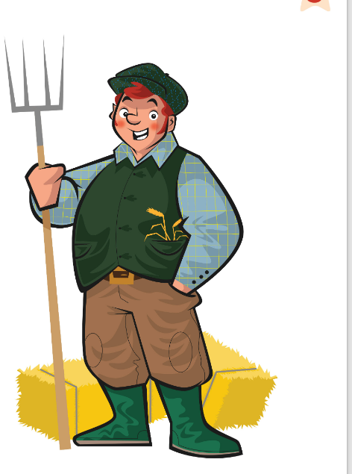
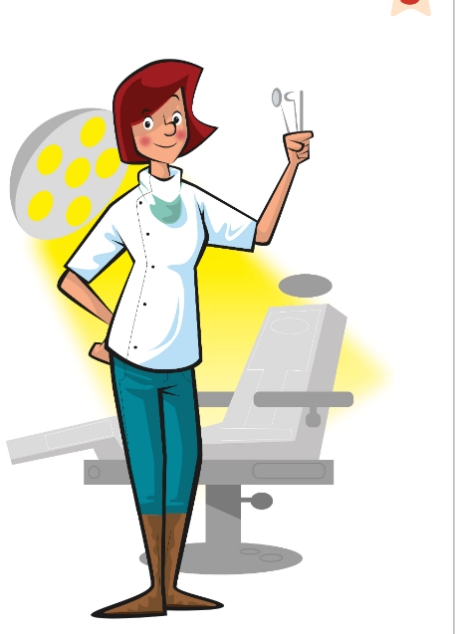


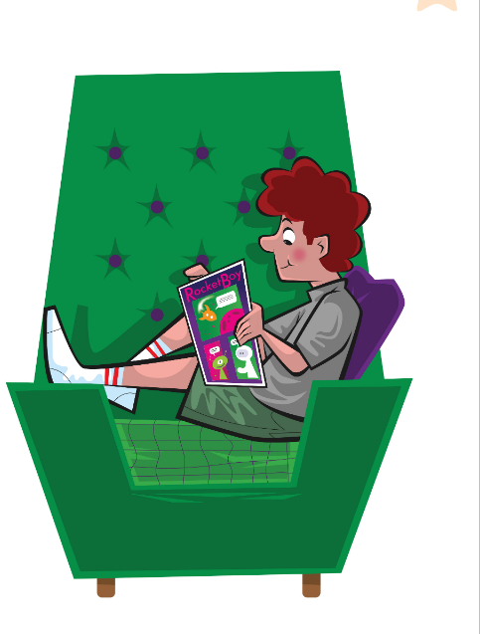
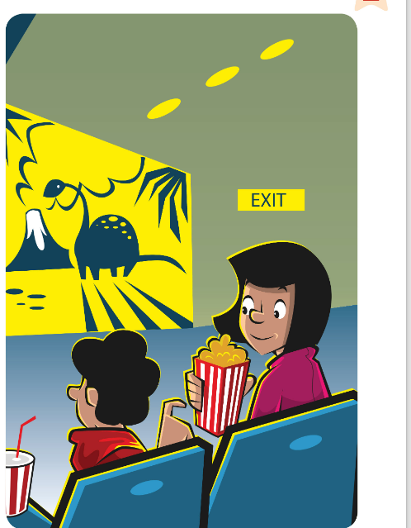
GAME
The class mimes. The hot seat guesses!
La classe mima. Chi è sulla sedia indovina!
EXTRA: Hot seat!
👥👥 TEAMS · ⏱ 5 MIN
1
👀 LOOK
Hot seat child: back to the board.
Chi è sulla sedia: di spalle alla lavagna.
2
⚙️ DO
Class: mime the picture on the board!
Classe: mimate l'immagine alla lavagna!
3
💬 SPEAK
'You're cooking!' – 'Yes, we are!'
'Voi state cucinando!' – 'Sì!'
⭐ You're …ing!
Notes:
EXTRA – HOT SEAT (5 min). SEE: 8 pictures, no words. TEACHER: one child sits with their back to the screen (the hot seat); click/point to a picture. STUDENTS: the class mimes it silently; the hot-seat child guesses with a full sentence: 'You're reading a comic!' GROUPING: 2 teams take turns in the hot seat. SCORE: correct in 1 guess = 3 points, 2 guesses = 2, 3 guesses = 1. LANGUAGE: You're …ing! REVEAL: the hot-seat child turns round to look. TIME: about 30 seconds per turn.

Slide 20
GAME
Pass the ball. Music stops? Answer!
Passa la palla. Musica ferma? Rispondi!
EXTRA: Pass the ball!
🗣 CLASS · ⏱ 5 MIN
1
👂 LISTEN
Do you often dress up?
What are you wearing today?
Does your dad cook every day?
What's your teacher doing now?
Do you always do your homework?
What are you doing at the moment?
Music on – pass the ball.
Musica – passa la palla.
2
💬 SPEAK
Music off – answer a question!
Musica spenta – rispondi a una domanda!
🔥 Ask the next question!
Notes:
EXTRA – PASS THE BALL (5 min). SEE: 6 questions (support). TEACHER: plays music, stops it at random. STUDENTS: pass a soft ball in a circle; whoever has it when the music stops answers a question with a full sentence, then asks the next question to someone they choose. GROUPING: whole class circle. SCORE: no points; a good full answer earns a class star. LANGUAGE: Do you often…? / What are you …ing? REVEAL: n/a (personal answers).

