Slide 1

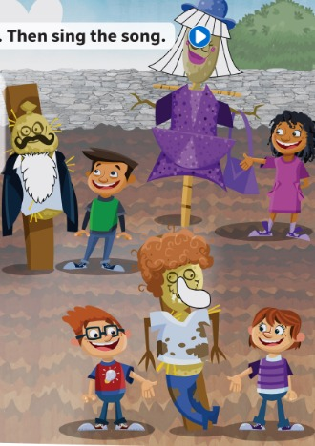
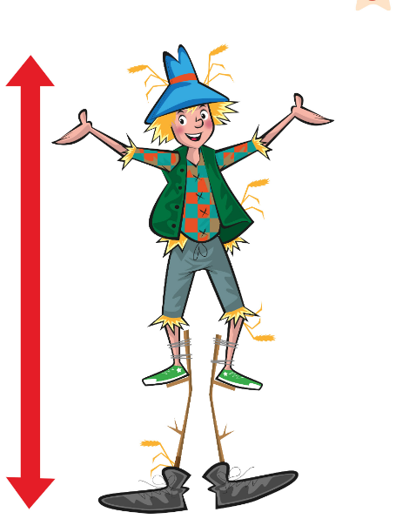
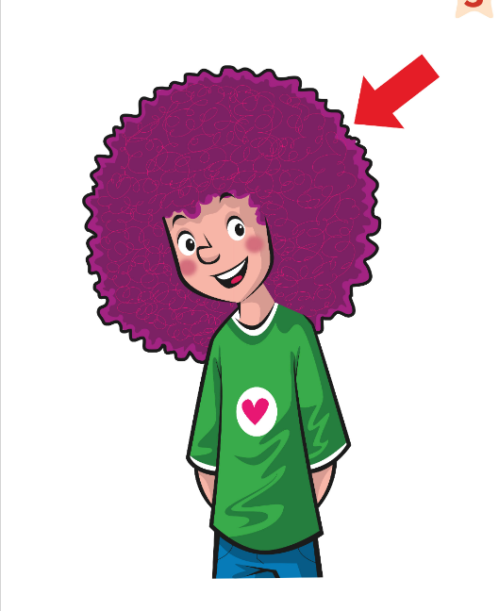
UNIT 3 · LESSON 3
Today: describing people 🧔👱
Oggi: descrivere le persone
Scarecrow song!
1
👀 LOOK
Learn 10 words to describe people.
Impara 10 parole per descrivere.
Describe your hair!
Descrivi i tuoi capelli!
2
🎵 SING
Sing the scarecrow song!
Canta la canzone dello spaventapasseri!
3
💬 SPEAK
Ask Why…? Answer Because…
Chiedi Why…? Rispondi Because…
📘 Pupil's Book p.34–35 · 🎧 1.42–1.46 · 🎬 song video
Notes:
COVER (2 min). 'Who can you see? (Eva, Tom, Jim and Jenny) Where are they? (On a farm.) Why do farmers need these? (To make birds go away.) They're scarecrows!' (spaventapasseri). Optional TB warm-up if you have time and clothes: DRESS-UP DICE – a double on two dice = come to the front and put on a clothing item ('Put on the blue T-shirt!').

Slide 2


REMEMBER?
Which one is different? Why?
Quale è diverso? Perché?
Odd one out!
👥👥 TEAMS · ✍ WRITE · ⏱ 4 MIN
1 clown · pirate · present · nurse
present – it's not a person!
2 cook · doctor · treasure · farmer
treasure – it's not a job!
3 works · feeds · is watching · helps
is watching – it's NOW!
4 always · never · often · today
today – not 'how often'!
⭐ … is different. It's not a job.
🔥 Find a 2nd answer!
Notes:
RETRIEVAL OF LESSONS 1–2 – ODD ONE OUT (4 min). SEE: 4 words per line, answers hidden. TEACHER: read line 1 aloud. STUDENTS: teams have 15 seconds to write the odd word on paper/whiteboard and hold it up (commit). GROUPING: 3–4 teams. SCORE: 1 point for the right word, +1 for a reason in English ('It's not a job'). Accept other well-argued answers (challenge: 'Find a 2nd answer!'). LANGUAGE: Lesson 1 jobs, Lesson 2 present simple vs continuous. REVEAL: click after all teams show their boards.

Slide 3
FLASHCARDS
Look! Say the word before it appears!
Guarda! Di' la parola prima che appaia!
What's this?
🏃 TPR Stretch up high – on your toes! ⬆️
alto
tall
📘 Pupil's Book p.34 · 🎧 1.42
1 / 10
Notes:
FLASHCARDS (8 min, TB34). Teach the words with the flashcards. Then ask: 'Has anyone in your family got a beard/moustache? Is your mum/dad tall? Who's got curly hair in your family?' Picture first – students guess. Click 1: word. Click 2: Italian. Click 3: TPR. TPR: Stretch up high – on your toes! ⬆️

Slide 4
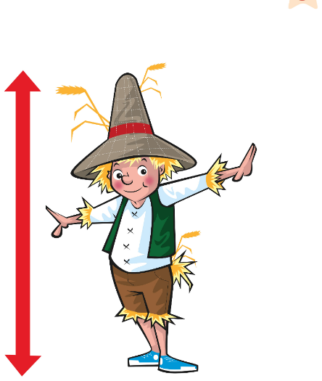
FLASHCARDS
Look! Say the word before it appears!
Guarda! Di' la parola prima che appaia!
What's this?
🏃 TPR Crouch down small! ⬇️
basso
short
📘 Pupil's Book p.34 · 🎧 1.42
2 / 10
Notes:
FLASHCARDS (8 min, TB34). Teach the words with the flashcards. Then ask: 'Has anyone in your family got a beard/moustache? Is your mum/dad tall? Who's got curly hair in your family?' Picture first – students guess. Click 1: word. Click 2: Italian. Click 3: TPR. TPR: Crouch down small! ⬇️

Slide 5
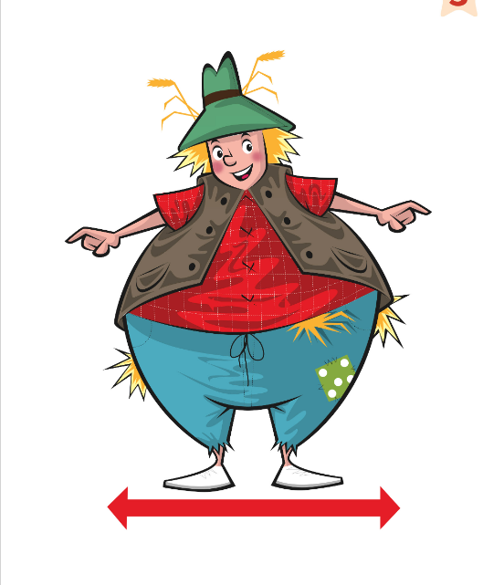
FLASHCARDS
Look! Say the word before it appears!
Guarda! Di' la parola prima che appaia!
What's this?
🏃 TPR Puff your cheeks, arms in a big circle! 🎈
grasso / robusto
fat
📘 Pupil's Book p.34 · 🎧 1.42
3 / 10
Notes:
FLASHCARDS (8 min, TB34). Teach the words with the flashcards. Then ask: 'Has anyone in your family got a beard/moustache? Is your mum/dad tall? Who's got curly hair in your family?' Picture first – students guess. Click 1: word. Click 2: Italian. Click 3: TPR. TPR: Puff your cheeks, arms in a big circle! 🎈

Slide 6
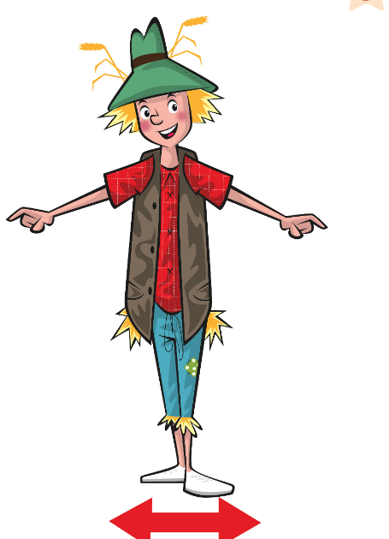
FLASHCARDS
Look! Say the word before it appears!
Guarda! Di' la parola prima che appaia!
What's this?
🏃 TPR Arms by your sides – be thin like a pencil! ✏️
magro
thin
📘 Pupil's Book p.34 · 🎧 1.42
4 / 10
Notes:
FLASHCARDS (8 min, TB34). Teach the words with the flashcards. Then ask: 'Has anyone in your family got a beard/moustache? Is your mum/dad tall? Who's got curly hair in your family?' Picture first – students guess. Click 1: word. Click 2: Italian. Click 3: TPR. TPR: Arms by your sides – be thin like a pencil! ✏️

Slide 7
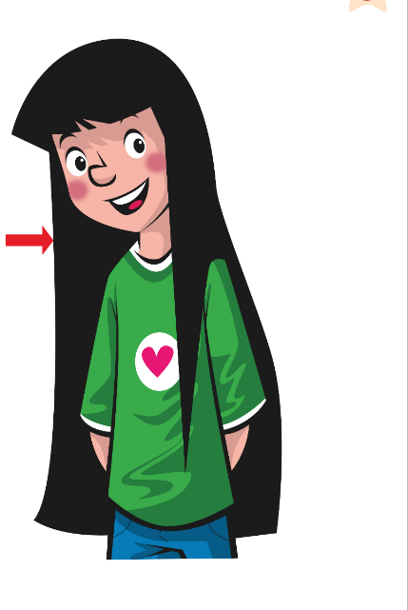
FLASHCARDS
Look! Say the word before it appears!
Guarda! Di' la parola prima che appaia!
What's this?
🏃 TPR Stroke your hair down: straight! 💇
(capelli) lisci
straight
📘 Pupil's Book p.34 · 🎧 1.42
5 / 10
Notes:
FLASHCARDS (8 min, TB34). Teach the words with the flashcards. Then ask: 'Has anyone in your family got a beard/moustache? Is your mum/dad tall? Who's got curly hair in your family?' Picture first – students guess. Click 1: word. Click 2: Italian. Click 3: TPR. TPR: Stroke your hair down: straight! 💇

Slide 8
FLASHCARDS
Look! Say the word before it appears!
Guarda! Di' la parola prima che appaia!
What's this?
🏃 TPR Draw curls in the air with your finger! 🌀
(capelli) ricci
curly
📘 Pupil's Book p.34 · 🎧 1.42
6 / 10
Notes:
FLASHCARDS (8 min, TB34). Teach the words with the flashcards. Then ask: 'Has anyone in your family got a beard/moustache? Is your mum/dad tall? Who's got curly hair in your family?' Picture first – students guess. Click 1: word. Click 2: Italian. Click 3: TPR. TPR: Draw curls in the air with your finger! 🌀

Slide 9
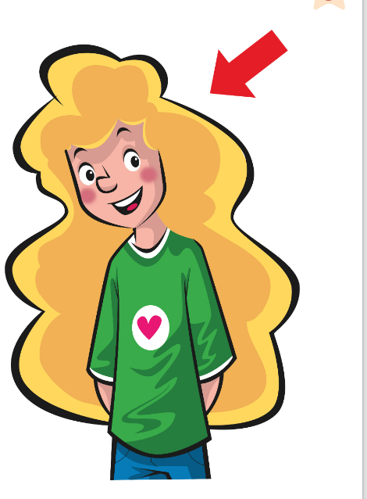
FLASHCARDS
Look! Say the word before it appears!
Guarda! Di' la parola prima che appaia!
What's this?
🏃 TPR Point to someone with blonde hair! 👱
biondo
blonde
📘 Pupil's Book p.34 · 🎧 1.42
7 / 10
Notes:
FLASHCARDS (8 min, TB34). Teach the words with the flashcards. Then ask: 'Has anyone in your family got a beard/moustache? Is your mum/dad tall? Who's got curly hair in your family?' Picture first – students guess. Click 1: word. Click 2: Italian. Click 3: TPR. TPR: Point to someone with blonde hair! 👱

Slide 10
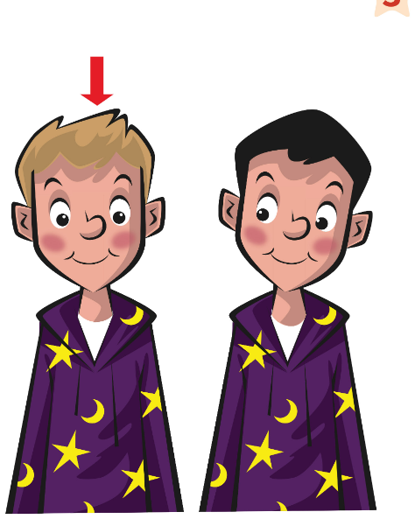
FLASHCARDS
Look! Say the word before it appears!
Guarda! Di' la parola prima che appaia!
What's this?
🏃 TPR Touch your hair: is it fair or dark? 🤔
chiari / biondi
fair
📘 Pupil's Book p.34 · 🎧 1.42
8 / 10
Notes:
FLASHCARDS (8 min, TB34). Teach the words with the flashcards. Then ask: 'Has anyone in your family got a beard/moustache? Is your mum/dad tall? Who's got curly hair in your family?' Picture first – students guess. Click 1: word. Click 2: Italian. Click 3: TPR. TPR: Touch your hair: is it fair or dark? 🤔

Slide 11
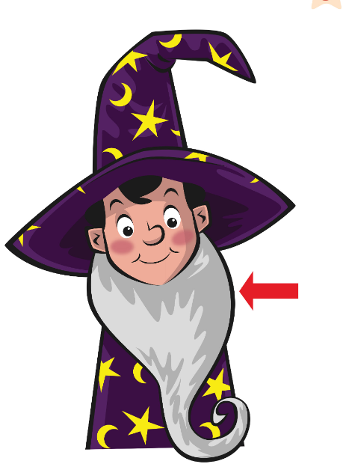
FLASHCARDS
Look! Say the word before it appears!
Guarda! Di' la parola prima che appaia!
What's this?
🏃 TPR Stroke your long beard like a wizard! 🧙
barba
beard
📘 Pupil's Book p.34 · 🎧 1.42
9 / 10
Notes:
FLASHCARDS (8 min, TB34). Teach the words with the flashcards. Then ask: 'Has anyone in your family got a beard/moustache? Is your mum/dad tall? Who's got curly hair in your family?' Picture first – students guess. Click 1: word. Click 2: Italian. Click 3: TPR. TPR: Stroke your long beard like a wizard! 🧙

Slide 12
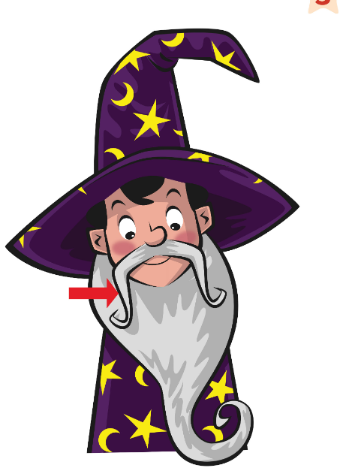
FLASHCARDS
Look! Say the word before it appears!
Guarda! Di' la parola prima che appaia!
What's this?
🏃 TPR Finger under your nose – a moustache! 🥸
baffi
moustache
📘 Pupil's Book p.34 · 🎧 1.42
10 / 10
Notes:
FLASHCARDS (8 min, TB34). Teach the words with the flashcards. Then ask: 'Has anyone in your family got a beard/moustache? Is your mum/dad tall? Who's got curly hair in your family?' Picture first – students guess. Click 1: word. Click 2: Italian. Click 3: TPR. TPR: Finger under your nose – a moustache! 🥸

Slide 13

SAY IT!
Hand in front of your mouth. Feel the H!
Mano davanti alla bocca. Senti la H!
Hairy H!
🗣 CLASS · ⏱ 4 MIN
1 hair – air?
HAIR! Feel the warm breath ✋
2 his · her · he's got
/h/ every time!
3 thin – tin?
THin: tongue out! 👅
4 capelli lunghi e neri → ?
long black hair (hair at the END!)
5 Ha i capelli ricci. → ?
He's got curly hair.
🔥 Hair, his, her – 3 times fast!
Notes:
PRONUNCIATION + ITALIAN TRAPS (4 min). Italians usually drop the H ('air' for hair) and say 'tin' for thin. SEE: the prompts, answers hidden. TEACHER: say 'air' – 'Is that HAIR?' – students hold a hand in front of their mouth and say it until they FEEL the breath. Then click. CATCH IT: say 'He's got 'air' / 'is 'air' / tin' – students catch you. 'th': tongue between the teeth – a silly face is OK! WORD ORDER TRAP (4): Italian puts the colour after the noun; English puts describing words BEFORE: long black hair, a big purple nose. Teams race: you say 'capelli corti biondi' – first team to say 'short blonde hair' wins a point. (5) Italian 'ha i capelli' → English 'He's got … hair' (no 'the').

Slide 14
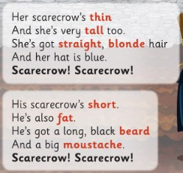
SONG
Listen and colour. What colour is it?
Ascolta e colora. Di che colore è?
Scarecrow! 1
👂 LISTEN · 🖍 COLOUR
1 What colour is her hair?
blonde (yellow) – not 'yellow hair'!
2 What colour is his beard?
black
3 Whose scarecrow's tall?
Eva's
4 Whose scarecrow's short?
Tom's
📘 Pupil's Book p.34 · 🎧 1.42 · 🎬 song video
Notes:
SONG (8 min, both slides, TB34). 'Listen and colour.' Point to the blank areas in the book. Play 1.42 (or the video): students colour the hair blonde (yellow), the beard black and the nose purple. Check: 'What colour hair has she got?' (Blonde.) Make sure they don't say 'yellow hair'! Ask: 'Whose scarecrow's tall? (Eva's) Whose scarecrow's short? (Tom's)'.

Slide 15
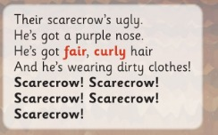
SONG
Sing the song! Three groups – one verse each.
Canta la canzone! Tre gruppi – una strofa ciascuno.
Scarecrow! 2
🎵 SING · ⏱ 4 MIN
1 What colour is his nose?
purple
2 Whose scarecrow's got curly hair?
Jim and Jenny's
3 What's he wearing?
dirty clothes!
📘 Pupil's Book p.34 · 🎧 1.42 · karaoke 🎧 1.43
Notes:
Students stand up. Practise the song in sections, then play again: three groups, one verse each. Everybody shouts 'Scarecrow! Scarecrow!'. Actions: tall = stretch up, short = crouch, fat = arms wide, beard = stroke chin, moustache = finger under nose, curly = twirl fingers. EXTENSION: once confident, sing the karaoke version (1.43).

Slide 16
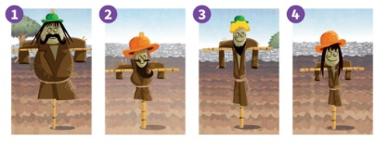
LISTEN
Listen and say the number. Then play the game.
Ascolta e di' il numero. Poi gioca.
Which scarecrow?
👥 PAIRS · ⏱ 5 MIN
1 Number 1: Has he got a beard? Is he fat?
No, he hasn't. Yes, he is.
2 There's a tall scarecrow… a small green hat… curly blonde hair… thin.
Number 3!
3 Your turn! Describe one scarecrow.
Your partner says the number.
📘 Pupil's Book p.34 · 🎧 1.44
⭐ It's got … hair.
🔥 Only ask questions!
Notes:
LISTEN + PAIR GAME (6 min, TB34). Point to scarecrow 1: 'Has he got a beard?' (No, he hasn't.) 'Is he fat?' (Yes, he is.) 'Has he got blonde hair?' (No, black.) Play 1.44 – students say the number. KEY: 3. Then pairs: one chooses a scarecrow and describes it, the other says the number. Stronger learners: guess by asking questions only ('Has it got a beard? Is it fat?'). Finally: Rocky says 'Describe your hair' – students: 'I've got short, black hair. It's curly.'

Slide 17
GAME
Listen and make the shape with your body!
Ascolta e fai la forma con il corpo!
Body shapes!
🏃 CLASS · ⏱ 3 MIN
Be TALL! Arms up! 🙌
Be SHORT! Squat down!
Be FAT! Big circle arms! 🎈
Be THIN! Like a pencil! ✏️
Grow a long BEARD! 🧙
Twist your MOUSTACHE! 🥸
Notes:
TPR – BODY SHAPES (3 min). SEE: 6 pictures, actions on click. TEACHER: call the words faster and faster; then combinations: 'Tall with a beard!' 'Short and fat with a moustache!'; last round whispered. STUDENTS: make the shape and SAY the word. GROUPING: whole class. SCORE: none – 'the best statue' chooses the next word. LANGUAGE: tall, short, fat, thin, beard, moustache (receptive + repeating).

Slide 18
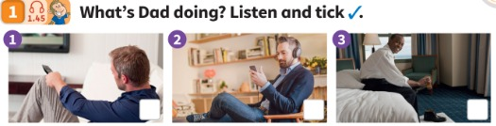
LISTEN
What's Dad doing? Listen and tick ✓.
Cosa sta facendo papà? Ascolta e spunta ✓.
What's Dad doing?
👂 LISTEN · ⏱ 4 MIN
1 What's Dad doing?
He's cleaning his shoes. ✓ picture 3
2 Why's Julia watching TV?
Because it's Saturday morning and she hasn't got school.
3 Why's Dad cleaning his shoes?
Because they're dirty and he needs them for a party.
4 Why's Mum listening to music?
Because she likes listening to music when she cooks.
📘 Pupil's Book p.35 · 🎧 1.45
Notes:
LISTEN AND TICK (5 min, TB35). Point to each picture: 'What's he doing?' (Watching TV / listening to music / cleaning his shoes). Play 1.45, students tick. KEY: He's cleaning his shoes (picture 3). EXTENSION (TB35): write 'Why?' on the board, ask the 3 Why questions and play again (answers from the audioscript).

Slide 19

GRAMMAR
Gracie's Grammar
🗣 CLASS · ⏱ 4 MIN
Why are you asking a lot of questions?
Because I love asking questions.
Why…? = perché…? Because… = perché… (risposta)
1 ___ are you laughing?
Why
2 ___ it's funny!
Because
3 Why ___ she wearing a helmet?
is
4 Because she ___ riding a bike.
's (is)
📘 Pupil's Book p.35 · 🎧 1.46
Notes:
GRAMMAR (5 min, TB35). Write the question and answer on the board. Play 1.46 – students repeat. PRESENTATION idea (TB35): 'Why are you listening to me?' (Because you're a teacher.) Mime an activity, e.g. running – students ask 'Why are you running?' – give a funny reason: 'Because there's a tiger behind me!' We use 'why' to ask the reason and 'because' to give the reason. In Italian both are 'perché'!

Slide 20
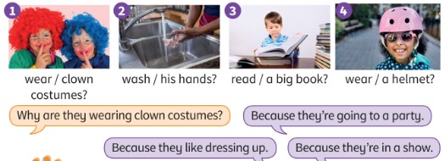
SPEAK
Ask and answer with your own ideas.
Fai domande e rispondi con le tue idee.
Why? Because…
👥 PAIRS · ⏱ 5 MIN
1 Why are they wearing clown costumes?
Because they're going to a party / they like dressing up / they're in a show.
2 Why is he washing his hands?
Because they're dirty / it's lunchtime.
3 Why is he reading a big book?
Because he likes reading / he's doing his homework.
4 Why is she wearing a helmet?
Because she's skating / riding a bike.
📘 Pupil's Book p.35
⭐ Because they're …
🔥 Give 2 reasons!
Notes:
ASK AND ANSWER (6 min, TB35). Point to picture 1 and read the bubbles. Ask for more ideas ('Because they live in a circus'). Pairs ask and answer about pictures 2–4. Pairs share the best/funniest reasons. KEY (possible answers, TB35): 2 Because they're dirty / it's lunchtime 3 Because he likes reading / he's doing his homework 4 Because she's skating / riding a bike.

Slide 21
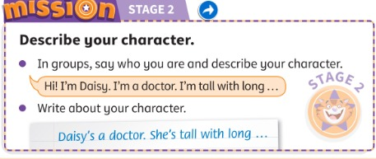
MISSION
Say who you are. Describe your character.
Di' chi sei. Descrivi il tuo personaggio.
Stage 2: Describe!
👥👥 GROUPS · ⏱ 6 MIN
1 Say who you are.
Hi! I'm Daisy. I'm a doctor.
2 Describe your character.
I'm tall with long, blonde hair.
3 Write about your character.
Daisy's a doctor. She's tall with long, blonde hair.
📘 Pupil's Book p.35 · Activity Book p.30
⭐ I'm … I've got … hair.
🔥 Add what you're wearing!
Notes:
MISSION STAGE 2 (7 min, TB35). Remind students of the characters they drew in Lesson 2 (Stage 1). Groups: each child 'becomes' their character and introduces him/herself with a funny voice. Then they write a short description (worksheet TRB p.34 or paper). Keep it for Lessons 4 and 6. AB p.30: smiley for stage 2.

Slide 22
WELL DONE!
Today I can… · Oggi so…
Show me with your thumbs! 👍 👌 👎
Bye bye! 👋
⭐ I can describe people: tall, short, curly…
So descrivere le persone.
🏠 HOMEWORK · COMPITI
• Homework sheet
• Activity Book p.34: ex.2
• Activity Book p.35: ex.1–2
⭐ I can sing the scarecrow song.
So cantare la canzone dello spaventapasseri.
⭐ I can ask Why…? and answer Because…
So chiedere Why…? e rispondere Because…
➡ Next: people who help us! 🚒👮
Notes:
EXIT (3 min, TB34). Self-assessment with the flashcards. Play the song again – everyone joins in. Give a completion sticker for Mission Stage 2. NOTE: AB p.34 ex.1 needs the AB audio (4.17) – do it in class at the start of next lesson.

Slide 23
GAME
Listen and draw the person!
Ascolta e disegna la persona!
EXTRA: Draw it!
👤 ALONE · ⏱ 5 MIN
1
👂 LISTEN
He's / She's tall · short · fat · thin
He's got … hair: long / short + curly / straight + colour
He's got a beard / a moustache.
Listen to the teacher (or a friend).
Ascolta l'insegnante (o un compagno).
2
🖍️ DRAW
Draw the person – 1 minute!
Disegna la persona – 1 minuto!
3
💬 SPEAK
Show and say: 'He's tall. He's got…'
Mostra e di': 'He's tall. He's got…'
⭐ He's got … hair.
Notes:
EXTRA – DRAW IT! (5 min). SEE: the description frame only (support). TEACHER: reads a description slowly twice – DON'T show it: 1) 'He's tall and thin. He's got short, curly, black hair and a big moustache.' 2) 'She's short. She's got long, straight, blonde hair. She's a pop star!' 3) 'He's fat. He's got a long white beard. He's a pirate with treasure!' STUDENTS: draw in 1 minute on paper / mini whiteboards, then 'Show me!'. GROUPING: alone, then pairs (A describes a secret flashcard, B draws). SCORE: 1 point for each correct detail in the drawing (count together). LANGUAGE: He's / She's + adjective, He's got + adjective order. REVEAL: read the description again and check details; or show the flashcard in pair rounds.

Slide 24
GAME
Ask 'Why…?' Give a silly answer!
Chiedi 'Why…?' Dai una risposta buffa!
EXTRA: Silly reasons!
👥👥 TEAMS · ⏱ 5 MIN
1
👀 LOOK
running 🏃 · laughing 😂 · crying 😢
hiding under the table 🙈 · eating 10 cakes 🎂
wearing a clown costume 🤡 · looking for treasure 💰
Watch the mime.
Guarda il mimo.
2
💬 SPEAK
Ask: 'Why are you running?'
Chiedi: 'Why are you running?'
3
🎲 PLAY
Funniest 'Because…' wins a point!
Il 'Because…' più buffo vince un punto!
⭐ Because …
Notes:
EXTRA – SILLY REASONS (5 min). SEE: actions to mime. TEACHER: mimes the first action (e.g. running). STUDENTS: ask 'Why are you running?'; the mimer (teacher, then a child) answers 'Because…' with a silly reason ('Because there's a tiger behind me!' – TB35). GROUPING: 2 teams; each team sends a mimer, the OTHER team asks Why. SCORE: the class votes for the funniest correct Because-sentence = 2 points; any correct sentence = 1 point. LANGUAGE: Why are you …ing? Because … REVEAL: n/a (creative).

