Slide 1

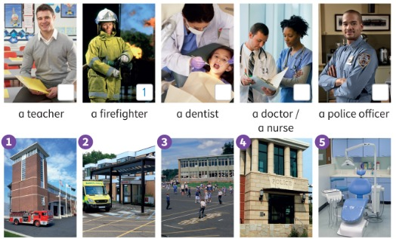


UNIT 3 · LESSON 4
Today: who helps us? 🚒🏥
Oggi: chi ci aiuta?
People who help us
1
🎬 WATCH
Watch a video about people who help us.
Guarda un video su chi ci aiuta.
Who can help?
Chi può aiutare?
2
📖 READ
Read about jobs. Who is it?
Leggi dei mestieri. Chi è?
3
✏️ WRITE
Mission: write a helping scene!
Missione: scrivi una scena di aiuto!
📘 Pupil's Book p.36–37 · 🎬 video · 🎧 1.47–1.48
Notes:
COVER (2 min, TB36). Stick the doctor, dentist and nurse flashcards together on the board: 'What's the same about these people?' (They all help people.) 'Let's find out more about people who help us.'

Slide 2
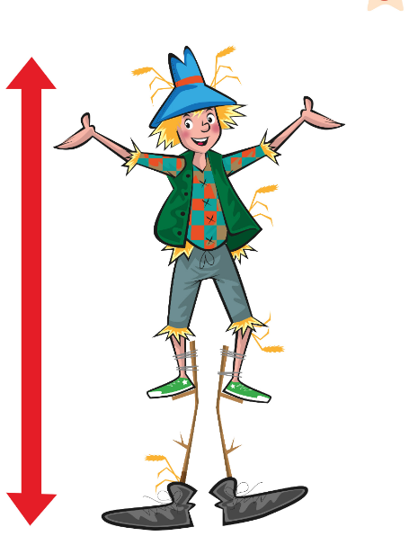
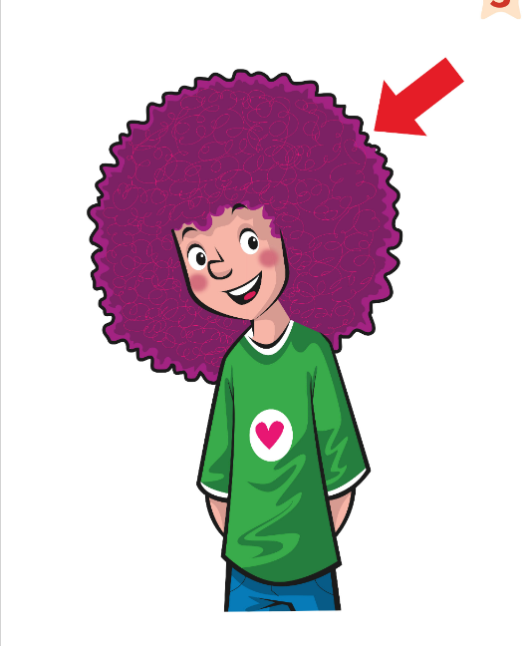
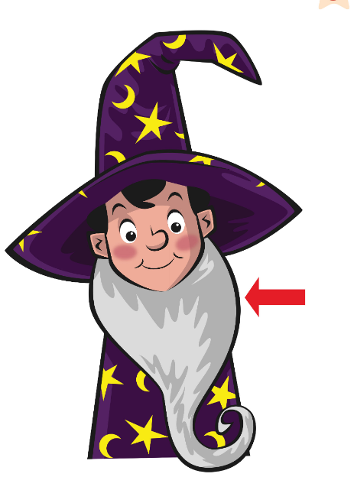
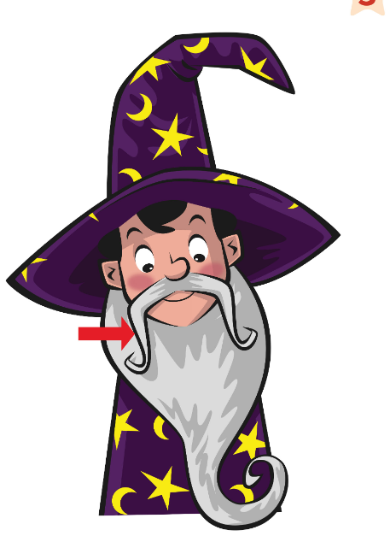
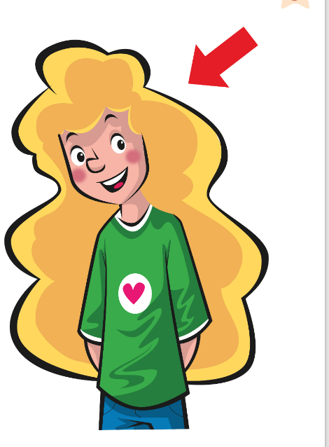
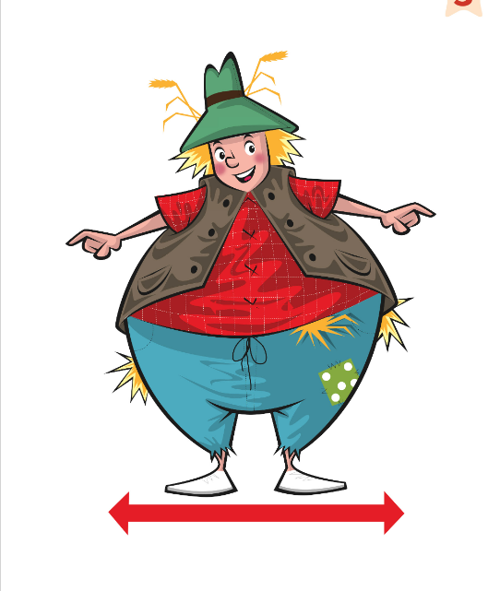
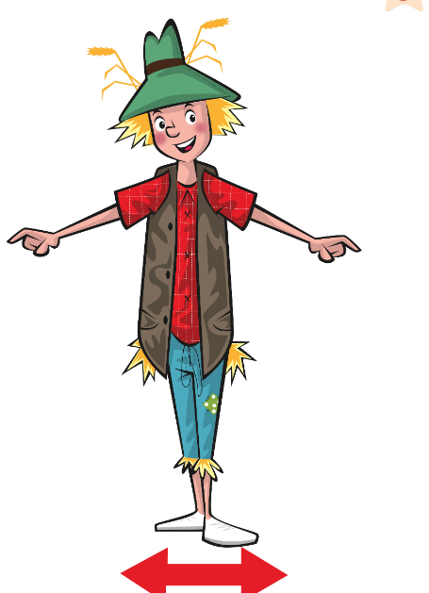
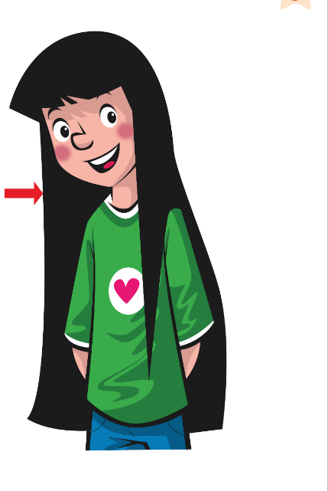
REMEMBER?
True = JUMP! False = SIT and correct it!
Vero = SALTA! Falso = SIEDITI e correggi!
True? Jump!
🏃 CLASS · ⏱ 4 MIN
1
👀 LOOK
Look at the picture.
Guarda l'immagine.
2
👂 LISTEN
Listen to the sentence.
Ascolta la frase.
3
🏃 MOVE
True: jump! False: sit down!
Vero: salta! Falso: siediti!
⭐ No! He's got …
🔥 Correct it with 2 words!
Notes:
RETRIEVAL OF LESSON 3 – TRUE? JUMP! (4 min). SEE: 8 appearance pictures, no words. TEACHER: point to a card and say a sentence, e.g. 'He's got a moustache' (pointing at beard = FALSE), 'She's got curly hair' (curly = TRUE), 'He's short' (tall = FALSE), 'She's got long, blonde hair' (blonde = TRUE), 'He's thin' (fat = FALSE). STUDENTS: everyone stands; TRUE = jump and say 'Yes!'; FALSE = sit down and someone corrects: 'No! He's got a beard!'. GROUPING: whole class (then a child takes the teacher's role). SCORE: a correct correction = 1 point for that child's team. LANGUAGE: He's/She's + adjective; He's/She's got + hair words (Lesson 3), word order 'long, blonde hair'. REVEAL: the teacher confirms TRUE/FALSE after everyone has moved.

Slide 3
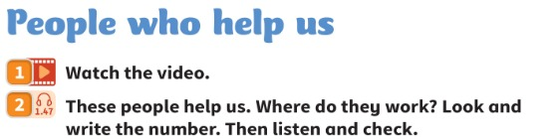
WATCH
Watch. Who helps us? Answer the questions at the end.
Guarda. Chi ci aiuta? Rispondi alle domande alla fine.
Watch the video!
👀 WATCH · ⏱ 5 MIN
▶ People who help us video (YouTube search)
▶ Community helpers song (YouTube search)
Who helps us? · Chi ci aiuta?
Where do they work? · Dove lavorano?
Teacher: preview every link before class (ads, content). The lesson works without it. · Controllare i link prima della lezione.
📘 Pupil's Book p.36 · 🎬 video (ex.1)
Notes:
VIDEO (5 min, TB36). 'Let's watch the video about people who help us.' Play the Power Up cross-curricular video for Unit 3 (from the book's digital resources) and answer the questions at the end. If not available, use the YouTube search link for a short community helpers video. External resources are suggestions only: the teacher must preview and check all links, videos, adverts and content before using them with children. Always have the PowerPoint/classroom alternative ready.

Slide 4

FLASHCARDS
Look! Say the word before it appears!
Guarda! Di' la parola prima che appaia!
New words!
🏃 TPR Hold the hose: spray the water! Shhhh! 💦
vigile del fuoco / pompiere
firefighter
📘 Pupil's Book p.36 · 🎧 1.47
1 / 6
Notes:
NEW WORDS (6 min, TB36). 'What does a firefighter do?' (Fights fires, rescues people, helps people when there's bad weather.) 'What does a police officer do?' (Keeps us safe, catches criminals.) 'Is anyone in your family a firefighter / police officer?' Note (TB): 'firefighter' can be one or two words in YLE exams. 'Surgery' = the place where a dentist or doctor works (UK). TPR: Hold the hose: spray the water! Shhhh! 💦

Slide 5
FLASHCARDS
Look! Say the word before it appears!
Guarda! Di' la parola prima che appaia!
New words!
🏃 TPR Hand up: STOP! Blow your whistle! 🛑
poliziotto / poliziotta
police officer
📘 Pupil's Book p.36 · 🎧 1.47
2 / 6
Notes:
NEW WORDS (6 min, TB36). 'What does a firefighter do?' (Fights fires, rescues people, helps people when there's bad weather.) 'What does a police officer do?' (Keeps us safe, catches criminals.) 'Is anyone in your family a firefighter / police officer?' Note (TB): 'firefighter' can be one or two words in YLE exams. 'Surgery' = the place where a dentist or doctor works (UK). TPR: Hand up: STOP! Blow your whistle! 🛑

Slide 6

FLASHCARDS
Look! Say the word before it appears!
Guarda! Di' la parola prima che appaia!
New words!
🏃 TPR Slide down the pole! Nee-naw! 🚒
caserma dei pompieri
fire station
📘 Pupil's Book p.36 · 🎧 1.47
3 / 6
Notes:
NEW WORDS (6 min, TB36). 'What does a firefighter do?' (Fights fires, rescues people, helps people when there's bad weather.) 'What does a police officer do?' (Keeps us safe, catches criminals.) 'Is anyone in your family a firefighter / police officer?' Note (TB): 'firefighter' can be one or two words in YLE exams. 'Surgery' = the place where a dentist or doctor works (UK). TPR: Slide down the pole! Nee-naw! 🚒

Slide 7

FLASHCARDS
Look! Say the word before it appears!
Guarda! Di' la parola prima che appaia!
New words!
🏃 TPR Drive the police car! 🚓
commissariato / stazione di polizia
police station
📘 Pupil's Book p.36 · 🎧 1.47
4 / 6
Notes:
NEW WORDS (6 min, TB36). 'What does a firefighter do?' (Fights fires, rescues people, helps people when there's bad weather.) 'What does a police officer do?' (Keeps us safe, catches criminals.) 'Is anyone in your family a firefighter / police officer?' Note (TB): 'firefighter' can be one or two words in YLE exams. 'Surgery' = the place where a dentist or doctor works (UK). TPR: Drive the police car! 🚓

Slide 8

FLASHCARDS
Look! Say the word before it appears!
Guarda! Di' la parola prima che appaia!
New words!
🏃 TPR Lie down in bed: 'I'm sick!' 🤒
ospedale
hospital
📘 Pupil's Book p.36 · 🎧 1.47
5 / 6
Notes:
NEW WORDS (6 min, TB36). 'What does a firefighter do?' (Fights fires, rescues people, helps people when there's bad weather.) 'What does a police officer do?' (Keeps us safe, catches criminals.) 'Is anyone in your family a firefighter / police officer?' Note (TB): 'firefighter' can be one or two words in YLE exams. 'Surgery' = the place where a dentist or doctor works (UK). TPR: Lie down in bed: 'I'm sick!' 🤒

Slide 9

FLASHCARDS
Look! Say the word before it appears!
Guarda! Di' la parola prima che appaia!
New words!
🏃 TPR Sit in the dentist's chair: 'Aaah!' 🦷
studio (del dentista / medico)
surgery
📘 Pupil's Book p.36 · 🎧 1.47
6 / 6
Notes:
NEW WORDS (6 min, TB36). 'What does a firefighter do?' (Fights fires, rescues people, helps people when there's bad weather.) 'What does a police officer do?' (Keeps us safe, catches criminals.) 'Is anyone in your family a firefighter / police officer?' Note (TB): 'firefighter' can be one or two words in YLE exams. 'Surgery' = the place where a dentist or doctor works (UK). TPR: Sit in the dentist's chair: 'Aaah!' 🦷

Slide 10
SAY IT!
Clap the word. Where's the BIG part?
Batti le mani. Dov'è la parte FORTE?
Stress detectives!
👥👥 TEAMS · ⏱ 4 MIN
1 hospital
HOS-pi-tal ● • •
2 police
po-LICE • ● (not PO-lice!)
3 firefighter
FIRE-figh-ter ● • •
4 surgery
SUR-ge-ry ● • •
5 Mia mamma è infermiera. → ?
My mum's A nurse.
6 Lavora all'ospedale. → ?
She works IN a hospital.
⭐ BIG = ● · small = •
Notes:
PRONUNCIATION + ITALIAN TRAPS (4 min). SEE: the words, answers hidden. TEACHER: say each word; teams hold up 1, 2 or 3 fingers to show the BIG syllable (commit), then click. Clap it: big clap on the strong part. Italian 'ospedale/polizia' push stress to the wrong place – CATCH IT: say 'hos-PI-tal', 'PO-lice' on purpose; first team to shout 'NO!' and say it right wins a point. Final consonants: 'hospitaL', 'surgerY' – no extra vowel. TRAPS: (5) no article in Italian, 'a' in English: 'She's a nurse'. (6) 'all'ospedale/a scuola' → 'in a hospital / at school'. Teams translate quickly for a point.

Slide 11
LISTEN
Look and write the number. Then listen and check.
Guarda e scrivi il numero. Poi ascolta e controlla.
Where do they work?
👥 PAIRS · ✍ WRITE
1 a teacher
3 (school)
2 a firefighter
1 (fire station) – example
3 a dentist
5 (surgery)
4 a doctor / a nurse
2 (hospital)
5 a police officer
4 (police station)
📘 Pupil's Book p.36 · 🎧 1.47
⭐ He / She works in a …
Notes:
WHERE DO THEY WORK? (6 min, TB36). Point to the firefighter, then the places: 'Where does she work?' Students point to the fire station – number 1 is the example. Pairs number the rest. Play 1.47 to check. KEY (TB36): a teacher – 3, a firefighter – 1, a dentist – 5, a doctor / a nurse – 2, a police officer – 4. Then pairs: one points to a person and asks 'Where does he/she work?', the other points to the place.

Slide 12
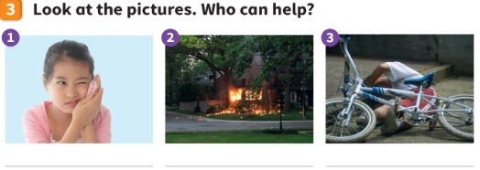
LOOK
Look at the pictures. Who can help?
Guarda le immagini. Chi può aiutare?
Who can help?
👥 PAIRS · ⏱ 3 MIN
1 Picture 1: She's got a toothache! 😣
a dentist
2 Picture 2: There's a fire! 🔥
a firefighter
3 Picture 3: He's fallen off his bike. Ouch!
a doctor or a nurse
📘 Pupil's Book p.36
⭐ A … can help!
🔥 Say why: Because…
Notes:
WHO CAN HELP? (4 min, TB36). Say: 'Listen. Which picture? He's fallen off his bike. Ouch!' Students point. Point to picture 1: 'Who can help?' (A dentist.) Pairs ask and answer, then write the words under the pictures. KEY (TB36): 1 a dentist 2 a firefighter 3 a doctor or a nurse.

Slide 13
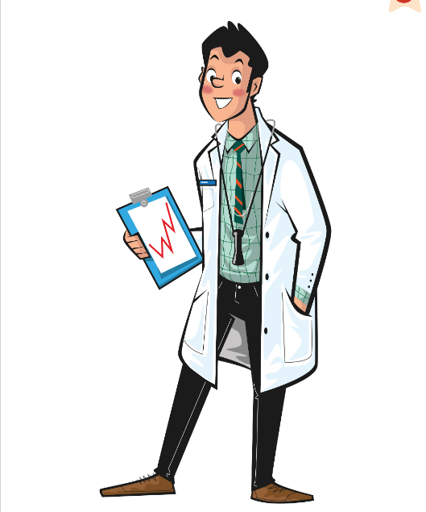
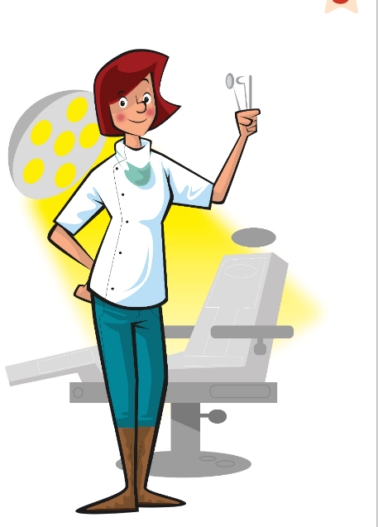
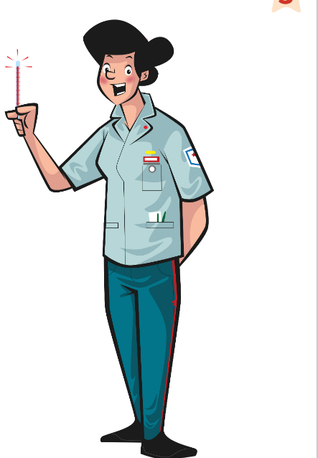

GAME
Teacher shouts 'Help!' – be the right helper!
L'insegnante grida 'Aiuto!' – fai l'aiutante giusto!
Help! Help!
🏃 CLASS · ⏱ 4 MIN
Fire! Spray the water! 💦
Stop the cars! Whistle! 🛑
Listen to the heart! 🩺
Check the teeth! 🦷
Put on a plaster! 🩹
Write on the board! ✍️
Notes:
TPR – HELP! HELP! (4 min). SEE: 6 helpers; actions appear on click (click all first, saying them). TEACHER: shout a PROBLEM, not the job: 'Help! There's a fire!' (firefighter), 'Help! My tooth!' (dentist), 'Help! I can't do my homework!' (teacher), 'Help! Lots of cars!' (police officer), 'Ouch, my arm!' (nurse), 'I'm ill!' (doctor). STUDENTS: do the helper's action and shout the job: 'Firefighter!'. GROUPING: whole class. SCORE: last one to start the right action sits out for ONE round only. LANGUAGE: jobs (retrieval from a problem = meaning, not just the word). Speed up each round.

Slide 14
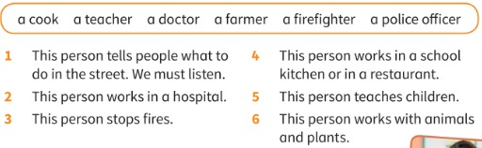
READ
Read the sentences. Who is it?
Leggi le frasi. Chi è?
Who is it?
👤 ALONE · ⏱ 4 MIN
1 This person tells people what to do in the street. We must listen.
a police officer
2 This person works in a hospital.
a doctor
3 This person stops fires.
a firefighter
4 This person works in a school kitchen or in a restaurant.
a cook
5 This person teaches children.
a teacher
6 This person works with animals and plants.
a farmer
📘 Pupil's Book p.37
Notes:
READ (4 min, TB37). Read the jobs in the box together (students say them – retrieval). Students read and match ALONE (write 1–6 + job), then compare in pairs; click to check. KEY (TB37): 1 a police officer 2 a doctor 3 a firefighter 4 a cook 5 a teacher 6 a farmer. Follow up: 'Who stops fires? Who works in a restaurant?'

Slide 15
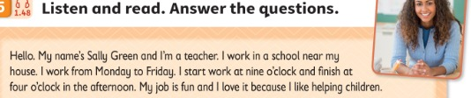
READ
Listen and read. What's her job?
Ascolta e leggi. Che lavoro fa?
Meet Sally Green!
👂 LISTEN · 📖 READ
📘 Pupil's Book p.37 · 🎧 1.48
Notes:
READ (big text). Play 1.48 while students follow on the screen. Then go to the questions on the next slide.

Slide 16
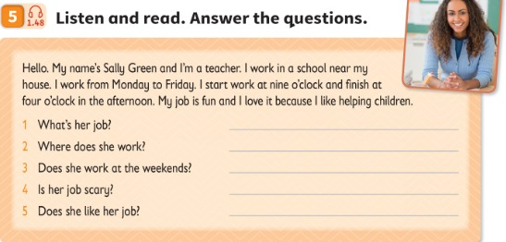
LISTEN
Listen and read. Answer the questions.
Ascolta e leggi. Rispondi alle domande.
Sally Green
👥 PAIRS · ⏱ 4 MIN
1 What's her job?
She's a teacher.
2 Where does she work?
She works in a school.
3 Does she work at the weekends?
No, she doesn't.
4 Is her job scary?
No, it isn't.
5 Does she like her job?
Yes, she does. (She loves it.)
📘 Pupil's Book p.37 · 🎧 1.48
🔥 When does she start?
Notes:
LISTEN AND READ (6 min, TB37). Read the questions together, check 'scary' (che fa paura). Play 1.48. Students read and answer in pairs. KEY (TB37): 1 She's a teacher. 2 She works in a school. 3 No, she doesn't. 4 No, it isn't. 5 Yes, she does. (She loves it!) EXTENSION: What's her surname? (Green) Where's the school? (Near her house) When does she start/finish work? (Nine / four o'clock) Why does she love her job? (Because she likes helping children).

Slide 17
GAME
Listen to the clues. Guess the job fast = more points!
Ascolta gli indizi. Indovina subito = più punti!
What do I do?
👥👥 TEAMS · ⏱ 6 MIN
1
👂 LISTEN
I don't help people. I can work in a theatre or on TV. I love music. I wear beautiful costumes. (pop star)
I work in a hospital. I wear a uniform. I help sick people. (nurse / doctor)
I start work very early. I've got a tractor. I feed the cows. (farmer)
Listen to clue 1… 2… 3…
Ascolta l'indizio 1… 2… 3…
2
💬 SPEAK
Guess! 'You're a pop star!'
Indovina! 'You're a pop star!'
3
🎲 PLAY
Clue 1 = 5 points · clue 2 = 4 · clue 3 = 3
Indizio 1 = 5 punti · 2 = 4 · 3 = 3
⭐ You're a …!
Notes:
WHAT DO I DO? (6 min, TB36 Ending). SEE: 3 example clue sets (the answers in brackets are for the teacher – read the clues, cover the screen or skip to the next slide when playing for real). TEACHER: say one sentence at a time about a secret job. STUDENTS: teams confer and may guess after each sentence ('You're a farmer!'). GROUPING: 2–3 teams. SCORE: guess after clue 1 = 5 points, clue 2 = 4, clue 3 = 3; a wrong guess = team waits until the next clue. LANGUAGE: present simple 'I work… I help… I wear…' (input) and 'You're a …' (output). REVEAL: the teacher says 'Yes, I'm a …!' Then volunteers give 3 clues about a job of their choice (support on the board: I work in… I help… I wear…).

Slide 18
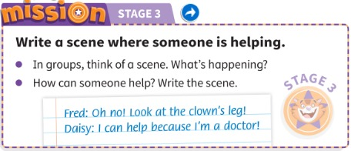
MISSION
In groups, think of a scene. How can someone help?
In gruppi, pensate a una scena. Come può aiutare qualcuno?
Stage 3: Write it!
👥👥 GROUPS · ✍ · ⏱ 10 MIN
1 What's happening?
Oh no! Look at the clown's leg!
2 Who can help?
I can help because I'm a doctor!
3 Useful lines
Help! · What's the problem? · Can I help you? · Thank you very much!
📘 Pupil's Book p.37 · Activity Book p.30
⭐ Help! · Can I help you?
🔥 Add a Why…? Because…
Notes:
MISSION STAGE 3 (10 min, TB37). Groups look at their four characters (Stages 1–2), choose a setting (school, street, park, home) and a problem (someone falls off their bike, there's a fire, someone can't find their little brother…). They write the lines of their scene and a title. Each child must have something to say. Encourage Why…? Because…. Extra support: useful lines on the board. AB p.30: smiley for stage 3. Give a completion sticker.

Slide 19
WELL DONE!
Today I can… · Oggi so…
Show me with your thumbs! 👍 👌 👎
Bye bye! 👋
⭐ I can say where people work.
So dire dove lavorano le persone.
🏠 HOMEWORK · COMPITI
• Homework sheet
• Activity Book p.36: ex.1–2
• Activity Book p.37: ex.3–4
⭐ I can read about jobs and answer questions.
So leggere dei mestieri e rispondere.
⭐ I can write a scene with my group.
So scrivere una scena con il mio gruppo.
➡ Next: a story – The costume party!
Notes:
EXIT (3 min). Self-assessment (TB36): thumbs for each 'I can'. Keep the Mission scenes safe for Lesson 6!

Slide 20
GAME
Walk and ask. Find a friend for each line!
Cammina e chiedi. Trova un compagno per ogni frase!
EXTRA: Find a friend!
🏃 CLASS · ⏱ 6 MIN
1
🏃 MOVE
… wants to be a doctor or a nurse.
… has got a teacher in the family.
… sometimes goes to the dentist.
… wants to be a pop star or a film star.
… knows a police officer or a firefighter.
Walk around the class.
Gira per la classe.
2
💬 SPEAK
Ask: 'Do you want to be a doctor?'
Chiedi: 'Do you want to be a doctor?'
3
✏️ WRITE
'Yes, I do!' → write the name.
'Yes, I do!' → scrivi il nome.
⭐ Do you want to be …?
Notes:
EXTRA – FIND SOMEONE WHO (6 min). SEE: 5 lines (copy onto paper or a mini worksheet). TEACHER: model one question with a strong student first ('Do you want to be a doctor?' – 'Yes, I do!'). STUDENTS: walk around and ask Yes/No questions; write a classmate's name next to a line when the answer is 'Yes'. Different name on each line. GROUPING: whole class, mingle. SCORE: first to complete all 5 lines shouts 'Finished!' – then they report: 'Luca wants to be a doctor.' LANGUAGE: Do you want to be…? Have you got…? Do you know…? / He wants to be… (3rd person -s!). REVEAL: report back as a class.

Slide 21
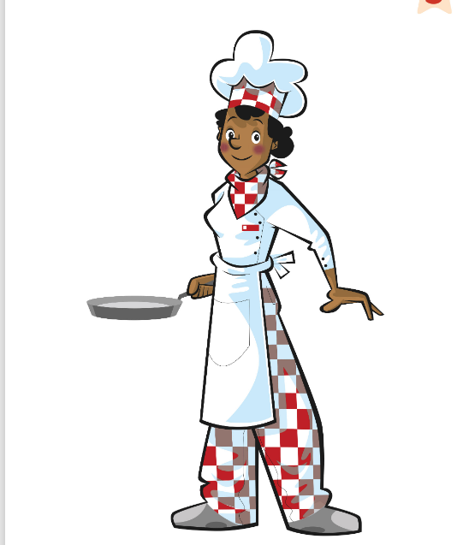
GAME
👀 Look for 10 seconds. Remember ALL the pictures!
Guarda e ricorda tutte le immagini!
Look and remember!
Notes:
WHAT'S MISSING? Step 1 – LOOK (10 s). Say the words together first (choral). Count down aloud. Then: "Close your eyes!" and go to the next slide.

Slide 22
GAME
Open your eyes! What's missing? Write it or whisper it to your partner.
Apri gli occhi! Cosa manca? Scrivilo o dillo al compagno.
What's missing?
?
Notes:
Step 2 – COMMIT. Students write the word on a mini-whiteboard / paper (or teams agree in 10 s). 'Show me!' Then go to the next slide. Points: 1 per team with the right word, +1 if spelt correctly.

Slide 23
ANSWER
Fire station!
È la caserma dei pompieri!
Were you right?
Notes:
Step 3 – REVEAL. The missing card comes back with a green frame. Everybody says the word 3 ways: whisper, normal, monster voice. EXTRA – WHAT'S MISSING? (3 min). Cards without words: students say the words first. Click 1: one card covered. Click 2: answer (fire station).

