Slide 1

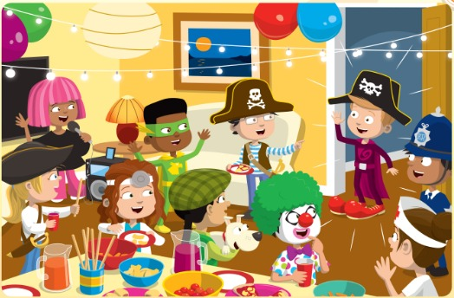
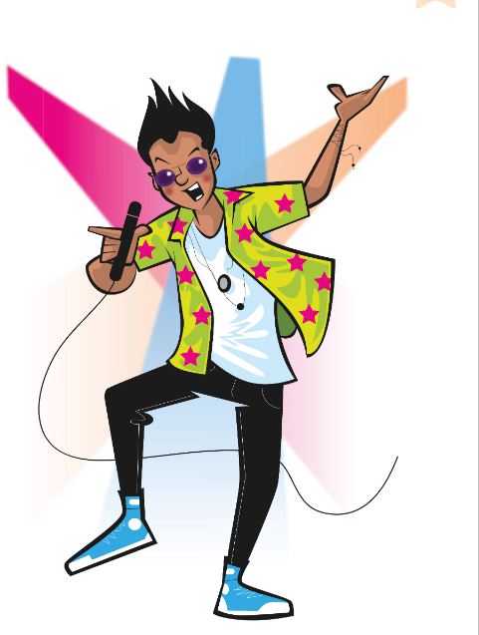
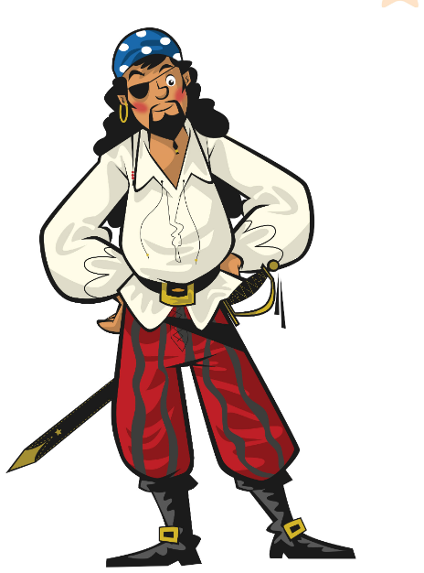
UNIT 3 · LESSON 5
Today: a story about helping 💡
Oggi: una storia sull'aiutare
The costume party
1
💬 SPEAK
Talk about costume parties.
Parla delle feste in maschera.
Can you help me?
Mi puoi aiutare?
2
📖 READ
Read the story: The costume party.
Leggi la storia: La festa in maschera.
3
💬 SPEAK
Ask for help and offer help!
Chiedi aiuto e offri aiuto!
📘 Pupil's Book p.38–39 · 🎧 1.49
Notes:
COVER (2 min, TB38). 'Who helps you?' Students say people who help them and share short stories of when someone helped them. 'We're going to read a story about someone who needs help.'

Slide 2
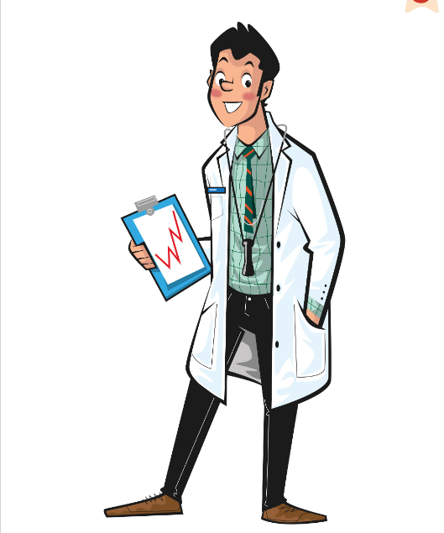
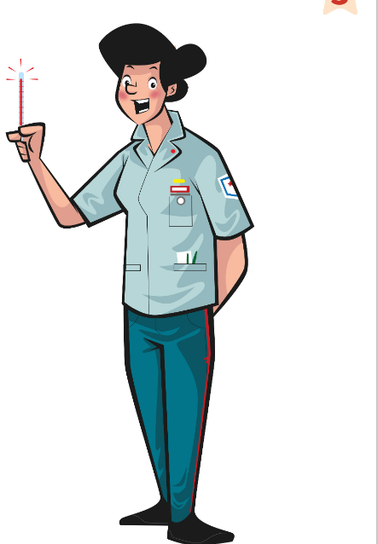
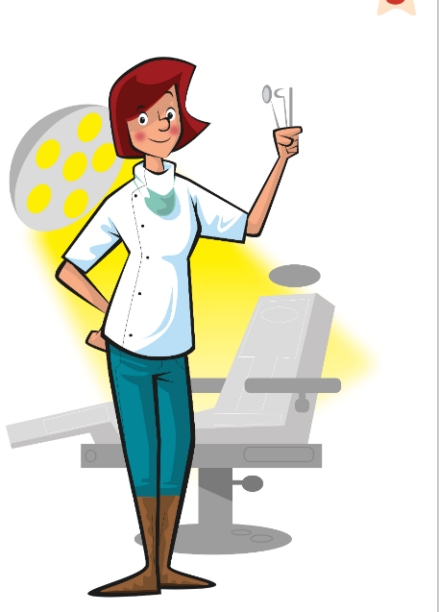


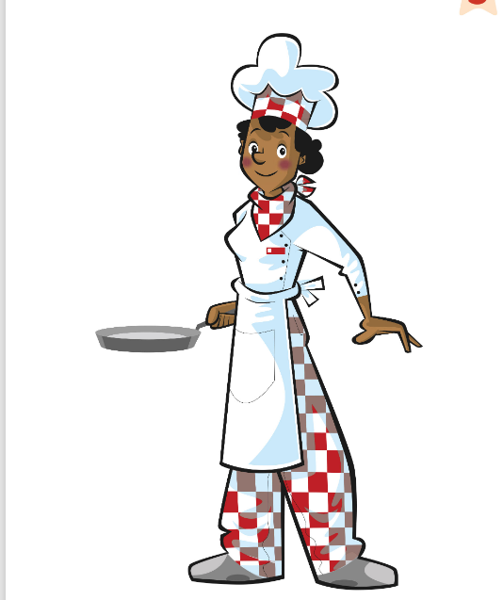
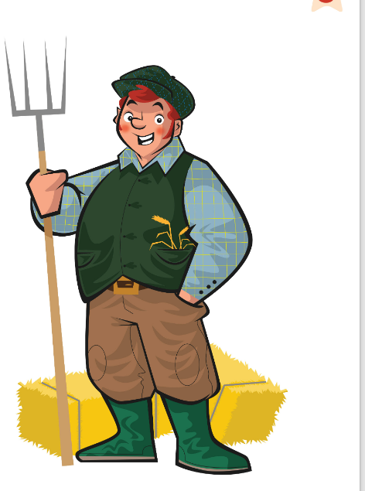

REMEMBER?
Say a job and where they work. Hit it back!
Di' un mestiere e dove lavora. Rimanda la palla!
Word tennis!
👥👥 TEAMS · ⏱ 4 MIN
1
👂 LISTEN
Team A: 'A nurse!'
Squadra A: 'A nurse!'
2
💬 SPEAK
Team B: '…works in a hospital!'
Squadra B: '…lavora in ospedale!'
3
🎲 PLAY
Too slow? Point to the other team!
Troppo lenti? Punto all'altra squadra!
⭐ A … works in a …
🔥 No repeats! 3 seconds!
Notes:
RETRIEVAL OF LESSONS 1 + 4 – WORD TENNIS (4 min). SEE: 8 helpers (pictures only). TEACHER: mime a tennis serve to Team A. STUDENTS: Team A says a job ('A dentist!'), Team B 'hits it back' within 3 seconds with the place ('…works in a surgery!'), then Team B serves a new job. Each turn a DIFFERENT child speaks (go along the row). GROUPING: 2 teams facing each other. SCORE: a point when the other team is too slow, wrong, or repeats a job. LANGUAGE: jobs + work in a hospital / school / surgery / fire station / police station / restaurant / on a farm. Round 2 (challenge): serve a PROBLEM ('There's a fire!') – return the job ('A firefighter can help!'). REVEAL: teacher is the umpire – confirms or corrects each answer.

Slide 3

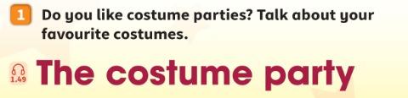
SPEAK
Do you like costume parties? Talk about your favourite costumes.
Ti piacciono le feste in maschera? Parla dei tuoi costumi preferiti.
Costume parties!
👥 PAIRS · ⏱ 4 MIN
1 Do you like costume parties?
Yes, I do! / No, I don't.
2 What's your favourite costume?
I'm wearing… I'm a cat! I've got a long tail.
3 Does anyone dress up as a superhero?
Yes! Spider-Man, Superman, Wonder Woman…
📘 Pupil's Book p.38 · ex.1
⭐ I'm a … I've got …
🔥 Which would an alien choose?
Notes:
EX.1 (4 min, TB38). MODEL first: show a photo of yourself in fancy dress (or describe one): 'I'm wearing my favourite costume. I'm a cat! I've got a long tail and black ears.' Then pairs talk using the support frame. Answers on click are MODELS, not 'correct answers'. VARIATION questions: 'Which costume would your mum choose? Which would an alien choose? Which costume would you NEVER wear?' Write famous superheroes on the board. (TB38 spelling warm-up moved to EXTRA: Spelling bee.)

Slide 4

FLASHCARDS
Look! Say the word before it appears!
Guarda! Di' la parola prima che appaia!
Story words
🏃 TPR Superhero pose! Fly! 🦸
supereroe
superhero
📘 Pupil's Book p.38–39 · 🎧 1.49
1 / 3
Notes:
STORY WORDS (3 min). New language (TB38): have an idea, laugh, superhero, be good at …ing, What about …? Do the TPR for each word. TPR: Superhero pose! Fly! 🦸

Slide 5

FLASHCARDS
Look! Say the word before it appears!
Guarda! Di' la parola prima che appaia!
Story words
🏃 TPR Finger up: 'I've got an idea!' 💡
avere un'idea
have an idea
📘 Pupil's Book p.38–39 · 🎧 1.49
2 / 3
Notes:
STORY WORDS (3 min). New language (TB38): have an idea, laugh, superhero, be good at …ing, What about …? Do the TPR for each word. TPR: Finger up: 'I've got an idea!' 💡

Slide 6

FLASHCARDS
Look! Say the word before it appears!
Guarda! Di' la parola prima che appaia!
Story words
🏃 TPR Laugh! Ha ha ha! 😂
ridere
laugh
📘 Pupil's Book p.38–39 · 🎧 1.49
3 / 3
Notes:
STORY WORDS (3 min). New language (TB38): have an idea, laugh, superhero, be good at …ing, What about …? Do the TPR for each word. TPR: Laugh! Ha ha ha! 😂

Slide 7

SAY IT!
Listen. How do we say it? Show me 1 or 2!
Ascolta. Come si dice? Mostra 1 o 2!
Tricky words!
🗣 CLASS · ⏱ 3 MIN
1 laugh: 1 'lau-gh' or 2 'laaf'?
2 – laugh = /lɑːf/ (gh = f!)
2 idea: 1 I-dea or 2 i-DEA?
2 – i-DEA ● big in the middle
3 superhero: 1 su-per-HE-ro or 2 SU-per-he-ro?
2 – SU-per-he-ro
4 Ha un'idea! → ?
She HAS an idea! (not 'She have')
5 È brava ad aiutare. → ?
She's good AT helping!
🔥 Find more 'gh = f' words!
Notes:
PRONUNCIATION + ITALIAN TRAPS (3 min, before the story so the words are easy to hear). SEE: two options per word, answers hidden. TEACHER: say option 1 and option 2 aloud; students hold up 1 or 2 fingers (commit), then click. Whisper → normal → monster voice for each word. Italians read 'laugh' as it's written – 'gh' here sounds like /f/ (also 'enough'). 'Superhero': Italian 'supereroe' has stress on E – English stresses SU. TRAPS: 'She has' (not 'have') with he/she/it; 'good AT + -ing' (Italian 'bravo A' + infinitive). Challenge: 'enough', 'cough', 'tough'.

Slide 8
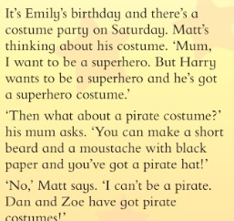
STORY
Listen and read. What costume does Matt want?
Ascolta e leggi. Che costume vuole Matt?
The costume party 1
👂 LISTEN · 📖 READ
1 Whose birthday is it?
Emily's
2 What does Matt want to be?
a superhero
3 Why can't he?
Harry wants to be a superhero.
4 What can Matt make?
a beard and a moustache
5 Why can't he be a pirate?
Dan and Zoe are pirates.
📘 Pupil's Book p.38 · 🎧 1.49
Notes:
STORY PART 1 (TB38). Also ask: What's the boy's name? (Matt) Why can't he wear a superhero costume? (Because Harry wants to be a superhero.) Why can't he be a pirate? (Because Dan and Zoe have got pirate costumes.) First look at the pictures: Picture 1 – Is the boy happy? (No) What's on the walls of his bedroom? (Posters of superheroes) Who's the woman? (The boy's mum). Picture 2 – What does the picture in the 'Think' bubble mean? (She has an idea.) Play the audio, pause after 'superhero costume' and after 'pirate costumes!' Ask the questions; answers on click.

Slide 9
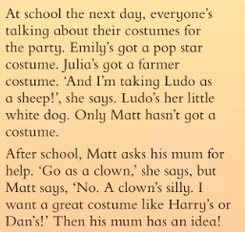
STORY
Listen and read. Who hasn't got a costume?
Ascolta e leggi. Chi non ha un costume?
The costume party 2
👂 LISTEN · 📖 READ
1 What's everyone talking about at school?
their costumes
2 Who's got a farmer costume?
Julia
3 What kind of animal is Ludo?
a dog 🐶
4 Is Ludo a dog at the costume party?
No, a sheep! 🐑
5 Who hasn't got a costume?
Matt
6 Why doesn't Matt want to be a clown?
Because he thinks it's silly.
📘 Pupil's Book p.38 · 🎧 1.49
Notes:
STORY PART 2 (TB38). Play the next part, pause after 'has an idea!'. Check 'silly' (sciocco). 'What do you think Mum's idea is?' – students predict!

Slide 10
STORY
Look! Who can you see at the party?
Guarda! Chi vedi alla festa?
The party!
📘 Pupil's Book p.39 · 🎧 1.49
Notes:
PICTURE 3 (TB38): 'Where's the boy? (At a party.) Is he happy? (Yes.) Which costumes can you see?' (A pirate, a pop star, a dentist, a superhero, a farmer, a clown, a nurse, a police officer.) Point and say: 'She's a pop star. He's a police officer.'

Slide 11
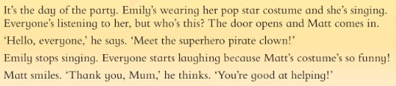
STORY
Listen and read. What's Matt's costume?
Ascolta e leggi. Qual è il costume di Matt?
The costume party 3
📘 Pupil's Book p.39 · 🎧 1.49
Notes:
STORY PART 3 (TB38). Play the rest of the story while students read on the screen. Explain 'good at' (bravo a). EXTENSION: play the whole story again without pauses; students just listen and read.

Slide 12
STORY
Answer the questions about the party.
Rispondi alle domande sulla festa.
Everyone is laughing!
1 What's Emily wearing?
a pop star costume
2 What's she doing?
She's singing. 🎤
3 What's Matt's costume?
a superhero pirate clown!
4 Why is everyone laughing?
Because his costume is funny.
5 What is Matt's mum good at?
helping!
📘 Pupil's Book p.39 · 🎧 1.49
Notes:
QUESTIONS PART 3 (TB38): What's Emily wearing? (A pop star costume) What's she doing? (Singing) What is Matt's costume? (A superhero pirate clown) Why is everyone laughing? (Because his costume is funny) What is Matt's mum good at? (Helping)

Slide 13

READ
Answer the questions.
Rispondi alle domande.
Answer the questions
👥 PAIRS · ⏱ 4 MIN
1 Does Matt choose his costume?
No, he doesn't.
2 Who has the idea for his costume?
His mum has the idea.
3 Does Matt like the idea?
Yes, he does.
4 How do you know?
Because he's very happy at the end of the story.
📘 Pupil's Book p.39 · ex.2
⭐ Yes, he does. / No, he doesn't.
Notes:
EX.2 (4 min, TB39). Check 'choose' (scegliere). Pairs think and talk, then check. KEY (TB39): 1 No, he doesn't. 2 His mum has the idea. 3 Yes, he does. 4 Because he's very happy at the end of the story.

Slide 14

GAME
Listen to the story and mime it!
Ascolta la storia e mimala!
Act the story!
🏃 CLASS · ⏱ 4 MIN
Superhero flying pose! 🦸
Sword fight! ⚔️
Sing into a microphone! 🎤
Drive a tractor! 🚜
Be a sheep! Baaa! 🐑
Mum has an idea! 💡
Notes:
TPR – ACT OUT THE STORY (4 min, TB39 extra support). SEE: 6 pictures, actions on click. TEACHER: tell the story sentence by sentence and mime: 'There's a costume party for Emily's birthday. Matt's thinking (mime thinking). He wants to be a superhero (flying pose). But Harry's got a superhero costume. Matt can be a pirate (sword fight). But Dan and Zoe have got pirate costumes. Emily's a pop star (sing). Julia's a farmer (drive a tractor). Ludo's a sheep (baa!). Matt's sad. Then his mum has an idea! (finger up)'. STUDENTS: act with you; second time you stop before the key word and they say it ('He wants to be a…' – 'SUPERHERO!'). GROUPING: whole class. LANGUAGE: story retelling (gap-fill orally).

Slide 15
GAME
Who is it? Write the name. Show me!
Chi è? Scrivi il nome. Mostralo!
Story detectives!
👥👥 TEAMS · ✍ · ⏱ 4 MIN
1 It's her birthday.
Emily
2 He needs a great costume.
Matt
3 They've got pirate costumes.
Dan and Zoe
4 He's a dog, but he's a sheep at the party.
Ludo
5 He's got a superhero costume.
Harry
6 She has a good idea.
Matt's mum
📘 Pupil's Book p.38–39
⭐ Matt · Emily · Ludo · Harry…
Notes:
STORY DETECTIVES (4 min, TB39 warm-up). SEE: the party picture + 6 sentences, answers hidden. TEACHER: read sentence 1. STUDENTS: teams have 10 seconds to write the NAME on a mini whiteboard / paper and hold it up together ('Show me!') – commit before reveal. GROUPING: 3–4 teams. SCORE: 1 point per correct name, +1 for a correct spelling. LANGUAGE: reading/listening for detail; character names. REVEAL: click after all boards are up. KEY (TB39): Emily, Matt, Dan and Zoe, Ludo, Harry, Matt's mum. Bonus question: 'What is Matt's costume at the end?' (Superhero pirate clown).

Slide 16
SPEAK
It's OK to ask for help! Use these in class.
È giusto chiedere aiuto! Usale in classe.
Can you help me?
👥 PAIRS · ⏱ 5 MIN
1
💬 SPEAK
What does … mean? · Cosa vuol dire…?
Can you repeat that, please? · Puoi ripetere, per favore?
How do I do this? · Come si fa?
How do you say … in English? · Come si dice… in inglese?
Can I help you? – Yes, please! Thank you!
Ask the teacher or a friend.
Chiedi all'insegnante o a un compagno.
2
✏️ WRITE
Copy the questions on a card.
Copia le domande su un cartoncino.
3
💬 SPEAK
Role-play in pairs!
Recitate a coppie!
Notes:
SOCIAL AND EMOTIONAL SKILL: ASKING FOR AND OFFERING HELP (6 min, TB39). 'Matt asks his mother for help. Why does he need help? (He needs a costume.) Does his mother help him? (Yes.)' Ask what their parents do for them. Point out it's good to do things ourselves, but sometimes we need to ask for help – also in class (when I can't do my homework, when I can't find something…). Write the list; students copy it on A4 paper, decorate it and role-play in pairs.

Slide 17
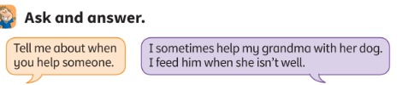
SPEAK
Ask and answer. When do you help someone?
Domanda e rispondi. Quando aiuti qualcuno?
Ask and answer
👥 PAIRS · ⏱ 4 MIN
1 Tell me about when you help someone.
I sometimes help my grandma with her dog. I feed him when she isn't well.
2 How do you help at home?
I wash the car / do the shopping / clean my bedroom.
3 Who do you help?
I look after my brother / sister.
📘 Pupil's Book p.39 · ex.3
⭐ I sometimes help my …
🔥 Say when and why!
Notes:
EX.3 (4 min, TB39). Read the speech bubbles. Pairs talk about helping. Extra support: prompts on the board – wash the car, do the shopping, clean my bedroom, look after my brother. Model answers on click (students' own answers).

Slide 18
GAME
Pick a problem card. Your partner offers help!
Pesca un problema. Il compagno ti offre aiuto!
Role-play: Help!
👥 PAIRS · ⏱ 5 MIN
1
📖 READ
I can't find my pencil case! ✏️
My bag is very heavy! 🎒
I don't understand this word. 🤔
I've fallen off my bike! 🚲
I haven't got a costume for the party! 🎉
Read the problem card.
Leggi il problema.
2
💬 SPEAK
'Oh no! I can't find my pencil!'
'Oh no! Non trovo la matita!'
3
💬 SPEAK
Partner: 'Can I help you? Here you are!'
Compagno: 'Posso aiutarti? Ecco!'
⭐ Can I help you?
🔥 What about a …?
Notes:
ROLE-PLAY (5 min). SEE: 5 problem lines + support. TEACHER: MODEL with a strong student first (teacher has the problem, student offers help); then a supported pair at the front. STUDENTS: pairs – A picks a problem and says it with feeling, B offers help ('Can I help you? / I can help! / What about a …?'), A says 'Thank you very much!'; swap. GROUPING: pairs, then 2 volunteer pairs perform. SCORE: no points – the class gives a 'best actors' clap. LANGUAGE: Can I help you? Can you help me? Thank you very much! What about…? Good practice for the Mission scene next lesson.

Slide 19
WELL DONE!
Today I can… · Oggi so…
Show me with your thumbs! 👍 👌 👎
Bye bye! 👋
⭐ I can understand the story 'The costume party'.
Capisco la storia 'La festa in maschera'.
🏠 HOMEWORK · COMPITI
• Homework sheet
• Activity Book p.38: ex.1–3
• Activity Book p.39: ex.4
⭐ I can ask for help: 'Can you help me?'
So chiedere aiuto.
⭐ I can offer help: 'Can I help you?'
So offrire aiuto.
➡ Next: Movers speaking + our Mission show! 🎭
Notes:
EXIT (3 min, TB38). Ask 'How does your family help you?' Make a list of ways. Pairs write sentences ('My parents cook every day. My dad takes me to football.'). Self-assessment on the story (TB39).

Slide 20
GAME
Two teams. Spell the word. Correct = 1 point!
Due squadre. Fai lo spelling. Giusto = 1 punto!
EXTRA: Spelling bee!
👥👥 TEAMS · ⏱ 5 MIN
1
👂 LISTEN
costume · party · pirate · clown
farmer · sheep · superhero · funny
moustache · present · birthday · idea
Listen: 'How do you spell costume?'
Ascolta: 'Come si scrive costume?'
2
💬 SPEAK
Spell it: C-O-S-T-U-M-E!
Fai lo spelling: C-O-S-T-U-M-E!
Notes:
EXTRA – SPELLING BEE (5 min, TB38 warm-up). Two teams at the front with their backs to the board. Ask one child: 'How do you spell pirate?' Correct = 1 point. Children swap so everyone gets a turn. Stronger: police officer, firefighter, hospital.

Slide 21
GAME
Run, read, remember, tell your team, write!
Corri, leggi, ricorda, detta alla squadra, scrivi!
EXTRA: Running dictation
👥👥 TEAMS · ✍ · ⏱ 8 MIN
1
🏃 MOVE
Matt wants to be a superhero.
Dan and Zoe have got pirate costumes.
Matt's mum has an idea.
Matt is a superhero pirate clown!
Everyone laughs. Matt is happy.
Runner: run to the wall and read.
Corridore: corri al muro e leggi.
2
💬 SPEAK
Run back and say the sentence.
Torna e di' la frase.
3
✏️ WRITE
Team: write it. Put the story in order!
Squadra: scrivetela. Mettete in ordine la storia!
Notes:
EXTRA – RUNNING DICTATION (8 min). Stick the 5 sentences (mixed order) on the wall outside / far from the teams. Runners change each sentence. When all 5 are written, the team puts them in the story order. Check spelling. Order: as on the slide.

