Slide 1

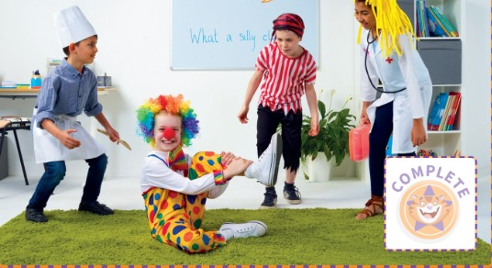
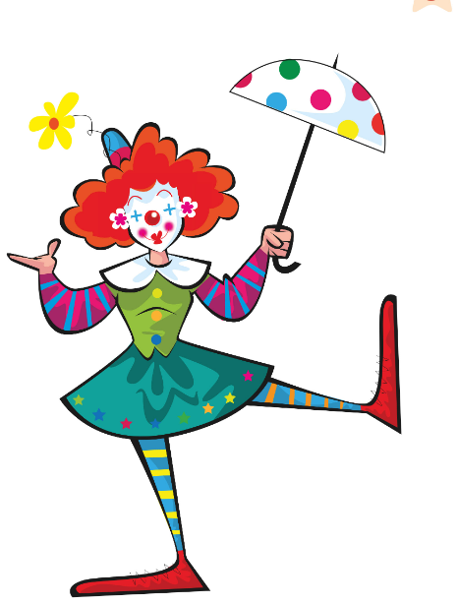
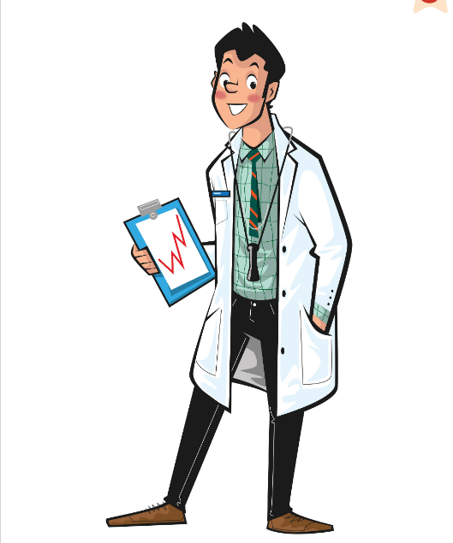
UNIT 3 · LESSON 6
Today: picture stories + our show! 🎭
Oggi: storie illustrate + spettacolo!
Mission in action!
1
👀 LOOK
Look at a picture story.
Guarda una storia illustrata.
Lights, camera, action!
Luci, camera, azione!
2
💬 SPEAK
Tell the story like in the Movers exam.
Racconta la storia come all'esame Movers.
3
⚙️ DO
Act out our Mission scene!
Recitiamo la scena della Missione!
📘 Pupil's Book p.40–41
Notes:
COVER (2 min, TB40). 'Let's practise for a speaking exam!' Explain Movers Speaking Part 2: four pictures that make a story; the name of the story is at the top. You look and think about the story, then tell the examiner. The name of the main character is given.

Slide 2


REMEMBER?
Two are true. One is a LIE! Which one?
Due sono vere. Una è una BUGIA! Quale?
Spot the lie!
👥👥 TEAMS · ⏱ 4 MIN
1 ① Matt: superhero ② Ludo: cat ③ Emily: pop star
② Ludo is a DOG!
2 ① Mum: an idea ② Harry: pirate ③ everyone: laughs
② Harry is a superhero!
3 ① firefighter: hospital ② dentist: teeth ③ Sally: teacher
① fire station!
⭐ Number … is a lie!
🔥 Correct the lie!
Notes:
RETRIEVAL OF LESSONS 4–5 – SPOT THE LIE (4 min). SEE: 3 sentences per row, answers hidden. TEACHER: read row 1 aloud as full sentences with a 'poker face' (Matt wants to be a superhero. Ludo is a cat. Emily is a pop star.). STUDENTS: teams have 10 seconds to agree and hold up 1, 2 or 3 fingers (commit) – THEN click. GROUPING: 2–3 teams. SCORE: 1 point for the lie, +1 if the team corrects it in a full sentence ('Ludo is a dog!'). LANGUAGE: story recall (L5) + jobs and places (L4). Round 4 (if time): a team invents 2 truths + 1 lie about themselves for the others. (TB40 'Draw a party' warm-up: optional, only if you have extra time.)

Slide 3
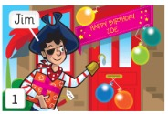
A1 MOVERS
Look and read. Tick ✓ the sentences which describe the picture.
Guarda e leggi. Spunta ✓ le frasi che descrivono l'immagine.
Tick the sentences
👥 PAIRS · ⏱ 3 MIN
1 Jim is going to a costume party.
✓
2 Jim's having a party at his house.
✗
3 He's got a present for his friend, Zoe.
✓
4 He's opening a present.
✗
📘 Pupil's Book p.40 · ex.1
Notes:
EX.1 (4 min, TB40). Ask about picture 1: 'What's the boy's name? (Jim) What has he got? (A present) What's he wearing? (A pirate costume) Whose birthday is it? (Zoe's)'. Pairs read and tick. KEY (TB40): 1, 3. Extra support: read the sentences as a class and decide together which to tick.

Slide 4
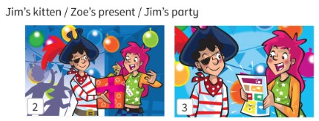
A1 MOVERS
Look at pictures 2–4. What's the story called? Circle.
Guarda le figure 2–4. Come si chiama la storia? Cerchia.
What's it called?
👥👥 VOTE · ⏱ 3 MIN
1 Who's this girl?
Zoe
2 What's Jim giving to Zoe?
his present 🎁
3 Is Zoe wearing a costume? Which one?
Yes – a pop star costume.
4 Jim's kitten / Zoe's present / Jim's party?
Zoe's present ✓
📘 Pupil's Book p.40 · ex.2
Notes:
EX.2 (4 min, TB40). Point to picture 2: 'Who's this girl? (Zoe) Jim's giving his present to Zoe. Is Zoe wearing a costume? What costume is it? (Pop star)'. 'Look at pictures 3 and 4. What's happening? What's the story about?' Read the three titles; students vote. KEY (TB40): Zoe's present.

Slide 5

SAY IT!
Listen. 1 = he's 2 = his. Show me!
Ascolta. 1 = he's 2 = his. Mostra!
He's or his?
🗣 CLASS · ⏱ 3 MIN
1 ___ wearing a pirate costume.
1 He's (= he is)
2 ___ present is a comic.
2 His
3 ___ got a present for Zoe.
1 He's (= he has)
4 Zoe's sad. ___ present!
Her! (girl = her)
5 Her hair / Air hair?
HER HAIR – breathe the H! ✋
🔥 Say: His hair's pink!
Notes:
PRONUNCIATION + TRAP (3 min). Italian learners mix 'he's' /hiːz/ and 'his' /hɪz/, and drop the h. SEE: gapped sentences, answers hidden. TEACHER: read each sentence saying ONE of the two words clearly. STUDENTS: hold up 1 finger (he's – long smiley 'eee') or 2 fingers (his – short 'i'), then click. CATCH IT: say 'is present' / 'er hair' without h – students catch you. Whisper → normal → monster voice: 'His hair is long. Her hair is pink.' Then into the story-telling.

Slide 6
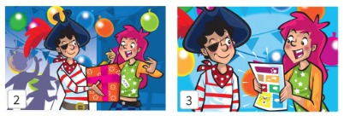
A1 MOVERS
Make sentences about the pictures. Use these words.
Fai delle frasi sulle immagini. Usa queste parole.
Tell the story! 1
👥 PAIRS · 🗣 · ⏱ 4 MIN
1 Picture 2: What's Zoe wearing?
She's wearing a pop star costume. She's got long, pink hair.
2 How does Zoe feel?
Zoe likes the present. Zoe's happy.
3 Picture 3: What's the present?
It's a comic (book).
4 Where's the comic book?
on the table
📘 Pupil's Book p.40 · ex.3
⭐ Zoe's … · There's a …
🔥 Add: because …
Notes:
EX.3 (8 min, both slides, TB40). Read the phrases in the box: Zoe's/Jim's … · Zoe's/Jim's got … · The kitten's walking … · …'s happy/sad · … are looking/pointing · There's / There are …. Elicit sentences about each picture, then pairs describe pictures 2–4. KEY (possible answers, TB40): Zoe's wearing a pop star costume. She's got long, pink hair. Zoe likes the present. Zoe's happy. It's a comic (book). The comic book's on the table.

Slide 7
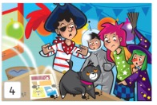
A1 MOVERS
What's happening? Tell the examiner!
Cosa succede? Raccontalo all'esaminatore!
Tell the story! 2
👥 PAIRS · 🗣 · ⏱ 4 MIN
1 What's open?
The window's open.
2 What's the kitten doing?
The kitten's walking on Zoe's present.
3 How does Zoe feel?
Zoe's sad. 😢
4 What are the other children doing?
They're looking at the kitten. A girl is pointing at it.
📘 Pupil's Book p.40 · ex.3
⭐ The kitten's …ing
🔥 What happens next?
Notes:
KEY (possible answers, TB40): The window's open. There's a kitten. The kitten's walking on Zoe's present. Zoe's sad. The other children are looking at the kitten. A girl is pointing at the kitten. MONKEY TIP (TB40): don't worry if you don't follow the story at first or can't find the words – the examiner can ask questions to help you, e.g. 'What's the kitten doing?'. EXTENSION: students imagine what happens next and draw 4 pictures with a title; partners tell each other's story.

Slide 8
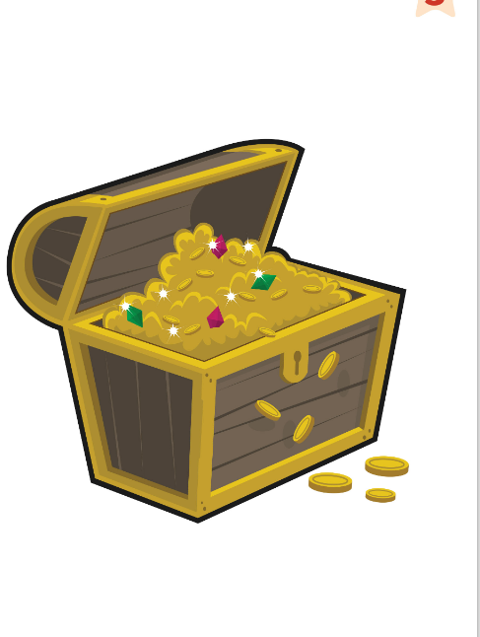
GAME
Listen to the clue. Find the flashcard word!
Ascolta l'indizio. Trova la parola!
Team quiz!
👥👥 TEAMS · ✍ · ⏱ 5 MIN
1 Someone who works with animals.
a farmer
2 Hair men sometimes have above their mouths.
a moustache
3 Two jobs which help us.
doctor, nurse, dentist, firefighter…
4 Two words for hair colour.
blonde, fair (black, brown…)
5 Someone who likes treasure.
a pirate
6 Something we give at a birthday party.
a present
🔥 Spell it right: +1!
Notes:
TEAM QUIZ (5 min, TB41 warm-up). SEE: treasure picture + 6 clues, answers hidden. TEACHER: read a clue. STUDENTS: teams write the word on a mini whiteboard in 10 seconds and hold it up together (commit). GROUPING: 3–4 teams. SCORE: 1 point per correct word, +1 if spelt correctly. LANGUAGE: Unit 3 words from definitions. REVEAL: click after all boards are up. KEY: a farmer, a moustache, doctor/nurse/dentist/firefighter/police officer (any two), blonde/fair/black/brown (any two), a pirate, a present. (Hangman is the Review's 'Shark attack', so not here.)

Slide 9






GAME
Actors! Show the feeling with your face and body!
Attori! Mostra l'emozione con faccia e corpo!
Show me!
🏃 CLASS · ⏱ 3 MIN
Happy! Big smile! 😀
Sad! Cry! Boo-hoo!
Surprised! 'Wow!' 😮
Ouch! My leg! 🤕
Laugh! Ha ha ha!
Scared! 'Help!' 😱
Notes:
TPR – SHOW ME! (3 min). Warm up the actors before the show. SEE: 6 feeling faces; actions on click. TEACHER: say a feeling – everyone shows it with face and body. Then add a line: 'Say Oh no! – SAD voice!', 'Say Thank you! – HAPPY voice!', 'Say Help! – SCARED voice!'. GROUPING: whole class. SCORE: none – a 'best actor' leads the next round. LANGUAGE: feelings + useful lines for the Mission scene.

Slide 10
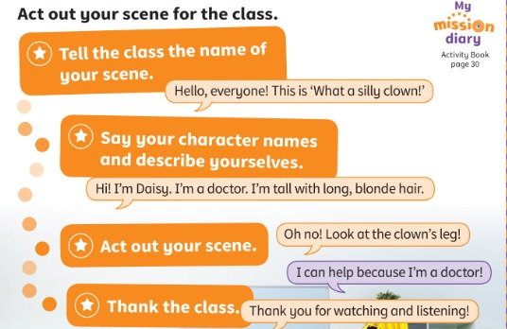
MISSION
Act out your scene for the class.
Recitate la vostra scena per la classe.
Mission in action!
👥👥 GROUPS · ⏱ 8 MIN
1 Say the name of your scene.
Hello, everyone! This is 'What a silly clown!'
2 Say who you are.
Hi! I'm Daisy. I'm a doctor.
3 Act out your scene.
Oh no! Look at the clown's leg!
4 Thank the class.
Thank you for watching and listening!
📘 Pupil's Book p.41 · Activity Book p.30
⭐ Hello, everyone! This is …
Notes:
MISSION IN ACTION (15 min with the next slide, TB41). Go through the stages. Model: pretend you're presenting a scene – say a title, mime with a picture of your character and describe yourself; say 'Here is our scene' and act it out. Mission groups (from Lessons 2–4) get time to practise presenting their characters and rehearsing the scene. Use props / costumes if possible.

Slide 11
GAME
Watch your friends' scenes. Be a great audience!
Guarda le scene dei compagni. Sii un bravo pubblico!
Showtime! 🎭
👀 WATCH · ⏱ 10 MIN
1
🎬 WATCH
⭐ Big, clear voices
⭐ Good acting (faces + bodies!)
⭐ English all the time!
Audience: 'Thank you! Well done!' 👏
Watch and listen. Shhh!
Guarda e ascolta. Shhh!
2
💬 SPEAK
Who's the helper? What's the problem?
Chi aiuta? Qual è il problema?
3
⚙️ DO
Clap! ⭐ Give 3 stars!
Applaudi! ⭐ Dai 3 stelle!
Notes:
SHOWTIME. Groups take turns to present and act. Remind them to thank the audience ('Thank you for watching and listening!'). After each scene ask the audience: 'Who's the helper? What's the problem?' Then each group gets a star for each criterion. Take a short video for the parents if the school's privacy rules allow it.

Slide 12
WELL DONE!
Today I can… · Oggi so…
Show me with your thumbs! 👍 👌 👎
Bye bye! 👋
⭐ I can tell a picture story (Movers Speaking Part 2).
So raccontare una storia illustrata.
🏠 HOMEWORK · COMPITI
• Homework sheet
• Activity Book p.40: ex.1 (tell the story)
• Activity Book p.41: play the game!
• Activity Book p.30: My mission diary
⭐ I can act out a scene in English!
So recitare una scena in inglese!
⭐ I know all the Unit 3 words.
Conosco tutte le parole dell'Unità 3.
➡ Next: Review Units 1–3 – games day! 🎲
Notes:
SELF-ASSESSMENT (TB41). 'Did you like the Plan and act out a scene Mission?' Students draw a happy, neutral or sad face. 'Was this Mission better than the last one?' (thumbs). Next Mission: 'Act out a visit to my cousins' new home.' Students write one thing they can do better (e.g. 'I can talk more in groups.'). AB p.30: look at the 'I can' leaves (colour green/orange) and add 5 new words to the word stack (AB p.120). Give the completion sticker: 'You have finished your Mission! Well done!'

Slide 13
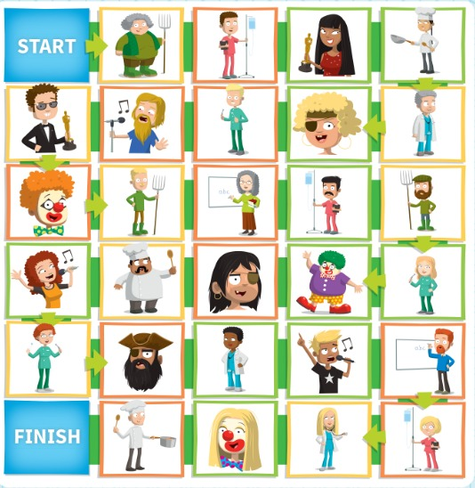
GAME
Roll the dice and move. Describe the person!
Lancia il dado e muoviti. Descrivi la persona!
EXTRA: Dice game!
👥👥 GROUPS · ⏱ 8 MIN
📘 Activity Book p.41
⭐ He's … He's got …
Notes:
EXTRA – BOARD GAME (8 min, AB p.41). SEE: the AB board. TEACHER: groups of 3–4 with a dice and counters (or 2 teams on the screen: a child moves the team's counter). STUDENTS: roll, move, describe the person on the square: 'The farmer's tall. He's got fair hair and a moustache.' GROUPING: small groups / 2 teams. SCORE: a correct 2-detail description = stay; wrong or 1 detail = back 1 square; first to FINISH wins. LANGUAGE: He's/She's + adjective, He's/She's got + adjective order.

Slide 14
GAME
Two teams: O and X. Say the word and a sentence!
Due squadre: O e X. Di' la parola e una frase!
EXTRA: X and O!
👥👥 TEAMS · ⏱ 5 MIN
1
👀 LOOK
Row 1: beard · nurse · curly
Row 2: firefighter · treasure · tall
Row 3: dentist · moustache · pop star
Choose a square.
Scegli una casella.
2
💬 SPEAK
Say a sentence: 'He's got a beard.'
Di' una frase: 'He's got a beard.'
3
🎲 PLAY
Correct? Put your O or X! 3 in a row wins.
Giusto? Metti O o X! Tris vince.
Notes:
EXTRA – NOUGHTS AND CROSSES (5 min). SEE: 9 words in 3 rows (draw them as a 3×3 grid on the board, or use the real flashcards). TEACHER: draws the grid; Team O starts. STUDENTS: the team chooses a square and makes a correct sentence about it ('He's got a beard.' / 'A nurse works in a hospital.'). GROUPING: 2 teams, a different speaker each turn. SCORE: correct sentence = O/X; three in a row wins. LANGUAGE: Unit 3 description + jobs sentences. REVEAL: teacher accepts/rejects each sentence (class helps correct).

