Slide 1


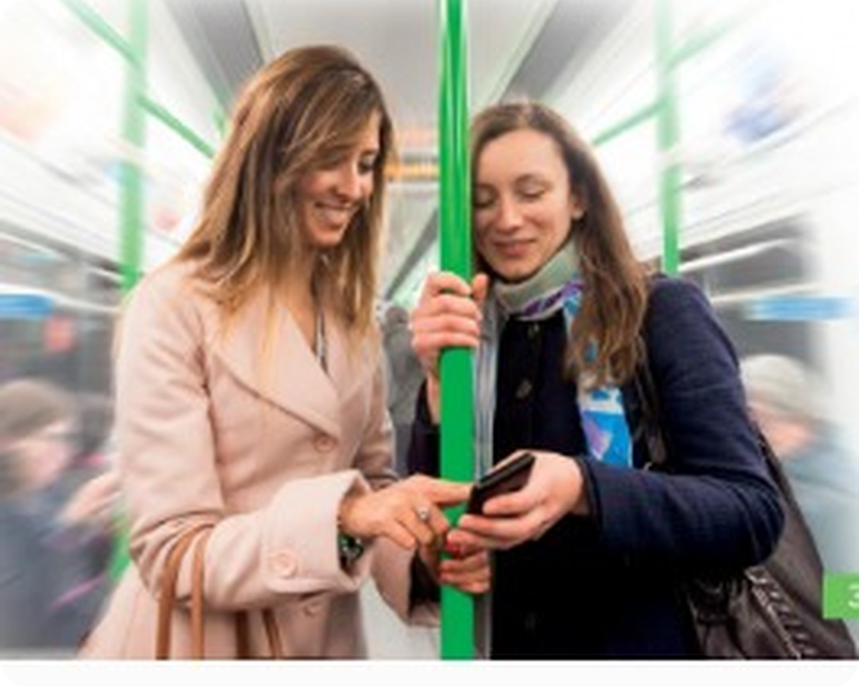


English File Elementary · SB pp.30–31 · VB p.155
💡 THINK · PENSA
4A
Family photos
Possessive 's · Whose…? · family
🎯
Today you're going to…
👪 say who's who: my brother's wife
❓ ask Whose is it? – It's Maria's.
🌳 learn family words: aunt, cousin, nephew
🔤 say the letter o: doctor, phone, mother, do
🎧 listen to Grace showing her photos
Do you have family photos on your phone? Who's in them?
EXAMPLE Yes! That's my sister's son. He's three.
Notes:
1. OPENING (2 min)
OPENING (2 min). Personalise: show a (non-student) family photo of your own if you like.

Slide 2

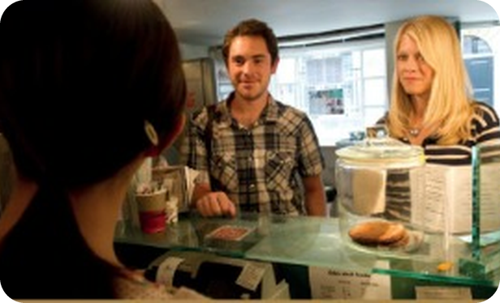
2
Remember last lesson?
💡 THINK → 💬 TALK
⏱ 3 min 👥 pairs
🎯 Revision · Retrieval
Can you remember? Say it – then use it in a sentence!
Ti ricordi? Dillo – poi usalo in una frase!
🔤 Can you remember these words? What do they mean?
quarter past
half past
twenty to
o'clock
Can I help you?
Regular or large?
To take away
How much is that?
⭐ What does it mean?
⭐⭐ Use it in a sentence.
⭐⭐⭐ Make it negative or a question!
📅
Last lesson…
PE2: Coffee to take away
telling the time · buying a coffee
Your turn: What time is it?
Make a past (right side) · a to (left side)
7.15 → It's quarter past seven.
8.40 → It's twenty to nine.
4A · Revision · last lesson
Notes:
2. Revision · last lesson (3 min)
ACTIVE RECAP (3 min). Pairs: one orders a coffee, the other is the barista – 30 seconds each.
HOW TO RUN IT (active recap): pairs. Words: A points at a word, B says what it means (⭐); then a sentence with it (⭐⭐); strong students make it negative or a question (⭐⭐⭐). Grammar: pairs make their own example for each use (offer, plan…) BEFORE you click – then click to show the model answers.

Slide 3

3
I'm not famous…
👀 READ → ✅ CHECK
⏱ 6 min 👤 alone
🎯 Reading · → grammar
Read the article. Who is Doug's brother? Does Doug like having a famous brother?
Leggi l'articolo. Chi è il fratello di Doug? Gli piace avere un fratello famoso?
I'm not famous… but my brother is
Doug is a businessman, and a photographer. He is also the founder of Care to Learn, an organization which helps poor children in the USA to do well at school. He's married with three children, and he and his family have a normal life. But for many people, he is always ' (1) ________ 's brother'.
Doug's life can be difficult. People follow him in the street. They ask him questions about his brother, his brother's ex-wife, who is also very famous, and their six children. The paparazzi follow Doug's children and take photographs.
But it also has advantages. 'I go to film premieres and I meet famous actors. And when I phone people and ask for money for Care to Learn, it helps when I say I'm (2) ________ 's brother.'
Doug is not jealous of his older brother. He is happy with his life. 'I see the world of famous people from the outside. I can leave it, but my brother can't.'
🕶️
Before you read
I'm not famous… but my brother is
Doug is a businessman, and a photographer. He is also the founder of Care to Learn, an organization which helps poor children in the USA to do well at school. He's married with three children, and he and his family have a normal life. But for many people, he is always ' (1) Brad Pitt 's brother'.
Doug's life can be difficult. People follow him in the street. They ask him questions about his brother, his brother's ex-wife, who is also very famous, and their six children. The paparazzi follow Doug's children and take photographs.
But it also has advantages. 'I go to film premieres and I meet famous actors. And when I phone people and ask for money for Care to Learn, it helps when I say I'm (2) ________ 's brother.'
Doug is not jealous of his older brother. He is happy with his life. 'I see the world of famous people from the outside. I can leave it, but my brother can't.'
I'm not famous… but my brother is
Doug is a businessman, and a photographer. He is also the founder of Care to Learn, an organization which helps poor children in the USA to do well at school. He's married with three children, and he and his family have a normal life. But for many people, he is always ' (1) Brad Pitt 's brother'.
Doug's life can be difficult. People follow him in the street. They ask him questions about his brother, his brother's ex-wife, who is also very famous, and their six children. The paparazzi follow Doug's children and take photographs.
But it also has advantages. 'I go to film premieres and I meet famous actors. And when I phone people and ask for money for Care to Learn, it helps when I say I'm (2) Brad Pitt 's brother.'
Doug is not jealous of his older brother. He is happy with his life. 'I see the world of famous people from the outside. I can leave it, but my brother can't.'
Look at the photo of Doug.
Who do you think his brother is?
Is it good or bad to have a famous person in your family?
His brother is Brad Pitt. Yes – Doug likes it.
4A · Reading · I'm not famous… but my brother is · 📖 SB p.30 · 1a, 1b (SB key)
Notes:
3. Reading · I'm not famous… but my brother is (6 min)
ARTICLE (6 min). 1a: guess from the photo. 1b: read; click for the gaps (Brad Pitt). Key: His brother is the actor Brad Pitt. Yes, he does (like it). Ask: good things? bad things? Would you like a famous brother?

Slide 4
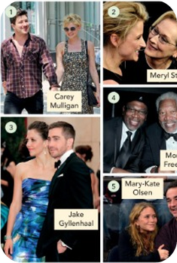
4
Famous families
💡 THINK → 🎧 LISTEN
⏱ 4 min 👥 pairs
🎯 Grammar · Controlled practice
Look at the photos. Choose a or b. Then listen and check.
Guarda le foto. Scegli a o b. Poi ascolta.
⭐
Example
1
He's Carey Mulligan's … husband / brother
He's Carey Mulligan's husband.
He's Carey Mulligan's … a husband / b brother?
2
She's Meryl Streep's … sister / daughter
She's Meryl Streep's daughter.
3
She's Jake Gyllenhaal's … wife / sister
She's Jake Gyllenhaal's sister.
4
He's Morgan Freeman's … son / brother
He's Morgan Freeman's son.
5
He's Mary-Kate Olsen's … father / husband
He's Mary-Kate Olsen's husband.
🎧 4.1
4A · Grammar · possessive 's · 📖 SB p.30 · 1c, 1d · audio 4.1 (SB key)
Notes:
4. Grammar · possessive 's (4 min)
FAMOUS FAMILIES (4 min). Pairs choose, then play 4.1 (audio to come – read the answers if it isn't in yet). Key from the SB answer key.

Slide 5
5
Whose is it?
👀 LOOK → 🔊 SAY IT
⏱ 4 min 🙋 whole class
🎯 Grammar · Communicative
Say it with 's. Then click!
Dillo con 's. Poi clicca!
the brother of Brad Pitt
person
+ 's
He's Brad Pitt's brother.
the laptop of James
name in -s
+ 's
It's James's laptop.
the car of my parents
plural in -s
+ '
It's my parents' car.
the bag – Maria?
Whose…?
It's…'s
Whose is this bag? – It's Maria's.
the film – the end
a thing
of
The end of the film is fantastic.
the city – the centre
a place
of / noun
I live in the city centre.
4A · Grammar Bank 4A · the rule · 📖 Grammar Bank 4A p.130 · audio 4.2 (SB script)
Notes:
5. Grammar Bank 4A · the rule (4 min)
RULE (4 min). Students say the 's version, click to check. Note for Italians: 'il fratello di Brad' → Brad's brother (no 'of' for people). For things: the end of the film. Whose? vs Who's? – same sound!

Slide 6
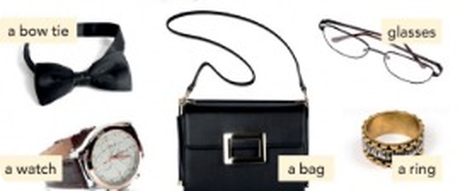
6
Whose bow tie is it?
💡 THINK → 🔊 SAY IT
⏱ 4 min 👥 pairs
🎯 Grammar · Controlled practice
Grammar Bank 4A c: Whose or Who's? Then f: whose are the things?
Grammar Bank 4A c: Whose o Who's? Poi f: di chi sono le cose?
⭐
Example
1
___ is this coat? (= di chi?)
Whose
A: Whose bow tie is it? B: It's Morgan Freeman's bow tie.
2
___ that man? (= Who is)
Who's
3
Whose watch is it?
It's Jake Gyllenhaal's watch.
4
Whose bag is it?
It's Carey Mulligan's bag.
5
Whose glasses are they?
They're Meryl Streep's glasses.
6
Whose ring is it?
It's Mary-Kate Olsen's ring.
4A · Grammar practice · Whose…? · 📖 SB p.30 · 1f · Grammar Bank 4A c (SB key)
Notes:
6. Grammar practice · Whose…? (4 min)
WHOSE (4 min). Items 3–6 = SB key for 1f. Then the real thing: collect 5 objects from the students (pen, phone, keys…), hold one up: Whose is this? – It's Marco's!

Slide 7
7
The family
✅ CHECK · CONTROLLA
⏱ 5 min 🙋 whole class
🎯 Vocabulary · TPRS · meaning
Vocabulary Bank: who's who in Richard's family? Say it, then click!
Vocabulary Bank: chi è chi nella famiglia di Richard? Dillo, poi clicca!
👴
grandfather
👵
grandmother
👩
aunt
👨
uncle
nonno
nonna
zia
zio
🧒
cousin
👰
wife
👧
niece
👦
nephew
cugino / cugina
moglie
nipote (della zia)
nipote (dello zio)
👫
parents
🏠
parents-in-law
👨‍👩‍👧
grandparents
💑
a couple
genitori
suoceri
nonni
una coppia
⚠ Watch out! Italian 'nipote' = niece / nephew (of an aunt / uncle) BUT grandson / granddaughter (of a grandparent)! · cousin = male or female
🎧 4.3
4A · Vocabulary Bank p.155 · the family · 📖 VB p.155 · The family a, b · audio 4.3 (SB key)
Notes:
7. Vocabulary Bank p.155 · the family (5 min)
FAMILY (5 min). Key from VB a: John = grandfather, Jennifer = grandmother, Sue = aunt, Nick = uncle, Hugh / Sarah = cousins, Emma = wife, Ruby = niece, Oliver = nephew. VB b: parents, parents-in-law, grandparents, children, a couple. Classic Italian error: nipote!

Slide 8
8
Who's…?
💡 THINK → 🔊 SAY IT
⏱ 3 min 👥 pairs
🎯 Vocabulary · Controlled practice
Answer the questions with a partner. Who's…?
Rispondi con un compagno. Who's…?
⭐
Example
1
your father's brother
my uncle
your mother's mother → my grandmother
2
your brother's / sister's daughter
my niece
3
your aunt's child
my cousin
4
your husband's / wife's brother
my brother-in-law
5
your niece's brother
my nephew
4A · Vocabulary · family riddles · 📖 SB p.31 · 2b (SB key)
Notes:
8. Vocabulary · family riddles (3 min)
RIDDLES (3 min). Key (SB): 2 uncle 3 niece 4 cousin 5 brother-in-law 6 nephew. Fast finishers write 2 riddles for the class.

Slide 9

9
The letter o
🔊 SAY IT → 🔗 MATCH
⏱ 4 min 👥 pairs
🎯 Pronunciation · Guided discovery
How is the letter o pronounced? clock, phone, up or boot?
Come si pronuncia la o? clock, phone, up o boot?
🏷️
The sounds
doctor
⏰ clock /ɒ/
job
⏰ clock /ɒ/
⏰ clock /ɒ/
📱 phone /əʊ/
model
⏰ clock /ɒ/
Scotland
⏰ clock /ɒ/
⬆️ up /ʌ/
👢 boot /uː/
don't
📱 phone /əʊ/
go
📱 phone /əʊ/
home
📱 phone /əʊ/
no
📱 phone /əʊ/
come
⬆️ up /ʌ/
🎧 4.5
London
⬆️ up /ʌ/
money
⬆️ up /ʌ/
one
⬆️ up /ʌ/
do
👢 boot /uː/
who
👢 boot /uː/
4A · Pronunciation · /ʌ/ and the letter o · 📖 SB p.31 · 3a–3c · audio 4.4, 4.5 (SB key)
Notes:
9. Pronunciation · /ʌ/ and the letter o (4 min)
LETTER O (4 min). 3a: /ʌ/ up – mother, brother, son, husband, uncle, couple, cousin (4.4). 3b–c key (SB). Remember box: the same vowel can have different sounds.

Slide 10
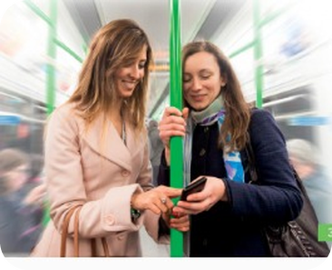
10
Who's that?
💬 TALK · PARLA
⏱ 3 min 👥 pairs
🎯 Pronunciation · Communicative
Practise the conversations. Then change the people!
Esercitati con i dialoghi. Poi cambia le persone!
1
A Who's that? B My mother.
e.g. A She's very young! B No, she's sixty-one. She's a doctor.
2
A Who are they? B My brother and his son.
e.g. A Do they live in Scotland? B No, they don't. They live in London.
3
A What's her job?
e.g. B She's a model. She earns a lot of money.
💬
Useful phrases
4
Now change the people and places!
e.g. Who's that? – My cousin. He lives in Palermo.
Who's that? – My mother.
Who are they?
What's her job?
She's very young!
4A · Pronunciation · practice · 📖 SB p.31 · 3d
Notes:
10. Pronunciation · practice (3 min)
CONVERSATIONS (3 min). Listen for the o sounds: mother, young, doctor, son, London, model, money.

Slide 11
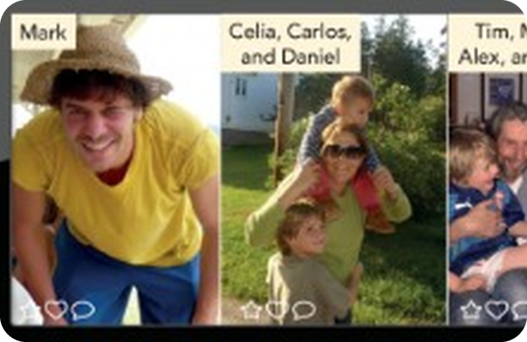
11
Grace's photos
🎧 LISTEN → ✅ CHECK
⏱ 6 min 👤 alone
🎯 Listening · for detail
Listen to Grace showing a friend photos. Who are Mark, Celia and Miriam?
Ascolta Grace che mostra le foto. Chi sono Mark, Celia e Miriam?
🎧 4.6 · play twice
Mark is Grace's…
boyfriend (example)
Celia is Grace's…
sister
Miriam is Grace's…
sister-in-law
Mark: more information
good-looking · 26 · medical student at University College London · loves it
Celia: more information
looks like Grace · 35 · two sons: Carlos (2), Daniel (6) · live in Chile
Miriam: more information
married to Tim (Grace's brother) · Tim = lawyer, Miriam = teacher · Helen 13 months, Alex 4
💡
Listen again: ages, jobs, where they live…
When's the wedding?
'Wedding! No, thanks! I'm too young!'
4A · Listening · Grace's photos · 📖 SB p.31 · 4a, 4b · audio 4.6 (SB key + script)
Notes:
11. Listening · Grace's photos (6 min)
GRACE (6 min). 4a: first row of the chart. 4b: listen again for more information. Key from the SB answer key. If the audio isn't in yet: two students read the script (SB p.120) as Anna and Grace.

Slide 12
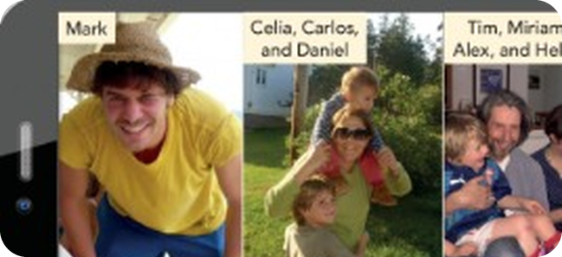
12
Who's that?
💬 TALK · PARLA
⏱ 7 min 👥 pairs
🎯 Speaking · Communicative
Show your partner photos of family or friends – or write their names. B asks 3 questions about each person.
Mostra al compagno foto di famiglia o amici – o scrivi i nomi. B fa 3 domande su ogni persona.
1
Who's that?
e.g. That's Yolanda. She's my sister.
2
How old is she? · What does she do?
e.g. She's 30. She's a nurse.
3
Where does she live? · Do you see her a lot?
e.g. In Bagheria. I see her every Sunday.
💬
Useful phrases
4
Tell the class about your partner's family!
e.g. Maria's brother is a chef in London.
Who's that?
That's Yolanda. She's my sister.
How old is she?
What does she do?
Where does she live?
She looks like you!
4A · Speaking · my family · 📖 SB p.31 · 4c
Notes:
12. Speaking · my family (7 min)
MY FAMILY (7 min). Phones or names on paper – students choose (privacy: no need to show real photos). Extra: B asks a follow-up question every time.

Slide 13
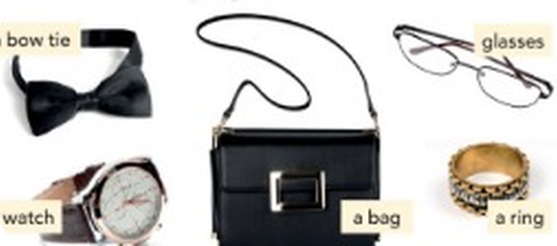
13
Whose is it?
🎲 PLAY → 💬 TALK
⏱ 5 min 👨‍👩‍👧 groups
🎯 Speaking · Communicative game
Whose is it? Put one thing each in a bag. Pick one – guess whose it is!
Di chi è? Mettete un oggetto a testa in una borsa. Pescane uno – indovina di chi è!
🎲
How to play
Whose is this pen?
→ I think it's Anna's.
1
Groups of 4–5. Everyone secretly puts one small thing in a bag (pen, keys, ring…).
One student picks a thing: Whose is this pen? – The group guesses: I think it's Marco's.
The owner says: Yes, it's mine! / No, it isn't mine. 1 point for a correct guess.
Whose keys are these?
→ They're Luca's!
2
Is it your mother's ring?
→ No, it's my grandmother's.
3
Round 2: family riddles! My mother's sister's son is…
→ your cousin!
4
4A · Game · Whose is it? · 📖 Extra · zero-prep game
Notes:
13. Game · Whose is it? (5 min)
GAME (5 min). Real objects = real Whose…? practice. Round 2: students make riddles for each other (my father's father = my grandfather).

Slide 14
14
3 · 2 · 1
⏱ 2 min 👥 pairs
🎯 Revision · Retrieval
Books closed! Tell your partner…
Libri chiusi! Di' al compagno…
3
Tell me 3 family words – and the Italian 'nipote' problem!
📝
Homework · Compiti
Workbook 4A pp.26–27
2
Tell me 2 sentences with 's: my brother's car…
Next lesson: 4B From morning to night – present simple, adverbs of frequency (SB p.32)
1
Ask me 1 question with Whose…?
4A · Exit · what can you remember?
Notes:
14. Exit · what can you remember? (2 min)
EXIT (2 min). Pairs, books closed.

Slide 15
15
Today you…
💡 THINK · PENSA
⏱ 1 min 🙋 whole class
🎯 Revision · Reflection
Can you do it now? Thumbs up or thumbs down!
Ora sai farlo? Pollice su o pollice giù!
👪
Said who's who: my brother's wife
✅
👍 👌 👎
Can you do it now?
Ora sai farlo?
❓
Asked Whose is it? – It's Maria's.
✅
🌳
Learnt family words: aunt, cousin, nephew
✅
🔤
Said the letter o: doctor, phone, mother, do
✅
🎧
Listened to Grace showing her photos
✅
4A · Review · what did you do today?
Notes:
15. Review · what did you do today? (1 min)
TODAY YOU… (1 min). Read each line (one per click: the tick appears). Students show thumbs up / middle / down: can they do it now? Note any thumbs down for the next lesson's recap.

