Slide 1
Show N Tell QuanTIFIED SELF LONDOn – 26th NOV 2013
Maneesh Juneja

Slide 2
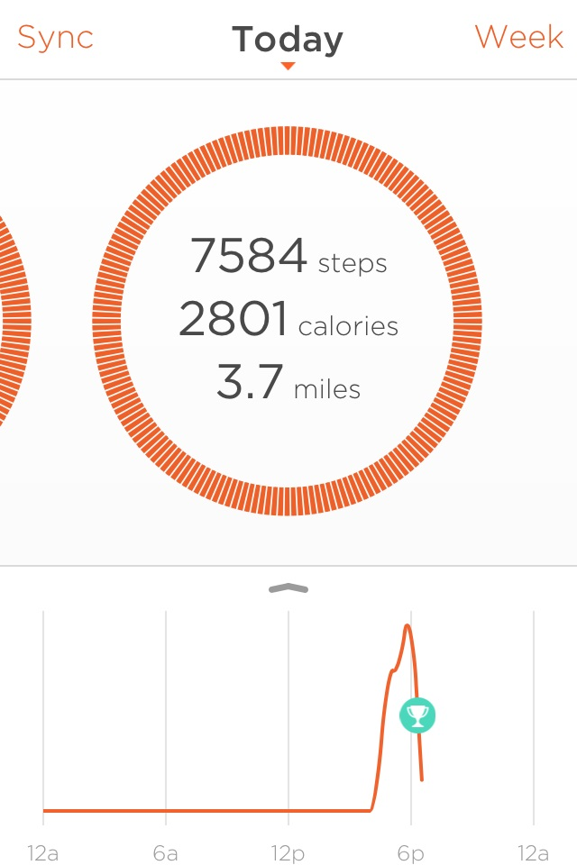
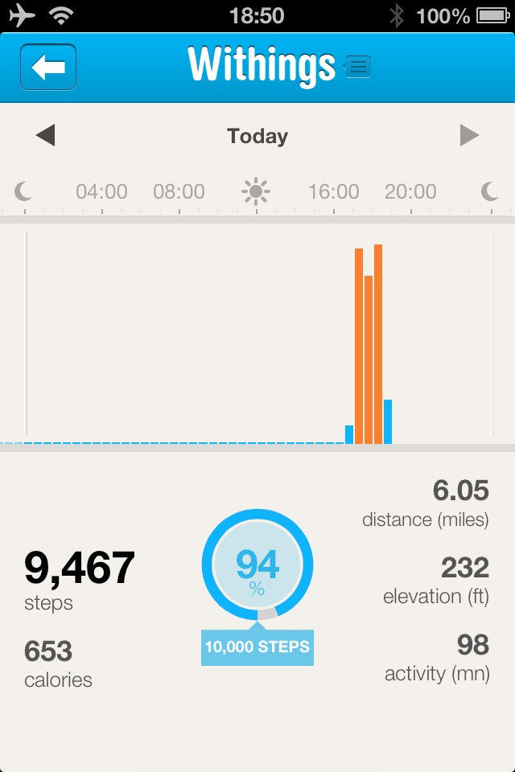
Comparison of Withings Pulse & Misfits Shine – 3rd September 2013
Today, I went for a walk, wearing both of these devices. Yet, the results in steps and distance aren’t even close. Google Maps says my route is 3.8 miles in walking mode. Which is closer to the truth?
SHINE result (worn in wristband)
PULSE result (kept inside the pocket of my shorts)
© Maneesh Juneja 2013

Slide 3
What did WITHINGS SAY?
“seldom happens when your stride is very different (shorter or larger) than the same users of the same height.” (Source: http://withings.zendesk.com/entries/26559277-Run-tracking-with-my-Pulse-why-does-the-distance-seem-erroneous-)
“You will soon be able to calibrate your stride in the Health Mate app. As we are confident about the accuracy of our step counter, this will solve the distance calculation.” (Source: http://www.slideshare.net/mjaltd/pulse-shine-comparison)

Slide 4
LET’S TRY THAT AGAIN

Slide 5
WHAT DID I LEARN?

