Slide 1


London 20 Nov 2014
Do Facts Speak For Themselves?
Alan Newman, Psychologist agnewman.is@virgin.net

Slide 2
THE QUANTIFIED SELF
THE NARRATIVE SELF
Connected home
Diet and nutrition data
Financial data (e.g. Credit Score)
IQ & EQ
Medical data (e.g. DNA)
Physical exercise data
Social data
Travel and telematics data
Ancestry data
Bucket list
CV
Family stories
Film & Music
The imagined self
Politics & Religion
Social data
SWEET
SPOT
agnewman.is@virgin.net

Slide 3
3
An insight from our use of Amazon
Most brains don’t do ‘data’.
A lesson from Africa
QS’s major challenge?
Stories trump numbers.
Ancestry data
Bucket list
CV
Family stories
Film & Music
The imagined self
Politics & Religion
Social data
agnewman.is@virgin.net

Slide 4
What makes you, YOU ?
Age
Alumnus of [ University ]
Apple tribe-member
Birth sign
Brought up overseas
Bucket lister
Charity activist
Children / twins
Diabetic
Divorced
Dyslexic
Economist subscriber
Football team supported
Gender
(London) marathon runner
Major illness in the family
MENSA member
Nationality
Political beliefs
QS practitioner
Religious beliefs
Special holiday destination
Sports enthusiast
Where you live
agnewman.is@virgin.net

Slide 5
What makes you, YOU ?
Age
Alumnus of [ University ]
Apple tribe-member
Birth sign
Brought up overseas
Bucket lister
Charity activist
Children / twins
Diabetic
Divorced
Dyslexic
Economist subscriber
Football team supported
Gender
London marathon runner
Major illness in the family
MENSA member
Nationality
Political beliefs
QS practitioner
Religious beliefs
Special holiday destination
Sports enthusiast
Where you live
agnewman.is@virgin.net

Slide 6
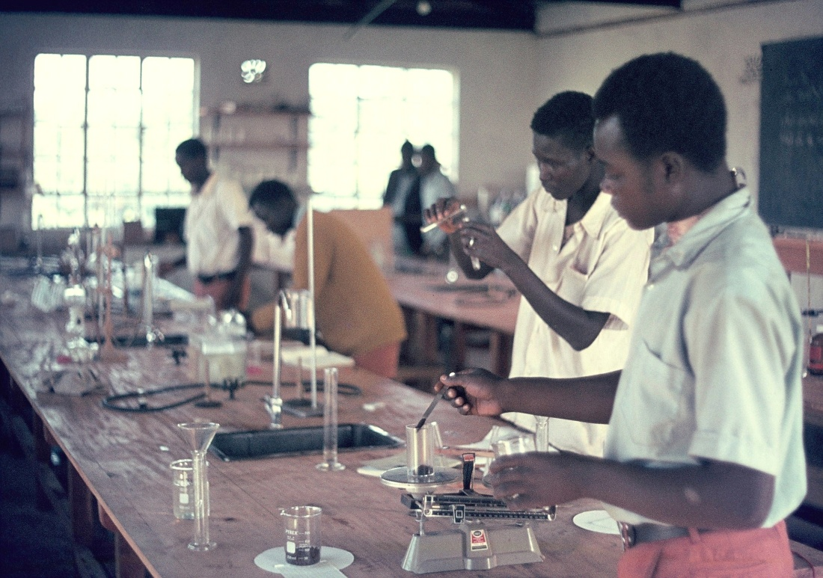
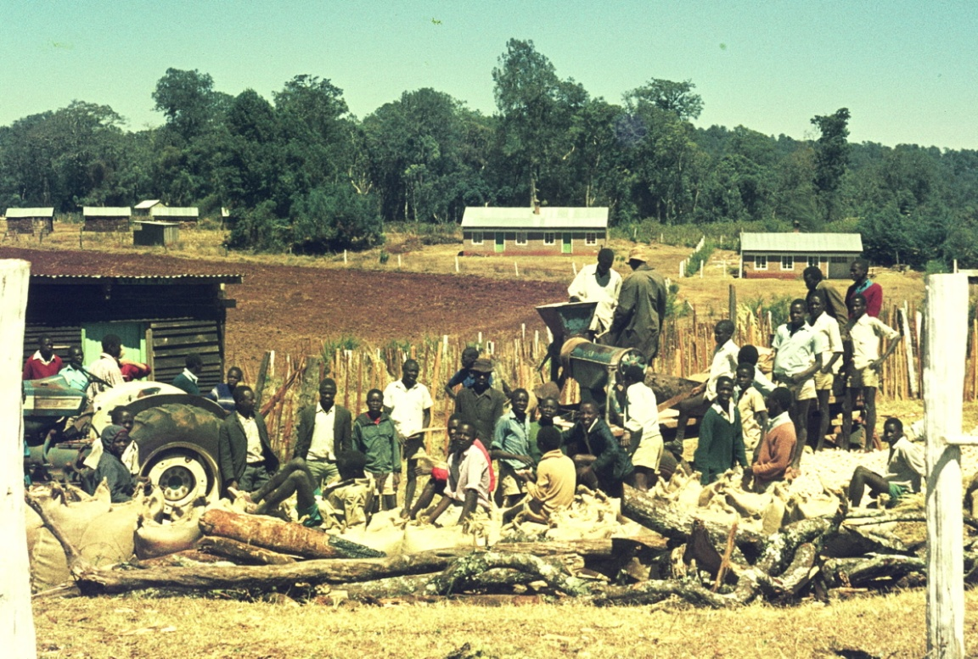
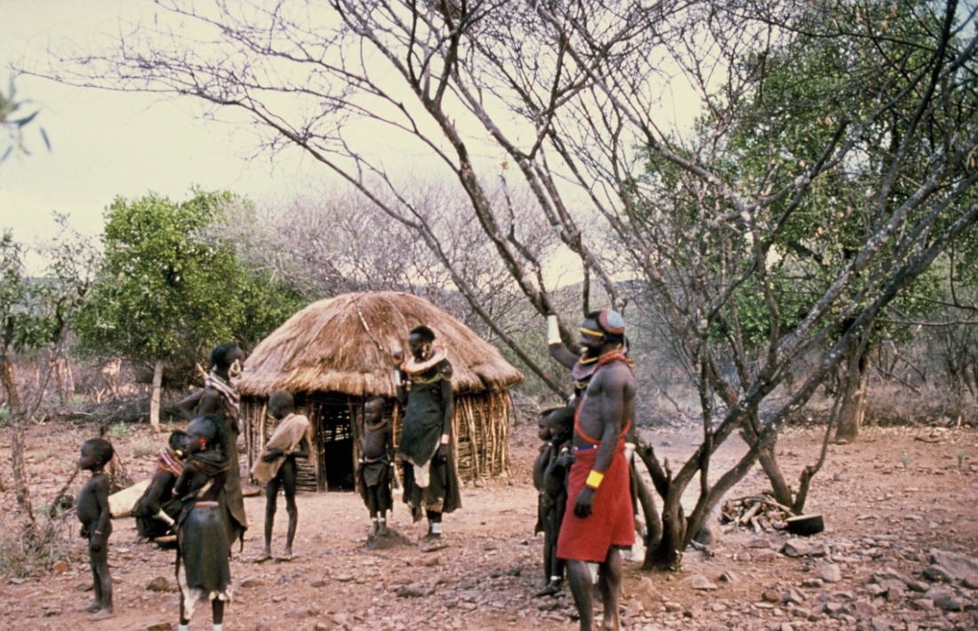
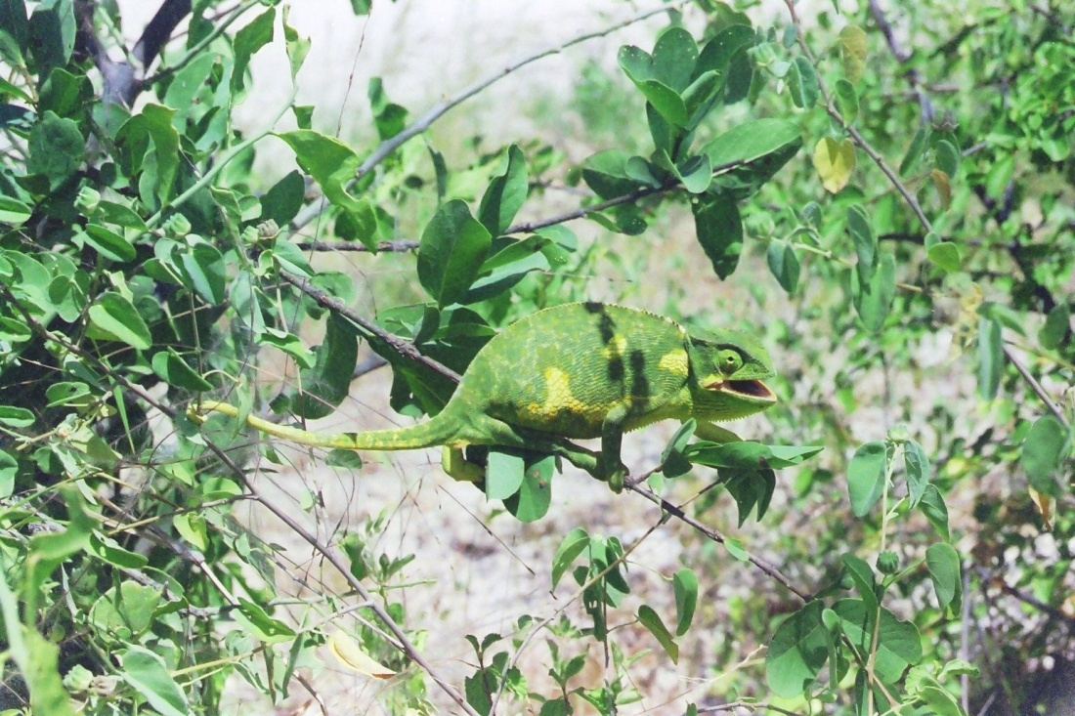
agnewman.is@virgin.net

Slide 7
A
88 %
90% Effective
TREATMENT
7 %
B
30% Effective
Negative
STORY
Positive
Source: Freymuth & Ronan 2004
agnewman.is@virgin.net

Slide 8
39 %
88 %
90% Effective
TREATMENT
7 %
78 %
30% Effective
Negative
STORY
Positive
Source: Freymuth & Ronan 2004
agnewman.is@virgin.net

Slide 9

MULTIPLE (MONEY) SELVES
BBC Big Money Test - OU and UCL
Bargain hunter
Gambler
Miser
Spender
Tycoon
agnewman.is@virgin.net

Slide 10
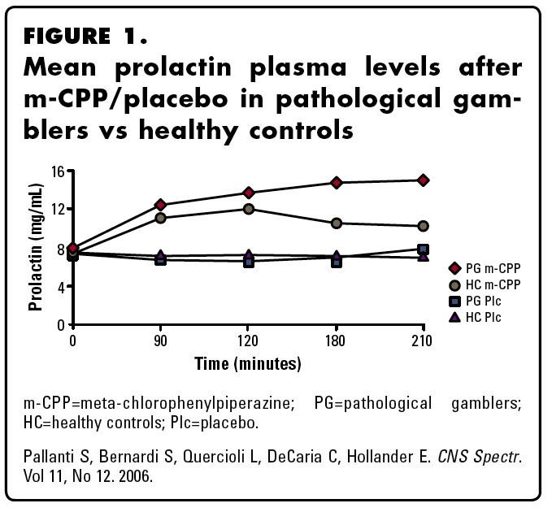
MULTIPLE (RISK) SELVES
BBC Big Risk Test - Cambridge University
Understanding and Judging risk
Experiential and Analytical risk
Health, Safety and Physical risk
Psychological, Ethical and Social risk
agnewman.is@virgin.net

Slide 11
3
An insight from our use of Amazon
Most brains don’t do ‘data’.
A lesson from Africa
QS’s major challenge?
Stories trump numbers.
Ancestry data
Bucket list
CV
Family stories
Film & Music
The imagined self
Politics & Religion
Social data
agnewman.is@virgin.net

Slide 12
London 20 Nov 2014
Thank You
Alan Newman, Psychologist agnewman.is @ virgin.net

