Slide 1
Managing type 1 diabetes
How QS can help

Slide 2
What is type 1 diabetes?
My immune system is killing off the insulin producing cells in my pancreas.
I need to inject insulin to allow my body to absorb sugar from my blood. Insulin dose depends on amount of carbohydrate I eat.
Because I inject, I have a risk of experiencing “hypos” - low blood sugar.
I now have to do the job of my own pancreas.

Slide 3
Exercising with type 1 is risky
Sensitivity to insulin increases when people exercise.
Higher risk of hypos. In extreme cases can lead to loss of consciousness, seizure or death.
The doctor told me exercise would be “more complicated”.

Slide 4

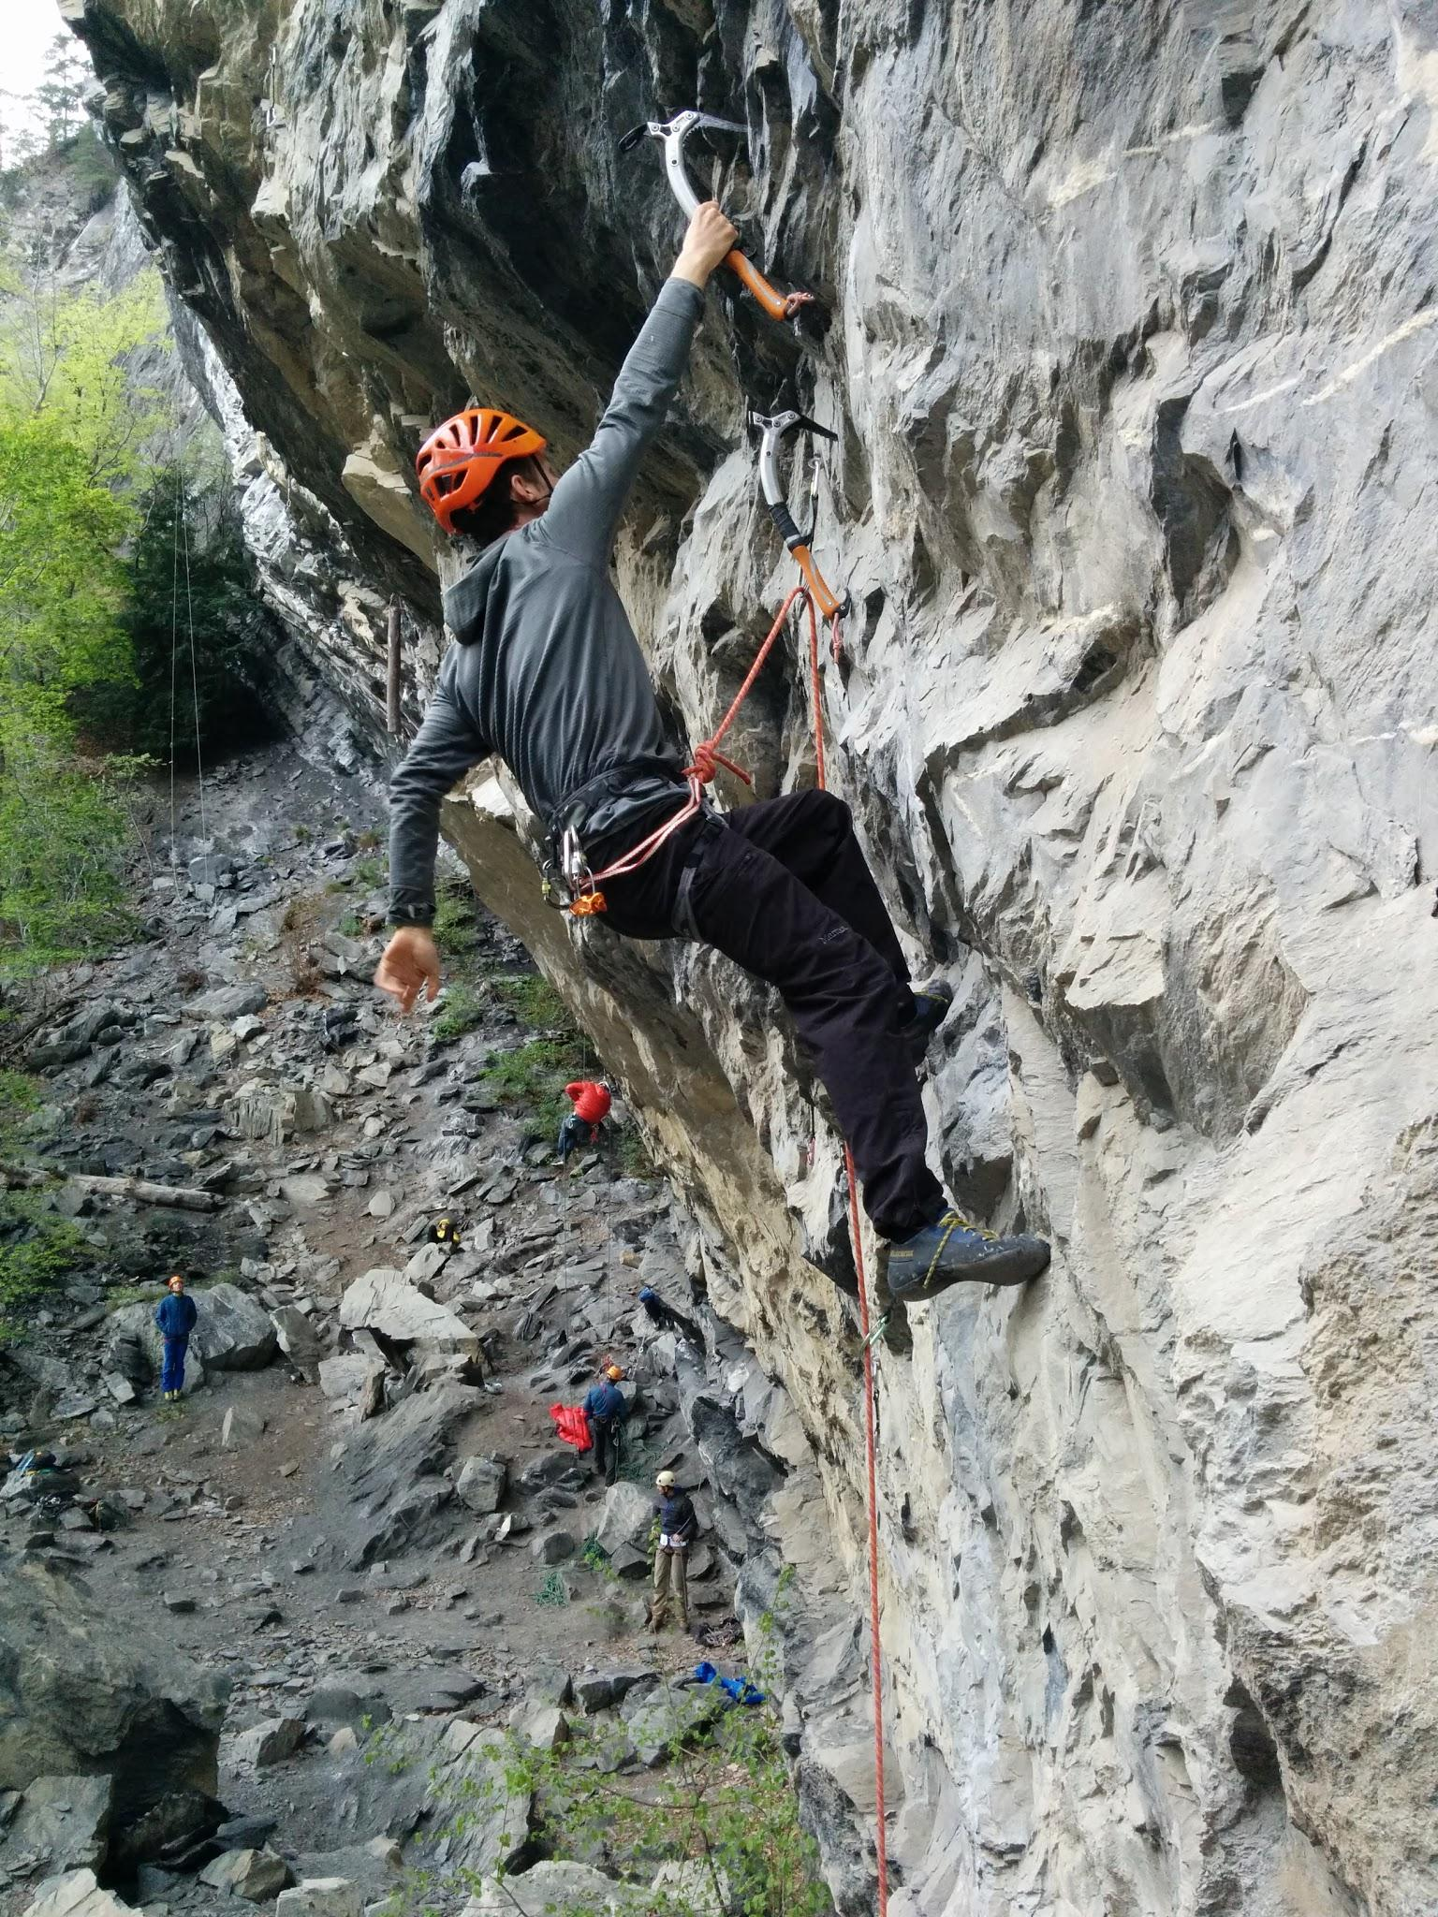
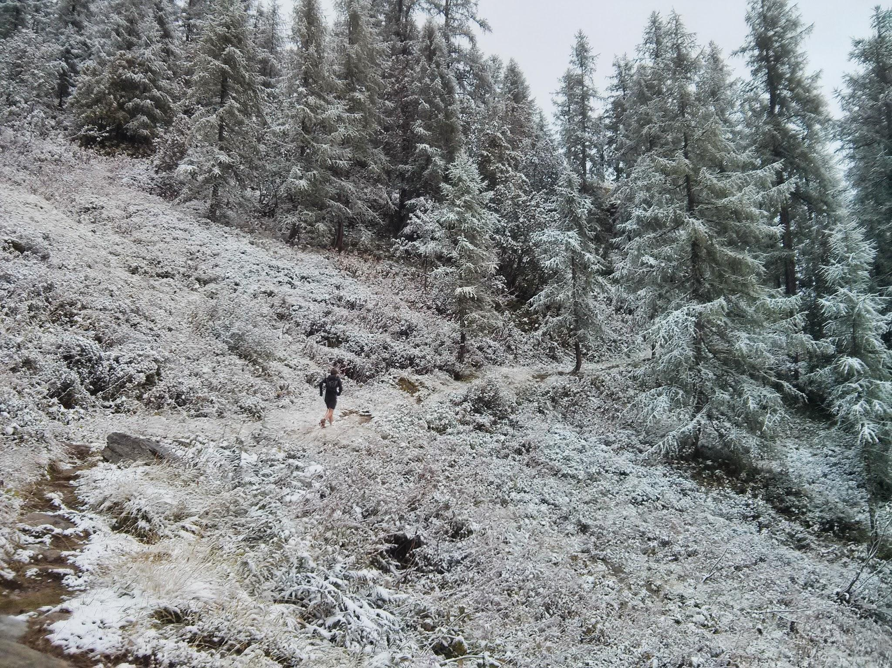
My passions - my motivations to manage type 1

Slide 5
QS is a powerful tool. My aims
Learn how my blood sugar changes whilst I exercise. Do all the activities I could before, safely.
Learn how my blood sugar is affected by food, exercise and medication choices I make on a daily basis. Minimise the risk of long term complications.

Slide 6
Tools - a mobile app
What do I record?
Grams of carbohydrate eaten. Meal descriptions can be free text.
Insulin doses.
Exercise - type, duration, free text.
Blood sugar readings.

Slide 7
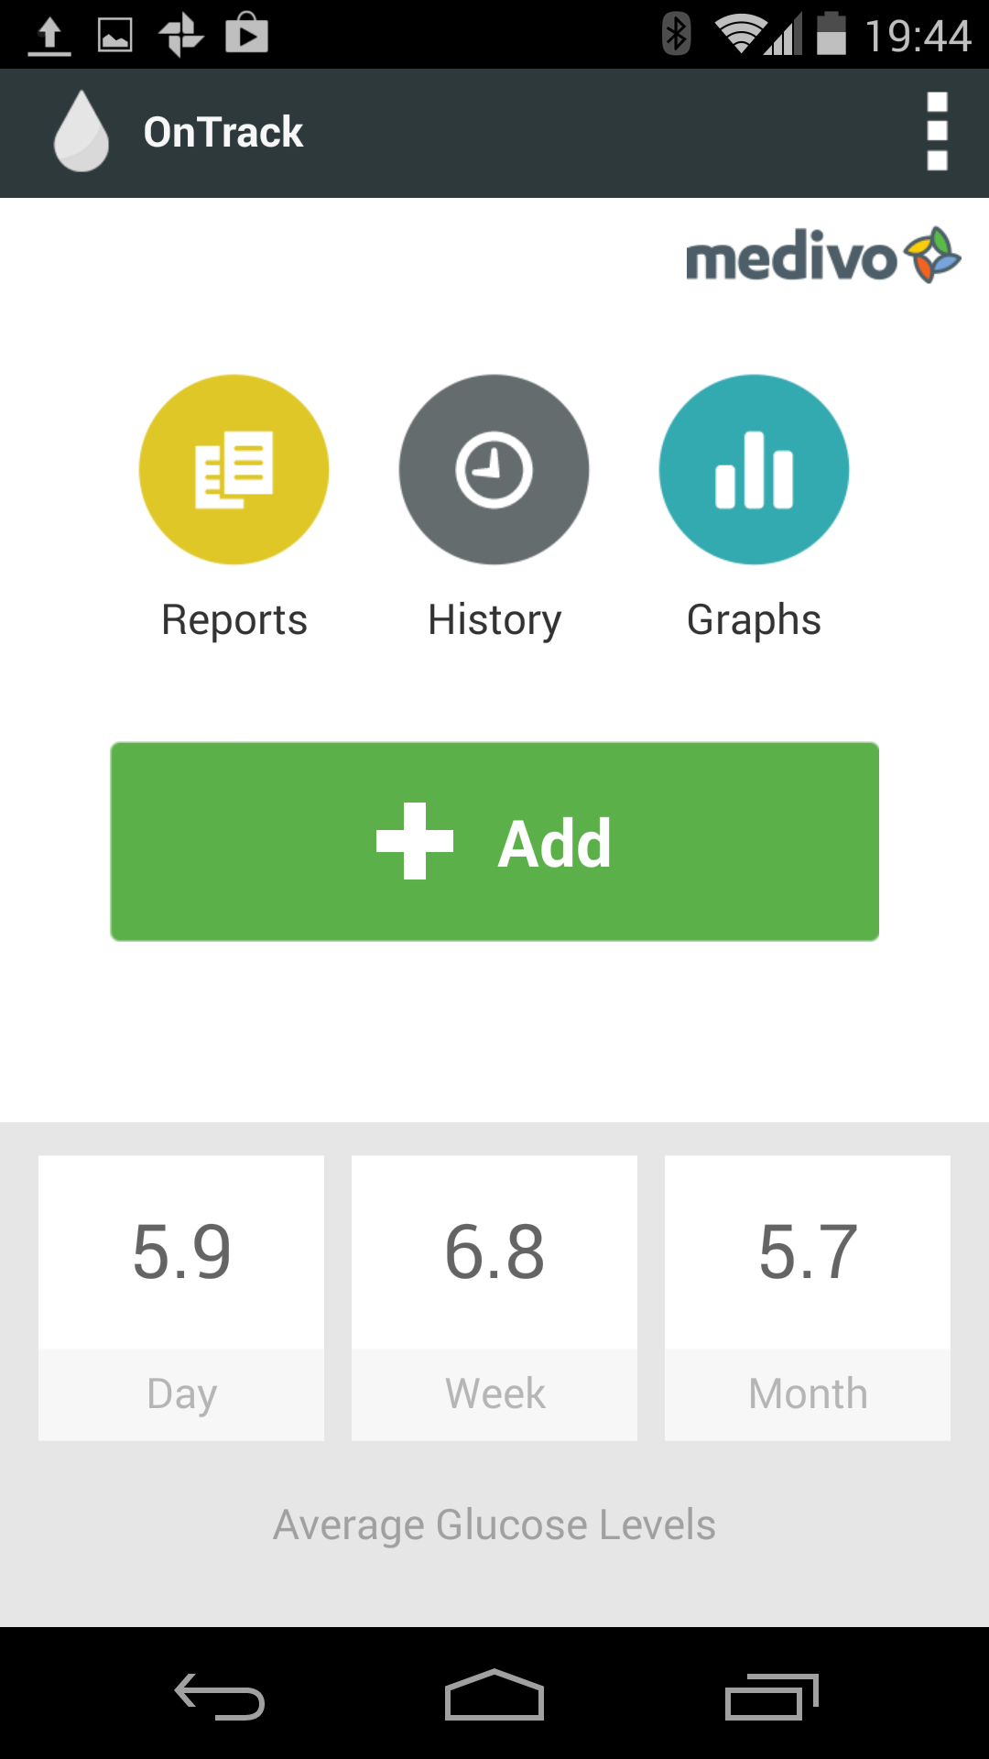
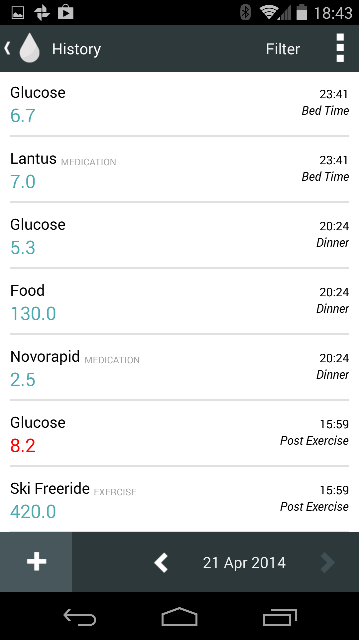
App

Slide 8
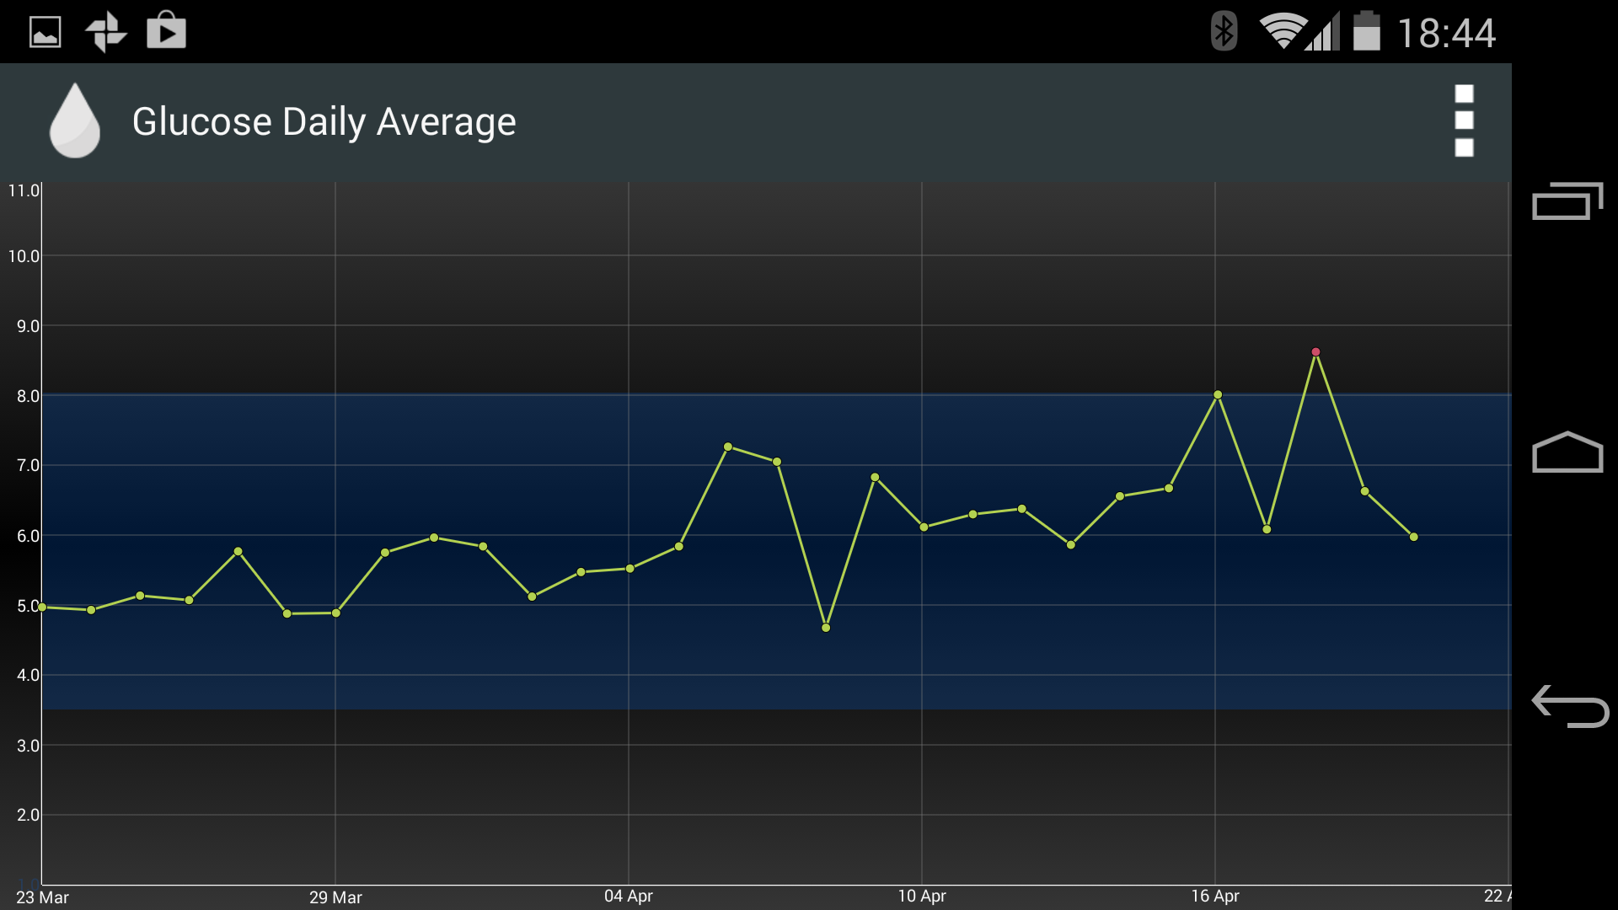
I use app for very simple analysis

Slide 9
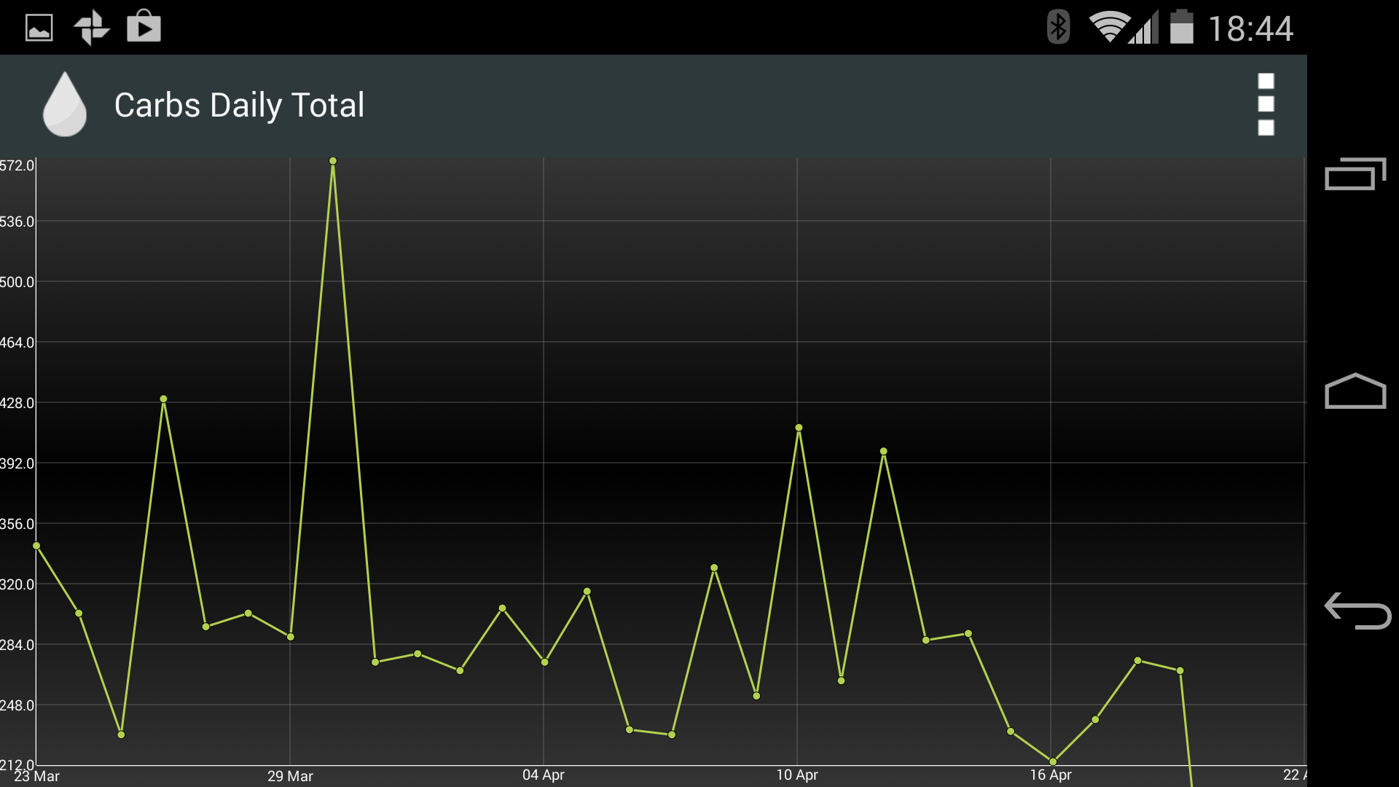
What was my insulin sensitivity today?

Slide 10
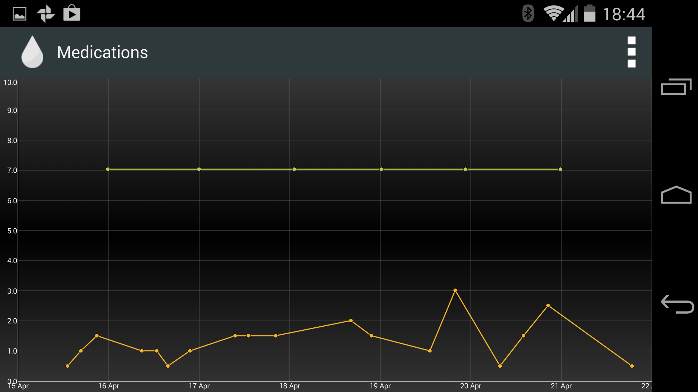
What was my insulin sensitivity today?

Slide 11
More powerful tools - I use excel
Blood sugar levels are influenced by many factors - carbs consumed, type of carb, fat consumed with carbs, exercise, heat, stress etc etc.
I need something more powerful than apps available in the app store!
I export data in CSV files to excel to do bespoke analysis.

Slide 12
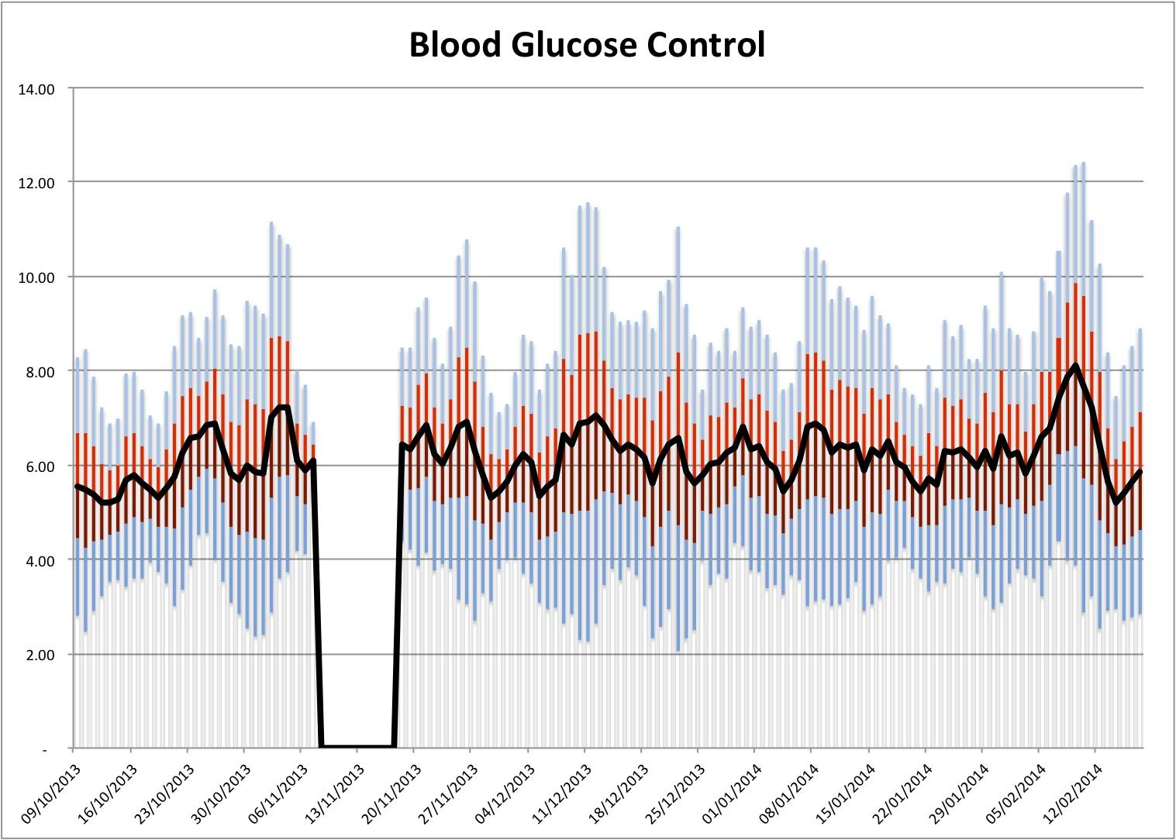
How successful is my blood sugar control? Fan chart.

Slide 13
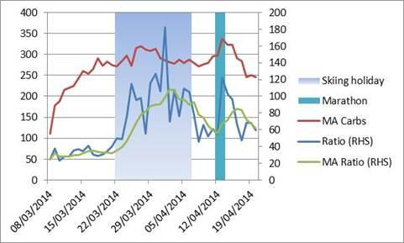
Analysis - exercise and BG control

Slide 14
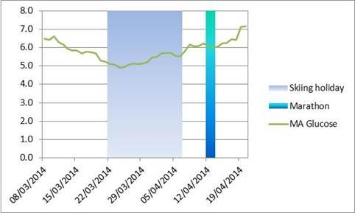
Analysis - exercise and BG control

Slide 15
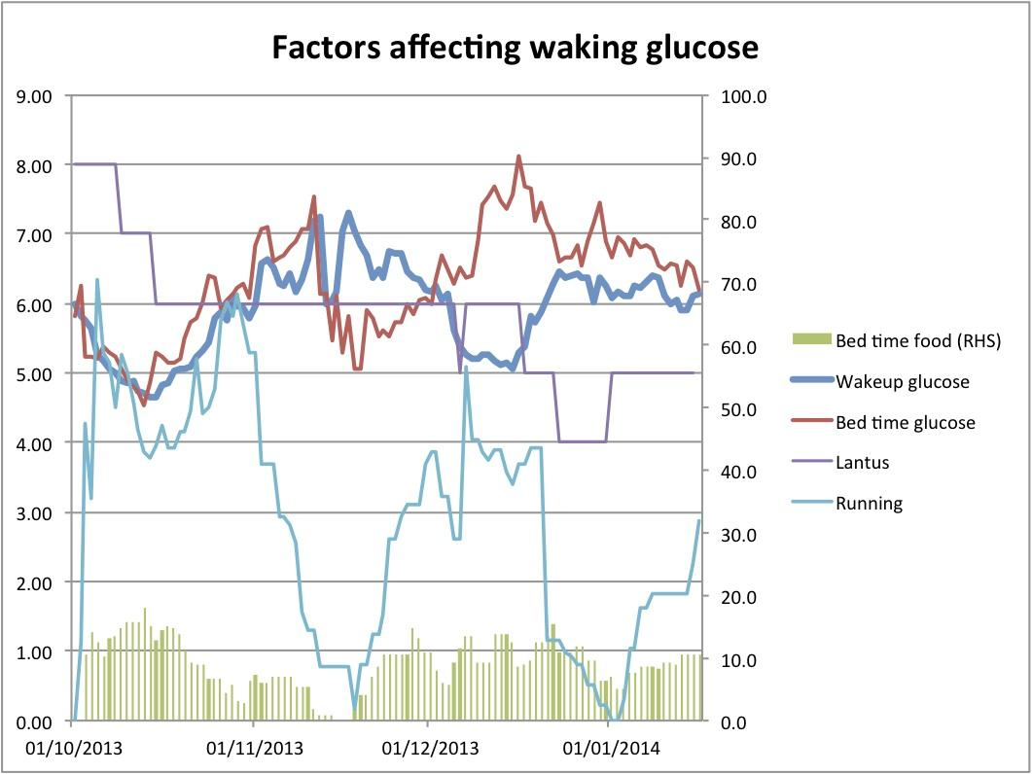
Analysis - wake up glucose

Slide 16
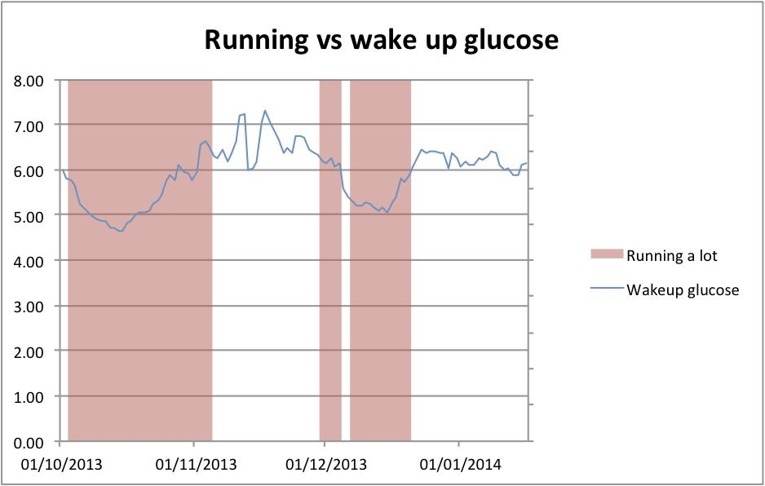
Running a lot helps glucose control

Slide 17
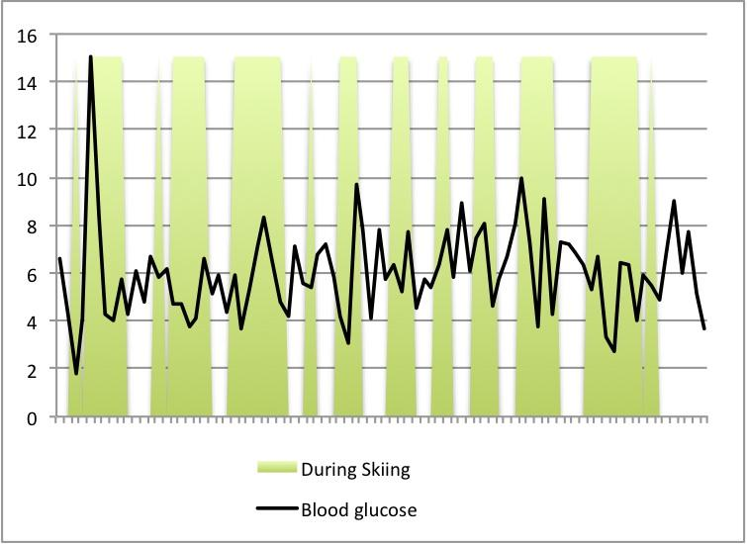
Blood glucose control whilst skiing

Slide 18
Limitations
Time
Need for simplicity.
I wrote “complex” VBA programme to analyse data but now just use basic excel.
Complex data analysis is hard.

Slide 19
Exercise
I need to eat carbs (e.g. jelly babies) whilst exercising to prevent hypos.
Over the first hour of exercise blood sugar varies differently.
I test blood before, after and during exercise.

Slide 20
Carbohydrate needs whilst exercising
Running. 40g per hour. First 40 minutes depend on speed or type of training.
Climbing. Not much.
Ski touring - walking up hill. Same as running.
Skiing - off-piste. 20g per hour.
Standing in very cold places. Approx 20g extra per hour.

Slide 21
Disadvantages with my method
Data recording done on phone.
Especially before bed.
Reliant on technology working.
My laptop is grinding to a halt.

Slide 22
Has QS had a positive impact?
Hospital blood tests give a measure of average blood sugar over the past three months - called HbA1c.
My HbA1c has been in a “healthy” range since October. My risk of suffering from diabetes-related complications is low.

Slide 23
Has QS had a positive impact?
I do all the physical activity I did pre-diagnosis.
I understand pretty well how my blood sugar responds to different factors.
I did my first ultra marathon in December, and...

Slide 24
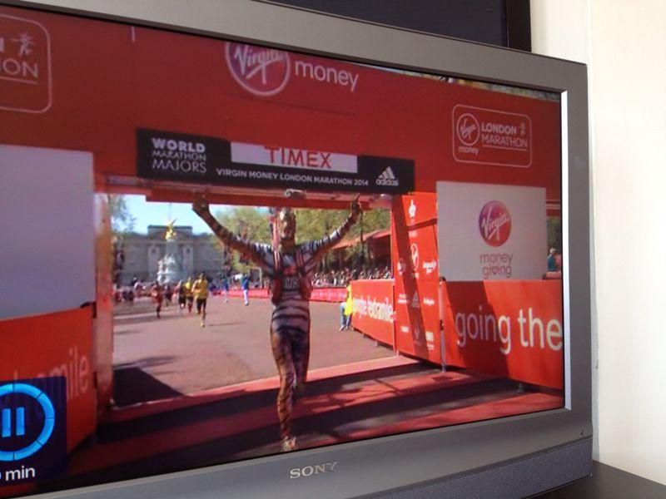
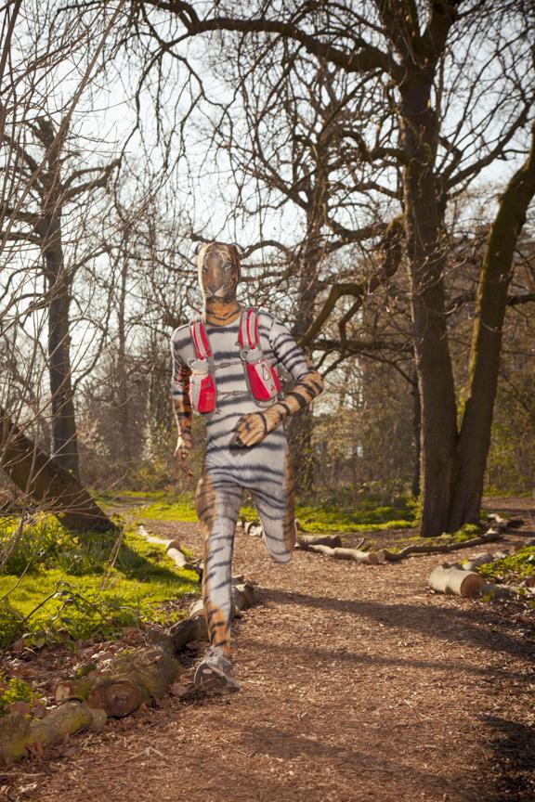
… I got the Guinness World Record for fastest marathon run in an animal costume!

Slide 25
For more information and more data analysis, see www.masteringdiabetes.wordpress.com

