Slide 1

Automatic Lifelogging for Non-Qsers and FluxStream demo
Blaine.Price@open.ac.uk @bp5

Slide 2
A bit about me…
I’ve been logging some things for a long time
1997: Weight and BP
2003: Running time/distance since
1992: Car mileage/fuel efficiency (lost until 2009)
2006: household water consumption
2009: household gas/electricity consumption
2011: solar PV generation
2011: physical activity level/steps
2011: sleep times, duration, quality (actigraphy/EEG)
2011-12: visual image logging
2013: Electric car mileage/efficiency
2013: Heart Rate/Heart Rate Variability

Slide 3
Studies conducted
On myself
On ‘normal’ people
Reported at early London QS meetings
Part of last study broadcast on BBC Horizon (Monitor Me, may be available on Vimeo)
12 non-QSers given Fitbits and sleep monitors
Found we ‘created’ 3 types of self-quantifiers:
Dedicated, Pragmatic, and Calibrated
Found people were most interested in the invisible

Slide 4
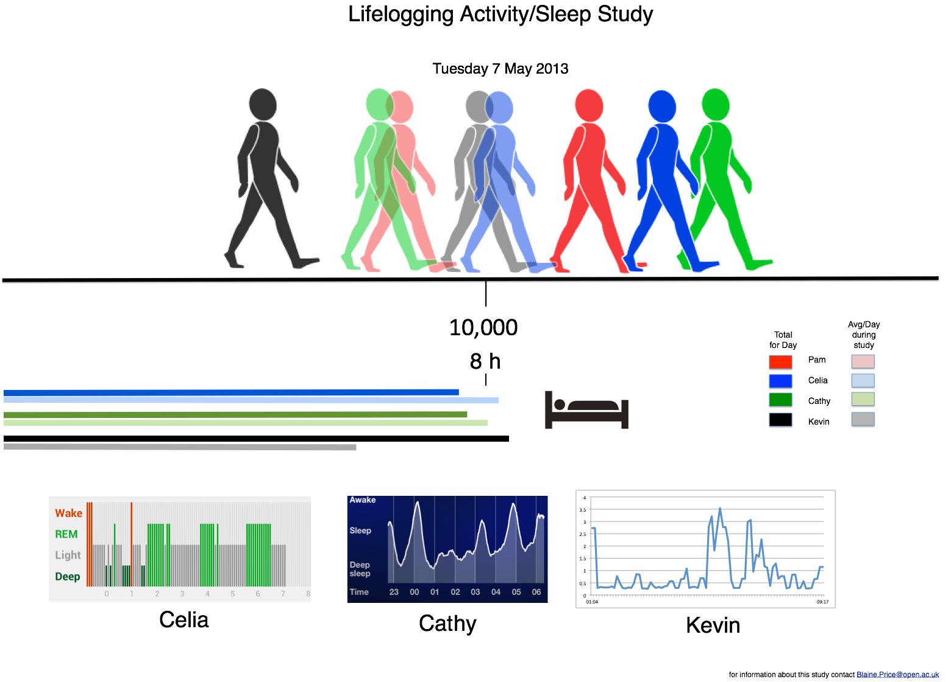

Slide 5
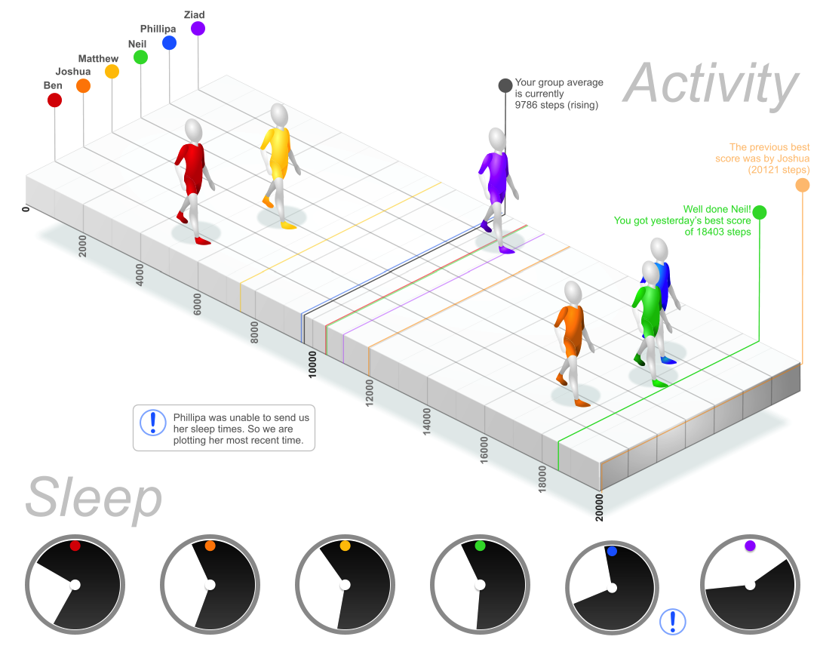

Slide 6
What is going on inside my head?
Sleep
Heart Rate/Breathing
Heart Rate Variability
FluxStream Demo

Slide 7
Blaine.Price@open.ac.uk
@bp5

