Slide 1
Recording My Life on My Mobile
Dirk Trossen
(and Dana Pavel, really)

Slide 2
Some Background
Mobile Enthusiast
Mobile lifestyle since before mobiles were mainstream
Technology Geek
Research and developing own tools
Love to reminisce
Always liked to store and look back
…less about understanding (myself)

Slide 3
About This Talk
Goal: Stimulate discussion on what’s useful to lifelog, why and how to use recorded information
What have I recorded (for the last 2+ years)?
Recording tool
Information, information, information
What has been most useful?
Lessons learned
How do I use my recordings?
More on tools

Slide 4
My Setup
Developed own mobile solution
For recording (AIRS)
Started back in Nokia (NORS)
Co-developed solution with Dana Pavel
Ported to Android in 2011
Runs on Android 2.3.6 upwards
Stores data only on mobile for privacy reasons!
Open source and fully documented
For visualizing (STORICA)
Based on Dana Pavel’s Ph.D. research
Runs on Android 4.0.4 upward
Links to AIRS database in secure manner, right on the device!
Browser-based visualization
Developed by Dana Pavel as the original concepts for the mobile version
Importing AIRS recordings
Can also access more than just mobile data (desktop, email, …)
Focus here on the mobile part!

Slide 5
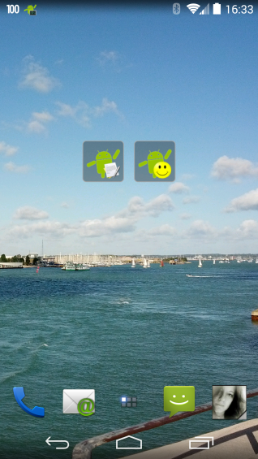
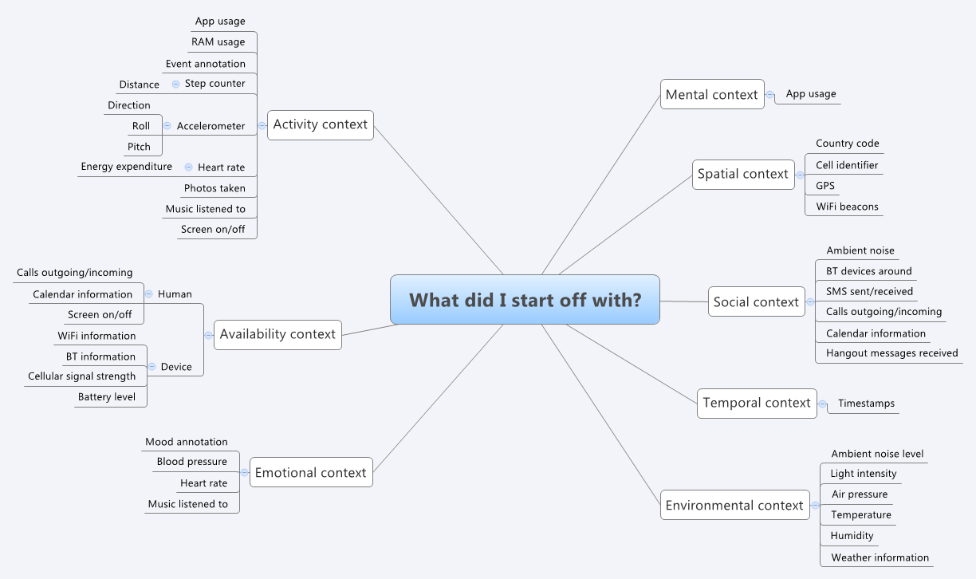
self annotation

Slide 6

Interesting…for a while

Slide 7
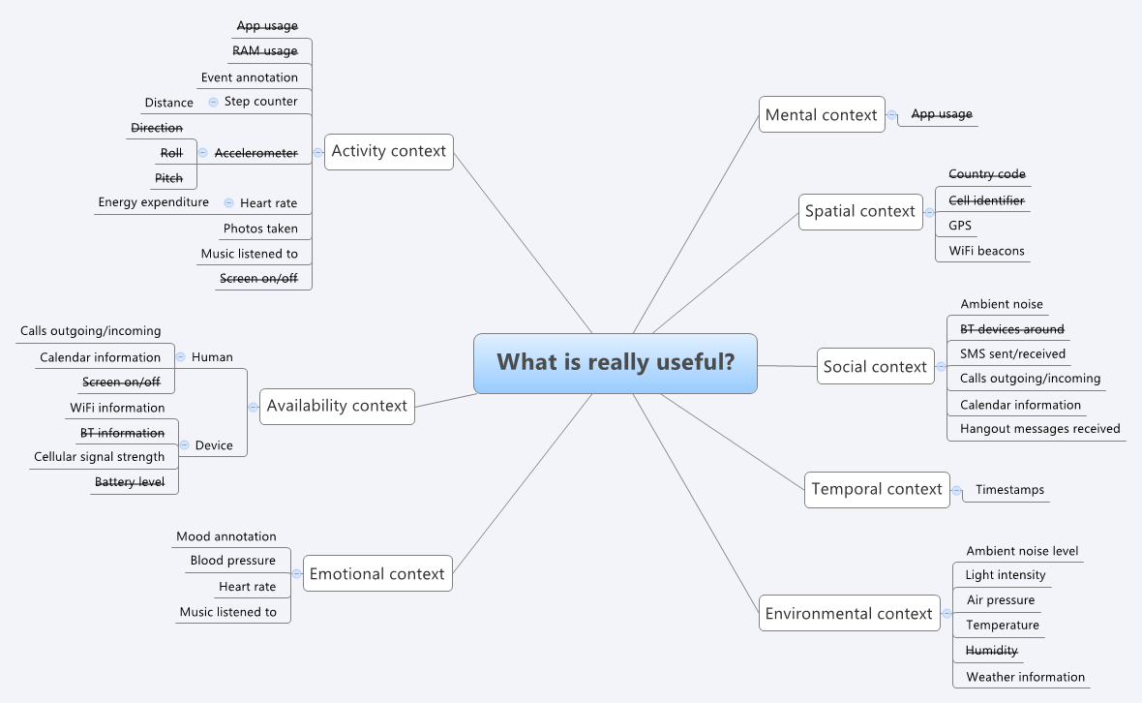
Not much use anymore
with today’s smartphones!

Slide 8
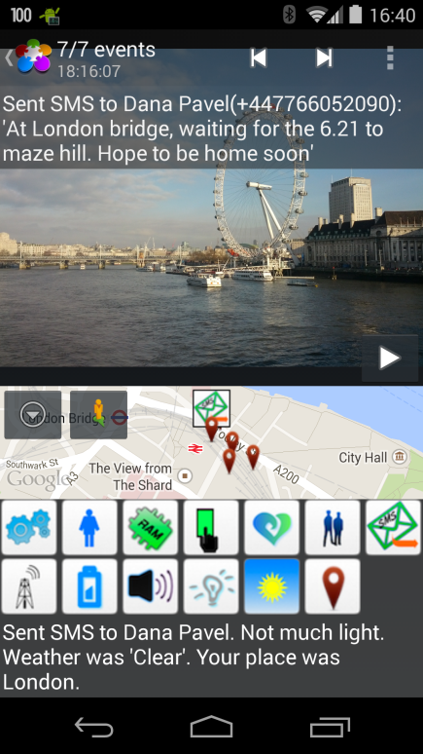
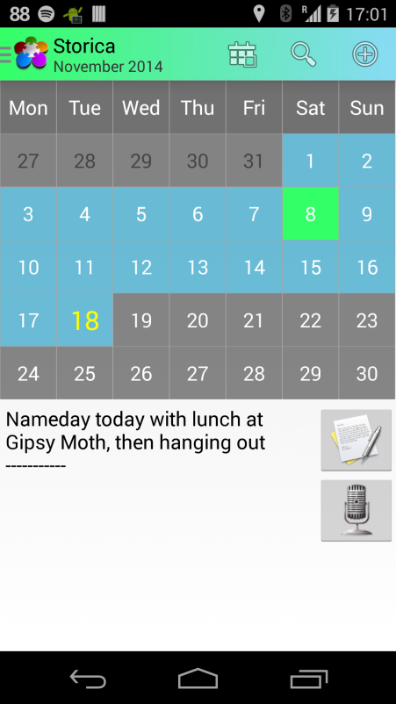
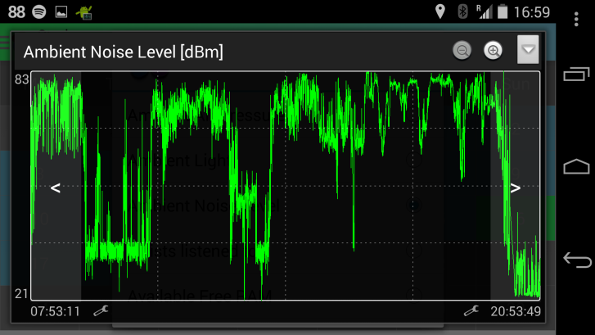
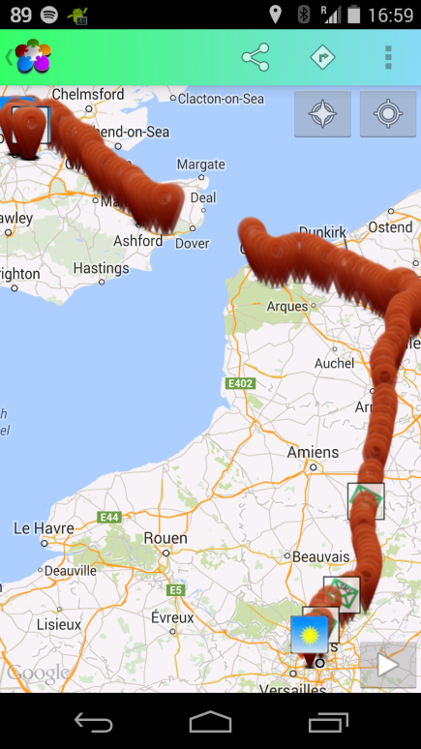
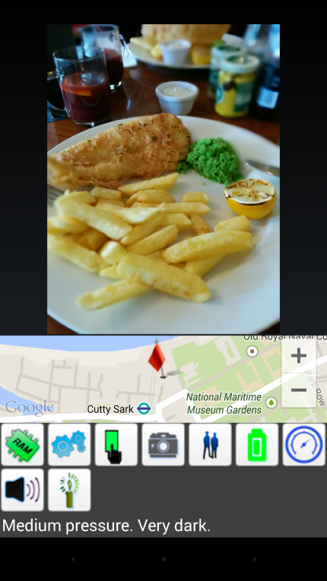
Correlating Information Through Visualisations
Stories
Maps
Media
Calendar-based
starting point

Slide 9
What is My Own Take-Away?
I love to look back
Individual and joint memories
I like sharing my memories
Across all visualizations
Information usefulness changes over time
Some is curiosity
Some is sporadically useful
…but there is little harm recording it
I can adapt my mobile usage to the recording
Battery lifetime
Switching it on (and off again)

Slide 10
Thank You…Questions?

