Slide 1
Monitoring My Memory
Andrew Laughland
@andrewlaughland
a.laughland@herts.ac.uk

Slide 2
About Me
Originally a physicist
Career in IT in healthcare and clinical trials
Developed an interest in psychology
Now a PhD student looking at memory using diary methods

Slide 3
Memory? What memory?
Involuntary Autobiographical Memory (IAM)
Memories that pop into your mind
Often triggered
Everyday memory failures
Retrospective memory (looking back)
Prospective memory (planning, future)

Slide 4
Why Study?
Involuntary Autobiographical
Creativity
Day-dreaming
Depression
Everyday memory errors
Normal ageing
Dementia

Slide 5
Why Diary?
Because retrospective recall is unreliable!

Slide 6
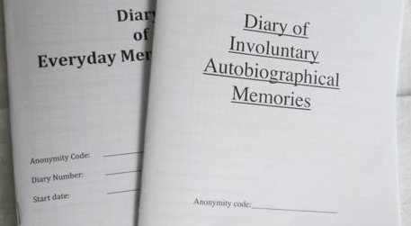
Technologies – Pen and Paper

Slide 7
Technologies - Smartphone
My own software
Web apps
Commercial apps like Memento

Slide 8
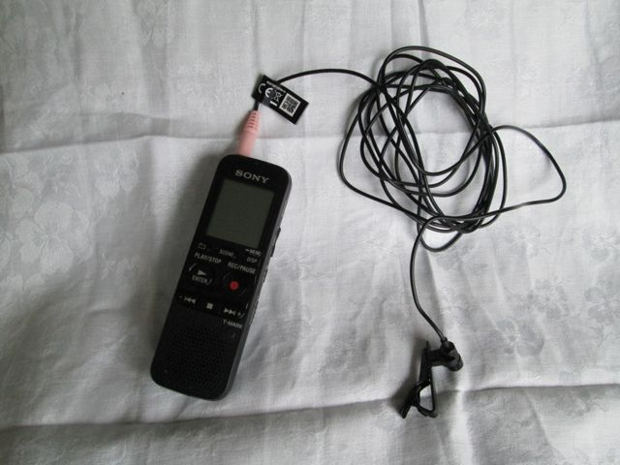
Technologies – Audio Recording
Experimenting with a digital recorder
Recording spoken descriptions of memories when travelling a standard route
Processing with Audacity software

Slide 9
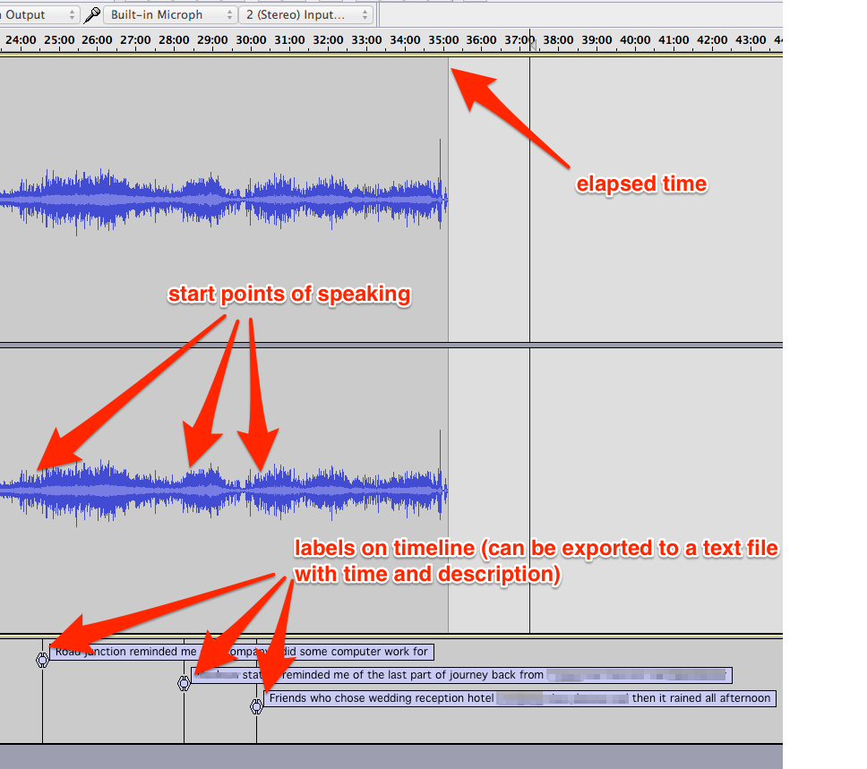
Data Extraction

Slide 10
Some Numbers
40 minute journey
Standard route
Journey 1: 29 IAMs
Journey 2: 22 IAMs
Not usually the same memories

Slide 11
Contact Details
Andrew Laughland
@andrewlaughland
a.laughland@herts.ac.uk

