Slide 1






How do healthy choices affect my happiness?
Quantified Self 20th Sep 2013
Roland White &
Dr Mark Tyrrell
Notes:
INTRO
me and situation
Personal experience of tracking my Lifestyle, Exercise, Nutrition Sleep and wellbeing through a system I’ve developed over last 28 days.
WHY?
Personal Problem, Ups and downs in week, not know why, HMY?
Grandfather, mother
Worked Marketing, Personal Trainer, nutrition and lifestyle coach, write Times,
Track, help Restore Natural State Wellbeing right fuels

Slide 2
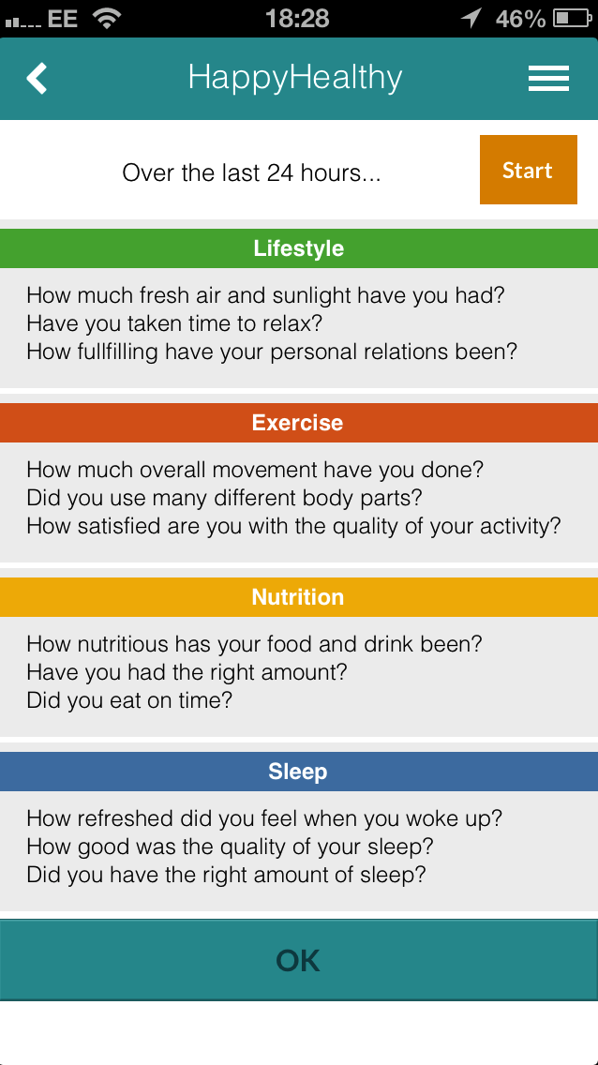
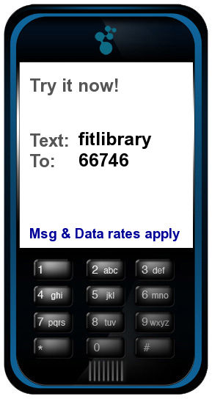
Reply to text:
LENS 46546
Notes:
HOW?
Wanted Simple, quick, 1 minute, Acronym
Self-Rating, Human Brain, great aggregator, “ The brain is a great organ. It starts when you wake up and doesn’t stop until you get into the office.” Robert Frost
Actually it works all day and a little in the night.
Accuracy improves
Holistic, Lifestyle category to include everything that might affect your mood

Slide 3
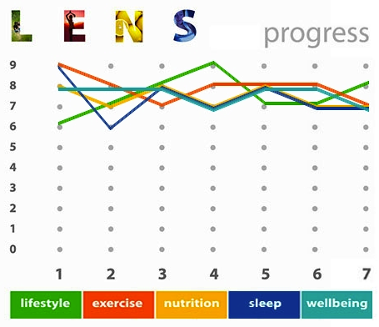
Score
Does being healthy increase happiness?
Prove it!
Silicon Drinkabout
cricket
Travel Brighton to Techhub
Roland White
Dr Mark Tyrrell
Thurs
Day
Notes:
Me fit freak, meant for others less with anxiety

Slide 4
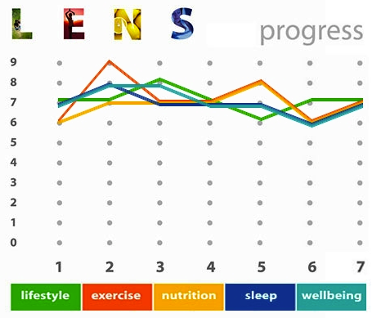
Gym
Sat
Salty Takeaway and Early start
Silicon Drinkabout
cricket
Travel Brighton to Techhub
Friday tired after London
London living
Roland White
Dr Mark Tyrrell
Skip a day scoring fri
Notes:
Week Wellbieng less, less able to get good food in, more stress
nutrition – stress , sympathetic nervous system

Slide 5
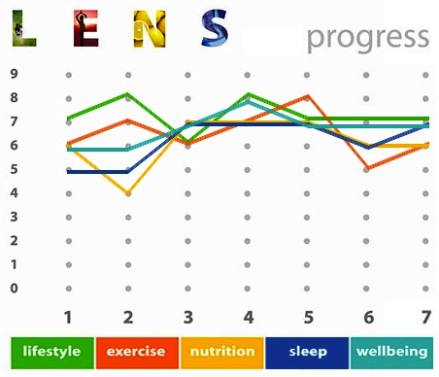
Mon, hurt foot, we won!
Mon, hurt foot, we won!
cricket
swim
cricket
swim
Bad neck, no supplements, Silicon Drinkabout
Bad neck, no supplements, Silicon Drinkabout
Scoring Friday

Slide 6
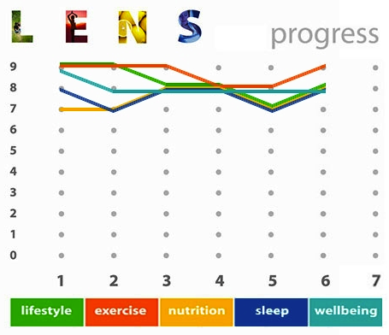
Consistency of scores lowest 7, exercising more, run this morning, don’t drink often!

Slide 7
My Observations
All starts from planning exercise
Bad traveller, tires me
A night out screws up whole routine!
Spiral up or down, chicken and egg.
More 7 and 8s in happiness than if not tracking this (6s and 7s)
Healthier Happier Person (a little obsessed!)

Slide 8
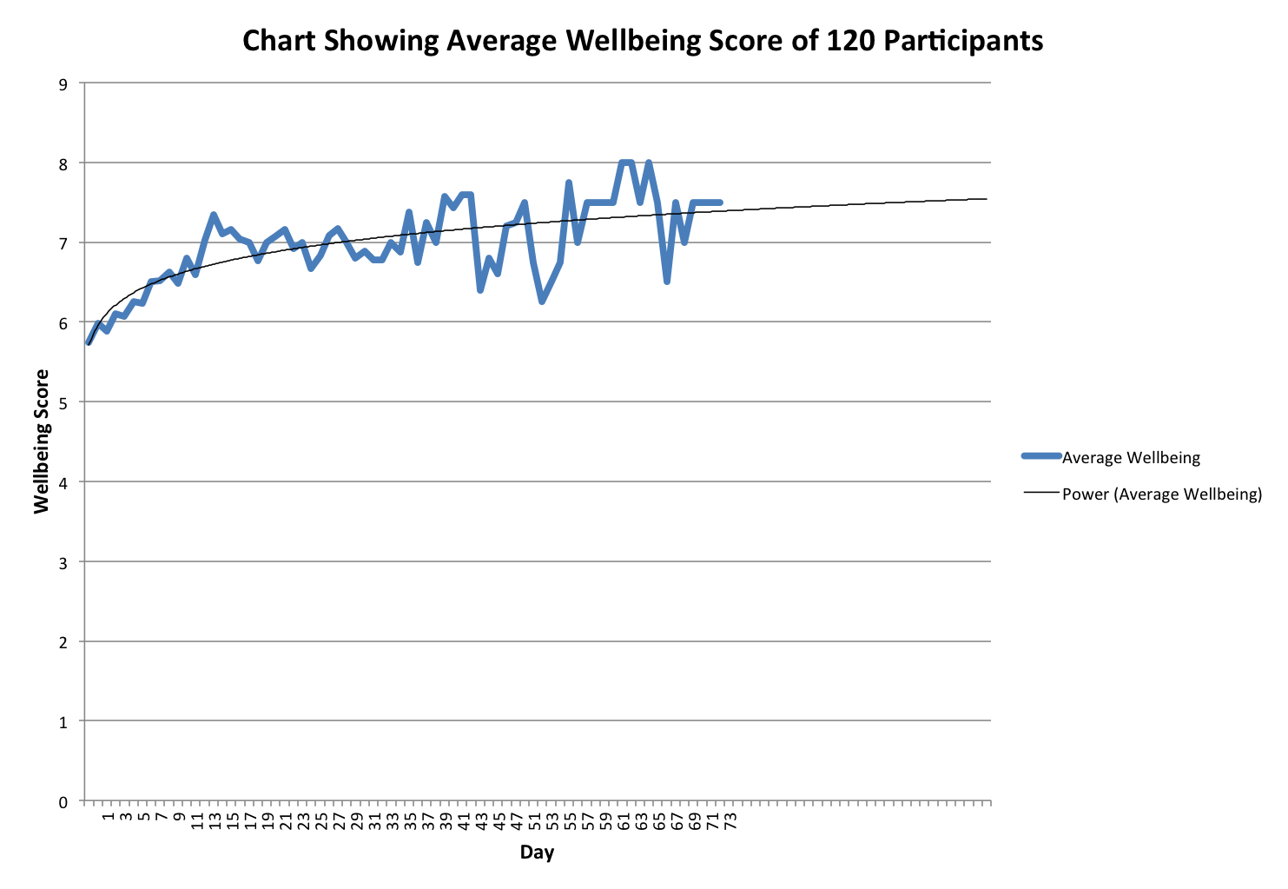
Evidence of effectiveness
The largest change is in the first 12 days of texts then this level is sustained
11% in 6 days
Over 20% in 6 months
Notes:
Average just under 6
Increase knowledge sustainably increase happiness to av 7 half

Slide 9
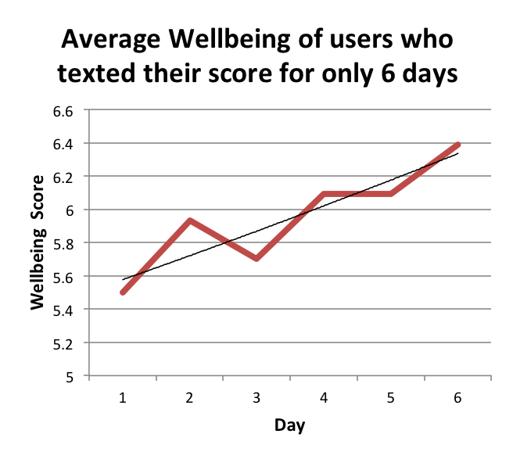
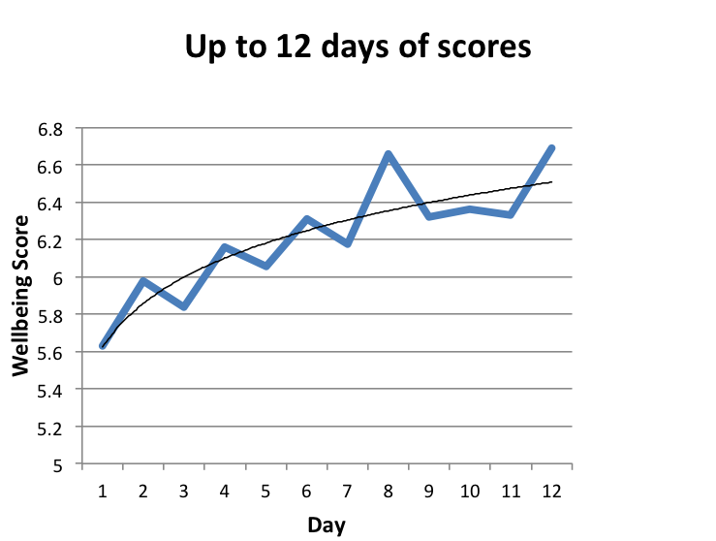
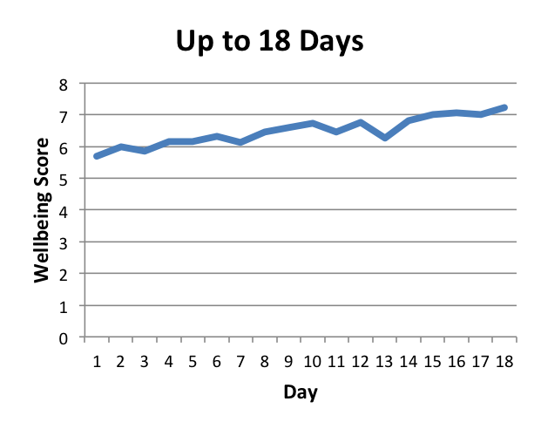
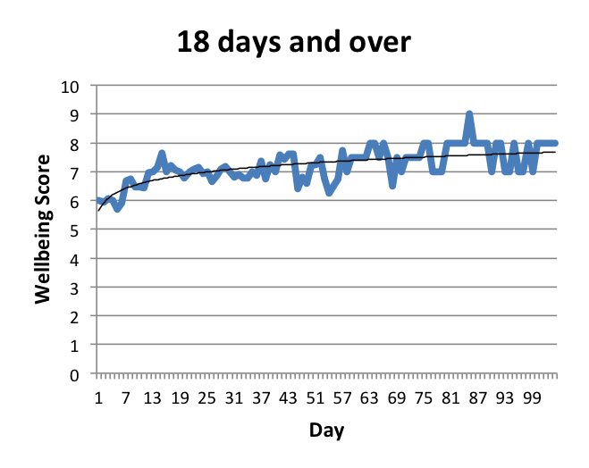

Slide 10
Observations about HappyHealthy?
Observations for Group
Increasing awareness of choices improves decisions
90% of the time scores for wellbeing factors are within 2 of happiness
Exercise is the lowest category
Each factor leads into the next
Customers 85% women
Men not as aware, prefer hard data
Stimulants run out, people need sustainable long term highs
Good for ptsd, anxiety, stress, need nudging.

Slide 11

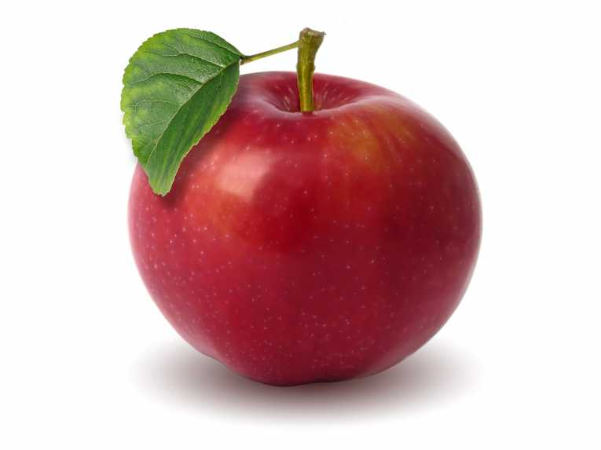
aims to…
Encourage reflection
Impart knowledge
Motivate user
Improve overall wellbeing
Be cost effective
Aid gradual behaviour
change

Slide 12
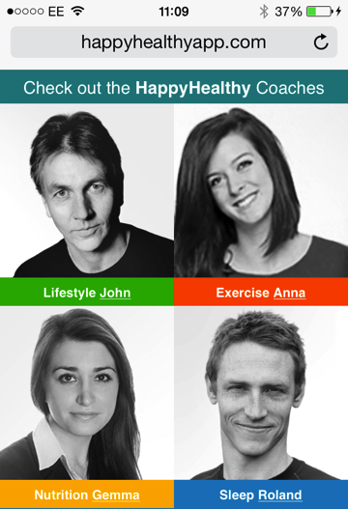
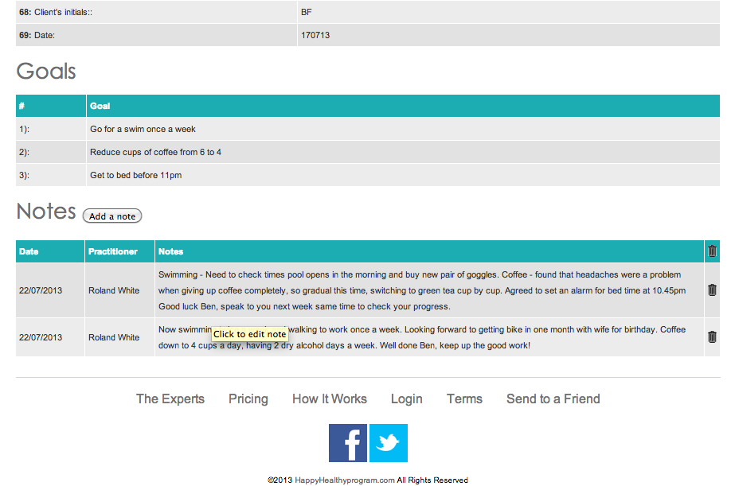
Example Follow Up after Consultation – Visible in dashboard

Slide 13




Who uses HappyHealthy?
NHS patients with anxiety and depression through GPs in New
Crondall Surgery
Staff in these companies:
IOS or SMS

Slide 14

What do users feel about HappyHealthy ?
“It definitely works!”
Bob Ford - TV Producer
“It’s a great way to stay on top of your game. It makes you think about the important factors that make the difference in your performance. I’d recommend it to anyone.” Gareth Thomas - 100 Caps for Wales,
Captain of The British and Irish Lions.
“I am making an effort to eat more regularly and making time for breakfast and an evening meal. My sleep is getting a little better. HappyHealthy is a good health kick start! A gentle reminder to look after yourself and focus on how you are feeling. Its not too invasive and gets you thinking about what you want and how you feel!” Isabel de Galleani – Travel Agent
“I was really impressed, he put me at ease and came over as knowledgeable, receptive, caring and modern. The process flowed seamlessly and what could be a difficult scenario (some people might find it tricky to discuss weaknesses) ended up feeling like an exciting set of opportunities.”
Annabel Palin – Business Analyst

Slide 15
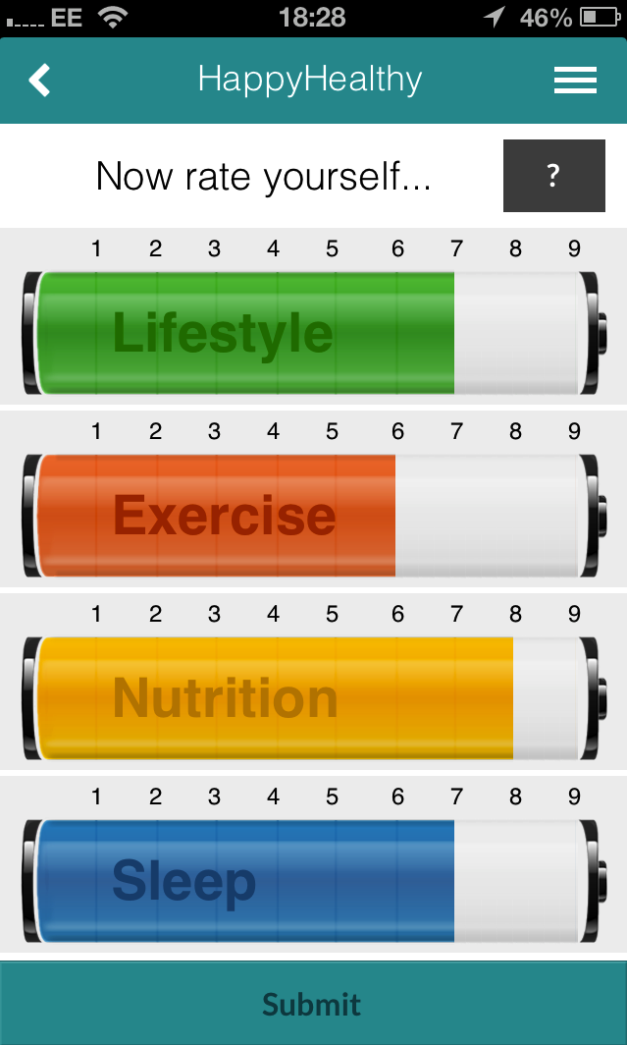
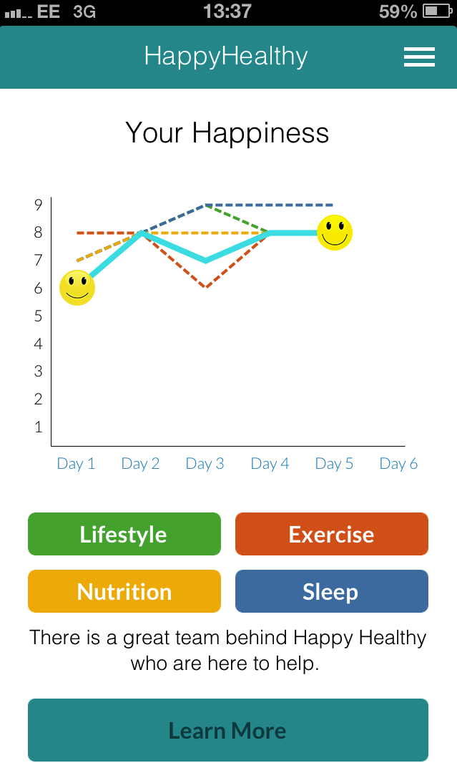
Mission
“To help restore users’ body and minds to a natural state of wellbeing by encouraging extremely healthy fuels.”

Slide 16
Search
Happy Healthy IOS
or web search:
Happyhealthyapp.com
28 day Program
Download
Feedback
Ideas
Search:
Notes:
Bullet proof ourselves to life’s events prepare our mind through our physical body.
So many Stressed people, getting worse - More people can avoid medication.

