Slide 1
Ana Viseu
ana@anaviseu.org
www.anaviseu.org
ISCTE-IUL, Portugal

Slide 2
My quantified self

Slide 3
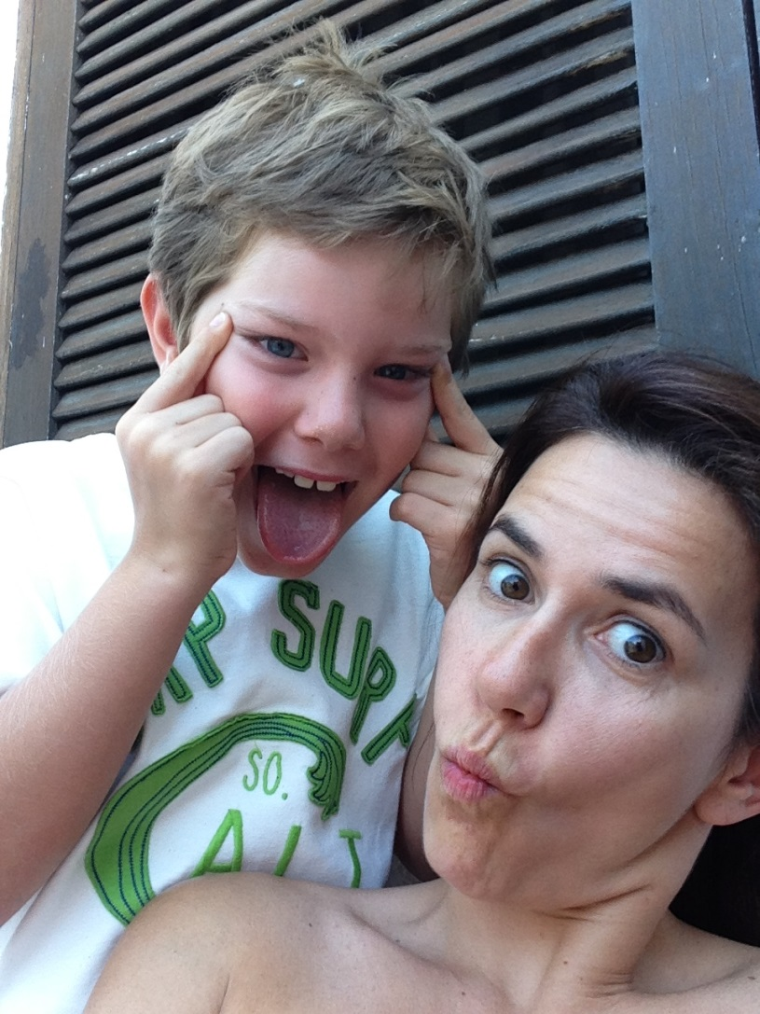
My narrative self

Slide 4
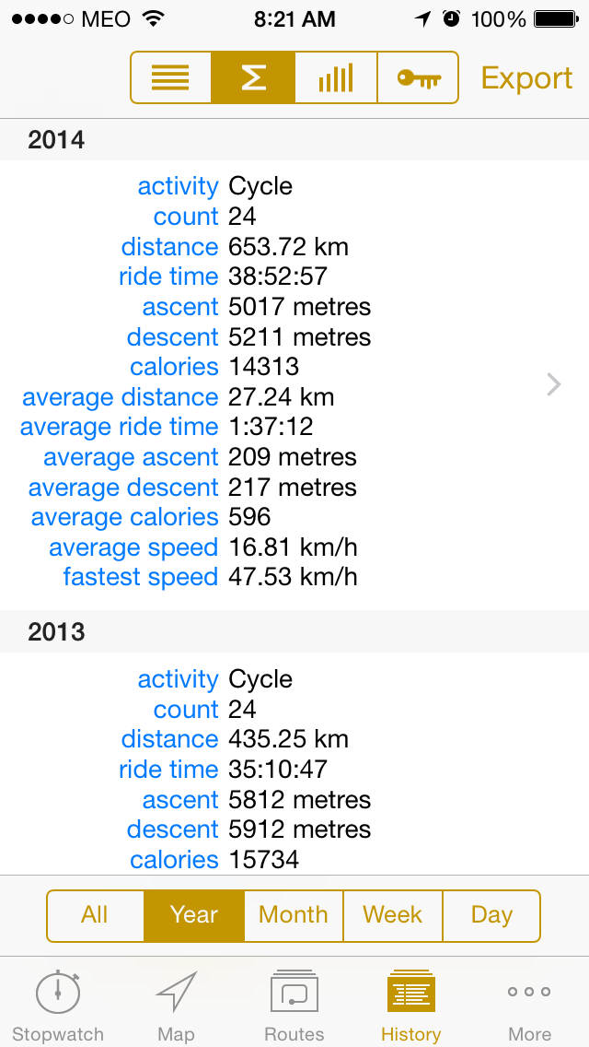
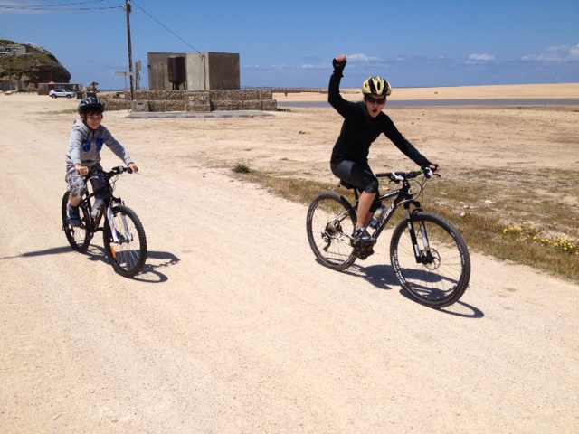
Tracking: bike riding

Slide 5
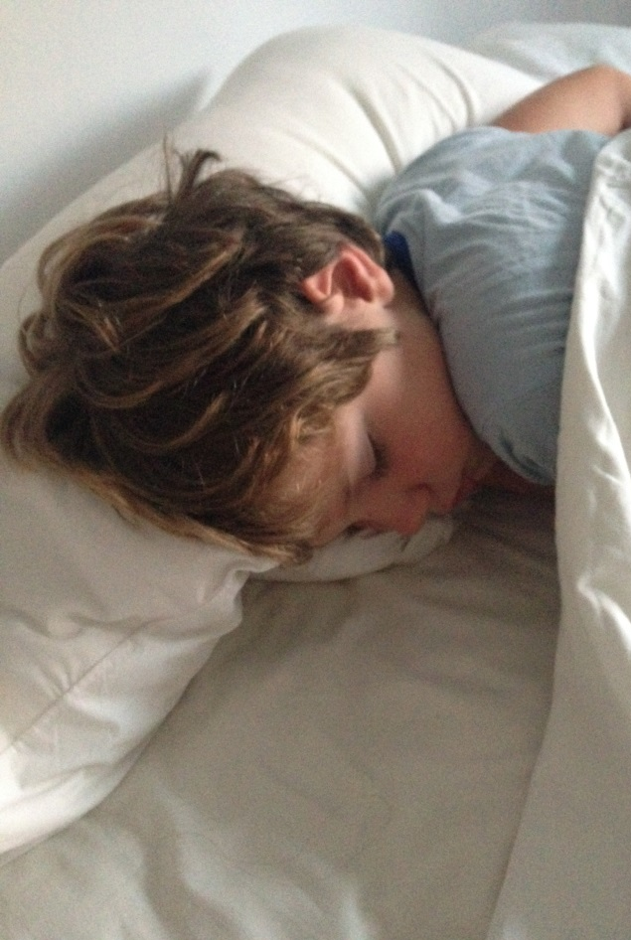
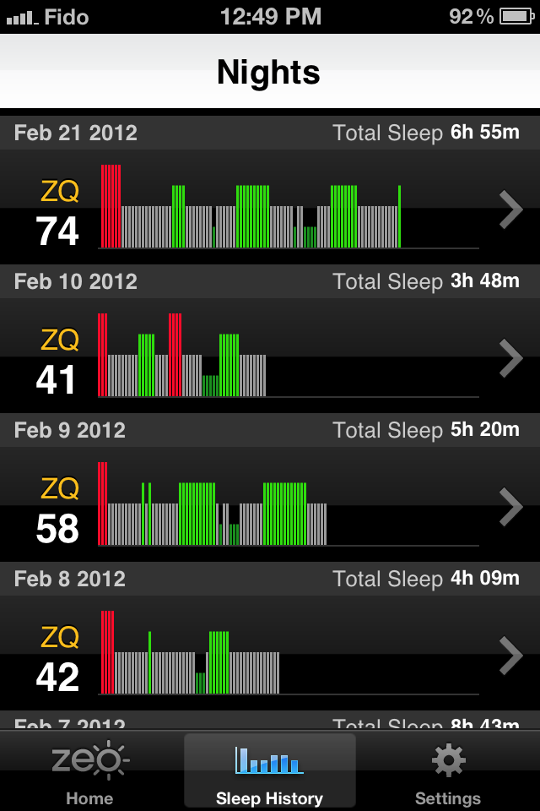
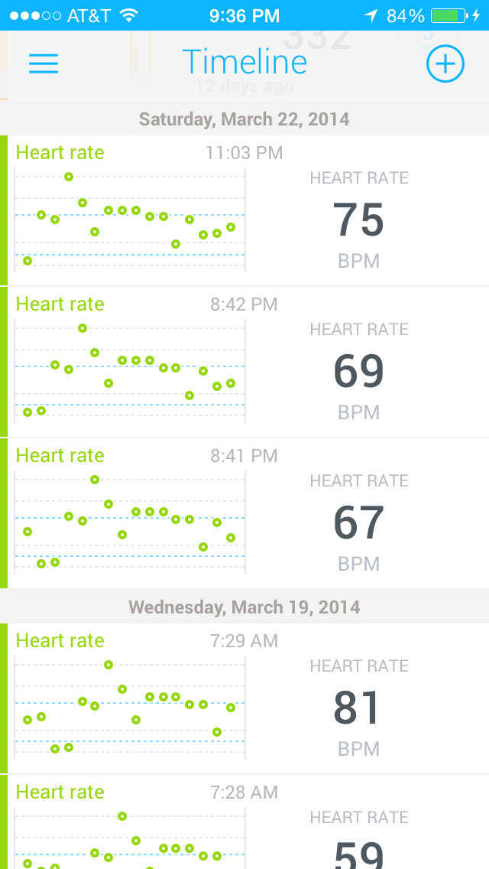
Tracking: Sleep

Slide 6
QS and ‘self-knowledge through numbers’
Mutual adaptation
“first we shape our tools, then they shape us” McLuhan
Research questions:
What visions, assumptions, desires are being materialized in and by the QS movement (apps & people)?
What changes and new, facts and values are brought about by this movement?

Slide 7
Studying the QS movement
What is being developed? Why? For what? For whom? By whom? How do we make meaning out of bodily extracted information? What does it mean to optimize performance through techno-science? Why quantification? What is the history of QS and its links to other discursive practices (i.e., wearable computers, IofThings, big data, inf society)? How does using these technologies affect the experience of users?

Slide 8
Studying the QS movement
No judgments or normative assessments
Ethnographic study:
Participant observation (for the past year)
Interviews (starting now)

Slide 9
Recruiting participants!
Anonymity
Withdraw at any point
Send you what I write
Present findings at this forum

Slide 10
Thanks!
ana@anaviseu.org

