Slide 1

Life Track
Happiness through fulfillment
Ian Billett

Slide 2
Life Track
Ideas behind Life Track
What data is being collected
Analysing and deducing insight from the data
Developing this concept further

Slide 3
Ideas behind Life Track
What makes a person who they are?
Every person = Σ (previous experiences)
Simple but powerful idea
Purely an exercise of curiosity

Slide 4
What data is being collected?
Excel spread sheet, 5 minute intervals, classify activities through tags.
Quickly realized aggregation was obscuring nuances of the data.
Latest iteration: 1 minute resolution, 5 columns, build up activities through combinations of tags.
Data integrity – vital to durability of dataset

Slide 5
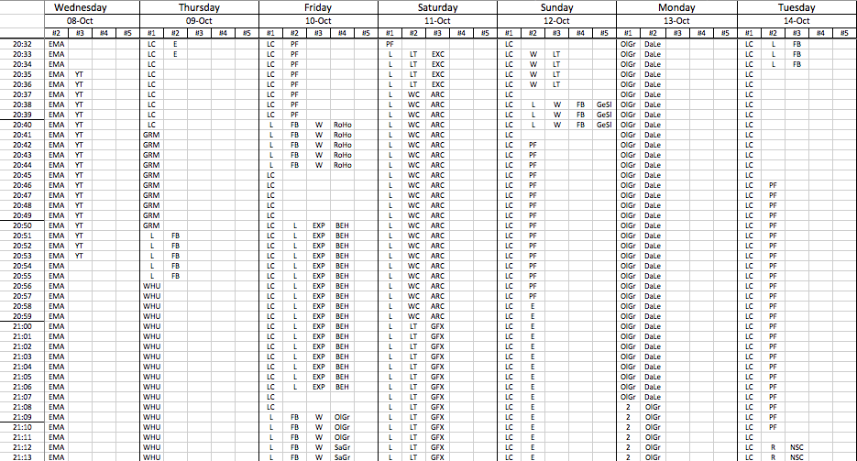
What data is being collected?

Slide 6
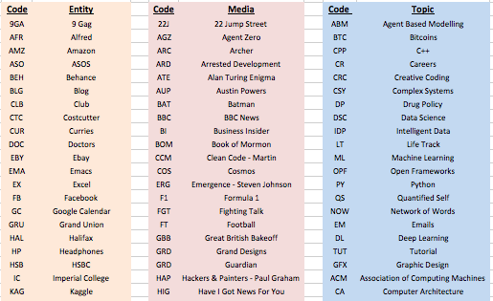
What data is being collected?

Slide 7
Data analysis
Life balance analysis – happiness through fulfillment
Best days are when I achieve the right balance of activities.
Defined ideal day: 8h productivity, 2h social, 30m reading, 7h sleeping… – everyone is different!
Produce a [0.00-1.00] rating based on how far my day deviated from ideal

Slide 8
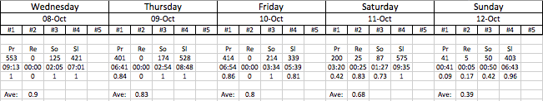
Data analysis: Findings
Python linked into excel via xlwings module
30th August – 5th October: 0.60
6th October – 19th October: 0.79
Represents a significant increase in fulfillment

Slide 9
Data analysis
Sheer depth and detail the data: barely scratching the surface in terms of analysis.
Correlation between minutes of TV watched and overall rating = -0.65
Monitor skills acquisition – Robert Green’s book Mastery, 10,000 hours of dedicated practice. C++ : 0.008% of the way there!

Slide 10
Developing Life Track further
Automation of Data Analysis: GPS location, Internet browsing history, computer activity
Pattern recognition on high scoring days & low scoring days – common features?
One ideal day at the moment, better to have ideal week

Slide 11
Life Track
Thanks for listening!
Questions?

