Slide 1
Tracking 120,856 pushups
in twelve months
Ulrich Atz
@statshero

Slide 2
London Quantified Self: show & tell
What did we do?
How did we do it?
What did I learn?

Slide 3

New Year’s party 2013/14

Slide 4
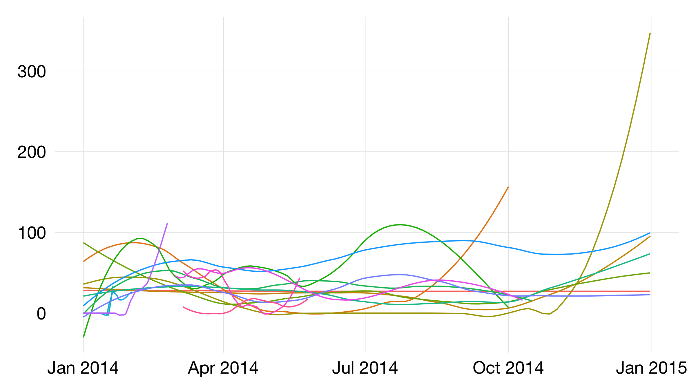

Slide 5



A year is long...

Slide 6
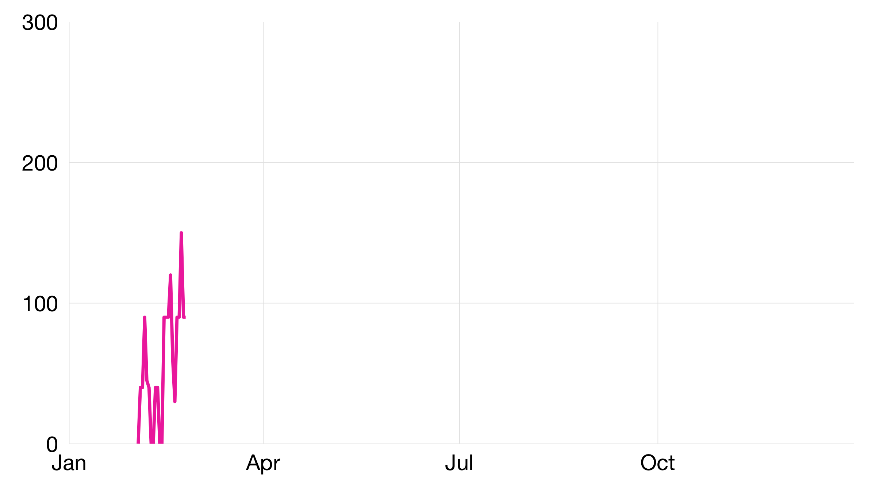
The quitters

Slide 7
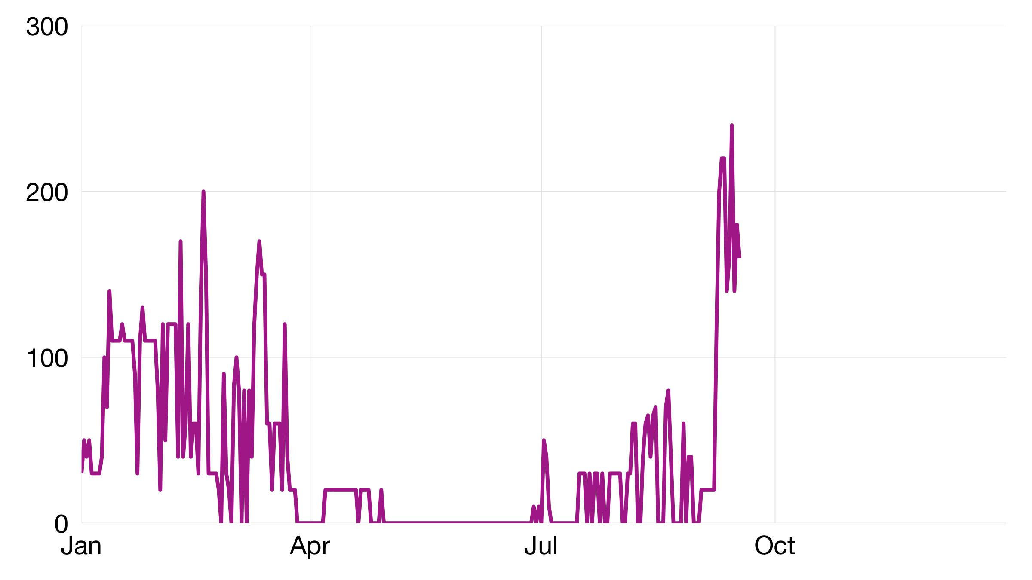
The achievers

Slide 8
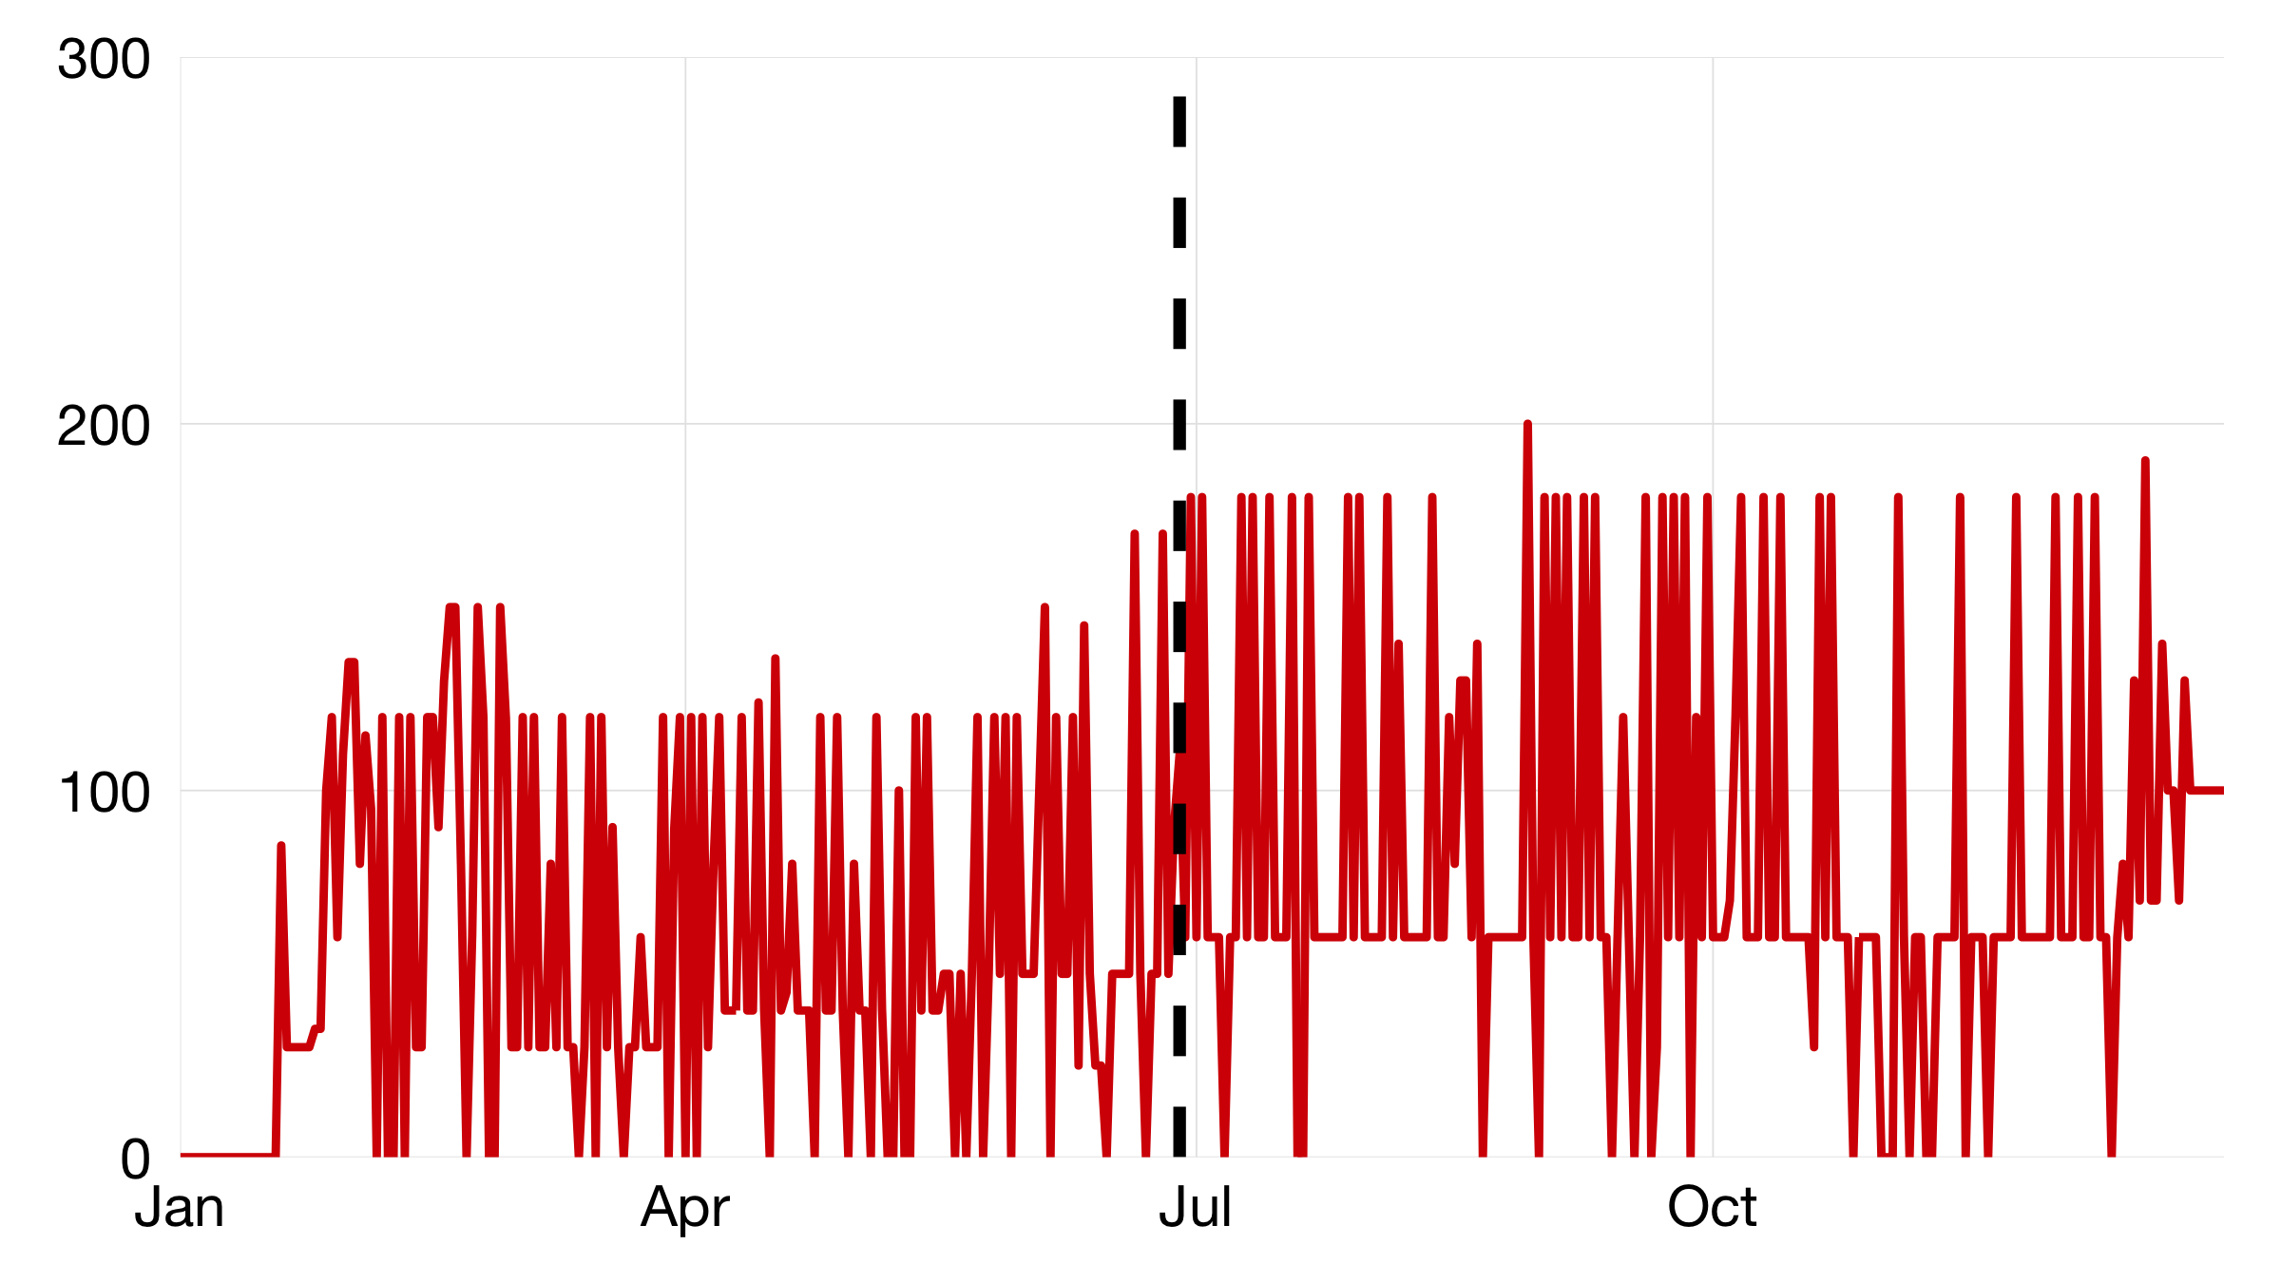
The overachievers

Slide 9
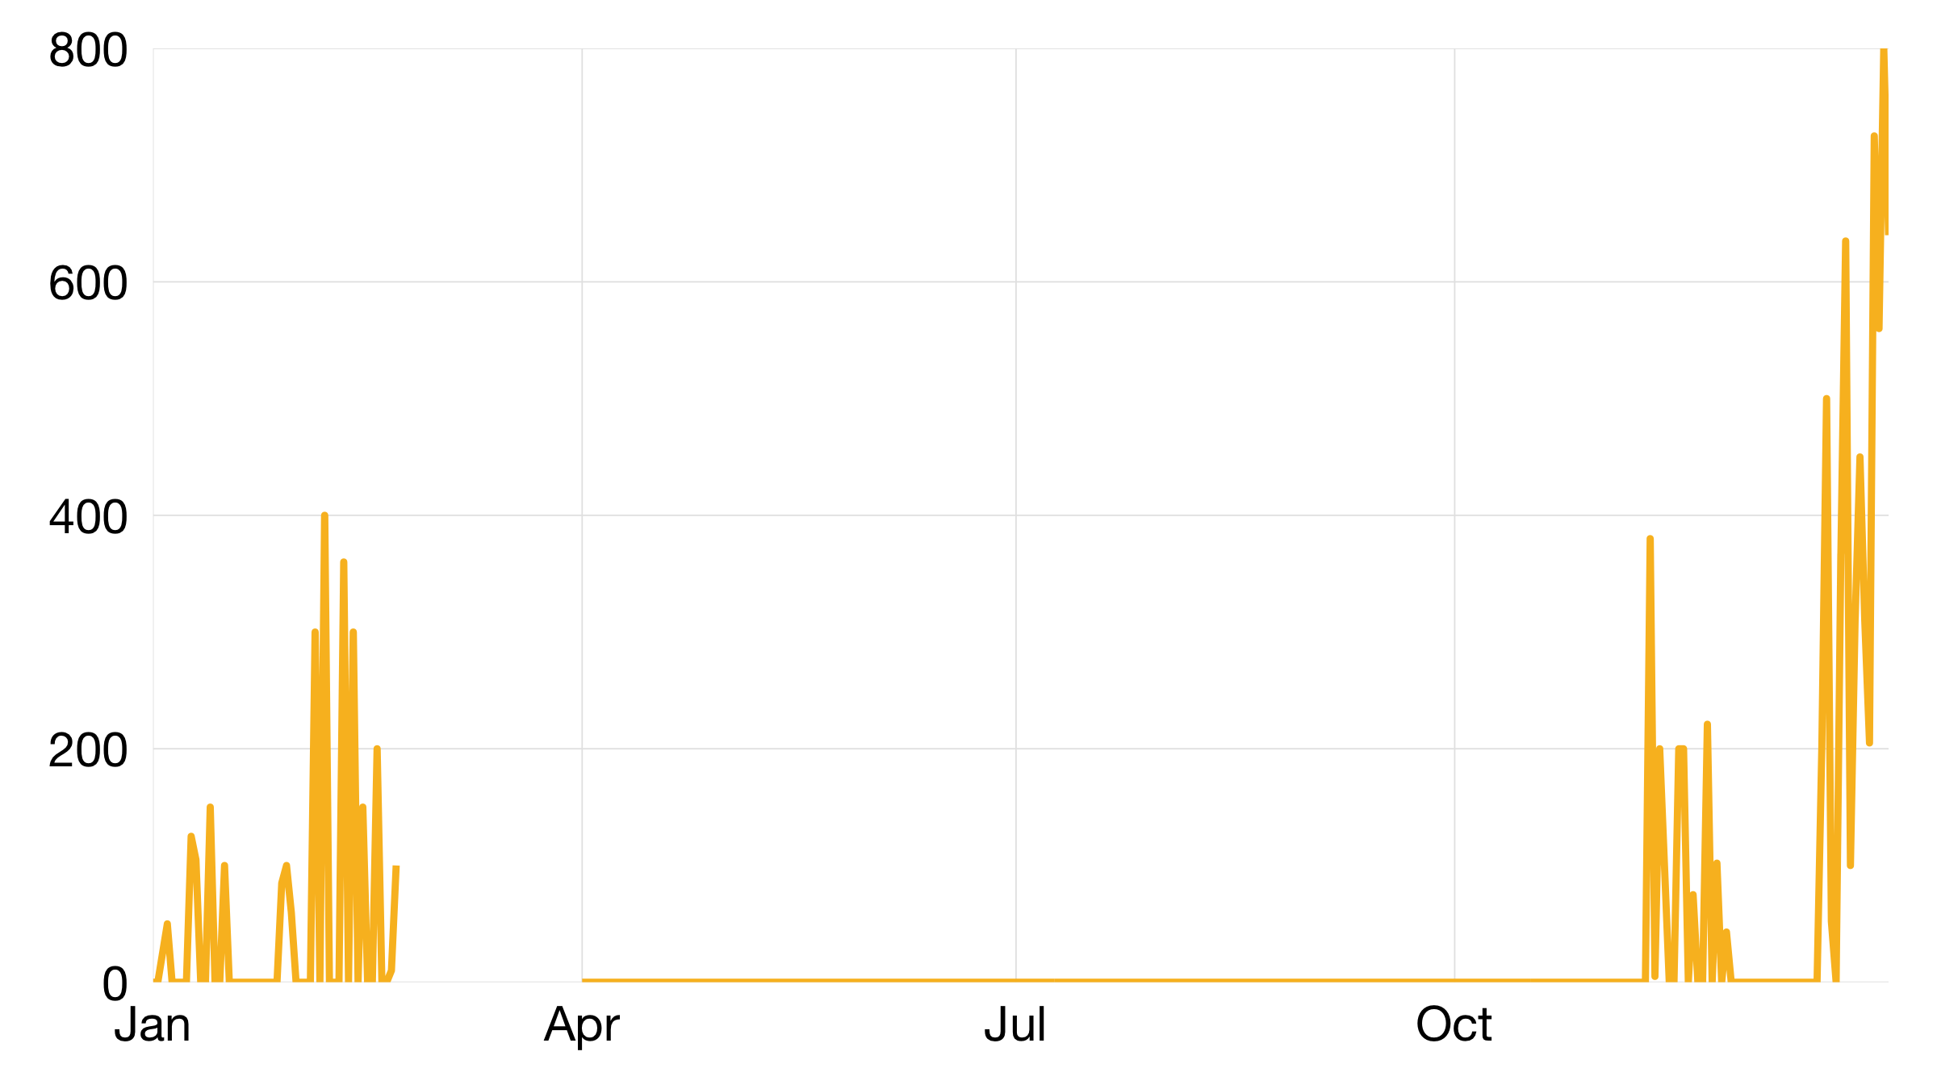
The miraculous

Slide 10
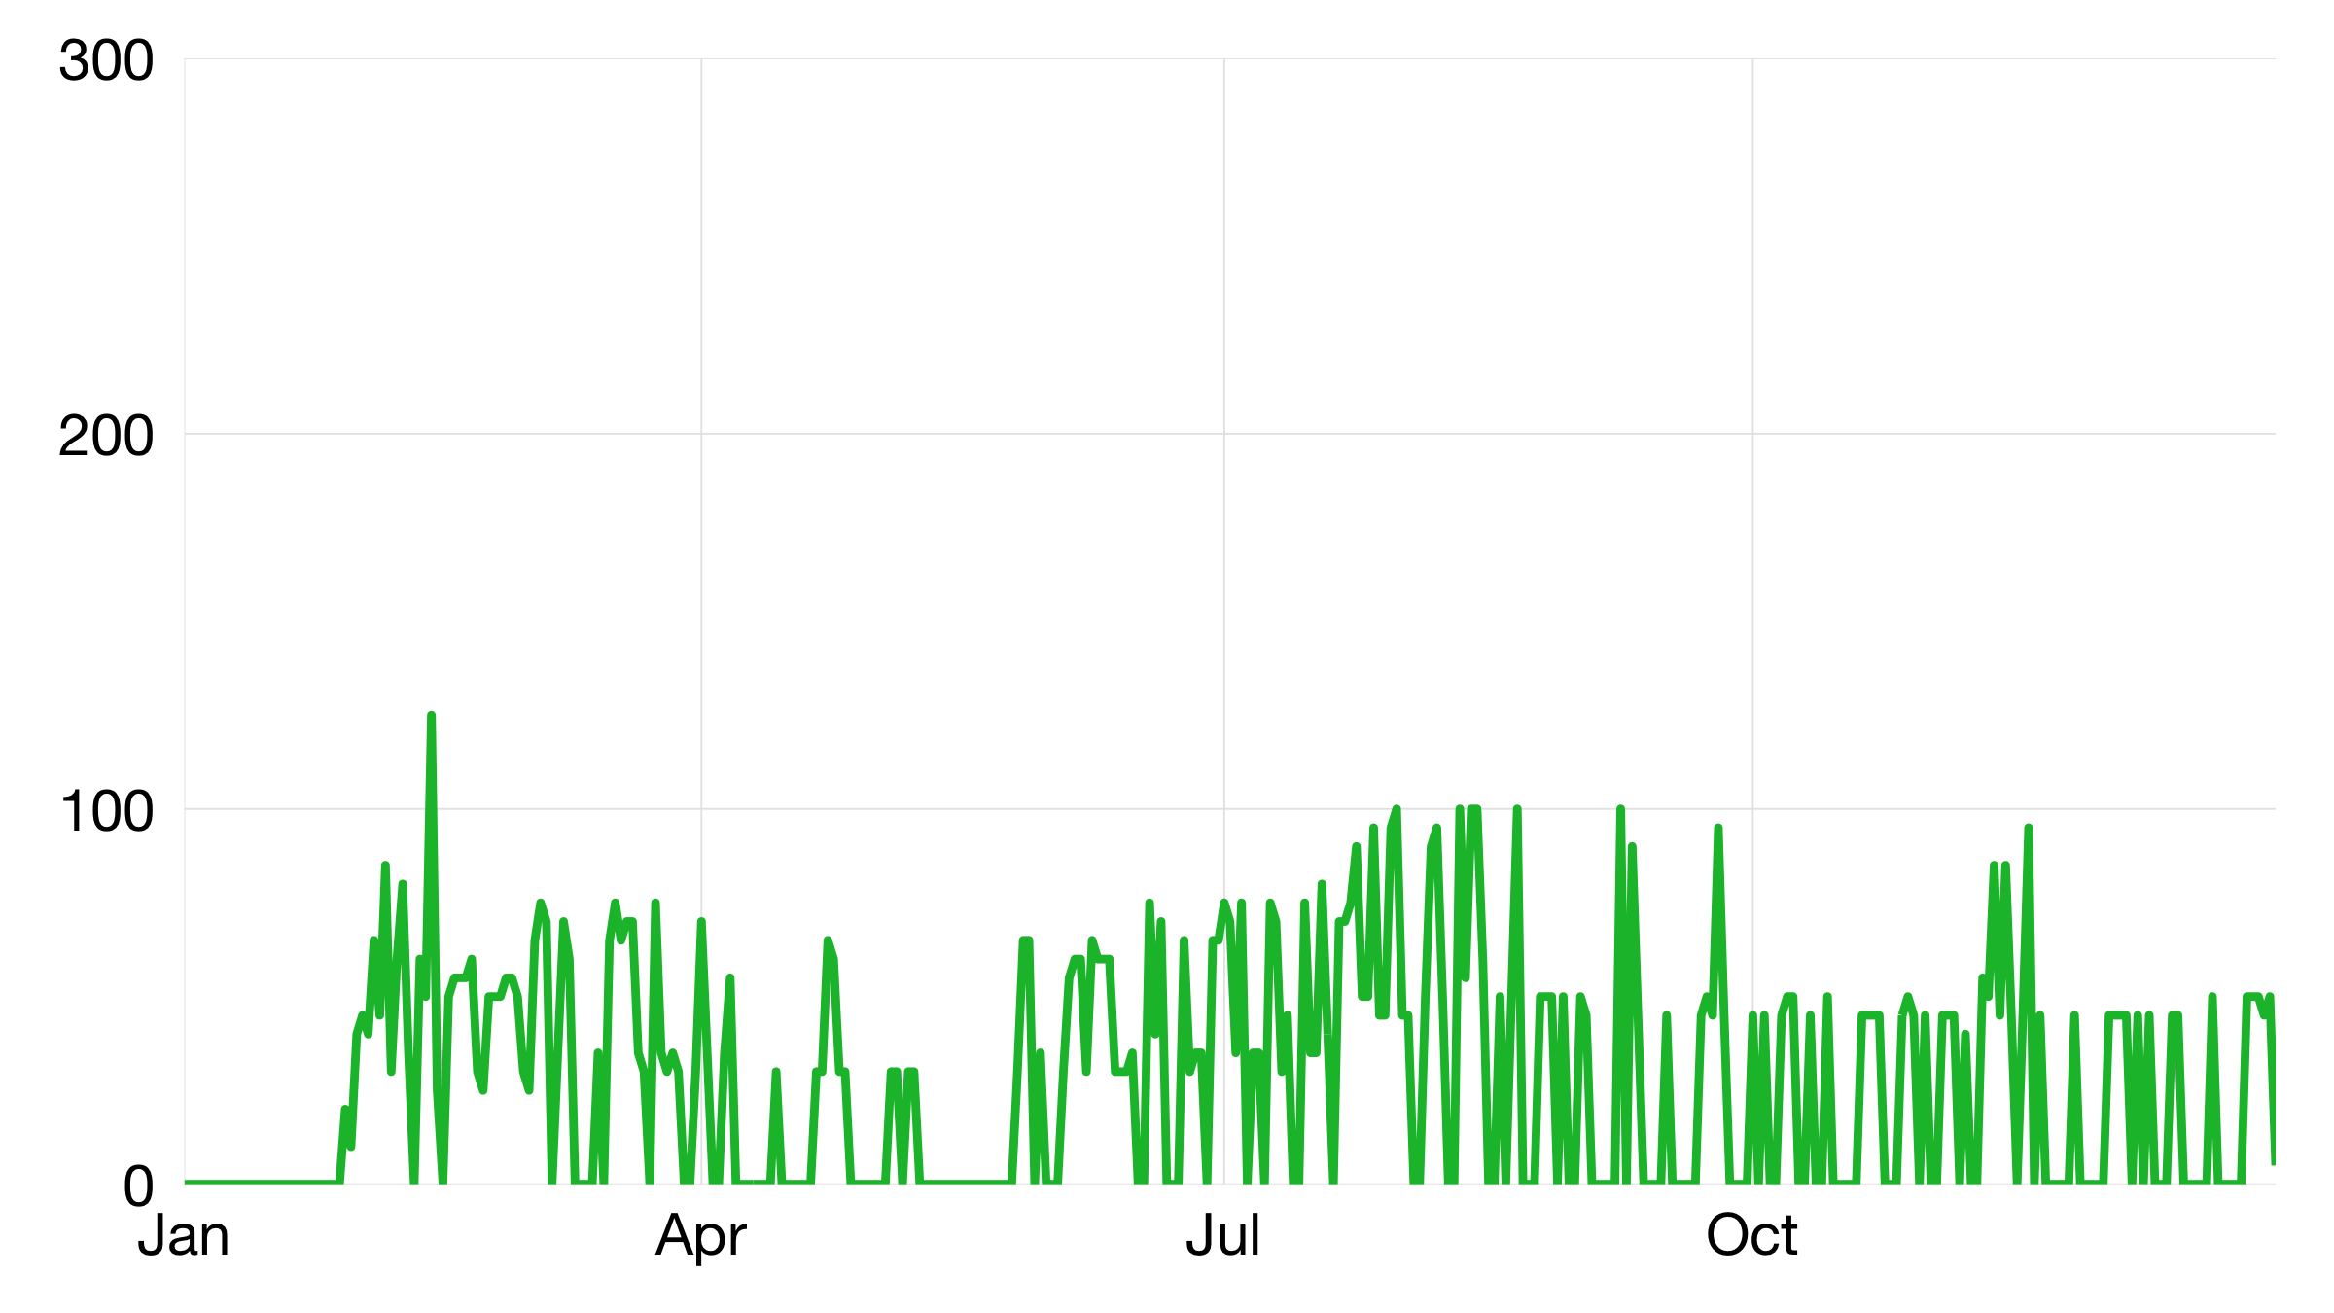
The reliable

Slide 11
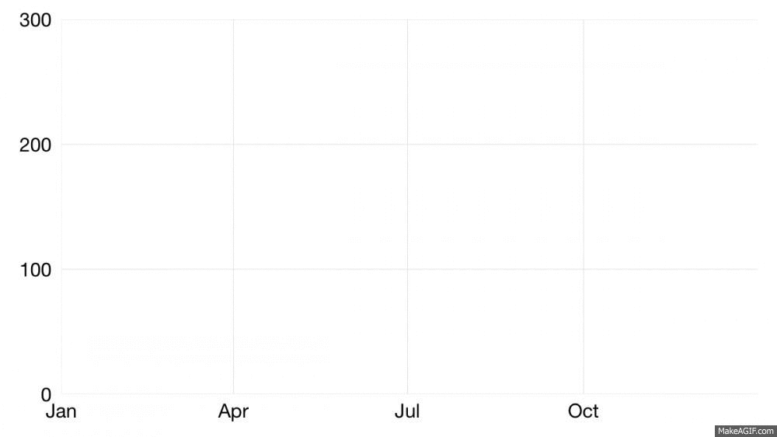

Slide 12
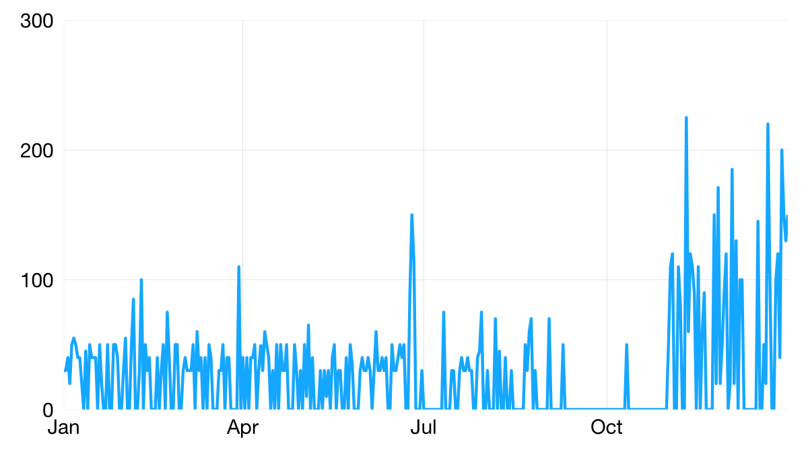

Slide 13
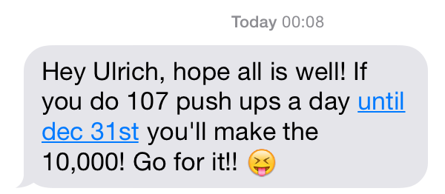

Slide 14
What did I learn?

Slide 15
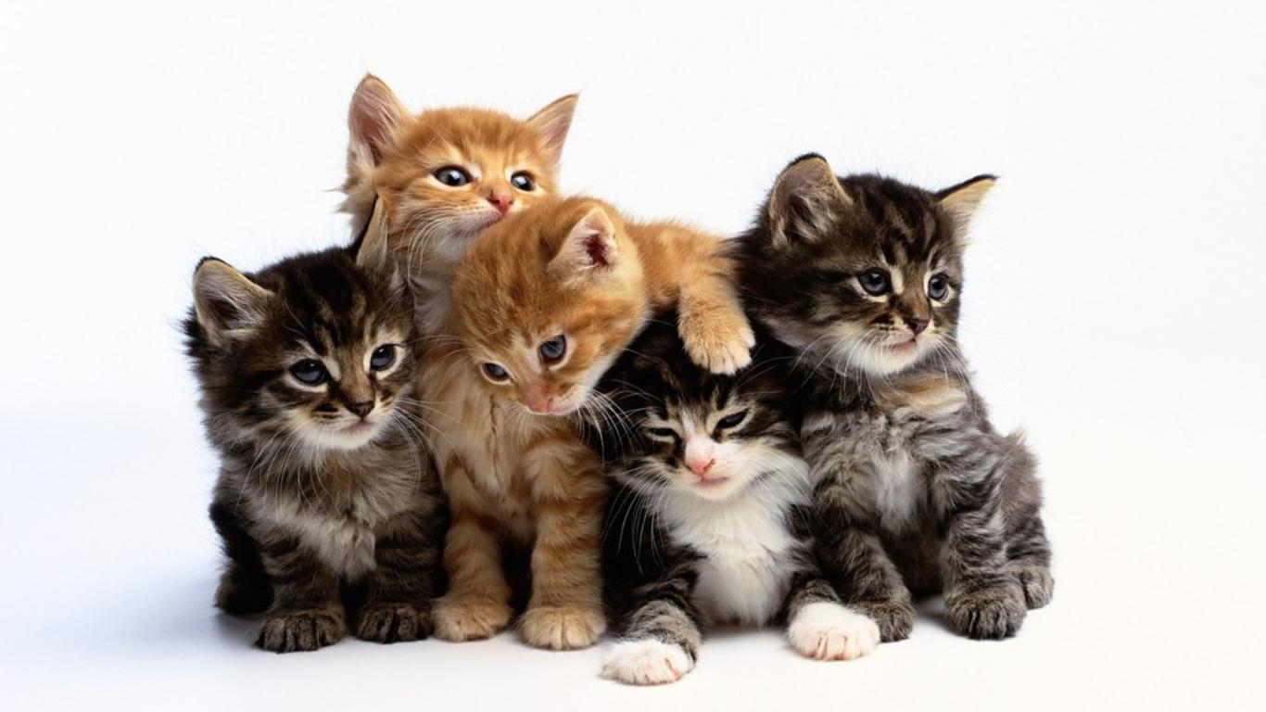
Almost 50% completion rate!

Slide 16
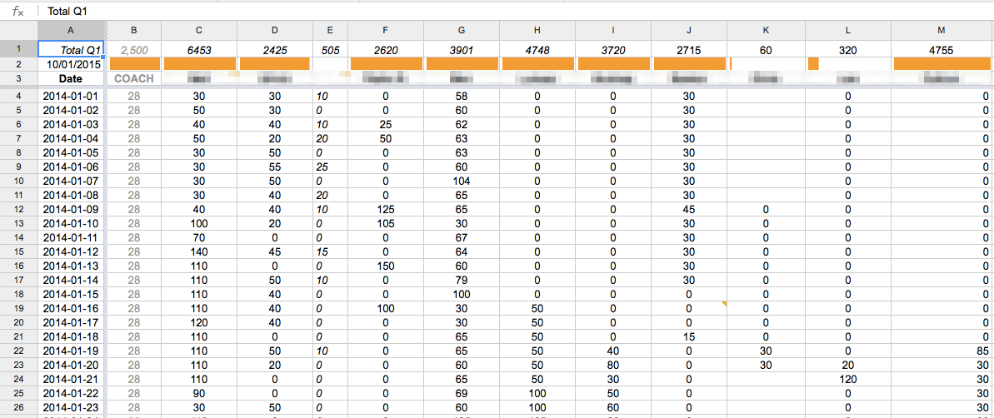
The format matters

Slide 17

Your beliefs become your thoughts,
Your thoughts become your words,
Your words become your actions,
Your actions become your habits,
Your habits become your values,
Your values become your destiny.
CC-BY-SA | ulrichatz.eu

Slide 18
Your beliefs become your thoughts,
Your thoughts become your words,
Your words become your actions,
Your actions become your habits,
Your habits become your values,
Your values become your life.
CC-BY-SA | ulrichatz.eu

Slide 19
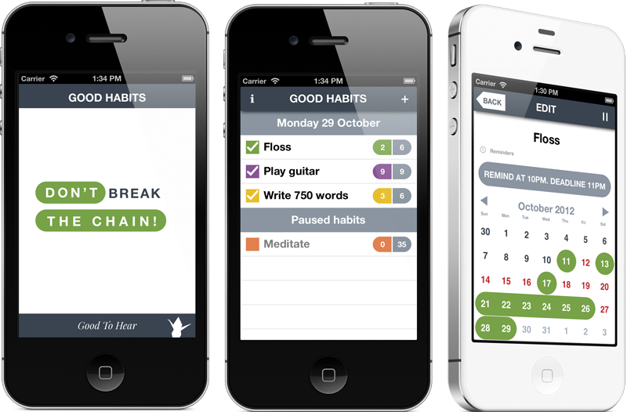
http://bit.ly/habitsapp now with ~100k downloads

Slide 20
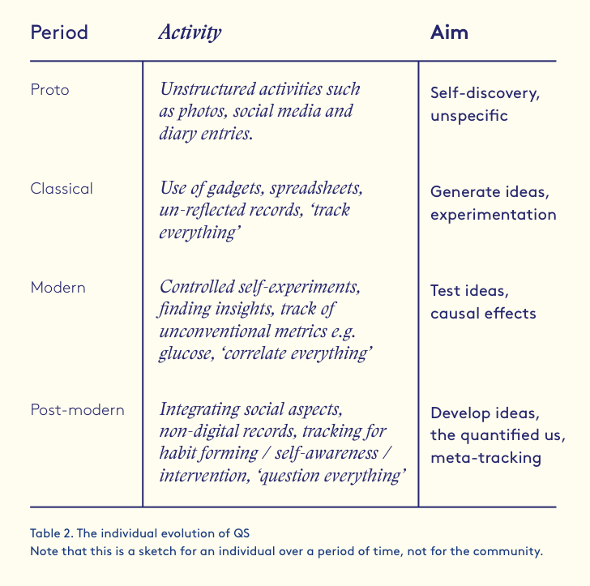

What’s next?
http://issuu.com/daniellearets/docs/_05_stressedout_issuu, p.32

Slide 21

Reach me at ulrich001+habits@gmail.com
or on Twitter @statshero.
Thank you!
CC-BY-SA | ulrichatz.eu

