Slide 1
Health Metrics (Work in Progress)
Ian Clements
QS 11 Feb 15

Slide 2
Initial main goal from 1966: longevity
I considered cardio-vascular disease the main limitation
I thought healthy eating and supplements like Vit.C would take care of the cancer risk (not on my horizon then) & everything else
By 1974, my set of recorded (QS) metrics were:
How far could I run in 12’ – I thought a good measure of CV health
3-yearly BUPA MOT – including cancer biomarkers, CV stress-testing, etc
The upset came in 2007 when, despite being given a good MOT report in 2006, I was diagnosed with terminal cancer and given weeks to live. So no more BUPA tests

Slide 3
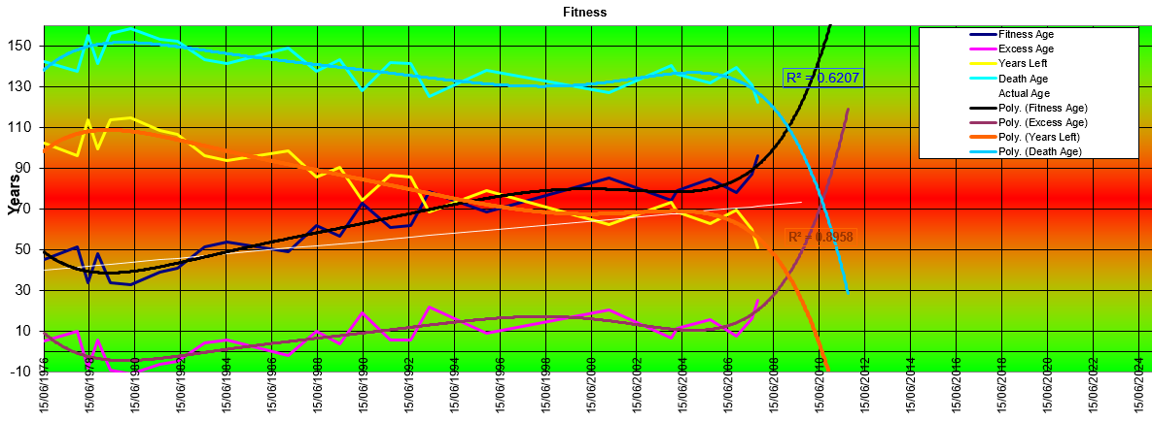

Slide 4
Healthiness Advice?
I was a believer – in the now-known lousy science:
Fat makes you fat – so low fat foods best
Exercise reduces fat – so more means less body fat
Calories count (but I could never be bothered with that)
So I measured exercise and weight/fat/muscle – no relationship
I’m now more tentative, but presently believe:
More steps/day = longer life
Carbs make me fat
Fat & veggies are good for me
Alcohol, Meat & Dairy is bad for me
High Intensity Training good, aerobics bad
No matter what the advice is, it may not be true for me. So QS!

Slide 5
Now: optimising health
I’ve now got three morbidities: recurrent cancer (quiescent now), hypertension, and impaired single kidney (one atrophied along the way)
I believe that improving my health will extend my survival
So the problem is: how do I know my health is improving or declining?

Slide 6
Possible Health Metrics
There are a plethora of touted health or ageing metrics – skin elasticity, hand grip, 12’ walk & pulse to name a few
The problem, for me, is that most are either too vague, not susceptible to accurate repeatable measurement, or change too slowly to be usable on a daily basis (my preference) – tho’ they may be useful as a check on the daily ones
My criterion is that any such metric be easily do-able on a daily basis to enable quick feedback – “knowledge of results improves performance”

Slide 7
My Tentative Health Metrics
Daily body composition (using Tanita InnerScan) – the less fat and more muscle I have, the better
Daily blood pressure – aiming for 120/80
Daily pulse – lower is better
Daily urine Reagent Strip markers
Monthly or tri-monthly: molecular biomarkers for cancer and kidney function
[Daily: Vitality Analyzer – used, but odd results]

Slide 8
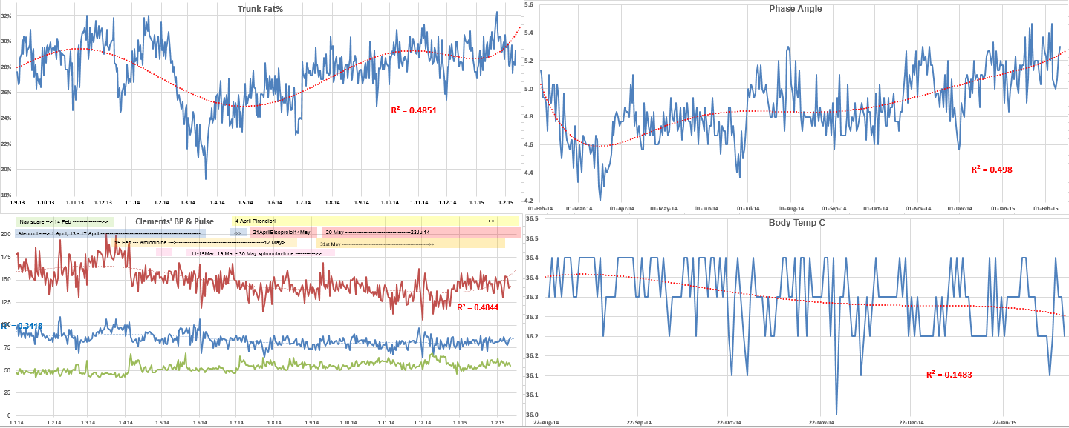
Some Graphs of Targets

Slide 9
Actions I Think Will Improve My Health Metrics
Exercise (resistance, steps, HRM)
Complementary treatments (hyperthermia, enhanced oxygen, etc)
Supplements
Liquids
Foods
Nutrition categories (alcohol, fat, protein, carbs, etc)
Prescription drugs

Slide 10
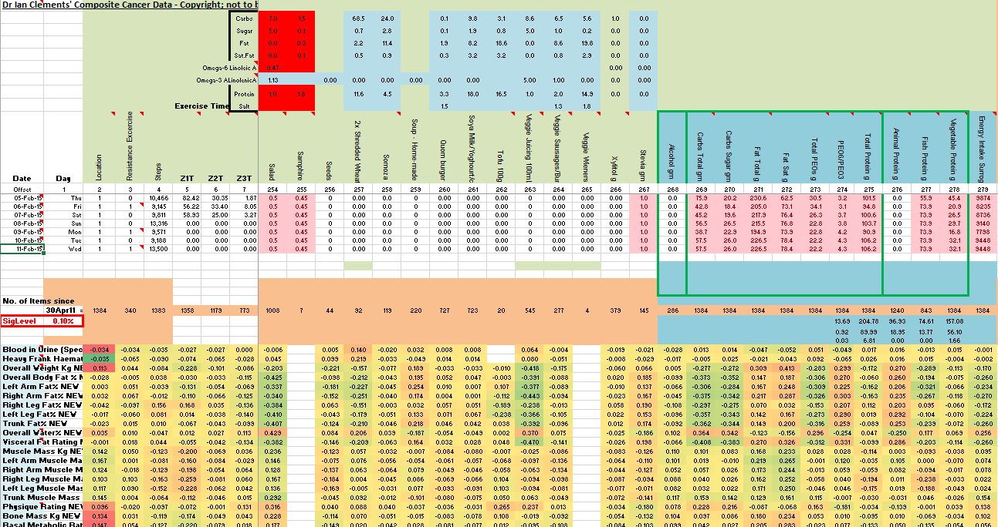

Slide 11
Problems
Am I recording all the important daily events in my life that will influence the health metrics? Mood? Sleep? Altzheimer’s?
Do the chosen health metrics correlate highly with each other?
Alas, often not; but sometimes
Am I able to obtain meaningful relationships between my independent variables (lifestyle) and the dependent health metrics?
Simple correlations may obscure interactions from other variables
Multiple linear regressions need 20+ events for each variable – and I have 300 variables for less than 6,000 ‘events’ (days)
Presently I do alter my lifestyle to reflect such analyses and track the changes

