Slide 1
MULTITRACKING ANDREA ZHU
London QS Meet Up # 35, Rainmaking Loft March 18th 2015

Slide 2
Structure
My Approach
Examples of what I’ve done
Future Ideas
MULTITRACKING, Andrea Zhu – London QS Meet Up # 35, Rainmaking Loft, March 18th 2015

Slide 3
How it Started
Organize Things
Keep Things
Archiving
Tracking
MULTITRACKING, Andrea Zhu – London QS Meet Up # 35, Rainmaking Loft, March 18th 2015

Slide 4
Tracking Approach
Additive
Holistic
Net Easy
MULTITRACKING, Andrea Zhu – London QS Meet Up # 35, Rainmaking Loft, March 18th 2015

Slide 5

Reading
Jobs
Expenses
Oyster
Twitter
Gmail
Travel
MULTITRACKING, Andrea Zhu – London QS Meet Up # 35, Rainmaking Loft, March 18th 2015

Slide 6
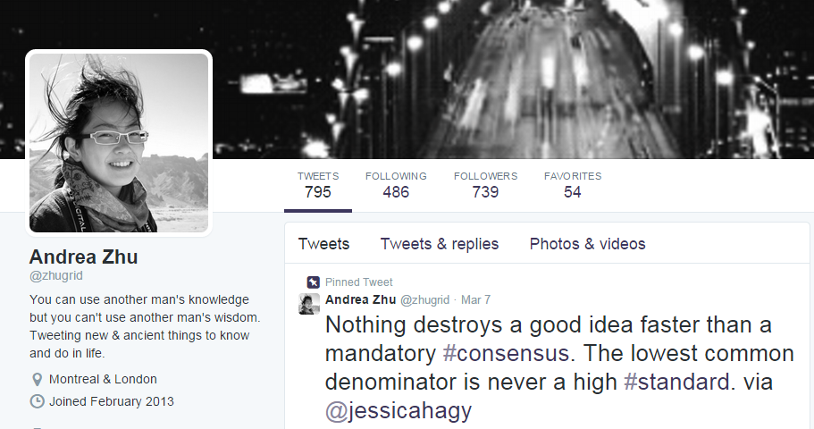
Twitter
MULTITRACKING, Andrea Zhu – London QS Meet Up # 35, Rainmaking Loft, March 18th 2015

Slide 7
Twitter
MULTITRACKING, Andrea Zhu – London QS Meet Up # 35, Rainmaking Loft, March 18th 2015

Slide 8
Twitter
MULTITRACKING, Andrea Zhu – London QS Meet Up # 35, Rainmaking Loft, March 18th 2015

Slide 9
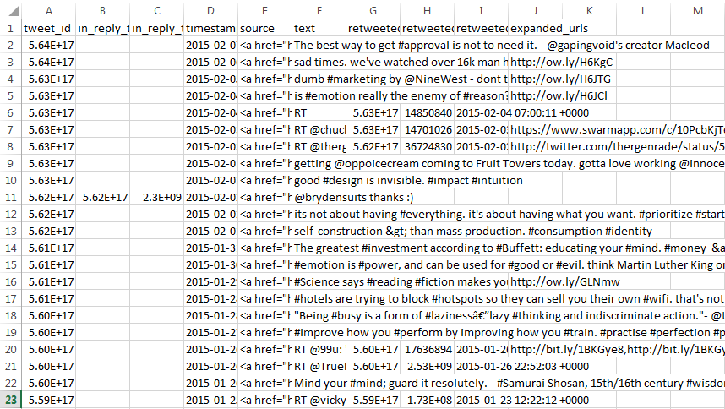

Twitter
MULTITRACKING, Andrea Zhu – London QS Meet Up # 35, Rainmaking Loft, March 18th 2015

Slide 10
Twitter
How long does it take?
Download Archive – 3 min
Format Dates – 5 min
Visualize Data – 2 min
Total Time: 10 min
MULTITRACKING, Andrea Zhu – London QS Meet Up # 35, Rainmaking Loft, March 18th 2015

Slide 11

Gmail
MULTITRACKING, Andrea Zhu – London QS Meet Up # 35, Rainmaking Loft, March 18th 2015

Slide 12

Gmail
MULTITRACKING, Andrea Zhu – London QS Meet Up # 35, Rainmaking Loft, March 18th 2015

Slide 13
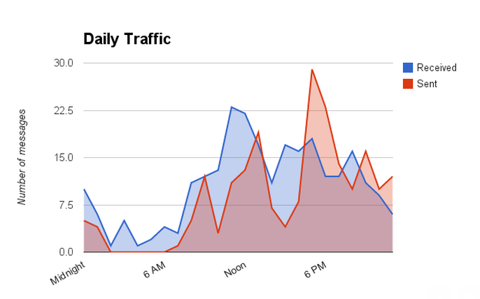
Gmail
MULTITRACKING, Andrea Zhu – London QS Meet Up # 35, Rainmaking Loft, March 18th 2015

Slide 14
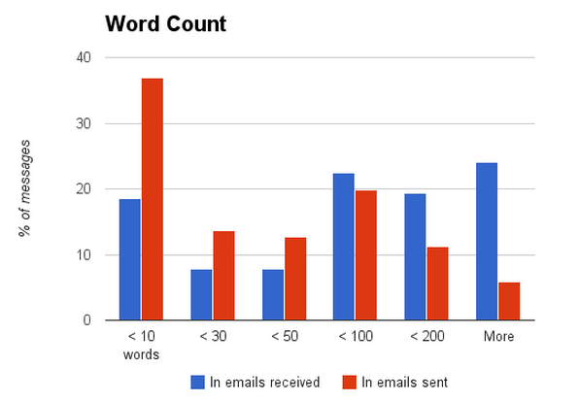
Gmail
MULTITRACKING, Andrea Zhu – London QS Meet Up # 35, Rainmaking Loft, March 18th 2015

Slide 15
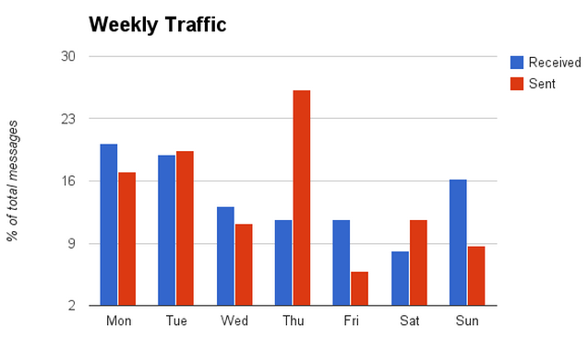
Gmail
MULTITRACKING, Andrea Zhu – London QS Meet Up # 35, Rainmaking Loft, March 18th 2015

Slide 16
Gmail
How long does it take?
Request Report – 2 min
Total Time: 2 min
MULTITRACKING, Andrea Zhu – London QS Meet Up # 35, Rainmaking Loft, March 18th 2015

Slide 17

Travel
MULTITRACKING, Andrea Zhu – London QS Meet Up # 35, Rainmaking Loft, March 18th 2015

Slide 18
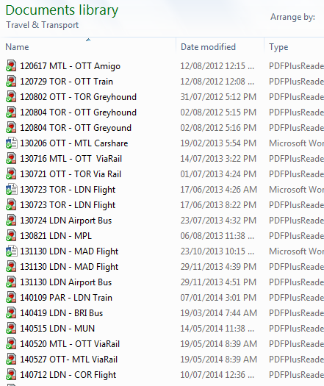
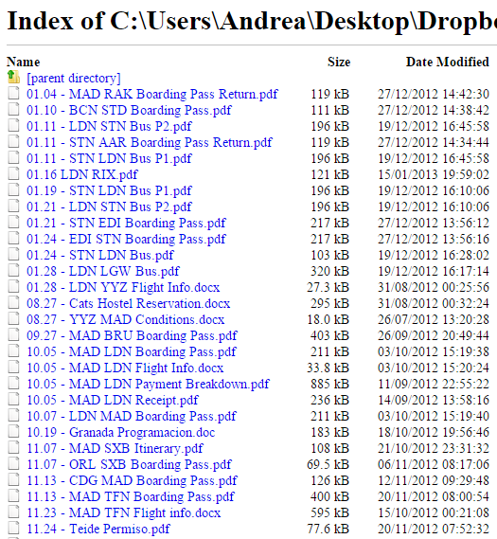
Travel
MULTITRACKING, Andrea Zhu – London QS Meet Up # 35, Rainmaking Loft, March 18th 2015

Slide 19
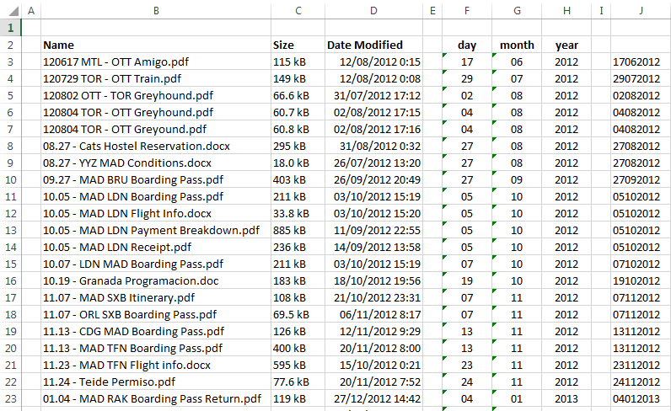
Travel
MULTITRACKING, Andrea Zhu – London QS Meet Up # 35, Rainmaking Loft, March 18th 2015

Slide 20
Travel
MULTITRACKING, Andrea Zhu – London QS Meet Up # 35, Rainmaking Loft, March 18th 2015

Slide 21
Travel
MULTITRACKING, Andrea Zhu – London QS Meet Up # 35, Rainmaking Loft, March 18th 2015

Slide 22
Travel
How long does it take?
Open File Directory in Browser – 30sec
Copy to Excel – 30sec
Extract Dates by Month – 5min
Plot Frequency – 2min
Visualize Data – 2min
Total Time: 10 min
MULTITRACKING, Andrea Zhu – London QS Meet Up # 35, Rainmaking Loft, March 18th 2015

Slide 23

Reading
MULTITRACKING, Andrea Zhu – London QS Meet Up # 35, Rainmaking Loft, March 18th 2015

Slide 24

Reading
MULTITRACKING, Andrea Zhu – London QS Meet Up # 35, Rainmaking Loft, March 18th 2015

Slide 25
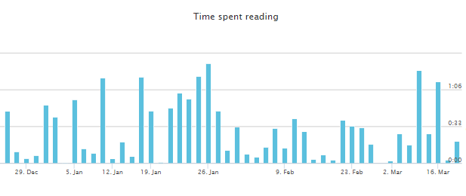
Reading
MULTITRACKING, Andrea Zhu – London QS Meet Up # 35, Rainmaking Loft, March 18th 2015

Slide 26
Reading
MULTITRACKING, Andrea Zhu – London QS Meet Up # 35, Rainmaking Loft, March 18th 2015

Slide 27


Reading
MULTITRACKING, Andrea Zhu – London QS Meet Up # 35, Rainmaking Loft, March 18th 2015

Slide 28
Reading
How long does it take?
Create Roundview Account – 2min
Create IFTTT Account – 2min
Set up IFTTT Recipe – 2min
Visualize Data – 2min
Total Time: 2-8 min
MULTITRACKING, Andrea Zhu – London QS Meet Up # 35, Rainmaking Loft, March 18th 2015

Slide 29

Expenses
MULTITRACKING, Andrea Zhu – London QS Meet Up # 35, Rainmaking Loft, March 18th 2015

Slide 30
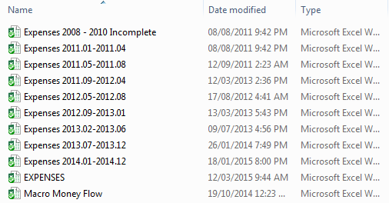
Expenses
MULTITRACKING, Andrea Zhu – London QS Meet Up # 35, Rainmaking Loft, March 18th 2015

Slide 31
Expenses
MULTITRACKING, Andrea Zhu – London QS Meet Up # 35, Rainmaking Loft, March 18th 2015

Slide 32
Expenses
MULTITRACKING, Andrea Zhu – London QS Meet Up # 35, Rainmaking Loft, March 18th 2015

Slide 33
Expenses
How long does it take?
Make or Get a Tracking Template – 20+min
Record Expenses – 20+min
Visualize Data – 20+min
Total Time: 60+ min
MULTITRACKING, Andrea Zhu – London QS Meet Up # 35, Rainmaking Loft, March 18th 2015

Slide 34

Job Applications
MULTITRACKING, Andrea Zhu – London QS Meet Up # 35, Rainmaking Loft, March 18th 2015

Slide 35
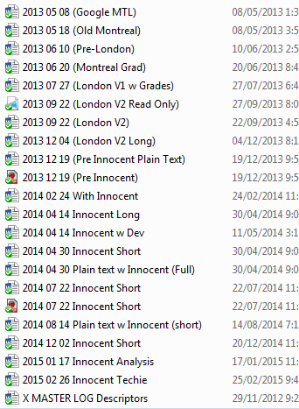
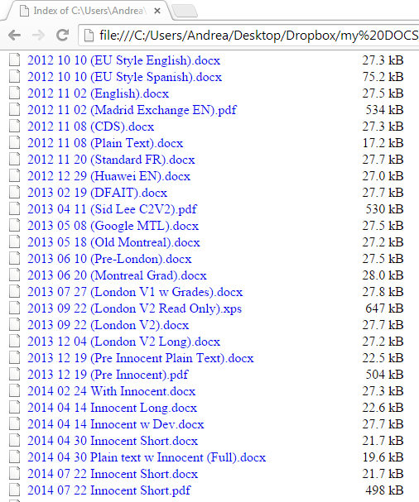
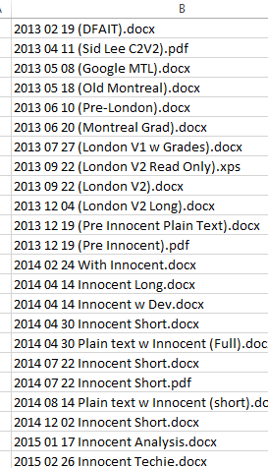
Job Applications
MULTITRACKING, Andrea Zhu – London QS Meet Up # 35, Rainmaking Loft, March 18th 2015

Slide 36
Job Applications
MULTITRACKING, Andrea Zhu – London QS Meet Up # 35, Rainmaking Loft, March 18th 2015

Slide 37
Job Applications
How long does it take?
Open File Directory in Browser – 20sec
Copy to Excel – 20sec
Manipulate Dates – 1min
Plot Frequency – 1min
Graph it – 20sec
Total Time: 3 min
MULTITRACKING, Andrea Zhu – London QS Meet Up # 35, Rainmaking Loft, March 18th 2015

Slide 38

Commute
MULTITRACKING, Andrea Zhu – London QS Meet Up # 35, Rainmaking Loft, March 18th 2015

Slide 39
Commute
MULTITRACKING, Andrea Zhu – London QS Meet Up # 35, Rainmaking Loft, March 18th 2015

Slide 40
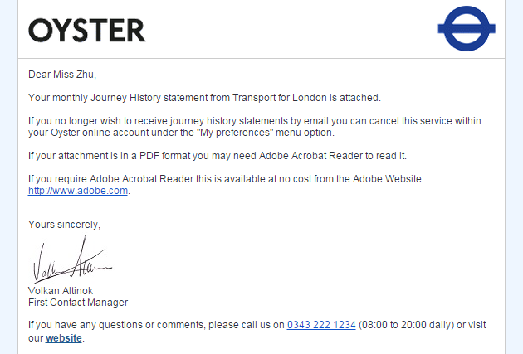
Commute
MULTITRACKING, Andrea Zhu – London QS Meet Up # 35, Rainmaking Loft, March 18th 2015

Slide 41
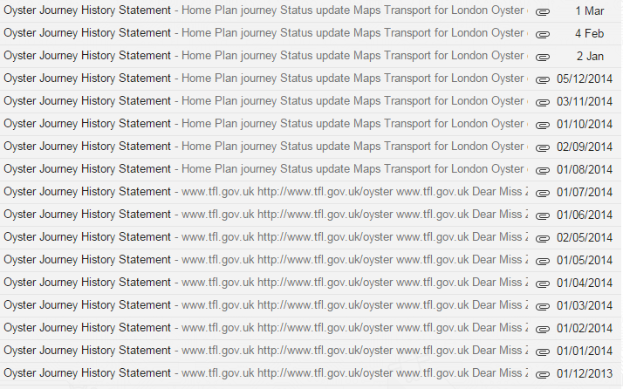
Commute
MULTITRACKING, Andrea Zhu – London QS Meet Up # 35, Rainmaking Loft, March 18th 2015

Slide 42
Commute
How long does it take?
Register Oyster – 3min
Sign up for monthly report – 2min
Download Report – 30sec
Visualize Data – 30sec
Total Time: 6 min
MULTITRACKING, Andrea Zhu – London QS Meet Up # 35, Rainmaking Loft, March 18th 2015

Slide 43
Reading
Jobs
Expenses
Commute
Twitter
Gmail
Travel
MULTITRACKING, Andrea Zhu – London QS Meet Up # 35, Rainmaking Loft, March 18th 2015

Slide 44
Considerations
Opportunist
Forensic
Looking backwards
With data you have, Passive approach
-
Where did all my money go?
Looking forward
With data you get, Active approach
-
When am I most creative?
MULTITRACKING, Andrea Zhu – London QS Meet Up # 35, Rainmaking Loft, March 18th 2015

Slide 45
Future Ideas
Keep Things
Organize Things
Visualizing Things
Sentiment Analysis
Brain Activity
Cartography
MULTITRACKING, Andrea Zhu – London QS Meet Up # 35, Rainmaking Loft, March 18th 2015

Slide 46



Thank you
GETTING IN TOUCH:
MULTITRACKING, Andrea Zhu – London QS Meet Up # 35, Rainmaking Loft, March 18th 2015

