Slide 1


Slide 2

QS Survey results
Blood based Quantification of lifestyle change
Our efforts

Slide 3
1
QS community survey results
Notes:
Key message, it is long due
- # of survey participants; - participants' geographic location (city); - % of participants working on QS projects; - description of on-going or planned QS projects, clustered according to health topics; - participants' health goals; - participants' interest in working with blood testing

Slide 4
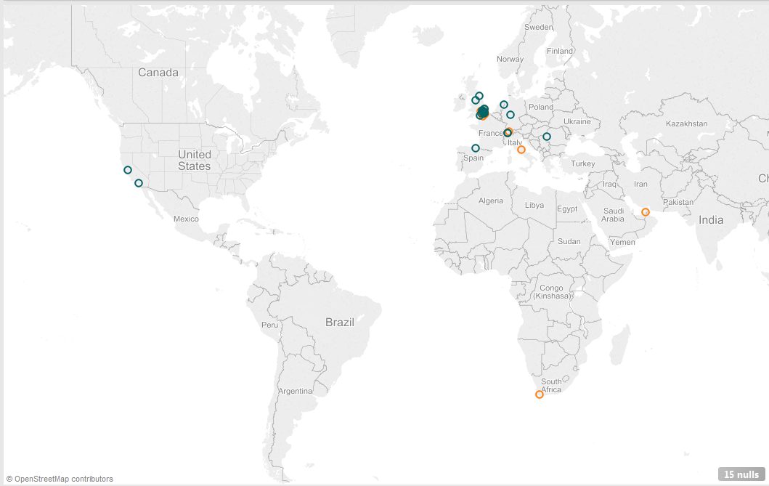
Survey results:
- Total # of evaluated responses: 70
- Surveyed group: QS London
- 48 participants provided contacts to receive additional information
Notes:
People were travelling around Christmas
The majority of responses still from London
Strong interest for additional information – we will send per e-mail the copy of the presentation

Slide 5
?Engaged!
58%
Basic health / activity tracking
28%
Mental health
18%
Working on or
planning a project
15%
Dietary & weight control
Health condition control
15%
* Highlights
Notes:
Top 4 category presented, other categories included sport performance, cardio vascular improvements, sleep control.

Slide 6
?WHY!
Manage lifestyle changes
31%
73%
Improve sport performance
31%
Control aging
27%
Want to be
Healthier in general
Lose weight
23%
Control health condition
23%
* Highlights refer only to the group with QS projects
Notes:
Almost everyone wants to be healthier in general, the rest of the categories are evenly . Foster scientific research & take care of an important one were 14 and 10% respectively

Slide 7
?Interested in blood testing!
Yes
87%
No
13%
Notes:
We analyzed the data from two angles, those who have QS project, and those who do not. Interest in blood testing was equally strong in both groups.

Slide 8

Rare side effects (affects less than 1 in 1,000 people)
Tachycardia (heart beating fast)
Notes:
Hayfever
Taking 10 years every spring
110 – 120 bp/s

Slide 9
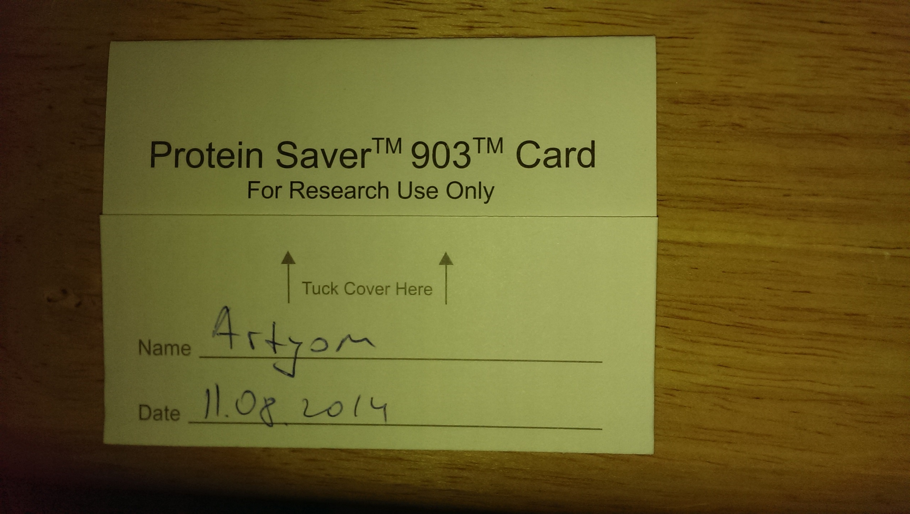
Notes:
To be honest I am not big fan of pricking myself
When I first encountered opportunity to do blood testing, I wondered why would I do that?
Curiosity?

Slide 10
2
Blood based Quantification of lifestyle changes
Meaningful insights about my lifestyle & health
Allows me to act upon
Personalized
Reliable / Reproducible
Convenient
Notes:
Insights – gives me a direction, raises awareness, helps me to achieve change. I want to be able to use it not only when I have a disease. Tweaking / improving versus fixing what is broken
Personalized – we are all different,
I am not interested in the exact number of molecules in my body, but I want to the results to be repeatable. I want the test to pick up change.
I wanted it to be accessible wheneve I need it.

Slide 11
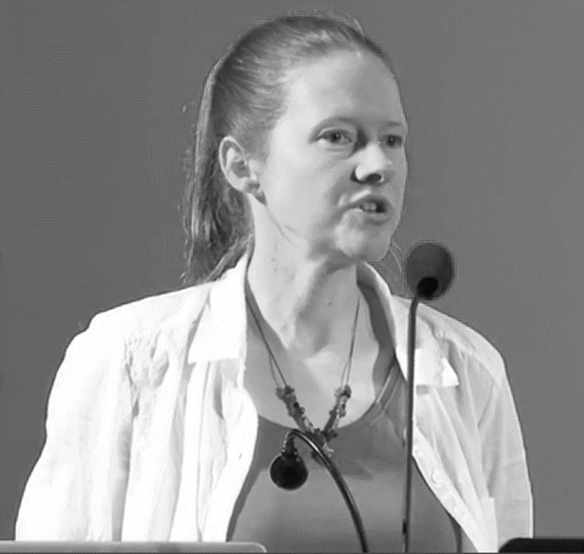
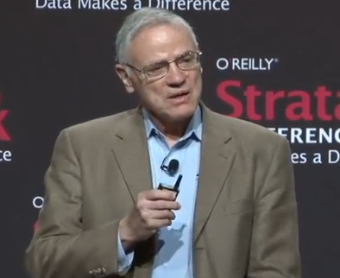
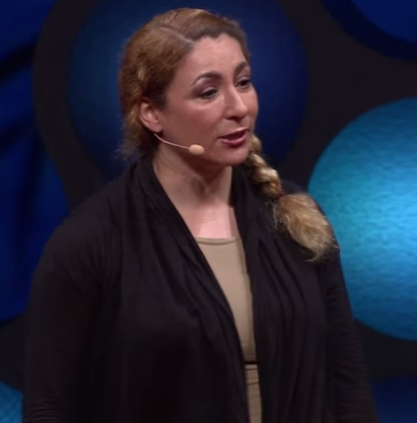
Meaningful insights about my lifestyle & health
A. Wright – The Tyranny of the Norm
L. Hood – Proactive medicine
J. Richman: Is science just for scientists?
„Healthy has a lot of shades“
„Systematic approach to biology“
„We can all make discoveries about health“
Notes:
Leeroy Hood - The Emergence of Proactive P4 Medicine: A Revolution in Healthcare
Anne Wright – The Tyranny of the Norm

Slide 12

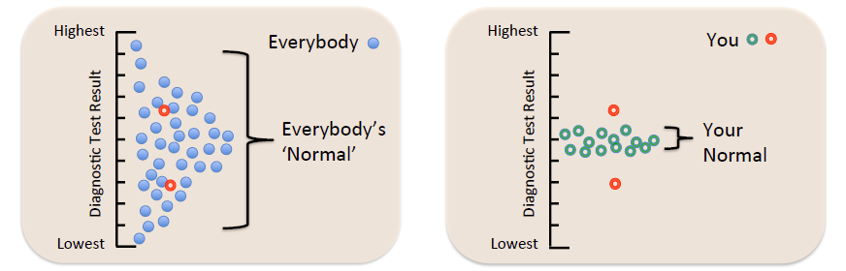
Personalized
* Source: SISCAPA assay technologies HUPO clinical day

Slide 13
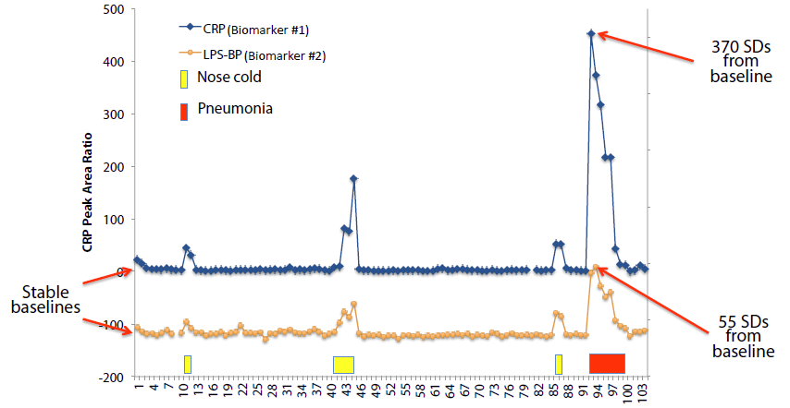
Personalized - Diagnostics
* Source: SISCAPA assay technologies HUPO clinical day

Slide 14
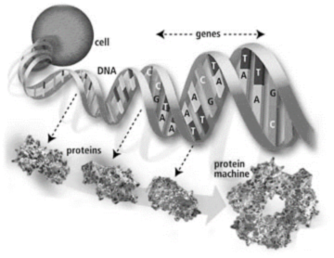
Personalized
50%
/
50%
Genes
Environment & Lifestyle
* Picture source: http://web.ornl.gov/
Notes:
Genomics it is just a list of ingredients (Applied Proteomics)
Genome tells what parts you have got in your body, but they need functional molecules (proteins) to carry out the job
School – transcription process, mRNA – ribosome, translation codon, protein
Genomics is fixed, like a library, which is passed on from generation to generation, and shows a family history. DNA is not influenced by the environment except in pathology when the environment induces mutations with usually a neutral but sometimes a negative outcome.
Proteins are dynamic, not passed on from the other generation and they react on the internal and external environment to adapt and survive. They are a read out of state. Therefore proteins change in abundance as a reaction to external cues, not only because of a pathology.

Slide 15

Personalized
Technical Median CV 15%
* Source: Biognosys 10th Sienna meeting from Genome to Proteome
Notes:
ApoA – libid binding and transportation. Apolipoprotein synthesis in the liver is controlled by a host of factors, including dietary composition Immunoglobulin kappa variable – participates in immune response

Slide 16
Proteins capture changes
Technical Median CV 15%
* Source: Biognosys 10th Sienna meeting from Genome to Proteome
Notes:
ApoB – lipid binding and transportation. Bad cholesterol
SHBG – sex hormone binding globulin (pregnancy indicator in this case). SHBG inhibits the function of for example testosterone

Slide 17
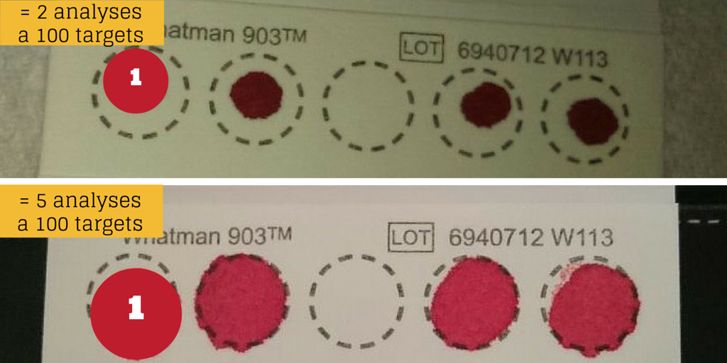
One drop tells it all
Notes:
Convenient – only one drop
Samples can be stored for up to 6 months in dried state

Slide 18
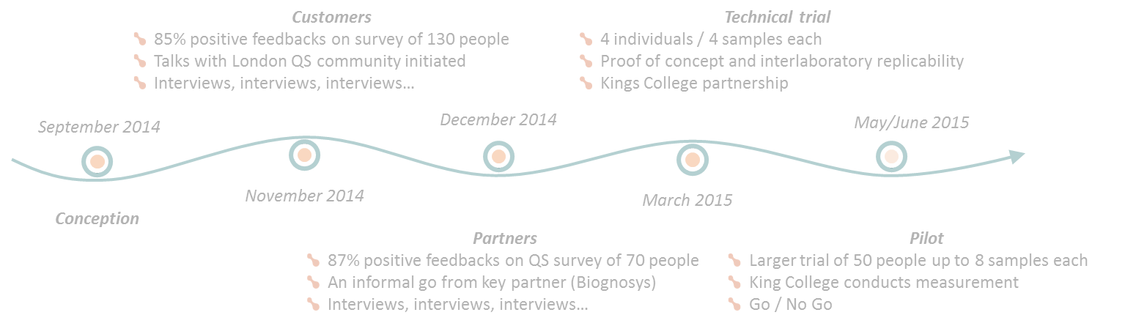
2
Our efforts

Slide 19



50 people - Pilot project May / June 2015
What do you get…
What we ask for…
Measurement of 100 proteins in KCL lab
All necessary material for handling samples
A list of relevant proteins for your project
Annotation of relevant proteins
A List of scientific and experimental papers
Correlation matrix for relevant proteins
Cost contribution of 60 GBP per sample (e.g. 240 GBP/4s)
6-8 weeks cardio related project (e.g. jogging)
Additionally metrics of intensity (e.g. own HR)
Sharing with us your fully anonymised data for research
Notes:
Absolute vs relative quantification

Slide 20
Some ideas for you…
Introduction of our trial
# people
# constraints (endurance)
Price
Key points on logistics (measured by KCL)
# of biomarkers
# additional options
50 participants max
6 people already signed up
4 or 8 samples package
Cycling – The Time Crunched Cyclist
Cardio related project
Mountaineering – Hiking Mount Everest
Currently self monitoring
Recreational Running

Slide 21
We love creative projects
Introduction of our trial
# people
# constraints (endurance)
Price
Key points on logistics (measured by KCL)
# of biomarkers
# additional options
“In a 2001 follow-on to the Queens University of Belfast study, researchers focused on cardiovascular health. Their finding? That by having sex three or more times a week, men reduced their risk of heart attack or stroke by half”.
Source: http://www.forbes.com/2003/10/08/cz_af_1008health.html

Slide 22
Introduction of our trial
# people
# constraints (endurance)
Price
Key points on logistics (measured by KCL)
# of biomarkers
# additional options
www.proteiq.com

Slide 23
Back-up

Slide 24

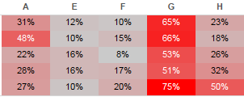
Cardio protein
Liver protein
Coefficients of
variation
Cardio protein
Liver protein
Cardio protein
G
Cardio protein
Liver protein
Month on month change
Cardio protein
Liver protein
Cardio protein
Notes:
The story I would get out of this is vague but it may be related to negative lifestyle choices affecting these proteins; perhaps taking up smoking, unhealthy eating, alcohol drinking (related to the liver proteins?), which may increase his risk of CVD or impact his immune system.

Slide 26
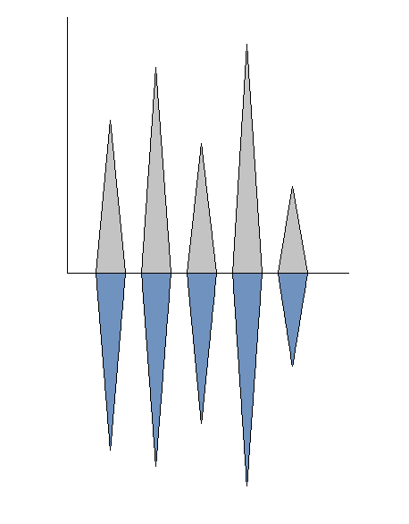
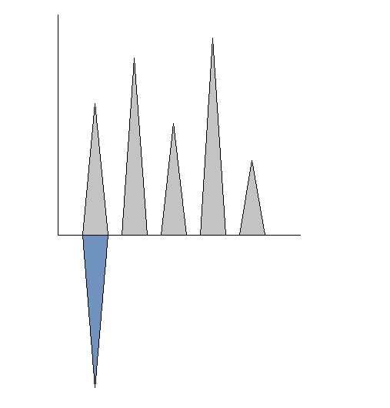
Absolute vs relative quantification
m/z
Absolute
m/z
Relative
100 Peptides
Quantify every peptides
+2500 Peptides
Quantify one peptide and use it as reference
Time
Time

