Slide 1
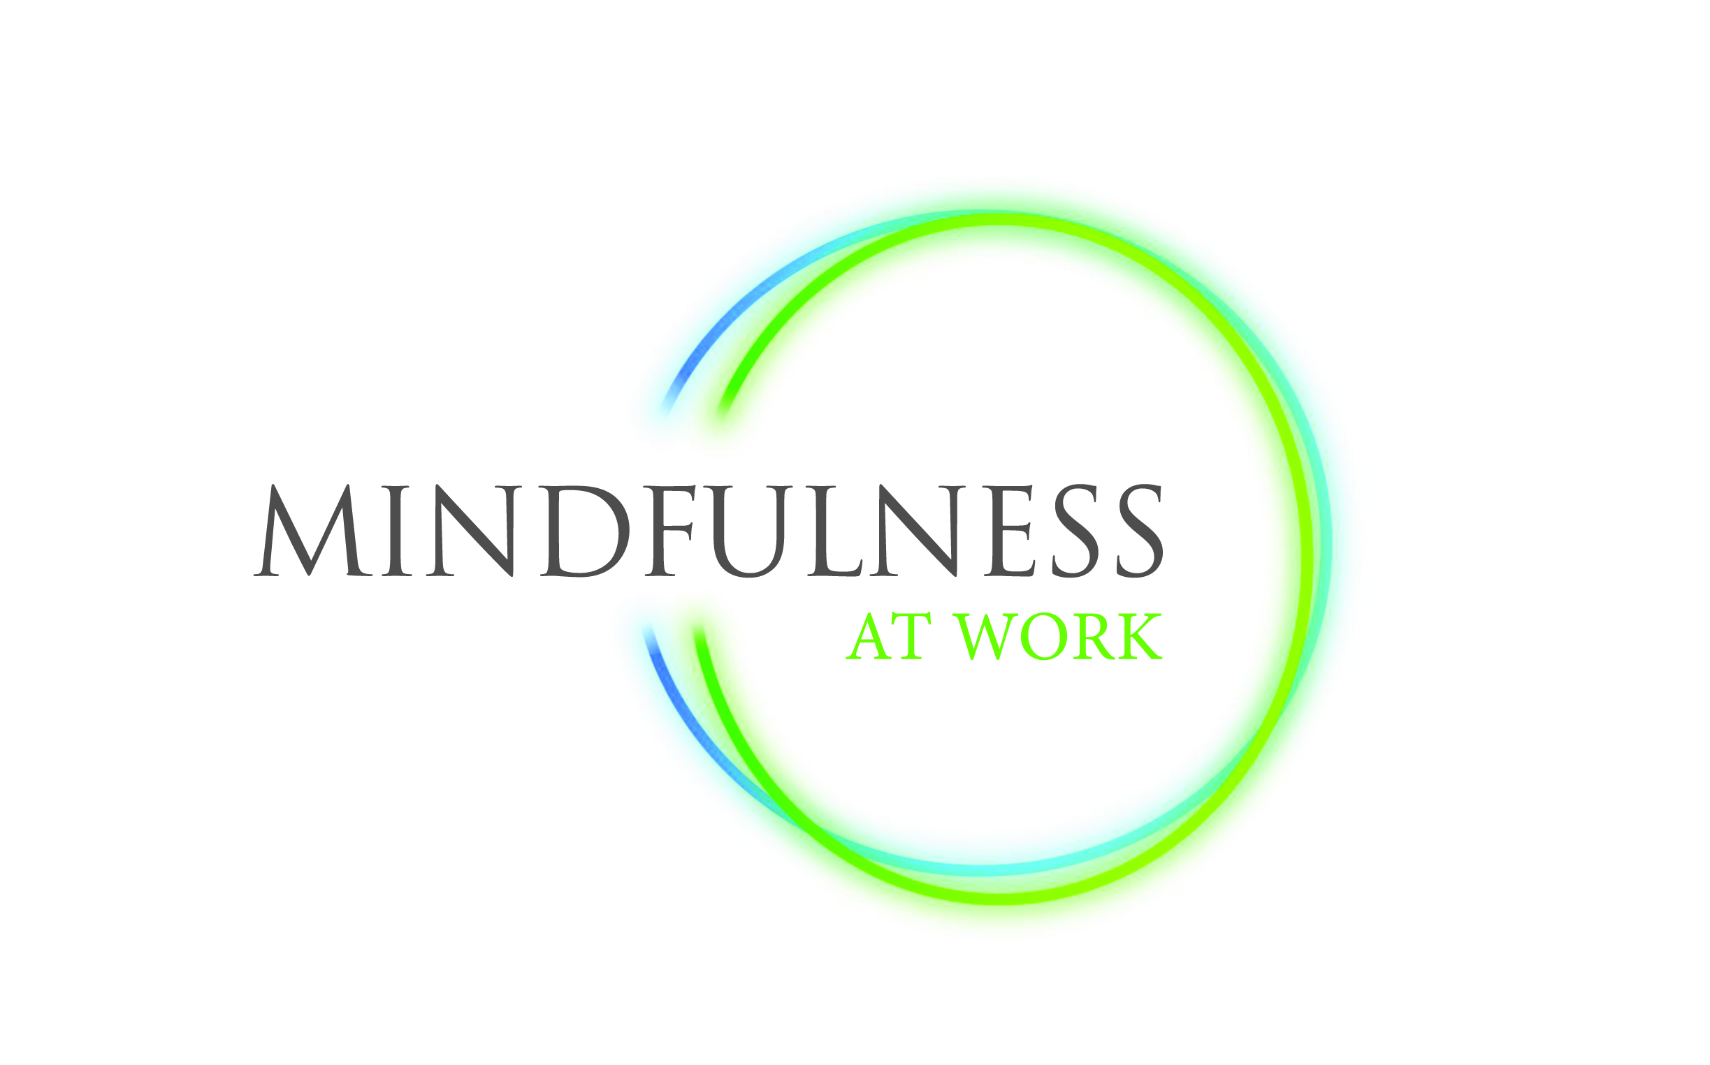
Tracking the impact of Mindfulness practice.

Slide 2
Nick Buckley
Doing
Mech Eng
Civil Service [DSS]
Web
BBC
Syzygy
Virgin
UpMyStreet
online Market Research
GfK NOP
Independent Consultant
50% authentic social media comms
50% Mindfulness training
Thinking
PhD Philosophy of Mind – perception & consciousness
Zen – theory & practice
Network effects and ‘emergent intelligence/awareness’
Communities & Neighbourhoods
CBT & self-hypnosis
Self logging
Mindfulness!!
Application in the workplace
Application to individual ‘purpose-based’ coaching.

Slide 3
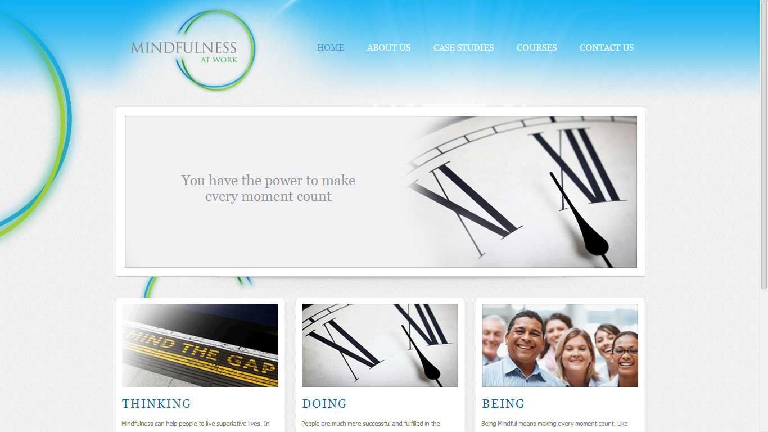
Mindfulness at Work
Founded 2010
http://mindfulnessatwork.com/
Speciality – provides group courses to enterprises as a ‘win-win’ employee benefit
Notes:
Working with organisations who are actively involved in the scientific evaluation of Mindfulness effects and benefits.
Mention Louise Cox Chester and The Retreat. [Our meeting some years previously]

Slide 4
What is Mindfulness?
It’s something you do - it has elements in common with meditation.
Mindfulness is a [secular] practice which cultivates your ability to pay attention, on purpose, to your experience of the present moment… without judging it.
It consists of ‘formal’ practices, for which you set aside time, and ‘informal’ practices which you can increasingly apply to the course of your daily life.
Informal practices including reminding yourself to look, however briefly, at your life and experience in a particular way.
The two types of practice nurture and inform each other.
Notes:
Ask who is already familiar or practicing.

Slide 5
Our Requirement
We want to give some tools to people who are learning and practising Mindfulness.
Some of these are to log practice, or provide resources. [Already use textual notes and audio recordings]
But primarily we want to develop ways of tracking the effects and benefits, in order to motivate and to create new means to ‘fine tune’ practice.

Slide 6
Stuff already out there?
Academic research projects – from diarising to brain scanning.
Apps for practice – content/tracking, some with tools for ‘awareness’ and background
iOS – dozens. Android 250+
Include Headspace, John Kabat-Zinn, MindApps
Mindfulness at Work uses SkillPill for simple audio and animated content delivery.
Notes:
NB Mindfulness is also being studies as a clinical intervention, including where used in combination with CBT

Slide 7
But…
We have seen nothing that tracks effects or benefits
Awareness prompting comes nearest
Also some Apps are associated with a specific change such as weight loss or pain management.
Notes:
‘By effects’ I mean changes – such as increased ability to separate an experience from thoughts about it, emotions arising and physical sensations… however briefly. These show a change is taking place. But they may not traditionally or universally be seen as a ‘benefit’ – i.e. a feel-good change.

Slide 8
So…
We’re looking to support three things for people that we train or continue to work with:
“Input” tracking
General well-being
Increased Mindfulness
Plus some kind of super-imposition of benefits on logged practice.
Notes:
I’ll - skip over input for now. Number of formal practices. Type of practice [body-scan, movement, breathing]. Maybe – noticed informal practices. [And maybe there is something interesting here about ‘catching’ yourself – in contrast to being reminded – so we could come to that. If any of you have been working with habits and habit change]

Slide 9
Generic Benefits
Reduced stress. Also impacts on:
Glucose levels and type II diabetes
Trunkal obesity
Heart disease
Improved immune system
Better decision-making, especially under pressure
Impact on specific stress response triggers & phobias
Impact on compulsive behaviour and negative habits
Better concentration
Reduced fatigue
Significant attenuation of the experience of chronic pain
Reduced inter-personal conflict
Raised empathy
Greater enjoyment of life – being “off-autopilot”
Positive mood shifting
Reduced recurrence of depression*
Notes:
* Mindfulness is often used ‘at clinical strength’ in combination with other therapies for depression such as CBT. [MBCBT MBSR]

Slide 10
Increased Mindfulness?
In some respects the practice is also the benefit. The former becomes the latter when it requires less conscious effort; when you ‘look back and notice’.
Characterisable?
An ability to pause and respond rather than react to events. [Not the same as resorting to ‘rational analysis’ of everything!]
An ability to create even a small separation between thoughts, emotions and physical sensations
Similarly to make a brief separation between ‘you’ and those thoughts, emotions or sensations
Noticing that you spend more time in the present moment – your experience of and responses to what is going on around you – rather than acting on autopilot whilst pre-occupied with past events or future events, including hypothetical ones.

Slide 11
Taxonomy for Mindful behaviours?
Non-judgement
Patience
Beginner’s Mind
Trust
Non-striving
Acceptance
Letting Go

Slide 12
Our main or initial goal?
Identify the easiest indicators of benefits – both direct and ‘proxy’ indicators – and establish these in a simple Version1.0 tracking application.
Help people to quantify or trend some of the improvements they are reaping. In particular to maintain motivation.
But also provide qualitative insights into the nature of the changes, which can also be taken back into an individual’s practice.
With permission, to aggregate data which will enable us to continuously improve our course, resources and support – also to make the case to B2B clients on behalf of their employees.
Notes:
May be fixed frequency. May not be fixed interval. May be combined with capture of practice.

Slide 13
Contact info and background
Dr Nick Buckley
nick@mindfulnessatwork.com
@grimbold
www.soshall.net
07958 516967
Mindfulness at Work http://mindfulnessatwork.com/
Mindfulness Centre. University of Oxford http://oxfordmindfulness.org/
Our recommended book for both understanding and self-conducted practice http://www.amazon.co.uk/Mindfulness-practical-guide-finding-frantic/dp/074995308X

