Slide 1
Cross Country Tracking
Pre-project Overview
Self-Hacking Nov '14

Slide 2
Wish List
We track today on Endomondo/ Android
"Hashers" running in the Chilterns
Download results as maps including route and elevation
I want to add heart rate (relates to Δelevation)
Retain data/ ability to download
Not have to switch 'phones

Slide 3
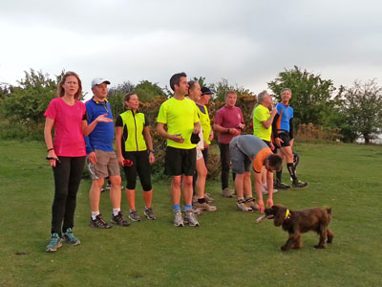
High Wycombe H3
(Drinkers with a Running Problem)

Slide 4
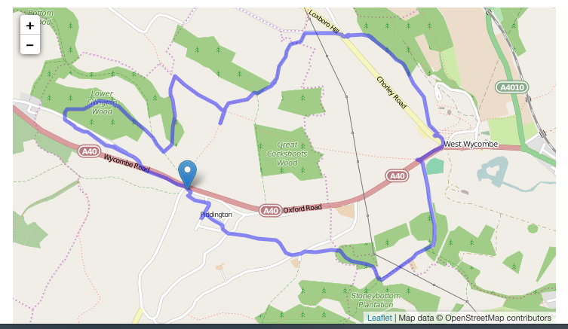

Slide 5
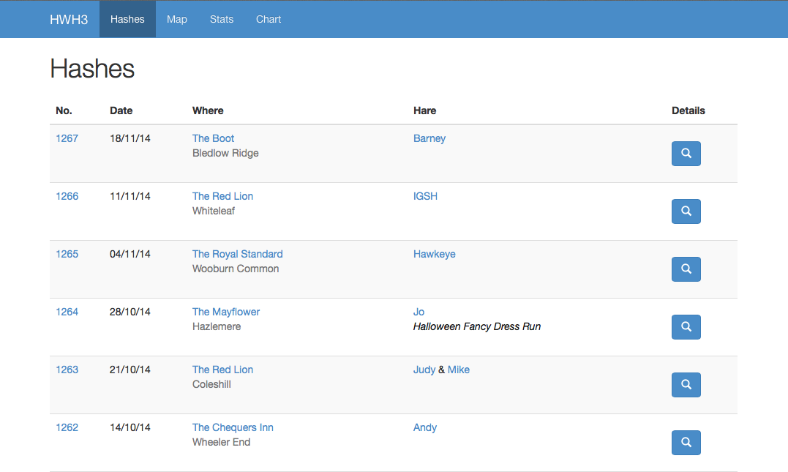

Slide 6
Opportunity
Much easier app development frameworks
Bluetooth SmartTM (open IoT connect)
Wahoo HR strap is one such device
Chance to own the data
Could automate updates etc.

Slide 7
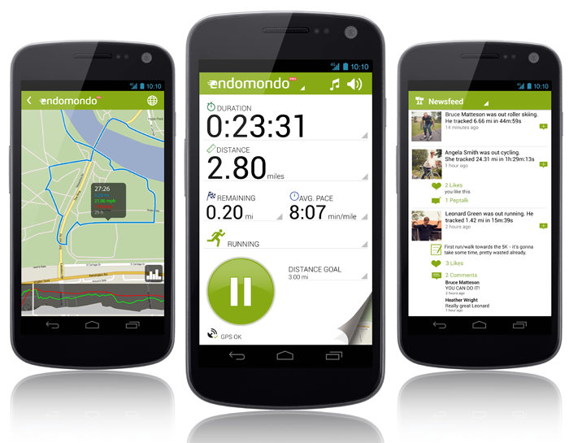
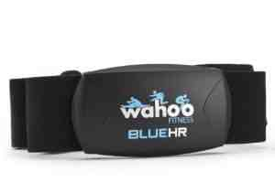
Look no Cables
+

Slide 8
Up/ Downsides
Work to do (as if we need more)
Need to get a grip on GPS accuracy issues
A fun new toy (mix in more sensors)
Open source approach will garner some help
A platform for other toys that are open
Data privacy

