Slide 1
“We Never Fight on Wednesdays!”
Mood management through reducing Upset Triggers

Slide 2
Environment
Hypothesis: “Happier if I train myself to react with less anxiety/anger in specific situations.”
Smart phone app capture and export to excel
33 weeks of data
723 entries

Slide 3
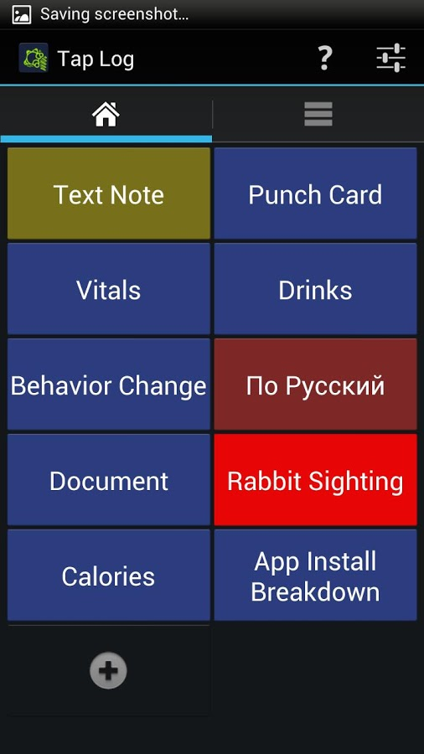
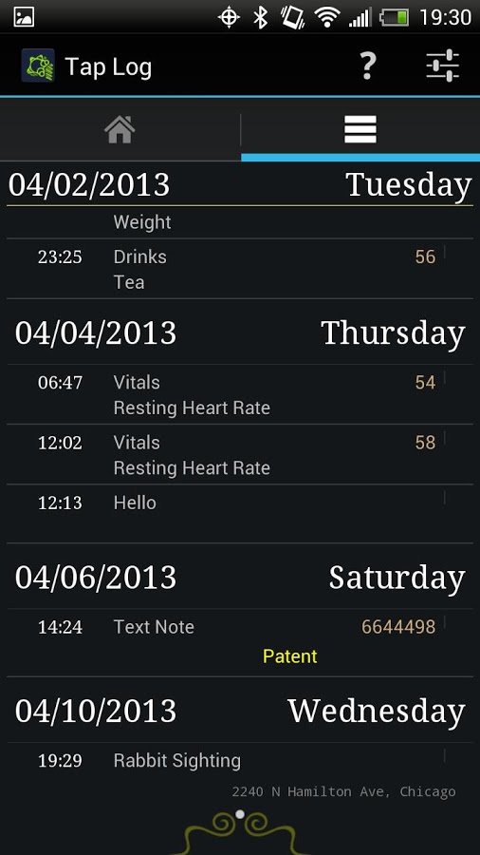
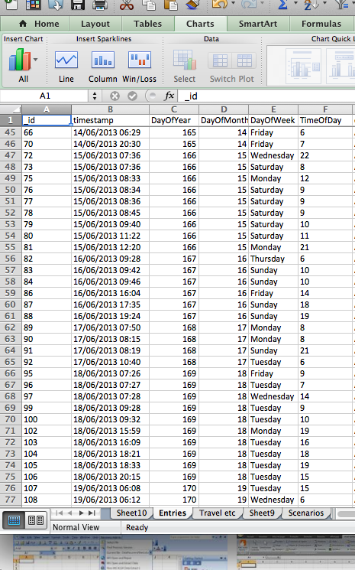
Mechanism

Slide 4
Log Entry Volume

Slide 5
Triggers in Total
26%
5%
5%
11%
14%
24%

Slide 6
Triggers - Wife

Slide 7
Triggers – Coworker by hour

Slide 8
Trend - Travel

Slide 9
Direct vs Self Induced

Slide 10
Direct/Self Induced Over Time

Slide 11
Followup Studies
Hypothesis: “Intensity of upsets is result of proximity to other upsets (ie in a bad mood).”
Hypothesis: “Training out of upset intensity takes a predictable number of interventions.”

