Slide 1
Financial tracking
2009 Financial
2010 Goals/Resolutions
2011 Food
2012 Amortization
2013 Activity: steps, sleeping, distance
2013 Food composition
2013 Health: bleeding, feeling, fibre, massage, stools
Rosa Delgado

Slide 2
Agenda
When
Why
How
Golden rules
Next steps

Slide 3
When
Started tracking personal finances back in 2009
The method has evolved and improved
Every month > every fortnight > every few days
From excel exports from the online bank account to manual input saving time and memory
The data shown is understood better

Slide 4
Why
Previous feelings and thoughts:
I’m spending too much in X
I don’t know where my money goes
I don’t earn enough to do Y
I would never be able to do Z
The shocking reality is:
I’m not spending that much in X but in Y
I have clear picture on my money
I define objectives and prioritize the expenditure accordingly

Slide 5
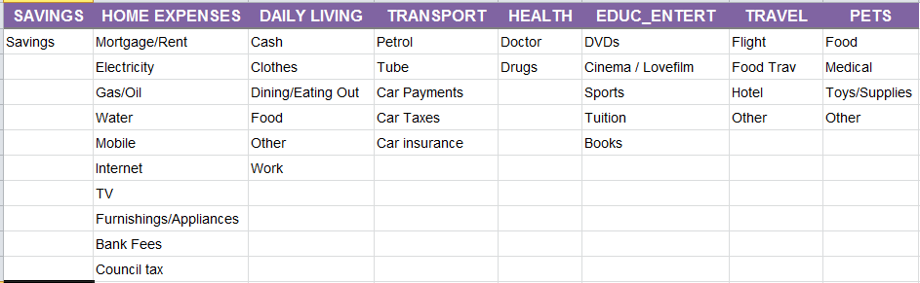
How do I use the tracking system
Set up my categories

Slide 6
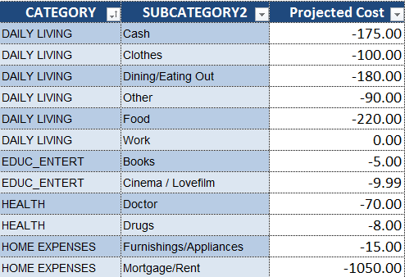
How do I use the tracking system
Set up Allowed expenditure for each category
Even for the fix expenditure (i.e. mortgage)

Slide 7
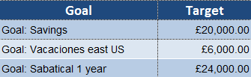
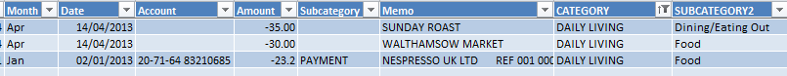
How do I use the tracking system
Set up my objectives and its associated cost
Start tracking

Slide 8
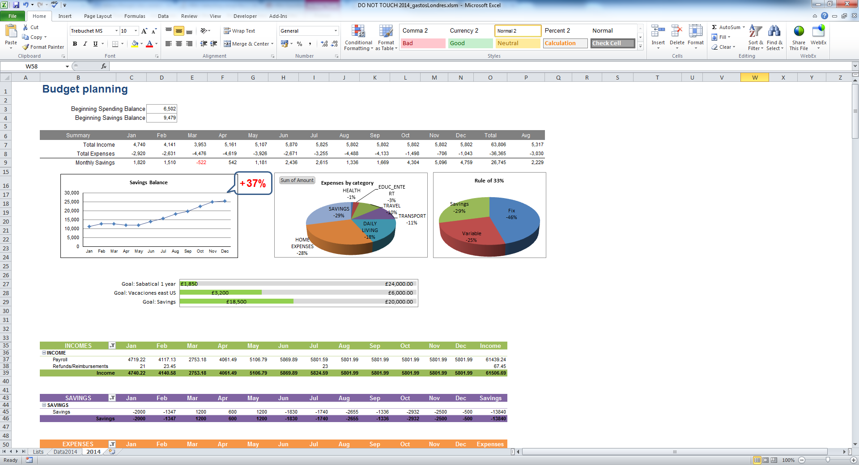
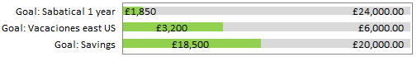
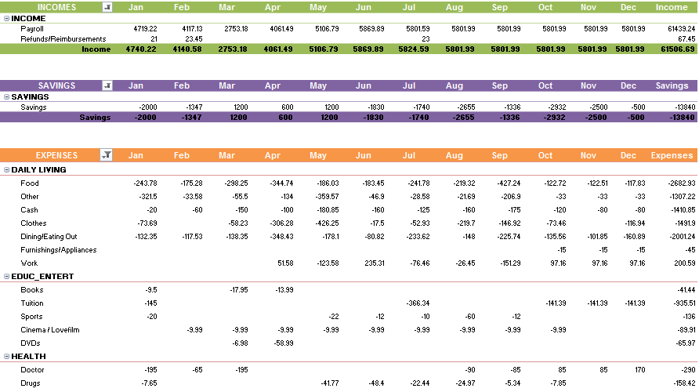
How do I use the tracking system
Analysing the data
>> Live demo

Slide 9
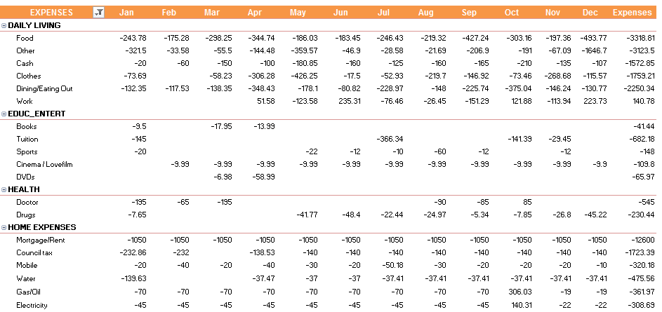
How do I use the tracking system
Analysing the data

Slide 10
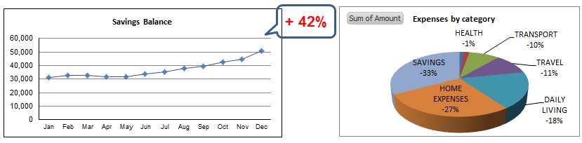

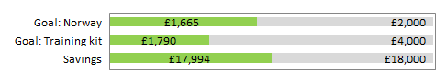
How do I use the tracking system
Analysing the data

Slide 11

Golden rules
Do not pay in cash whenever it´s possible
Believe what the data say
Do the tracking regularly
Set objectives that motivate you by importance
Check progress monthly
Reward yourself

Slide 12
Next steps
If you´d like to share your ideas,
If you´d like to improve your financial tracking or simply
to show me your method so I can improve mine,
Or just stay in contact
email: rosa.loncis@gmail.com
Blog: benefitsofphysicalactivity.net

