Slide 1

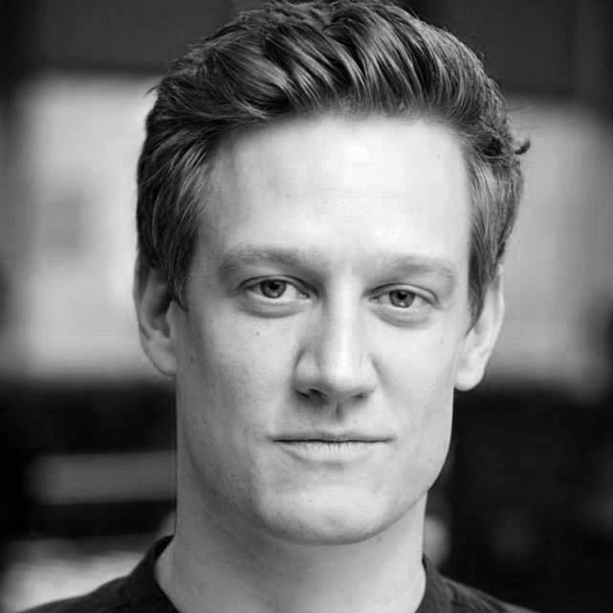
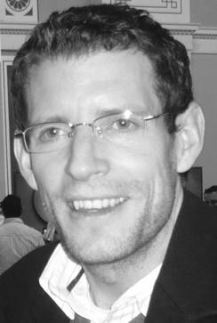
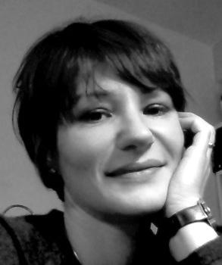

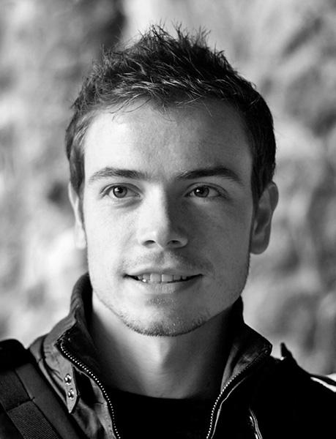
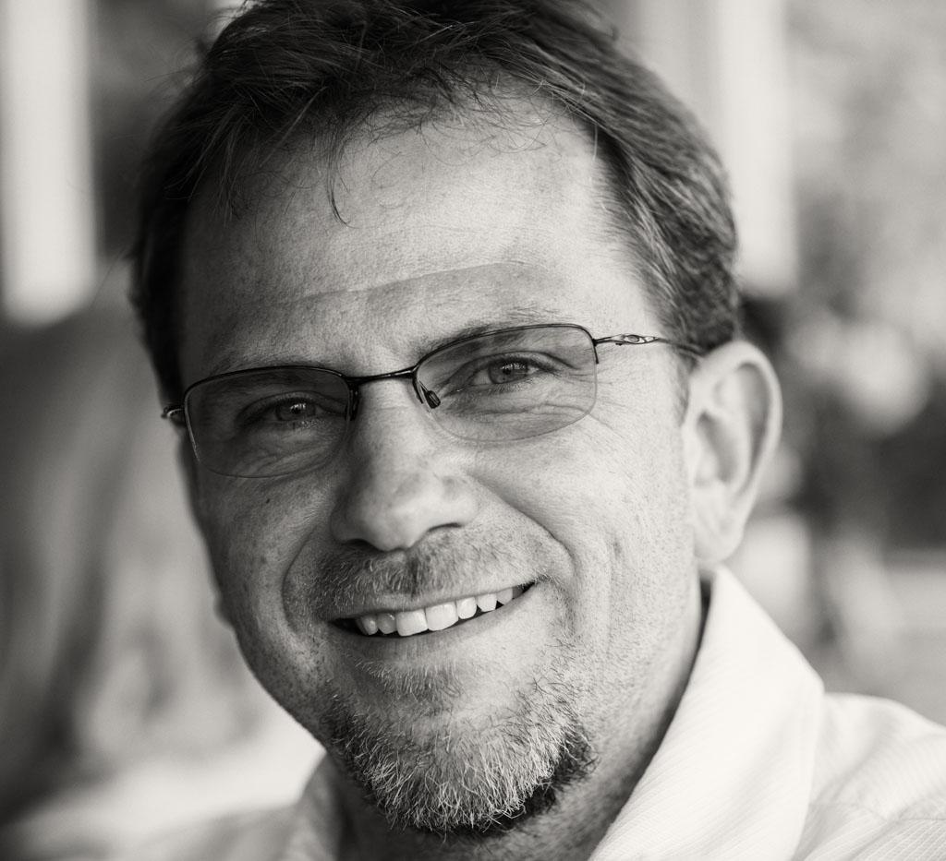
A survey of the uses in quantified self
Notes:
Arranged by Adriana, Colin, Farzana, Ken, Neil, Niels, Ollie, Paul, Rasmus, Ulrich

Slide 2
Why do a survey?
We estimate around 500 unique tools.
(Matches the 505 tools listed in the QS guide to self-tracking tools.)
having all the relevant data at my fingertips and being able to use it safely
What mobile device do you use?
iPhone / iOS | 52%
Android | 50%
Windows | 5.7%
Other | 4.7%
After my death definitely.

Slide 3
Overall top tools
Spreadsheet | 41%
Pen & Paper | 28%
Fitbit | 20%
MyFitnessPal | 16%
Moves | 14%
RunKeeper | 13%
Withings Scales | 13%
A total of 1452 tools were mentioned, that’s almost 14 per person.
An analog stronghold.
Surprising? But not really…
Notes:
https://docs.google.com/a/theodi.org/spreadsheet/pub?key=0Aia77oB33wA-dDNiaXFLeng0aVZmMlFYZVNSSEVkN0E&gid=1

Slide 4
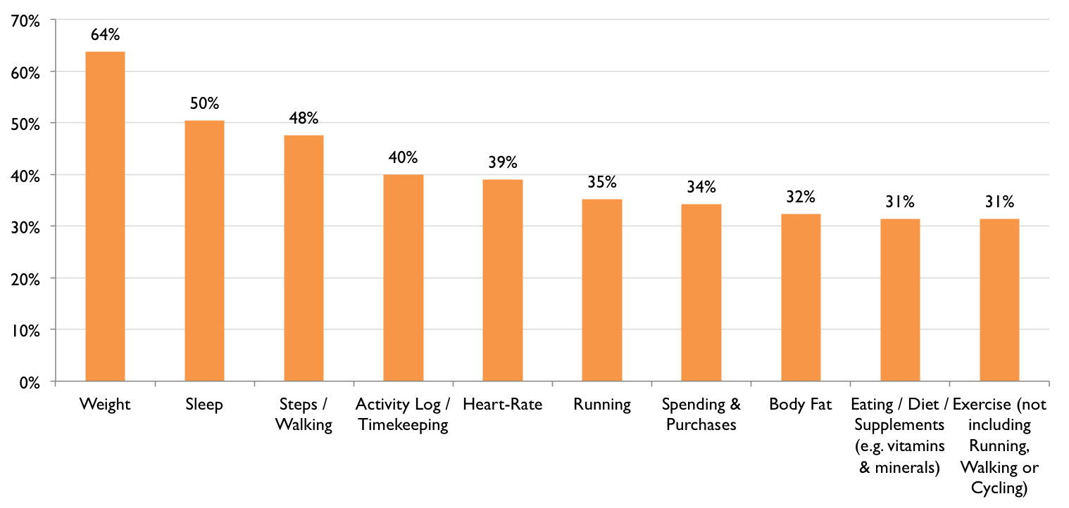
Here are the top ten!
Notes:
General health & wellbeing (1) 93 88.57%

Slide 5
Personas

Slide 6
Motivations: Do you have any particular motivation(s) for collecting personal data?
Answer | Count | Percentage of all
General health & wellbeing | 93 | 89%
Self-improvement | 82 | 78%
Curiosity | 70 | 67%
Self-knowledge | 70 | 67%
Productivity / skills development | 45 | 43%
Research | 33 | 31%
Specific health issue | 29 | 28%
Aid / encode memory | 17 | 16%
Other | 11 | 10%

Slide 7
Concerns: Do you have any major concerns regarding your QS activity & data?
Answer | Count | Percentage of all
Data Ownership (i.e. import/export of data & storing data) | 53 | 50%
Data Privacy (i.e. your data getting shared/used against your wishes) | 50 | 48%
Data Formats (i.e. open formats, data access, transferability) | 49 | 47%
Data Security (i.e. your data getting lost or stolen) | 40 | 38%
Commercial involvement (i.e. excessive exploitation/control) | 35 | 33%

Slide 8
Engagement
Number of data types collected or planning to collect
Length

Slide 9
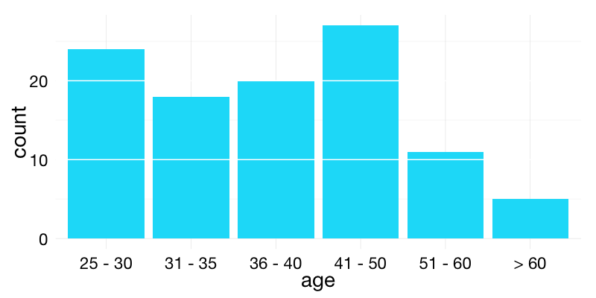
Attitudes and demographics
Openness
Skills
Gender
Age

Slide 10
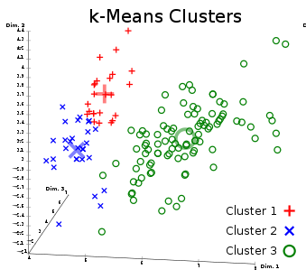
k-means clustering
Two problems:
How many clusters?
Are they robust?
http://en.wikipedia.org/wiki/File:Iris_Flowers_Clustering_kMeans.svg

Slide 11
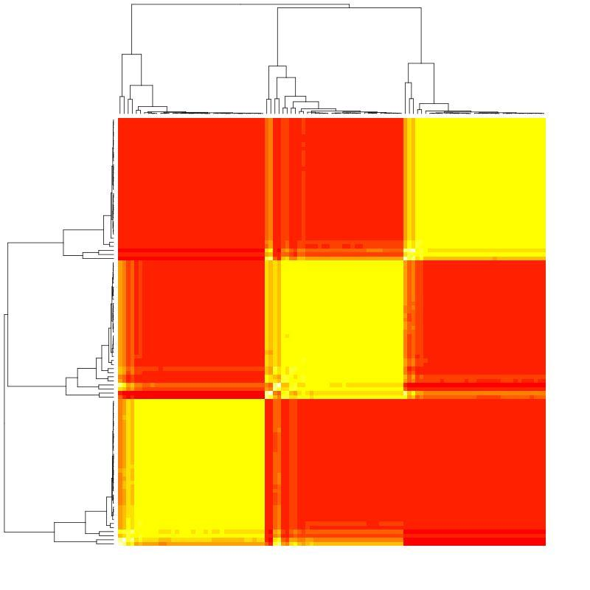
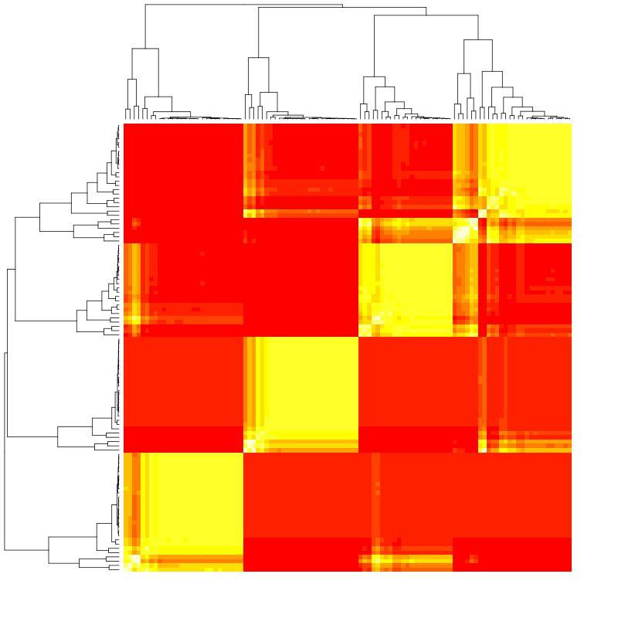
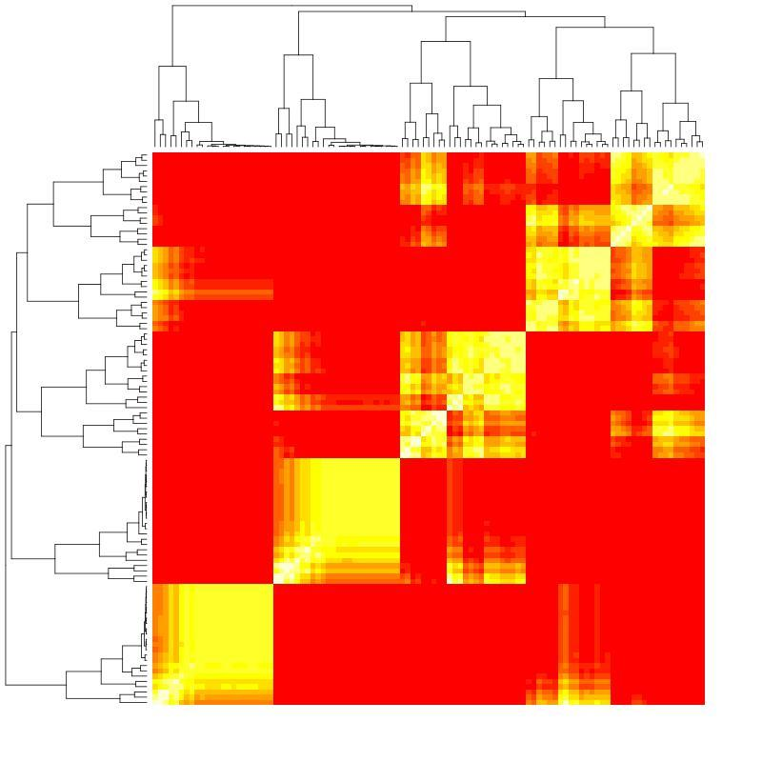
k-means consensus clustering

Slide 12
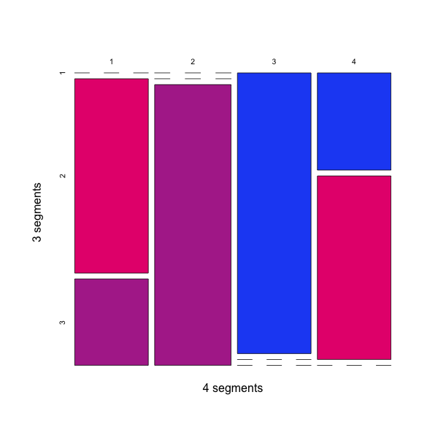
k-means consensus clustering

Slide 13
Perhaps 4 QS personas?
Group 1 | Group 2 | Group 4 | Group 4
 |  |  | Trackers
Productivity | Curiosity | General Health | Specific health
Android | Data privacy | Data privacy | Research
Data analysis | iPhone | Data formats | Self knowledge
Open to share | Visualisation/Design | Software development | Self improvement
 | Oldest |  | Youngest

Slide 14
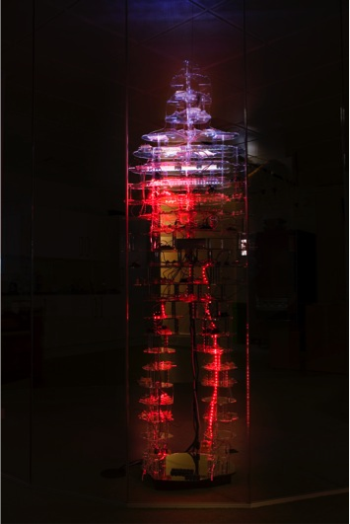
Questions?
Contact us
Adriana @adriana872
Ulrich @statshero

Slide 15
Appendix
Such data. Much slides.

Slide 16
 | Currently Collecting | Previously Collected | Plan to Collect in Future | Total Collected
Weight | 47% | 17% | 7% | 64%
Sleep | 31% | 19% | 17% | 50%
Steps / Walking | 35% | 12% | 3% | 48%
Activity Log / Timekeeping | 28% | 12% | 4% | 40%
Heart-Rate | 22% | 17% | 16% | 39%
Running | 28% | 8% | 4% | 35%
Spending & Purchases | 23% | 11% | 10% | 34%
Body Fat | 30% | 3% | 17% | 32%
Eating / Diet / Supplements (e.g. vitamins & minerals) | 18% | 13% | 15% | 31%
Exercise (not including Running, Walking or Cycling) | 19% | 12% | 8% | 31%

Slide 17
What are you measuring?
Physical (e.g. Blood Pressure, Weight, Sleep) | 84%
Emotional & Mental (e.g. Mood tracking, Happiness, Psychometrics) | 46%
Activity & Consumption (e.g. Exercise, Time, Diet, Travel, Email) | 83%
Money / Personal Finance (e.g. Income, Spending) | 50%
Social (e.g. Meetings, Facebook Use) | 21%

