Slide 1
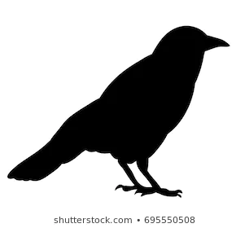
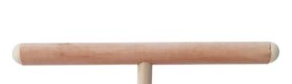
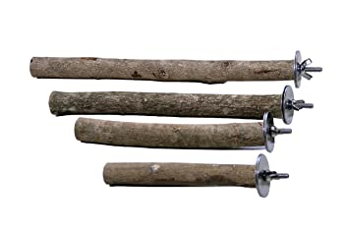
Back
Start Position
Left Choice
Right Choice
Front
Notes:
10 birds to the room and the apparatus and checking for side-bias we offered them every factorial pair from 1 to 6 10 times each. Resulting in 1200 data points of pairs to assess. I have a video of a trail that I am going to paly for you. It is only 20 sec long but is helpful is understanding how our trials are set up.
T
The video did a good job of showing how an exp trial ran and how the birds ate but I wanted to qickly be a little more explicit about how we trained and noted a “choice” by the bird.
(explain how this works quickly and move on)
Rearranged this and 6. less is more. Landing on 1 singles choice and gets the reward.

