Slide 1
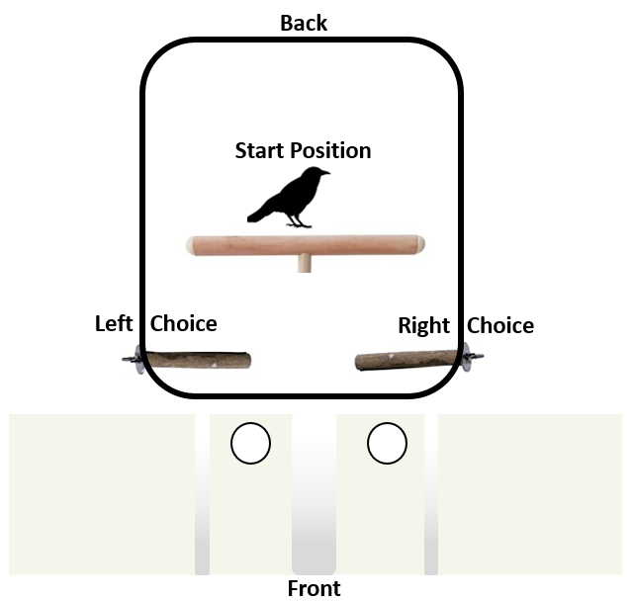
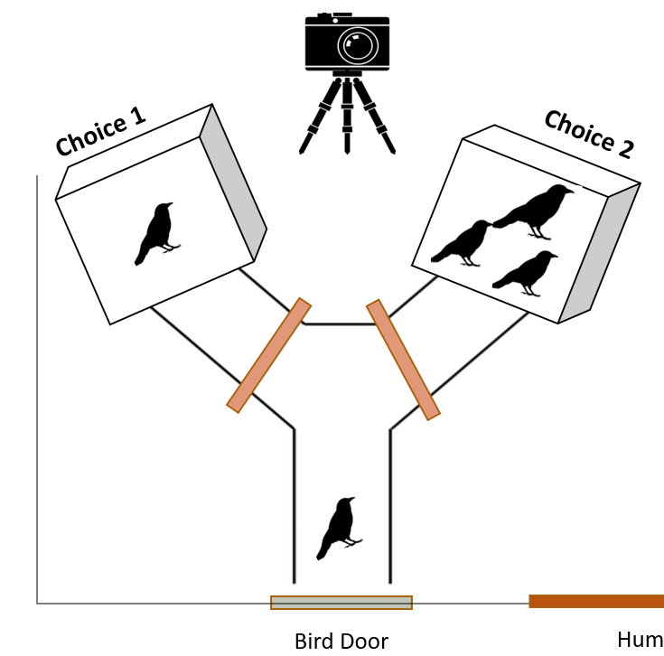

Slide 2
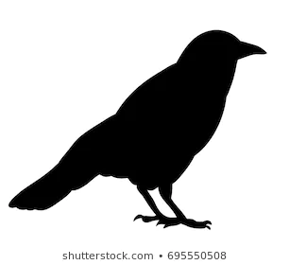
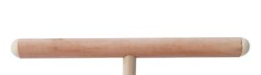
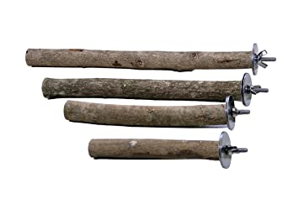
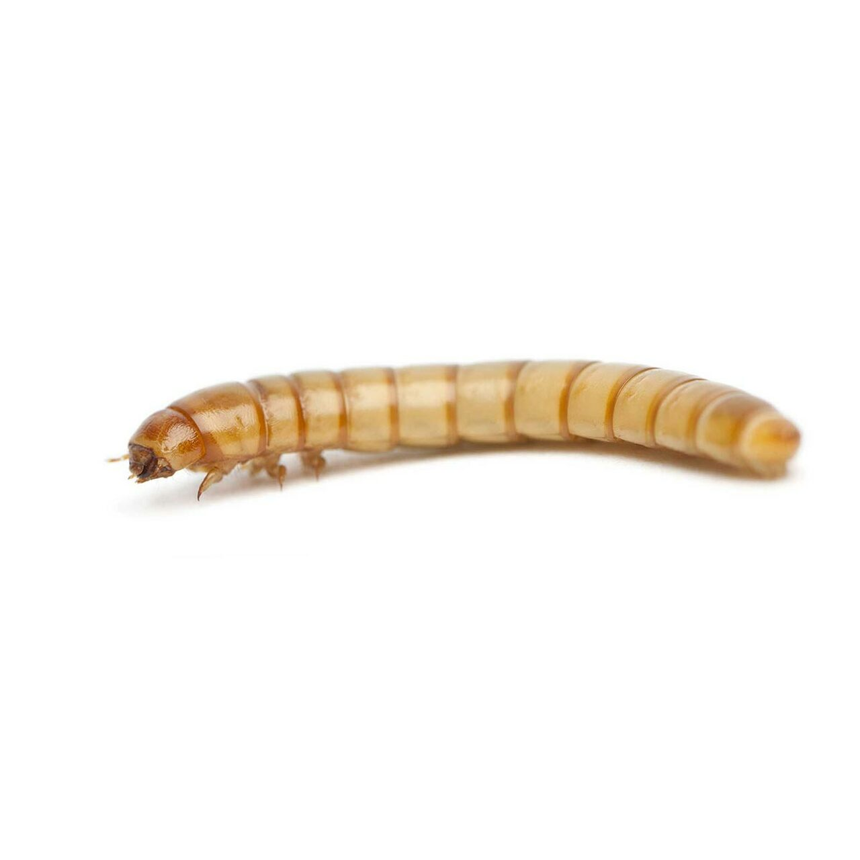
Start Position
Left Choice
Right Choice
Notes:
10 birds to the room and the apparatus and checking for side-bias we offered them every factorial pair from 1 to 6 10 times each. Resulting in 1200 data points of pairs to assess. I have a video of a trail that I am going to paly for you. It is only 20 sec long but is helpful is understanding how our trials are set up.
T
The video did a good job of showing how an exp trial ran and how the birds ate but I wanted to qickly be a little more explicit about how we trained and noted a “choice” by the bird.
(explain how this works quickly and move on)
Rearranged this and 6. less is more. Landing on 1 singles choice and gets the reward.

Slide 3

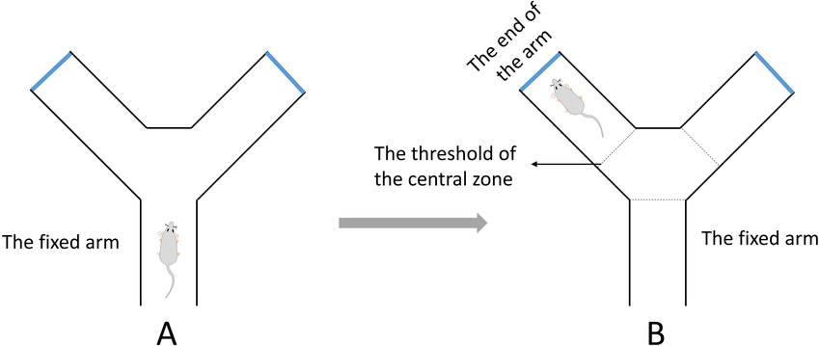
Choice 1
Choice 2
Bird Door
Notes:
Below you will see a diagram of our experimental set up.
y = binary choice per individual bird of smaller vs larger option
Smaller = “0”
Larger = “1”
Ratio’s were coded as small_num/ large_num with 0s being counted as 0.1 of a bird. “Determined by”
Difference was counted as large_num - small_num

Slide 4
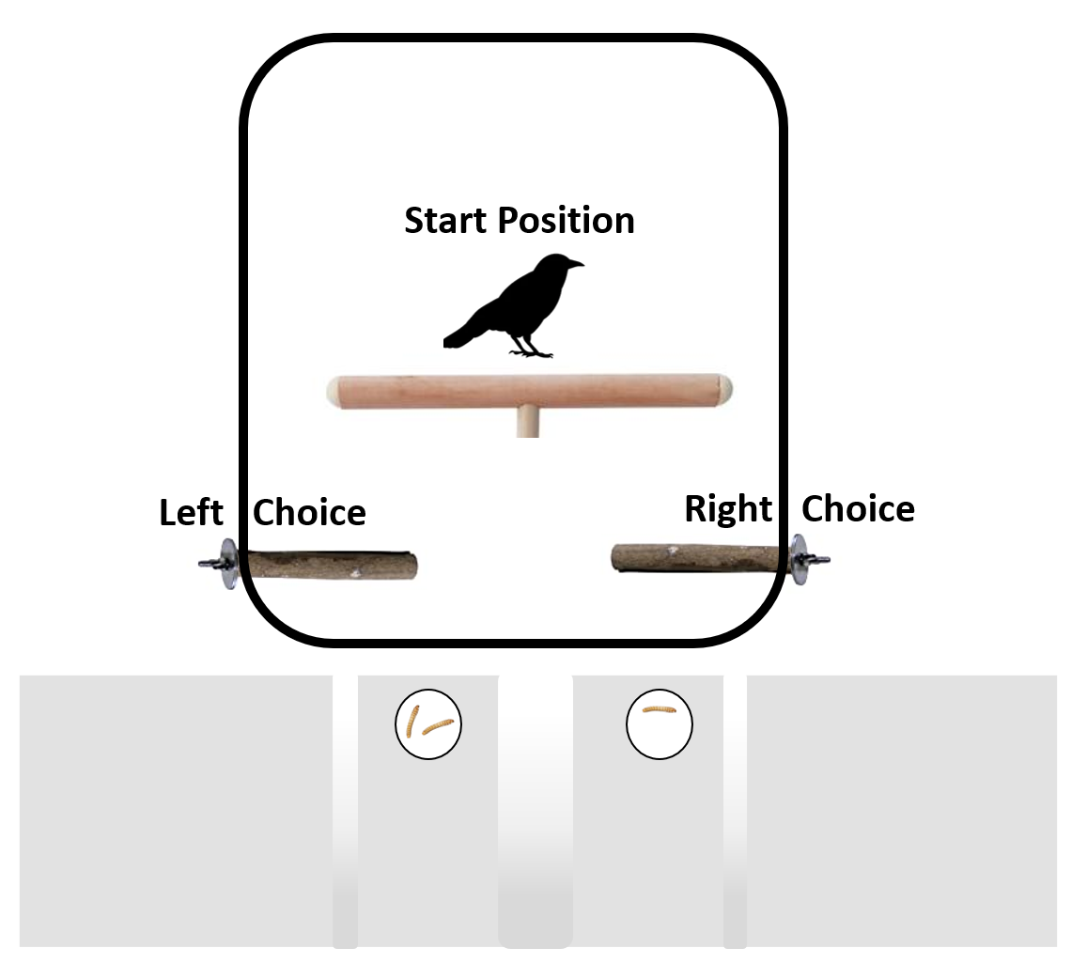
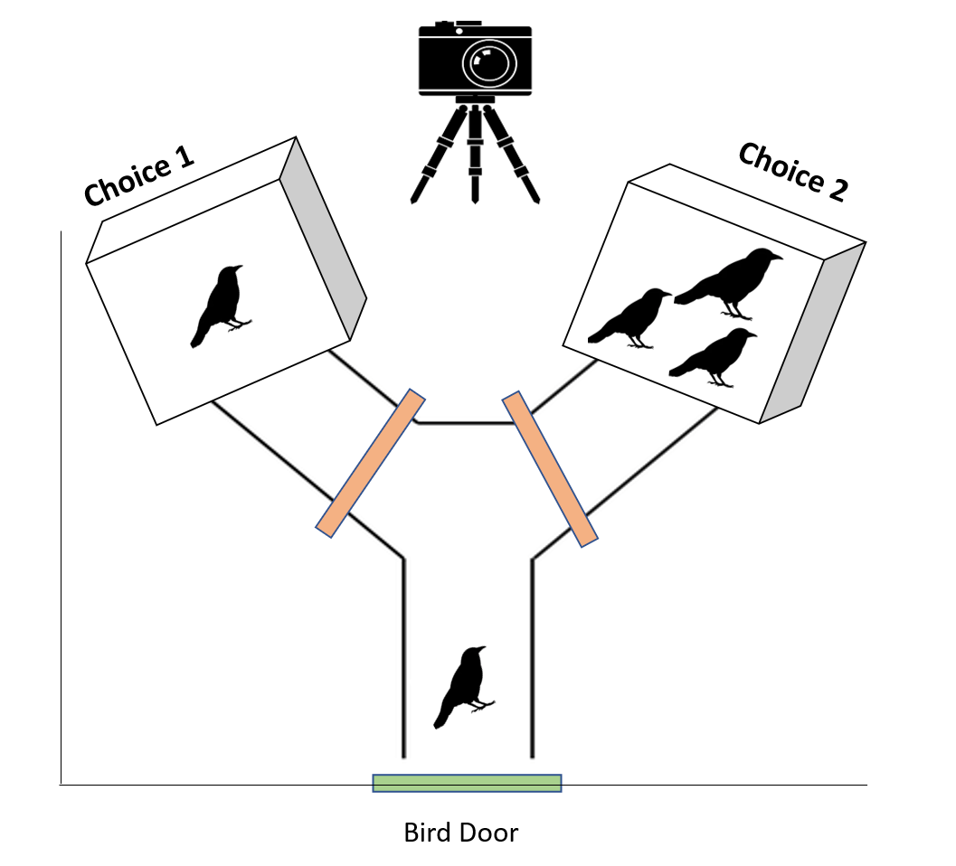
A) Food Experiment Apparatus
B) Social Experiment Apparatus

