Slide 1
Stopping Intruders Using a Wireless Honeypot to Track Hackers
Presented by Timber Wolfe
The Hacker Academy
lonegray@gmail.com
www.HackerAcademy.com

Slide 2
How to protect networks with wireless devices (802.xx/Zigbee/etc...)
This presentation is about a specific implementation of a methodology. The point here is to promote thinking about how to use this kind of thinking to secure all types of wireless networks on all types of platforms. Once an attacker is on the LAN all of the egress point protections are averted.

Slide 3
romanHunter (ROuter huMAN Hunter)
romanHunter is a system requiring a Netgear WG602Vx wireless access point and a device that can run python scripts
Will collect a set of MAC addresses for use as a data stream for MAC black listing
Think outside of the box, this methodology can be applied to any wireless router

Slide 4
Reverse Engineering the Router (WG602v4 Screen Shots)
Stations descriptions how this router works
No Stations Listed
Associations (wireless attempted connections)
Authorizations (wireless password accepted)
HTTPScoop (Reverse Engineering the Conversation)
URLs of Interest
http://192.168.0.227/cgi-bin/stalist.html (where the MAC addresses come from)
http://192.168.0.227/cgi-bin/security.html (Where the security settings are performed)
Notes:
Additional pages of interest
1 Download the firmware (automate MD5 or Whirlpool Hash checking). This would assure the firmware was not modified by someone with a momentary connection
2

Slide 5
WG602v4 Defaults and Notes
Default IP: http://192.168.0.227
Default Username: admin
Default PW: password
Notes:
Additional pages of interest
1 Download the firmware (automate MD5 or Whirlpool Hash checking). This would assure the firmware was not modified by someone with a momentary connection
2

Slide 6
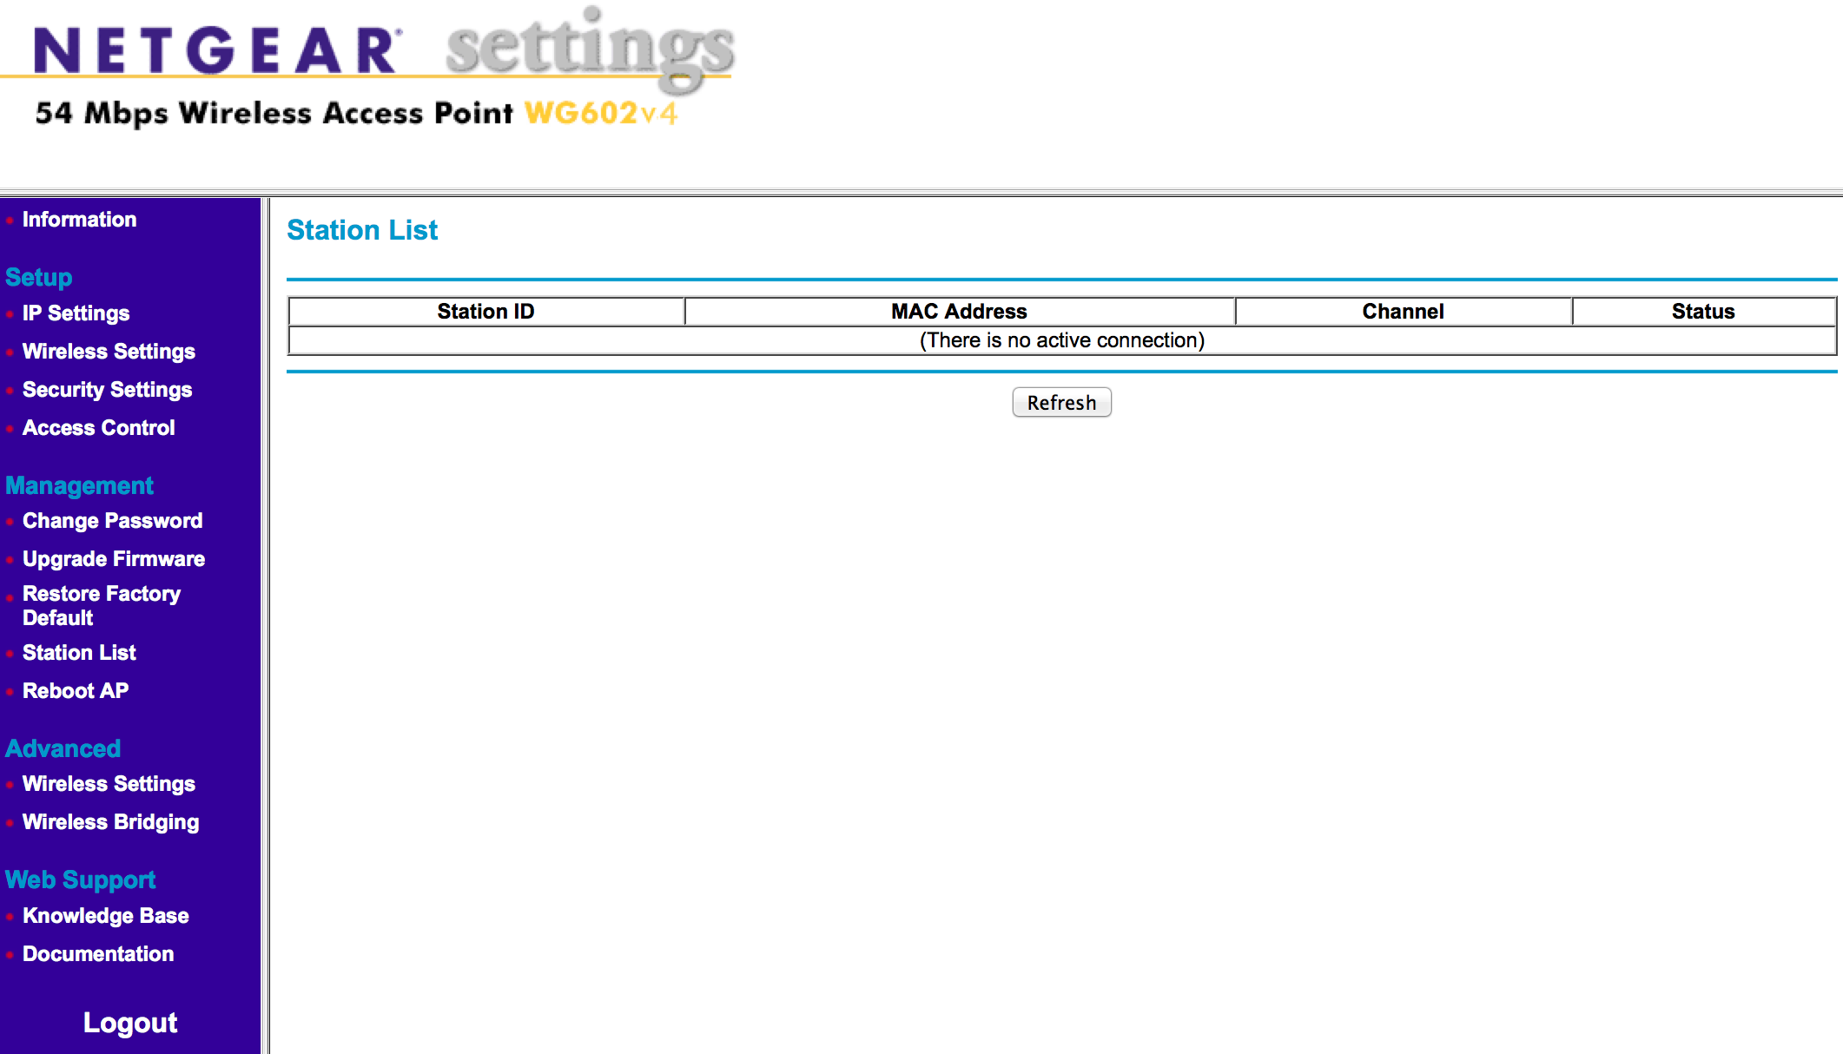
No Stations Listed

Slide 7
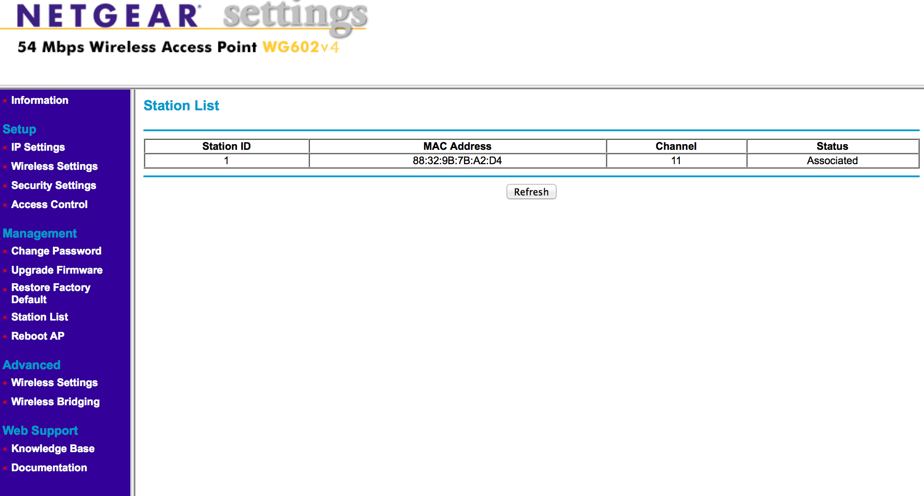
Associations

Slide 8
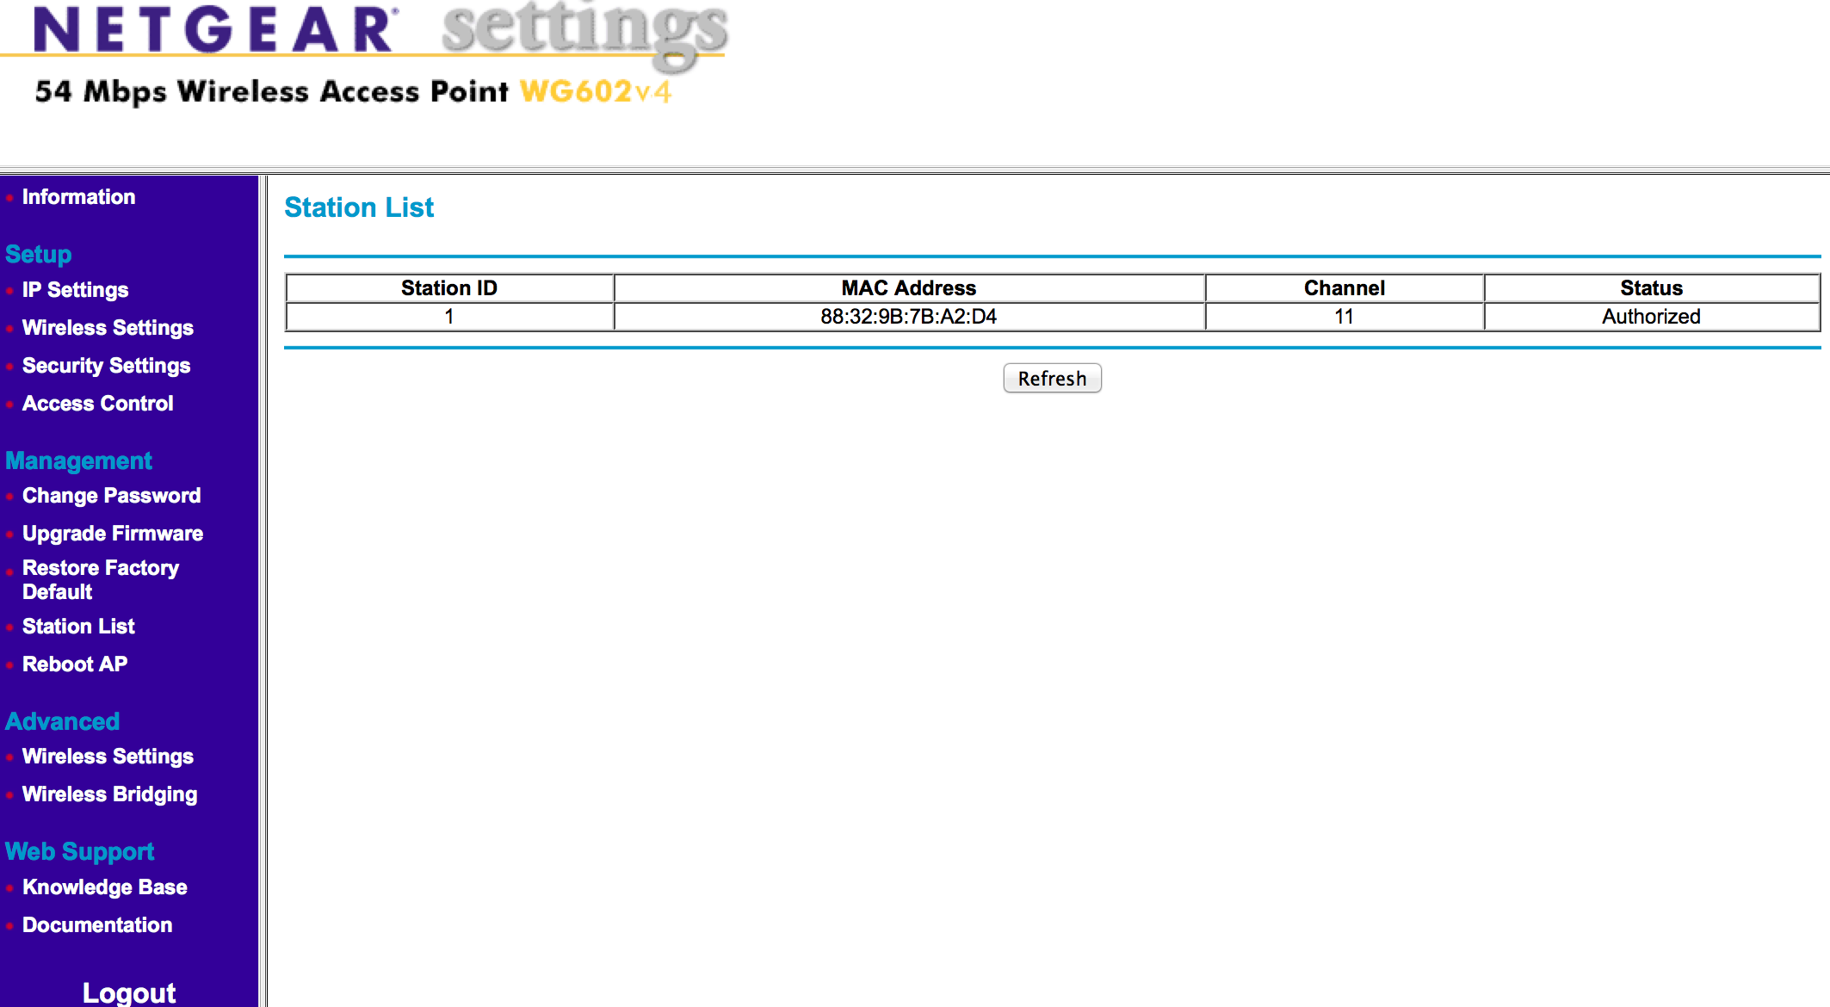
Authorizations

Slide 9
HTTPScoop Screenshots
Reverse engineering the router protocol with the client

Slide 10
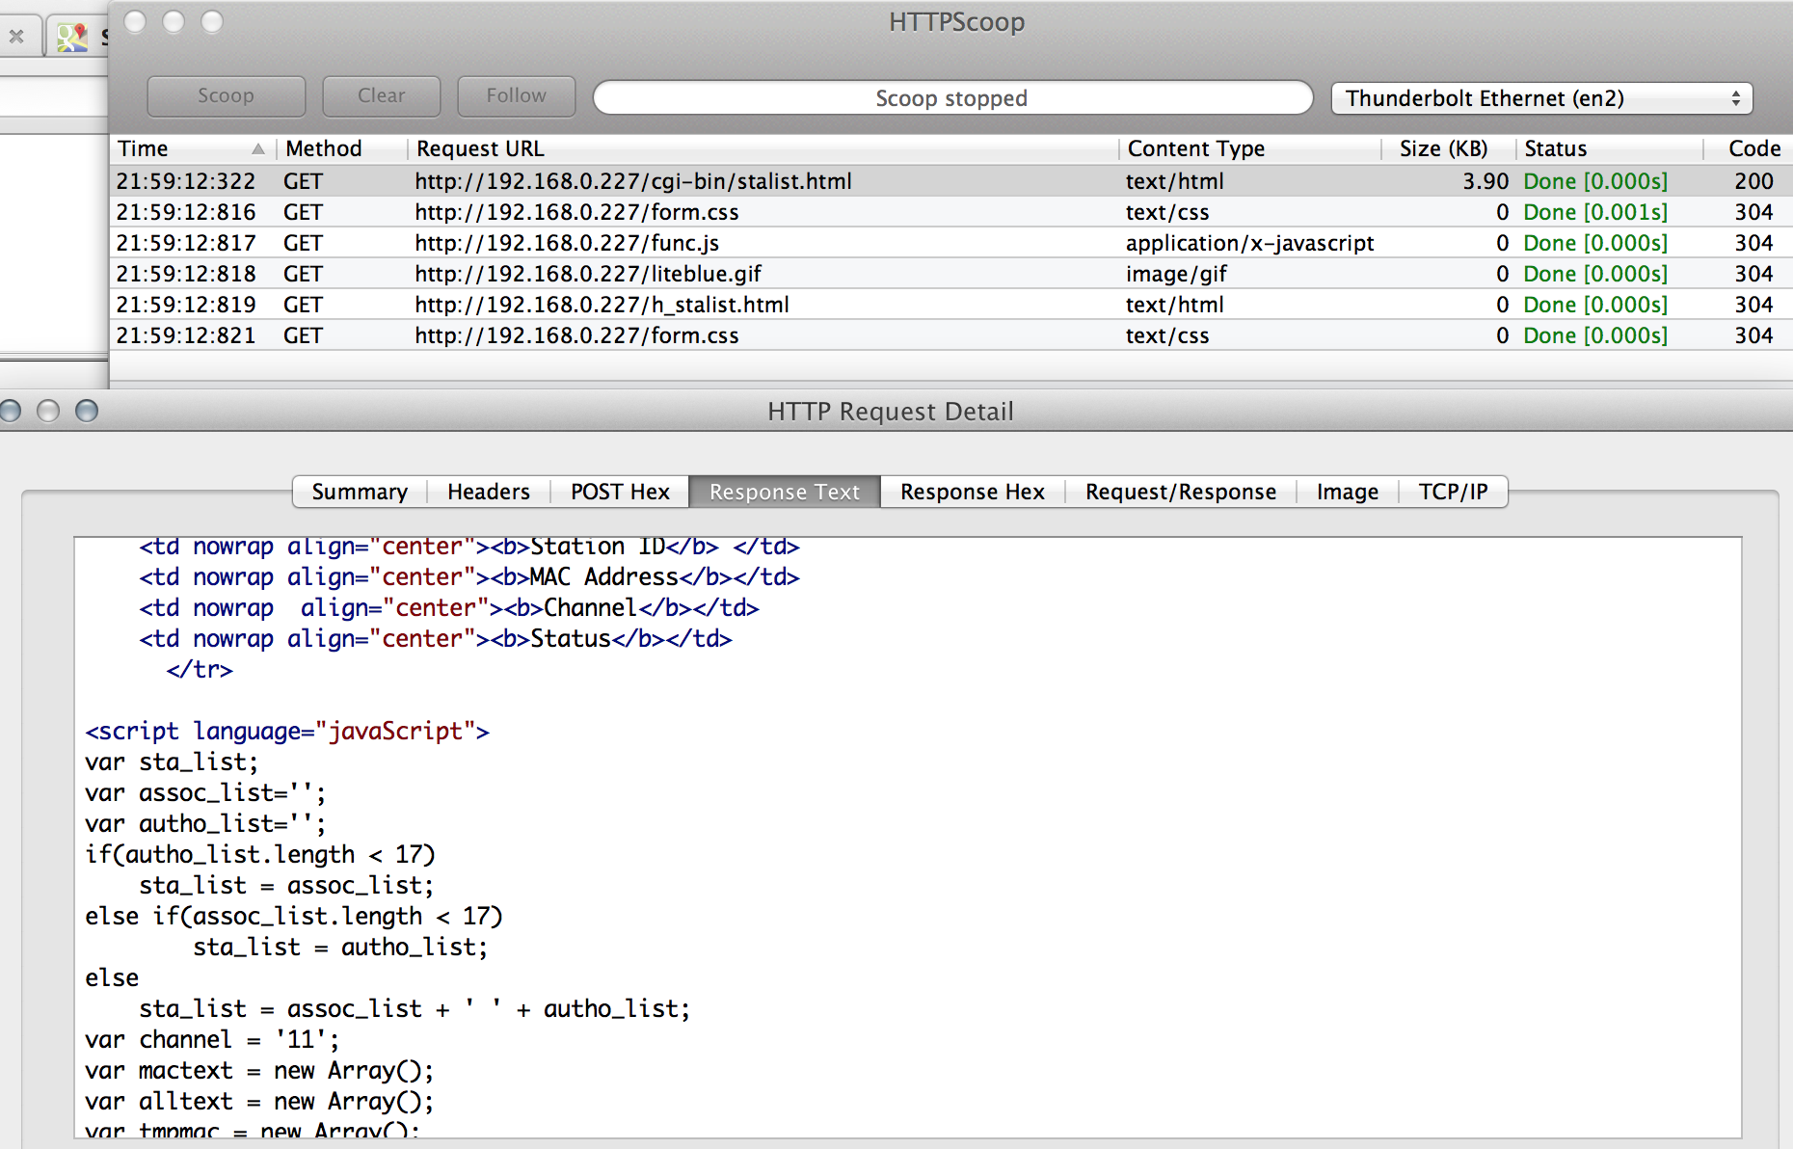
Viewing the Existing Connections on the Router
Notes:
Double clicking on the stalist.html line will bring up the details window.
Note the variable names in the response text on the statlist.html URL.
The variables of interest are:
1 var assoc_list=''
2 var autho_list=''
If there are either type of connection, they would be listed here.
NOTE: This python script does NOT check for more than one concurrent connection currently. While testing, no situation occurred where more than one simultaneous connections were listed on this page. Even under load testing.

Slide 11
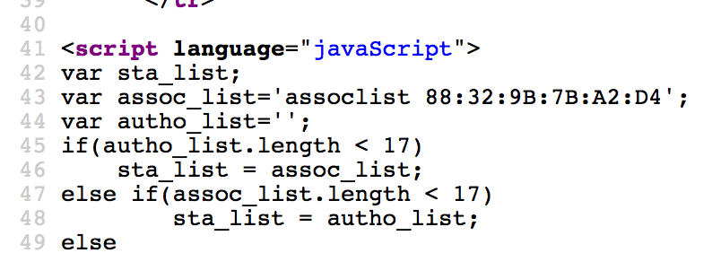
An Association
An association is an attempted connection that did not get authorized.
The red arrow denotes the associated MAC address.

Slide 12
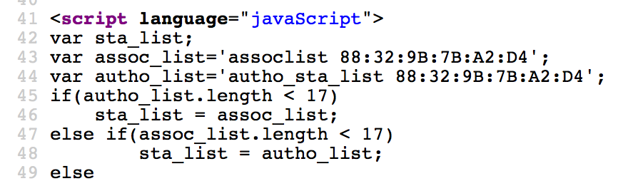
An Authorization
An authorization is a MAC that will be displayed when that user has entered the correct password.
The red arrow denotes the authorized MAC address.
An authorized MAC is also associated.
Notes:
An authorized MAC address is also associated.
Understanding this is important. This is the information that will be used in the regular expression (a search string) to locate the line to parse and begin looking for MAC addresses.

Slide 13
An Authorization
An authorization is a MAC that will be displayed when that user has entered the correct password.
The red arrow denotes the authorized MAC address.
An authorized MAC is also associated.
Notes:
An authorized MAC address is also associated.
Understanding this is important. This is the information that will be used in the regular expression (a search string) to locate the line to parse and begin looking for MAC addresses.

Slide 14
Changing the Wireless PW on the Router
To change the PW on this router several variables must be submitted to the wpas.html page.
setobject_secuirty_type=4
setobject_wpapskPhrase=TheNewPassword
If WEP is enabled the variables required must be scooped. This ONLY applies when WPA is in use.
Also, keep in mind that realm security is used. Each page must include that realm token in each request for it to be accepted.
Notes:
Post Data from HTTPScoop:
setobject_security_type=4&setobject_wpaspskPhrase=timberwolfe
The REALM token can be found in every header of every single request for this router. Some devices may have a more complex security model. All of this information can be obtained via HTTPScoop.
Note: HTTPScoop will be unable to see HTTPS traffic. You must be able to communicate w/the router over http (port 80). There are protocol scrapers that can be used on port 443 (HTTPS).

Slide 15
Roman Hunter Overview File Structure
romanHunterv3C.py (Python Script)
romanHunterv3.txt (Logging File)
pw_list.txt (File containing the list of passwords to use)

Slide 16
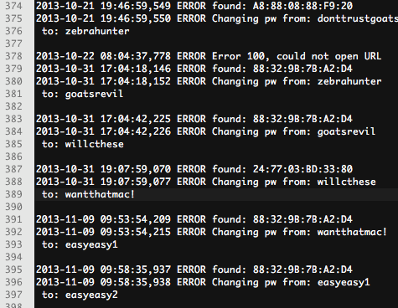
romanHunterv3.txt Sample
Notes:
This file is not monitored in this version of romanHunter for unlimited growth. Log rotation could be used or simply monitor for file size and disk space accordingly.
If the PW state is ever lost I can be recovered here or just change it on the router to whatever you like. If the romanHunter finds a PW it does not recognize it will start over from the beginning of the list.

Slide 17
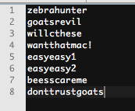
pw_list.txt Sample
Notes:
This file will be used in a round robin fashion
The PW's should be crafted with care, not too complex, not too simple.
The attacker will see the names prior to attempting to use them. Do not give away the trap prior to the attacker using the PW's they have cracked.

Slide 18
romanHunter Screen Shots
The following screenshots illustrate the romanHunter in action.

Slide 19
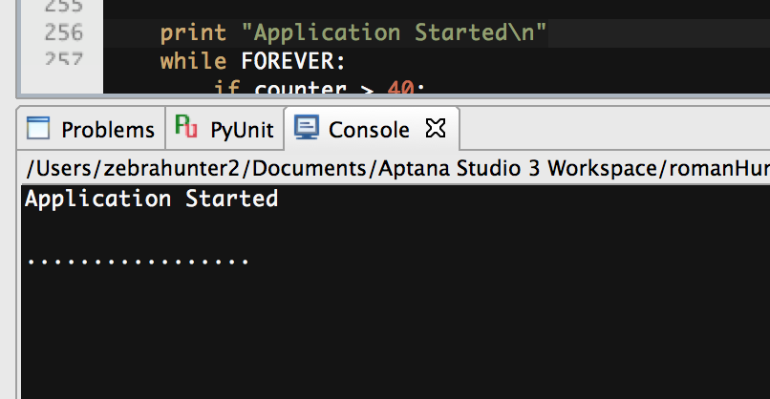
Idle, illustrating the heartbeat signal
Note the dots, they illustrate the heartbeat signal. This denotes the scripts is running and is not monitoring any activity.
It is critical to know the Python script monitoring one or more honeypots is not locked up.
Notes:
If the python script were locked up or appeared to be running but was not and an intrusion occurred, not only would it be missed but the intruder could compromise one or more routers and the computer monitoring the honeypots.
This is only one reason why the firmware should be periodically monitored against its original condition, via hashes.

Slide 20
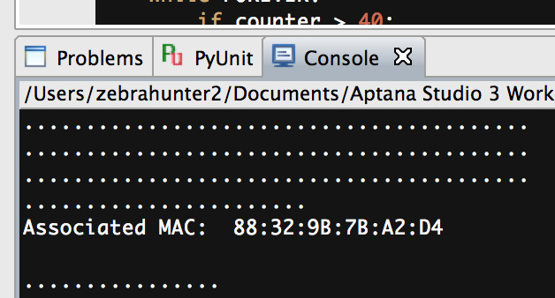
The Output of an Association
The following output is what would be produced when an association is seen by the script.
Associations denote 'attempted' connections, if they are also not authorized.

Slide 21
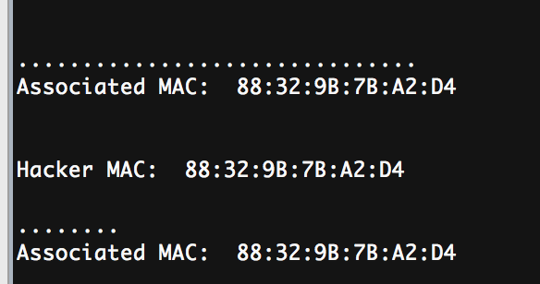
The Output of an Authorization
Note the line that says 'Hacker MAC'. That is the MAC address of the machine we are after.
THIS MAC address is the point of this exercise. This information can then be used to block the hackers attempts to access nearby networks and alert CERT/CIRT members. The MAC could also be used to direct the attacker to a honeypot.

Slide 22
Basic Script Logic
Run Main()
Call check4ConnectionsR()
Call changePassword() (if applicable)
Call generateNewWIFIPW() (if applicable)
Notes:
Main()
- setup the logging
- run forever
- print a dot periodically, serves as a heartbeat signal
- check for connections to the wireless router
- sleep for one second
Check4ConnectionsR():
- Setup a few regular expression search patterns
- Print some debugging statements if required
- Pull some data from the router (looking for MAC addresses from authorized list)
- For each line in the returned data check for a MAC address and log it.
- Print the MAC if its an authorization and associations
- Log the MAC if its an authorization
- Change the pw if an authorization is found
ChangePassword()
- Generate a new password
- Setup a string to pass to the router to facilitate the change
- Log the change (so we can recall our state later)
- Print debugging output if required
- Be sure the router accepted the change
- Log the status code if it was not recorded
generateNewWIFIPW()
- Open and parse the log file, look for the last PW
- Build a string of what we are changing the PW too (using the round robin list file)
- Log the new PW used

Slide 23
Caveats for a Working Environment
If you are using WEP Security:
There does not need to be any additional configuration or connections
If you are using WPA or anything other than WEP:
A device of any kind MUST be connected to the access point, once its in production. This is required for the attacker to disconnect.

Slide 24
Roman Hunter Screen Shots
Stations descriptions how this router works
No Stations Listed
Associations (wireless attempted connections)
Authorizations (wireless password accepted)
Python scripts in action
Heartbeat signal the romanHunter produces

Slide 25
Implementations
Wireless Mesh
Adjacent AP to a corporate network
Standalone AP (pen tests, testing for future office location)
Can be used with WEP for faster hacker identification (15 minutes to compromise)
Can be used to illustrate time to compromise with current PW implementations and infrastructure configurations as well as the distance the AP reaches, with zero impact on the customer network(s)

Slide 26
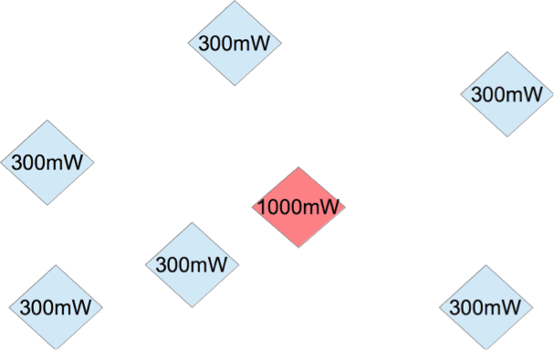
Mesh Implementation

Slide 27
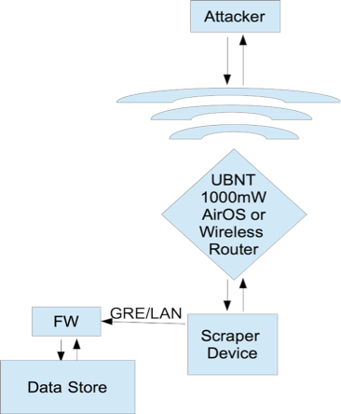
Typical Deployment

Slide 28
Python Script Review
Functionalized
Limitations
Not enough error checking
Should include more abstraction for functionality that does not change between different router versions and types
Should include database functionality for storing the MAC addresses
Should include a function for uploading to a central repository of MAC's found

Slide 29
Tools Used During Development
OS X Laptop
HTTPScoop (Fiddler2 on Windows)
VM Ware (Fusion 5)
Windows 7 VM (initial setup of AP)
Python (for scripting) (Can use any scripting language)
Cell phone with wireless to simulate attacker

Slide 30
Tools Used
HTTPScoop HTTP Protocol Analyzer.
High Level protocol analyzer usage is easier to comprehend and find instructions versus something like wireshark.
OS X (can use: fiddler2 for Windows)

Slide 31
Other Tools for Extending romanHunter
Scapy (protocol dissector and manipulator)
MySQL
Wireshark

Slide 32

Questions or Comments?
Contact Timber Wolfe
lonegray@gmail.com
http://sourceforge.net/projects/romanhunter/
www.HackerAcademy.com

