Slide 1
EE113DB 2015 FINAL Presentation
Voice recognition and control system
Present By:
George Li (Zhuoqi Li)
Ben kim (Bumjoong Kim)
Notes:
Work division:
George:
slides 1 - 6, 11 - 12
Ben:
Slides 7 – 10, 14 - 16

Slide 2
System Overview
Goal:
- interpret spoken words
- differentiate different people’s voices
- operate according to spoken commands
Objective of this project: to accurately identify spoken vocabularies as well as their speakers from a 70-word database and operate as told
Notes:
Voice recognition system is widely used in the real world bcs of its reliability and convience.
To build a prototype for voice recognition security system which equires <Goal>

Slide 3
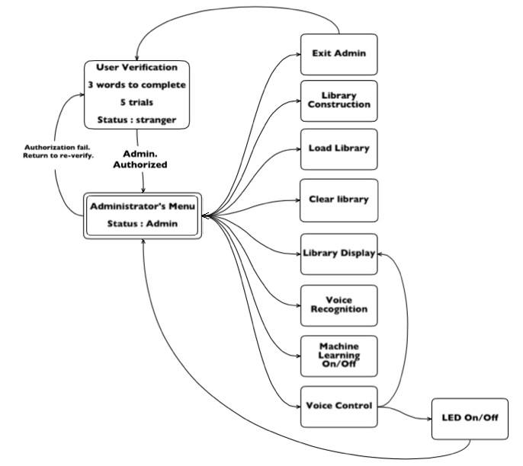
Notes:
The user needs to complete three voice recognition test to verify their status
They have 5 trials to pass three voice recognition tests, if fail, start over
If the system detects they are the admin (which means they pass these three voice recognition test), they are granted the access to all functions of the system including….
Voice control has two func..

Slide 4
Technical Design
Primary principle behind: to model human hearing system
Based on EE113DA Miniproject 2
Voice recognition process:
- Synchronization
- Feature extraction
- Library Matching
- Machine learning
Voice control process:
- conditional statements
Sychronization
detect the valid voice input and start voice recognization
Feature Extraction
calculate input frequency features using MFCC
Library Matching
match the input with data stored in library using DTW algorithm
Machine Learning
supervised machine learning
Notes:
If the system detects the input speech matches certain word combination, then it operates accordingly.

Slide 5
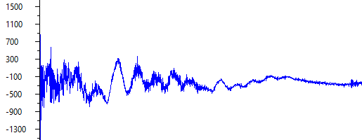
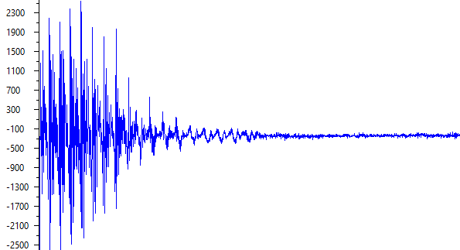
Synchronization
Differentiate between environmental noise and human speech
Utilize the STE (short time energy algorithm)

Slide 6
Feature Extraction
Mainly based on EE113DA Miniproject 2
Mel Frequency Cepstral Coefficient + Delta-delta = WMFCC
For each speech input, break it into many frames
Power spectrum information in different frequency range
Notes:
Beyond delta-delta to have WMFCC
fixed size input sample array and break into many frames
then apply MFCC + delta-delta = WMFCC to have power spectrum information in different frequency range
MFCC enables to capture energy in input voice signal from microphone to the system and to convert the audio information into
from frequency scale to Mel scale using Discrete Cosine Transform and 26 band pass filter with triangular shape frequency response.
This process is similar to human ear function of hearing of the voice to capture tone and pitch (within hearing range of 0 to 4000Hz),
but more precisely into suitable form to match with the library reference in further process in DTW
it uses energy spectrum in different frequency range with 26 filterbanks to capture the voice information

Slide 7
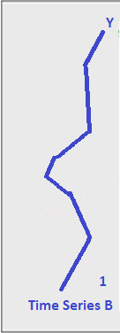
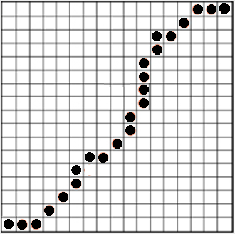
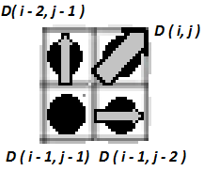
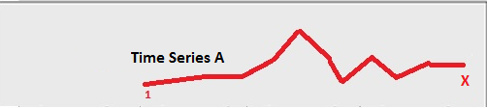
Library Matching
Library data saved in txt files
Library data loaded from txt files when needed
DTW (Dynamic Time Wrapping)
Notes:
For the library data, File input and output were used to save and load specific characteristics of our speech.
After we extract data from MFCC process, we build a library to have a matching process.
Library data contains few information of speaker and words and they are utilized to compare with new input voice signal after MFCC.
Before we talk about dynamic time warping,
we have to consider that our voice signal we deal with here has uncertain nature varies in speed and time.
To capture the voice signal, varying in speed and time,
instead of getting Euclidian distance between WMFCC feature vector,
we used dynamic time warping algorithm to find a closest match to the input from the library.
Dynamic time warping algorithm
takes difference in MFCC values between new input voice signal and library template database
creates weighted frequency axises called warping path in graph above in matrix calculation and
prompts the minimum library index that is closest match to our input with lowest deviation cost.

Slide 8
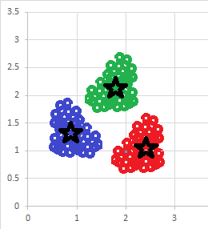
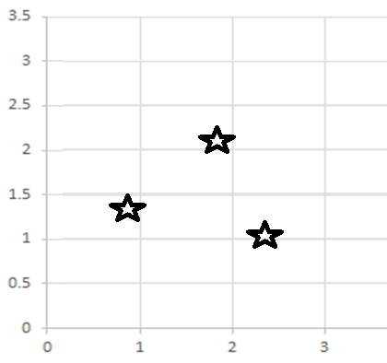
Machine learning
* Supervised machine learning algorithm
- user judge the result and give feedback
* K-mean cluster algorithm
* Update the library data every time
* Can be turned off when the library is fully updated
Notes:
After the system recognize the voice extracted from the input feature vector,
user can judge that recognition result is valid or not.
We employ the formula to create the cluster around the correct word (valid data) in order for

Slide 9
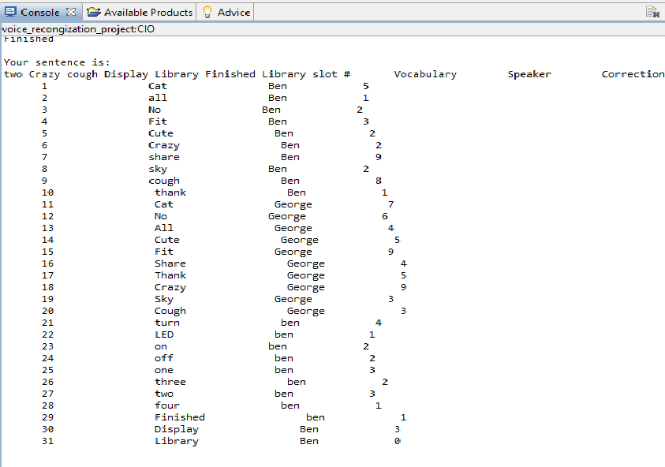
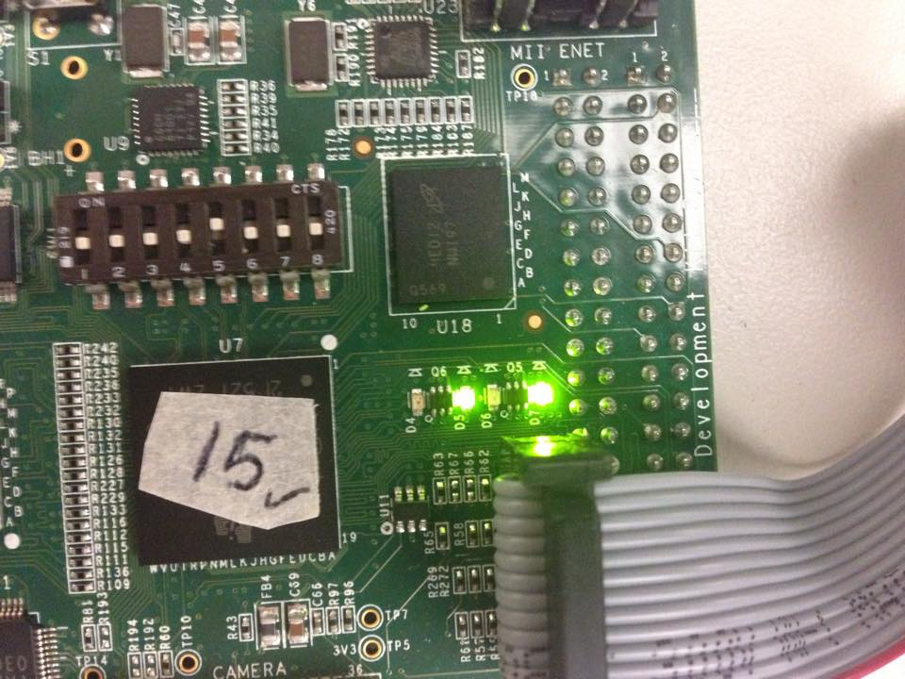
Voice Control
Display Library
Turn on LED on the DSP chip

Slide 10
Technical & General issues
Coding challenges
Equipment uncertainty
Processing speed optimization
Uncertain nature of human voice
- intonation effects
- Volume of the voice
- length of the speech
Notes:
Coding challenges:
C language does not have string type ➔ save to array
LCDK reboots its memory after the process ➔ Load and save memory data -> save txt. File
Dynamic memory allocation: run out of sometime bcs did not use dynamic memory allocation
Intonation challenges
1. We realize that if the intonation of speaker does not match that of the library, the system has hard time identifying it
Equipment uncertainty
Sensitivity and performance of microphone is different (amplitude, battery) ➔ different data for same type of speech
Different DSP chip has different settings
Same microphone and same LCDK
Processing speed optimization
Processing speed is very slow at the beginning
Utilization of the CCS optimization level
Uncertain nature of human voice
Two diagram show different length of the same word
Voice volume goes out of bound
There are three factors that we discovered in uncertain nature of voice.

Slide 11
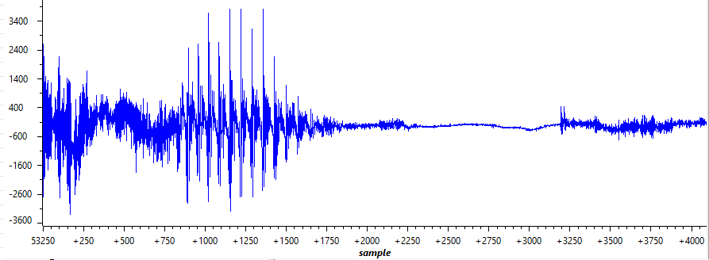
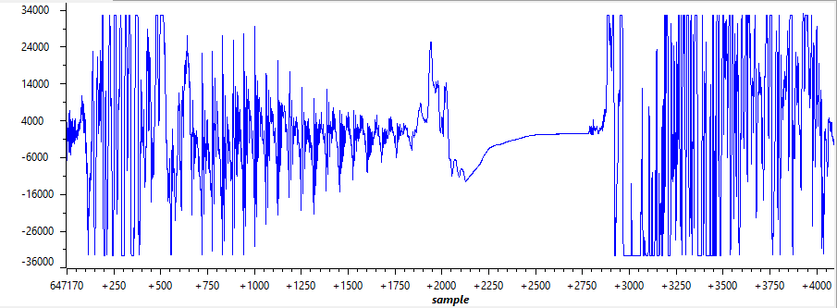
Technical & General issues – Speech volume
‘Cat’ with normal volume
‘Cat’ with high volume

Slide 12
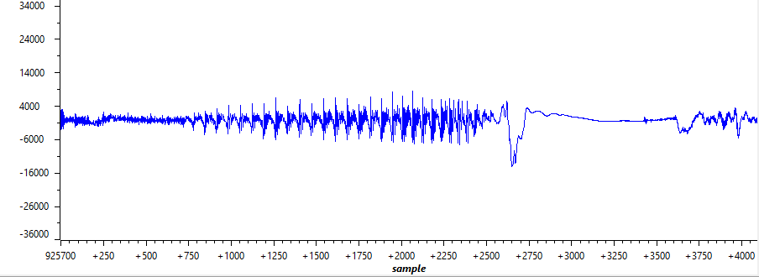
Technical & General issues - Intonation
‘Cat’ with exclamatory intonation
‘Cat’ with interrogative intonation

Slide 13
Experimental Result
Experimental procedure
- Words with clear vowels: cat, no, all fit, cute
- Words with obvious consonants: share, crazy, sky, cough, thank
Experimental results:
 | Version 1.3 | Version 1.4 | Version 1.8
Total Recognition rate | 65.0% | 77.5% | 85.7%
Speaker Recognition rate | 75.0% | 87.5% | 85.7%
Vocab Recognition rate | 90.0% | 87.5% | 100.0%
Trial times | 40 | 40 | 42
Optimization level | Processing Time (s)
0 | 22.5
1 | 14.5
2 | 5.45
3 | 4.5
Notes:
Experimental procedure
Each person speaks 10 words in sequence
Speaker judges the result, speaker recognition rate and vocab recognition rate
System keeps track of the rate and displays it on screen
1.3 mfcc dtw
1.4 WMFCC + Delta-Delta
1.8 library with sharpened data with machine learning algorithm

Slide 14
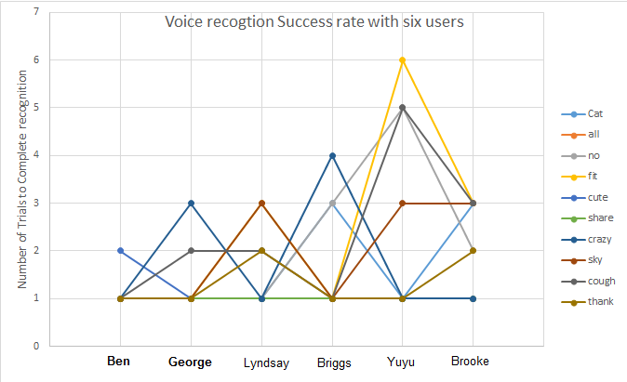
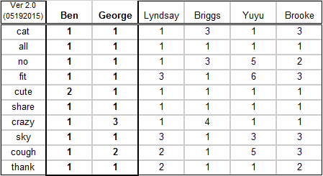
Experimental Result
Notes:
These are the data table after we collected speech of 10 words from 6 different speakers
the crieteria of collecting data table above was that how many trials till can system successfully recognize each person’s voice.
speakers are chosen from different sex and different voice level
from the data we can find that machine learning works to achieve the better level of recognition Ben and George has lowest deviation

Slide 15
Conclusion
vocabulary recognition but human voice identification needs to be improved
MFCC algorithm works good but the system is still not robust enough
More voice control operation could be added
A more efficient machine learning algorithm could be employed

