Slide 1
Desktop assistant
A modest application
to automate and support desktop functions

Slide 2
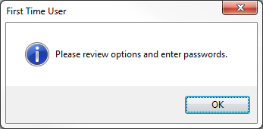
First time using desktop assistant
Desktop Assistant will pop open a window box and take you directly to the options menu.

Slide 3
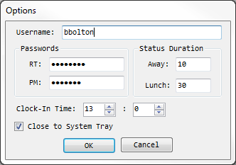
Options menu
Username
Passwords, for RT and Project Manager
Status Duration
Minutes for going AWAY and on LUNCH
Clock-In Time
[24 HR] : [MIN]
Close to System Tray
(Closing will send app to Task Bar)

Slide 4
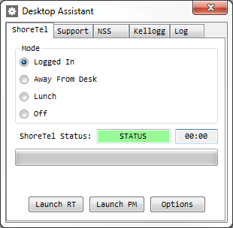
Shoretel Design
ShoreTel Tab
ShoreTel Status
Change Desktop Status
Duration ShoreTel has been signed out
Progress Bar of OFFLINE
Launch Project Manager
Launch RT
Open Options Menu

Slide 5
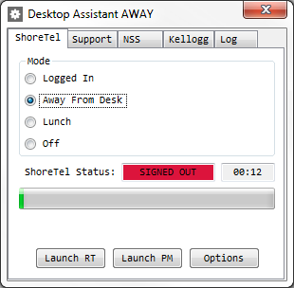
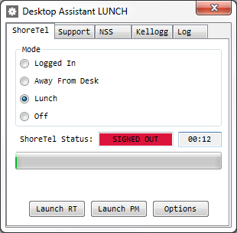
Desktop Assistant Modes

Slide 6
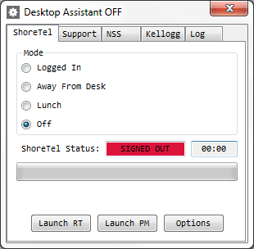
Desktop assistant modes
If you choose the OFF mode, Desktop Assistant will automatically sign you back in to ShoreTel at the time specified in the Options menu.
It will NOT log you in if you are not logged in to your computer, or the screen is locked.

Slide 7
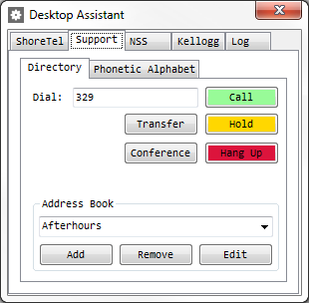
Support Design / directory
Support Tab Selector
Phone Number / Extension to Dial
ShoreTel Phone
Quick Buttons
Address Book Drop Down Menu
Add / Remove / Edit Address Book Entries

Slide 8
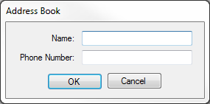
Support Design / directory
Adding or Editing the Current Address will open a window.
Press Enter to Save Changes.
Address Book entries are saved to disk.

Slide 9
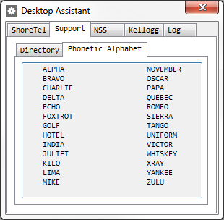
Support Design / Phonetic alpha
Support Tab Selector

Slide 10
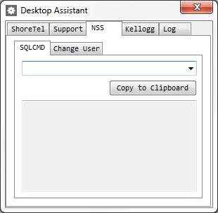
NSS Design / SQLCMD
NSS Tab Selector
SQLCMD Drop Down Menu
Copy to Clipboard
Console Text Box

Slide 11
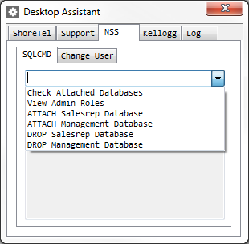
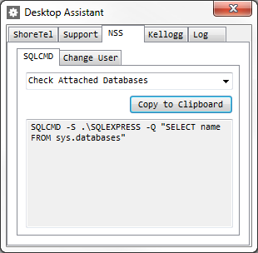
NSS Design / SQLCMD
Common SQLCMD Queries
Results Automatically added to Clipboard

Slide 12
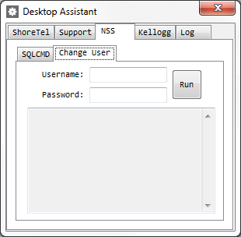
NSS Design / Change user
NSS Tab Selector
New Username and Password
Run Script
Console Text Box

Slide 13
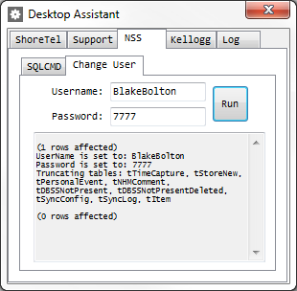
Nss design / change user
Desktop Assistant will run the Change User script from inside and display the results.

Slide 14
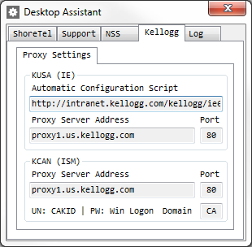
Kellogg Design
KUSA Proxy Settings
KCAN Proxy Settings

Slide 15
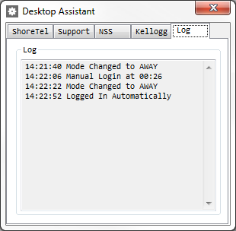
Log design
Desktop Assistant will keep track of your online / offline changes to ShoreTel

